Slide 1
STAC Browser
Matthias Mohr
Ind. Consultant
matthias@mohr.ws

Slide 2
Introduction
Web user interface for STAC (static & APIs)
  basic support for OGC API - Features & Records
Advanced Search
Customizable / Themable
Crawlable by Google
Repository: github.com/radiantearth/stac-browser
Demo: radiantearth.github.io/stac-browser

Slide 3
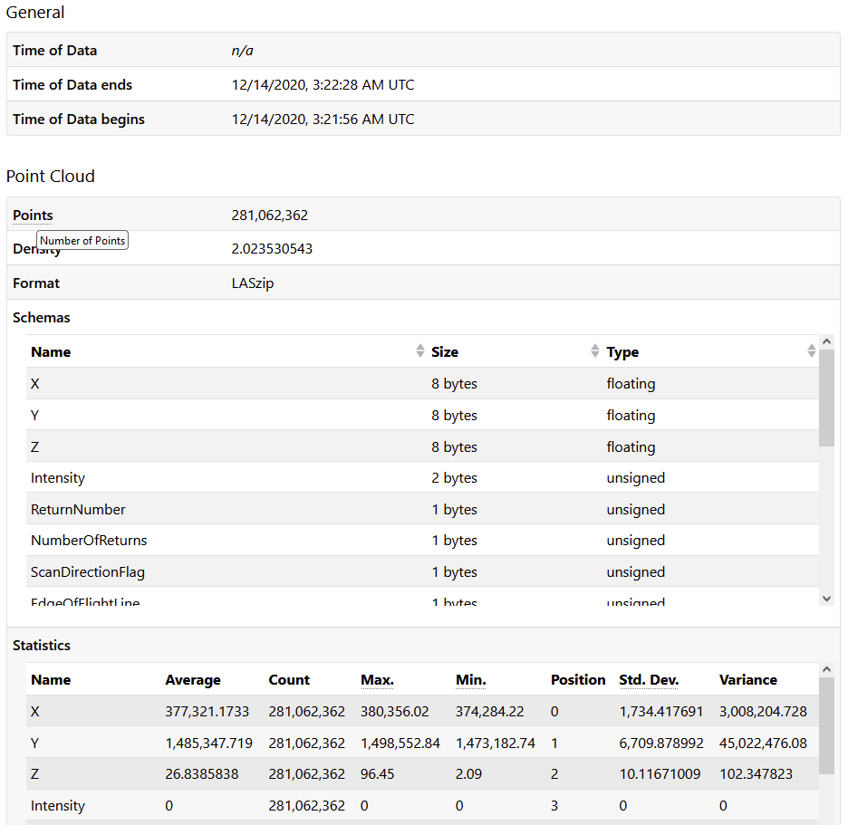
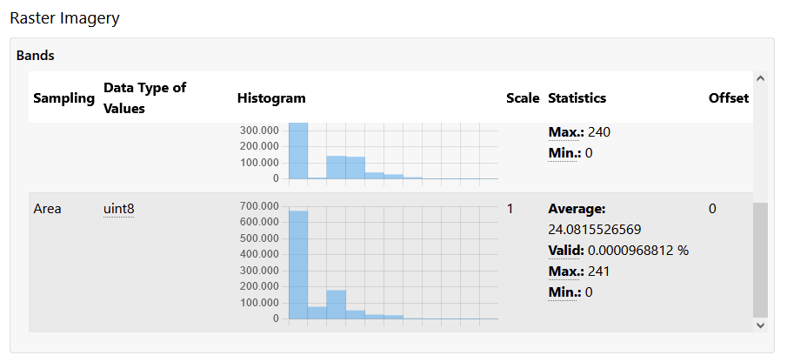
Metadata many extensions pre-configured and
extensible for custom extensions
Registry.addExtension('ceos', 'Committee on Earth Observation Satellites');
Registry.addMetadataField('ceos:is_cool', {
label: "Is CEOS cool?",
formatter: value => value ? "Sure!" : "Meh!"
});

Slide 4
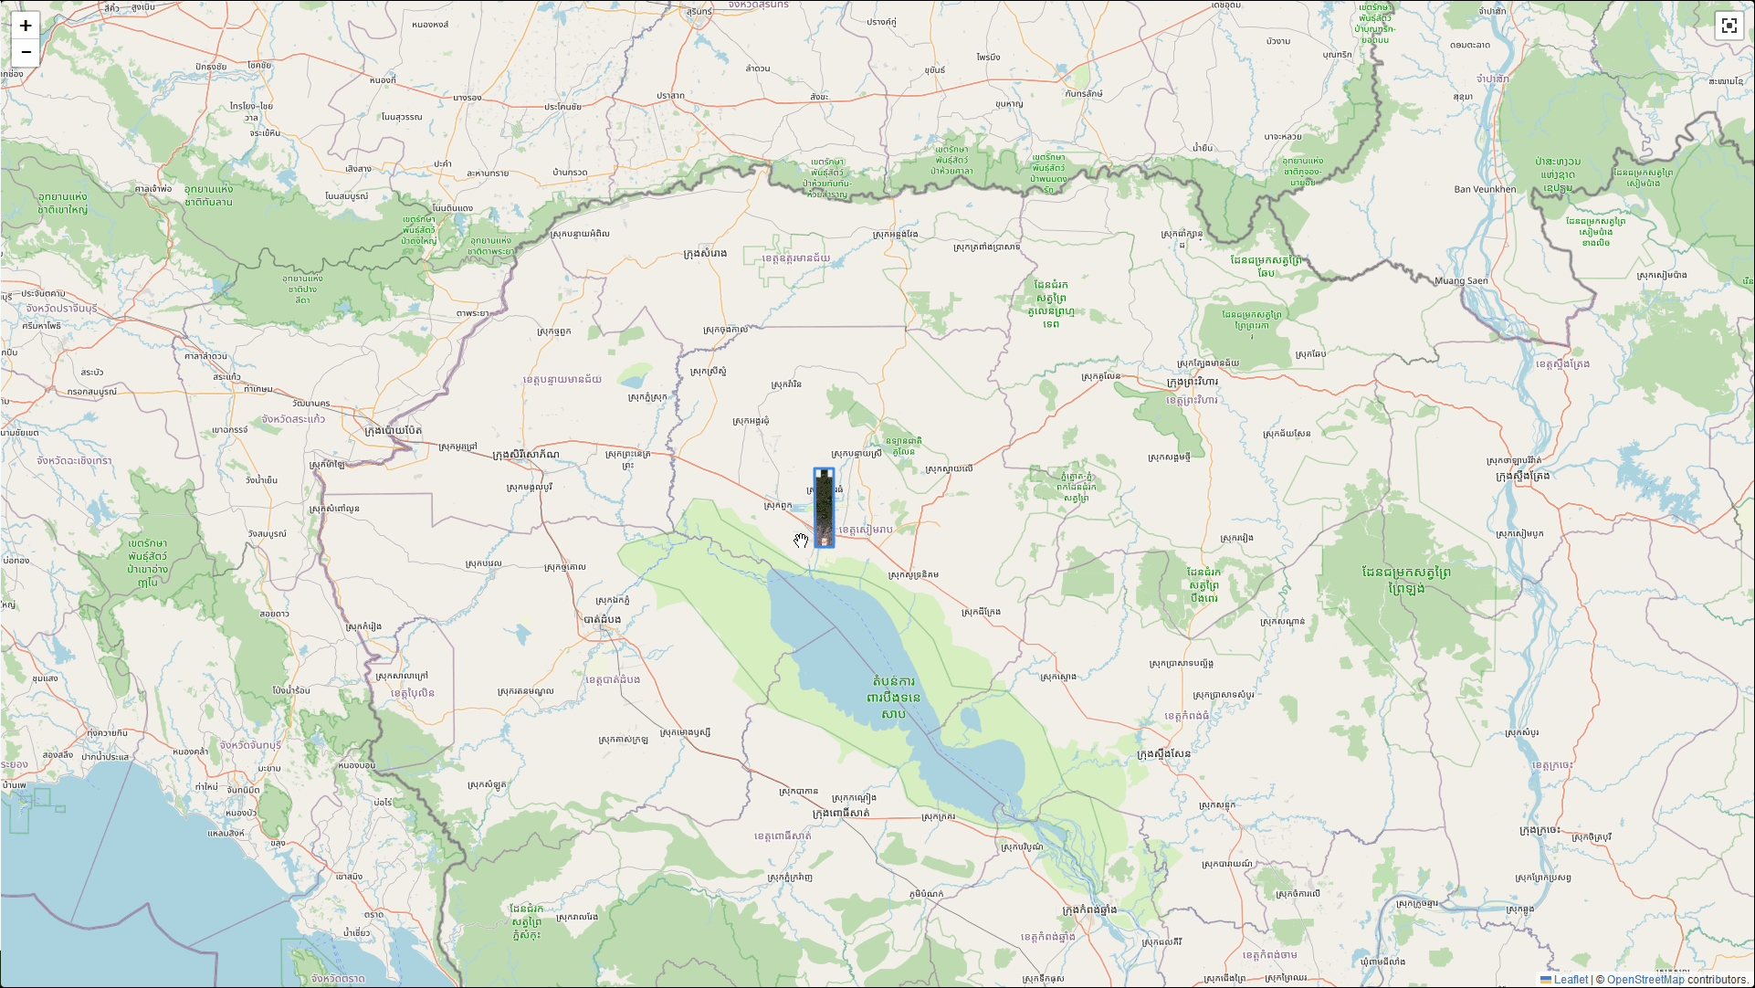
Data Visuazliation
COG =>
XYZ
WMS (unrel.)
Future
  WMTS
  PMTiles
  GeoZarr?
  GeoParquet?
  COPC?

Slide 5
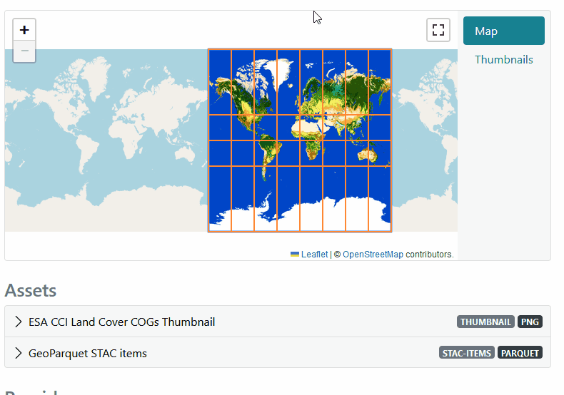
Map-based
Item Preview
and Selection available for
Catalogs / Collections and
Item Search

Slide 6
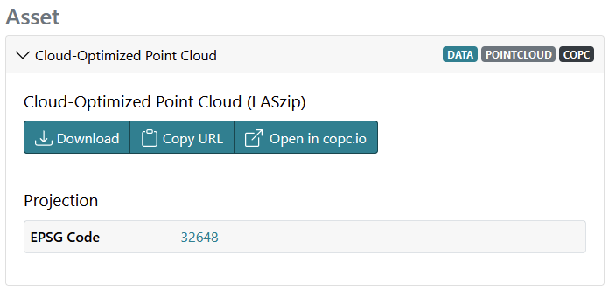
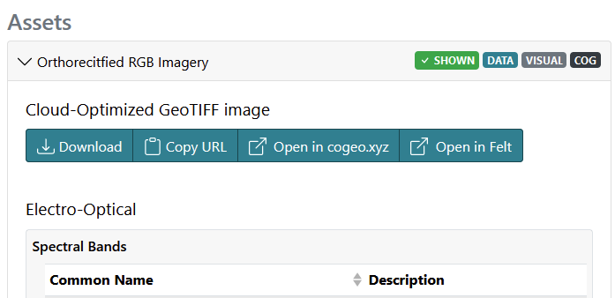
Actions
import CopcViewer from './src/actions/assets/CopcViewer.js';
import CoGeoXyz from './src/actions/assets/CoGeoXyz.js';
import GeoJsonIo from './src/actions/assets/GeoJsonIo.js';
import Felt from './src/actions/assets/Felt.js';
export default {
CopcViewer,
CoGeoXyz,
GeoJsonIo,
Felt
};
export default class CopcViewer extends AssetActionPlugin {
get show() {
return this.asset.type === 'application/vnd.laszip+copc';
}
get uri() {
let uri = new URI("https://viewer.copc.io");
uri.addQuery('copc', this.component.href);
return uri;
}
get text() {
return i18n.t('actions.openIn', {service: 'copc.io'});
}
}

Slide 7
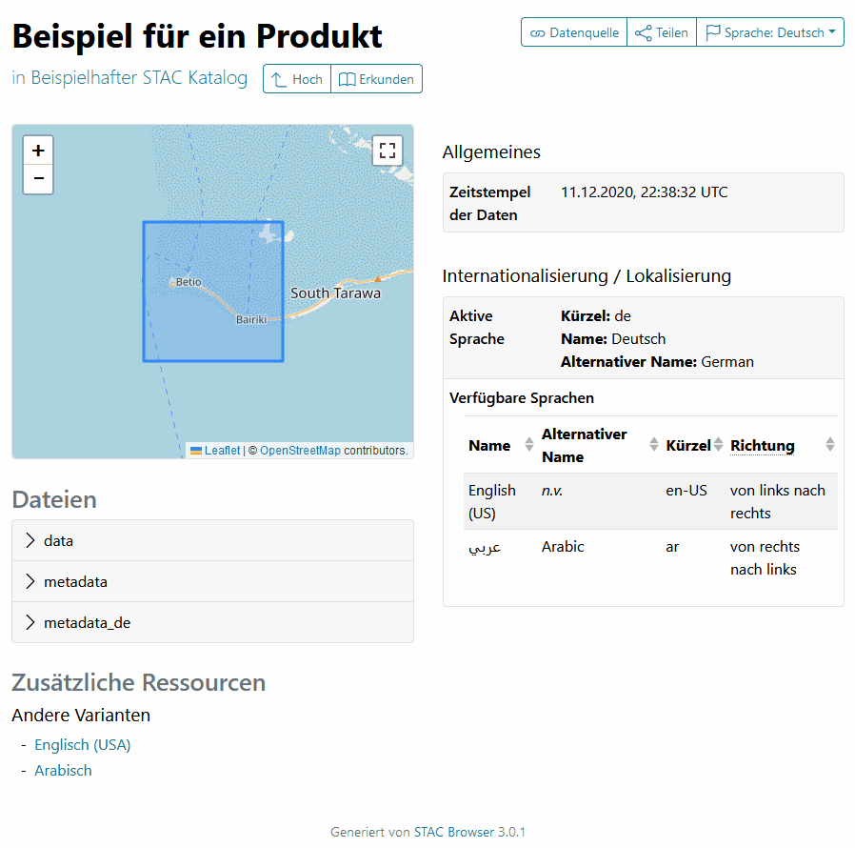
Multi-Language
English
French
German
Italien
Romanian
Spanish and your language?

Slide 8
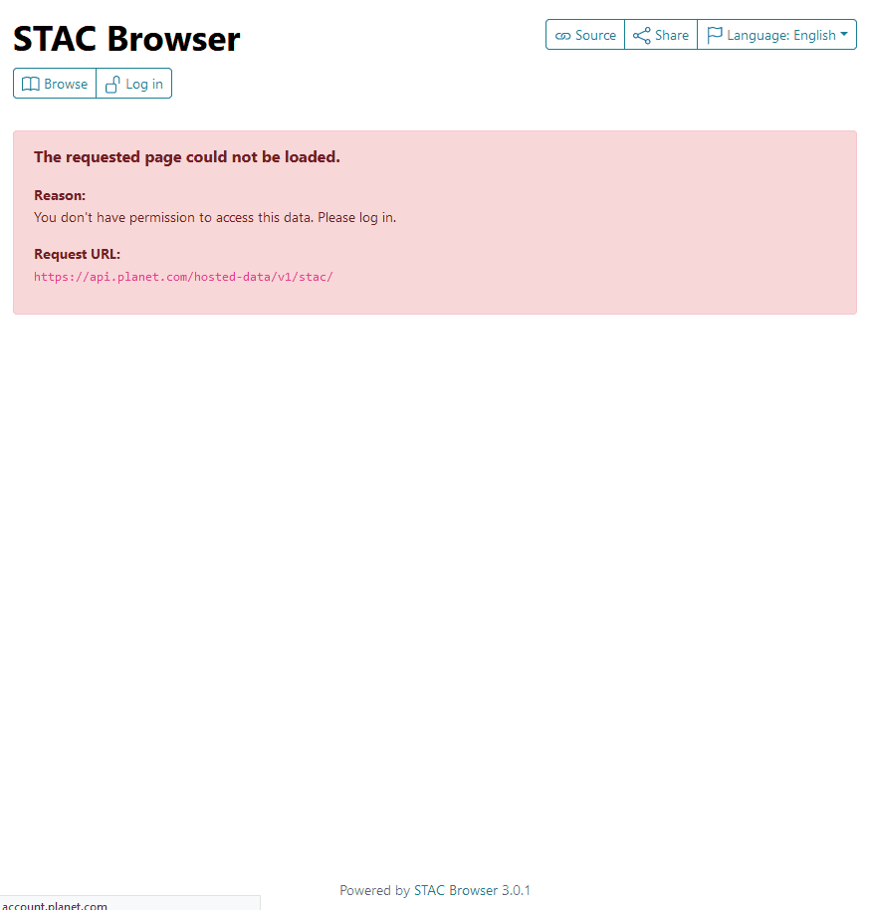
Authentication
API Tokens
OpenID Connect (unreleased)
authConfig: {
type: 'header',
key: 'Authorization',
formatter: 'Bearer',
tokenGenerator: 'oidc',
generatorOptions: {
issuer: 'https://account.example.co/oidc',
clientId: 'client-id-123',
scopes: ['openid'],
redirectUri: 'https://example.com/auth',
postLogoutRedirectUri: 'https://example.com/auth/logout'
}
}

Slide 9
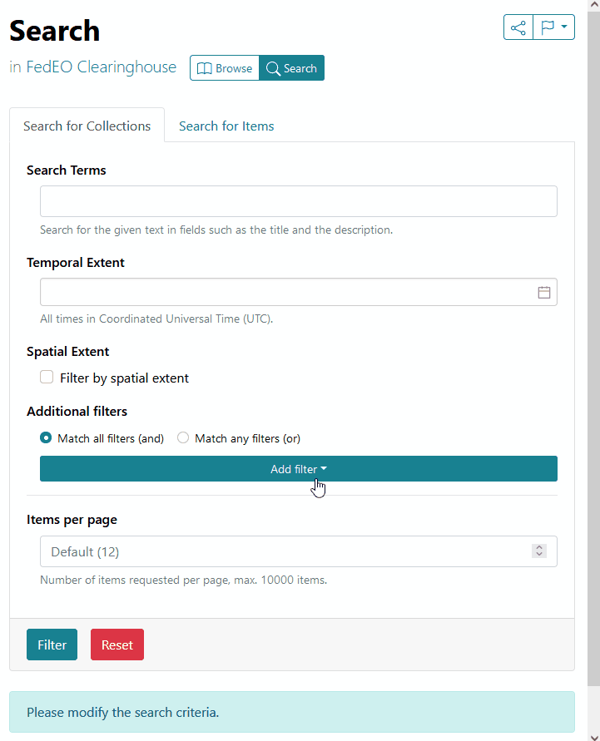
Search
All Collections
All Items
Items per Collection
CQL2 & Queryables
Free-Text Search

Slide 10
Demo
FedEO Clearinghouse
by Spacebel
Notes:
Demo steps:
Collection Search:
Parent identifier EOP:ESA:EARTH-ONLINE
and
A) Platform: Proba-1
or
B) Search terms: proba
or
Platform: Envisat
Processing level: level 0
Envisat ASAR IM L0
extent to paris
orbit direction: asc / desc
PROBA CHRIS Level 1A:
Open Filter Collection in new tab
Set extent to paris
Show queryables
Sensor Mode = MODE-4
Select Proba collections and “Open 2 Collections in Item Search”
Set extent to paris
Search
Item Search:
- Collections: Proba | -V | S10 | TOC 300 m

Slide 11
Q&A
Thanks for your attention!
Contact me:
matthias@mohr.ws

