Slide 1

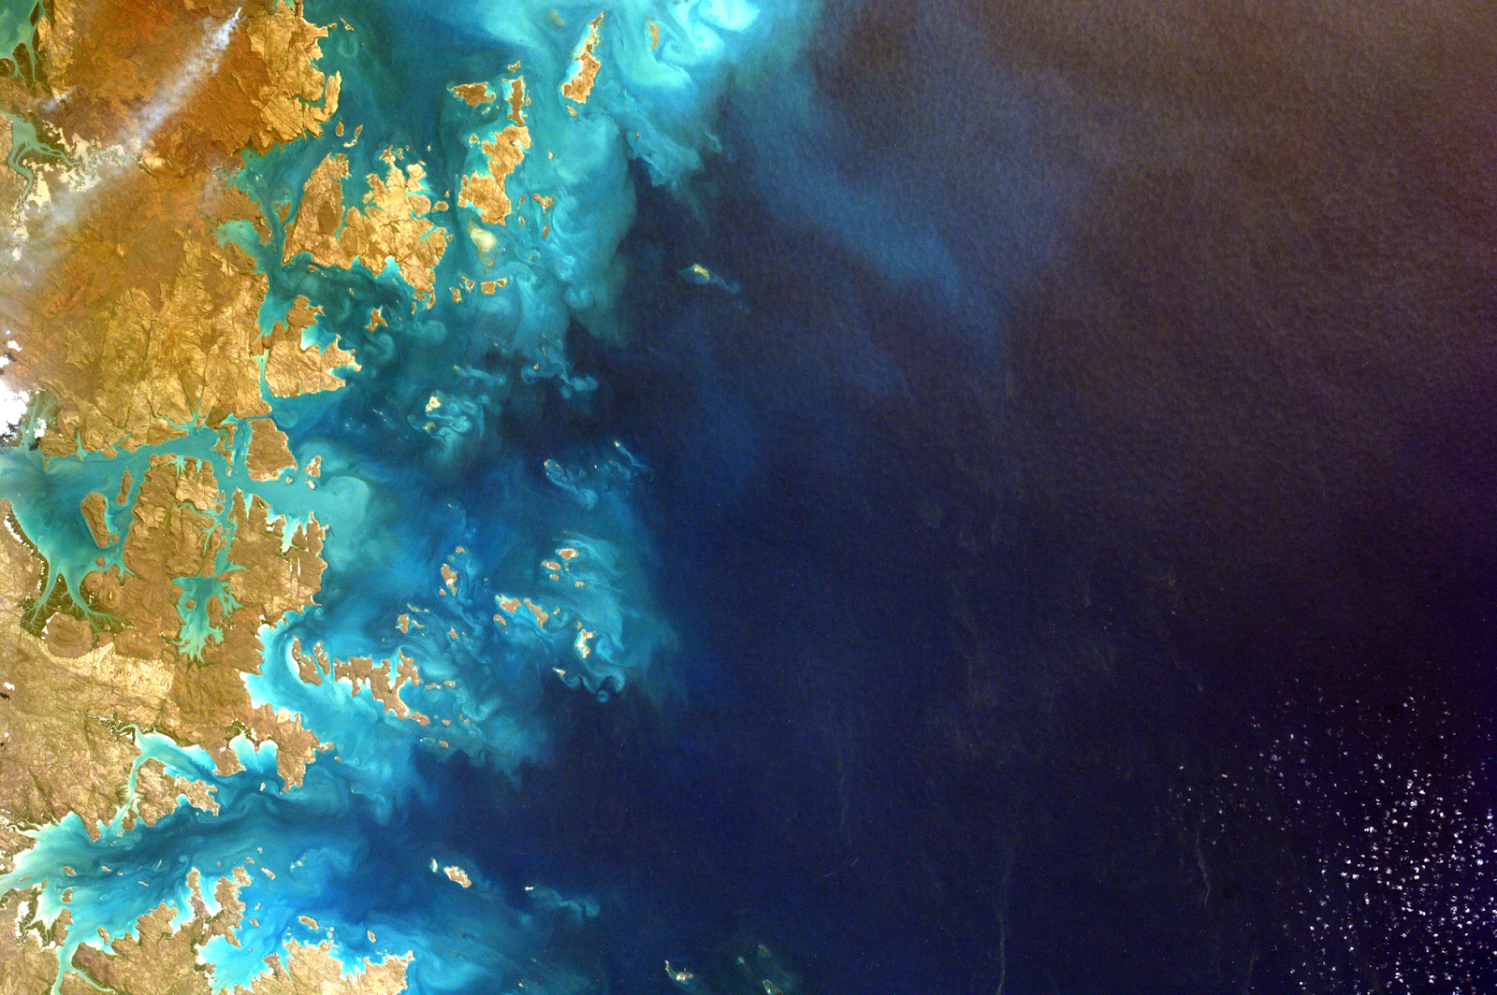



STAC Best practices for federation & interoperability
WGISS-56
Oct 24-25, 2023
Doug Newman
NASA ESDIS Project, Goddard Space Flight Center
douglas.j.newman@nasa.gov
Notes:
Acronyms:
ESDIS - Earth Science Data Information System
WGISS - Working Group on Information Systems and Services
STAC - Spatio Temporal Asset Catalog

Slide 2

Agenda
The driver
The focus
The communication
The current state
The next steps

Slide 3
STAC Best Practice drivers

Slide 4
Revitalising CWIC
The CWIC architecture has been very successful in linking our agency repositories from a discovery perspective.
However,
OpenSearch has no traction outside of this use case.
Agencies have deprecated their OpenSearch APIs in some cases.
Notes:
Acronyms:
CWIC - CEOS WGISS integrated catalog
CEOS - Committee for Earth Observation Satellites
API - application programming interface

Slide 5
The alternative - STAC
STAC fulfills all the requirements that made OpenSearch a suitable candidate for our CWIC architecture.
It has traction beyond the federated use case.
Several agencies are standing up their own STAC APIs on their own initiative.

Slide 6
STAC as a CEOS standard
The CEOS Interoperability Framework would benefit from adopting STAC as a discovery standard.
Notes:
Acronyms:
CEOS - Committee for Earth Observation Satellites

Slide 7
STAC Best Practices focus

Slide 8
From a high level
Provide the ability to use STAC in CWIC
Remove ambiguity and present a single path to implementation

Slide 9
Driven by our STAC survey…
Input from 15 organizations
90% of participants either have STAC implementations or intend to
Top desired features:
Search API
Advertising
Easy federation of search
Migration from OpenSearch BP and implementations
Github repository

Slide 10
STAC Best Practices communication

Slide 11
An open, collaborative approach
Our best practices will be staged on a github repo and rendered using markdown.
Updates will be developed, submitted, reviewed and applied using standard github pull requests
Anyone can submit an update
Github.io may be used to enhance the user experience in the future

Slide 12
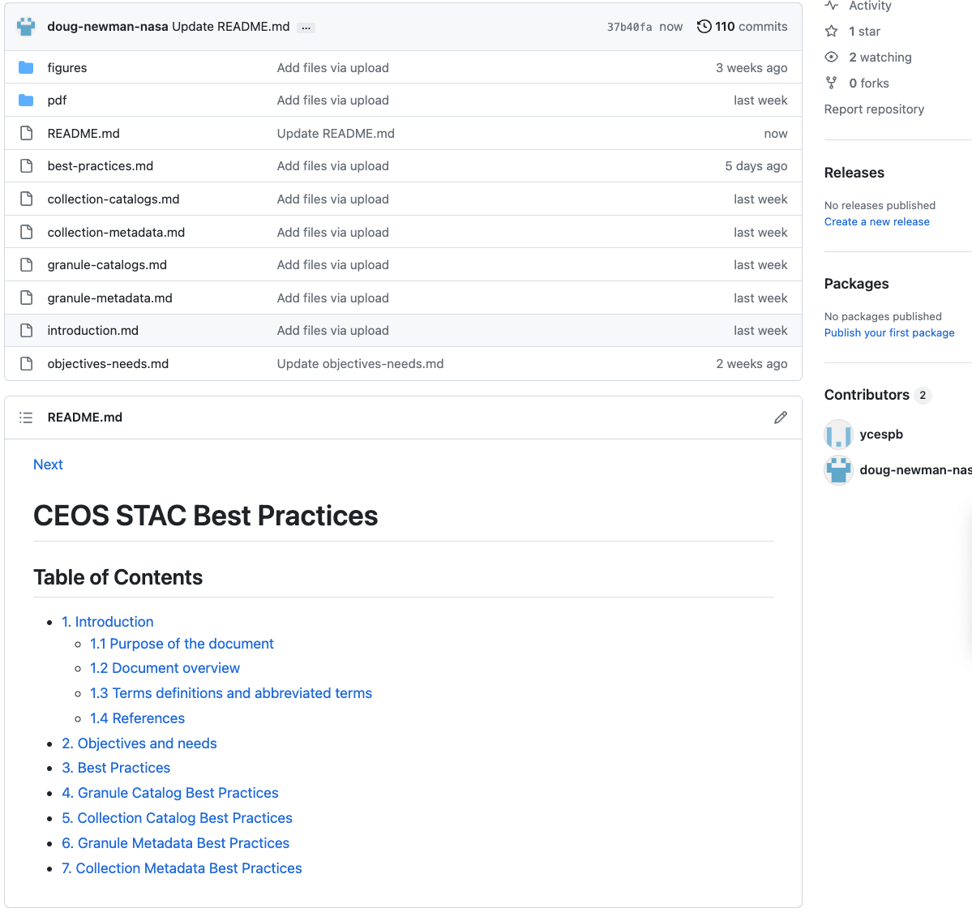
Github repository
https://github.com/ceos-wgiss/stac-best-practices

Slide 13
STAC Best Practices current state

Slide 14
Table of contents!
We have a rough outline of our goals.
General Best Practices
Catalog Best Practices at collection and granule level
Metadata Best Practices at collection and granule level
To facilitate interoperability for both data discovery and usage

Slide 15
What else?
Use cases
Requirements
Recommendations
Permissions
Unanswered questions

Slide 16
STAC Best Practices next steps

Slide 17
Complete the best practices document
There are several areas which need to be completed. For example,
There are a number of unanswered questions in the BP that need to be resolved
Flesh out the content of the BP
We welcome your contributions!
https://github.com/ceos-wgiss/stac-best-practices

Slide 18
Questions to be answered
Should a STAC API extension be proposed that allows the aliasing of parameter names to standard query filters? (OSDD aliases)
Should we allow Cross-collection searching?
Should a /collections search endpoint be a requirement?
Should Free text search for /collections endpoint be a requirement?
There is currently no mechanism to advertise different CQL filtering capabilities at different endpoints. In the federated case (CMR -> agency), this could be problematic. Insist on a minimum subset?

Slide 19
Implement in CWIC
First step is to provide a STAC implementation in line with our BP at the collection level (NASA CMR) and one granule level implementation (possibly ISRO)
Next step: add more agencies.

Slide 20




Questions
Email Address:
douglas.j.newman@nasa.gov
Website:
earthdata.nasa.gov
Social Media:
@NASAEarthData

