Slide 1
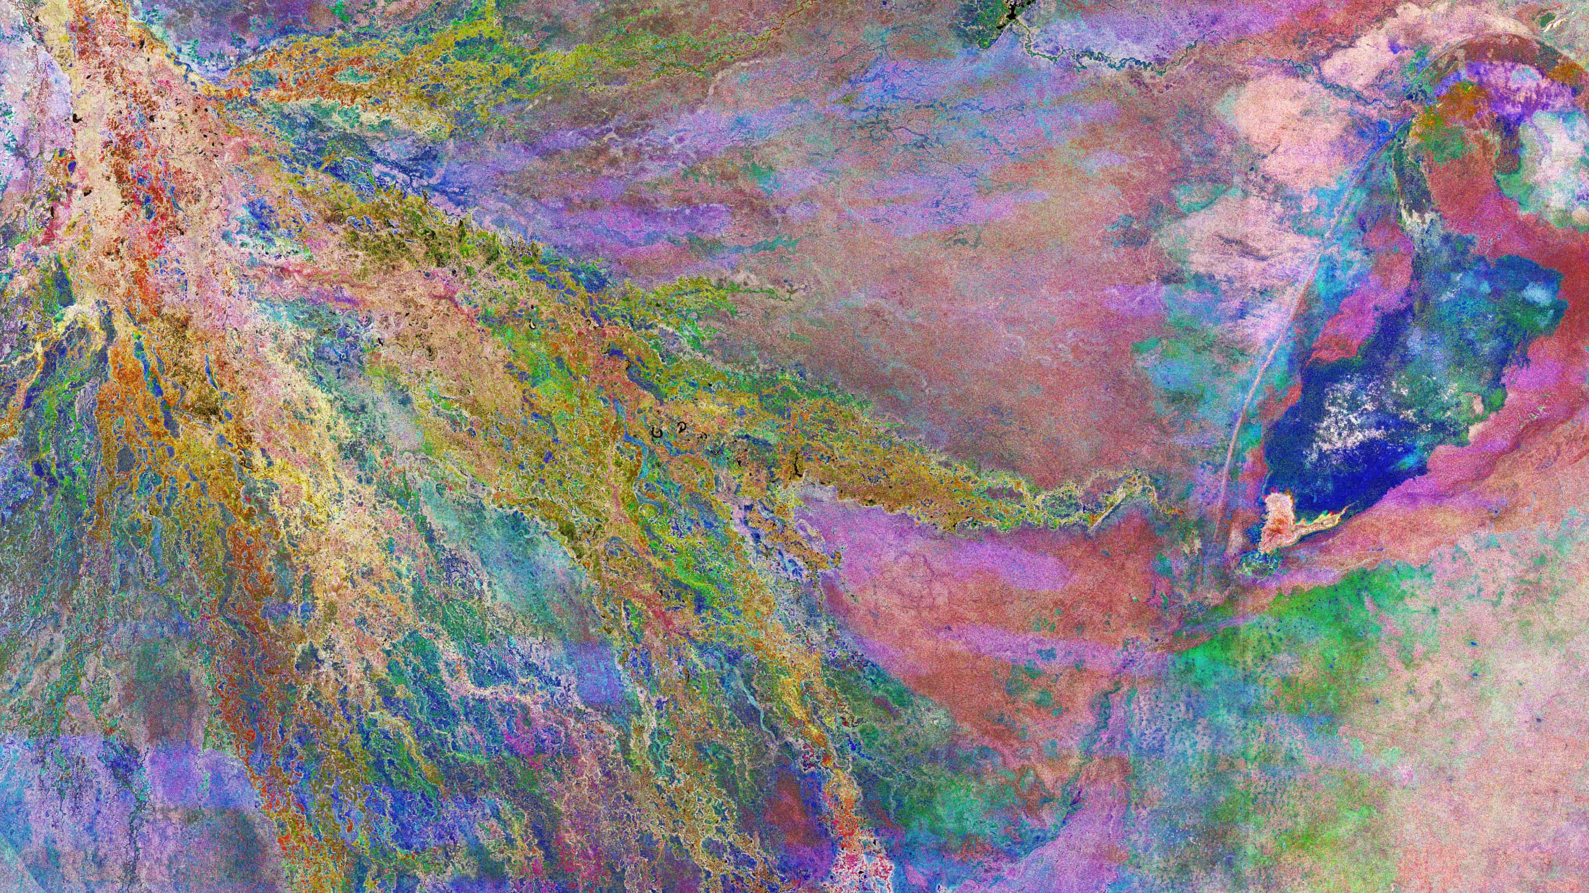

Increasing shared understanding of our world by expanding access to Earth science data.
Image: multitemporal radar image of Botswana’s Okavango Delta, contains modified Copernicus Sentinel data (2021), processed by ESA. © ESA, CC BY-SA 3.0 IGO

Slide 2
Massive geospatial datasets collected from surveys, sensing, and social media provide rich data sources and geospatial context for GeoAI. However, the GeoAI community still faces enormous challenges in integrating large, spatially heterogeneous, multi-modal geospatial datasets into existing machine learning frameworks.
Trillion-Pixel GeoAI Challenges Workshop Report
Oak Ridge National Laboratory

Slide 3




Initial vision
APIs
Enabling integration with ML tools from other platforms
Training Datasets & Models
Publishing and registration
ML
Data Competitions
Use data as basis for global challenges and training
Ground Referenced Labels
Training data features and characteristics

Slide 4
Metrics
58
Data Products
6,540
17,123
159
Users
Dataset Downloads
Countries
*As of Dec 31, 2022

Slide 5
Lessons learned
What worked
Neutral arbiter and steward of data
Increased data access has successfully enabled new use cases in low- and middle-income countries
Challenges
Rigid metadata requirements hampered onboarding of new data
Larger datasets don’t work with existing download methods or APIs
Need to find middle path between “cloud-optimized” data access methods and the data-hungry demands of model training workloads
Rigid landing page format leaves little room for experimentation

Slide 6

Source Cooperative is the next generation of Radiant MLHub
Source Cooperative is a vendor-neutral cloud-based data publishing utility. Can accommodate virtually any kind of data at any scale, including raster, SAR, n-dimensional arrays, vectors, and point clouds.
https://source.coop
Tenets
Be flexible. ML research needs a wide variety of data types.
It should be easier for people to publish data on the Internet.
Standards agnostic, but standards aware. Nudge people toward standards.

Slide 7
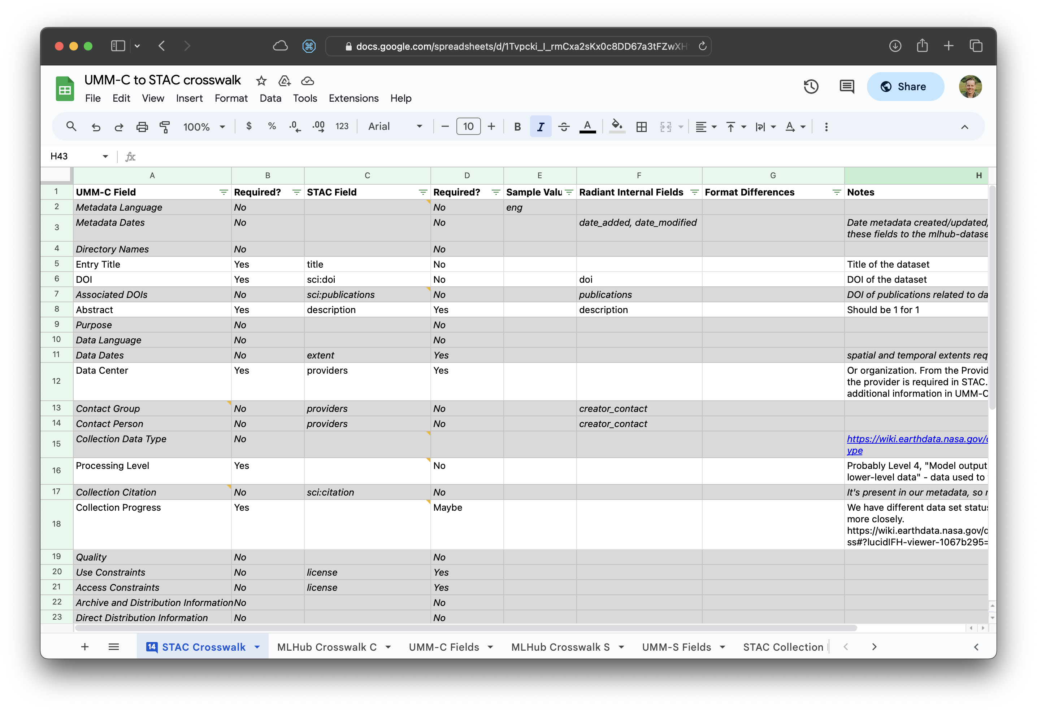
Getting data into CMR from Source Cooperative
Step 1: Crosswalk to generate CMR-compliant metadata

Slide 8
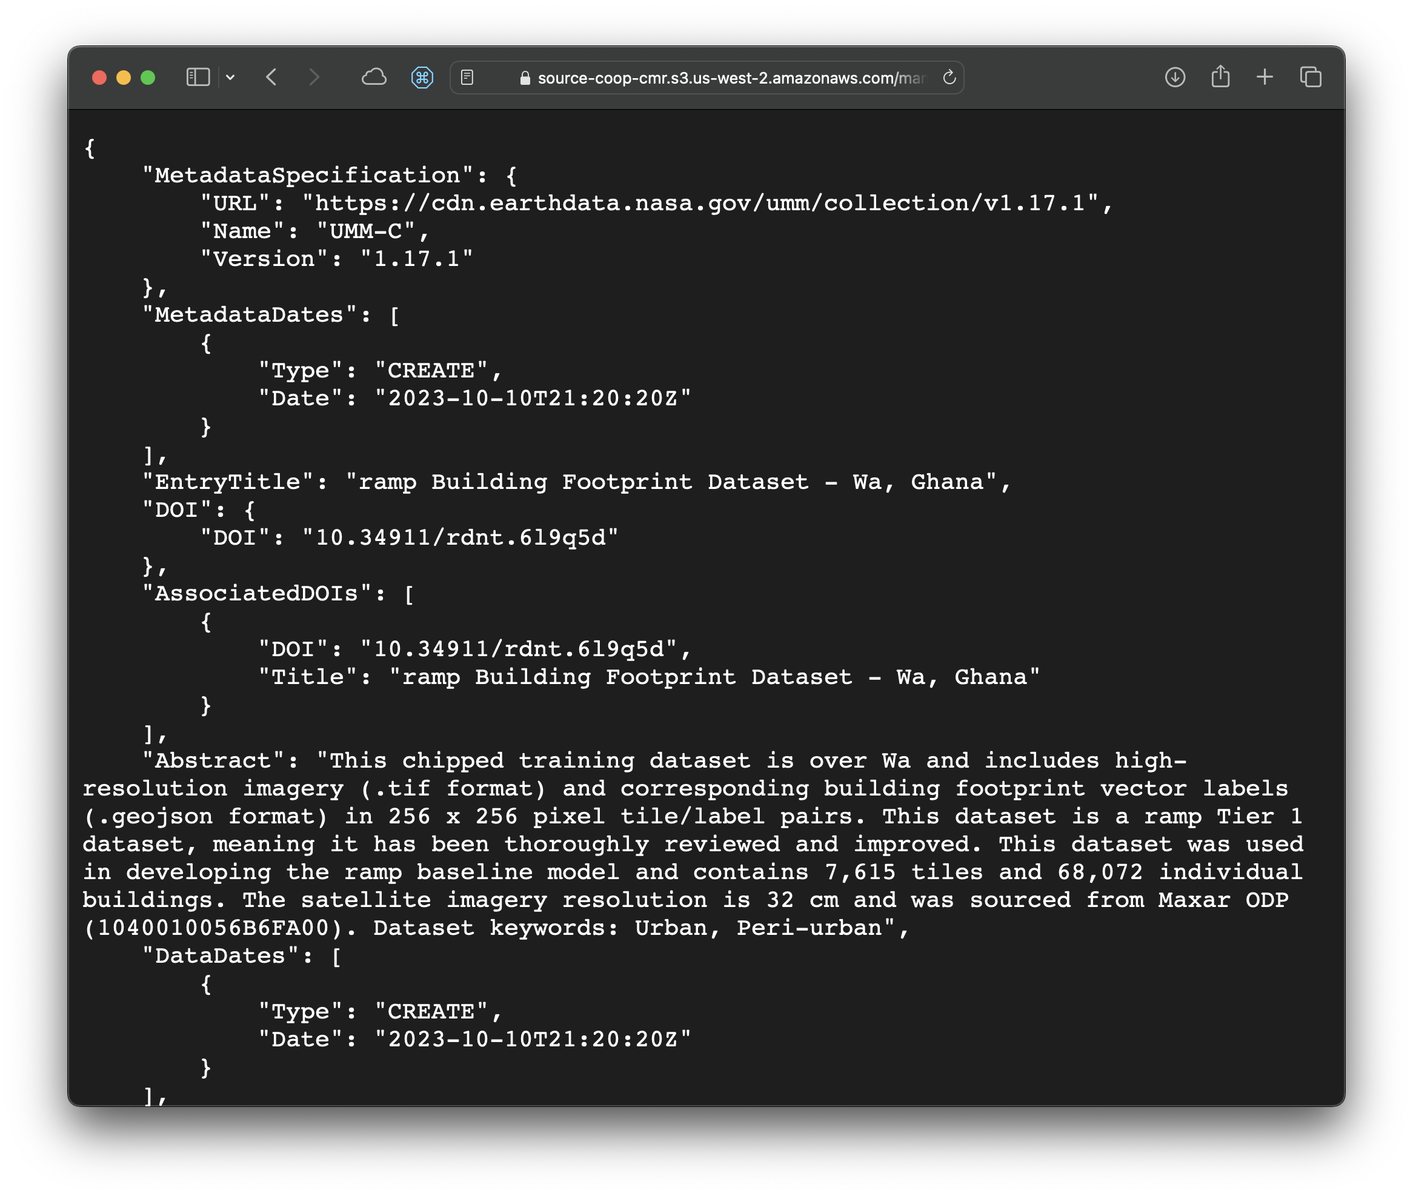
Getting data into CMR from Source Cooperative
Step 2: Publish CMR metadata for each data product

Slide 9
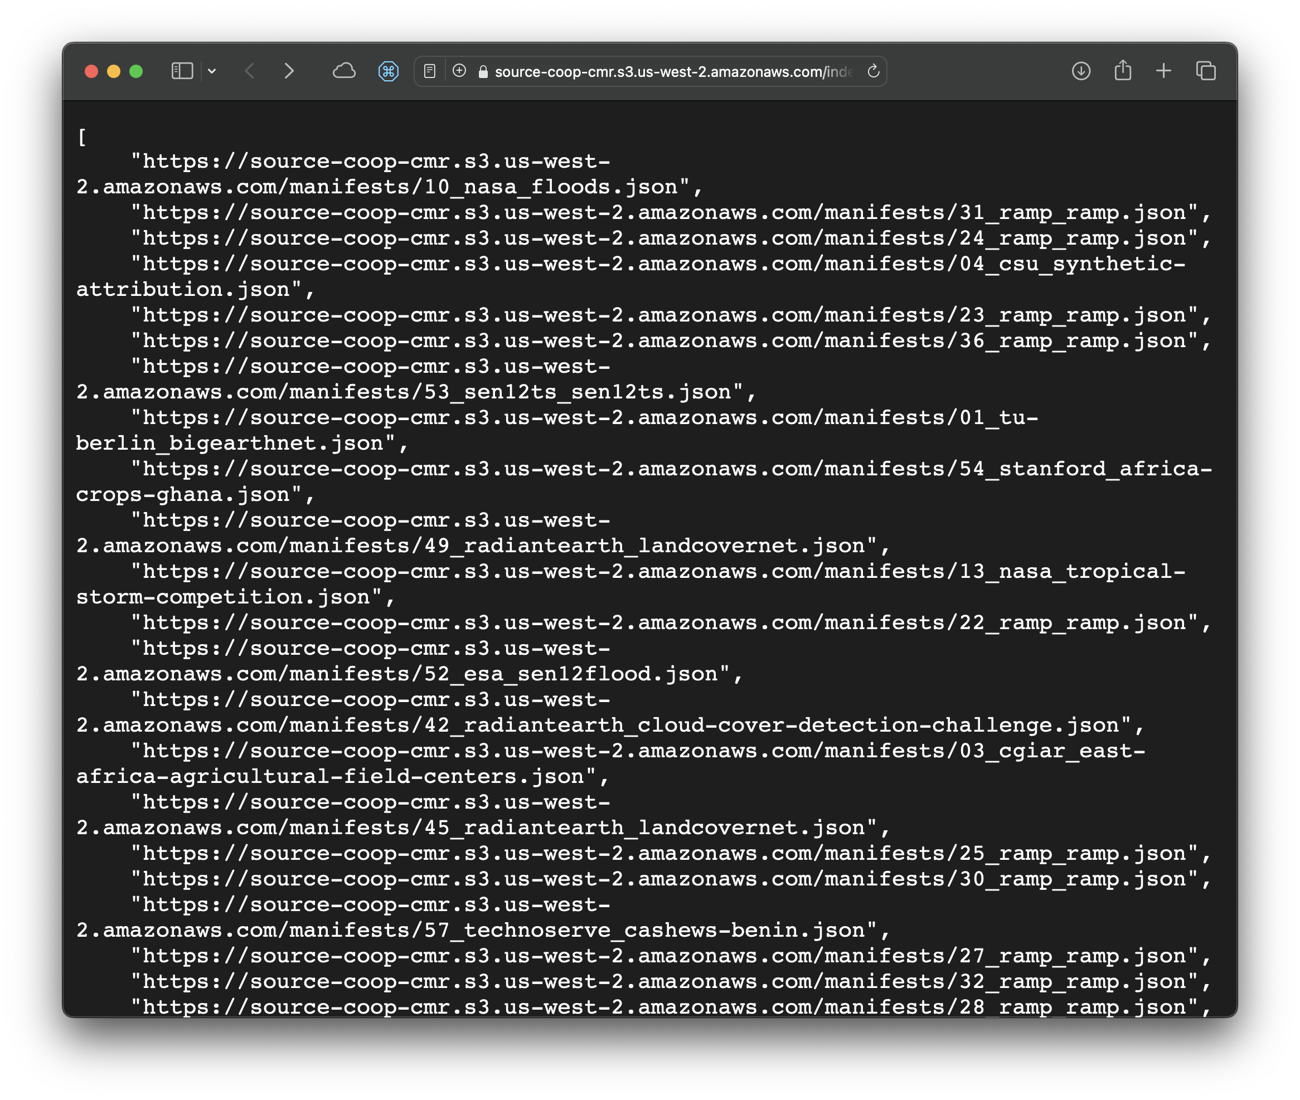
Getting data into CMR from Source Cooperative
Step 3: Publish index of metadata files

Slide 10
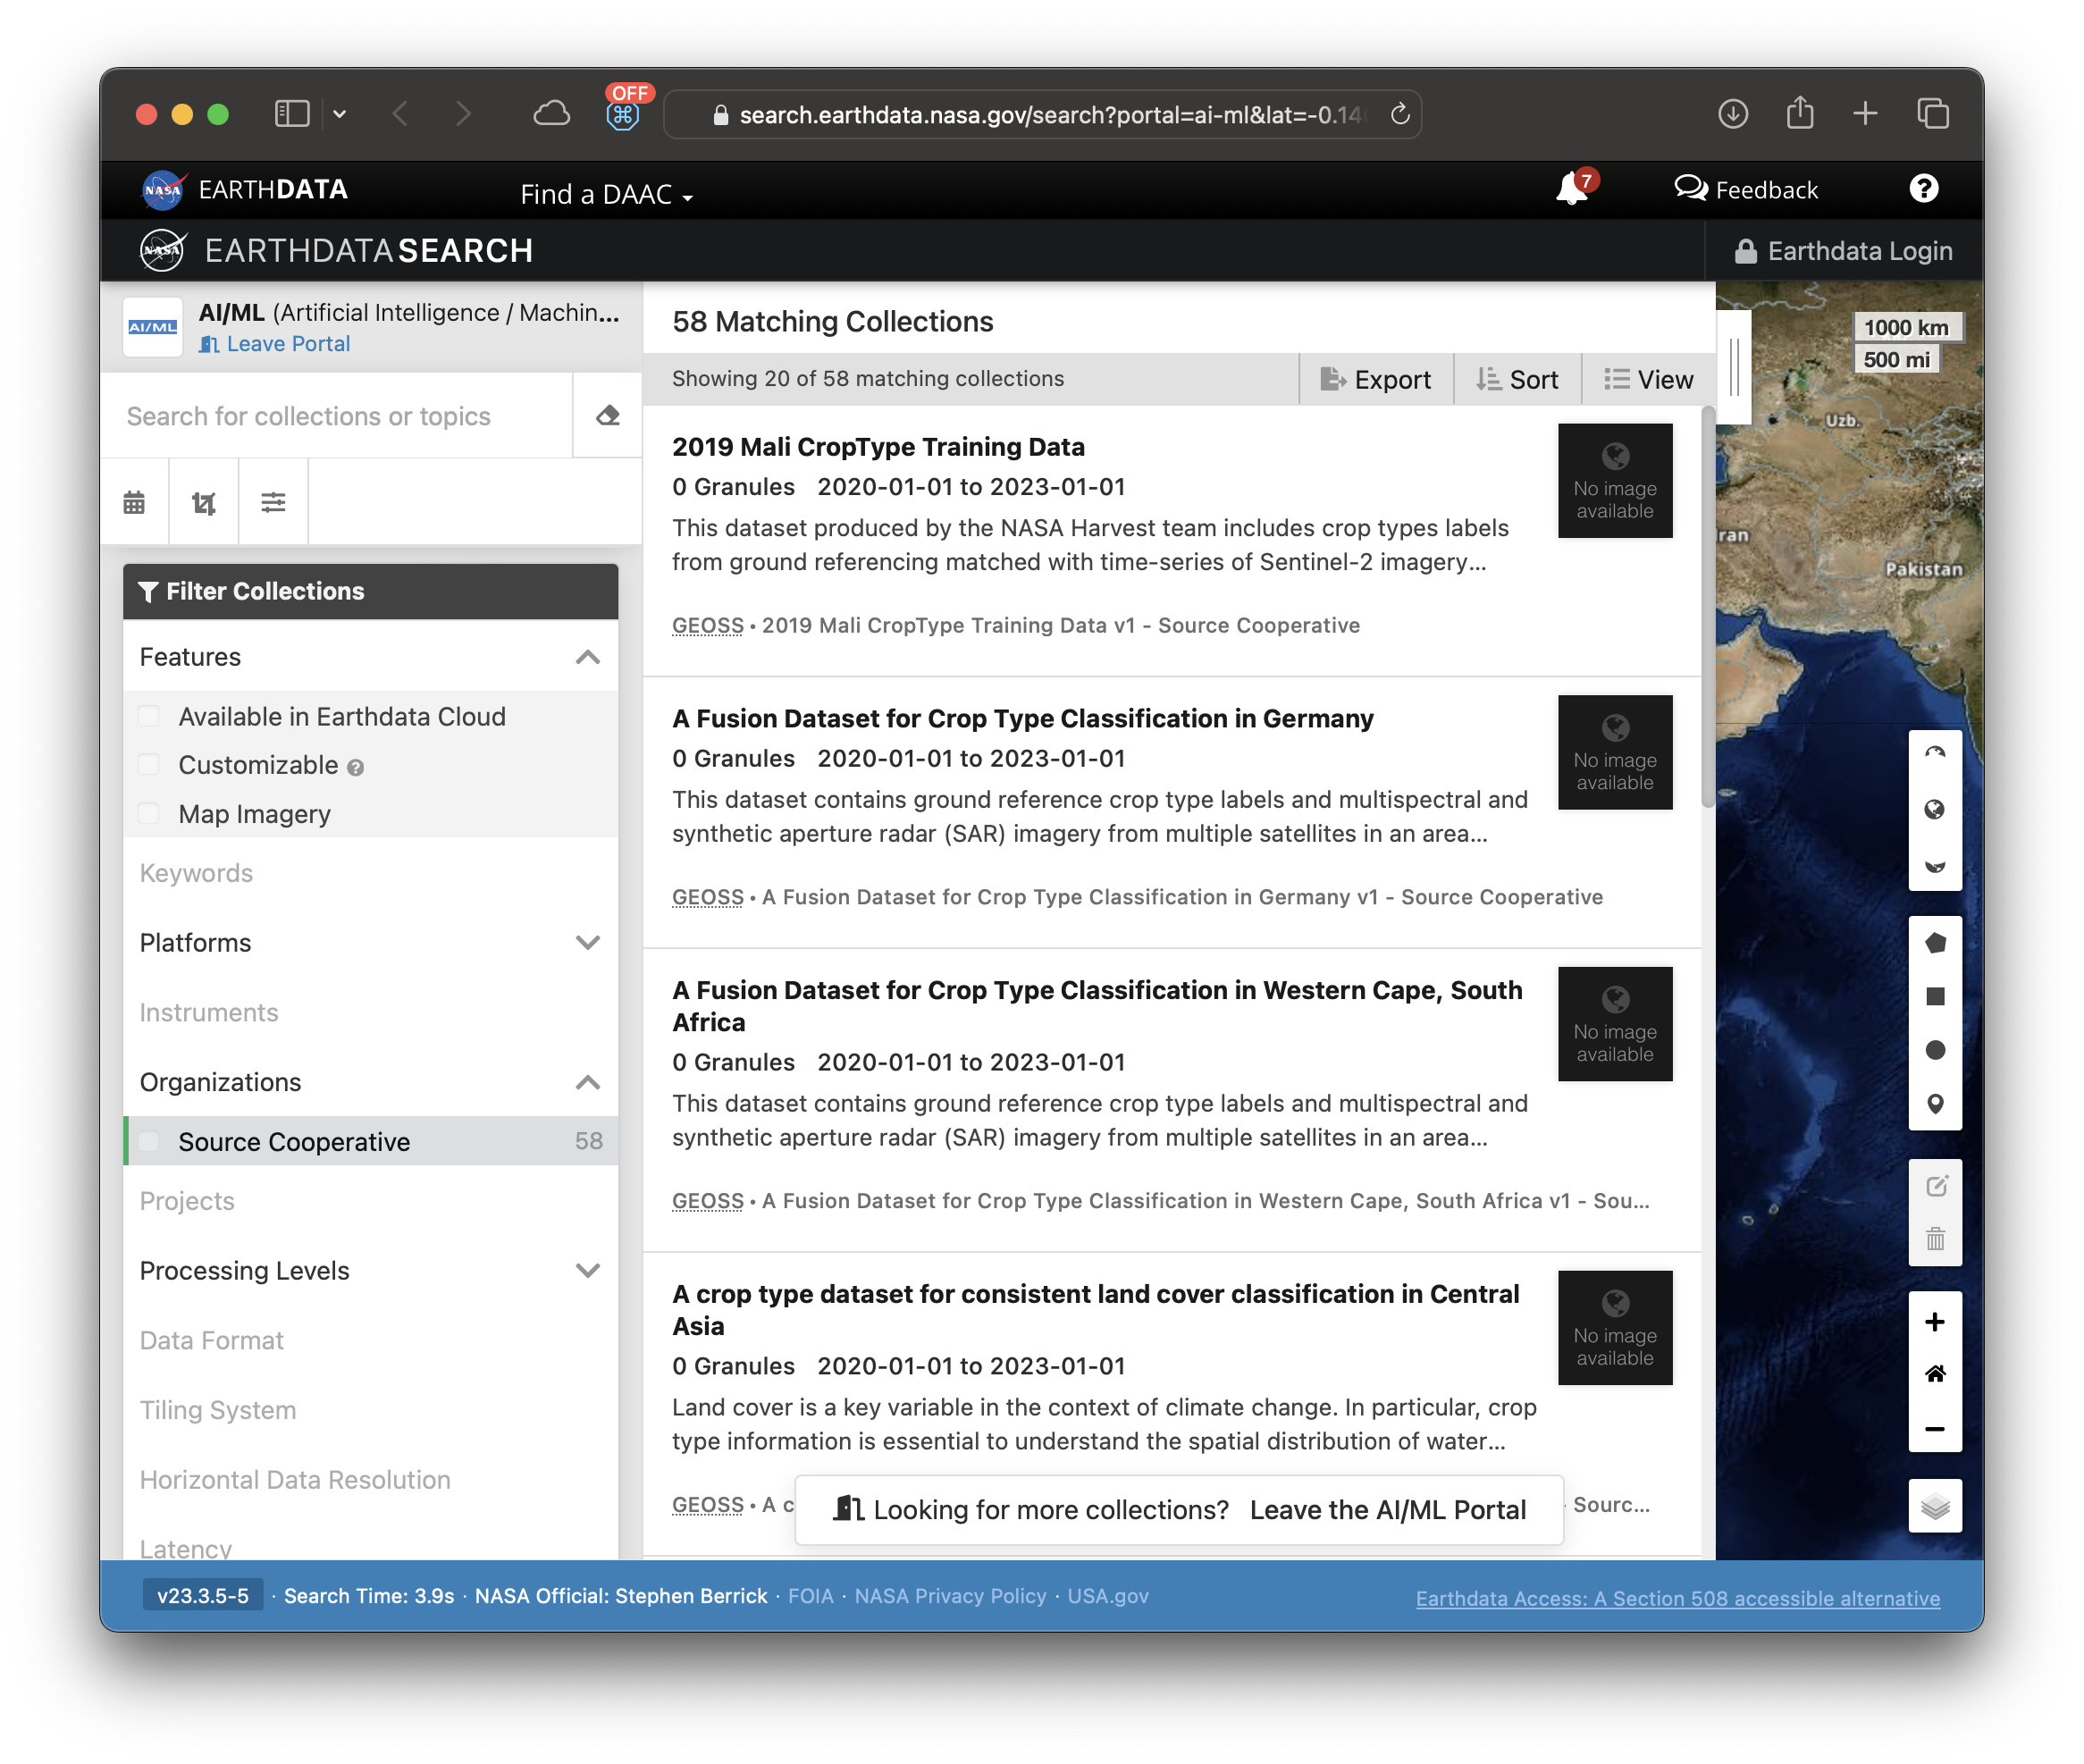
Getting data into CMR from Source Cooperative
😍
Step 4: NASA validates and adds data to CMR

Slide 11
Looking forward
Massive geospatial datasets collected from surveys, sensing, and social media provide rich data sources and geospatial context for GeoAI. However, the GeoAI community still faces enormous challenges in integrating large, spatially heterogeneous, multi-modal geospatial datasets into existing machine learning frameworks.
Trillion-Pixel GeoAI Challenges Workshop Report
Oak Ridge National Laboratory

Slide 12

Looking forward
Making it easy to publish data on the Internet.
Promoting efficient and accessible approaches to work with geospatial data over the Internet.
Areas of interest:
What is a data product?
  What is a good data product? What is an “analysis ready” data product?
Evolution of STAC as vehicle for more metadata
Best practices to decouple labels for training datasets from imagery
  https://github.com/cloudnativegeo/mlrd

Slide 13
Thank you!
Jed Sundwall, Executive Director
jed@radiant.earth

