Slide 1
FedEO Connections Result
Yousuke Ikehata, JAXA
Agenda ID: 2023.10.25_14.45
WGISS-56
25th October 2023

Slide 2

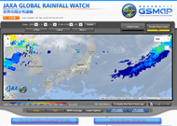
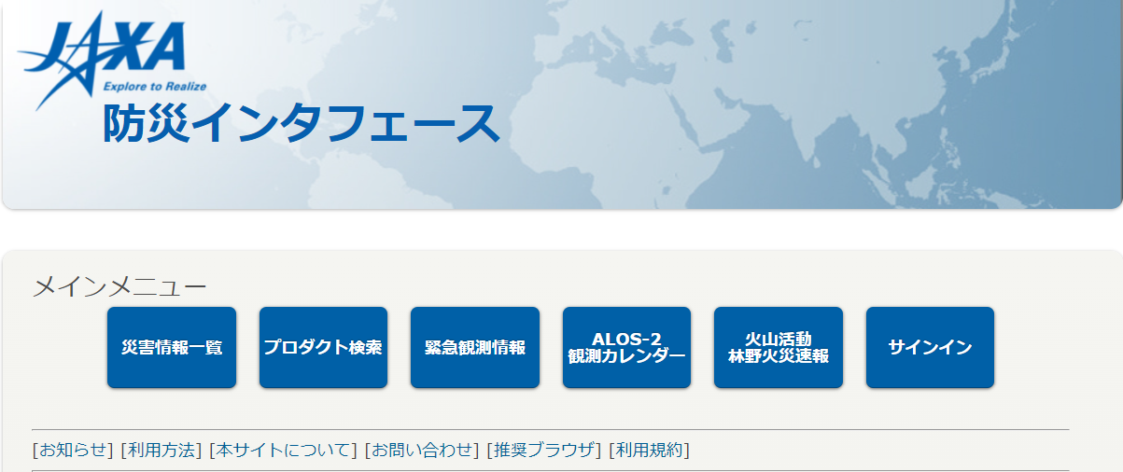


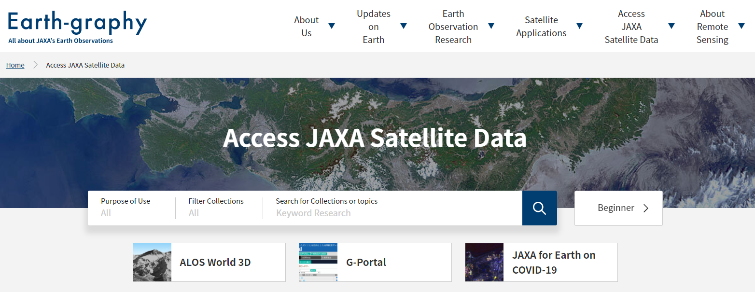
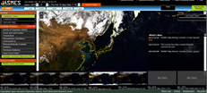

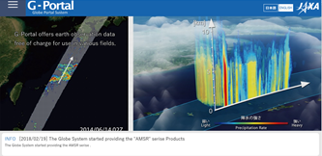
JAXA Portals and Data Provision to Partner Portals
JAXA Portals
Partner Portals
Thematic
Portals
JASMES
Ocean
GSMaP
Precipitation
Bousai Interface
Disaster
GDAS GHG
Earth-graphy
Knowledge Hub
https://earth.jaxa.jp/en/
Web Portal
Knowledge Hub
Portal Search (*)
International Charter Disaster
* Associate 21 portals are findable via Earth-graphy.
G-Portal is also works as DAB
(Discovery and Access Broker)
Data
Provision
G-Portal
Search & Data Provision for JAXA Standard Products
Sentinel Asia
Disaster
Slide 2
Notes:
This is relations between our dissemination portal site and user interfaces.
As knowledge hub, our portal site earth-graphy is centerized.
Earth-graphy points other portals.
Data provide is owned G-Portal.
これは、JAXAのデータ提供ポータルサイトとユーザのインターフェースを記したチャートである。
JAXAは、標準プロダクトと複数のThematic Portalサイトを横断的に検索できる入口“Earth-graphy”を立ち上げた。
ここには、Knowledge Hubとしての機能もあり、最初にユーザが訪れた際に必要とする情報を集約している。

Slide 3
Catalog linkage
Uploading by multi path/ways
  JAXA -> IDN by DIF
  JAXA -> FedEO by Opensearch
Unified into FedEO
After Apr. 2024
DIF
JAXA
JAXA
Slide 3
Notes:
As already mentioned, JAXA connects FedEO for IDN and GEOSS.
We use DIF as catalog before but we connects IDN through FedEO after next year.

Slide 4


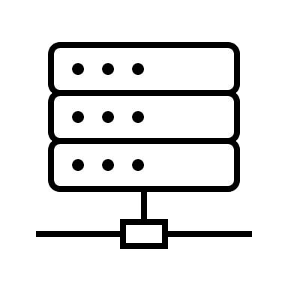


System architecture
Front-end Service
G-Portal
Interface System
Back-end Service
=
CSW(3.0)
Open search client
(FedEO)
Open search server
(Collection)
Open search server
(Granule)
Ex.
FedEO, IDN
Provides façade function for JAXA catalog linkage
focuses fully compatibility for CEOS BP
Stores collection level information(OSDD)
Base data format is DIF-10. But we can provide ISO-19115.
A part of micro service for G-Portal
Basically compatible for CEOS BP
Stores granule level information(OSDD)
Slide 4

Slide 5
System architecture
Open search description document(OSDD)
For Collection level
Open search description document(OSDD)
For Granule level
Open search client
(FedEO)
Open search server
(Collection)
OSDD
Open search server
(Granule)
OSDD
Ingest granule search information preliminary.
Harvest collection level information
Returns collection level result.
Search granule level information
Returns granule level result.
Slide 5

Slide 6

Metadata conversion
Missing metadata.
Address
Project = Fedeo
ARCHIVE, PROCESSOR, ORIGINATOR
DISTRIBUTOR(SAOC->EOC)
GET DATA=Fedeo
Metadata_last_revision
IDN
Metadata
(ISO19115)
Step 2. convert catalog
ISO19115->DIF
Fedeo
lack
Facade
We checked opensearch connection between IDN and JAXA directly and it works well.
Metadata
(ISO19115)
ISO19115 -> façade -> DIF
Missing metadata.
Address
Keyword, topic category
Resolution
Distribution_media/format
Product level ID
Collection Data Type
Step1. convert metadata
DIF -> ISO19115
lack
JAXA Opensearch Server
(collection level)
Facade
Metadata
(DIF)
ISO19115 <- façade <- DIF

Slide 7
Result
JAXA can provides Opensearch function to Fedeo.
  Past: e-mail base update to IDN
  Now: opensearch interface to Fedeo ( and IDN)
  The number of catalog are 1017.
There’re some points for improvement
  Missing part
  Performance

