Slide 1
International Directory Network (IDN) Report
CEOS WGISS-56, hosted by CNES
Paris, France, October 25, 2023
Michael Morahan (KBR (contractor))
IDN Coordinator
Michael.P.Morahan@nasa.gov
WGISS-1023-MM
Notes:
CEOS: Committee on Earth Observation Satellites
WGISS: Working Group on Information Systems and Services
CNES: National Centre for Space Studies
KBR: Kellogg Brown & Root ltd

Slide 2
Table of Contents
EDSC IDN Search Portal Demo on JAXA Data Discovery
CEOS/IDN/CWIC Collaborations
UMM Updates
GCMD Keyword
IDN Metrics
WGISS-1023-MM
Notes:
EDSC: Earthdata Search Client
JAXA: Japan Aerospace Exploration Agency
CWIC: CEOS WGISS Integrated Catalog
UMM: Unified Metadata Models
GCMD: Global Change Master Directory

Slide 3
EDSC IDN Search Portal Demo on JAXA data discovery
WGISS-1023-MM

Slide 4
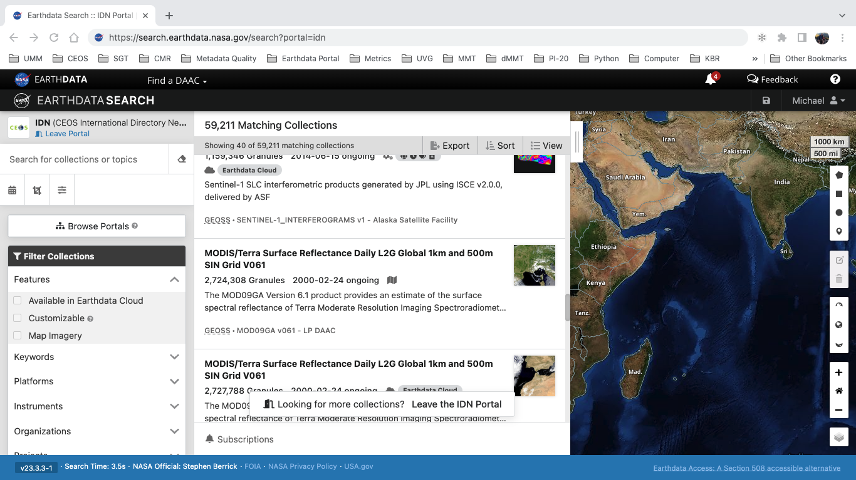
IDN Search Portal JAXA Collection-Granule DEMO
IDN Search Portal: https://search.earthdata.nasa.gov/search?portal=idn
WGISS-1023-MM
Notes:
IDN Search Portal: https://search.earthdata.nasa.gov/search?portal=idn

Slide 5
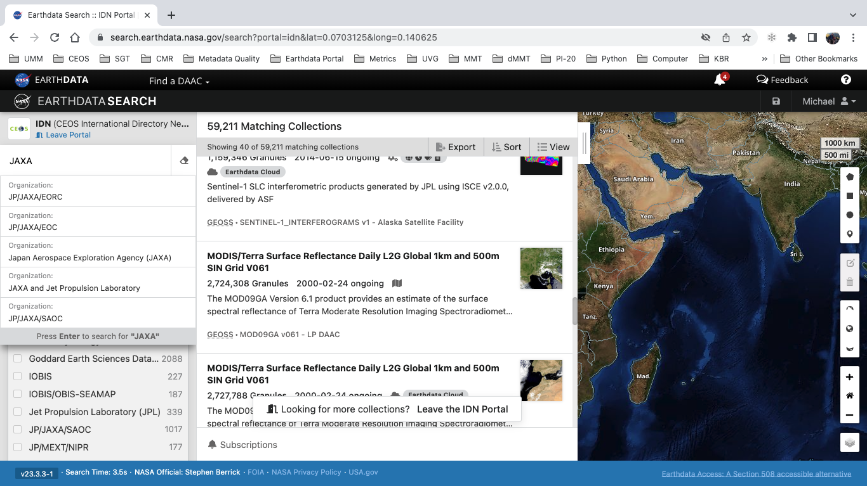
JAXA Collection Discovery
The user can either refine searches for JAXA collections by (see red boxes):
Typing JAXA into the free-text box and selecting the desired facet element.
Or, selecting Organization Data Center facet value “JP/JAXA/SAOC”.
The collection results will be narrowed down to only show the JAXA collections.
WGISS-1023-MM

Slide 6
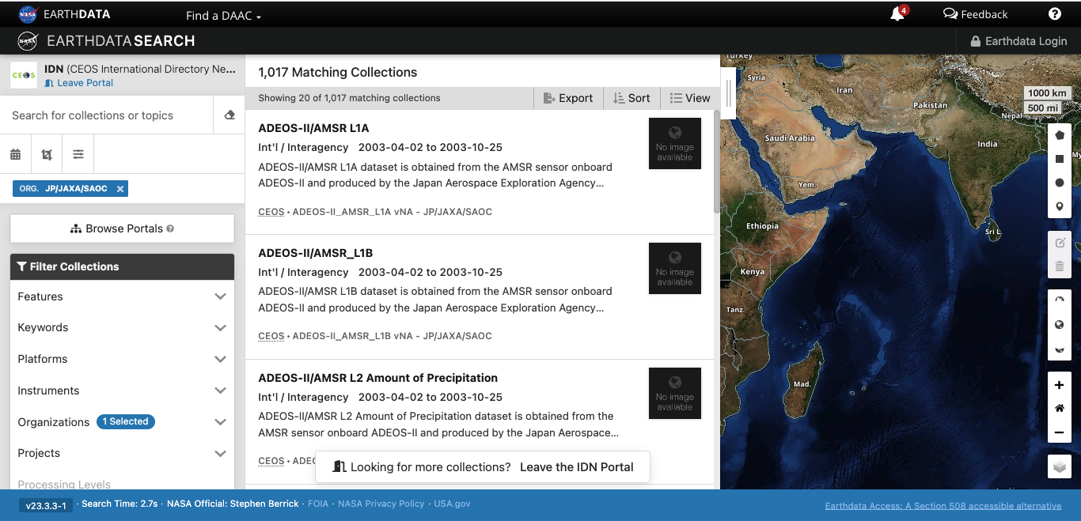
JAXA Collection Discovery Results
WGISS-1023-MM
Notes:
IDN Search Portal link to JAXA Collections: https://search.earthdata.nasa.gov/search?portal=idn&fdc=JP%2FJAXA%2FSAOC&ac=true&as[organization][0]=JP/JAXA/SAOC

Slide 7
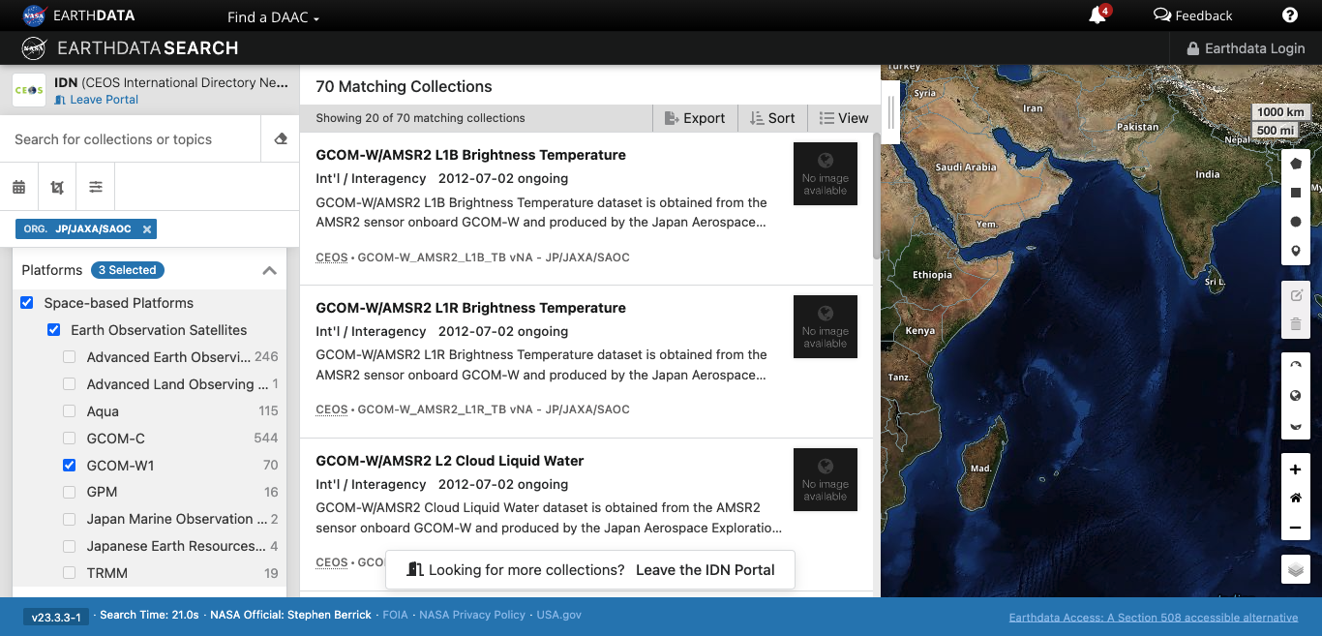
Collection Refinement by Platform
Refine by Platform using client Filter Collections feature (see red boxes):
Click on Platforms
Then click on Space-based Platform
Finally click on GCOM-W1
The results will be narrowed down to only show the JAXA GCOM-W1 platform collections.
WGISS-1023-MM
Notes:
GCOM-W1: Global Change Observation Mission 1st-Water
IDN Search Portal link to JAXA GCOM-W1 Plaform Collections: https://search.earthdata.nasa.gov/search?portal=idn&fdc=JP%252FJAXA%252FSAOC&ac=true&as[organization][0]=JP/JAXA/SAOC&fpc0=Earth+Observation+Satellites&fps0=GCOM-W1&fpb0=Space-based+Platforms

Slide 8
Selecting JAXA Collection:
GCOM-W/AMSR2 L3 Sea Ice Concentration (1-Month, 0.1 deg)
Selecting from resulting JAXA GCOM-W1 collections:
Scroll down to wanted collection.
Click on collection (see red box).
WGISS-1023-MM

Slide 9
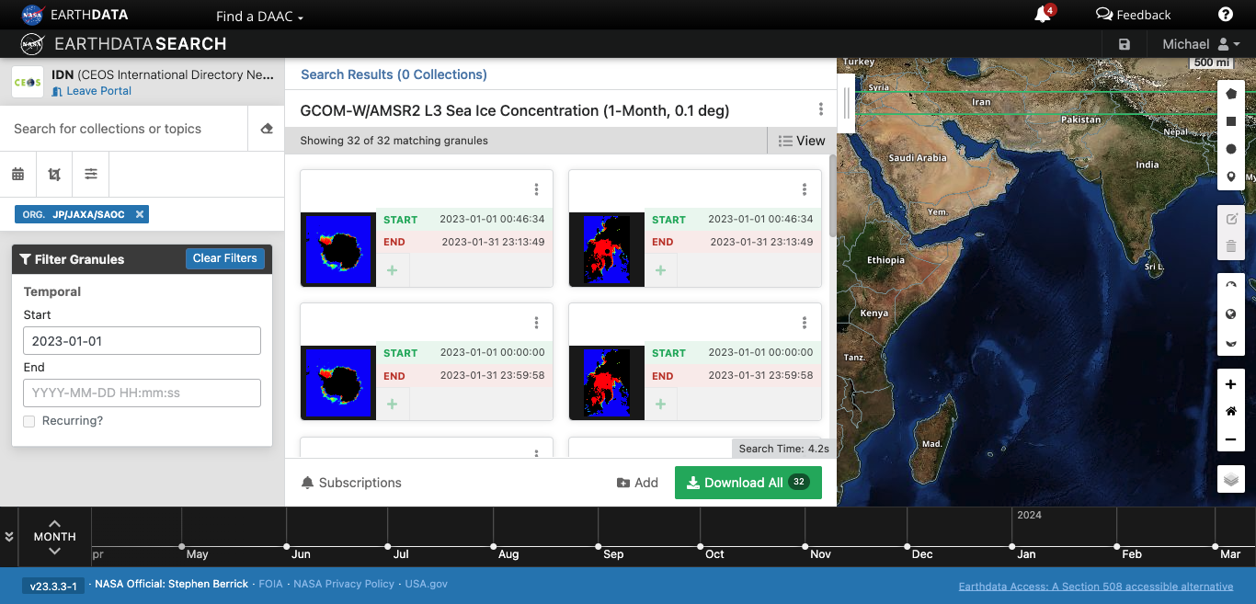
Granule Refinement by Temporal
Refine by time using client Filter Granules feature (see red box):
Enter temporal values
Temporal format YYYY-MM-DD HH:mm:ss
The results will be narrowed down to only show the granules within the temporal range.
WGISS-1023-MM
Notes:
YYYY: Year
MM: Month
DD: Day
HH: Hour
mm: Minute
Ss: Second
IDN Search Portal link to JGCOM-W/AMSR2 L3 Sea Ice Concentration (1-Month, 0.1 deg) granule: https://search.earthdata.nasa.gov/search/granules?portal=idn&p=C2698130467-JAXA&pg[0][v]=f&pg[0][qt]=2023-08-01T00%3A00%3A00.000Z%2C&pg[0][gsk]=-start_date&q=GCOM-W/AMSR2%20L3%20Sea%20Ice%20Concentration%20(1-Month%2C%200.1%20deg)&tl=1694637931.268!3!!

Slide 10
View Granule Details or Download Data
The user can choose to:
View the granule details by clicking on the 3 vertical dots (see red box).
Or, click Download All to proceed to download data files (see green box).
WGISS-1023-MM

Slide 11
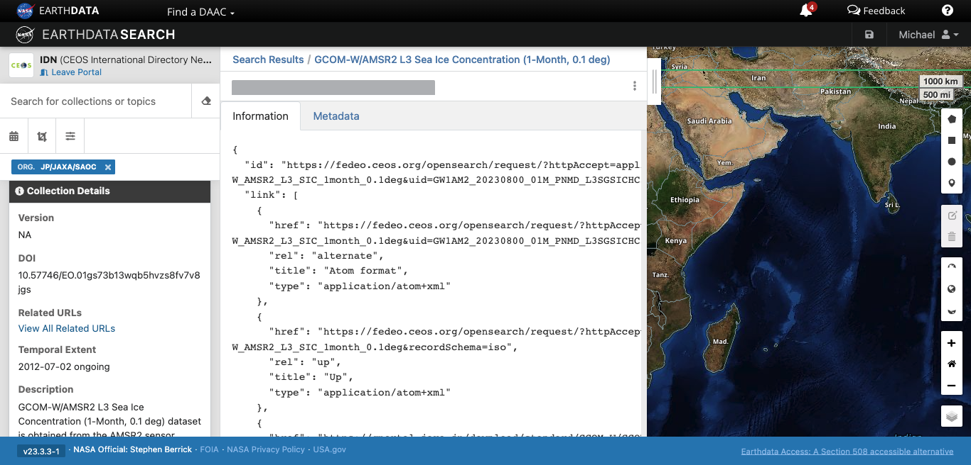
Viewing Granule Details
The user is able to see:
Collection details in the left box of the client.
Data files associated with the granule in the main box.
WGISS-1023-MM

Slide 12
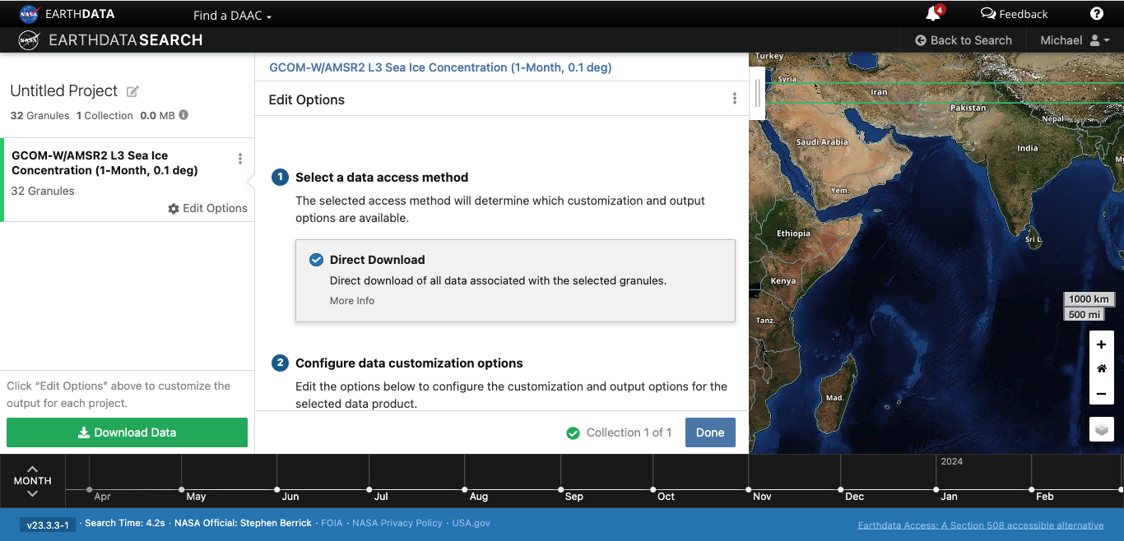
Data Access Method
The client automatically selects Direct Download for the user (see red box).
The user can change the download options or continue with Download Data (see green box).
WGISS-1023-MM

Slide 13
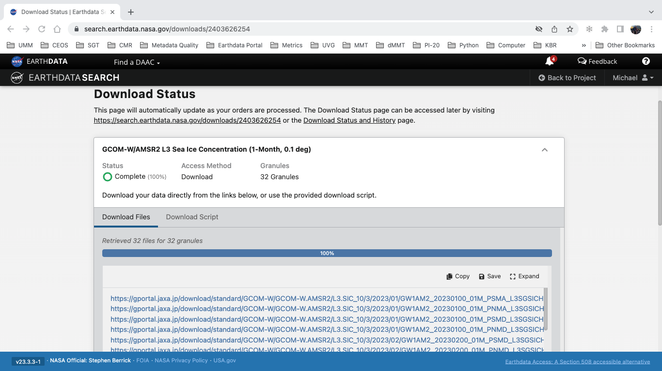
Granule Download Status
The Download status page shows the user:
Status of the order
Access Method
Number of Granules
The user can choose the Download method (see red box):
Download files through direct links.
Or, copy a script from the Download Script tab that can run on the user’s device.
WGISS-1023-MM

Slide 14
JAXA G-Portal (Globe Portal System) Login
JAXA G-Portal link: https://gportal.jaxa.jp/gpr/?lang=en
WGISS-1023-MM

Slide 15
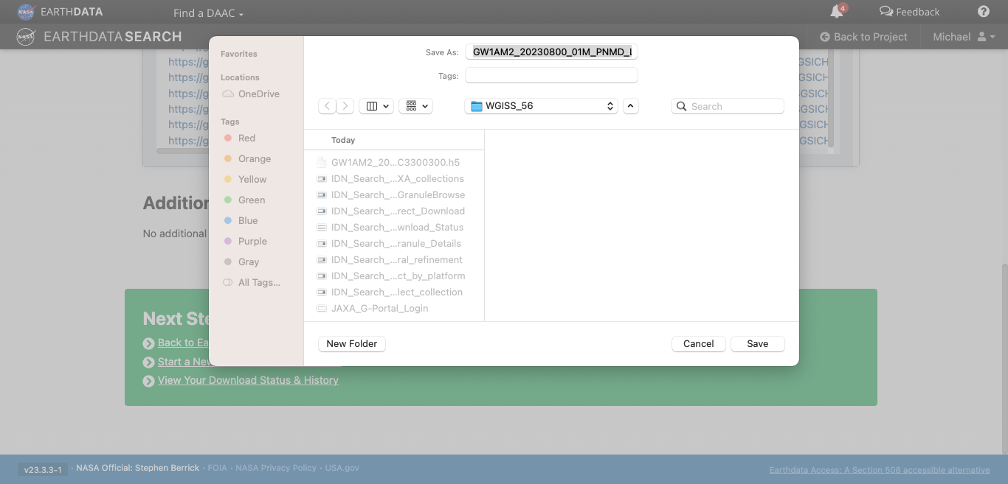
Granule Download by way of G-Portal API
WGISS-1023-MM
Notes:
API: Application Programming Interface

Slide 16
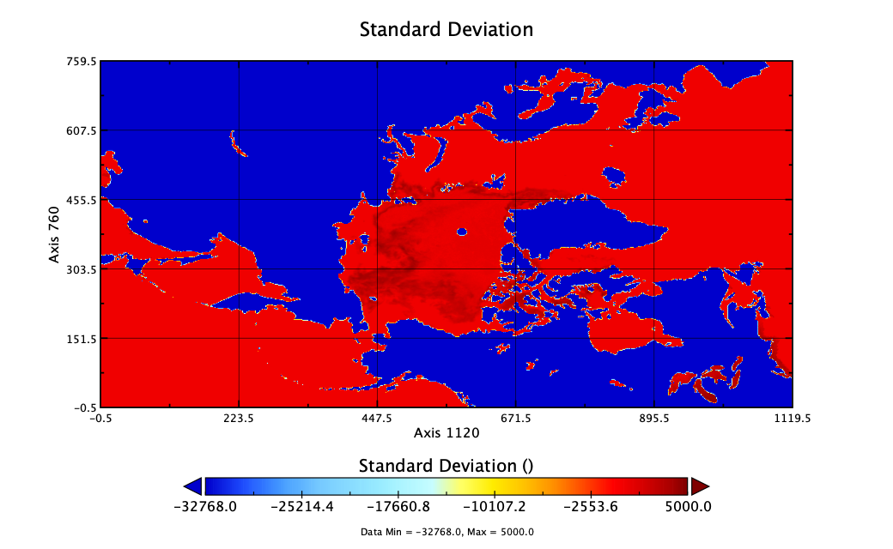
Display Granule Data on User’s Device with Panoply
GCOM-W/AMSR2 L3 Sea Ice Concentration (1-Month, 0.1 deg)
Data’s temporal value August 2023
Panoply is developed by NASA's Goddard Institute for Space Studies (GISS).
The program is a cross-platform application that plots geo-referenced and other arrays, from Network Common Data Form (NetCDF), Hierarchical Data Format (HDF), and GRIdded Binary (GRIB). Panoply offers additional functionality, such as slicing and plotting arrays, combining arrays, and exporting plots and animations.
Download link: https://www.giss.nasa.gov/tools/panoply/
NASA's Goddard Institute for Space Studies (GISS), Panoply is 5.2.9, released 2023-07-31., https://www.giss.nasa.gov/tools/panoply/
Japan Aerospace Exploration Agency. 2012. GCOM-W/AMSR2 L3 Sea Ice Concentration (1-Month, 0.1 deg). https://doi.org/10.57746/EO.01gs73b13wqb5hvzs8fv7v8jgs
WGISS-1023-MM
Notes:
NASA's Goddard Institute for Space Studies (GISS), Panoply is 5.2.9, released 2023-07-31., https://www.giss.nasa.gov/tools/panoply/
Japan Aerospace Exploration Agency. 2012. GCOM-W/AMSR2 L3 Sea Ice Concentration (1-Month, 0.1 deg). https://doi.org/10.57746/EO.01gs73b13wqb5hvzs8fv7v8jgs

Slide 17
CEOS/IDN/CWIC Collaborations
IDN Search and CWIC Portals, IDN/CWIC Metrics, CEOS/IDN/CWIC Collaborations
WGISS-1023-MM

Slide 18
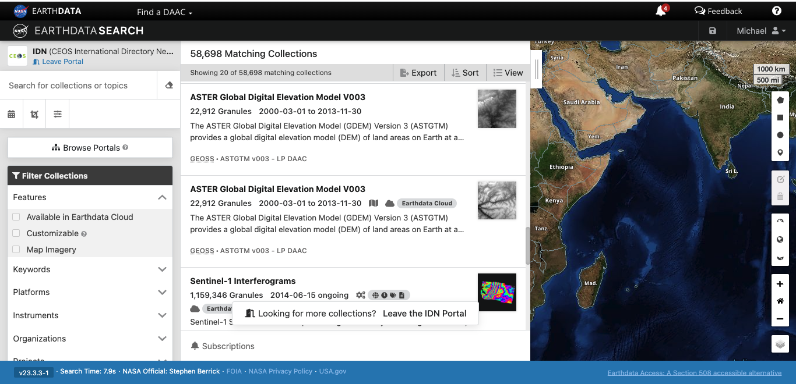
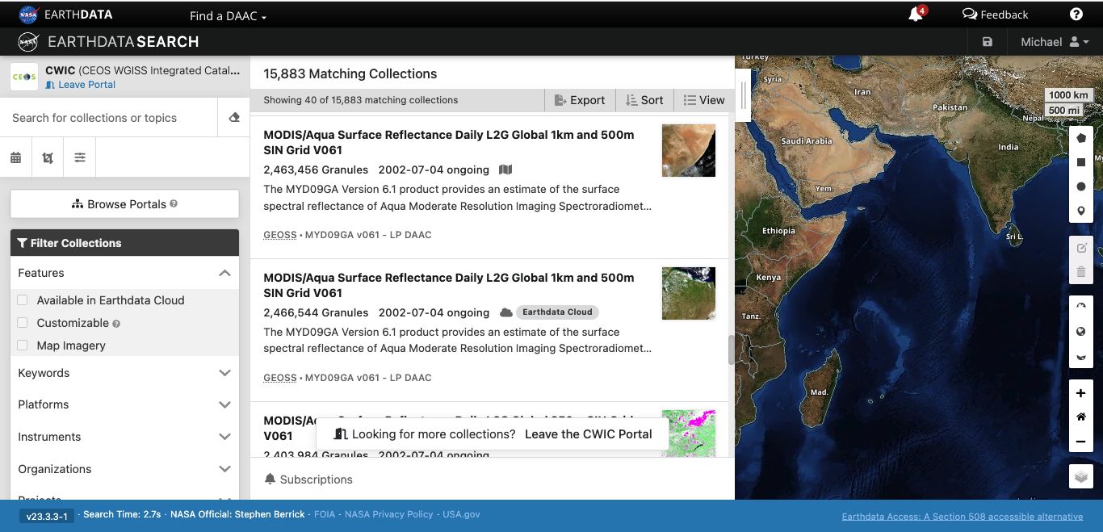
IDN Search and CWIC Portals
IDN Search Portal
CWICPortal
https://search.earthdata.nasa.gov/portal/idn/search
https://search.earthdata.nasa.gov/portal/cwic/search
WGISS-1023-MM

Slide 19
IDN/CWIC Metrics
Total Collections and Granules offered by the CWIC and FedEO:
CEOS Interfaces | Total Collections | Total Granules
CWIC | 366 | 16,343,605
FedEO | 528 | 55,666,056
JAXA/FedEO | 1017 | 13,719,472
Total Collections and Granules offered by the IDN:
IDN Search Portal | Total Collections | Total Granules
IDN | 52,744 | 1,366,433,966
WGISS-1023-MM
Notes:
FedEO: Federated Earth Observation

Slide 20
CEOS/IDN/CWIC Collaborations
ESA/FedEO
VITO collections are consolidated from 2 VITO FedEO providers in one provider called VITO-TERRASCOPE (98 collections).
JAXA
Ingested all the 1017 JAXA collections from FedEO API into NASA’s CMR for the IDN.
The collections are connected to JAXA’s G-Portal OpenSearch API for granules discovery and download.
NOAA NCEI
NOAA/NCEI plans to update OpenSearch Description Documents (OSDD) to resume granule discovery in the IDN.
CEOS Tools
Search for CEOS tools by ShortName or Keyword examples:
ShortName: https://cmr.earthdata.nasa.gov/search/tools.umm_json?name=Proba-V%20MEP&pretty=true
Keywords: https://cmr.earthdata.nasa.gov/search/tools?keyword=Sentinel%20satellites
WGISS-1023-MM
Notes:
NOAA: National Oceanic and Atmospheric Administration
NCEI: National Centers for Environmental Information

Slide 21
UMM Updates
Updates to UMM Collection, UMM Service
WGISS-1023-MM

Slide 22
UMM Updates
UMM Collection (version 1.17.3)
Update URLMimeTypeEnum with new ‘application/x-vnd.iso.19139-2+xml' enumeration
"MimeType": "application/x-vnd.iso.19139-2+xml"
Collection Schema: https://git.earthdata.nasa.gov/projects/EMFD/repos/unified-metadata-model/browse/collection/v1.17.3
UMM Service (version 1.5.2)
Updated schema “oneOf” for DataResourceSpatialExtentType element.
Service Schema: https://git.earthdata.nasa.gov/projects/EMFD/repos/unified-metadata-model/browse/service/v1.5.2
UMM Tool (version 1.2.0)
No Updates
Tool schema: https://git.earthdata.nasa.gov/projects/EMFD/repos/unified-metadata-model/browse/tool/v1.2.0
UMM VAR (version 1.9.0)
IDN plans to review the UMM Variable schema metadata entries as a source for NASA’s CEOS Climate Data Records (CDR) for the Essential Climate Variables (ECV) Inventory.
VAR schema: https://git.earthdata.nasa.gov/projects/EMFD/repos/unified-metadata-model/browse/variable/v1.9.0
WGISS-1023-MM

Slide 23
GCMD Keywords
GCMD Keyword Releases, GCMD Keyword Forum, GCMD Keyword Interfaces
WGISS-1023-MM
Notes:
GCMD: Global Change Master Directory

Slide 24
GCMD Keywords
GCMD Keyword Releases:
All Keyword releases: https://wiki.earthdata.nasa.gov/display/ED/Keyword+Release+Announcements
11 Keyword releases (Version 15.7 to 16.7) since WGISS-56 with various additions to Science Keywords, Platforms, Instruments, Providers, Projects, Data Format, and Product Level ID
GCMD Keyword Forum: https://forum.earthdata.nasa.gov/app.php/tag/GCMD+Key words
Forum lets GCMD metadata providers request new or updates to the GCMD Keywords and allows users to provide feedback and comments.
Forums User Guide: https://forum.earthdata.nasa.gov/docs/assets/sitedocs/userguide.pdf
GCMD Keyword Interfaces:
All public GCMD Keywords can reviewed using Keyword Viewer or KMS API:
Keyword Viewer: https://gcmd.earthdata.nasa.gov/KeywordViewer
KMS API: https://gcmd.earthdata.nasa.gov/kms/
Example: https://gcmd.earthdata.nasa.gov/kms/concepts/concept_scheme/instruments?format=rdf
WGISS-1023-MM
Notes:
KMS: Keyword Management System

Slide 25
IDN Metrics
IDN Homepage Usage, IDN SearchPortal Usage
WGISS-1023-MM

Slide 26
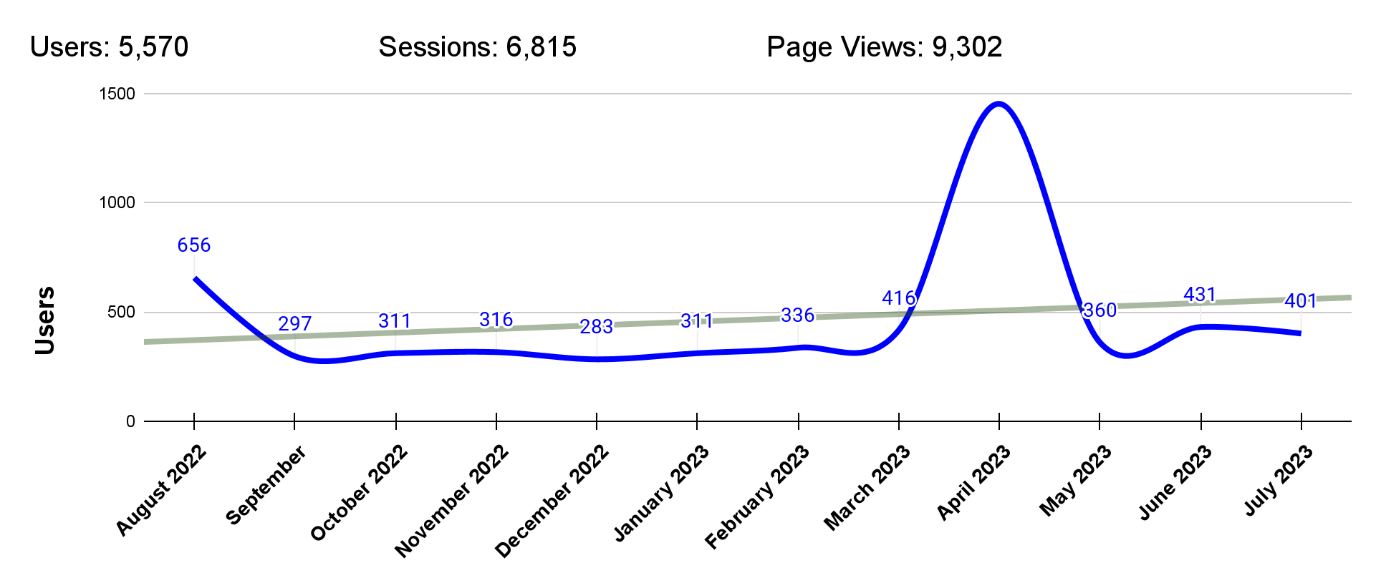
IDN Homepage Usage
(August 2022 to August 2023)
(https://idn.ceos.org/)
User: An individual person browsing the website.
Sessions: A single visit to the website, consisting of one or more pageviews.
Page Views: A pageview is reported when a page has been viewed by a user on the website.
WGISS-1023-MM

Slide 27
IDN Homepage Usage (continue)
(August 2022 to August 2023)
(https://idn.ceos.org/)
WGISS-1023-MM

Slide 28
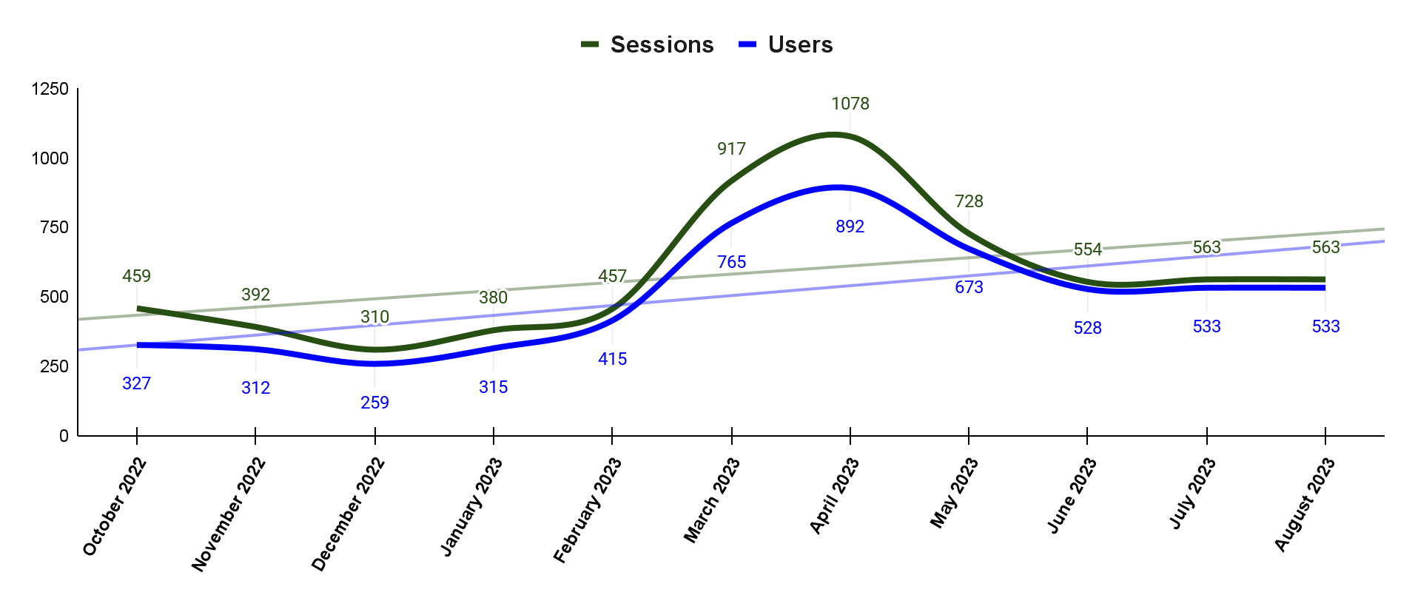
IDN Search Portal Usage
(October 2022 to August 2023)
(https://search.earthdata.nasa.gov/portal/idn/search)
User: An individual person browsing the website.
Sessions: A single visit to the website, consisting of one or more pageviews.
WGISS-1023-MM

Slide 29
IDN SearchPortal Usage (continue)
(October 2022 to August 2023)
(https://search.earthdata.nasa.gov/portal/idn/search)
Page | Sessions | Views | Users
/portal/idn/search | 6168 | 35785 | 6127
/portal/idn/search/granules | 2531 | 74260 | 2527
/portal/idn/projects | 81 | 5369 | 587
/portal/idn/search/granules/collection-details | 109 | 1395 | 379
/portal/idn/search/granules/granule-details | 21 | 1038 | 307
/portal/idn/downloads | 83 | 1357 | 997
/portal/idn/preferences | 5 | 36 | 25
/portal/idn/contact_info | 2 | 29 | 24
/portal/idn/subscriptions | 1 | 18 | 19
/portal/idn/search/granules/subscriptions | 4 | 33 | 9
WGISS-1023-MM

Slide 30
Draft MMT Usage
(March 1, 2023 to August 31, 2023)
(https://draftmmt.earthdata.nasa.gov)
MMT Usage from April 2022 to February 2023.
User | Unique Login | Total Logins
Metadata Authors | 22 | 68
Break down of Drafts created, submitted, and approved.
 | Created | Submitted | Approved
New Draft Proposals | 61 | 55 | 54
Update Collections | 153 | 153 | 141
Draft MMT will only save unsubmitted collection metadata for 30 days.
WGISS-1023-MM
Notes:
MMT: Metadata Management Tool

Slide 31
Thank You
Any Questions?
Email Addresses:
michael.p.morahan@nasa.gov (KBR)
valerie.dixon@nasa.gov (NASA)
support@earthdata.nasa.gov
Websites:
https://idn.ceos.org/
https://search.earthdata.nasa.gov/search?portal=idn
https://gcmd.earthdata.nasa.gov/KeywordViewer
WGISS-1023-MM

Slide 32
Acronyms
API | Application Programming Interface
CEOS | Committee on Earth Observation Satellites
CMR | Common Metadata Repository
CNES | National Centre for Space Studies
CWIC | CEOS WGISS Integrated Catalog
EDSC | Earthdata Search Client
ESA | European Space Agency
FedEO | Federated Earth Observation
GCMD | Global Change Master Directory
GCOM-W1 | Global Change Observation Mission 1st-Water
JAXA | Japan Aerospace Exploration Agency
KMS | Keyword Management System
MMT | Metadata Management Tool
NCEI | National Centers for Environmental Information
NOAA | National Oceanic and Atmospheric Administration
NASA | National Aeronautics and Space Administration
UMM | Unified Metadata Models
WGISS | Working Group on Information Systems and Services
WGISS-1023-MM

Slide 33
Background Slides
WGISS-1023-MM

Slide 34
Useful Links
International Directory Network (IDN)
https://idn.ceos.org/
International Directory Network (IDN) Search Portal
https://search.earthdata.nasa.gov/portal/idn/search
EarthData Login
https://urs.earthdata.nasa.gov/home
Draft MMT
https://draftmmt.earthdata.nasa.gov/
Draft Metadata Management Tool (dMMT) User's Guide
https://wiki.earthdata.nasa.gov/display/CMR/Draft+Metadata+Management+Tool+%28dMMT%29+User%27s+Guide
WGISS-1023-MM

Slide 35
Useful Links (continue)
GCMD Keywords
https://earthdata.nasa.gov/earth-observation-data/find-data/gcmd/gcmd-keywords
GCMD Keyword Viewer
https://gcmd.earthdata.nasa.gov/KeywordViewer/
New KMS URLs
GET Capabilities
https://gcmd.earthdata.nasa.gov/kms/
All Science Keyword in CSV format
https://gcmd.earthdata.nasa.gov/kms/concepts/concept_scheme/sciencekeywords?case=native&format=csv
WGISS-1023-MM

Slide 36
Useful Links (continue)
UMM-C, UMM-G, UMM-S, UMM-T, UMM-V Documents
https://wiki.earthdata.nasa.gov/display/CMR/CMR+Documents
CMR Collection Metadata Schemas
https://git.earthdata.nasa.gov/projects/EMFD
CMR Search API
https://cmr.earthdata.nasa.gov/search/site/docs/search/api.html
CMR OpenSearch Documentation
https://cmr.earthdata.nasa.gov/opensearch/home/docs
WGISS-1023-MM

Slide 37
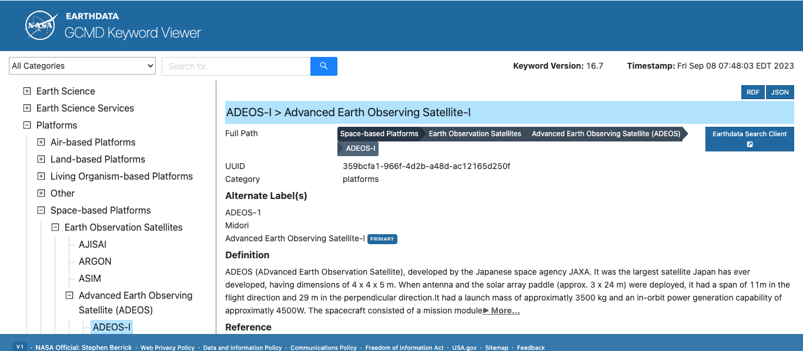
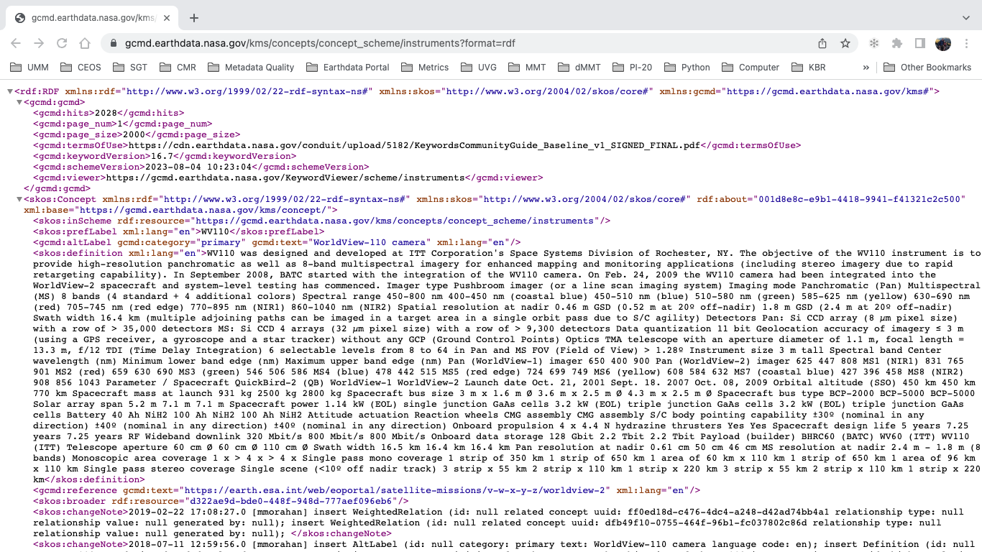
All public GCMD Keywords can reviewed using Keyword Viewer or KMS API:
Keyword Viewer: https://gcmd.earthdata.nasa.gov/KeywordViewer
KMS API: https://gcmd.earthdata.nasa.gov/kms/
Example: https://gcmd.earthdata.nasa.gov/kms/concepts/concept_scheme/instruments?format=rdf
WGISS-1023-MM

Slide 38
This work was supported by NASA/GSFC under Raytheon Technologies contract number 80GSFC21CA001.
WGISS-1023-MM

