Slide 1
FedEO Report
Yves Coene (Spacebel for ESA), Mattia Stipa (ESA)
CEOS WGISS #56, Paris (France)
Data Discovery and Access, 25/10/2023

Slide 2
Outline
FedEO in CEOS domain
FedEO current metrics and DIF-10 export status
FedEO evolution activities
Service discovery
ISO metadata
UMM-S/T metadata

Slide 3
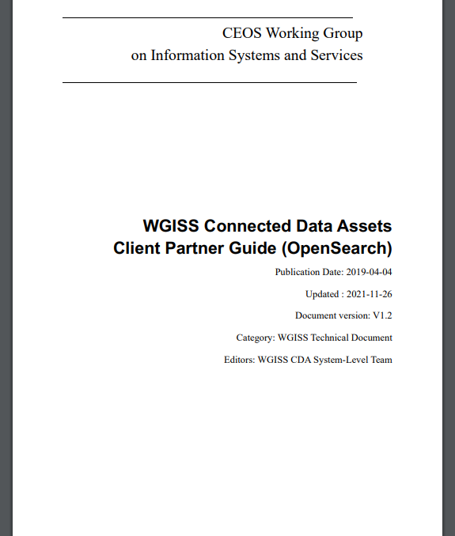
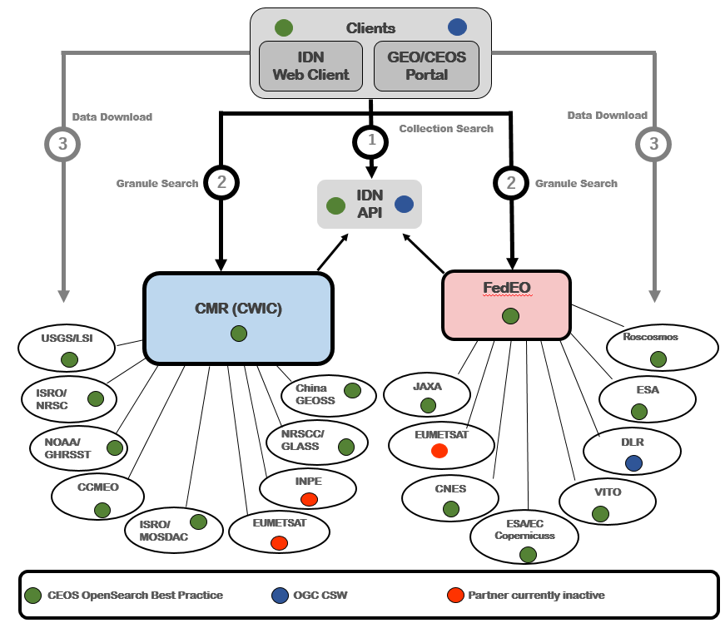
WGISS Connected Data Assets
FedEO: Federated Earth Observation missions access

Slide 4
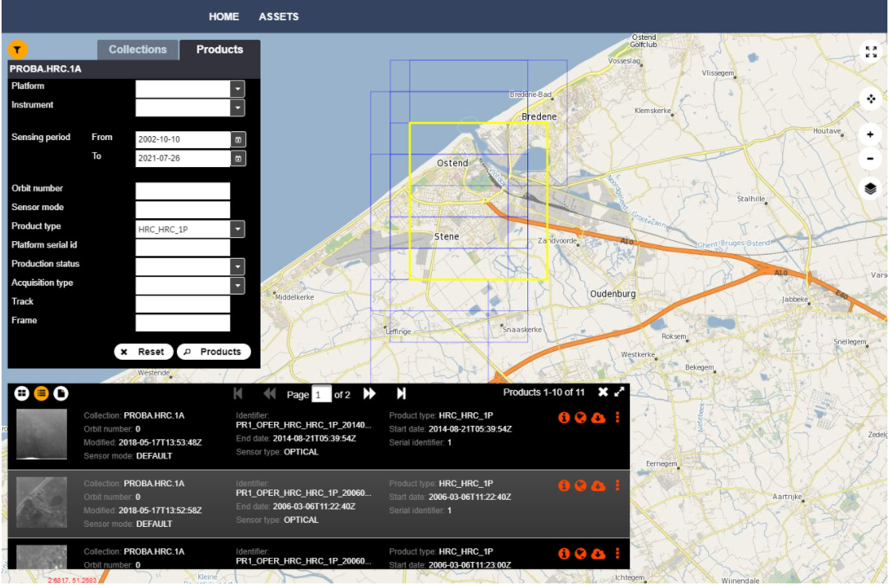
FedEO in CEOS Domain
Since September 2021:
FedEO Client available at https://fedeo-client.ceos.org
FedEO Server (API) available at https://fedeo.ceos.org/
Validation server available at https://geo.spacebel.be
Notes:
https://earth.esa.int/eogateway/news/new-version-of-the-fedeo-client

Slide 5
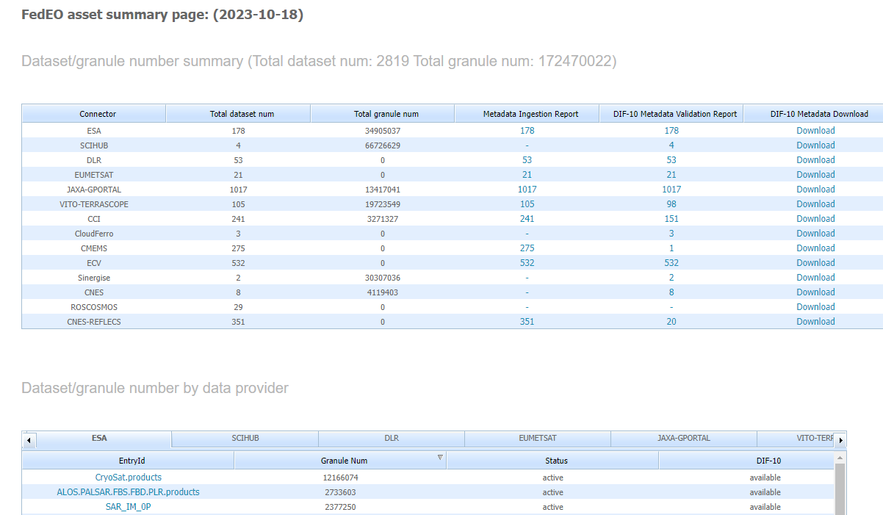
DIF-10 Metadata Export
https://fedeo.ceos.org/asset/index.html
Collections being harvested automatically by IDN, e.g. ESA, DLR, VITO, ESA CCI, JAXA.
VITO endpoints combined.
Temporary issue with DLR access.
See:
https://cmr.earthdata.nasa.gov/search/collections.umm_json?provider_id=FedEO&data_center=DE/DLR&pretty=true
https://cmr.earthdata.nasa.gov/search/collections.umm_json?provider_id=FedEO&data_center=VITO&pretty=true
https://cmr.earthdata.nasa.gov/search/collections.umm_json?provider_id=ESA&data_center=ESA/ESRIN&pretty=true
DIF-10 collections are available for being ingested into IDN, from
https://fedeo.ceos.org/asset/index.html
Notes:
https://cmr.earthdata.nasa.gov/search/collections.umm_json?provider_id=FedEO&data_center=DE/DLR&pretty=true
https://cmr.earthdata.nasa.gov/search/collections.umm_json?provider_id=FedEO&data_center=VITO&pretty=true
https://cmr.earthdata.nasa.gov/search/collections.umm_json?provider_id=ESA&data_center=ESA/ESRIN&pretty=true
https://access.earthdata.nasa.gov/holdings

Slide 6
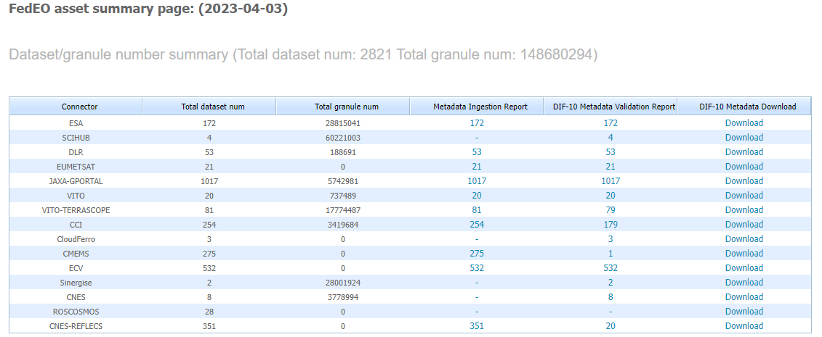
Metrics evolution
FedEO: 148 to 172 million granules (+16%) since WGISS-55 (Apr 2023)
ESA (EOCAT): 178 collections with 34.9 million granules.

Slide 7
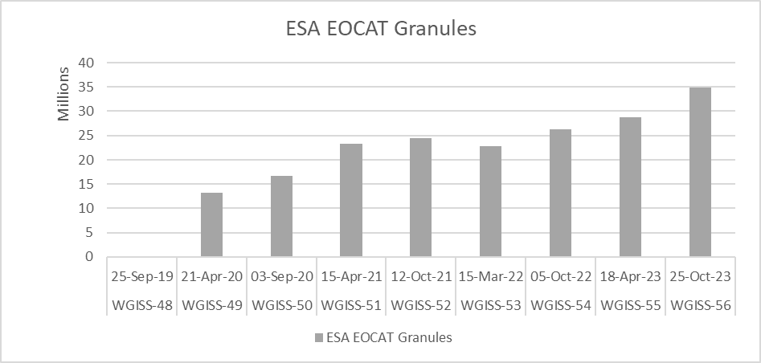
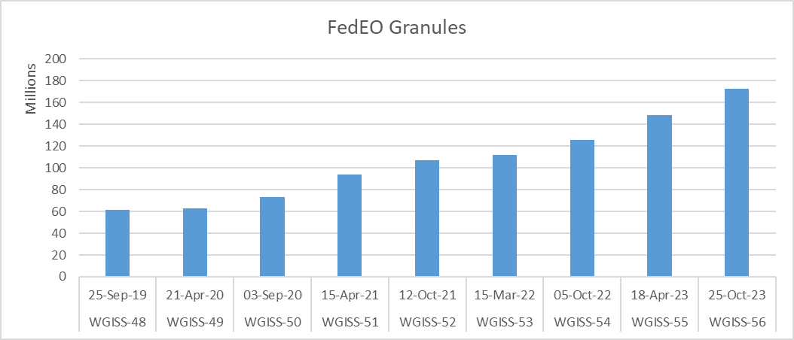
Metrics evolution

Slide 8
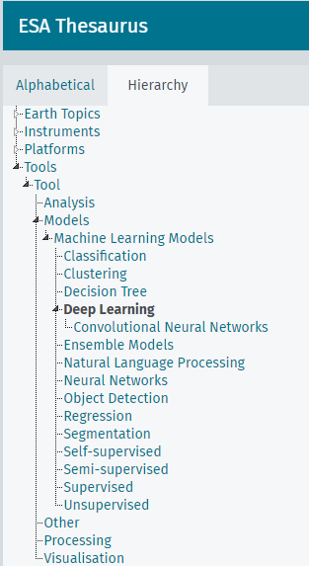
Evolution – Service Discovery
Service metadata records prepared for:
Earth Online Services (approx. 45)
AI4EO Jupyter Notebooks (approx. 20)
Available via all supported protocols:
OpenSearch
OGC API Features
STAC API
ESA SKOS Thesaurus expected to be extended with tool/service categories including correspondence with GCMD and DBpedia (TBC)
Static STAC Catalogs organize services/tools according to preliminary SKOS thesaurus.
DRAFT

Slide 9
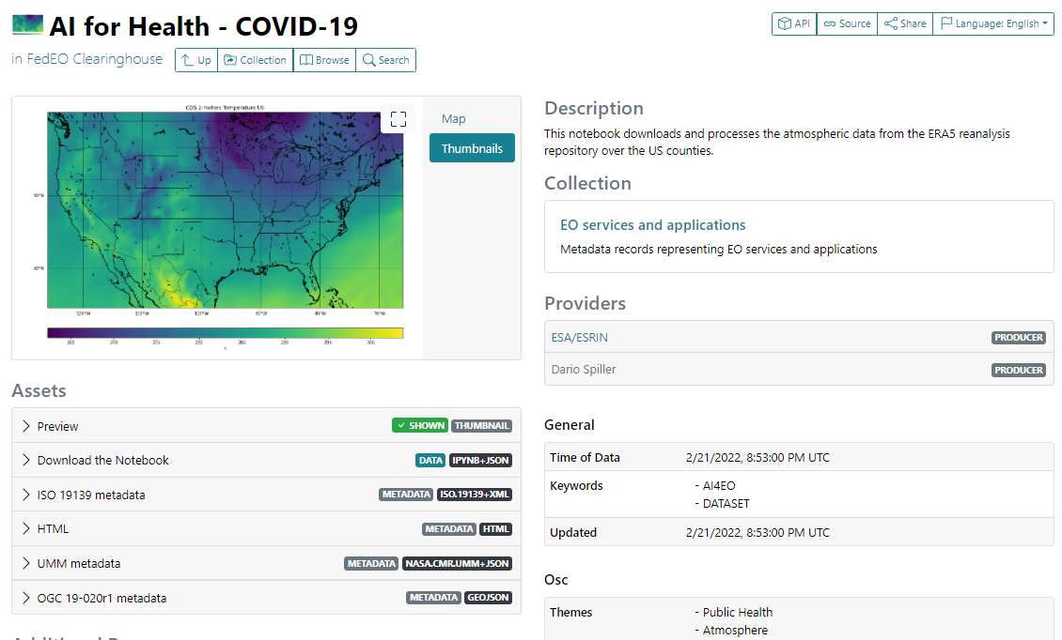
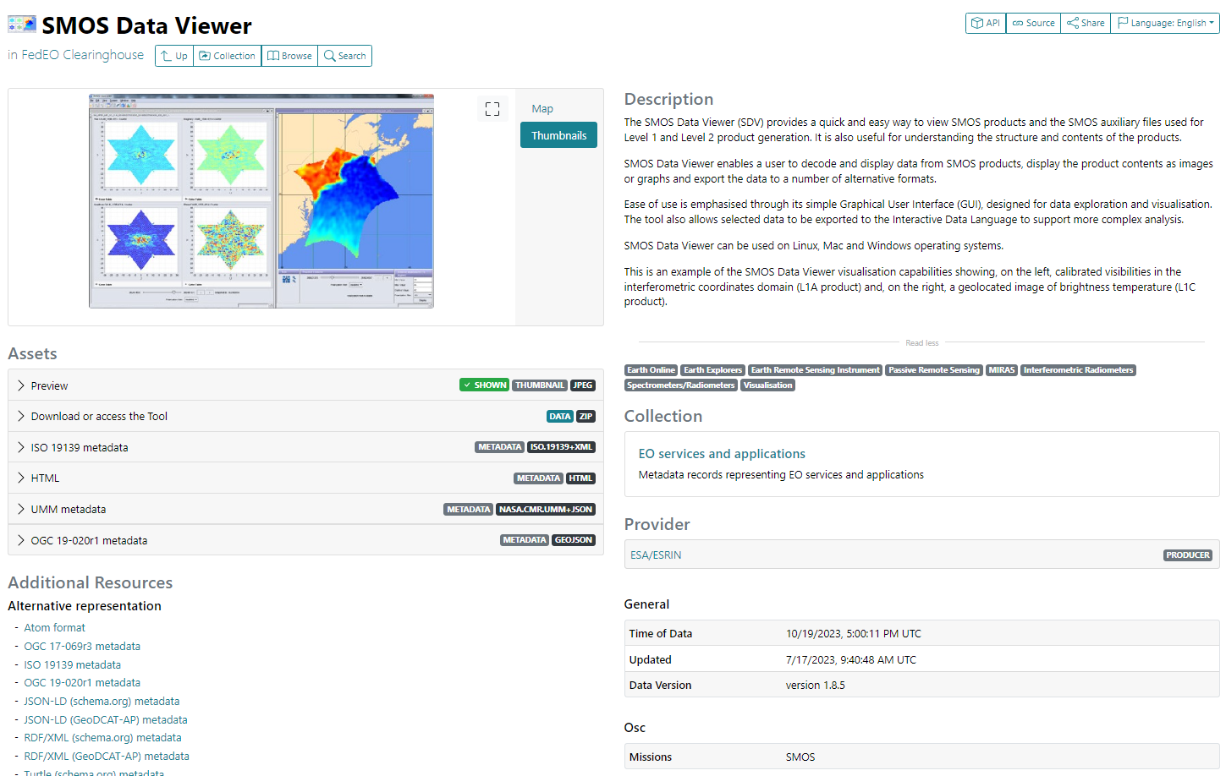
Evolution – Service Discovery
AI4EO Example: Earth Online Example:
Access to AI4EO / Earth Online Landing Page
Notebook and tool downloads
Access to Gitlab
Controlled vocabulary (Platforms, Instruments, Earth Topics, Tool Categories)

Slide 10
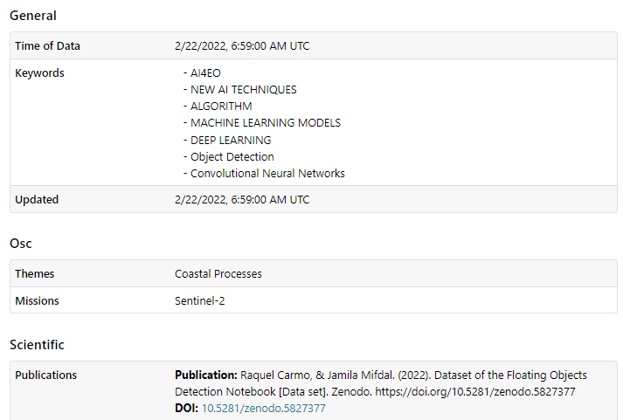
Evolution – Service Discovery
STAC “Scientific Extension” to include “publications” (associated DOI) related to a resource available in OGC GeoJSON (OGC 17-084r1, OGC 19-020r1, GeoDCAT-AP).
STAC “Open Science Extension” for representing “themes” and “missions” (controlled keywords).
Notes:
https://emc.spacebel.be/collections/services/items/ai4eo-detecting-floating-macro-objects?mode=owc
https://radiantearth.github.io/stac-browser/#/external/emc.spacebel.be/collections/services/items/ai4eo-detecting-wildfires?httpAccept=application%2Fgeo%2Bjson%3Bprofile%3Dhttps%3A%2F%2Fstacspec.org&.language=en

Slide 11
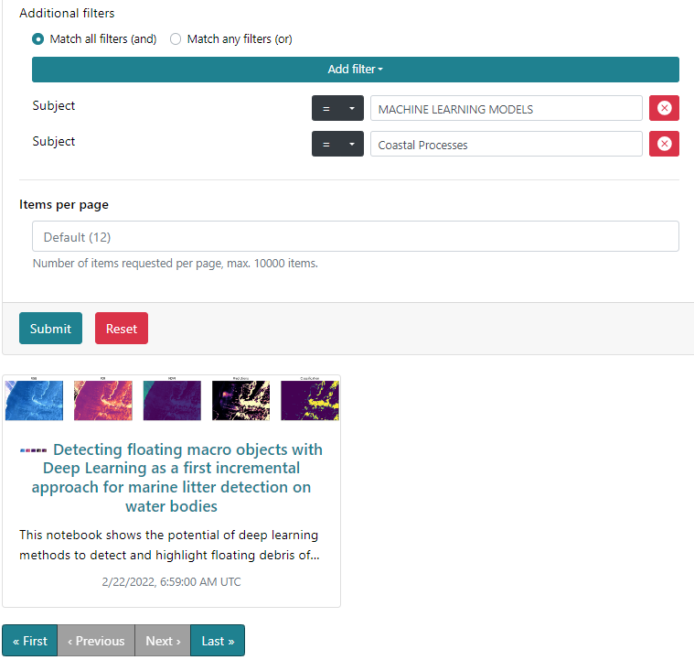
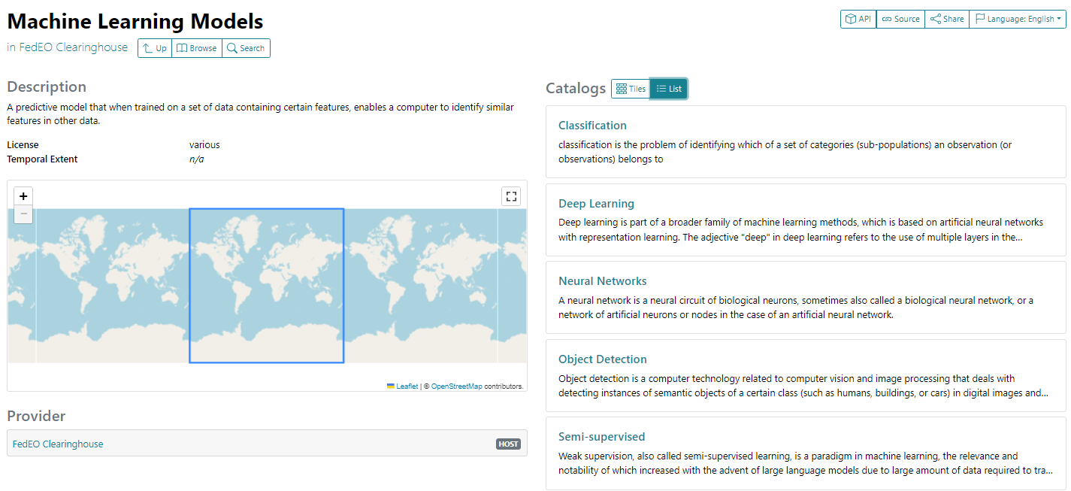
Evolution – Service Discovery
STAC API Search request (filter, CQL2) to find tools (“Machine learning”) about a subject (“Coastal processes”)
Free text search
Controlled keyword (concept) search
Static STAC Catalogs to browse “tool categories”

Slide 12
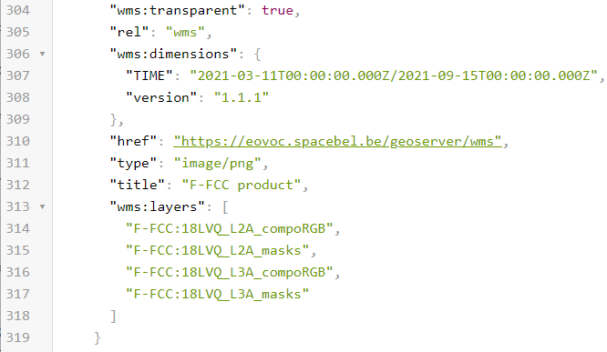
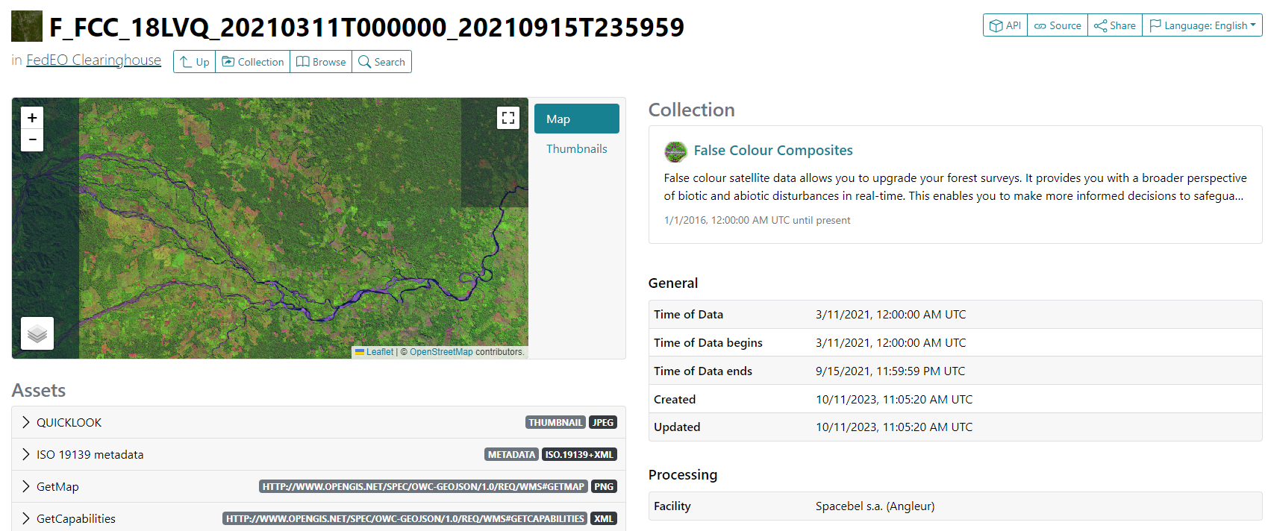
Evolution – Service Discovery
STAC “Web Map Links Extension” when WMS access for a granule is available (e.g. DataCube).

Slide 13
Evolution – ISO Metadata
ISO19115-3 supported for granules (done) and services (to do).
Added to recordSchema values and in OpenAPI.
Added as STAC asset.

Slide 14
Evolution – UMM metadata
Exchange formats between IDN and FedEO:
Collection metadata: DIF-10
Service and tool metadata: UMM-JSON
JSON encoding for UMM
Requires annotation with GCMD “EARTH SCIENCE SERVICES” keywords.
No possibility to add controlled science keywords.
FedEO will provide UMM-S or UMM-T (JSON) encoding according to the content of the metadata record.

Slide 15
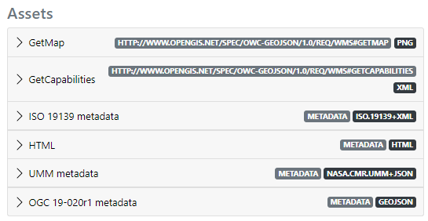
Evolution – UMM-S metadata
Services:
Encoding used when API are available, e.g. OGC offerings including WMS, WCS, WPS, …
Coupled resources to be provided.
Additional mediatype in OpenAPI
Also advertised as STAC asset
Examples:
https://emc.spacebel.be/collections/services/items/datacube-wcs
https://emc.spacebel.be/collections/services/items/datacube-wms
https://emc.spacebel.be/collections/services/items/tb19-d124
Notes:
https://emc.spacebel.be/collections/services/items/datacube-wms?httpAccept=text/html
https://emc.spacebel.be/collections/services/items/goce-user-toolbox_?httpAccept=text/html

Slide 16
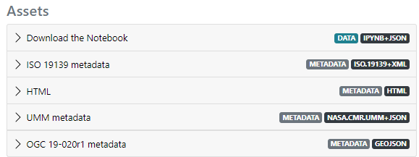
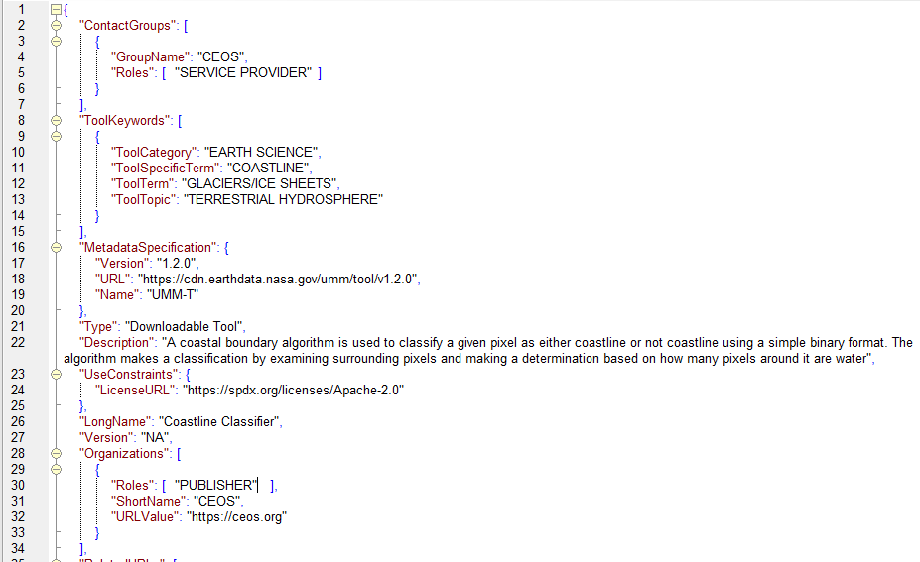
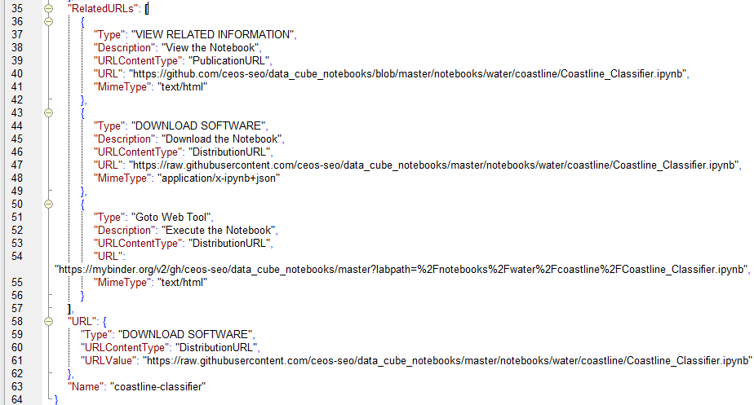
Evolution – UMM-T metadata
Encoding used for downloadable tools and Jupyter Notebooks
Also advertised as STAC “metadata” asset
UMM-T

Slide 17
Evolutions
ESA EOCAT interfaces updated significantly in September 2023.
OGC API-Features
STAC API
Etc.
Updated CEOS FedEO interfaces expected to be operational by end 2023 and contain important part of presented “evolutions”.
UMM export to IDN (e.g. for Jupyter Notebooks) requires further discussion.

Slide 18
DRAFT

