Slide 1
CGMS Cloud Best Practices and Approach to International Collaboration

Slide 2
Executive Summary
The CGMS Cloud Services Expert Group was established in July 2020 and is comprised of members from the National Oceanic and Atmospheric Administration (NOAA), European Organisation for the Exploitation of Meteorological Satellites (EUMETSAT), Korea Meteorological Administration (KMA), China Meteorological Administration (CMA), Japan Meteorological Agency (JMA), Indian Space Research Organisation (ISRO), and the World Meteorological Organization (WMO). The group hosts an annual CGMS Cloud Workshop and develops best practices and lessons learned based on the information exchange in the workshops. Over the past year (2022-2023), the group has focused on planning the 2023 annual Cloud workshop and finalizing the best practices document for CGMS publication.
Topics to discuss today:
CGMS Cloud Services Experts- Background and Deliverables
CGMS Annual Cloud Workshops
CGMS Cloud Best Practices Document
Significant Milestones and Key Accomplishments
CEOS Participation

Slide 3
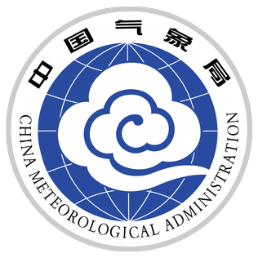
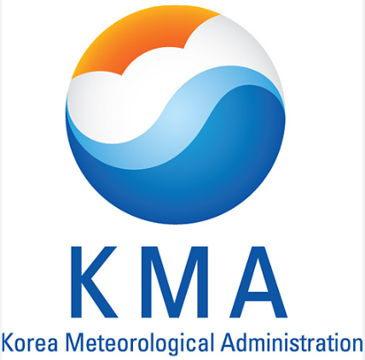
CGMS Cloud Services Experts- Background and Deliverables
Established in July 2020 and is comprised of members from:
National Oceanic and Atmospheric Administration (NOAA)
European Organisation for the Exploitation of Meteorological Satellites (EUMETSAT)
Korea Meteorological Administration (KMA)
China Meteorological Administration (CMA)
Japan Meteorological Agency (JMA)
Indian Space Research Organisation (ISRO), and
World Meteorological Organization (WMO)
Deliverables
*Develop the CGMS Cloud Best Practices Document
*Host an annual CGMS Cloud Workshop

Slide 4
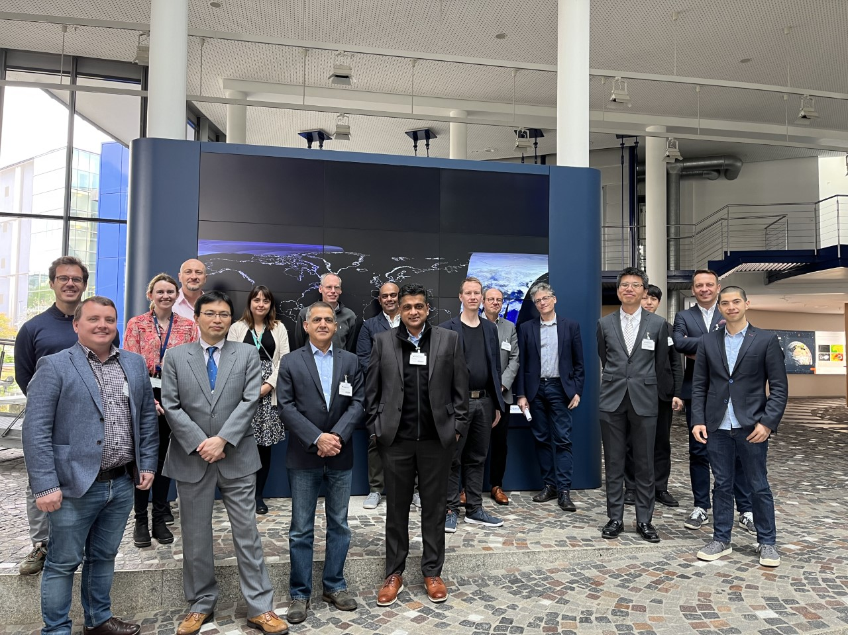
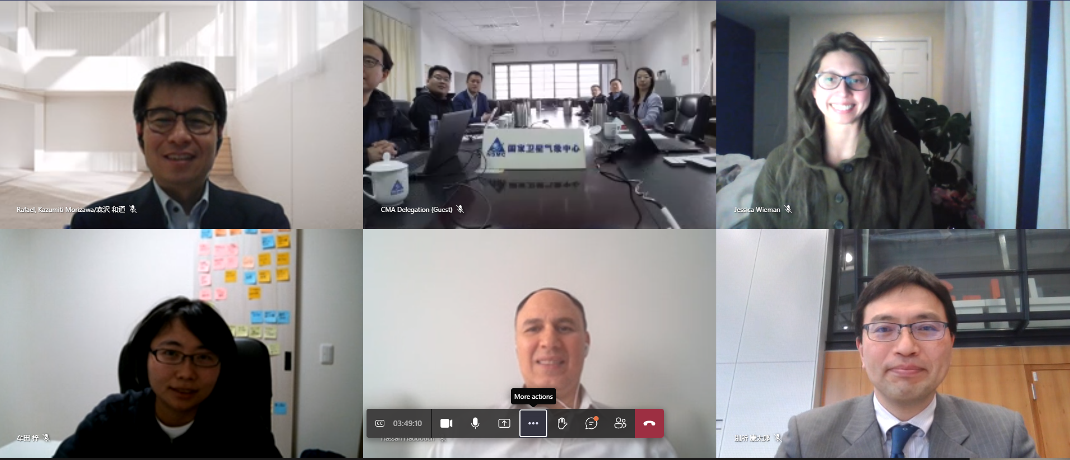
CGMS Annual Cloud Workshops
Purpose: Share cloud lessons learned and develop a set of best practices via an annual workshop to maximize interoperability
Hybrid format hosted in Darmstadt, Germany at EUMETSAT
3 days with industry and agency-only discussions
Topics
Cloud Architecture
Cyber Security
Cloud-to-Cloud Interaction
Cloud Native Data Access
Open Data Accessibility
Emerging Technology
Interoperability across clouds
2nd Annual CGMS Cloud Workshop In Person Attendees

Slide 5
CGMS Cloud Best Practices Document
CGMS Cloud Best Practices Document Outline
Developed based on workshop lessons learned from agencies and industry
Aligned with WMO WIS 2.0
Draft document recommends:
Cloud IT architecture
Creating Cloud Systems
Data Interoperability
Security
Cloud journey and workforce adoption
I. Best Practices for Cloud Architecture and Implementation
Architecture methods and approaches such as virtualization, automation, cloud-native design, and the creation of a dual environment for operations and research and development are highlighted in this section.
Implementation at the enterprise level includes discussion of hybrid models, global collaboration through the cloud, ingest and storage of data, and data access and security best practices.
II. Considerations for Data Standards
The benefits of cloud-compatible formats and data standards are summarized in this section.
III. The Cloud Journey and Adoption
Developing a business case, selection of CSPs, redundancy and business continuity, establishing governance including training and empowering the workforce, developing a financial strategy, and beginning with cloud pilots to the workforce are the best practices discussed in this section.
In process of final draft and then publishing the document within CGMS

Slide 6
Summary of Cloud Best Practices (1 of 3)
Cloud Architecture Considerations
Build new capabilities to align with industry cloud best practices versus lifting and shifting current systems into the cloud
Data should be at the center of the design to minimize need for routing
Build using cloud-native services versus repurposing to make workloads more efficient
If using hybrid cloud/on-premises solutions, use orchestration software to ensure consistency and configuration management
Creating Cloud System Solutions
Consolidate data whenever possible to create centralized repository or data lake
Leverage object storage to enable scaling for exponential increases of data
Change distribution to be a publish/subscribe model versus push/pull to allow stakeholders to curate their data pulls in real-time and for offline use
Build Infrastructure as Code (IaC) in the cloud so that systems deployment can be automated and enable more rapid releases of software

Slide 7
Summary of Cloud Best Practices (2 of 3)
Data Interoperability
Data formats can enable enhanced access and inspire innovative use - investigate and optimize data formats based on workflows of your system (use versus cloud optimization)
Consideration for WMO-compliant data formats with operational satellites
NetCDF is seeing increasing adoption by WMO and Zarr may be an emerging relevant cloud-native format
Align data standards across satellite agencies to enable swift and easy interoperable use of data and products in operations
Security
In the satellite world, we require high availability and potentially high integrity to the data - tailoring security controls on the cloud to meet this needs allows flexibility in use of cloud tools while preserving security needs
Build security considerations into system development using DevSecOps agile approaches

Slide 8
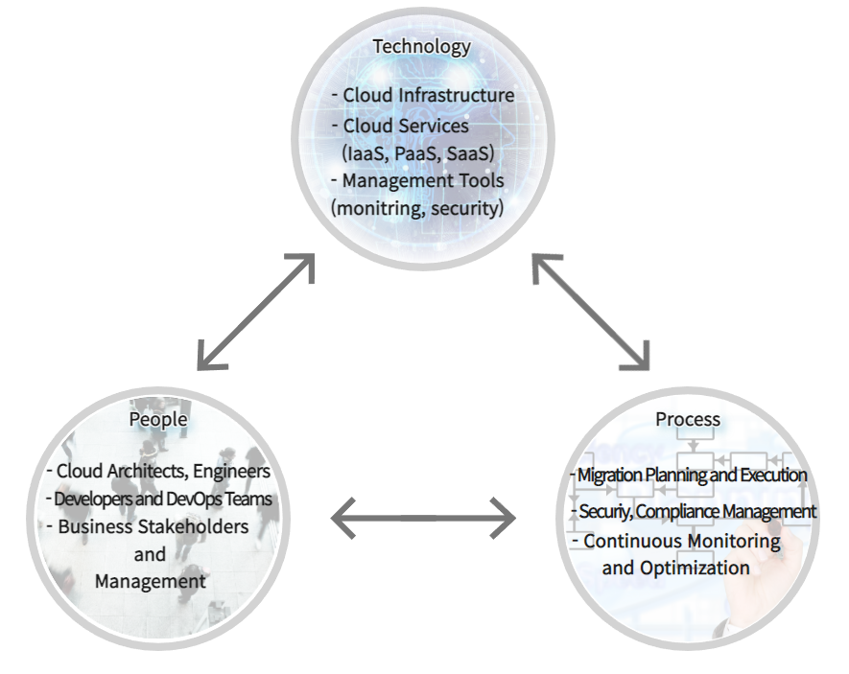
Summary of Cloud Best Practices (3 of 3)
Cloud Journey and Workforce Adoption
Cloud offers users the ability to scale on demand, agility with tools, and faster provisioning of infrastructure to meet need - but new business practices and work processes are required to take advantage of the offerings
Governance and process updates need to be adjusted to offer enhanced agility commensurate with cloud
Consider shifting from waterfall to agile development
Be intentional about decisions with cloud
Build a business case and cost model to define quantitative value and cost
Analyze cloud approaches, off-shelf versus built
Building trust is critical
Demonstrate capability
Find and empower early adopters to build the future
Training needs to be a priority

Slide 9
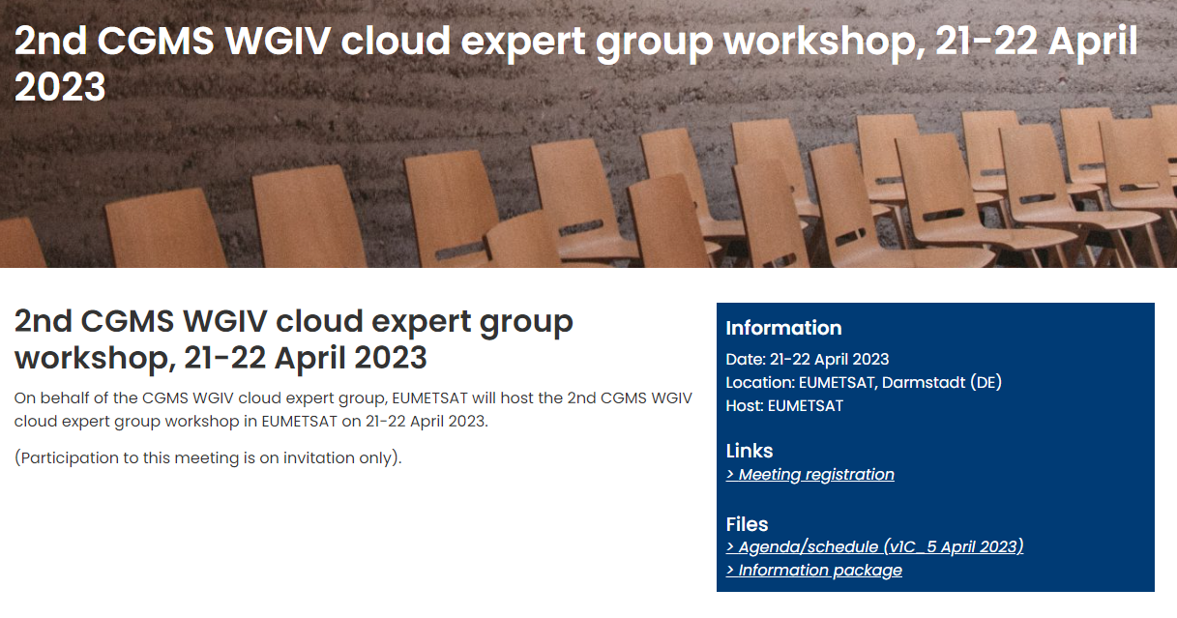
Next Steps & CEOS Collaboration
The CGMS Cloud Services Expert Group will
Expand work with identification of a Cloud Champion to represent efforts in forthcoming meetings
Baseline the best practices document formally within CGMS
Begin planning the third CGMS Cloud Workshop
We are looking for more and better ways to collaborate, so invite our CEOS colleagues to participate in future CGMS Cloud Workshops

