Slide 1

WIS 2.0
Enrico Fucile (WMO)
Head, Data and Information Management Division
Rémy Giraud (Meteo France)
Chair SC-IMT
Jeremy Tandy (Met Office)
Vice Chair SC-IMT
Tom Kralidis (Environment and Climate Change Canada )
Chair ET-WIS Metadata
Hassan Haddouch (WMO)
WIS2 Manager

Slide 2





WMO Information System 2.0 (WIS 2.0)
1963 World Weather Watch
1970s Global Telecommunication System
2007 WMO Information System (WIS)
2019 WMO Reform (Earth System Approach)
2021 WMO Unified Data Policy / GBON
WIS 2.0
… system of systems using Web-architecture and open standards to provide simple, timely and seamless sharing of trusted data and information …
  Internet and Web technologies
  Open Standards (OGC, W3C, IETF, …), royalty free
  Data sharing through Web and publication/subscription (pub/sub) protocols
  Cloud ready (turn-key solutions)
  Web APIs (Application Programming Interface)
Notes:
A little history to start …
The WMO Global Telecommunications System (GTS), established in the 1970s was designed to enable WMO Members to share data and products with each other in support of operational weather forecasting. Over the last 40 years or so, the GTS has successfully moved indispensable, time-critical data between NMHSs day-in, day-out.
But weather and climate data is important to everyone. So WMO Congress commissioned the WMO Information System (WIS) in 2007.
WIS builds on and incorporates the GTS, adding a data catalogue, data discovery portal and additional mechanisms for users to subscribe to and download data shared on the GTS. It is comprised of hundreds of data providing centres from across the globe (Data Collection and Production Centres, and National Centres), plus 15 Global Information System Centres (or GISCs) that are regional hubs for search, discovery, and access to data.
The original WIS is a child of its time – designed circa 2005. It’s based on service-oriented architecture principles, uses complex ISO 19115/19139-based XML for metadata, and is not well integrated into the Web. Since 2005, we’ve seen a move towards “webby” applications, with good practice characterised in the W3C Data on the Web and W3C Spatial Data on the Web Best Practices. In summary: Resource-oriented architecture, RESTful Web services, and JSON and HTML as core formats.
This is a journey that OGC has been on for some time now, and many of the OGC API standards appear ripe for inclusion in WIS2.
Our aim for WIS2 is to increase data provider participation by lowering the technical barriers to entry, and from the data consumer perspective, make weather and climate data Findable, Accessible, Interoperable, and Reusable (FAIR).
---
Adoption of Internet enables people to make the best local choice for a connection – leveraging technology that is often commonly available and well understood
…
In many locations, Internet is reliable enough for safety critical applications – provided applications are built to be fault tolerant; may need to combine with [high-performance] managed networks to ensure quality of service (QoS)
GISCs operate Area Meteorological Data Communications Network (AMDCN) considering reliability, security, and availability – high-performance managed networks may be necessary
Software Defined Wide-Area Networks (SD-WAN) enable Internet and managed networks to be used together to provide reliable connectivity at reasonable cost
---
The core change for WIS 2.0 is use the Web to share data and information.
According to the World Wide Web Consortium (W3C) “the Web is the World’s most successful distributed information system.”
With Web technology at its core, WIS 2.0 will use widely adopted open standards and leverage industry best practices.
… Firstly, this will allow the global user community to conveniently discover, access and use authoritative weather, water and climate information.
… Secondly, it will be simpler for NMHSs to partner with others to deliver services to end-users due to sharing the same base technology.

Slide 3
WIS2 in a box
Principles
Demonstration projects
Architecture
WIS2 in a box
Implementation
Workshop on WIS 2.0 demonstration projects
Demonstration of WIS 2.0 principles by WMO Community
Foundation of WIS 2.0 Architecture
WIS2 in a box
  Facilitate adoption of WIS2 by Members
  Reference implementation of the Technical Regulations of WIS2
WIS2 in a box
  Open-source reference implementation of WIS 2.0 for LDC, SIDS and Members adopting open-source solutions
Plug and play
Data exchange
Use & Visualize
Discover
Monitor
Notes:
WIS2 principle underpinning WIS2 technical framework → Demonstration projects to test the principles and provide basis for the architecture → demonstration projects workshop → recommendation to start WIS2 in a box project

Slide 4

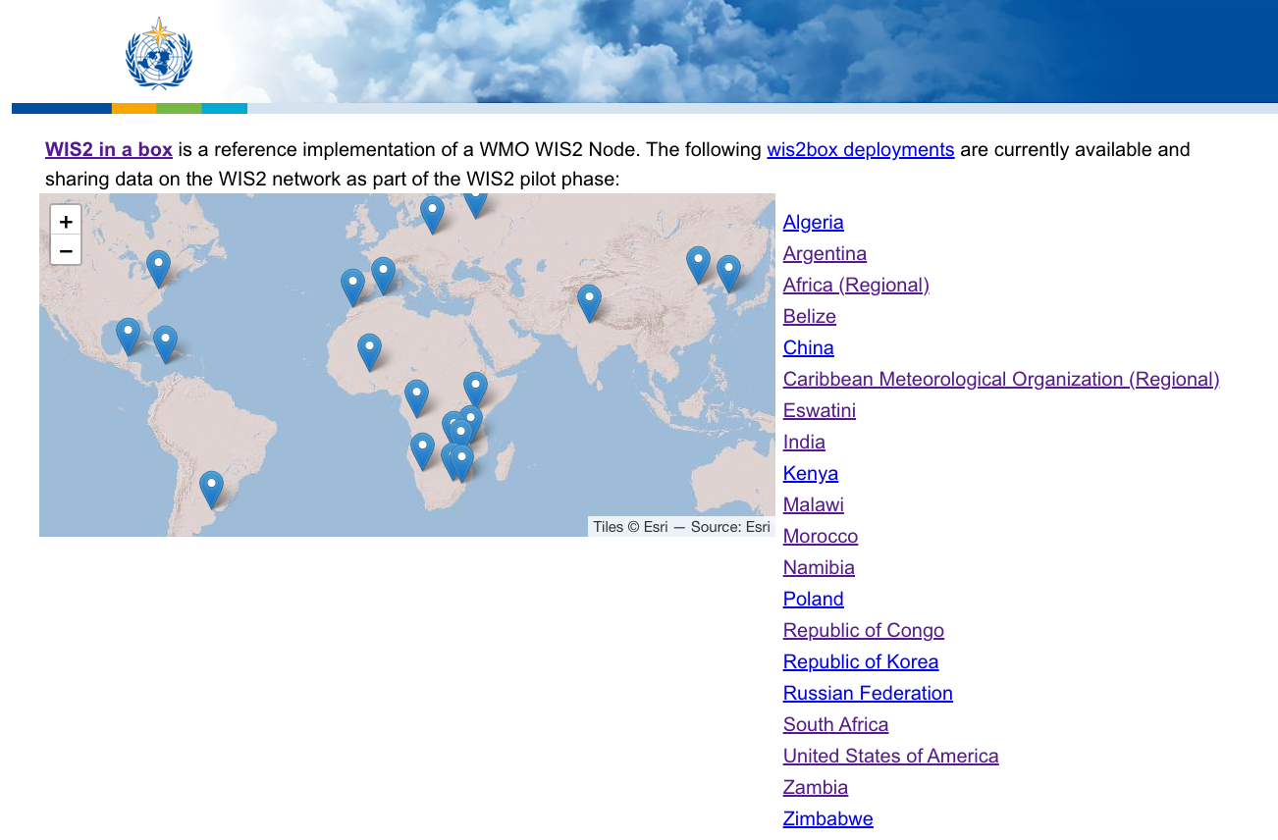
WIS2 in a box
gitHub repositories and docs
Code: https://github/wmo-im/wis2box
Documentation: https://docs.wis2box.wis.wmo.int
Demo: https://demo.wis2box.wis.wmo.int
Training: https://training.wis2box.wis.wmo.int
Apache license version 2.0
Permissions
Commercial use
Distribution
Modification
Patent use
Private use
Conditions
License and copyright notice
State any changes
Limitations
Liability
Trademark use
Warranty

Slide 5



Global Services
Discovers data from
Each WMO Member shall implement at least one WIS2 node to share data in WIS2
A WIS2 node replaces the GTS Message Switching System
Data and metadata are shared through a WIS2 node
A WIS2 Node shares data via an HTTPS service and sends notifications to MQTT subscribers
A WIS2 node shares data only with Global Services
Subscribes to
Receives notifications of new data from
Downloads data from
Downloads data from
Receives notifications of new data
Subscribes to
WIS2 node

Slide 6





Global Services
Global Monitoring
Discover datasets
Subscribes to topics
Downloads core data
Global Discovery Catalogue
Global Broker
Global Cache
Downloads recommended data
Downloads recommended data
Downloads recommended data
  Provides an API to discover datasets and services
  Sends notifications of new data to be downloaded from Global Caches or WIS2 nodes
Provides users HTTP download of core data cached from WIS2 nodes
WIS2 node
WIS2 node
WIS2 node

Slide 7
2023
2024
2025
2022
Pilot Phase
Pre-operational
Operational
2030
2033
Pilot Global Brokers
Pre-oper Global Brokers
Global Brokers operation
Pilot Global Discovery Catalogue
90% of Members migrated to WIS 2.0
Stop transition infrastructure and GTS transmission
Pilot Global Caches
Pre-oper Global Caches
Global Caches operation
Technical Regulations
NCs
DCPCs
Pre-oper Global Discovery Catalogue
Global Discovery Catalogue operation
WIS 2.0
Guidelines
Q1
Q2
Q3
Q1
Q2
Q3
Q1
Q2
Q3
WIS2 box release 1.0
Transition Infrastructure
WIS2 Monitoring
NCs & DCPCs
NCs & DCPCs
Workshops and training
INFCOM-2
EC 75
Cg-19
EC 76
WIS 2.0 Tech- Reg approved
Guidelines for WIS 2.0
implementation published
INFCOM-3
EC 77
technical guidance in the Guide to WIS
Report on WIS2 progress
NCs/DCPCs may stop WIS1 functions if migrated to WIS2
GISCs contributing to Global Services may stop WIS1

Slide 8
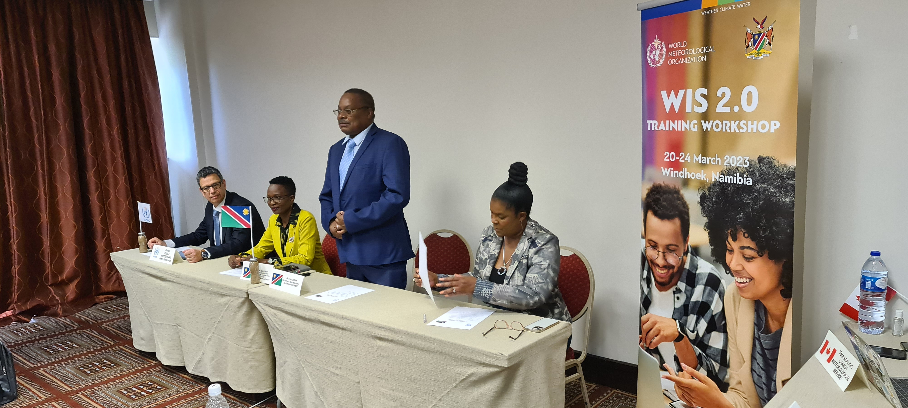

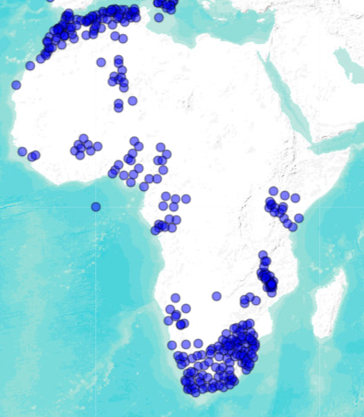
https://training.wis2box.wis.wmo.int
WIS 2.0 Training Namibia
20-24 March 2023, Windhoek
  Algeria
  Eswatini
  Kenya
  Malawi
  Morocco
  Namibia
  Republic of Congo
  South Africa
  Tanzania
  Zambia
  Zimbabwe
12-16 June 2023, Port of Spain, Trinidad and Tobago (CMO)
(15 countries)
9-13 October 2023, Jakarta, Indonesia (12 countries)
9 out of 11 countries are
now sharing
data on WIS2
 | 8

Slide 9


Pilot phase
WIS2 Node
New implementers
WIS2 Node
Earlier implementers
Global Services
WIS2 Nodes
Australia
Africa (hosted by Morocco)
      Burkina Faso
      Guinea
      Cameroon
China
Canada
Germany
France
Eswatini
India
Hong Kong, China (CAP SWIC)
Kenya
Korea
Malawi
Namibia
New Zealand
Poland
Republic of Congo
Zambia
Zimbabwe
United States of America
Australia
France
Global Broker
China
Algeria
Argentina
Italy
Morocco
Sweden
ECMWF
EUMETSAT
USA
40 Nodes on the 27th September 2023
Germany
Australia
Global Cache
Japan
Korea
USA / UK
Canada
Global Discovery Catalogue
Korea
China
Global Monitoring
Morocco
Running
Announced

Slide 10
WIS2 node implementation
Software
Infrastructure
Operations
Open source (WIS2 Box)
Commercial
On premises
Public cloud (AWS, Azure, Google,...)
Private cloud (EWC …)
NMHS
Regional, sub-regional
Private company (WIS2 node as a service)
Custom

Slide 11
WIS2 node implementation
Pilot phase 40 WIS2 nodes
Software
Infrastructure
Operations
Open source (WIS2 Box) 34
Commercial 1
On premises 27
Public cloud (AWS, Azure, Google,...) 10
Private cloud (EWC …) 1
NMHS 27
Regional, sub-regional 10
Private company (WIS2 node as a service) 1
Custom 5

Slide 12
WIS2 support
email wis2-support@wmo.int questions on how to implement and register a WIS2 node
Useful references
WIS Core Metadata Profile 2 https://wmo-im.github.io/wcmp2/
WIS2 topic hierarchy https://wmo-im.github.io/wis2-topic-hierarchy/
WIS2 notification message https://wmo-im.github.io/wis2-notification-message/
WIS2 in a box software https://docs.wis2box.wis.wmo.int
WIS2 training https://training.wis2box.wis.wmo.int

Slide 13
Thank you
Merci

