Slide 1
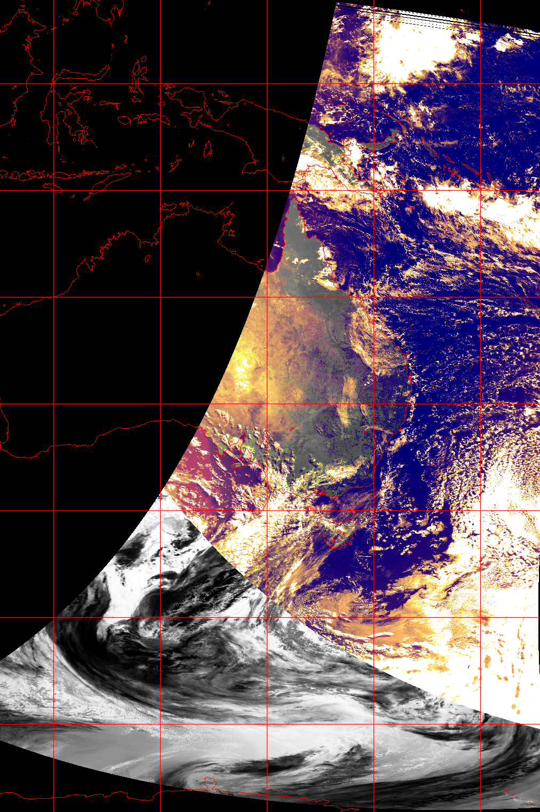
Australian AVHRR:
An Octant of the Earth
Collection & Activity at CSIRO
Edward King | 2023/10/25
with
Matt Paget, Aarond Dino
Rob Bridgart, Matt Stenson v1

Slide 2
Summary
A comprehensive collection of day+night Australasian L0 HRPT (1km)
From the NOAA/POES program satellites N08-N19 (not METOPs)
Mostly well-organised (& L0 stitched) from 1992 April-present, Can make available
Background efforts on curating
the first decade (from ~1983)
Antarctica (from ~1997)
Strong historical usage (up to ~2004), then decade(s)+ of relative neglect and lost expertise since
Recent (2022+) attempt at rejuvenation with
Good geolocation
OK radiometry + basic cloud
But looking for help or advice with
radiometry + cloud + atmospheric correction

Slide 3
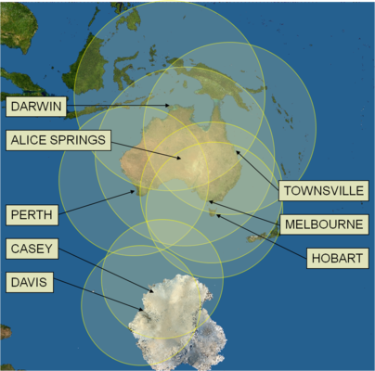
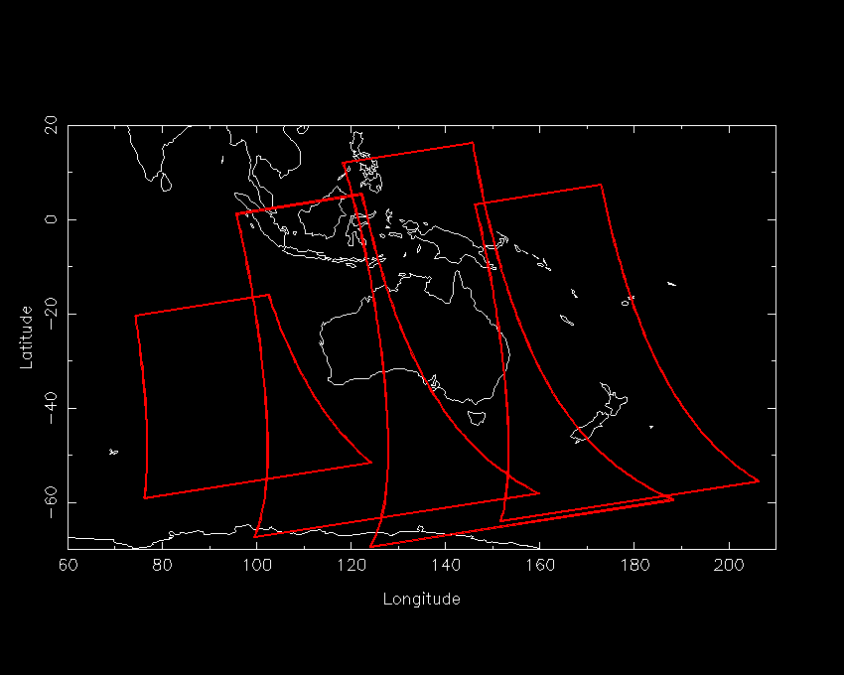
Base Data Set
First reception ~1983
9+ sites, some with multiple receivers
independent agencies and institutions
Global km project 1992
Near Real Time aggregation and sharing since ~2005 (network)
All data 1km HRPT in telemetry format
All passes that were acquired were kept
  Day and Night, Land and Sea
  Any transmitting satellites
  Up to 35 stitched passes per day at times
Notes:
USGS Global 1km Project led CSIRO to become de-facto national aggregator (and archiver) from 1992 in delayed mode (tapes)

Slide 4
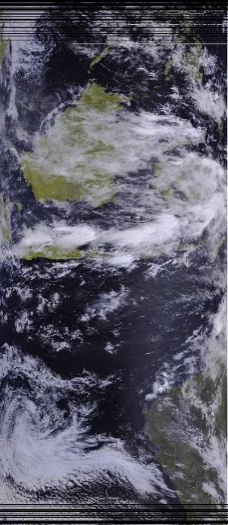
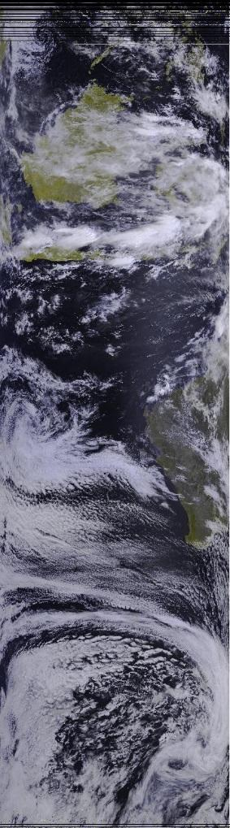
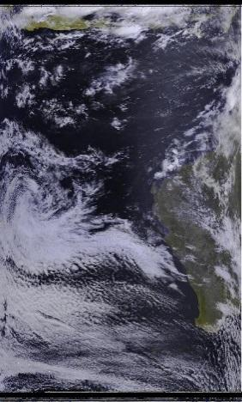
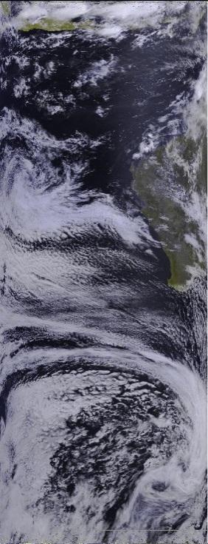
Stitched Archive
Darwin Alice Springs Perth Stitched
For each orbit
  Often many acquisitions
Smart exploitation of spatial:
  Complementarity (extent)
  Redundancy (overlap)
Produce: fewer, better, bigger passes
Since 1992 April
Consistent format, all at L0 (incl. TIP data – TOVS etc.)
~220,000 stitched passes
  From maybe 600K-800K individual acquisitions
Caveat – Antarctic station data NOT (yet) included in stitched archive
N17, 02:30 GMT, 2006-01-26
Notes:
Redundancy , using noise to choose line by line or voting to choose bit by bit

Slide 5
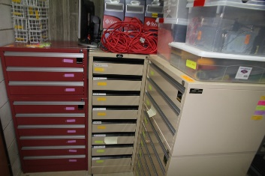
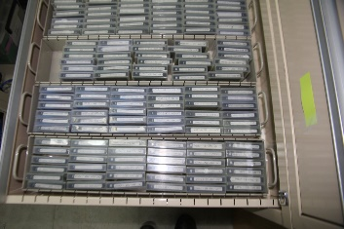
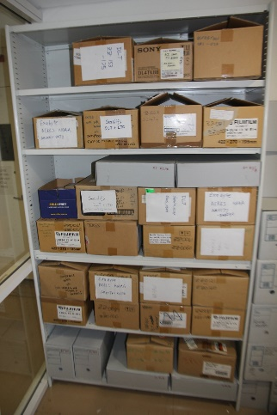
Other Historical Data
We accumulated two rooms full of tapes
From all reception stations
Technology variants: 4mm/Exabyte/DLT/LTO
Tapes with different write formats + labelling
Files with different storage formats/packing, endian-ness + naming
One-off reading in 2019-2021.
  ~10,000 tapes -> ~80TB of cloud storage
We hope to
  Identify pre-1992 data and decode it
  Produce an inventory and harmonise with the subsequent stitched archive
Currently in a scoping “pilot” phase (i.e. an un-resourced activity)

Slide 6
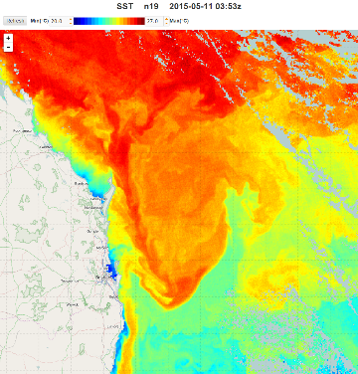
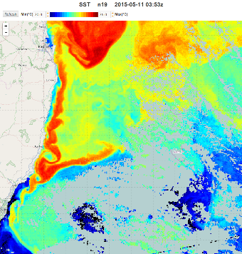
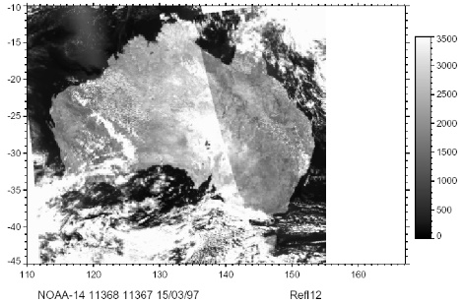
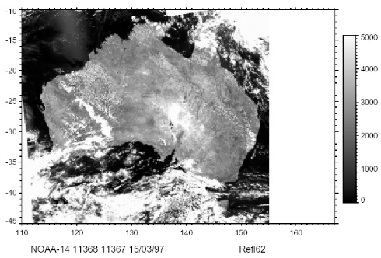
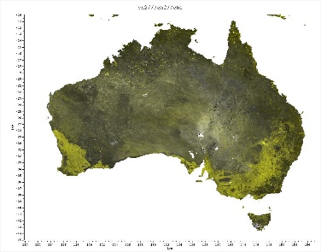
Historical AVHRR Strengths
Oceanography
  High quality automated geolocation system
  Real Time ocean situational awareness
  Good thermal cal/val
  Backbone of Australian SST record (IMOS + GHRSST)
Terrestrial Biosphere
  Strong efforts in reflectance cal/val
  Coupled Atmospheric correction and BRDF
  Primarily vegetation cover and change (superseded by MODIS, 2001+)
  Secondary land surface temperature (superseded by Himawari, 2015+)
Common AVHRR Processing System - CAPS
Uncorrected Atmocorr+BRDF

Slide 7

Rejuvenation
TERN invested in a modest project in 2022/23 to
Rebuild a processing capability,
Make “top of atmosphere” L2 data available,
Provide as a mapped datacube product,
Act as a pathfinder/interest generator for further work
Used a hybrid of local and international codes
Re-implemented a lot of Fortran66/77, Tcl/Tk and shell scripts in Python and C
Generating NetCDF4 and COG
Now (2023 Oct.) nearing completion
Stable system tested across whole archive from 1992
Commencing the data processing step for 31-year archive on HPC
Used parts of Pytroll/Pygac

Slide 8
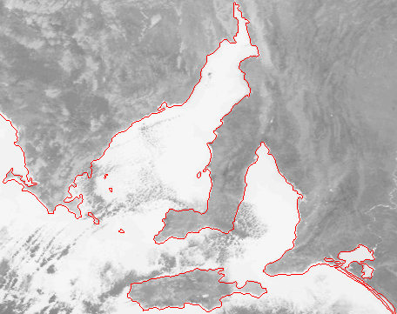
Geolocation
Fully automatic system
Phase 1
  Refine state vector via coastline matching
Phase 2
  High accuracy numerical state vector propagator (~+/-5days)
Permits efficient geolocation of pure ocean scenes or scenes with cloudy geo-referencing locations
Global (used in JRC World Fire Web, ~2000)
Modernised – now Python+C

Slide 9
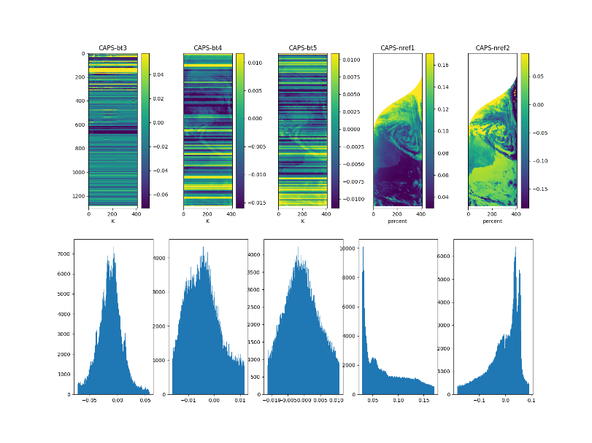
Radiometry & Cloud
Australian expertise in AVHRR calibration has all retired
We adopted code from Pygac, part of the Pytroll package https://pytroll.github.io/
  Implements PATMOS-x calibration coefficients (2017)
  Uses Heidinger et al 2010 for Reflectance and PODUG (Kidwell, 2000)/Trischenko, 2002 methods for Brightness Temperatures
Needs further work to verify
For cloud detection
  Implementation of CLAVR (Stowe et al., 1999)
  Expedient interim measure on a shoestring
Almost certainly not the best cloud solution
Advice / guidance is most welcome!
Images (top) and histograms (bottom) of differences (CAPS–new processing) N11, 1992
Notes:
Comparisons with early (reliable) CAPS data shows good performance.
Later in time series (CAPS not reliable) indicates divergence

Slide 10
Future work
Securing Data
Rescue early (1983-1992) imagery (hard) and Antarctic data (easier)
Get entire collection into trusted repository
Make it available – for collaboration and any users
Processing/exploiting
Verify calibration implementation
Improve cloud detection (as reqd.)
Atmospheric correction (atm. reanalyses and aerosol climatologies)
BRDF ?
Automate product generation (datacube)
Document

Slide 11









Acknowledgements
Present Effort
Australian National Collaborative Research Infrastructure
  Terrestrial Ecosystem Research Network (TERN)
  Integrated Marine Observing System (IMOS)
CSIRO Environment Business Unit
Honorary mention: Simon Pinnock (ESA)
40 years of data collection (ongoing)
CSIRO (several Divisions/Units)
Australian Bureau of Meteorology
Geoscience Australia
Australian Institute of Marine Science
Landgate (Western Australia)
Australian Universities (several)
Many colleagues – mostly retired

Slide 12
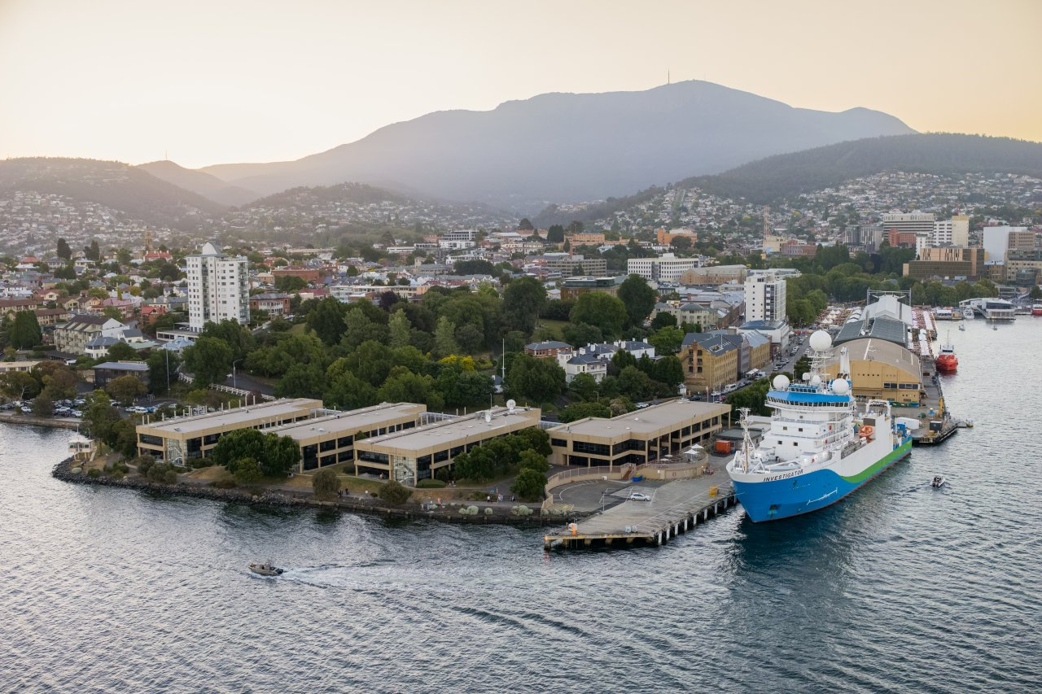
Thank you
CSIRO Environment
  Edward King
  Research Group Leader
    +61 3 6232 5334
    Edward.King@csiro.au
    https://people.csiro.au/K/E/Edward-King
and
  Matt Paget
  Aarond Dino
  Rob Bridgart
    Matt Stenson

