Slide 1

AVHRR International Cooperation Activities and Partners
WGISS
Committee on Earth Observation Satellites
Mirko Albani (ESA)

Slide 2
Executive Summary
AVHRR cooperation objectives
Unfold and make accessible 1km AVHRR data from regional archives (possibly open and free)
Transcribe unique AVHRR data from heritage media
Identify a common format for AVHRR Level-1b and Level-1c data and pursue (re)processing from AVHRR data owners/holders and data accessibility
Facilitate data discovery through the WGISS Connected Data Assets Infrastructure
Progress since last WGISS
Inventory of existing national/regional HRPT and LAC data archives under consolidation
  Version 2 updated and presented/circulated at WGISS#55. Version 3 will be produced in Q1 2024.
  A set of high priority datasets identified for further action: South Africa (SANSA), Argentina (GiDyC-Servicio Meteorológico Nacional), Brazil (INPE).
Identification of high priority heritage media to be transcribed and approaches/opportunities
  Activity started by ESA with a commercial company to transcribe three types of Optical Disks (ESA and UK University of Reading/Rhode Island University holdings) with potential unique AVHRR data. First batch of 100 disks were shipped to initiate the transcription.
  Successful transcription of 2 tapes containing data acquired in Malindi (Kenya) and received from ASI/University of Rome. Transcription of remaining 44 DLT tapes started in Oct. 2023. Around 5000 products are expected to be recovered from this activity.
Data discoverability and reprocessing to be addressed at a later stage

Slide 3
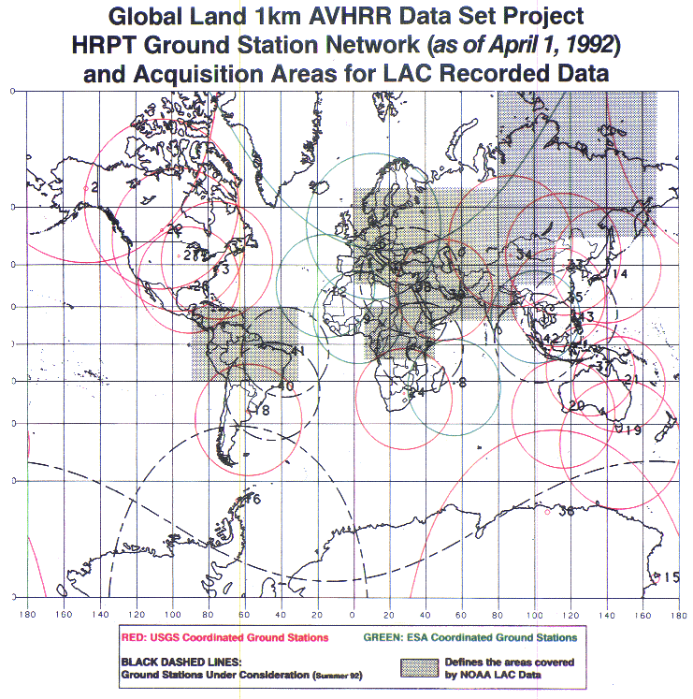
1km AVHRR dataset: a unique asset
The basis for global land applications is the Global Land 1-km AVHRR data set covering the period 1992-99
Spatial resolution makes a difference. Comparison of coarse resolution AVHRR GAC data and 1-km AVHRR LAC data gives new insights on structural changes on land.
In addition, there are many national / regional data archives of LAC data covering a longer period with high value for the retrieval of ECVs. The usage is today sometimes limited due to unknown:
Accessibility
Responsibility
Data format and structure
AVHRR receiving stations contributing to global land 1km AVHRR data set. (https://lta.cr.usgs.gov/1km/hrpt_image)

Slide 4
Cooperation Activities on AVHRR
Objectives
Unfold and make accessible 1km AVHRR data from regional archives (possibly open and free)
Transcribe unique data from heritage media
Identify a common format for AVHRR Level-1b and Level-1c data and pursue (re)processing from AVHRR data owners/holders and data accessibility
Facilitate data discovery through the WGISS Connected Data Assets Infrastructure

Slide 5
AVHRR Regional Archives
WGISS
Committee on Earth Observation Satellites

Slide 6
AVHRR 1 Km digital data archives (excerpt)
GLOBAL
NOAA POES AVHRR GAC global archive: 1978 onwards;
EUMETSAT MetOp AVHRR 1km FRAC global archive: late 2006 onwards.
LOCAL
Europe: ESA & University of Bern (Switzerland), STFC CEDA (UK, including Dundee Satellite Receiving Station), MeteoFrance (France), DLR (Germany), METoffice (UK), IGiK (Poland);
Americas: NOAA and USGS (USA), NRCan/CCMEO (Canada), GiDyC-Servicio Meteorológico Nacional (Argentina), INPE (Brazil);
Africa: SANSA (South Africa), ASI / University of Rome (Kenya);
Asia: CMA (China), IRIM (Mongolia), GITSDA (Thailand), Jaxa (Japan);
Australia: CSIRO.
Others missing?
FOCUS ON LOCAL ARCHIVES

Slide 7
Europe – ESA & University of Bern
Long time series (1981–2021) of AVHRR data from different platforms (POES, MetOp)
Unique source to retrieve Essential Climate Variables (ECV) to investigate climate change over last 40 yrs
European dataset includes data from University of Bern, Dundee Station and ESA holdings: more than 260.000 data products harmonized and consolidated through a dedicated ESA project (Heritage Space Programme).
In addition ESA holds the dataset outside Europe from the 1KM project in the ‘90s.
All data accessible free of charge via ESA dissemination services and safely archived at ESA.
Processing to Level-1c is completed and the data publication activity is starting.
Additional activities being defined for 2024-25 (FDR).
Presentation at WGISS#56

Slide 8
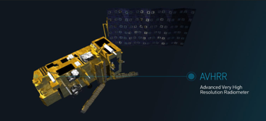




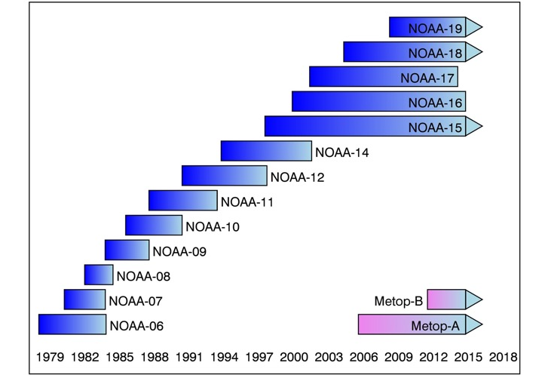
FDR for Advanced Very-High-Resolution Radiometer instrument (FDR4AVHRR)
  Project starting in Q4/2023 (following a series of AVHRR activities)
  Reprocessing AVHRR series LAC products (NOAA & MetOp missions)
  40+ years of length → climate record
  Applying best state-of-the-art algorithms and corrections
  Generating innovative Earth system data records:
    FDRs for TIR and VNIR channels mainly over Europe +
    Extending ESA 2020 AVHRR European Data Set Version 1.0 with data beyond 2020 not only over Europe but also for selected regions across the world.
FDR4AVHRR

Slide 9
FDR for Advanced Very-High-Resolution Radiometer instrument (FDR4AVHRR)
Main Expected Outcomes:
Cross-mission calibrated AVHRR FDR dataset at 1km spatial resolution for all channels;
Software package for the generation of the FDR dataset (including new modules for improved geocoding / orthorectification, error propagation and accurate uncertainty estimates in the calibration module) and related comprehensive documentation;
Improved Preserved Data Set Content information - based on CEOS best practices - for the AVHRR European Master Data Set and for the AVHRR dataset out of Europe, together with inventory files updated with data recently recovered by ESA.

Slide 10
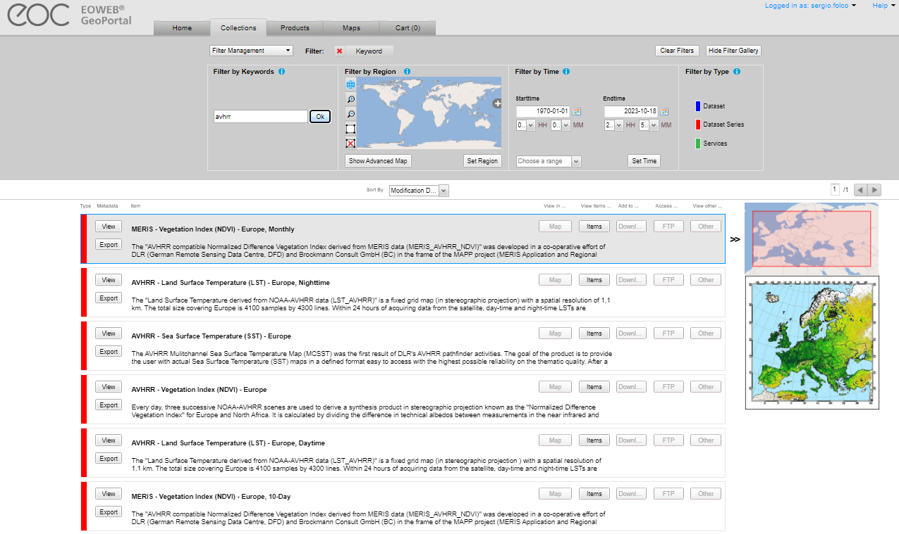
Europe – DLR
Four AVHRR datasets over Europe (N14,N16,N17,N18,N19) available in the DLR catalogue:
  AVHRR - Land Surface Temperature (LST) - Europe, Nighttime;
  AVHRR - Sea Surface Temperature (SST) - Europe;
  AVHRR - Vegetation Index (NDVI) - Europe;
  AVHRR - Land Surface Temperature (LST) - Europe, Daytime.
High redundancy with ESA dataset; not clear if L0 data available at DLR.
Will expand slide or have a dedicated presentation at next WGISS

Slide 11
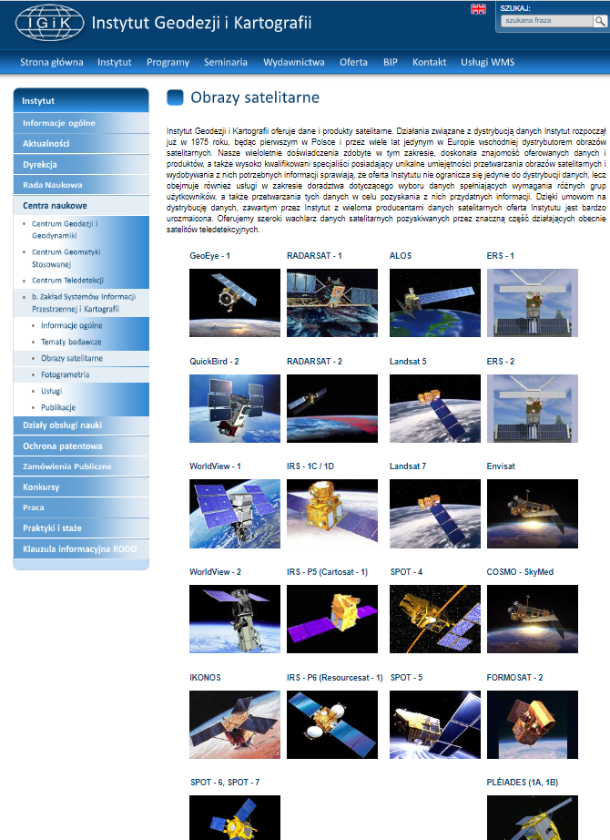
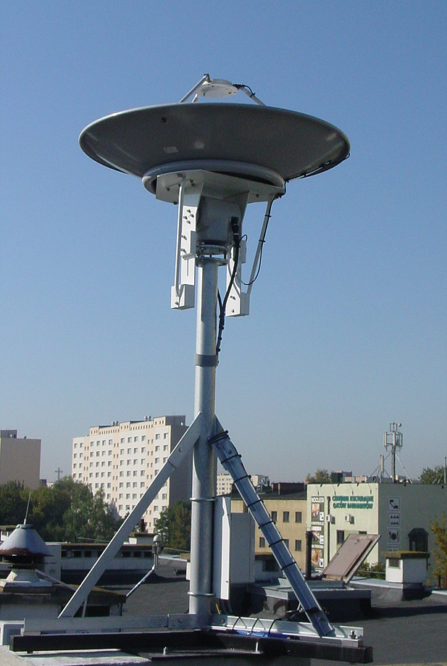
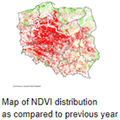
Europe – IGIK (Poland)
Polish Institute of Geodesy and Cartography.
Department of Remote Sensing maintains a database of satellite images and products derived from NOAA satellites since 1996 and used for agriculture studies
The receiving station recorded data in HRPT, SeaWiFS (and other formats) from NOAA, Seastar, Metop and NPOESS polar-orbiting satellites.
AVHRR products are not accessible from the web site.
Point of contact:
Dr. Dariusz Dukaczewski (dariusz.dukaczewski@igik.edu.pl)
Dr. Jan Musial (jan.musial@igik.edu.pl)
Will expand slide or have a dedicated presentation at next WGISS to better understand data volume and status of accessibility

Slide 12
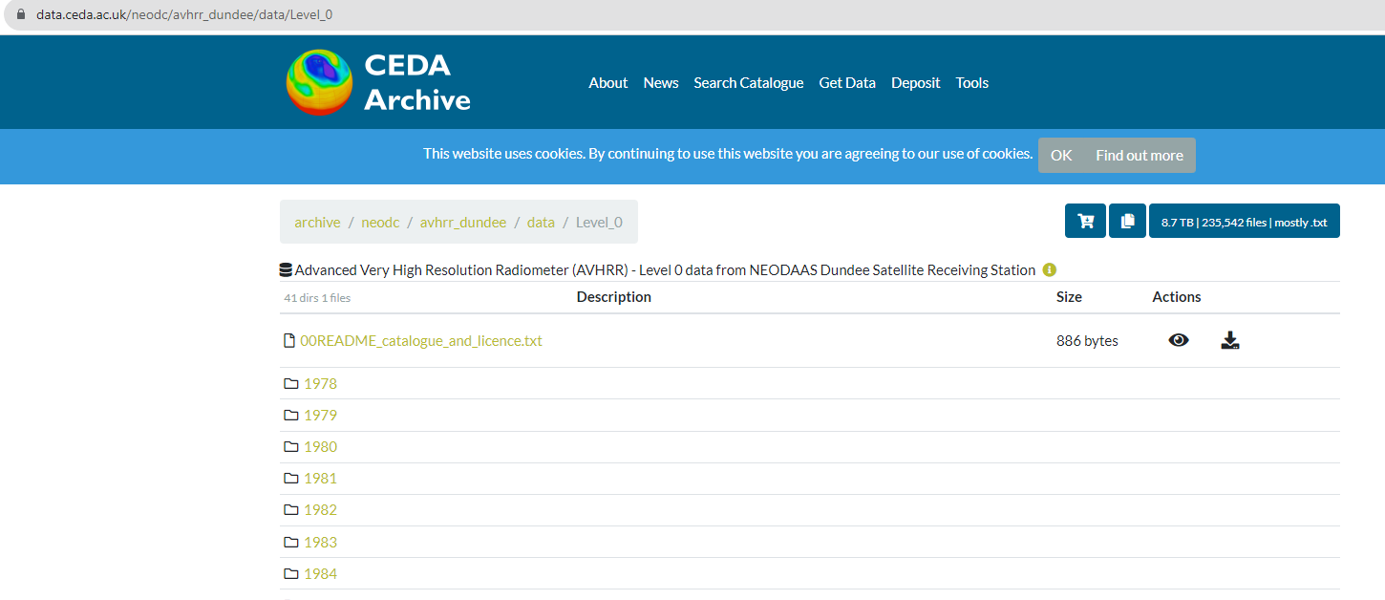
Europe – Dundee Station data at CEDA
1978 – 2018 - AVHRR L0 data available with free and open access.
ESA is considering the possibility to download and partially reprocess this level 0 dataset to extend the European Master Dataset geographical coverage over Greenland and the time coverage back to 1978. → Credits already provided to Dundee
Presentation at WGISS#56

Slide 13
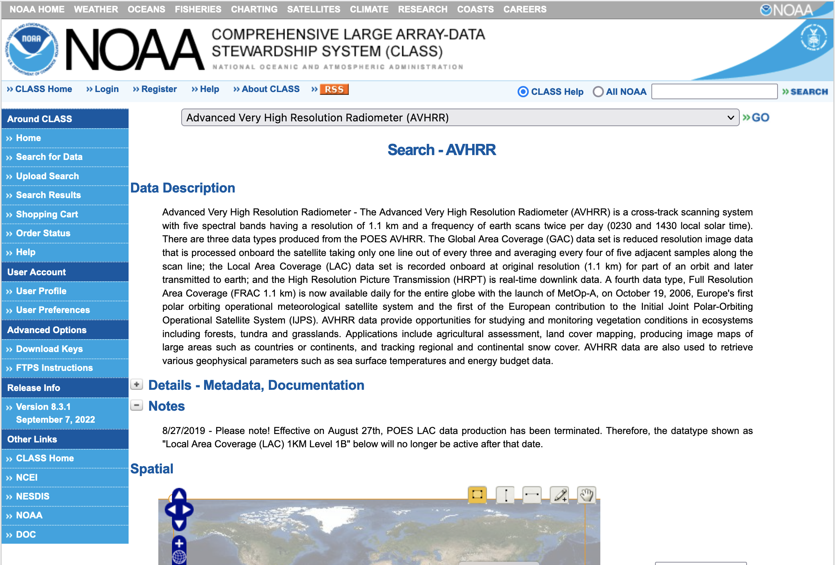
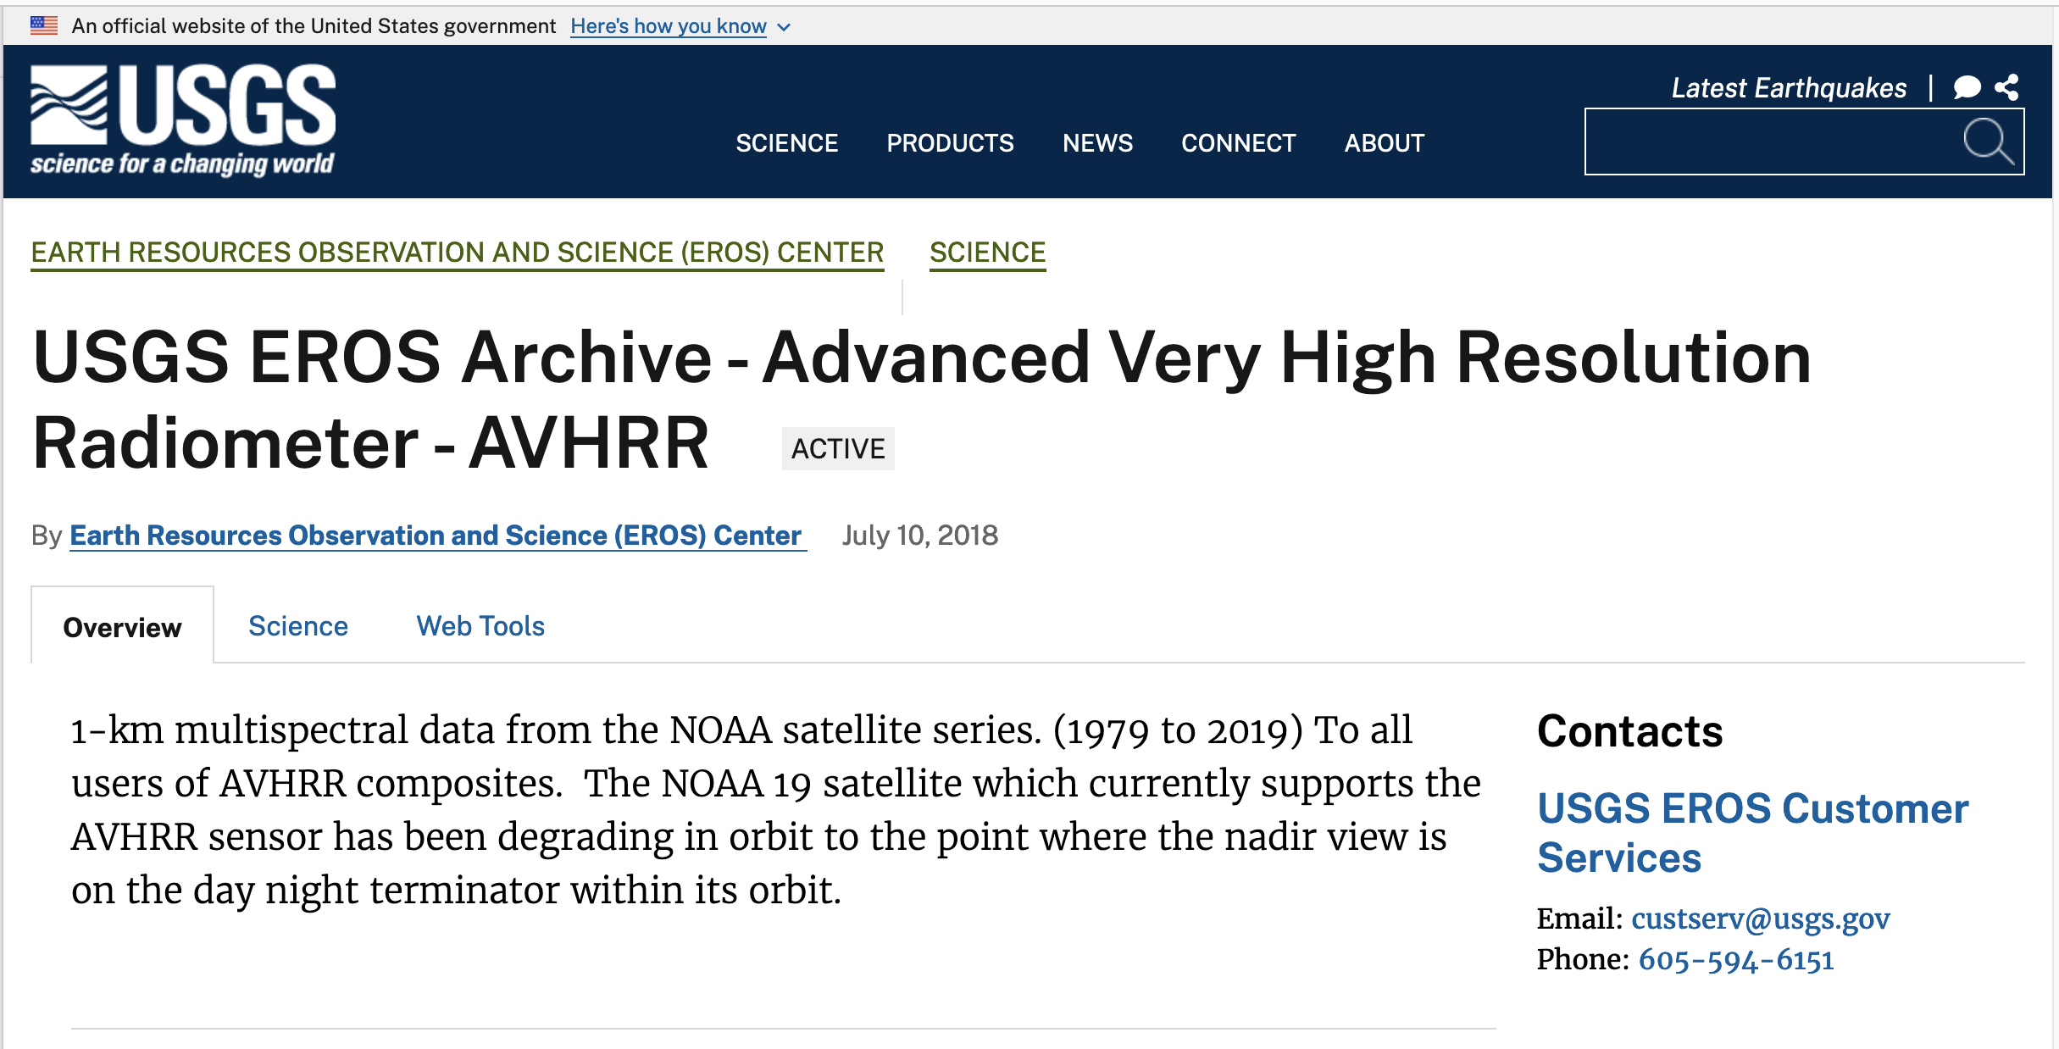
North America – NOAA & USGS
Presentation at WGISS#55
The CLASS acquisition stations are not fully compliant with the USGS 1-KM project acquisition station list;
Specific region of world (Africa, Asia, etc..) are always acquired at “Wallops Island” and “Gilmore Creek” station. Likely those data acquisitions were recorded on board and downloaded to these two stations.

Slide 14
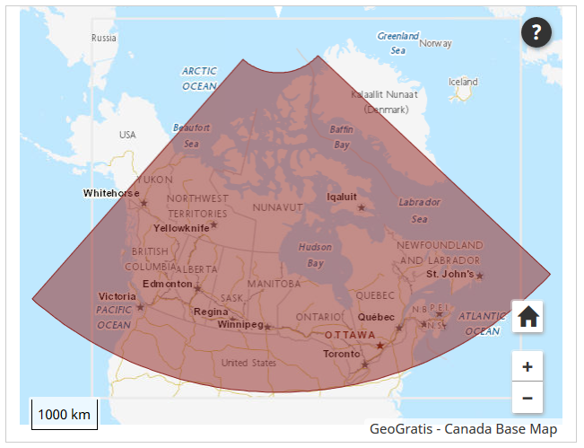
Canada – NRCan/CCMEO
1981 – 2013 (+ AVHRR L1B LAC/HRPT received after that date); L1C at CCMEO
These are open source data covered by WMO CGMS data distribution policy, they can be shared freely and without charge.
The Canadian sector is of high value to analyze changes of the environment.
The former developed pre-processing and retrieval of ECVs by A. Trishchenko and K.Klopenkov was of high quality and the standard for many other AVHRR processing chains.
Further development and processing was stopped some years ago but raw AVHRR data are available by NRCan.
https://open.canada.ca/data/en/dataset/9045136a-d6e7-a825-491d-ee5dc77a2620
Will expand slides or have a dedicated presentation at next WGISS to better understand data volume and status of accessibility

Slide 15
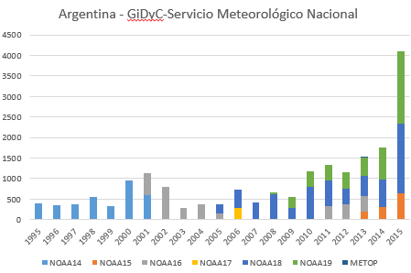
Argentina - GiDyC-Servicio Meteorológico Nacional
Source: Jefa Departamento Teledetección Y Aplicaciones Ambientales, GiDyC-Servicio Meteorológico Nacional, Buenos Aires, Argentina
Number of products: 19360
Volume size: 740GB
Satellites: N14, N15, N16, N17, N18, MetopA/B
Time Period: 1995 – 2015
Extent: roughly Lat=[-30,15] Lon=[-60,-15]
Format: QUO (HRPT)
Exchange of letters finalized between ESA and SMN.
Data transferring to ESA is on-going for further processing, harmonization with the European dataset (processing and format) and dissemination to users.

Slide 16

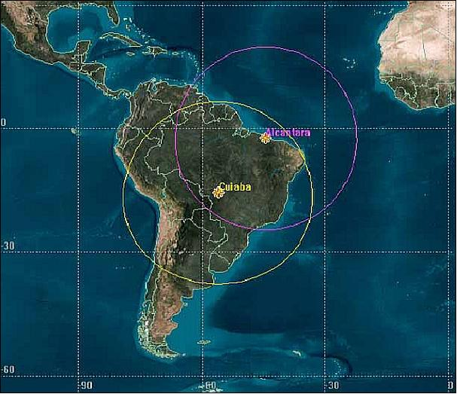
Brazil - INPE
Number of Scenes: 13.329
Satellites: N12, N14, N15, N16, N17, N18, N19
Number of products: 218647
Volume size: 10TB
Time Period: 1998 - 2022
Extent: Brazil
Format: HRPT
NO12 | Aug 1998-Aug 2007 | HRPT | 16335 products
NO14 | Aug 1998-Jun 2007 | HRPT | 10972 products
NO15 | Jul 2001-Aug 2019 | HRPT | 40877 products
NO16 | Jul 2001-Dec 2014 | HRPT | 26067 products
NO17 | Jn 2003 - Mar 2013 | HRPT | 27744 products
NO18 | May 2005 - Dec 2022 | HRPT | 54974 products
NO19 | Jan 2012 - Dec 2022 | HRPT | 41678 products
Exchange of letters being finalized between ESA and INPE

Slide 17
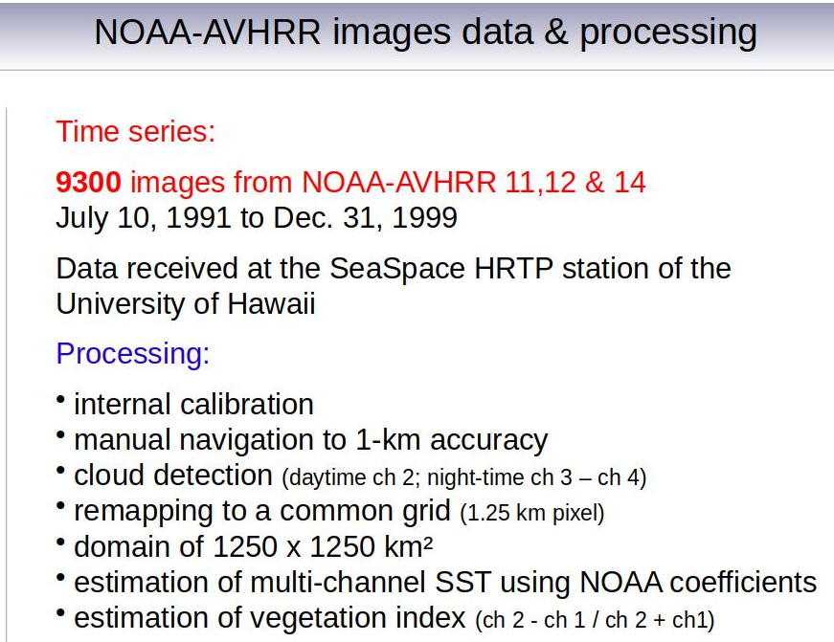
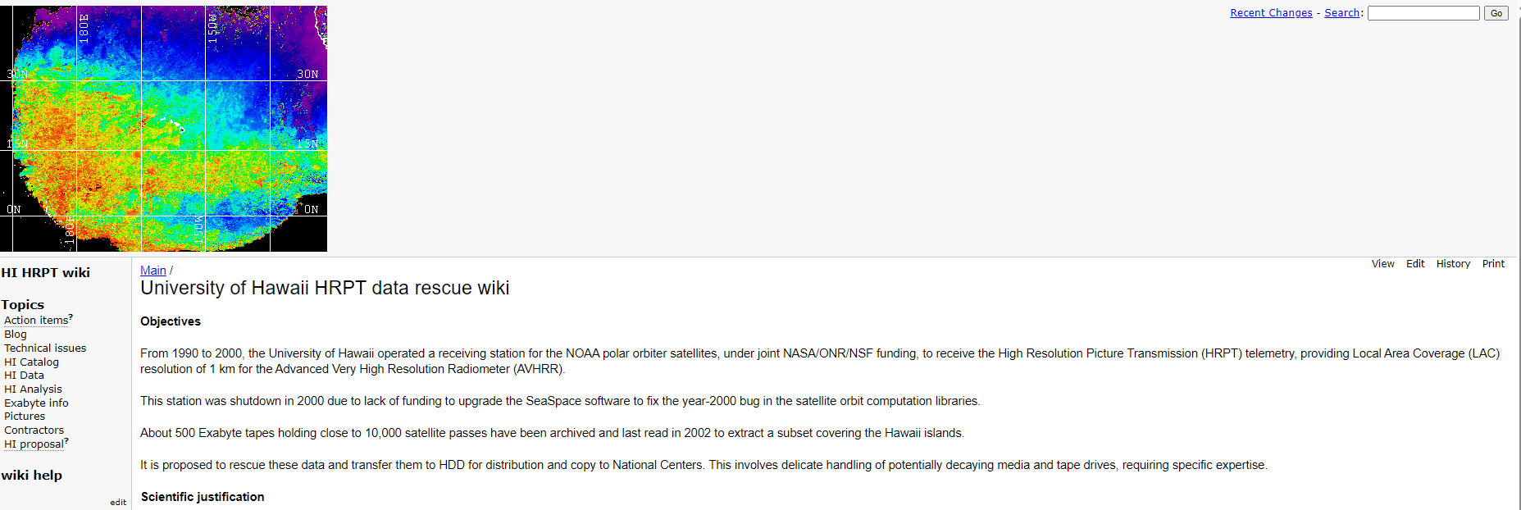
Hawaii – University of Hawaii
An AVHRR dataset was acquired at the Hawaii University between 1990 & 2000.
These data are still on tapes, some were extracted covering the islands but accessibility not clear.
Hawaii University looking for support to extract data from tapes. ESA is considering the possibility to support the recovery of this valuable dataset.
Metadata from the website

Slide 18
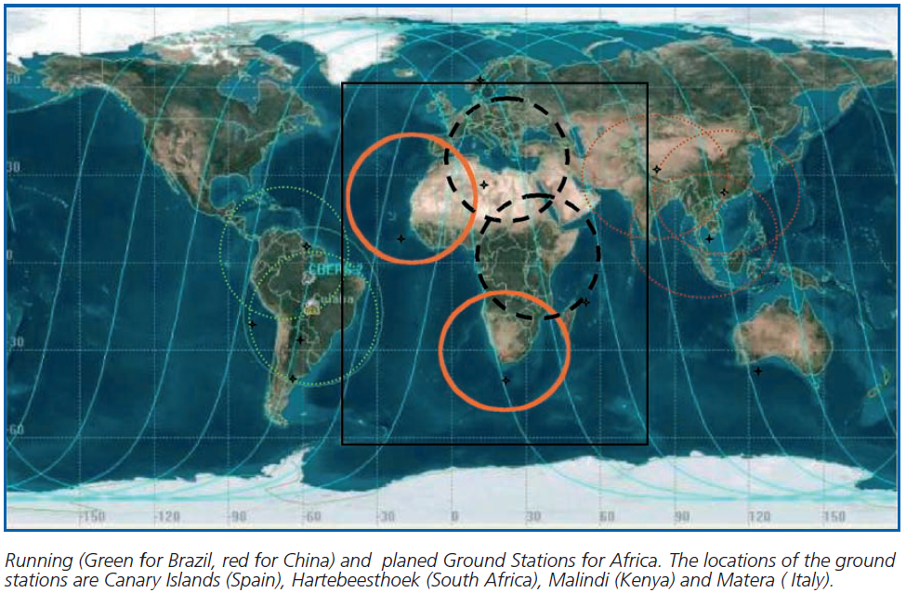
African Coverage
The combination of AVHRR data acquired in Maspalomas (Spain), Matera (Italy), Cairo (Egypt), Niamey (Niger), Hartebeesthoek (South Africa) and Malindi/Nairobi (Kenya) can provide full coverage of Africa;

Slide 19
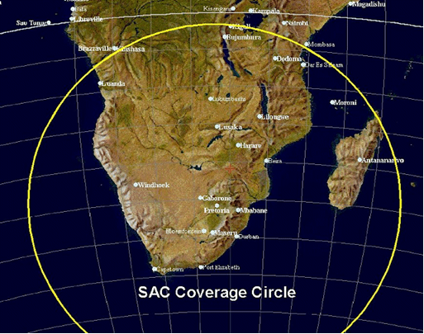
South Africa - SANSA
1km NOAA AVHRR data received at Hartebeesthoek, South Africa (25°53' S 027°42’ E) and maintained by SAC/SANSA – South African National Space Agency
NOAA 9 | 1985-1987
NOAA 11 | 1989-1993
NOAA 14 | 1995-2001
NOAA 16 | 2001-2005
NOAA 17 | 2005-2010
NOAA 18 | 2005-2009
Number of products: 7684
Volume size: 464GB
Exchange of letters finalized between ESA and SANSA.
Data transferring to ESA was completed. Further processing, harmonization with the European dataset and dissemination to users planned.

Slide 20
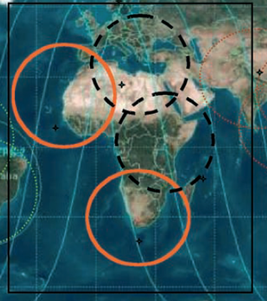
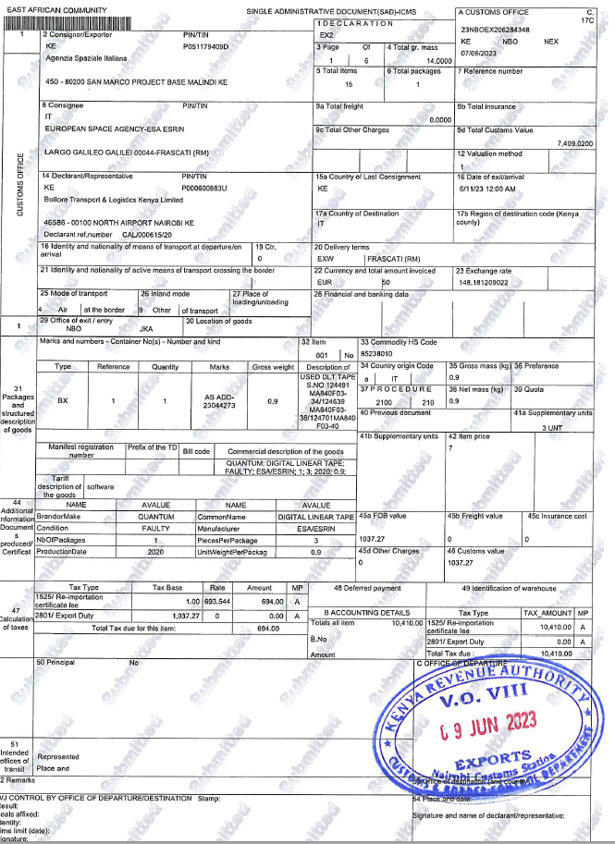
Central Africa (Kenya) - ASI/UniRoma
Data acquired at the Malindi station in Kenya from 2001 to 2009 and currently stored on 47 DLT tapes.
About 5000 products in L1B sharp format.
Agreement between ESA and ASI/University of Rome to rescue these data.
Two tapes successfully transcribed at ESRIN with an ad-hoc chain set-up in summer 2023; full transcription will start in Oct 23.

Slide 21
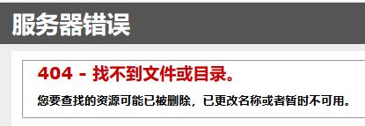
China - CMA
AVHRR-receiving stations for the global 1km land product (coordinated by USGS): Beijing, Urumqi, Guanzhou
Data access: National Satellite Meteorological Centre (NSMC)
Official contact: dataserver@cma.gov.cn
Searching for “AVHRR” on CMA web site results in
AVHRR 1-km data covering Himalaya-Hindukush of the period 1981 – 1992 would be of exceptional value for scientists to study the influence of climate change in this vulnerable region.
Will expand slide or have a dedicated presentation at next WGISS to better understand data volume and status of accessibility

Slide 22
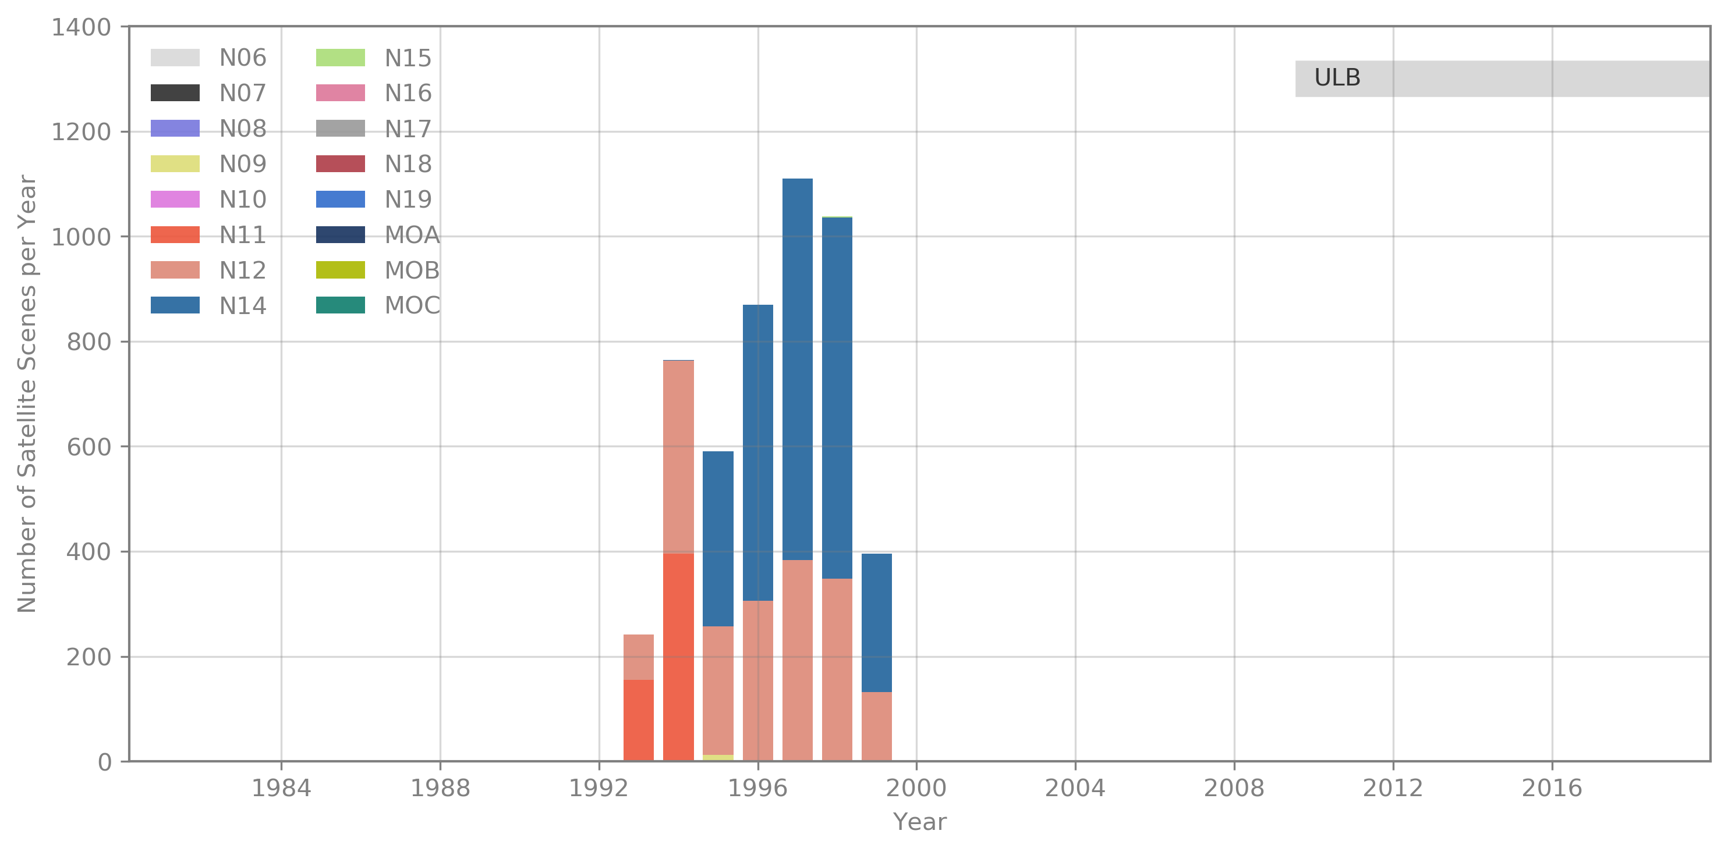
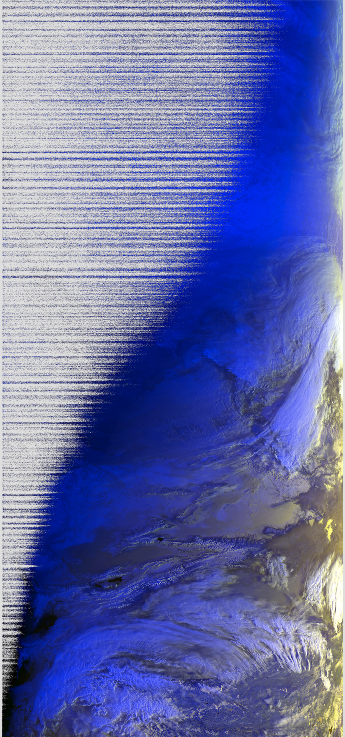
Mongolia - Remote Sensing Department, Information and Research Institute of Meteorology, Hydrology and Environment
AVHRR UBM data
Source: Remote Sensing Department, Information and Research Institute of Meteorology, Hydrology and Environment, Ulaanbatar, Mongolia
Number of Scenes: 5.016
Satellites: N09, N11, N12, N14, N15
Time Period: 1993 – 1999
Extent: roughly Lat=[20,70] Lon=[80,120]
Format: hmf (origin: dat, grid, lut)
Further info:- UBMx station data were included in the Global Land 1km AVHRR Data Project
Will expand slide or have a dedicated presentation at next WGISS to better understand data volume and status of accessibility

Slide 23
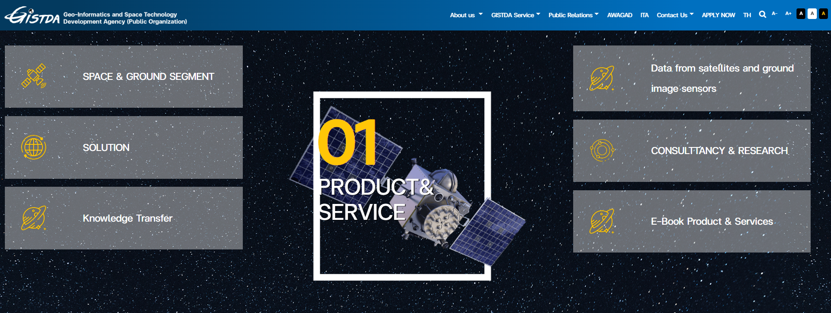
Thailand - GITSDA
GITSDA has been contacted and agreed to provide more information at the next WGISS meeting

Slide 24
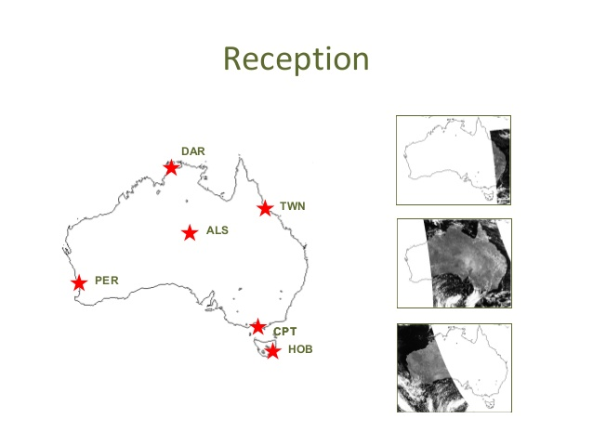
Australia - CSIRO
AVHRR reception based on 6 stations for continuous 1-km data set.
Multiple state and federal agencies have been acquiring the data in this manner with reception stations in Hobart, Melbourne, Perth, Alice Springs, Darwin and Townsville.
Since the early 1990s CSIRO has been merging these separate local data sets to produce a stitched archive which makes use of the redundancy arising from overlap between reception stations to produce a higher quality and consistently formatted data set with national coverage.
The assembly of this data set continues within CSIRO today, though it is likely to come to an end sometime this decade as the last of the AVHRR sensors has now been launched.
Data availability: 1981 (NOAA-7) onwards.
Presentation at WGISS#56
Ian Grant, Bureau of Meteorology, Australia
https://link.fsdf.org.au/dataset/advanced-very-high-resolution-radiometer-avhrr

Slide 25
AVHRR Media Transcription
WGISS
Committee on Earth Observation Satellites

Slide 26
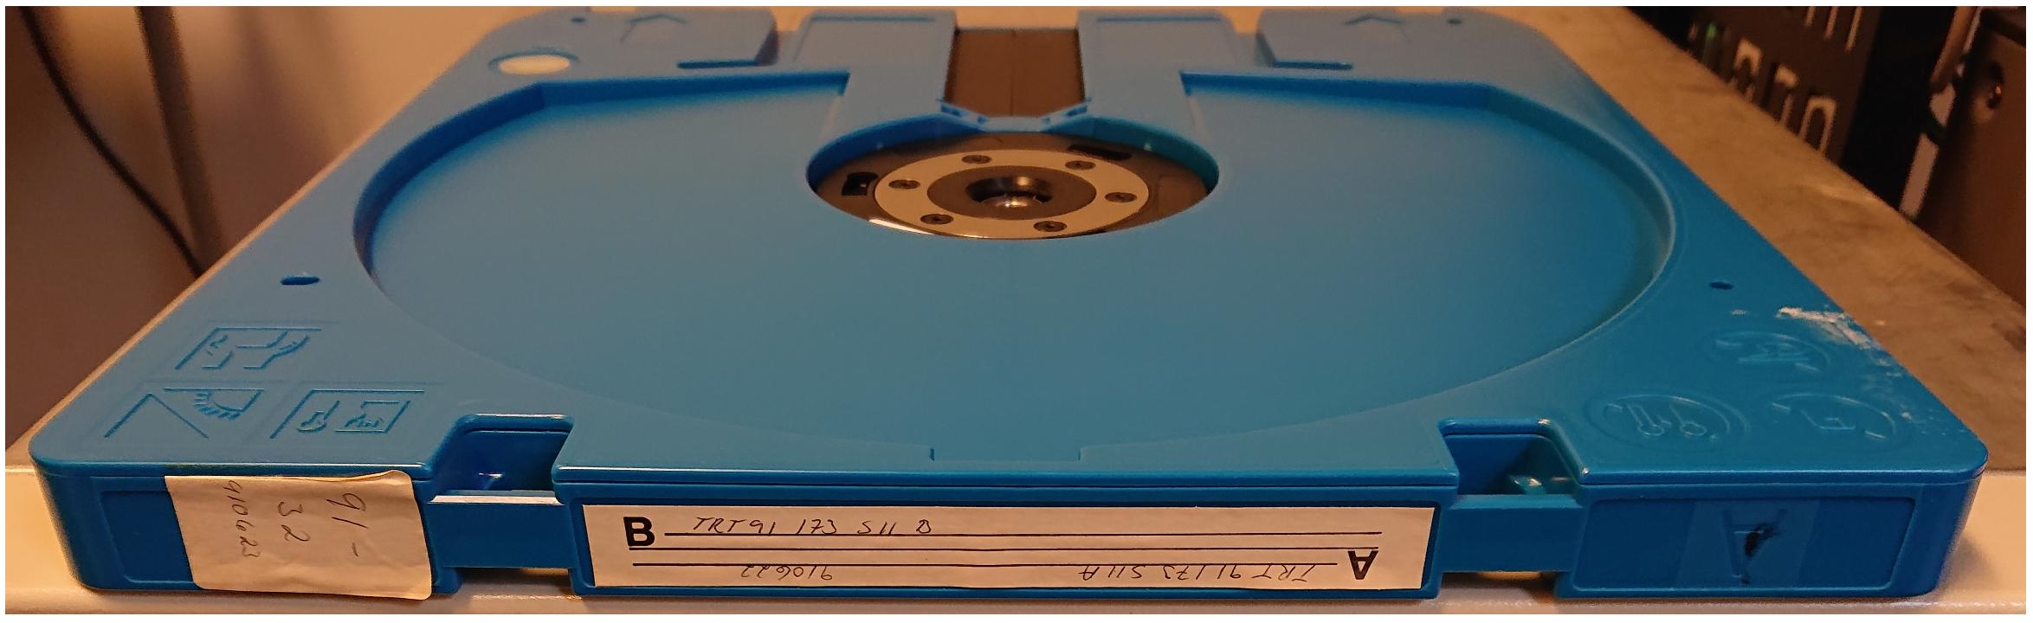
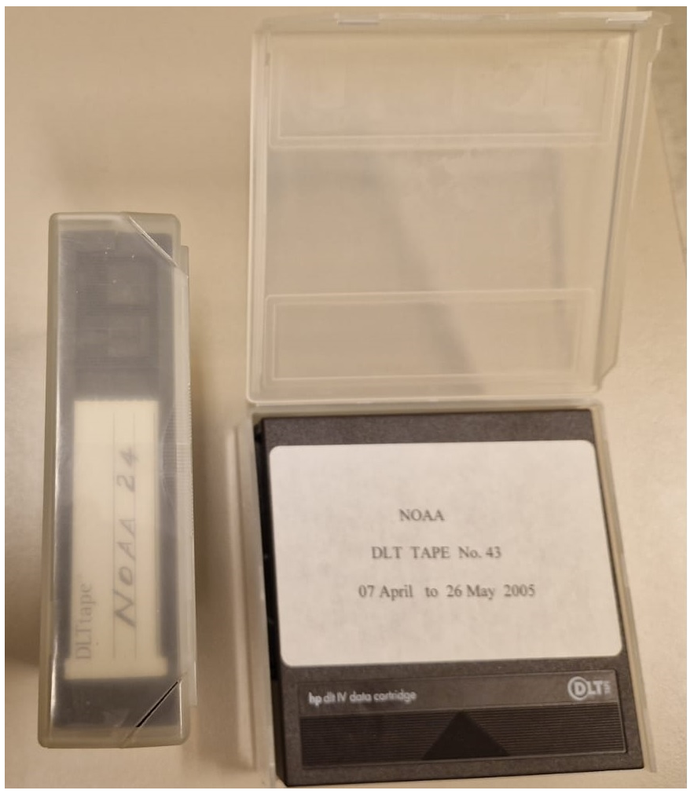
AVHRR 1 Km media
Several hundred heritage media (optical disks, DLTs) with potential unique AVHRR data are available in different places like for example:
  ESA (Optical Disks)
  University of Reading (Optical Disks)
  University of Rome (DLTs)
  Others to be added
LM 1200 optical Disk 2.4GB
DLT cassettes

Slide 27
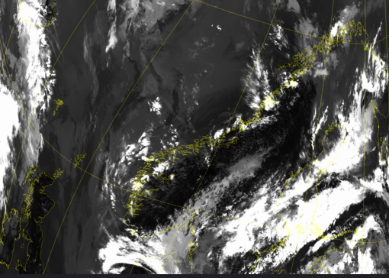
Optical Disks
ESA pilot activity completed with successful transcription of 2 different type of optical disks originally held at ESA and University of Reading.
Transcription of the full batch of available optical disks (around 522) contracted to a commercial company.
In Oct, ESA received the content of 15 transcribed optical disks. L1B products successfully processed using the ESA processor.
Transcriptions will continue in the next months.

Slide 28
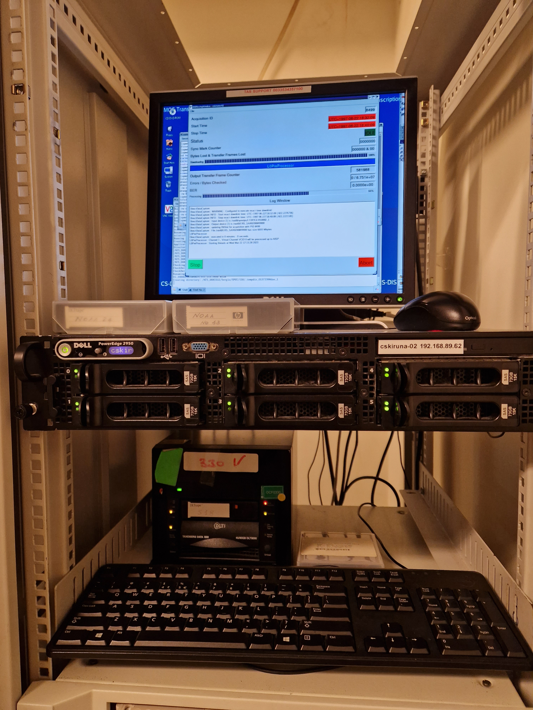
DLT Tapes
DLT transcription chain set-up at ESA/ESRIN to transcribe tapes containing unique AVHRR / SPOT and ERS data.
2 tapes received from ASI / University of Rome successfully transcribed and 280 AVHRR products acquired in Malindi (Kenya) now safely archived on disks at ESA.
Additional 47 DLT tapes containing AVHRR data acquired in Malindi in 2000-2009 will be transcribed in the upcoming months.

Slide 29
AVHRR Data Processing and Access
WGISS
Committee on Earth Observation Satellites

Slide 30
Cooperation Activities on AVHRR
Future activities
Provide AVHRR points of contact and stakeholders with the AVHRR Dataset Consolidation Procedure and Processing Format used in the European consolidation project run at ESA. Collect feedback and discuss possibility to have a common/harmonised format.
  To be started in 2024
Check status of Discoverability of AVHRR datasets worldwide and pursue common entry point through WGISS CDA infrastructure
  To be started in 2024
New FDR4AVHRR project being started at ESA. Development of new modules for error propagation, uncertainty estimation and inter-instrument and cross-mission calibrated FDR4AVHRR dataset.
  To be started by end 2023
  AVHRR Session follow-on will be held at WGISS#57

