Slide 1
WGISS Website Refreshments

Slide 2
Executive Summary
The new draft page of the Documents area will be presented
Few proposed changes will be presented
Text or feedback needed will be asked to the relevant owner of the Interest Group
Objective:
Implement any new approved changes, clean the pages of the WGISS website, reorganize the WGISS website if needed

Slide 3
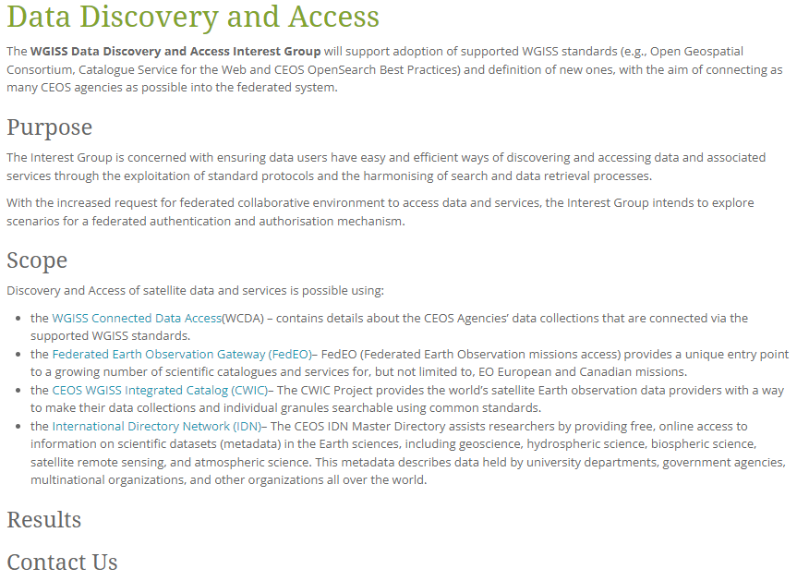
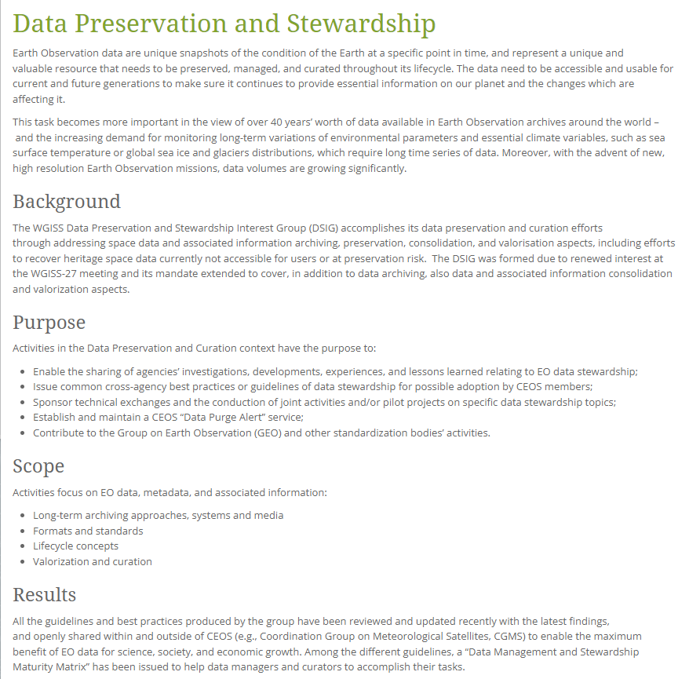
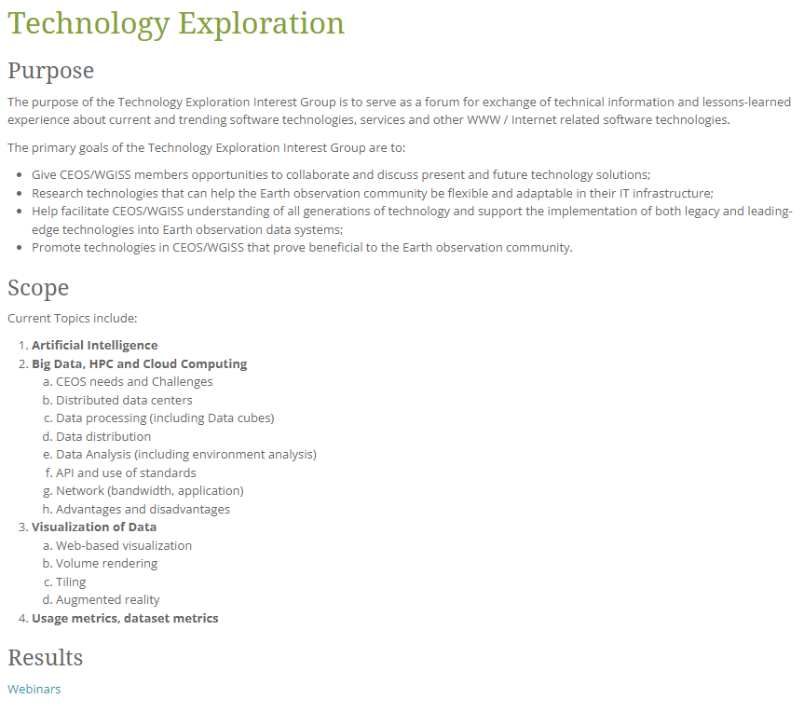
Interest Group webpages status
Interoperability and Use Interest Group under consolidation

Slide 4
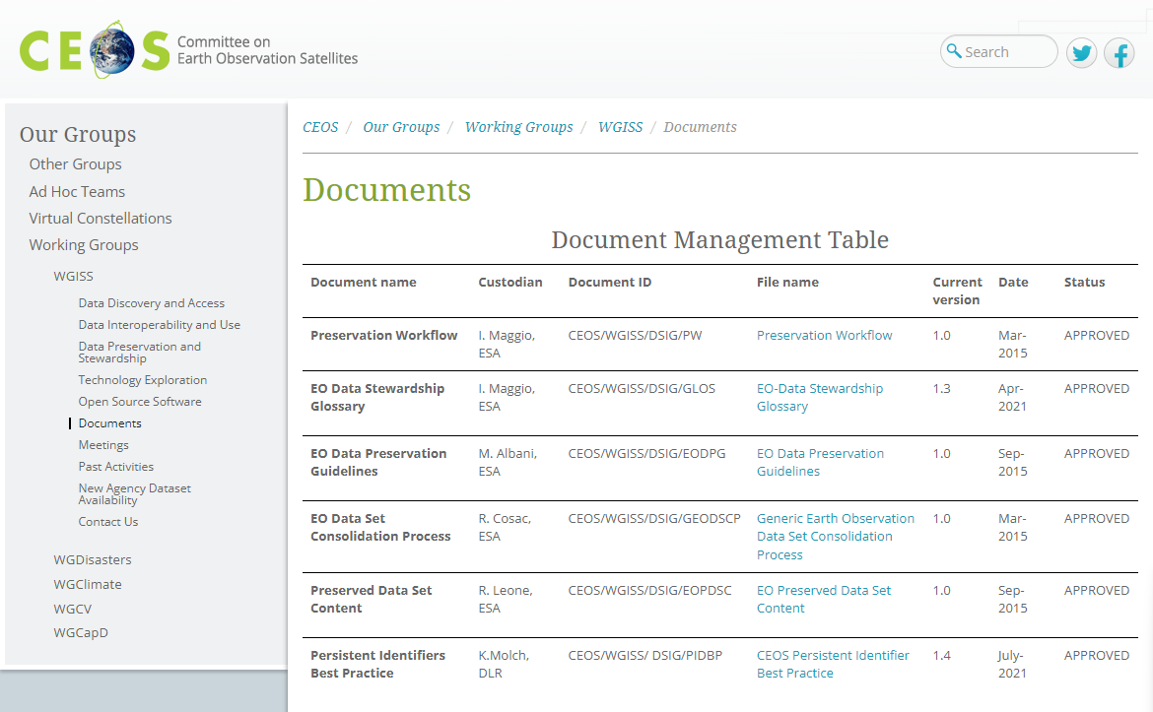
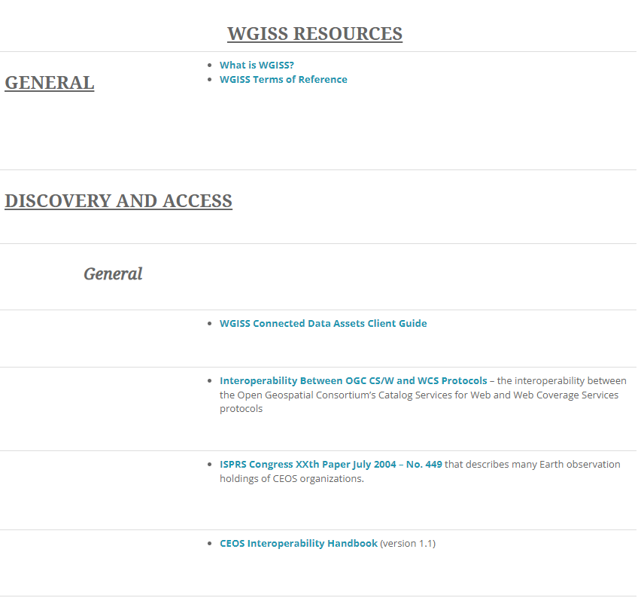
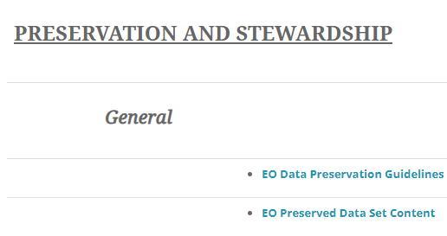
WGISS Website – Documents webpage
Status before changes implementation:
Each Interest Group Area with different look and feel;
Each Interest Group Area with different exposed metadata;
The table contains metadata not useful and not aligned with the real date of the issue of the documents

Slide 5
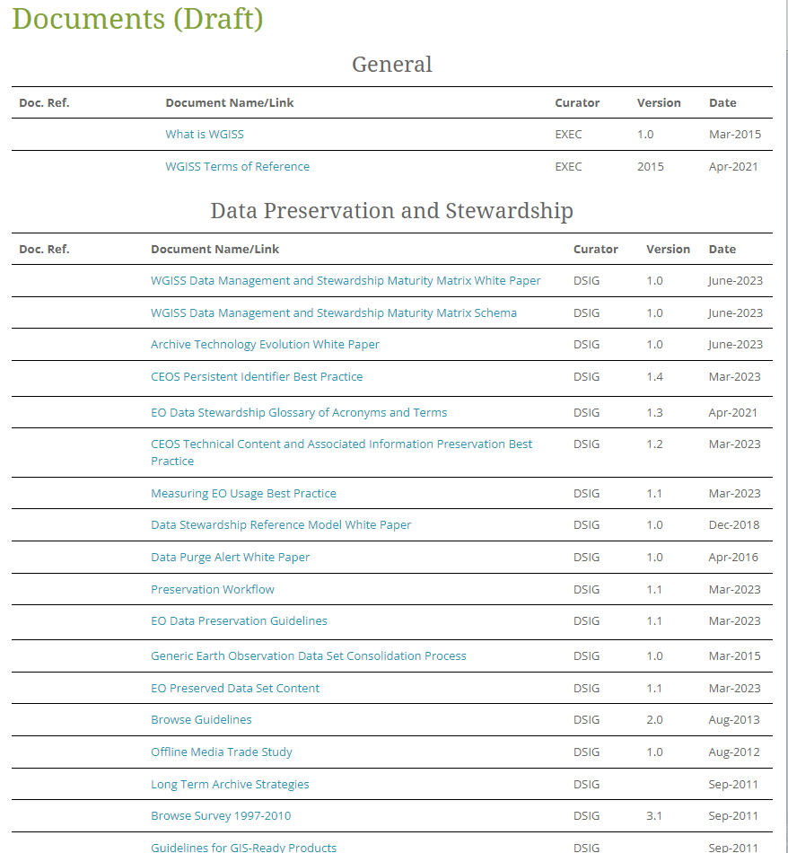
WGISS Website – Documents webpage
Status after changes implementation:
Each Interest Group Area with same look and feel;
Each Interest Group Area with same exposed metadata;
The table contains useful metadata.
ACTIONS:
Some metadata are missing. Please provide them.
Documents (Draft) | CEOS | Committee on Earth Observation Satellites

Slide 6
WGISS Website – Contact us
Differences between IG web pages. In the Data discovery and Access, Data Interoperability and Use and Data Preservation and Stewardship there is this part concerning the contacts.
In the technology exploration we have the following statement.
Changes already implemented but an alignment could be useful
we should use the same statement that introduce the contacts information

Slide 7
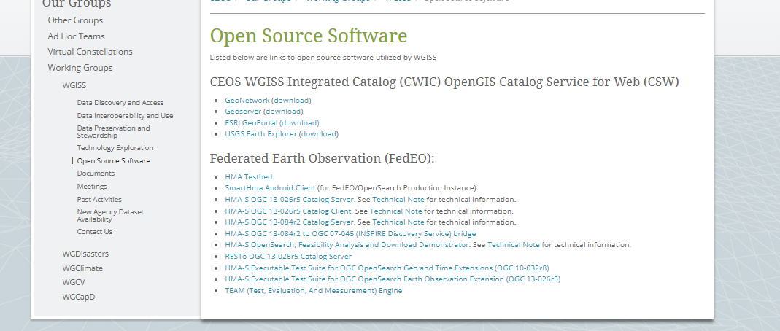
WGISS Website – Open Source SW
Is the Open Source Software web page at the same level of the IGs?
At the moment all OSS are relating to the data discovery and access.
It should be discussed together.

Slide 8
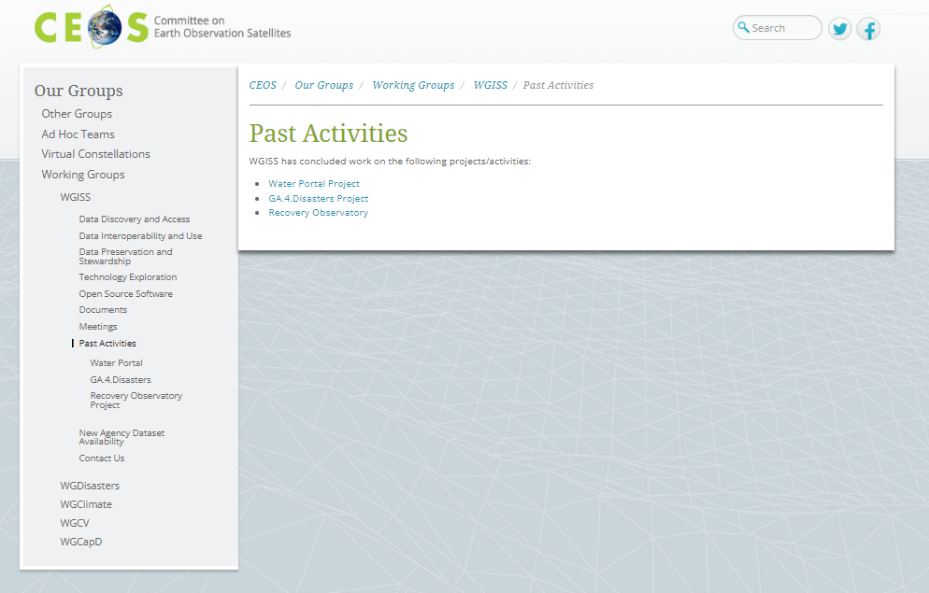
WGISS Website – Past Activities
Do we want to improve or move this page on another place?
Do we have material to update it?
It should be discussed together.

