Slide 1
Digital Earth Africa and Interoperability

Slide 2
Summary
Digital Earth Africa (DE Africa) is an African capability. We host >3 PB of EO data for all African countries and users. This is a free, operational service supported by our partners. We analyse EO and other data to produce services for our stakeholders.
DE Africa is all about interoperability. We think it is important to
Develop future-ready vocabularies
Implement user-oriented architectures
Support the community led work on interfacing; COG, STAC etc.
Improve data quality, including statements of uncertainty in the Framework
Recognise the vital role of data hosting in the Framework

Slide 3
DE Africa
DE Africa exists to facilitate better decision making with EO data in Africa, a continent of 54 countries and 1.5 billion people.
DE Africa plays a major role as a data host (>3 PB). We also fund data pipelines to achieve the necessary levels of availability and interoperability of datasets.
Interoperability between sources is vital. We host and use EO data from a range of public sources, and users can also use licenced data.
We invest in interoperability, so that we can benefit from more available and effective data sources.
Limitations in interoperability mean that the information that we can produce from EO data is not as detailed, accurate, complete, and frequent as would be expected if sources were more interoperable at the technical and measurement levels.
DE Africa must focus primarily on applications. Ultimately, we will look for the most interoperable and harmonised datasets, that lift EO datasets to the level of sensor-agnostic measurements (e.g., HLS), as inputs for DE Africa.

Slide 4
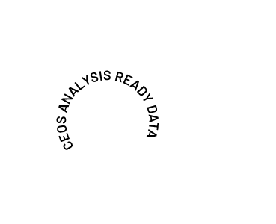
DE Africa
Space Agencies
Analysis Ready Data
p
COGS/STAC AWS S3 Cape Town
Explorer
Jupyter Sandbox
Map

Slide 5
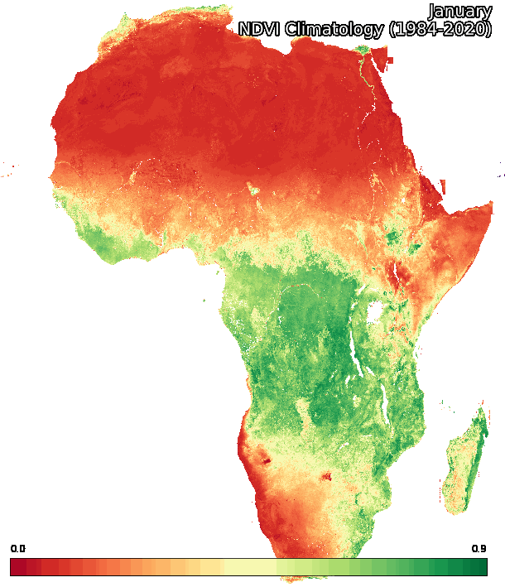
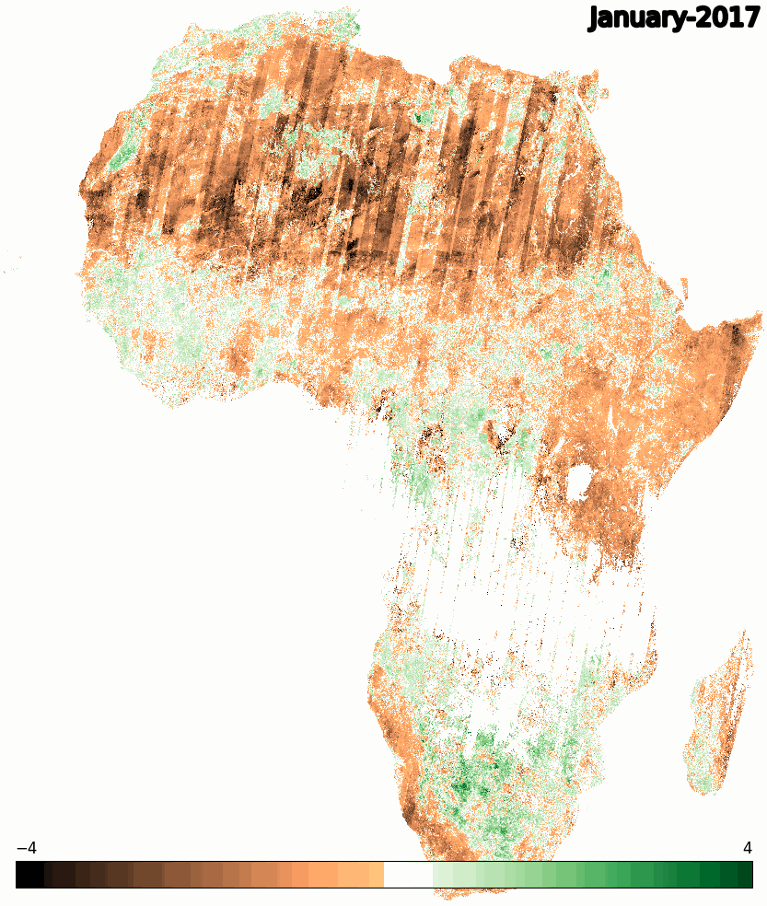
DE Africa
The platform is designed to foster data sharing and collaboration, discoverability and interoperability supported by:
ODC API (including OGC Web Services)
Spatio-Temporal Asset Catalog (STAC)
Enables interoperability
Microsoft PC, USGS, DE Aus/Africa, Planet, Sentinel-2 COGs…
Expanding ODC-STAC compatibility
Cloud Optimised GeoTIFFs
Enable continental and global scale workflows
Integration between local, regional and global data
Scalable product generation workflows
Argo on Kubernetes
Automated scene-based or regular scheduled processing
Empower scientists to develop, test and scale up
Enable rapid iteration
Monthly NDVI Climatology at 30m using Landsat from 1984 to 2020
Monthly Mean NDVI and Anomaly service, 2017 - present

Slide 6
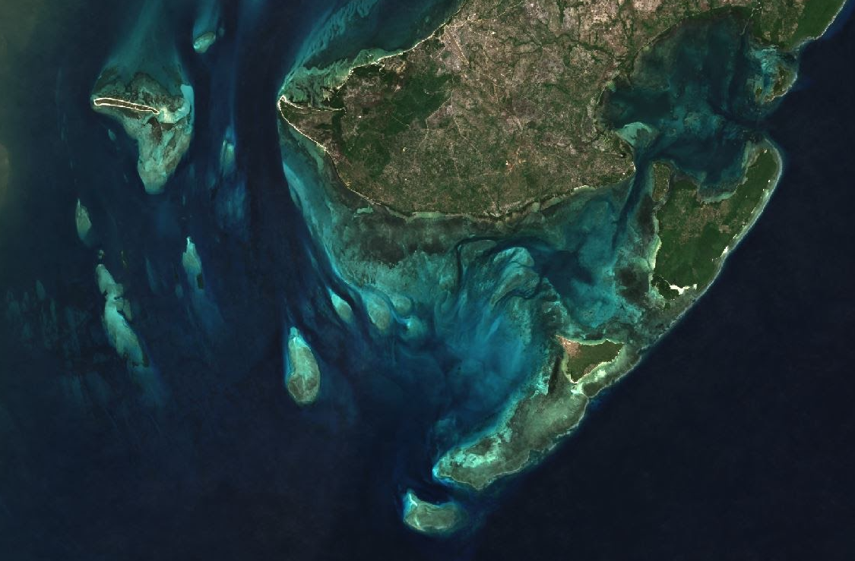
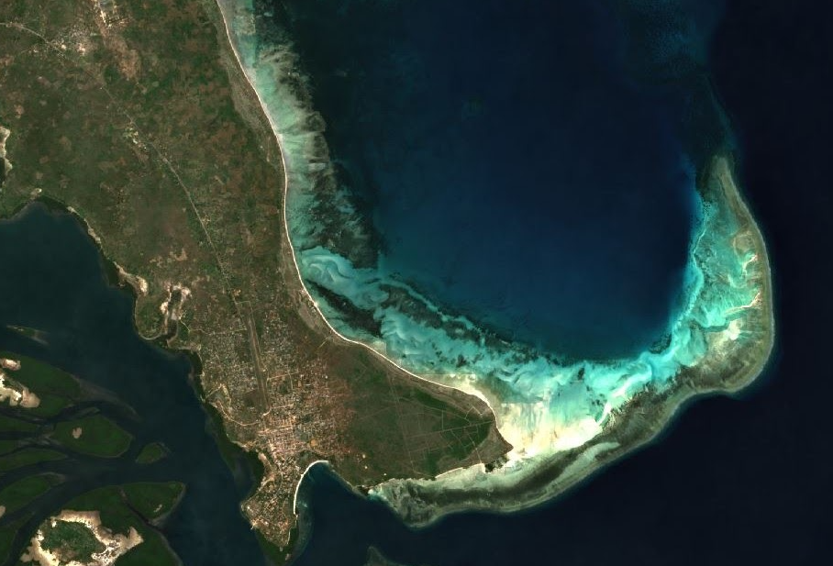
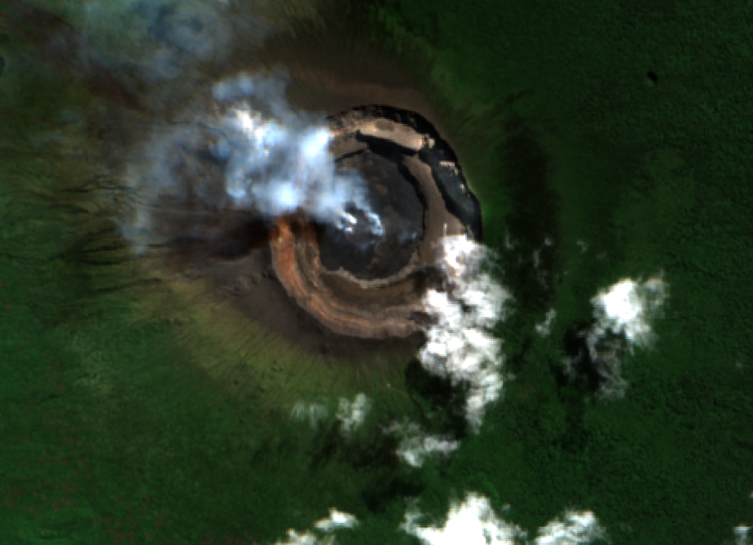
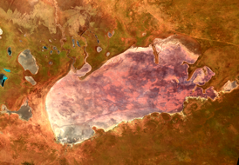
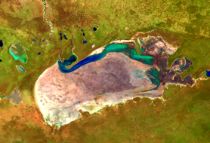
DE Africa
EO-based information services, co-developed with users, to address development challenges and drive impact across Africa.
Easy and reliable access to ARD significantly speeds up the development of information products, allowing application developers to focus on addressing user needs.
Access to ARD and open source tools opens up opportunities for non-expert users to use EO data, supports capacity building, and drives innovation across sectors.
Studying the Tanzanian Coastline with GeoMAD, 2019, RGB
Monitoring crops in Egypt 2001-2020, Landsat, RGB
Monitoring Mount Nyiragongo, 2018 Sentinel-2 RGB and 2021 Sentinel-1
Measuring water extent on rangelands in Etosha National Park, Namibia 1992-2021, Landsat, False Colour

Slide 7
A forward-looking Vocabulary
CEOS interoperability vocabulary needs to be ‘forward looking’
CEOS Analysis Ready Data has started EO vocabulary down a good path, for example the use of ‘surface reflectance’ as a measurement, and language that clearly separates the ideas of measurement, sensor, and platform.
The vocabulary of EO interoperability must start from the concept of scientific observations of Earth properties, and as far as possible move on from field-specific jargon such as bands, levels & etc.
Adopting the fundamental language of scientific observations is key to having data that interoperate as measurements, and which can be utilised with other scientific and geographic datasets.
Notes:
CEOS interoperability vocabulary needs to be ‘forward looking’. We would like the vocabulary of EO data to avoid, as far as possible, field-specific jargon and work from the concept of scientific observations of Earth properties. Adopting fundamental language of science is key to having data that interoperate as measurements, and which can be utilised with other scientific and measurement-based datasets. CEOS Analysis Ready Data has already moved EO vocabulary down this path, for example the use of ‘surface reflectance’ as a measurement, and language that clearly separates the ideas of measurement, sensor, and platform.
CEOS ARD does not comment on naming conventions, and leadership in this difficult and under-rated area could be useful. However naming conventions tend to strongly reflect concepts of vocabulary and architecture, and must be developed in ways that support interoperable exploitation of data rather than embedding current approaches, as described above.

Slide 8
User-focussed architecture
Design CEOS interoperability Architecture around the user and an interoperable and sensor-agnostic future!
Legacy approach
Resolution
(e.g., “moderate”)
Platform
(e.g. “Landsat-7”)
Sensor
(e.g. ETM+)
Band
(e.g. “blue”)
Future / user: Measurement
(of type, at resolution,
from sensor,
on platform)
Notes:
CEOS interoperability Architecture should be designed around the user, rather than the provider.
This is important for data exploitation. For example, traditionally, EO data have been organised according to platform, sensor, and measurement (more or less in that order), leading to surface reflectance and surface temperature data from Landsat-9 being collated together. A more logical organisational approach, if the aim is to exploit the data, is to organise surface reflectance measurements from multiple instruments together, and likewise surface temperature measurements. This encourages the most use of those datasets in conjunction with other sources of like measurements. Furthermore, spatial resolution is often given primacy, reflecting ‘imagery’ and cartographic philosophies. Yet from a measurement perspective this is a fundamental mistake; the distinguishing characteristics of the measurements is that they have different uncertainty for estimation of properties at different scales - a problem that should be addressed in the scientific combination of the observations.

Slide 9
Interfacing is moving quickly
Advances in ‘interfacing’ through COG and STAC have been significant
COG formats are essential to cloud-hosted data. We invest to convert Sentinel data to COG
DE Africa has encouraged and contributed to the development of STAC, working with the USGS and others
The benefits are clear; DE Africa users had access to data from Landsat-9 immediately on release.
There is room for other formats (Zarr, NetCDF) however we have not used these recently.
CEOS’ Interoperability Framework can promote, encourage and leverage these developments

Slide 10
Quality is a problem
We need EO data of sufficient quality to allow harmonised EO products and sensor-agnostic approaches. CEOS ARD is a good start but does not insist on improvements in data quality.
Measurement uncertainty must be understood, assessed and communicated
Quality limits interoperability because significant sources of noise or variance in the EO measurements are not understood, communicated, and addressed (e.g., BRDF)
Statements of uncertainty are needed in the interoperability framework to communicate uncertainties in EO measurements and provide a basis for comparisons and improvements
Notes:
The quality of EO datasets is limiting interoperability. CEOS ARD is a step in the right direction but does not itself assure high quality data. EO data need to be of sufficient quality to allow harmonised EO products and sensor-agnostic approaches. Looking forward, DE Africa will be drawn to interoperable datasets and harmonised datasets such as HLS, which lift EO datasets to the level of sensor-agnostic measurements.
Statements of uncertainty are needed in the interoperability framework to make clear the estimated uncertainties of EO measurements. CEOS Analysis Ready Data moves EO data toward being valid measurements of the land surface, but does not (yet, in practice) ensure high quality data or give sufficient assurance of any level of data quality. This limits progress in interoperability of datasets because significant sources of noise or variance in the EO measurements are not understood, and some sources are not removed. Examples include the variance in surface reflectance arising as a consequence of changing illumination and viewing geometries.

Slide 11
Policy – Hosting is a vital function
Hosting should be included in the CEOS interoperability framework. DE Africa is an example of data being hosted by an intermediary to enable greater access and interoperability:
The way forward for mass interoperability is for hosted datasets to work effectively together. That process that is already underway - DE Africa uses many datasets that are hosted elsewhere.
Data hosting is politically important. Hosting of data in Africa provides a new level of sovereignty for African nations and control and assurance for African users of EO data.
The role of free and open data cannot be overstated. DE Africa uses datasets that are free and open, with licensing that does not introduce additional layers of administration or operational complexity - generally CC-By.
However, interoperability must extend beyond free and open datasets. For example DE Africa users may, individually, use licenced data (typically high resolution datasets) in conjunction with DE Africa datasets, but the individual user then bears the responsibility for meeting the licence conditions.
Notes:
The role of free and open data cannot be overstated. DE Africa uses datasets that are free and open, with licensing that does not introduce additional layers of administration or operational complexity - generally CC-By.
However interoperability must extend beyond free and open datasets. For example DE Africa users may, individually, use licenced data (typically high resolution datasets) in conjunction with DE Africa datasets, but the individual user then bears the responsibility for meeting the licence conditions.
Hosting should be included in the CEOS interoperability framework. DE Africa is an example of data being hosted by an intermediary to enable greater access and interoperability. Whilst the stewardship of the reference collections and archives of EO data lies generally with the data producer, hosting of data is a key intermediary step because it is fundamentally user-led. The way forward for mass interoperability is for hosted datasets to work effectively together, a process that is already underway. DE Africa uses many datasets that are hosted elsewhere. Data hosting is also politically important. Hosting of data in Africa provides a new level of sovereignty and control for African nations and users of EO data.

Slide 12
Thank you!

