Slide 1
CEOS Interoperability Framework

Slide 2
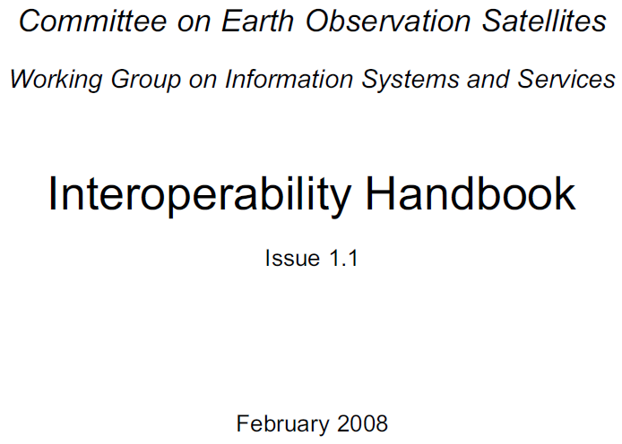
Context
Interoperability challenge discussed at 2022 CEOS Plenary
  Development of a CEOS Interoperability Framework and Roadmap needed
  Goal to consider Data and Service Interoperability
  Assigned to WGISS w/ goal of building upon WGISS expertise and prior work
Reference Interoperability Definition(s):
Interoperability is the
“ability of two or more systems or components to exchange information
and to use the information that has been exchanged.”
ISO 25964 Thesauri and Interoperability with other Vocabularies (ISO 25964-2:2013)
  F.A.I.R. Interoperability: Data is interoperable when it can be integrated with other data and systems to leverage open standards and specifications.
  The FAIR Guiding Principles for scientific data management and stewardship | Scientific Data (nature.com)

Slide 3
Framework Development Team
CEOS WGISS
CEOS ARD OG
CEOS WGCV
CEOS SEO
Other WG/VC

Slide 4
Framework Development
Meeting | Date | Topics
Kick off meeting | February 2023 | Discussed vision, teams, topics, membership and annual process. WGISS, LSI-VC, CEOS ARD OG, WGCV, SEO
#2 meeting | March 2023 | Discussed the components and the topics.
#3 meeting | March 2023 | Draft roadmap was proposed. Discussed the components and the topics based on the roadmap. Further discussions in each VC/WG were requested.
SIT-38 side meeting | March 2023 | Discussion on draft roadmap Initial identification of “Factors” critical for Interoperability
WGISS-55 | April 2023 | Reviewed SIT-38 recommendations Discussed history of WGISS Interoperability Handbook (2008)
#4 meeting | May 2023 | Reviewed current Framework concept (7 factors) Assigned action to WG Leads to identify Factor Champions Set up recurring Interoperability IG meeting (2nd Wed. of month)
WGCV, CGMS | June 2023 | Presented Status of Framework
#6 meeting | June 2023 | Reviewed Factors, Definitions, In/Out
#7 meeting | August 2023 | Roadmap Factors consensus Data Call to ALL CEOS WG Chairs re: Interoperability Supporting Activities
#8 meeting | September 2023 | Reviewed CEOS Work Plan initial mapping
LSI-VC | October 2023 | Present Status of Framework / Roadmap for Input
SIT-TW | October | Present Status of Framework / Roadmap
WGISS-56 | October | Discuss WGISS Interoperability Interest Group Goals
Plenary | November | Present Interoperability Framework / Roadmap for Endorsement

Slide 5
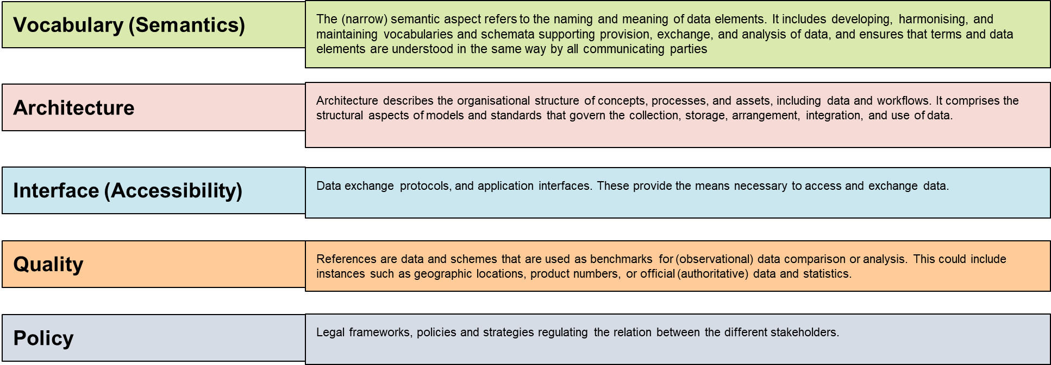
Interoperability Framework
Notes:
Looked at other frameworks
Didn’t try to re-invent wheel
This is the “CEOS” framework … vs. “adopting” someone else’s framework

Slide 6
Interoperability Roadmap
Mapping of Interoperability Factors to CEOS Activities Identified in 2023-2025 Work Plan (March 2023 v1.1)

Slide 7
Proposed Plenary Endorsement
(Decision) 36-09: CEOS Principals confirmed that coordination of interoperability related work remains within the WGISS perimeter.
(Action) 36-10: WGISS is invited to propose an interoperability roadmap.
Recommend Endorsement of proposed CEOS Interoperability Framework and approach toward development of Interoperability Roadmap.

Slide 8
Interoperability Presentations
Digital Earth Africa Overview and Interoperability Lisa Rebelo (GA/SANSA)*
SEO Report David Borges (NASA)*
Digital Earth Analysis Systems (IDEAS) Framework Thomas Huang (JPL/NASA)*
DLR Terrabyte Overview Jonas Eberle (DLR)
DLR/USGS Interoperability Pilot Jonas Eberle (DLR), Ryan Longhenry (USGS)*

Slide 9
Framework/Roadmap Next Steps
Framework will benefit from Factor “champions” to guide implementation
  Develop CEOS Interoperability Handbook 2.0
  Continue CEOS-wide Interoperability IG collaboration (and identify a champion(s) for each Factor)…
Activities may (likely) support more than one Factor
  Develop matrix of activities to Factor(s)
Activities benefit from the Factors as well as contribute to improving the overall Framework maturity
  Identify Use Cases (Demonstrators) for Framework
  Develop a Maturity Matrix (measure improvement & communicate ongoing maturity)
Initial Roadmap identifies existing activities, but this will be an ongoing effort
  Identify gaps and propose new supporting efforts
Other suggestions for discussion…..

