Slide 1
AI/ML White Paper Status Report
Yousuke Ikehata, JAXA
Agenda ID: 2023. 10.24_11.40
WGISS-56
24th October 2023

Slide 2
Background and Scope
This white paper shows a use case about Deep Learning (DL), Machine Learning (ML) and Artificial Intelligence (AI), which uses EO data.
Some CEOS agencies provide DL/ML/AI data and platforms and introduce them at WGISS meetings.
But there aren't any summarized documents.
This document can lead data users to data and platforms.
Additionally, data providers can know where to upload or what cloud is proven for DL/ML/AI dataset.

Slide 3
Progress
Fortunately, we could obtain cooperation from new people, who majored AI and MLs.
They have made our white paper improvements as follow.
  Corrected English descriptions.
  Input standards
  Organized methods by AI/ML experts
  Define a template based on ML operation for describing use case
  Start writing according to template.
  Recognized the big difference between agencies.

Slide 4
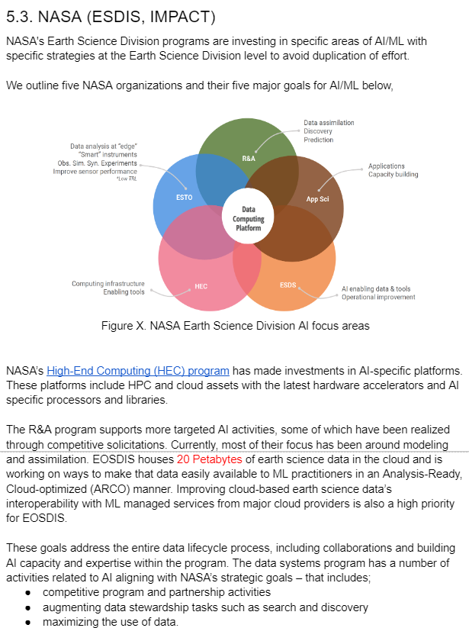
Current version case 1
NASA member has already written their section.
  NASA has program specified AI/ML.
  They has many papers and use cases.
  This description is very useful for readers.
    Reader can understand NASA activity at a glance.
    Obtain some useful links.
They can’t describe their activity by a template.

Slide 5
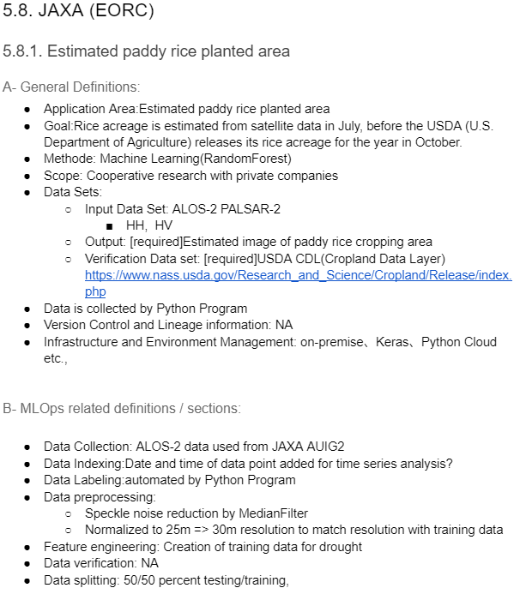
Current version: case 2
JAXA also tried writing.
  JAXA doesn’t have any initiatives and programs.
  There’re some papers.
  Templates are very useful for collect use cases
  and describing given sections.

Slide 6
Reorganize sections
Our white paper should include both cases.
  Major programs/initiatives help readers to use data/platforms.
  Individual use cases also help readers to know AI/ML study.
Reorganize sections.
  Before: methods -> use cases categorized by agency.
  After: major programs -> methods -> use cases categorized by methods

Slide 7
Table of contents
Version 0.3 (previous)
Version 0.4 (current)
1. Purpose of this document
2. Expected readers
3. Background
4. Usage methods of machine learning and AI for Earth observation
5. Use cases of machine learning and AI for WGISS
  5.1. NOAA (NCAI)
  5.2. USGS
  5.3. NASA
  5.4. UKSA (PML)
  5.5. ESA
  5.6. CNES
1. Purpose of this document
2. Expected readers
3. Project members
4. Background
5. Standards
  5.1. ISO 2
  5.2. OGC
6. Initiatives and Programs
  6.1. NASA (ESDIS, IMPACT)
  6.2. NOAA/NCAI
7. Usage methods of machine learning and AI for Earth observation 5
8. Use cases of machine learning and AI for WGISS
  8.1. Agriculture
  8.2. Marine monitoring
  8.3. Climate

Slide 8
Schedule updated
Share/Check Outline
In-house work
Allocate author to excels part.
Report in monthly meeting
Reorganize
Show draft
Publish
In-house work
Discussion
fulfill each section
Refinement
WGISS-54
WGISS-56
WGISS-57
WGISS-58
12 month
6 month
6 month

