Slide 1
CEOS Executive Officer
Report

Slide 2
Executive Summary
CEOS Mission & Objectives
  CEOS Long-term Priorities
  GISTDA CEOS Chair Priorities 2023
  WGISS Mission & Objectives
  WGISS Deliverables
CEOS Strategic Implementation Team (SIT)
  Technical Workshop (17-19 October 2023)

Slide 3
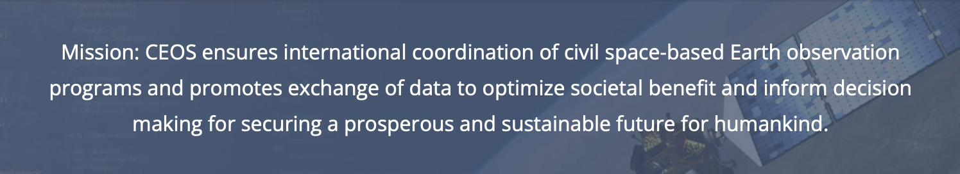
CEOS Mission & Objectives
  Primary Objectives:
To optimise the benefits of space-based Earth observation
To serve as the focal point for international coordination of space-based Earth observation activities
To encourage complementarity and compatibility

Slide 4





CEOS Long-term Priorities
Ensure that climate observation requirements identified by the Global Climate Observing System (GCOS) – and implications of the Paris Climate Agreement – are addressed.
Ensure, in the context of the Sendai Framework for Disaster Risk Reduction 2015-2030, that CEOS Agency data are made available in support of disaster risk reduction and that CEOS continues engagement with UN agencies and authorities.
Ensure that space-based Earth observations support the success of the next decade of the Group on Earth Observations (GEO), and that CEOS engagement in GEO governance and leadership is enhanced.
Proactively engage in global discussions on the critical challenges that face society, in support of the UN 2030 Agenda for Sustainable Development.

Slide 5
GISTDA CEOS Chair Priorities 2023
Space Technology for Better Environments, Economies, and Humanity
1
Supporting CEOS Preparations and Inputs to the Global Stocktake of the UNFCCC Paris Agreement
2
Supporting Exploration of New Geometries for Space Agencies and CEOS with New Space

Slide 6

WGISS Mission & Objectives
Mission: To facilitate (CEOS) data and information management, and to support the provision of services for both data providers and data users
Objectives:
To enable Earth observation data and information to be more accessible and usable to both data providers and data users world-wide through international coordination.
To foster easier exchange of Earth observation and related data and information to meet the requirements of users and data providers.
To foster the development of best practices and encourage the development of interoperable services that exploit space-borne Earth observation data.
To enhance the complementarity, interoperability and standardization of Earth observation data and information management and services with other types of geospatial data such as in situ data.

Slide 7
WGISS Deliverables

Slide 8
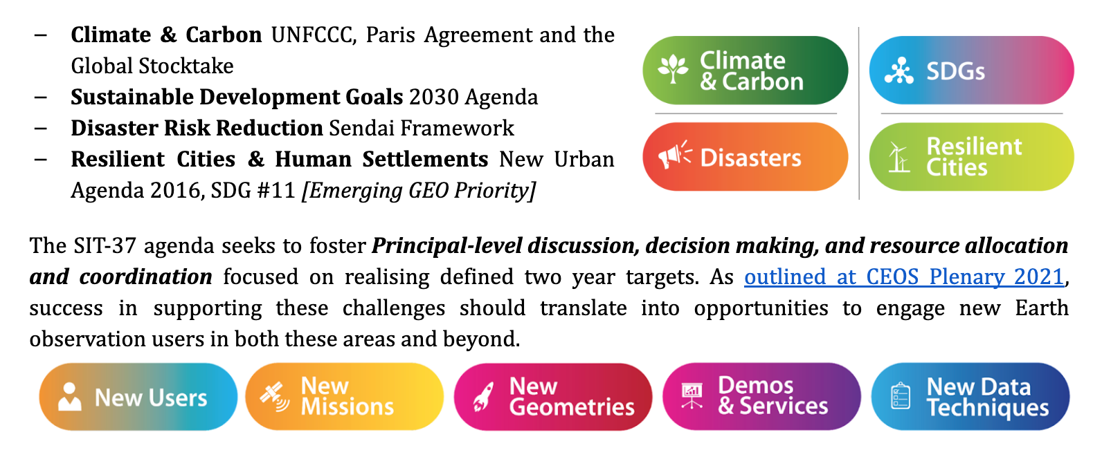
SIT Technical Workshop - Day 1
Session 2 - Greenhouse Gas Observation Coordination: Greenhouse Gas Roadmap update, IMEO Engagement, WMO Engagement, US GHG Centre, MIM GHG Portal
Session 3 - Carbon Roadmaps and Policy Impact: AFOLU Roadmap, Biomass harmonisation, Aquatic Carbon Roadmap, UNFCCC Interface and COP-28 planning, Earth Observation Handbook
Session 4 - GEO-CEOS Relationship: GEO Post-2025, GEO Work Programme, Examples: SDGs, GEO Blue Planet, GEO Wetlands

Slide 9
SIT Technical Workshop - Day 2
Session 5 - New Space: Recommendations from the New Space Task Team, and draft white paper Significant interest in how best to engage companies in the “New Space sector” that may bring an important added value to the public upstream and downstream sectors, for which the ultimate beneficiaries are data users.
Session 6 - Biodiversity: Ecosystem Extent Task Team recommendations, 2024 CSA CEOS Chair Priorities
Session 7 - Oceans and Coasts: Ocean Coordination Group update and way forward, Coastal Observations Applications Services and Tools (COAST) Ad Hoc Team - proposal for the creation of COAST Virtual Constellation
Session 8 - Other Business: MIM Database update, Interoperability Framework, Precipitation Virtual Constellation, SEO Report - including draft CEOS Communications Strategy and SDG Coordination Group continuity
Session 9 - Closing: JAXA 2024-25 SIT Chair Priorities, 2023 CEOS Plenary details

Slide 10
Thank you!

