Slide 1
WGISS Chair Report
Dr. Makoto NATSUISAKA, JAXA
Agenda ID: 2023.10.24_09.50
WGISS-56
Paris, France (CNES)
24-26 October 2023

Slide 2
Highlight of the Meeting
In addition to the regular topics…
cross-CEOS activities; CEOS ARD Oversight Group, CEOS Ocean Coordination Group, CEOS Engagement with Standard Organizations, CEOS New Space Task Team (NSTT), CEOS Interoperability Framework.
WGISS vice chair solicitation and the chair team transition
WGISS Cooperation with other entities
CGMS&WMO (Data stewardship), WGDisaster, WGCapD, SEO (cloud topics), GEO (GIDTT)
Jupyter Notebooks Workshop, cooperating with WGCapD, UN, GEO, SEO…
Slide 2

Slide 3
Major Events Since WGISS-55
CEOS SEC meetings (monthly) ⇒ WGISS activities were reported.
CEOS Work Plan 2023-2025 ⇒ CEO Report, Status of the WGISS deliverables were updated.
CEOS ARD Oversight Group ⇒ CEOS ARD OG including LSI-VC initiated standardization in OGC/ISO211.
CEOS Ocean Coordination Group ⇒ to be reported in the chair report.
CEOS Engagement with Standard Organizations ⇒ to be discussed.
CEOS New Space Task Team ⇒ to be reported in the chair report.
CEOS Interoperability Framework meetings (monthly) ⇒ CEOS Interoperability Framework session
SIT technical workshop (Oct. 28-30, 2023, ESA/ESRIN in Italy) ⇒ to be reported in the chair report.
CEOS Plenary 2023 ⇒ to be reported in the chair report.
Slide 3

Slide 4
CEOS Ocean Coordination Group
CEOS Ocean Coordination Group is a task force formally led by the SIT Chair and currently done by the Coast AHT Chair. The objective is to coordinate CEOS ocean-related activities and clarify CEOS’ contribution to the IOC/UN Ocean Decade.
6-month extension for further discussions was approved at SIT-38. => Concluded the activity at SIT-TW.
ref. COAST ad-hoc team will propose to establish COAST-VC to CEOS plenary 2023.
Slide 4

Slide 5
CEOS Engagement with Standards Organizations
The issue raised at SIT-TW 2022; In discussions around standards for Analysis-Ready Data, it became clear that CEOS was perhaps uncoordinated in its approach to engagement with standards bodies. For ARD, this coordination has since been resolved via the ongoing effort of the CEOS-ARD Oversight Group. Question remains whether CEOS generally needs more formal coordination around engagement with standards bodies, e.g., ISO / OGC / IEEE. Consultation with the CEOS community at 2022 SIT Technical Workshop side meeting – agreed that more coordination on the engagement of CEOS with standards organizations would be beneficial.
CEOS Plenary Discussion and Results
CEOS-36-09 | SIT Chair to organise a dedicated session on the topic of CEOS engagement with standards organisations at SIT-38 and invite CEOS entities to present their experience and status, with the aim of creating a snapshot inventory. | SIT-38
Slide 5

Slide 6
CEOS Engagement with Standards Organizations
WGISS was requested some input to SIT-38 and input the comments based on the discussions in the WGISS Exec meetings in 2022 as follows.
WGISS solicited a volunteer for the activity at the WGISS EXEC meetings.
WGISS doesn't have experts on standardizations except for Liping, who is a liaison with OGC/ISO-TC211 nor resources.
The direct commitment to the activity is difficult, but WGISS will support the activity through regular members of OGC/ISO-TC211 in individual agencies.
CEOS ARD OG initiated standardization for CEOS ARD in OGC and ISO TC211.
Slide 6

Slide 7
CEOS New Space Task Team
New Space Task Team was established for a period of one year, until 2023 CEOS Plenary, at 2022 CEOS Plenary.
Objective 1: Explore collaboration opportunities in New Space that bring mutual benefit to all parties, in delivering public benefit, including the identification of concrete actions
Define and propose actions within the CEOS framework that enhance the outcomes of CEOS entities (WGs, VCs, AHTs) working with New Space companies
Foster partnership at national level between individual CEOS members and their national “New Space” industry
Focus on the whole value chain – upstream and downstream sectors
Objective 2: Continue sharing country-level experience among CEOS
Slide 7

Slide 8
CEOS New Space Task Team
Commence with an assessment of the areas and issues that are common among CEOS agencies and that are predicted to impact public EO programs in future
Develop a series of objectives and activities that will guide CEOS in fostering the combined use of public and private EO New Space capabilities, both upstream and downstream
SIT-38: Continue agency sharing of experience from SIT-37 and TW, and Accelerate the definition of actions
A white paper was developed based on the think piece document. “COES Interoperability Framework” chapter was WGISS contribution.
SIT-TW: The white paper was reviewed, and the significance of the task was confirmed. However, the task team activity is supposed to be concluded after reporting the white paper to the CEOS Plenary.
Slide 8

Slide 9
CEOS SIT Technical Workshop 2023
Oct. 28-30, 2023, ESA/ESRIN in Italy
Tuesday, October 17 | Wednesday, October 18 | Thursday, October 19
Side Meetings: CEOS Secretariat (SEC-313) Ecosystem Extent Task Team GISTDA CEOS Plenary Carbon Accounting Workshop Preparation GHG Task Team (closed) AFOLU Roadmap (closed) CEOS COAST Products Demonstration New Space SDG Coordination Group Note: Final day of WGClimate-19 occurring in parallel (morning). | Opening Session Carbon Roadmaps Greenhouse Gas Coordination Climate Policy Relevance GEO-CEOS Relationship | New Space Task Team Ecosystem Extent Task Team CSA 2024 CEOS Chair Priorities Oceans and Coastlines Precipitation Virtual Constellation CEOS Interoperability Framework SEO and SDG Coordination Group Continuity JAXA 2024-25 SIT Chair Priorities Thailand CEOS Plenary details
Slide 9

Slide 10
CEOS SIT Technical Workshop 2023
CSA will be the CEOS chair in 2024-2025. The planned priorities were introduced at the SIT-TW 2023 and will be proposed to the CEOS Plenary 2023.
Slide 10

Slide 11
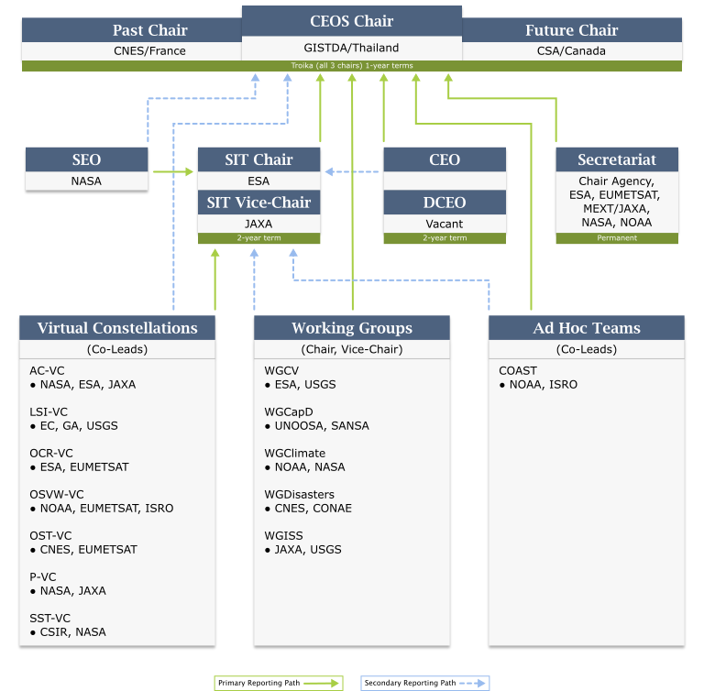
CEOS Plenary 2023
CEOS Chair (CNES) Decision
=> CEOS Interoperability Framework
New Chair (GISTDA) Priorities
=> “Earth Observation for Better Environment, Economy, and Humanity”; Supporting CEOS Preparations and Inputs to the Global Stocktake of the UNFCCC Paris Agreement
Supporting Exploration of New Geometries for Space Agencies and CEOS with New Space
CEOS Plenary 2023
Nov. 13-17th, 2023 @GISTDA in Chaing Rai THAILAND
=> will request the endorsement of the CEOS Interoperability Framework roadmap and initiation of Framework implementation.
Slide 11

