Slide 1


CEOS WGISS
Welcome presentation
Paris – CNES HQ
Véronique Mariette – CNES Copernicus program manager

Slide 2
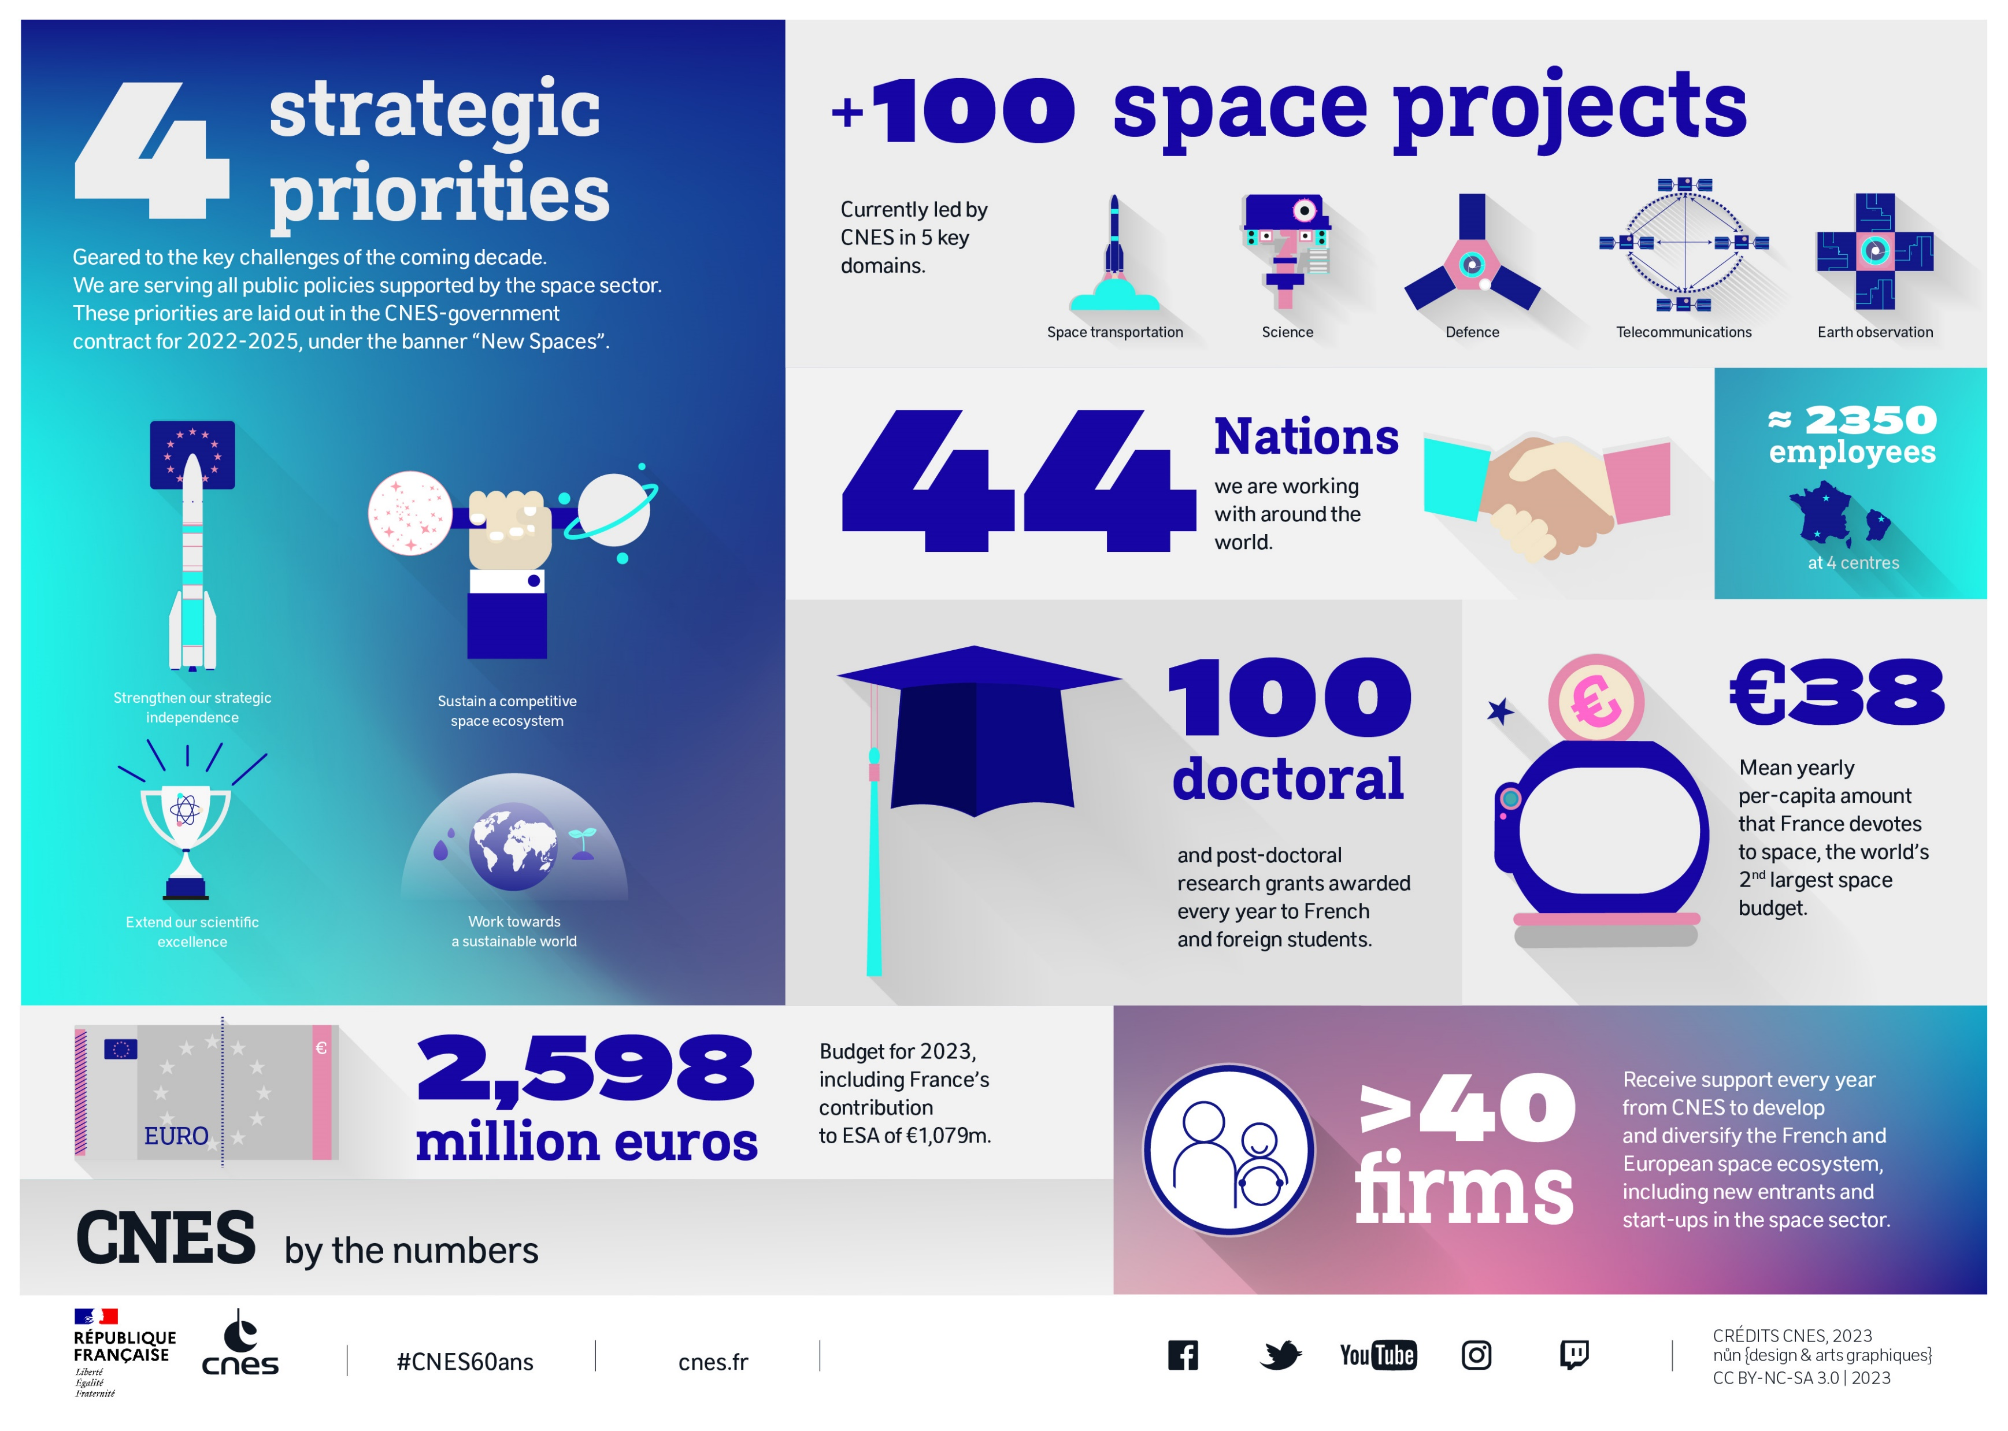

Slide 3

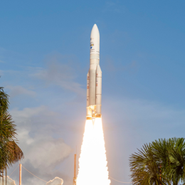
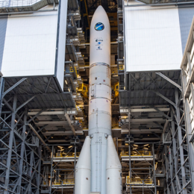
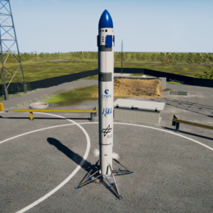
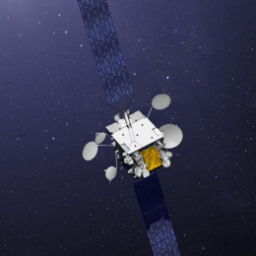
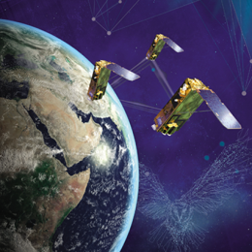
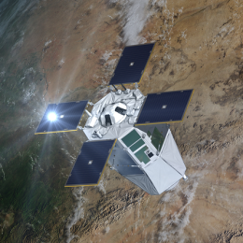
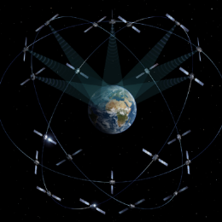
STRENGTHEN OUR STRATEGIC INDEPENDENCE
© CNES/ill.D.Ducros, 2019
Ariane 5
ELA 4 / Ariane 6
THEMIS, CALLISTO,
PROMETHEUS
Syracuse
CERES
CSO
CONSTELLATIONS
© CNES/ESA/Arianespace/
CSG video and photo dept./P Baudon, 2022
© CNES/ESA/Arianespace/
CSG video and photo dept./P.Baudon, 2022
© CNES, 2020
© Thales Alenia Space/E.Briot, 2016
© CNES/Mira Production, 2020
© CNES/Mira Production/R.Parot, 2019
© CNES/ill.P.carril, 2022
3
3
@ cnes
Notes:
Strengthen our strategic independence
Maintain independent and competitive access to space through entry into service of Ariane-6 and Vega-C, preparation of future European launchers and affirming the CSG as Europe’s spaceport
Execute military space and national security strategy, notably by supporting the ramp-up of military space systems and Space Command
Ensure safety and sustainability of space operations, through topflight expertise, innovative technical resources and the French Space Operations Act
Sustain and nurture an effective industry base able to compete in global markets
Assure access to space data, through CNES’s broad and systematic perspective of space projects

Slide 4



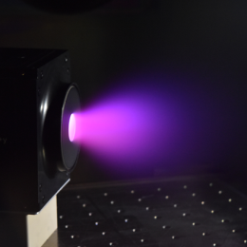
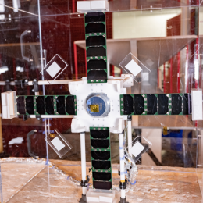
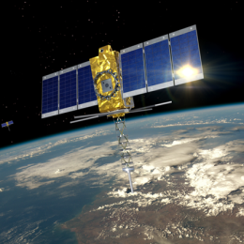
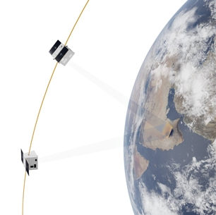
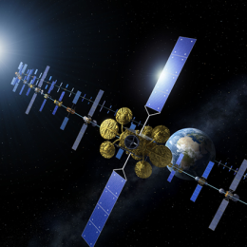
SUSTAIN A COMPETITIVE SPACE ECOSYSTEM
© CNES/N. Tronquart, 2019
France 2030
CONNECT’ BY CNES
R&T / GSTP
NɛSS
KINEIS
CO3D / SPACE
INSPIRE ONESAT
ARTES
© CNES/E.Grimault, 2022
© Comat
© CNES/T.De Prada, 2022
© CNES/ill.O.Sattler, 2022
© Airbus
© ESA.P.Carril
4
4
4
4
@ cnes
Notes:
Sustain a competitive space ecosystem
Support the national satellite industry and the applications sector
Bank on development of disruptive technologies, nurture innovation and experimentation
Develop technical resources and platforms, notably by opening up the Toulouse Space Centre to new challenges and partners
Aid the diversification of ecosystem players and invent new industry partnership models
Foster new applications and services, by developing a data-driven economy, forging partnerships with players from the digital sphere, stimulating user communities and contributing our expertise
Focus on CbC support portfolio:
(TBC)
Current & future national/multilateral projects:
ESA/EU:
ESA: ARTES, LEO PNT, GSTP (R&T)
EU:
France 2030:

Slide 5

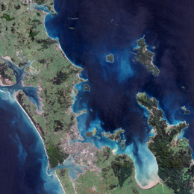
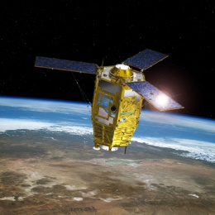
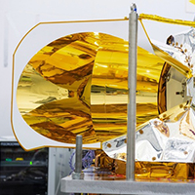
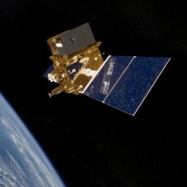
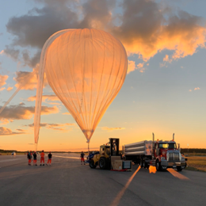
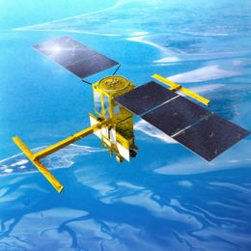
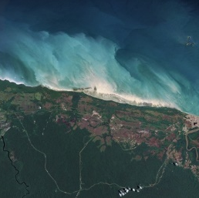
WORK TOWARDS A SUSTAINABLE WORLD
© Copernicus Sentinel Data, 2019
COPERNICUS /
FUTUREO
PLEIADES
MICROCARB
TRISHNA
BALLOONS
SWOT
SCO
© Copernicus Sentinel Data, 2022
© CNES/ill.D.Ducros, 2018
© CNES/E.Grimault, 2022
© CNES/Ill.M.Regy, 2021
© CNES/M.Clavery, 2022
© CNES/ill.D.Ducros, 2021
© Airbus DS, 2015
5
5
@ cnes
Notes:
Work towards a sustainable world
Execute our corporate social responsibility strategy aligned with the UN Agenda 2030
Consolidate our actions through Earth-observation programmes and by developing the Space for Climate Observatory (SCO)
Reduce our environmental footprint and thus play our part in the ecological transition with a low-carbon policy
Be a socially responsible employer, taking care to preserve a high level of well-being in the workplace, ensure exemplary governance and develop a dynamic HR policy
Current & future national/multilateral projects:
SWOT, MicroCarb, MERLIN, Trishna, Balloons, SCO
ESA/EU:
ESA: Future EO, Aeolus 2
EU: Copernicus
France 2030:
SWOT?

Slide 6

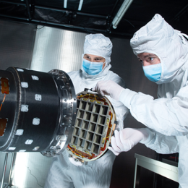
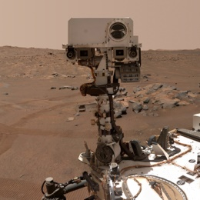
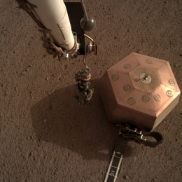
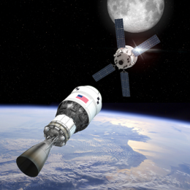
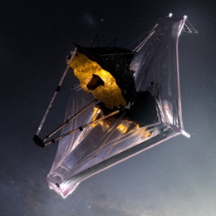
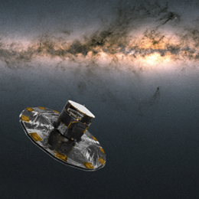
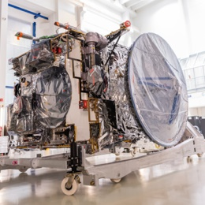
EXTEND OUR SCIENTIFIC excellence
© NASA/ESA/CSA/STScl/, 2022
SVOM
PERSEVERANCE
SEIS / INSIGHT
GATEWAY /
ARTEMIS
MIRI /
JAMES WEBB
GAIA
JUICE
© CNES/E.Grimault, 2022
© NASA/JPL Caltech/MSSS, 2021
© NASA/JPL Caltech, 2019
© ESA/D.Ducros, 2022
© NASA GSFC/CIL/A.
Manrique Gutierrez, 2021
© ESA/ATG medialab/Gaia/DPAC
© ESA-SJM Photography
6
6
@ cnes
Notes:
Sustain and extend French scientific excellence
Deploy ambitious missions at European and international levels
Support the scientific community throughout the space mission cycle and all mission phases, from the early design stage to operations and data exploitation
Strengthen scientific partnerships with institutions and industry: the historic ties between CNES and the scientific community are one of the strengths of the French space programme, which must continue to contribute to major international initiatives
Develop our ambition in space exploration and human spaceflight, through the expertise we have acquired from major international programmes and by reaching out to the emerging ecosystem
Take space culture to a wider audience
Current & future national/multilateral projects:
SVOM, Perseverance, SEIS
ESA:
ESA mandatory programme: Gaia, JUICE, Athena Future EO, Aeolus 2, MIRI, etc.
ESA exploration programme: Terra Novae
France 2030:

Slide 7

OUR MISSION
Maintaining & developing
Topflight technical expertise
© CNES.E.Grimault, 2021
7
@ cnes
Notes:
To accomplish its missions, CNES is able to call on the skills of its highly qualified people. The agency’s workforce is made up of about 85% engineers, scientists and executives, a great asset for France that it must leverage to meet new challenges. We are maintaining our technical expertise to serve government and industry, while also analysing and informing public policymaking in response to burgeoning new ideas from emerging players.
Achieving these goals requires us to invest massively in training and education, and to recruit more doctoral and post-doctoral graduates while revaluating CNES’s key competencies every two years.

Slide 8
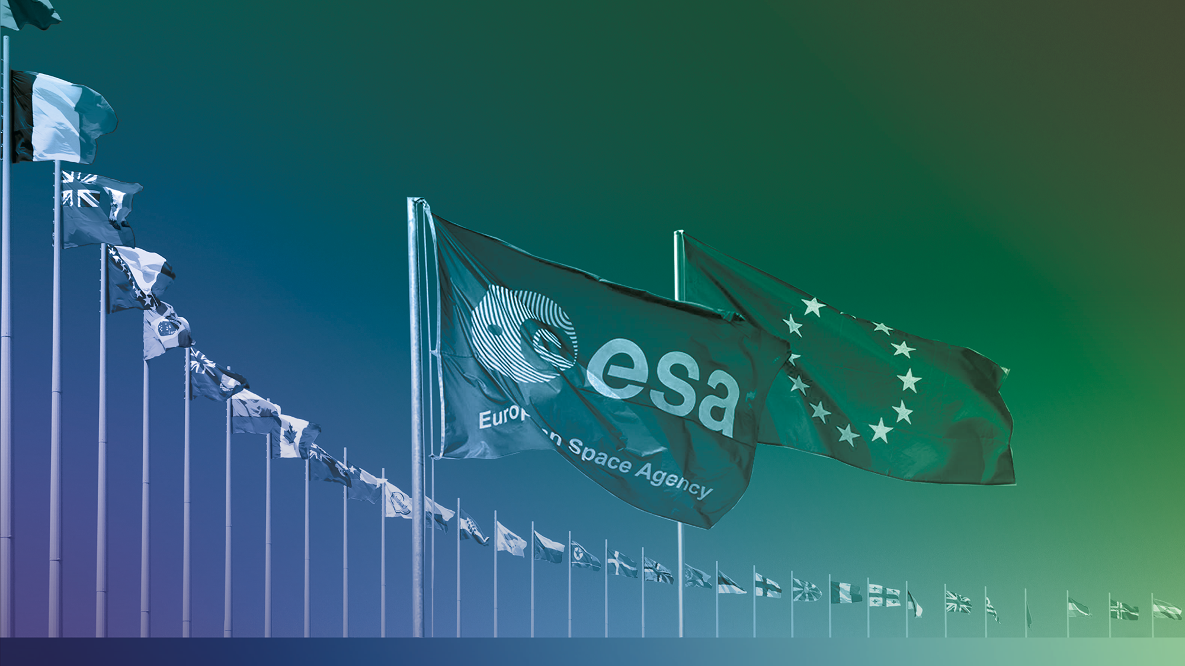
International REACH
CNES
is working with
44
countries around
the world
129
International agreements currently effective*
* figures and map as of 1 January 2023
8
@ cnes
Notes:
Version 1. Use this version if you don’t need to detail CNES’s partnerships (number, nations).
Remember to deactivate the version you don’t intend to use (right-click the left of the slide -> Hide Slide)
In a fast-moving international landscape:
an increasing number of nations are acquiring, conceiving or operating satellites
and this trend is being fuelled by cheaper access to space
CNES’s international actions are geared towards improving France’s position in a context of growing strategic, industrial and commercial competition:
They are enabling the French scientific community to contribute to ambitious projects it could never have accomplished alone, and giving CNES access to cutting-edge technological and scientific capabilities and expertise.
They are a tool for promoting the French space ecosystem, encouraging international partners to “think France” and helping our manufacturers to succeed in export markets.
They tie in with France’s broader diplomacy efforts. Space regularly occupies an important place in strategic dialogue, joint committees and bilateral summits with the nation’s diplomatic partners.
Our main partners
3 types of international partners:
Europe is the natural horizon and stage for France’s space effort. France is both the driving force behind Europe’s space programme and one of its principal beneficiaries.
France, represented by CNES, is one of the main annual contributors to ESA (with €3.2bn out of a budget over 2023-2025). Vital contributions include Ariane 5/6, Vega-C, demonstrators, space science, solar system exploration, navigation, Earth observation and telecommunications.
France has pushed for and driven forward the growing role of the European Union, which is now the second key institutional space player in Europe. CNES is also playing a central role in Galileo and Copernicus.
CNES maintains bilateral ties with numerous European and international partners (some 45 nations).
The main key partners with which CNES is involved in ambitious missions are the United States, China, India and Japan.
It is also collaborating with new entrants like the UAE, Israel and Singapore.
Due to the war in Ukraine and EU sanctions against Russia, bilateral cooperation has been suspended.

Slide 9

























SCIENCE & EXPLORATION
PROGRAMMES IN OPERATION
PROGRAMMES IN DEVELOPMENT
2018
BepiColombo
2028 Comet Interceptor
2025 ACES / Pharao
2016
ExoMars
2020
Solar Orbiter
2023
JUICE
2021
JWST
2027
PLATO
2013
Gaia
2028
ARIEL
SOHO (1995)
XMM (1999)
Cluster (2000)
2024
Euclid
2036
LISA
2019
CHEOPS
2033
Athena
2010
2015
2020
2025
2030
2035
Mars Express (2003)
Stereo (2006)
DECLIC (2009)
2014 Hayabusa2 /
Mascot
2018
Parker
Solar Probe
2019 EYESAT
2021
DECLIC-
EVOLUTION
2023
MTB2
2024
DORN
2025
Viral
Shukravaan
2027
Dragonfly
2028
ExoMars
2032
Envision
2012 MSL /
Curiosity
2022
Fireball3
2016 Microscope
2024
MMX
2017
PILOT V2
2019
PILOT V3
2020
Perseverance
2013
MAVEN
2018 InSight / SEIS
2023
SVOM
Notes:
ESA programme projects above the timeline, bilateral projects below.
A certain number of projects launched before 2010 are still in operation: SOHO (1995), XMM (1999), Cluster (2000), Mars Express (2003), Stereo (2006) and DECLIC (2009).
Projects now over (launch dates): Rosetta (2004), Fireball (2007), Herschel/Planck (2009), Expose (2008), T2L2 (2008), Cardiolab (2008), Fireball V1 (2009), MTB (2013), Eusoballon (2014), Microscope (2016), Taranis (2020).
Projets lancés depuis 2010 et dont l’exploitation est terminée : MTB (2013), Eusoballon (2014), Taranis (2020), SEIS/InSight (2022)

Slide 10
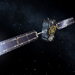
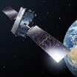
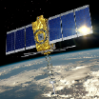
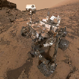
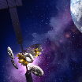
TELECOMMUNICATIONS & NAVIGATION
PROGRAMMES IN OPERATION
PROGRAMMES IN DEVELOPMENT
2021 – 2026
GALILEO
2010 – 2018
Galileo
2023
KINEIS
1st launch
2018
ARGOS 3
on
METOP C
2019
COSPAS-SARSAT
MEOSAR
IOC
2022
Argos 4
OAA
HoPS
2025
Argos 4 METOP SG 1b
2010
Galileo IOV
2015
Sarsat 3
on MSG-34 (GEO)
2019
ANGELS
Nanosat
with
Argos-Neo
2022
Argos 4
on Oceansat-3
2023
COSPAS-SARSAT MEOSAR FOC
2013
Argos 3
on SARAL
2025
Galileo 2nd generation
2026
Galileo 2nd generation
2011
Galileo IOV
2014
Galileo
FOC
2015
2016
2017
2018
Galileo
FOC
2021
Galileo
2023
2024
2025
Galileo
2010
2015
2020
2025
2030
2035
2019
KONNECT
1st flight of a NEOSAT platform (Spacebus NEO)
2022
HOTBIRD NEXT
1st flight of a NEOSAT platform (Eurostar NEO)
2024
IMMARSAT
GX FLEX
1st flight of a ONESAT platform
2025
1st flight of a SPACE INSPIRE satellite
2013
ALPHASAT
1st flight of an Alphabus platform
2017
E-172B
1st flight of an E3000-EOR platform
(all-electric propulsion)
2022
KONNECT VHTS
Larger VHTS satellite (THD SAT)
Notes:
Key milestones not shown:
Q1 2023: declaration of Galileo Navigation Message Authentication (anti-spoofing)
Q2 2023: declaration of Galileo High Accuracy Service (20 cm)
Galileo satellite launches: 21/10/2011, 12/10/2012, 22/08/2014, 27/03/2015, 11/9/2015, 17/12/2015, 24/5/2016, 17/11/2016, 12/12/2017, 25/7/2018, 5/12/2021
Planned future launches (the first three are relatively firm, the last three are still unsure...): Nov/Dec 2023 (A62), April 2024, end 2024, mid-2025, end 2025 => coinciding with first Galileo Transition launch, which has not been moved
Telecommunications:
HotBird Next: Q3 2022
Konnect VHTS: Q3 2022
Inm GX Flex : Q3 2024
Space Inspire : Q4 2024
ARGOS
ANGELS: December 2019
ARGOS4 on Oceansat3: September 2022
ARGOS4 on Hops: October 2022
ARGOS 4 on METOP SGB1: start 2025
Kineis: September 2023 for 1st launch

Slide 11








DEFENCE
PROGRAMMES IN OPERATION
PROGRAMMES IN DEVELOPMENT
2018
CSO Musis 1
2022
Syracuse IV B
2012
Pleiades 1B
2021
Syracuse IV A
2028
Syracuse IV C
2011
Pleiades 1A
Helios 2A (2004)
Helios 2B (2006)
2023
NɛSS
2010
2015
2020
2025
2030
2035
2020
CSO Musis 2
2023
CSO Musis 3
2014
Athena-Fidus
2024
CO3D
2021
CERES
Notes:
Projets lancés depuis 2010 et dont l’exploitation est terminée : Elisa (2011)

Slide 12
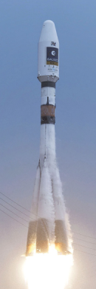
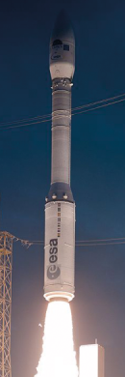
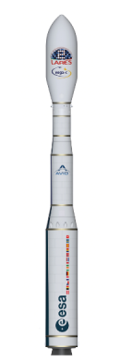
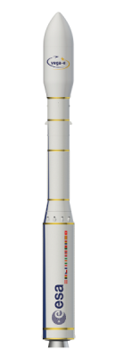

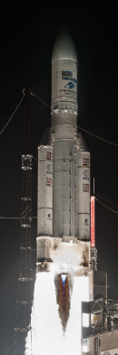
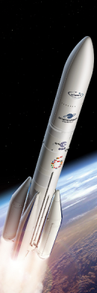
LAUNCHERS
PROGRAMMES IN OPERATION
PROGRAMMES IN DEVELOPMENT
2011 - 2022
Soyuz in Guiana
2012
1st launch of
VEGA
2022
1st launch of
VEGA-C
2026
1st launch of
VEGA-E
2024
CALLISTO
1st test
2023
DIAMANT launch complex
1st private launch
2010
2015
2020
2025
2030
2035
1st flight of ARIANE 5 (1996)
2018
ARIANE 5
100th
^{launch}
2023
1st flight of
ARIANE 6
2022
PROMETHEUS
1st full test
2025
THEMIS
1er flight test
Notes:
CSG launch history at https://centrespatialguyanais.cnes.fr/fr/historique-des-lancements

Slide 13
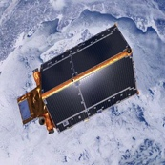
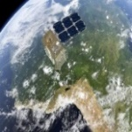

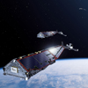
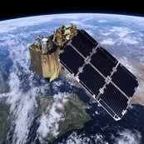
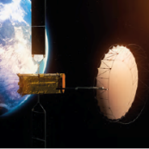
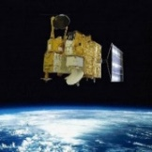
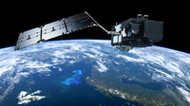
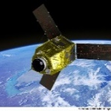
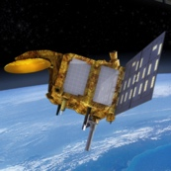
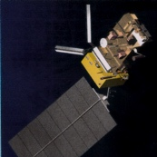
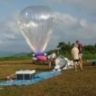











CNES Earth observation missions
Operational programmes
Programmes under development
Cryosat-2
Sentinel-2B
Sentinel-6 -MF
Swarm
Sentinel-2A
Biomass
Hy-2A
Sentinel-3A
Strateole 2-2
Pleiades
Saral-AltiKa
Hemera 1&2
Hemera 3
IASI-NG1 & 3MI
/Metop SG A1
IASI-NG2 & 3MI/Metop SG A2
Venμs
Iasi 3/MetopC
Iasi2/MetopB
Strateole 2-1
Calipso (2006)
Swot
Smos (2009)
CFOSAT
Merlin
Microcarb
Trishna
Projets lancés depuis 2010 et exploitation terminée : ConcordIasi (2010), Jason 3 (2016) , Megha-Tropiques (2011)
CO3D
Notes:
Projets terminés (date lancement) :

Slide 14
CNES EO Programme
Phase 0 / Phase A studies
R&T actions
Strategic in-situ observations (buoys, balloons, aircrafts, …)
Development of downstream applications
Support to research
CNES EO missions
Contributions to ESA / Copernicus / EUMETSAT programmes
Data and services centres
    A consistent set of actions aiming at covering all facets of the Earth System
    Collaborations / Partnerships
    Necessary combination of satellite + in-situ + model data
    From upstream (R&T) to downstream (applications)
    Guidance on strategy and level of support provided by scientific committes (CPS / TOSCA)
Notes:
Le programme concerne de nombreuses activités:
de la R&T, les missions (en phases de développement ou exploitation), les contributions aux programmes ESA et EUMETSAT, les synergies avec les réseaux/infras in situ + modèles, le support aux communautés scientifiques etc.. Et ce jusqu'à la valorisation et les applications.

Slide 15



























An international partnership – A need
Observing the Earth from space - GLOBAL ISSUES
The use of satellite to understand and tackle climate changes needs a close cooperation of all the actors over the globe
Space agencies are collaborating through several international groups to coordinate their efforts on Earth Observation
The Global Climate Observing System (GCOS) identifies climate observation requirements and addresses the implications of the Paris Climate Agreement
Notes:
To share the diagnosis worldwide on the causes, effects and evolution of climate change, satellites are key elements of the Global Earth Observing System of Systems (GEOSS) established by the Group on Earth Observation (GEO). They provide global, uniform and sustained observations of Essential Climate Variables (ECVs) defined by the Global Climate Observing System (GCOS), and efficiently complement in situ and model data
The Committee on Earth Observation Satellites CEOS, CGMS responding to GCOS observational needs and requirements and supporting GEO initiatives and other initiatives in the climate theme, are playing a major role for Space Observation Data.
CEOS is coordinating and harmonising Earth observations to make it easier for the user community to access and use satellite data by delivering space-based Earth observation data and solutions in an open, sustained and accessible way for all global citizens.
One of the objective is to optimise the benefits of space-based Earth observation through the cooperation of CEOS Agencies in mission planning and in the development of compatible data products, formats, services, applications and policies.

Slide 16






Observing the Earth from space – The missions
Ocean,Fresh Water,coastal :The new generation of altimetry mission, a breakthrough

Slide 17




Observing the Earth from space – The missions
The SWOT mission is a partnership between the hydrology and oceanography scientific communities
Ka-band SAR interferometric (KaRIn)
Jason-class altimeter for nadir coverage,
Radiometer for wet-tropospheric delay
GPS/DORIS/LRA for POD
Science mission duration of 3 years
Launch date 12 December 2022
Total Water on Earth
Fresh Water
S
W
O
T
Rivers and lakes
Oceanography
+ hydrology

Slide 18





Observing the Earth from space – The missions
MicroCarb mission
Launch date: 2024
Mission objectives: Quantify CO₂ Budget
Measure CO₂ atmospheric concentration at high precision all over the globe (ocean & land) to access CO₂ budget at regional scale
  Response of carbon cycle to global climate change: impact of warming and modification of water cycle on land sources and sinks and the ocean pump.
MicroCarb main innovations:
  New compact spectrometer concept (<70 kg)
  High spectral resolution for high precision
  Detection in 4 bands specific to CO₂ (1.6 µ, 2µ) plus 0₂ band (0.76µ, 1.27 µ)

Slide 19



MERLIN scientific mission
Launch date: 2028
Mission objectives: Quantify Methane CH₄ Budget
Methane observations above key regions for climate issues : Arctic regions (boreal forest, permafrost), Eurasia (anthropogenic emissions), the tropical regions (forest, wetlands).
Global and high accuracy measurements of CH₄ atmospheric concentration to estimate CH₄ fluxes at regional to continental scale.
MERLIN main innovations:
First active (Lidar IPDA) mission dedicated to greenhouse gas ➔ 1) global coverage including high latitude during winter, 2) small footprint, 3) self calibration allowing no bias from scattering by aerosol
Compatible to Microsatellite (Myriade Evolution)

Slide 20











TRISHNA (Thermal infraRed Imaging Satellite for High resolution Natural resource Assessment)
Objectives : Agriculture & Coastal Hydrology
  Monitoring water stress in ecosystems and water management,
  Coastal and continental monitoring and hydrology,
  Better understanding of the energy balance of agricultural, urban, atmospheric and cryospheric environments.
Surface temperature is a key parameter for the assessment of evapotranspiration and radiative budget of the land and water surfaces.
TRISHNA will also serve for four additional secondary thematic issues: Urban, cryosphere atmosphere and solid earth
Number of observations per cycle of 8 days.
In 99% Europe = mean revisit time better than 2 days.
Artist's impression of the Trishna satellite - © CNES/ISRO
Ground surface temperature and daily evapotranspiration
Launch scheduled
2025

Slide 21









Data Terra Research Infrastructure – Integrated Earth System observation
Gathers data and services for the 4 Earth System Compartments (Ocean, Atmosphere, Solid Earth, Land surfaces & in progress : Biodiversity)
Railway monitoring
(SNCF-CNES)
Dispositif Institutionnel
National d’Approvisionnement Mutualisé en Imagerie Spatiale
Data Terra
IASI-based NH3 maps
Van Damme et al, 2018
Aviso multi-mission products
Theia land cover map
http://www.theia-land.fr/fr/ces-occupation-sols
Notes:
Rôle accrue des pôles en lien avec les missions spatiales => CNES a ici un rôle majeur pour le traitement/stockage des données
CNES également attentif au Développement de services transverses pour toute la communauté. En cours.

Slide 22
FIND US ON
cnes.fr

