Slide 1
Assignment of DOI Numbers to
JAXA Earth Observation Satellite Data

Slide 2
DOI Numbers
JAXA assigned DOI numbers to G-Portal standard products in Feb. 2023.
The numbers were assigned to the collections and the total numbers were 1,017.
10.57746 / EO.xxxxxxxxxxxxxxxxxxxxxxxxxx
Space Technology Directorate I
(Satellite program division)
Earth Observation Product
Opaque Number (ULID)
Slide 2

Slide 3
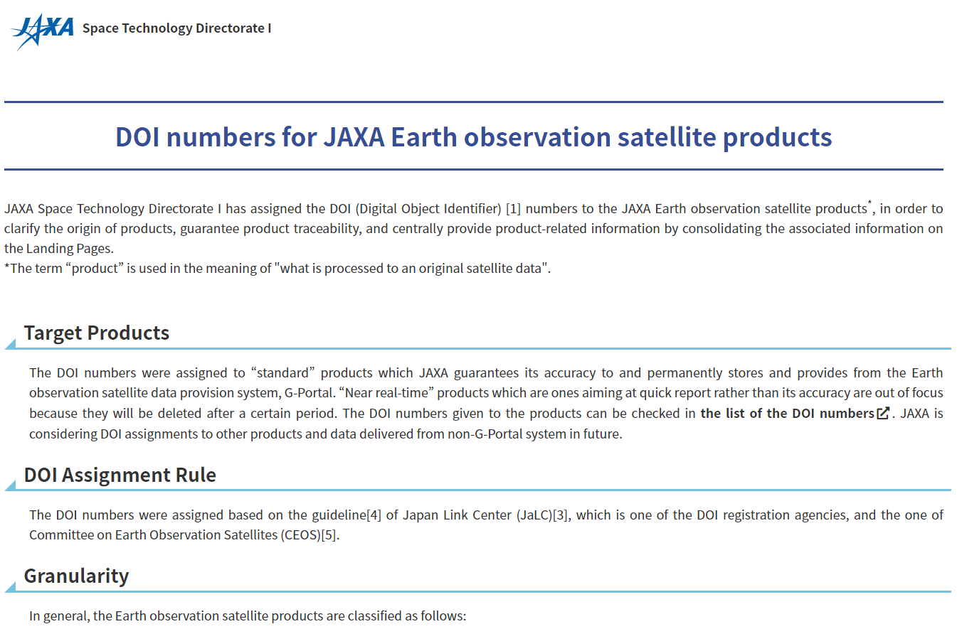
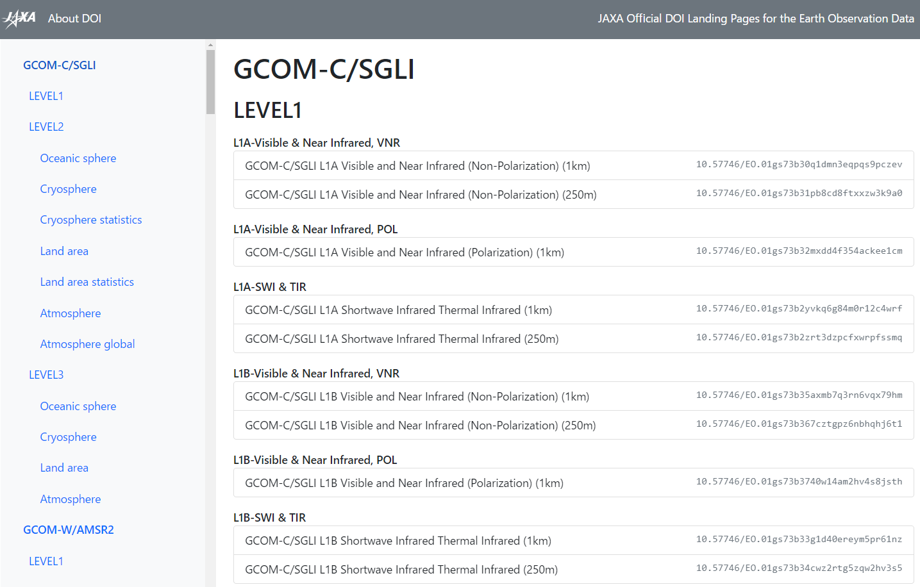
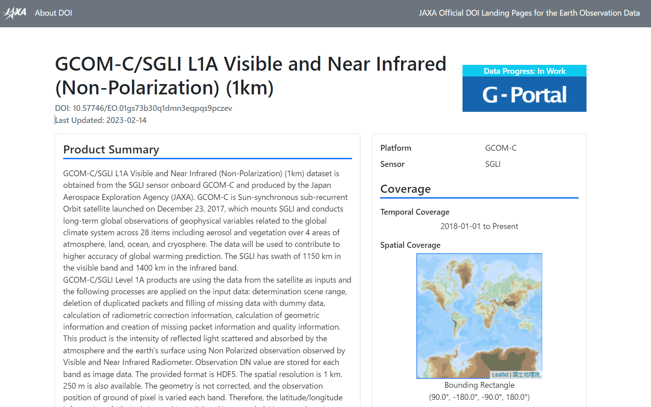
Guideline and Landing Page
Guideline
List of DOI/LP
Landing Page
https://earth.jaxa.jp/doi/en/
https://eolp.jaxa.jp/
Example
https://doi.org/10.57746/EO.01gs73b30q1dmn3eqpqs9pczev
Slide 3

Slide 4
Landing Page
Landing Page
Summary/Spatial resolution/Temporal resolution/Projection/File format/Spatial coverage/Temporal coverage, and so on.
Get Data URL and Fee/Citation/ATBD/User constraints
ISO Topic category/GCMD Science Keyword
Example
https://doi.org/10.57746/EO.01gs73b30q1dmn3eqpqs9pczev
Slide 4

Slide 5
Note: Granularity
JAXA decided to assign a DOI number to a collection, not to an individual granule.
JAXA does not give a new DOI number when product version up is made.
Guideline
Version history is listed in “ “ in the landing page.
User is requested to describe version number when a DOI number should be cited in a paper or document.
ex. https://doi.org/10.57746/EO.xxxxxxxxxxxxxxxxxxx version y.y
https://earth.jaxa.jp/doi/en/
Slide 5

Slide 6



Registration Agencies
The DOI numbers were registered through Japan Link Center (JaLC).
They were also registered to DataCite via JaLC.
JaLC is a DataCite’s consortium member.
Slide 6

Slide 7
Appendix.

Slide 8
Compatibilities with CEOS PID Best Practice
The draft plan is compatible with CEOS Persistent Identifiers Best Practices Version 1.3 as follows.
REC No. | Title | Summary | Compatibility | Comment
REC_01 | Choosing a PID system | DOIs are the most suitable persistent identifiers for the Earth Observation domain. | ○
REC_02 | PID numbering | Numbering should be completely opaque. | △ | Prefix/EO.xxxxxxxxxxxxxxxxxxxxxxxxxx xxx… is a partially opaque number.
REC_03 | PID numbering | PIDs must be universally unique. | ○ | xxx… is generated as a UUID
REC_04 | PID numbering | No hierarchies/versioning within the actual PID numbering. | × | “EO.” was introduced as a separator in order to make the DOI management easier.
REC_05 | PID numbering | Consider using a checksum. | * | We use ulid as number.
Slide 8

Slide 9
Compatibilities with CEOS PID Best Practice
REC_06 | Permanence | Data providers must commit themselves to the persistence of their PIDs. | ○
REC_07 | Permanence | The identifier should never change. | ○
REC_08 | Permanence | If the already existing data content changes (e.g. reprocessing, error correction, versioning), assign a new PID. | × | A new PID will not be assigned in case of reprocessing, error correction, versioning etc..
REC_09 | Permanence | If the file format of any data is changed, e.g. CDAT to GeoTIFF, assign a new PID. | × | A new PID will not be assigned even if the file format is changed.
REC_10 | Permanence | If the data are transferred to new physical storage media, it is not necessary to assign a new PID. | ○
REC_11 | Permanence | Only assign PIDs to data sets that are disseminated and archived for long-term – not auxiliary /ancillary data, experimental products, on-demand processing, or near-real-time (NRT) products that are not archived. | ○ | PIDs will not be assigned for auxiliary /ancillary data, experimental products, on-demand processing nor NRT.
Slide 9

Slide 10
Compatibilities with CEOS PID Best Practice
REC_12 | Permanence | only if the data provider commits to archiving the product for at least 10 years or if a science-quality version of the near-real-time product is archived. | × | So far, a science-quality version of NRT hasn’t been considered yet. DOIs were assigned to some auziliary data.
REC_13 | Permanence | If a data set is transferred to a new institution, keep the same PID. | ○
REC_14 | Permanence | updating the landing page URL in the resolver if the location changes. | ○
Slide 10

Slide 11
Compatibilities with CEOS PID Best Practice
REC_15 | Resolving | A PID must be actionable. | ○
REC_16 | Resolving | The PID should resolve to a landing page. | ○
REC_17 | Resolving | The landing page should contain provenance, quality, and access constraints． | △ | Qualities are not included in the landings, although those are included in the metadata of the individual data files.
REC_18 | Resolving | Use the landing page to link data sets that are related (e.g. reprocessing, versioning, subsets, and supersets). | ○
Slide 11

Slide 12
Compatibilities with CEOS PID Best Practice
REC_19 | Granularity | assign PIDs to data collections (e.g. a consistent time-series) rather than an individual scene. | ○
REC_20 | Granularity | Data from the same source but at a different processing level (e.g. L1B vs. L2) should receive separate PIDs. | ○
REC_21 | Granularity | Assign a single PID for a whole time-series． | ○
REC_22 | Granularity | Use one PID for a multi-satellite time-series． | ○
Slide 12

Slide 13
Compatibilities with CEOS PID Best Practice
REC_23 | Documentation | An institution that uses PIDs should have an official, written PID policy. | ○
REC_24 | Documentation | Make sure that the uses of PIDs are part of the written policy of the institution. | ○
REC_25 | Documentation | Provide citation guidelines that use the PID． | ○
REC_26 | Documentation | Documents related to a data set should be linked on the landing page． | ○
REC_27 | Documentation | Comply with the latest metadata standards from your PID provider． | ○
Slide 13

Slide 14
Compatibilities with CEOS PID Best Practice
REC_28 | Interoperability | The same data set should have the same PID． | ○
REC_29 | Interoperability | In case of inter-agency data records, a PID (e.g. based on DOI) can be associated with a list of all contributing collections and their respective PIDs (e.g. DOIs, ARK). | ○
REC_30 | Landing Page recommendations | landing pages use structured metadata (e.g. schema.org, DCAT, CSVW[1], and other community standards)． | ○
Slide 14

