Slide 1

AVHRR International Cooperation Activities and Partners
WGISS
Committee on Earth Observation Satellites
Mirko Albani (ESA)

Slide 2
Executive Summary
AVHRR cooperation objectives
Unfold and make accessible 1km AVHRR data from regional archives (possibly open and free)
Transcribe unique AVHRR data from heritage media
Identify a common format for AVHRR Level-1b and Level-1c data and pursue (re)processing from AVHRR data owners/holders and data accessibility
Facilitate data discovery through the WGISS Connected Data Assets Infrastructure
Progress since last WGISS
Inventory of existing national/regional HRPT and LAC data archives under consolidation
  Version 2 updated and presented/circulated at WGISS#55. Version 3 will be produced at end 2023.
  A set of high priority datasets identified for further action: South Africa (SANSA), Argentina (GiDyC-Servicio Meteorológico Nacional), Brazil (INPE).
Identification of high priority heritage media to be transcribed and approaches/opportunities
  Pilot activity started by ESA with a commercial company to assess feasibility of transcribing three types of Optical Disks containing unique AVHRR data: successful transcription of the provided samples; negotiations ongoing for full transcription of 300 disks from UK university of Reading plus additional available at ESA.
  Successful transcription of 2 tapes containing data acquired in Malindi (Kenya) and received from ASI/University of Rome. Transcription of several hundreds DLT tapes will be carried out in 2023
Data discoverability and reprocessing to be addressed at a later stage

Slide 3
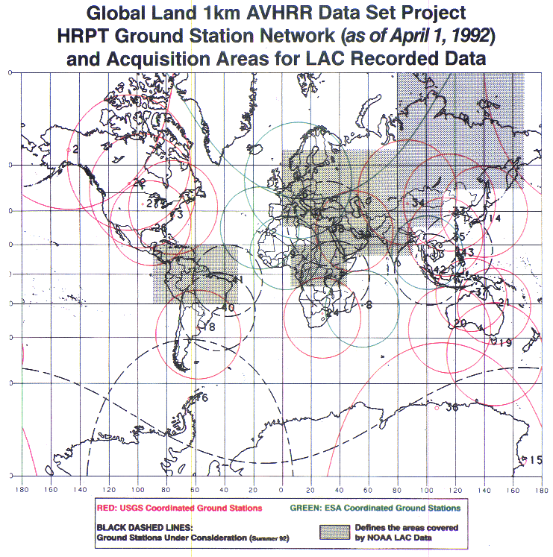
1km AVHRR dataset: a unique asset
The basis for global land applications is the Global Land 1-km AVHRR data set covering the period 1992-99
Spatial resolution makes a difference. Comparison of coarse resolution AVHRR GAC data and 1-km AVHRR LAC data gives new insights on structural changes on land.
In addition, there are many national / regional data archives of LAC data covering a longer period with high value for the retrieval of ECVs. The usage is today sometimes limited due to unknown:
Accessibility
Responsibility
Data format and structure
AVHRR receiving stations contributing to global land 1km AVHRR data set. (https://lta.cr.usgs.gov/1km/hrpt_image)

Slide 4
Cooperation Activities on AVHRR
Objectives
Unfold and make accessible 1km AVHRR data from regional archives (possibly open and free)
Transcribe unique data from heritage media
Identify a common format for AVHRR Level-1b and Level-1c data and pursue (re)processing from AVHRR data owners/holders and data accessibility
Facilitate data discovery through the WGISS Connected Data Assets Infrastructure

Slide 5
AVHRR Regional Archives
WGISS
Committee on Earth Observation Satellites

Slide 6
AVHRR 1 Km digital data archives (excerpt)
GLOBAL
NOAA POES AVHRR GAC global archive: 1978 onwards
EUMETSAT MetOp AVHRR 1km FRAC global archive: late 2006 onwards
LOCAL
Europe: ESA & University of Bern (Switzerland), STFC CEDA (UK, including Dundee Satellite Receiving Station), MeteoFrance (France), DLR (Germany), MET office (UK), IGiK (Poland)
Americas: NOAA and USGS (USA), NRCan/CCMEO (Canada), GiDyC-Servicio Meteorológico Nacional (Argentina), INPE (Brazil)
Africa: SANSA (South Africa), ASI / University of Rome (Kenya)
Asia: CMA (China), IRIM (Mongolia), GITSDA (Thailand)
Australia: CSIRO
Others missing?
FOCUS ON LOCAL ARCHIVES

Slide 7
Europe – ESA & University of Bern
Europe: Long time series (1981–2021 ongoing) of AVHRR data from different platforms (POES, MetOp)
Unique source to retrieve Essential Climate Variables (ECV) to investigate climate change over last 40 yrs
European dataset ncludes data from University of Bern, Dundee Station and ESA holdings: more than 260.000 data products harmonized and consolidated through a dedicated ESA project (Heritage Space Programme).
In addition ESA holds the dataset outside Europe from the 1KM project in the ‘90s
All data accessible free of charge via ESA dissemination services and safely archived at ESA.
Processing to Level-1c ongoing.
Additional activities being defined for 2024-25

Slide 8
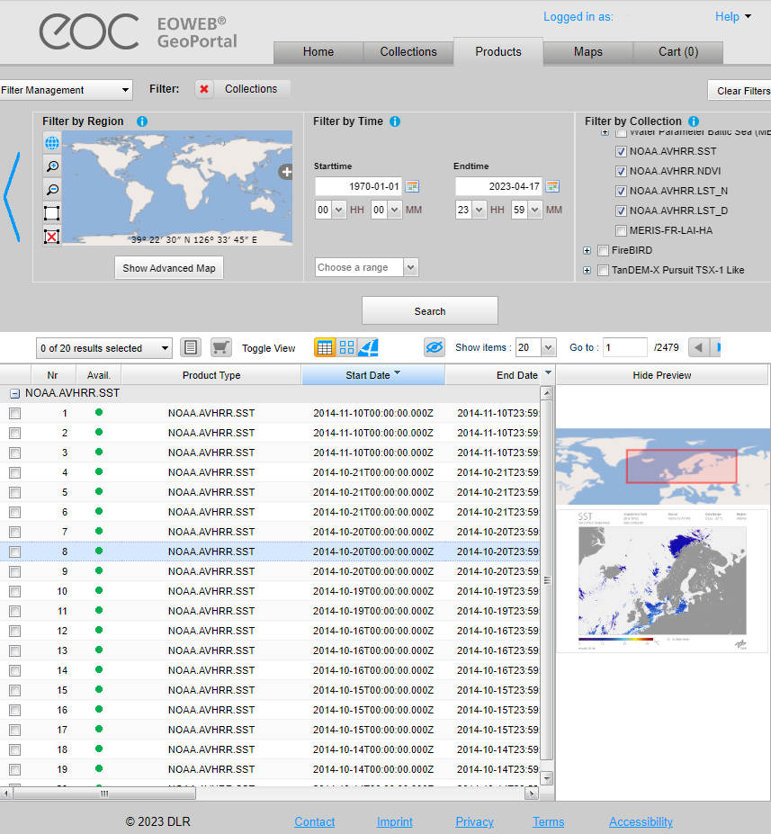
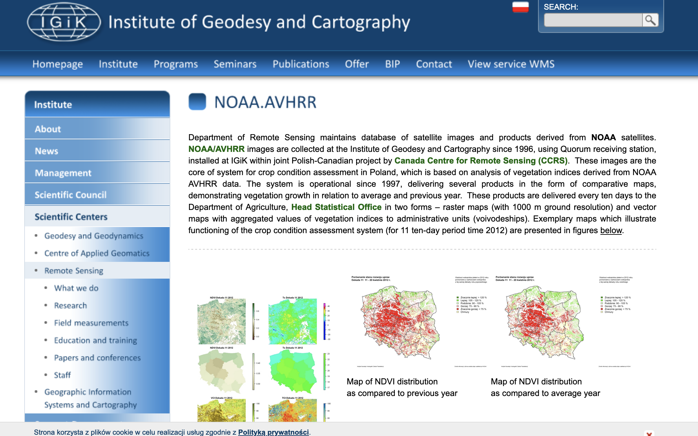
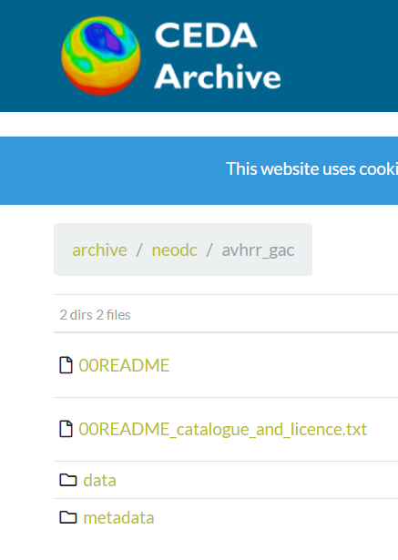
Europe – Others (excerpt)
DLR Catalogue
Will expand or have a dedicated presentation at next WGISS
to better understand data volume and status of accessibility

Slide 9
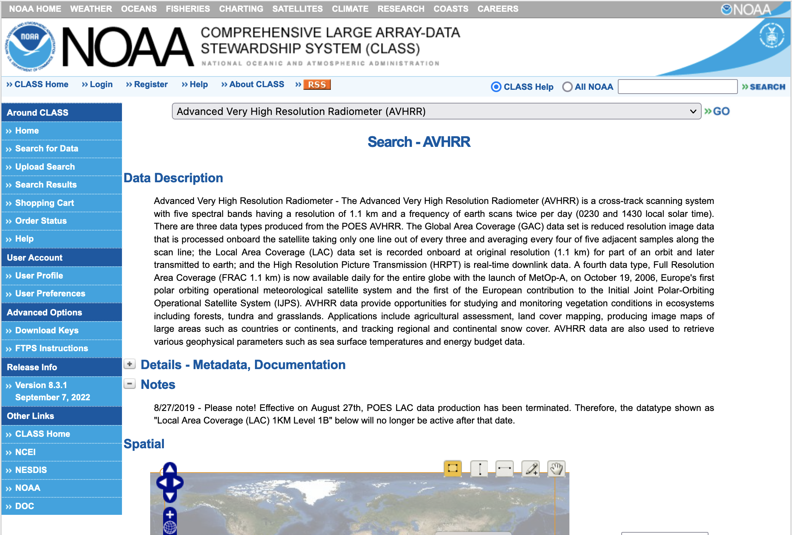
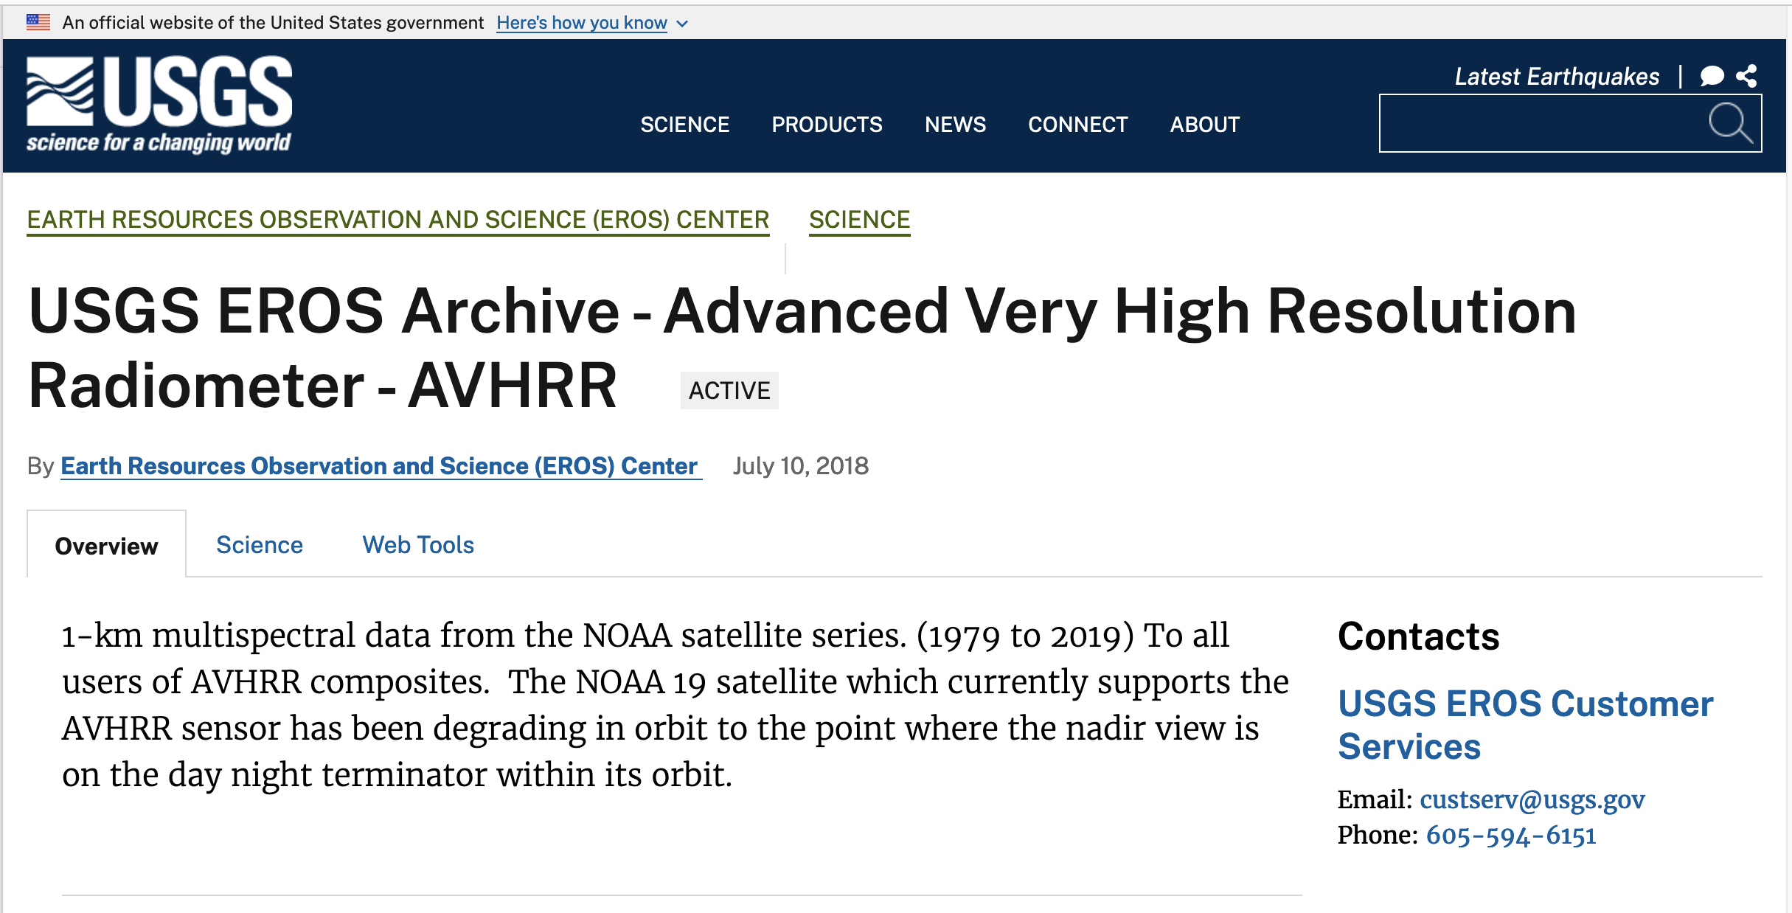
North America – NOAA & USGS
Dedicated presentation during WGISS#55

Slide 10
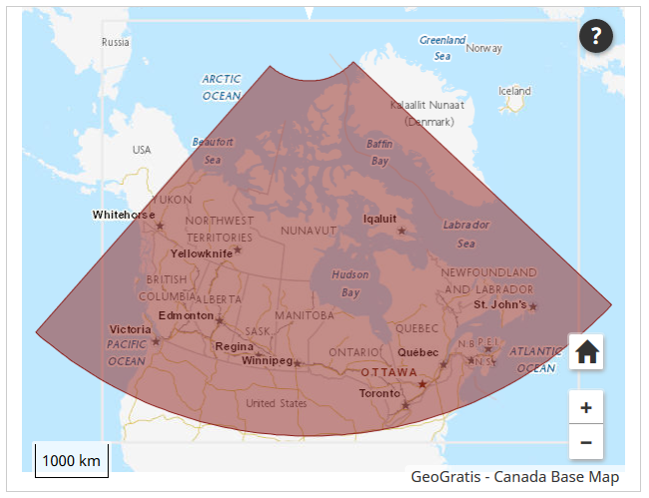
Canada – NRCan/CCMEO
1981 – 2013 (+ AVHRR L1B LAC/HRPT received after that date); level 1c at CCMEO
These are open source data covered by WMO CGMS data distribution policy, they can be shared freely and without charge.
The Canadian sector is of high value to analyze changes of the environment.
The former developed pre-processing and retrieval of ECVs by A. Trishchenko and K.Klopenkov was of high quality and the standard for many other AVHRR processing chains.
Further development and processing was stopped some years ago but raw AVHRR data are available by NRCan.
https://open.canada.ca/data/en/dataset/9045136a-d6e7-a825-491d-ee5dc77a2620
Will expand or have a dedicated presentation at next WGISS
to better understand data volume and status of accessibility

Slide 11
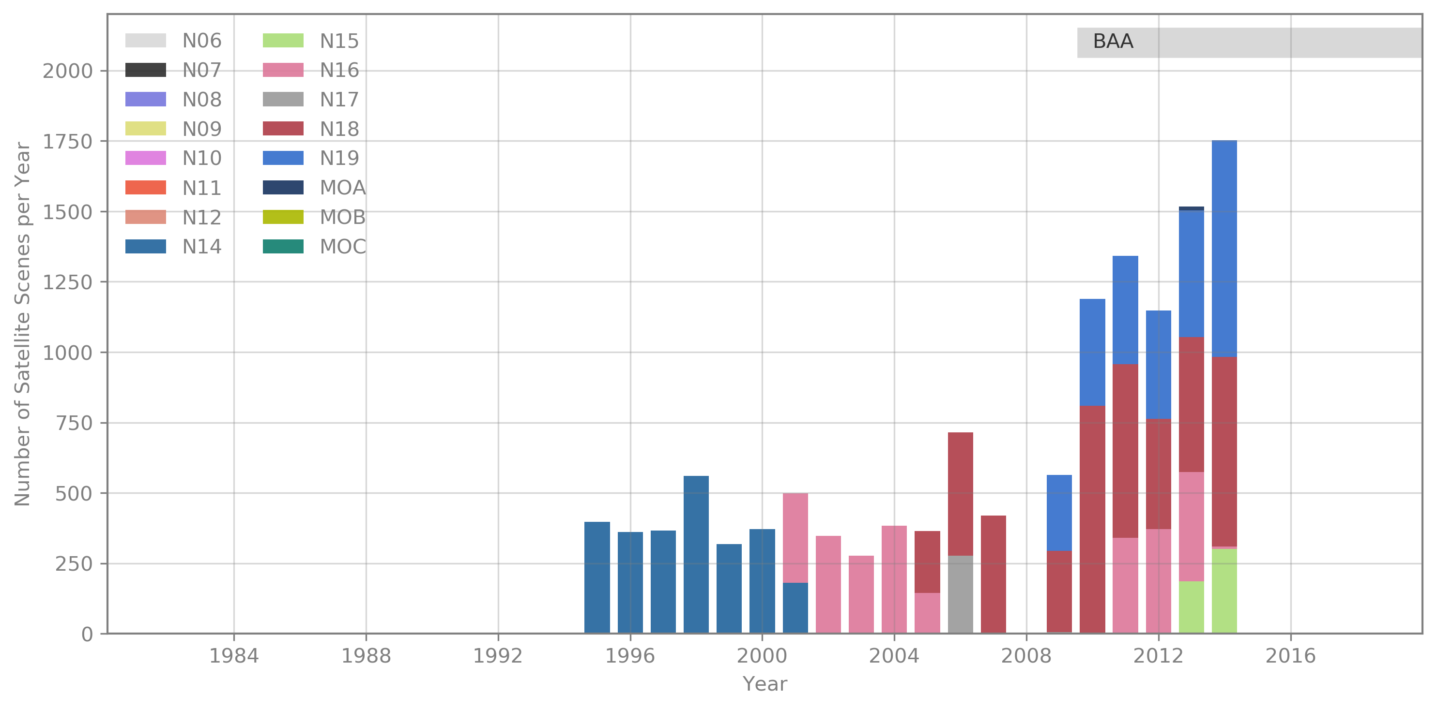
Argentina - GiDyC-Servicio Meteorológico Nacional
Source: Jefa Departamento Teledetección Y Aplicaciones Ambientales, GiDyC-Servicio Meteorológico Nacional, Buenos Aires, Argentina
Number of Scenes: 13.329
Satellites: N12, N14, N15, N16, N17, N18, MOA
Time Period: 1995 - 2014 (1995 - 2000 only evening overpasses)
Extent: roughly Lat=[-30,15] Lon=[-60,-15]
Format: QUO (HRPT)
Exchange of letters finalized between ESA and SMN
Data being now delivered to ESA for further processing, harmonization with the European dataset and dissemination to users

Slide 12
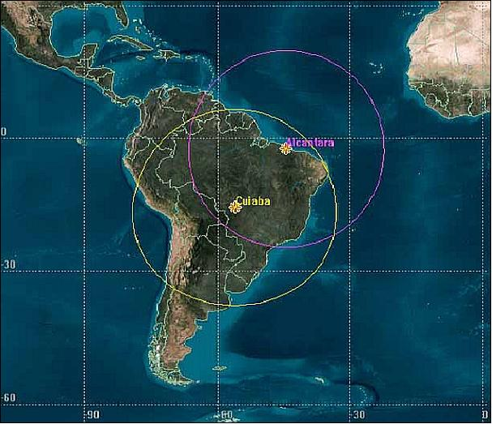
Brazil - INPE
Number of Scenes: 13.329
Satellites: N12, N14, N15, N16, N17,
N18, N19
Time Period: 1998 - 2022
Extent: Brazil
Format: HRPT
NO12 | Aug 1998-Aug 2007 | HRPT | 16335 products
NO14 | Aug 1998-Jun 2007 | HRPT | 10972 products
NO15 | Jul 2001-Aug 2019 | HRPT | 40877 products
NO16 | Jul 2001-Dec 2014 | HRPT | 26067 products
NO17 | Jn 2003 - Mar 2013 | HRPT | 27744 products
NO18 | May 2005 - Dec 2022 | HRPT | 54974 products
NO19 | Jan 2012 - Dec 2022 | HRPT | 41678 products
Coordination ongoing between ESA and INPE

Slide 13
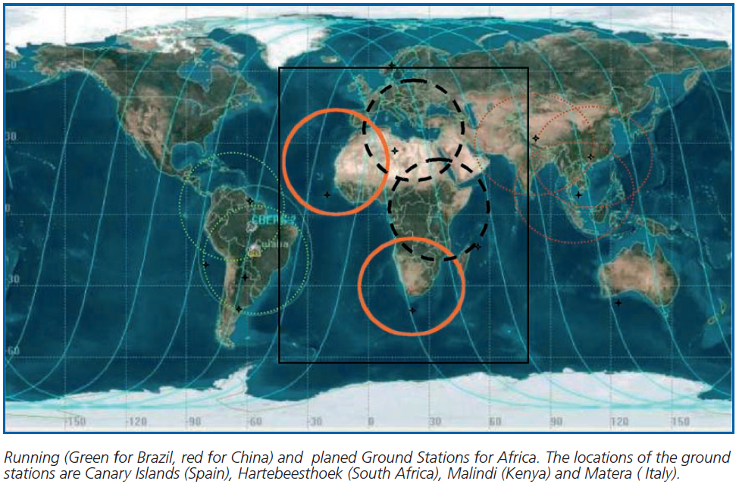
African Coverage
The combination of AVHRR data acquired in Maspalomas (Spain), Matera (Italy), Cairo (Egypt), Niamey (Niger), Hartebeesthoek (South Africa) and Malindi/Nairobi (Kenya) can provide full coverage of Africa;

Slide 14
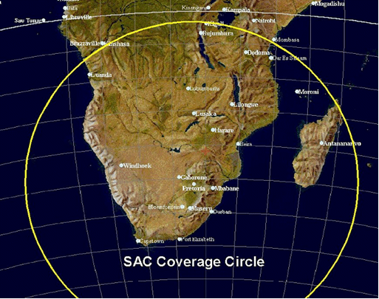
South Africa - SANSA
1km NOAA AVHRR data received at Hartebeesthoek, South Africa (25°53' S 027°42’ E) and maintained by SAC/SANSA – South African National Space Agency
NOAA 9 | 1985-1987
NOAA 11 | 1989-1993
NOAA 14 | 1995-2001
NOAA 16 | 2001-2004
NOAA 17 | 2005-2006
NOAA 18 | 2005-2006
Exchange of letters finalized between ESA and SANSA
Data being now delivered to ESA for further processing, harmonization with the European dataset and dissemination to users

Slide 15
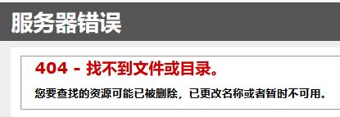
China - CMA
AVHRR-receiving stations for the global 1km land product (coordinated by USGS):
Beijing
Urumqi
Guanzhou
Agency for data access: National Satellite Meteorological Centre (NSMC)
Official contact: dataserver@cma.gov.cn
Searching for “AVHRR” on CMA web site results in
AVHRR 1-km data covering Himalaya-Hindukush of the period 1981 – 1992 would be of exceptional value for scientists to study the influence of climate change in this vulnerable region.
Will expand or have a dedicated presentation at next WGISS
to better understand data volume and status of accessibility

Slide 16
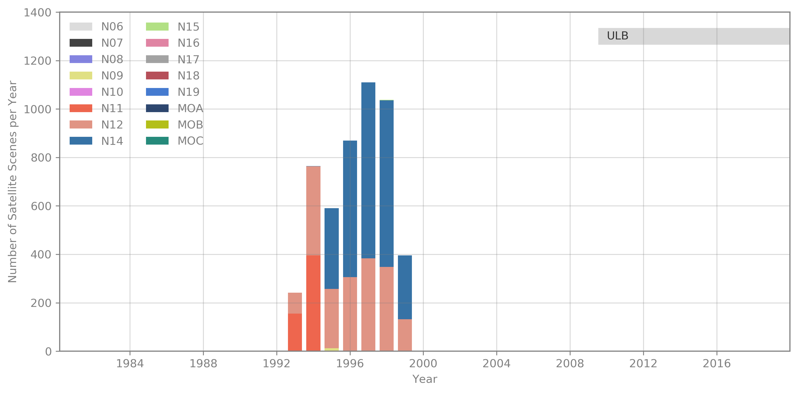
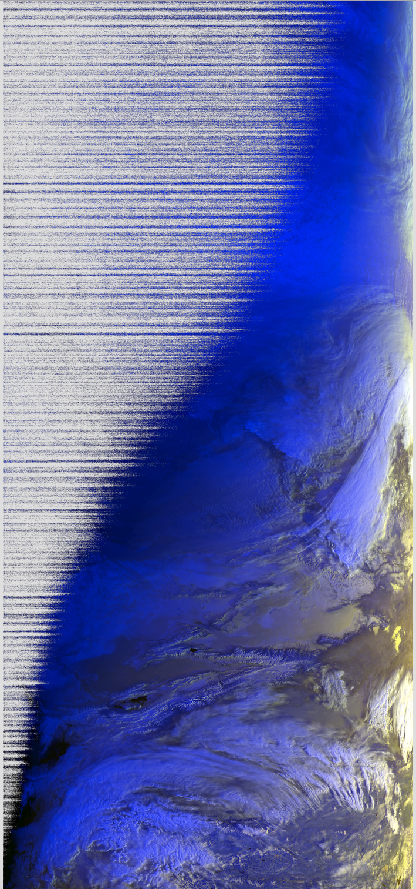
Mongolia - Remote Sensing Department, Information and Research Institute of Meteorology, Hydrology and Environment
AVHRR UBM data
Source: Remote Sensing Department, Information and Research Institute of Meteorology, Hydrology and Environment, Ulaanbatar, Mongolia
Number of Scenes: 5.016
Satellites: N09, N11, N12, N14, N15
Time Period: 1993 – 1999
Extent: roughly Lat=[20,70] Lon=[80,120]
Format: hmf (origin: dat, grid, lut)
Further info:- UBMx station data were included in the Global Land 1km AVHRR Data Project
Will expand or have a dedicated presentation at next WGISS
to better understand data volume and status of accessibility

Slide 17
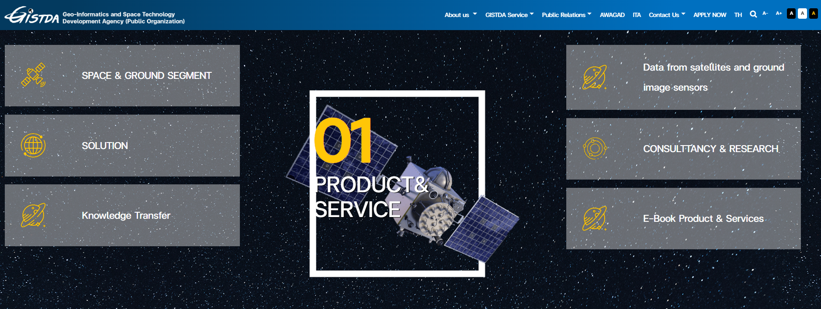
Thailand - GITSDA
Will expand or have a dedicated presentation at next WGISS
to better understand data volume and status of accessibility

Slide 18
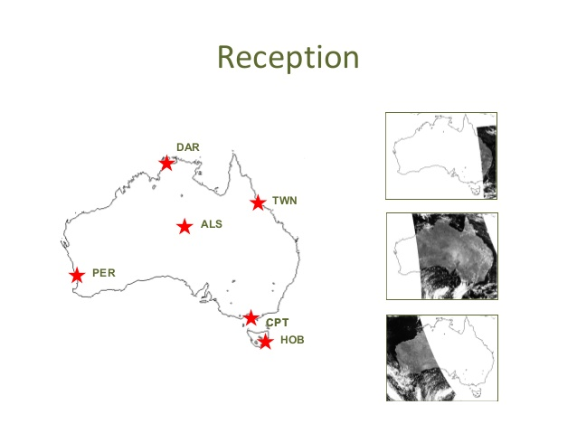
Australia - CSIRO
AVHRR reception based on 6 stations for continuous 1-km data set.
Multiple state and federal agencies have been acquiring the data in this manner with reception stations in Hobart, Melbourne, Perth, Alice Springs, Darwin and Townsville.
Since the early 1990s CSIRO has been merging these separate local data sets to produce a stitched archive which makes use of the redundancy arising from overlap between reception stations to produce a higher quality and consistently formatted data set with national coverage.
The assembly of this data set continues within CSIRO today, though it is likely to come to an end sometime this decade as the last of the AVHRR sensors has now been launched.
Data availability: 1981 (NOAA-7) onwards.
Ian Grant, Bureau of Meteorology, Australia
https://link.fsdf.org.au/dataset/advanced-very-high-resolution-radiometer-avhrr
Will expand or have a dedicated presentation at next WGISS
to better understand data volume and status of accessibility

Slide 19
AVHRR Media Transcription
WGISS
Committee on Earth Observation Satellites

Slide 20
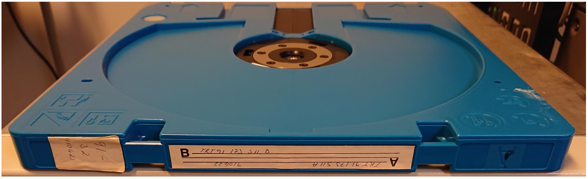
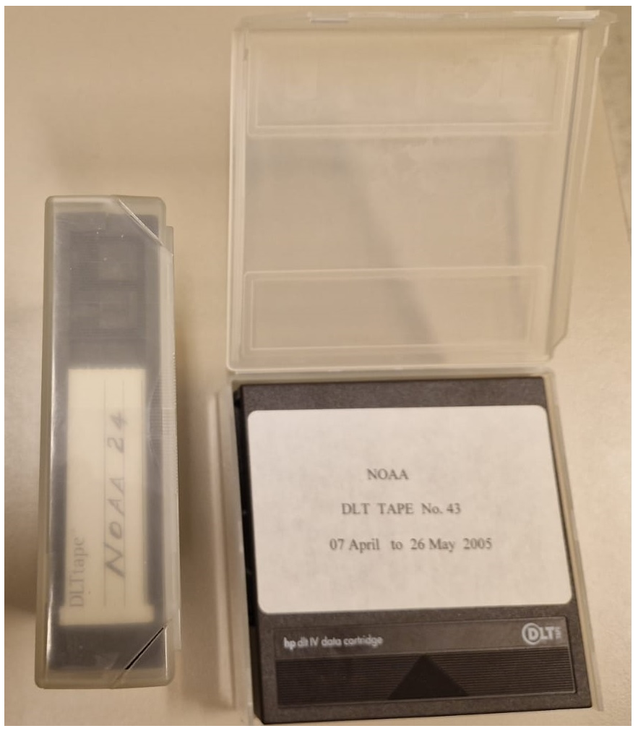
AVHRR 1 Km media
Several hundred heritage media (optical disks, DLTs) with potential unique AVHRR data are available in different places like for example:
  ESA (Optical Disks)
  University of Reading (Optical Disks)
  University of Rome (DLTs)
  Others to be added
LM 1200 optical Disk 2.4GB
DLT cassettes

Slide 21
Optical Disks
ESA pilot activity completed with successful transcription of 2 different type of optical disks originally held at ESA and University of Reading.
Negotiations ongoing with a commercial company for the transcription of the full batch of available optical disks (around 300).

Slide 22
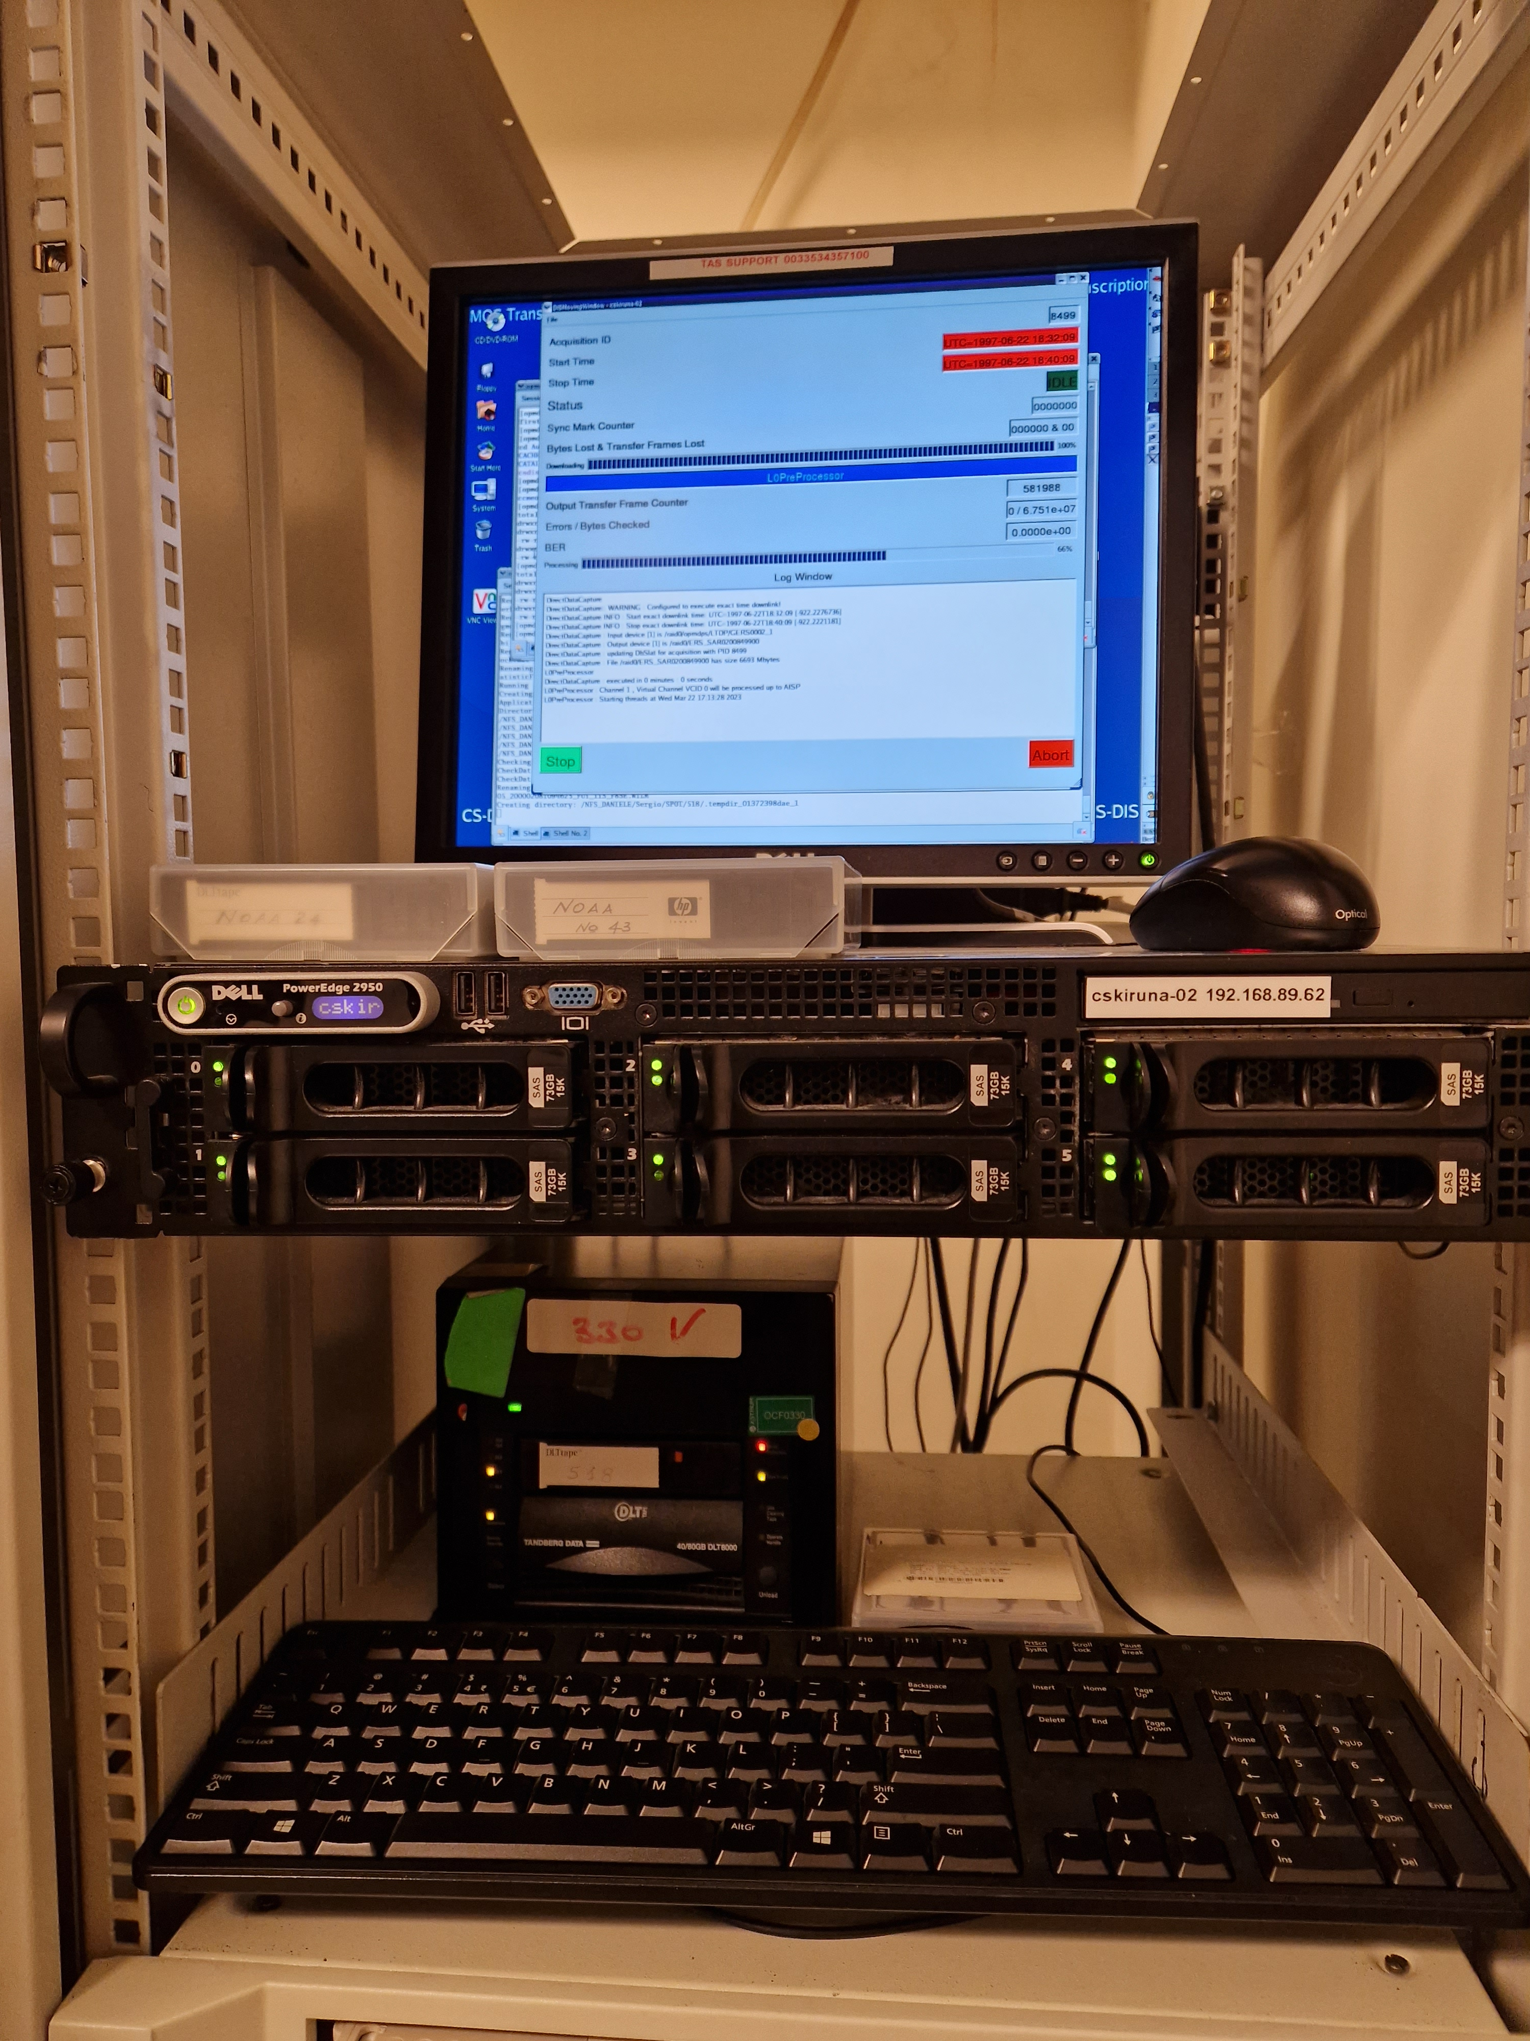
DLT Tapes
DLT transcription chain set-up at ESA/ESRIN to transcribe tapes containing unique AVHRR / SPOT and ERS data.
2 tapes received from ASI / University of Rome successfully transcribed and 280 AVHRR products acquired in Malindi (Kenya) now safely archived on disks at ESA
Additional 47 DLT tapes containing AVHRR data acquired in Malindi in 2000-2009 will be transcribed in the upcoming months

Slide 23
AVHRR Data Processing and Access
WGISS
Committee on Earth Observation Satellites

Slide 24
Cooperation Activities on AVHRR
Future activities
Provide AVHRR points of contact and stakeholders with the AVHRR Dataset Consolidation Procedure and Processing Format used in the European consolidation project run at ESA. Collect feedback and discuss possibility to have a common/harmonised format.
  To be started in 2024
Check status of Discoverability of AVHRR datasets worldwide and pursue common entry point through WGISS CDA infrastructure
  To be started in 2024
  AVHRR Session follow-on will be held at WGISS#56

