Slide 1
AVHRR Data Availability
NOAA NCEI
Sarah Menassian, Axel Graumann, and Philip Jones
National Centers for Environmental Information
Presented by: Kenneth S. Casey
20Apr2023

Slide 2
Introduction and Summary
NOAA archives AVHRR LAC, HRPT, and GAC data at NCEI using the CLASS system. AVHRR data of various forms are archived by many other organizations as well.
This presentation focuses on the AVHRR LAC and HRPT data in the NCEI/CLASS archive.
NASA has provided has provided some information as well, and it will be shown here as well
NCEI did an inventory analysis based on filenames. Further analysis on actual geographic extent would take more effort.

Slide 3

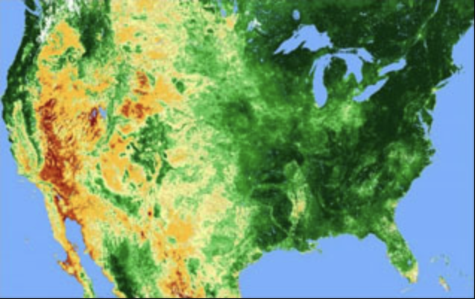
NASA AVHRR Data
NASA’s full collection of AVHRR data in CMR
Climate Data Record
Long-term Data Record
The Long-Term Data Record (LTDR) project was originally funded through a NASA REASoN program in 2002, and later via a MEaSUREs project in 2010. Currently, LTDR is being funded by a new MEaSUREs 2017 project besides the Climate Data Record Program from the NOAA National Climatic Data Center. With Eric Vermote as its Principal Investigator, this project continues to produce and distribute a global land surface climate data record (CDR) that is critically important to studying global climate change. The LTDR project is unique in that it serves as a bridge that connects data derived from the NOAA Advanced Very High Resolution Radiometer (AVHRR ), the EOS Moderate resolution Imaging Spectroradiometer (MODIS ), the Suomi National Polar-orbiting Partnership (SNPP ) Visible Infrared Imaging Radiometer Suite (VIIRS), and Joint Polar Satellite System (JPSS ) VIIRS missions. Starting from the 1980s decade, such a wide temporal extent helps offer data products that span four decades.
Field Campaigns
CLPX-Satellite: AVHRR/HRPT Brightness Temperatures and Reflectances, Version 1 (NSIDC-0152)
The data set includes AVHRR/HRPT (Advanced Very High Resolution Radiometer/High Resolution Picture Transmission) brightness temperatures and reflectances over the NASA Cold Land Processes Field Experiment (CLPX) Large Regional Study Area (LRSA).
ESDIS Project

Slide 4
NOAA AVHRR Data Availability Review
NOAA assessed its 1 km AVHRR data available in its Comprehensive Large Array-data Stewardship System (CLASS)
We conducted an initial assessment of both HRPT and LAC data
This analysis is focused on historical data, beginning with 1978 and ending with 2010

Slide 5
AVHRR Data Availability in NOAA CLASS
HRPT + LAC Basic Statistics
Metric | HRPT | LAC | Total
File Count | 395,852 | 298,409 | 694,261
Earliest Dataset* | 1979-02-08 | 1979-04-05
Latest Dataset in Analysis* | 2010-12-31 | 2010-12-31
Statistics are based on the number of files found in CLASS
Note that NOAA identified ~38,000 files that may have all or part of the same scan view of the earth as another file in CLASS
  We anticipate these would require additional analysis to determine which to use (e.g., which recording of two with overlapping time spans has the most scan lines)
  We have included these potential duplicate datasets in file counts throughout this analysis
* Based on recording start time
Notes:
We defined duplicates as recordings with overlapping time spans from the same receiving station, satellite, and processing block

Slide 6
HRPT Data in NOAA CLASS
Spatial Coverage

Slide 7
HRPT Files in NOAA CLASS by Receiving Station
Receiving Station Code | Receiving Station Location | Receiving Station Country | HRPT File Count | Earliest Dataset | Latest Dataset (in analysis)
CF | Cape Ferguson | Australia | 20,215 | 2006-07-11 | 2010-12-28
EB | Ewa Beach, Hawaii | USA | 19,285 | 2006-07-11 | 2010-12-31
GC | Fairbanks, Alaska | USA | 150,625 | 1982-01-09 | 2010-12-31
HO | Honolulu, Hawaii | USA | 15 | 1999-08-12 | 2000-06-29
MI | Miami, Florida | USA | 22,891 | 2006-07-11 | 2010-12-31
MO | Monterey, California | USA | 29,437 | 1998-01-01 | 2010-12-31
SF | Sioux Falls, South Dakota | USA | 50,526 | 1992-12-06 | 2009-10-27
WE | Lannion | France | 19 | 1985-04-27 | 1993-06-23
WI | Wallops Island, Virginia | USA | 102,839 | 1979-02-08 | 2010-12-31

Slide 8
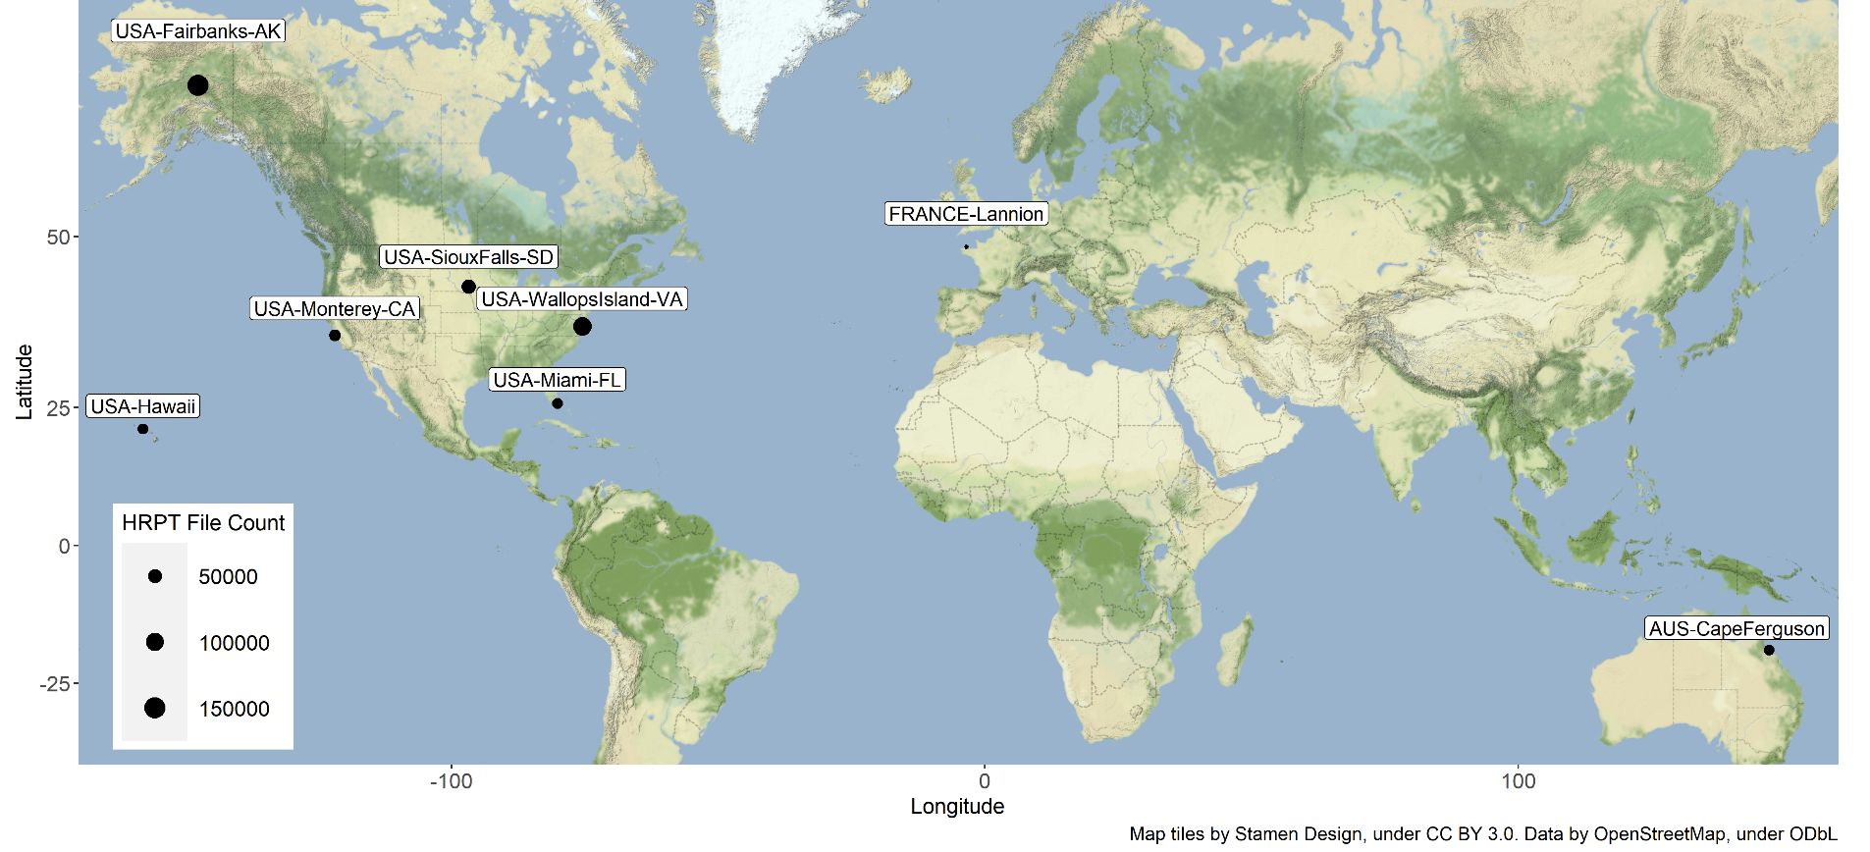
HRPT Files in NOAA CLASS, 1979 – 2010
*On this map, “USA-Hawaii” combines file counts from Ewa Beach and Honolulu stations

Slide 9
HRPT Data in NOAA CLASS
Temporal Coverage

Slide 10
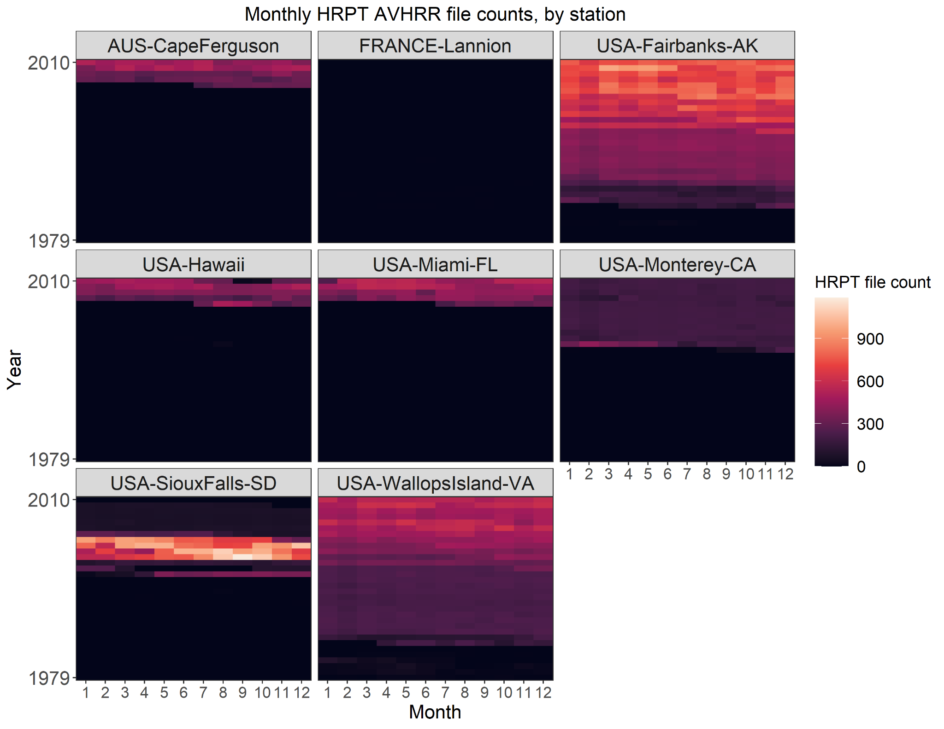
HRPT Data in
NOAA CLASS
All Stations
Monthly File Counts
*Note that this visualization combines data from Honolulu (1999-2000) and Ewa Beach (2006-2010) stations on Oahu into “USA-Hawaii”

Slide 11
HRPT Data in NOAA CLASS
Temporal Coverage
Fairbanks, Alaska, USA
Visualizations for additional stations included in the appendix to this presentation

Slide 12
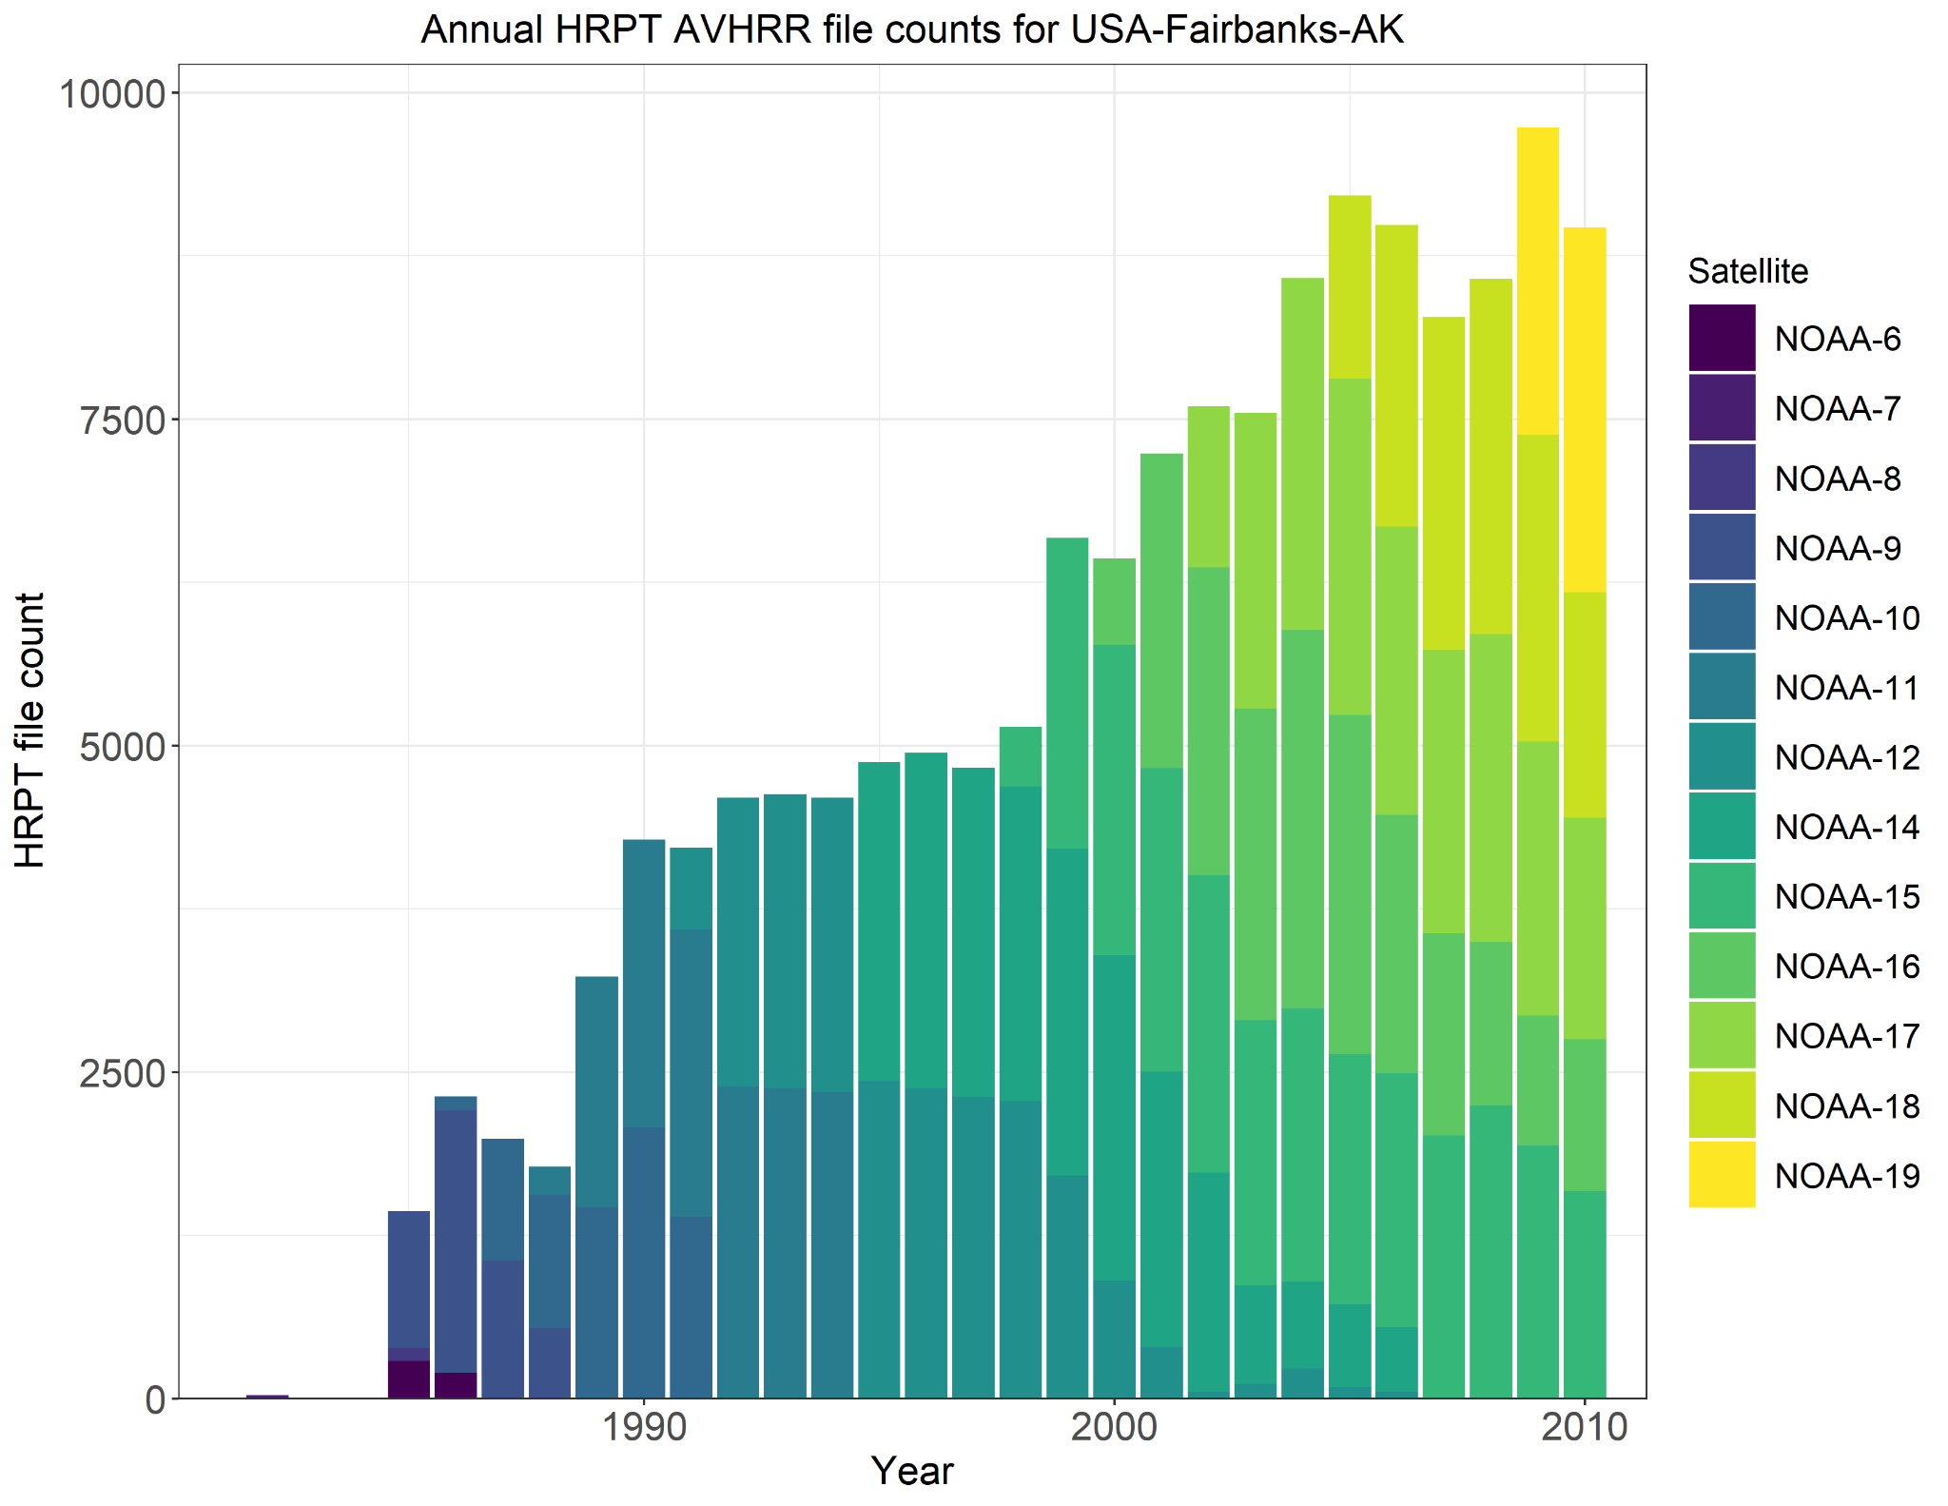
HRPT Data at Fairbanks, AK
Annual File Counts

Slide 13
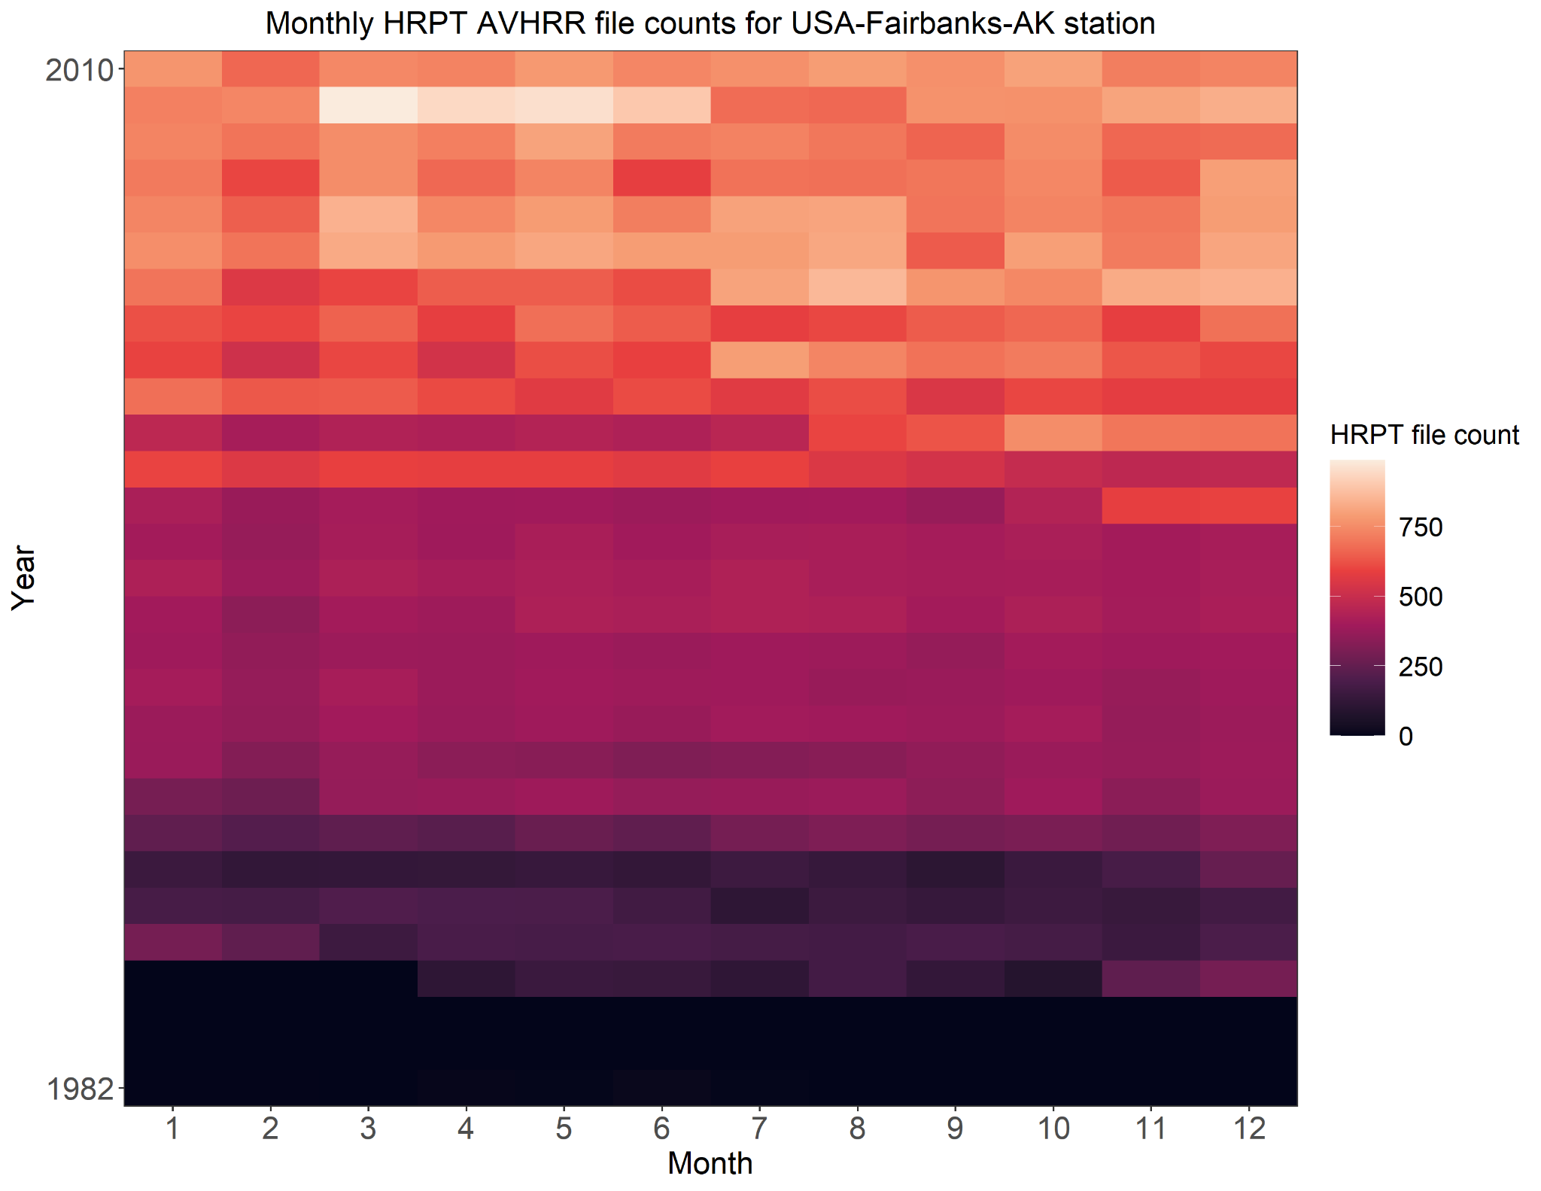
HRPT Data at Fairbanks, AK
Monthly File Counts

Slide 14
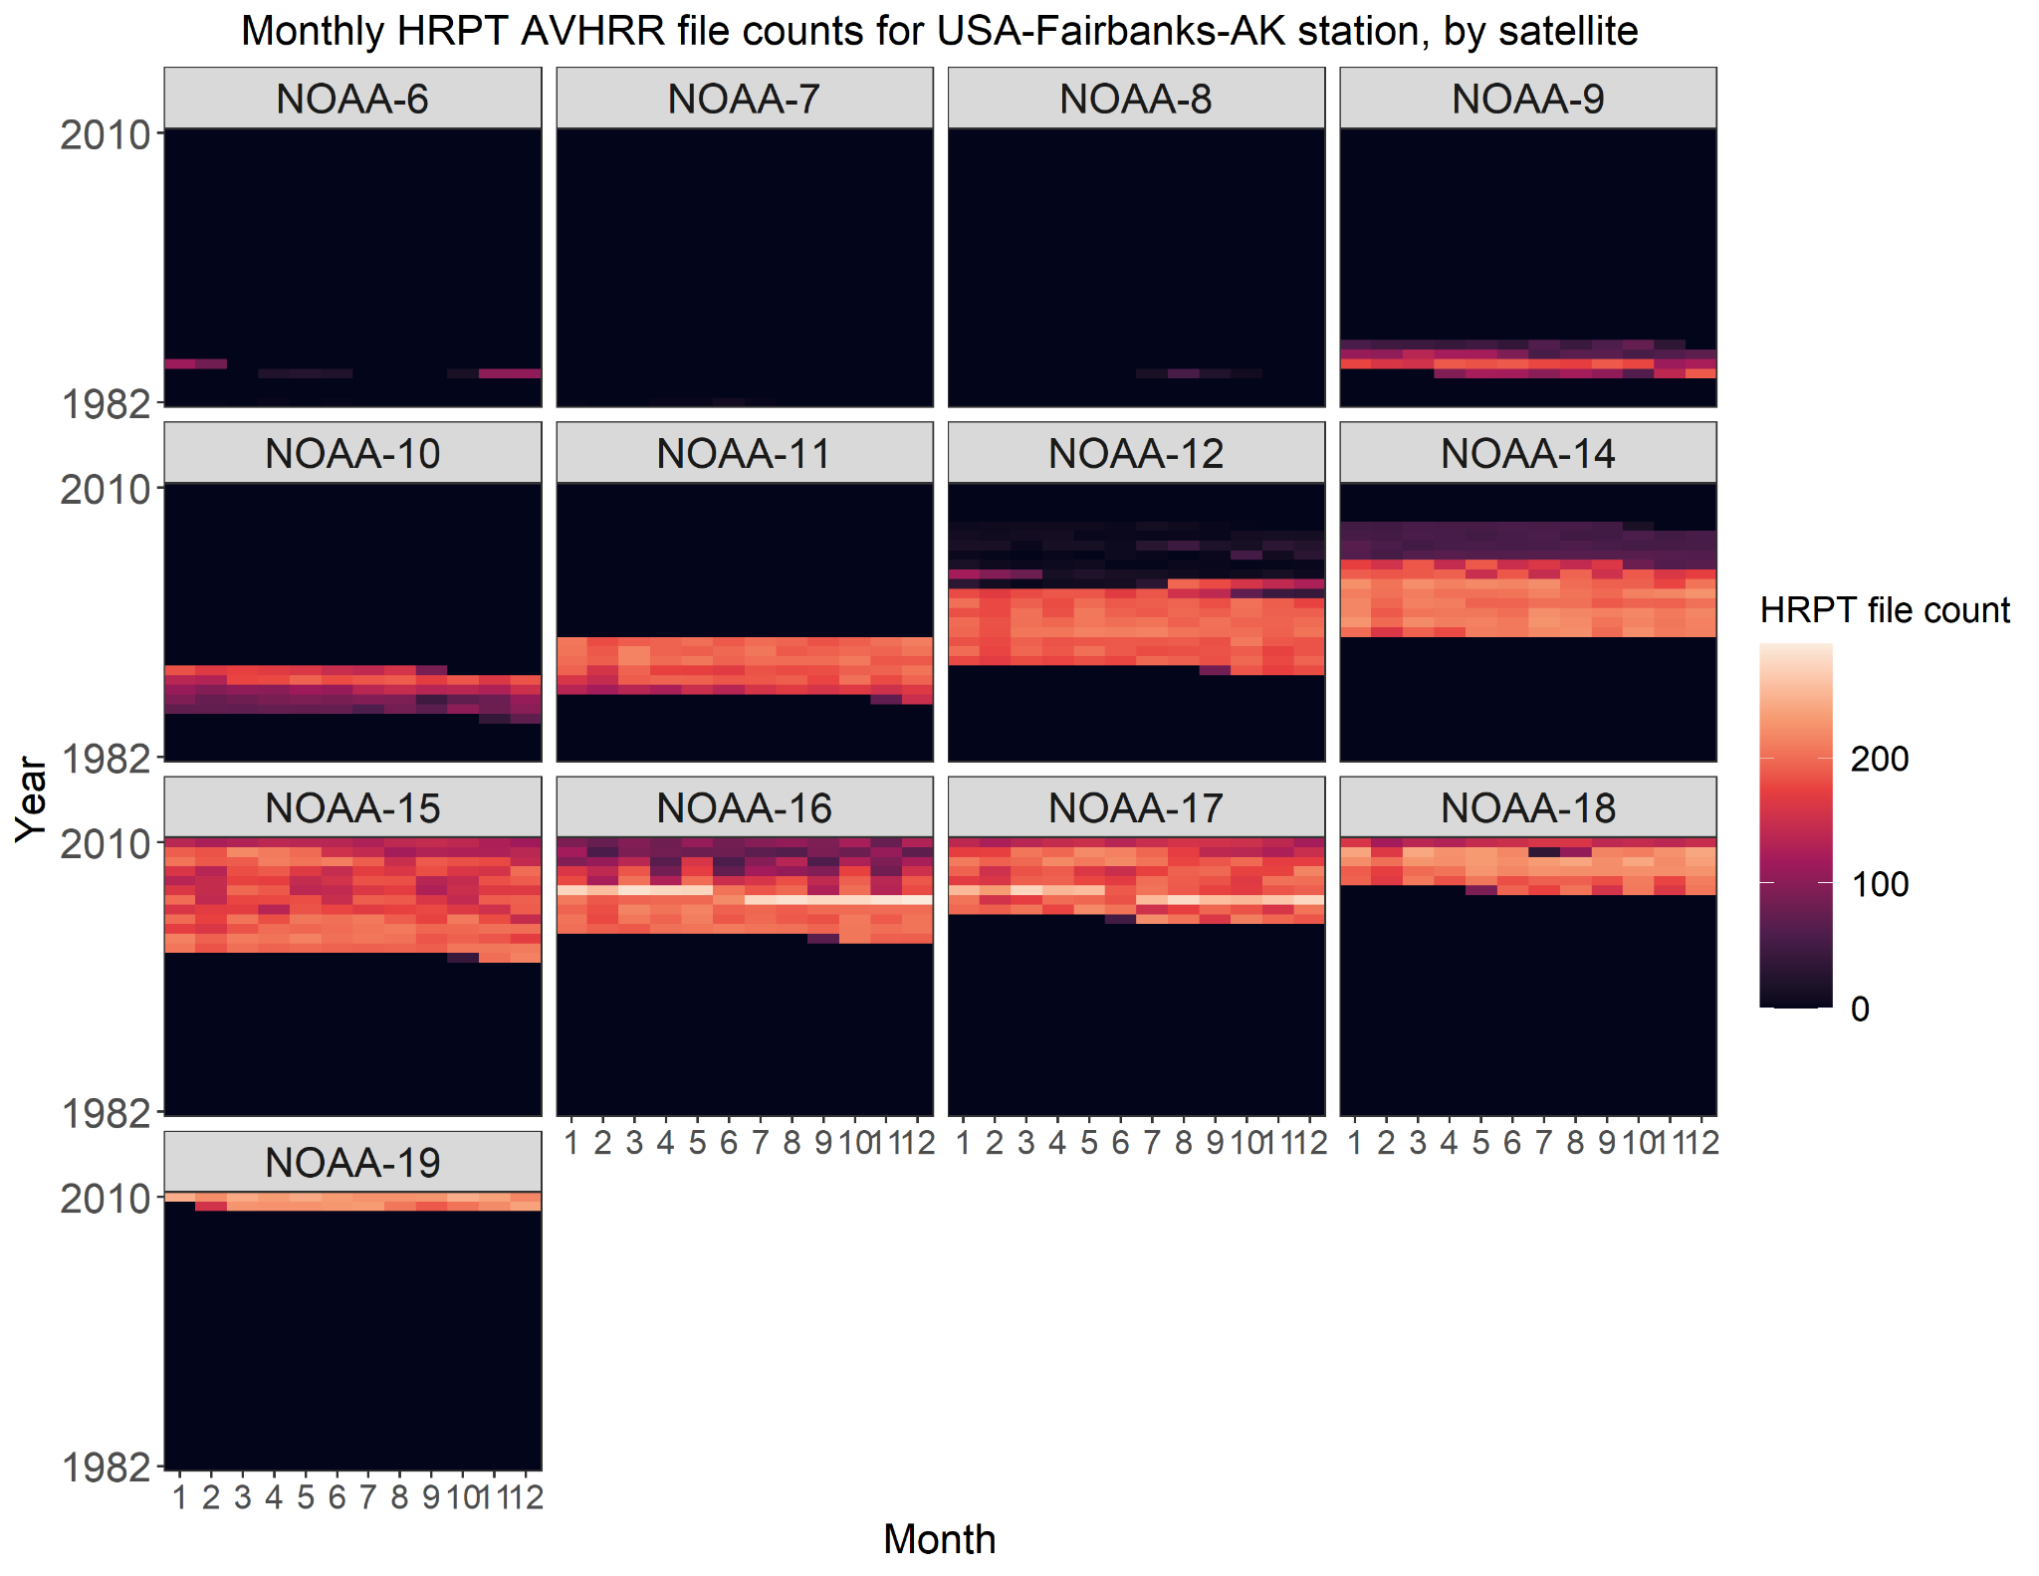
HRPT Data at Fairbanks, AK
Monthly File Counts,
by Satellite

Slide 15
LAC Data in NOAA CLASS
Temporal Coverage

Slide 16
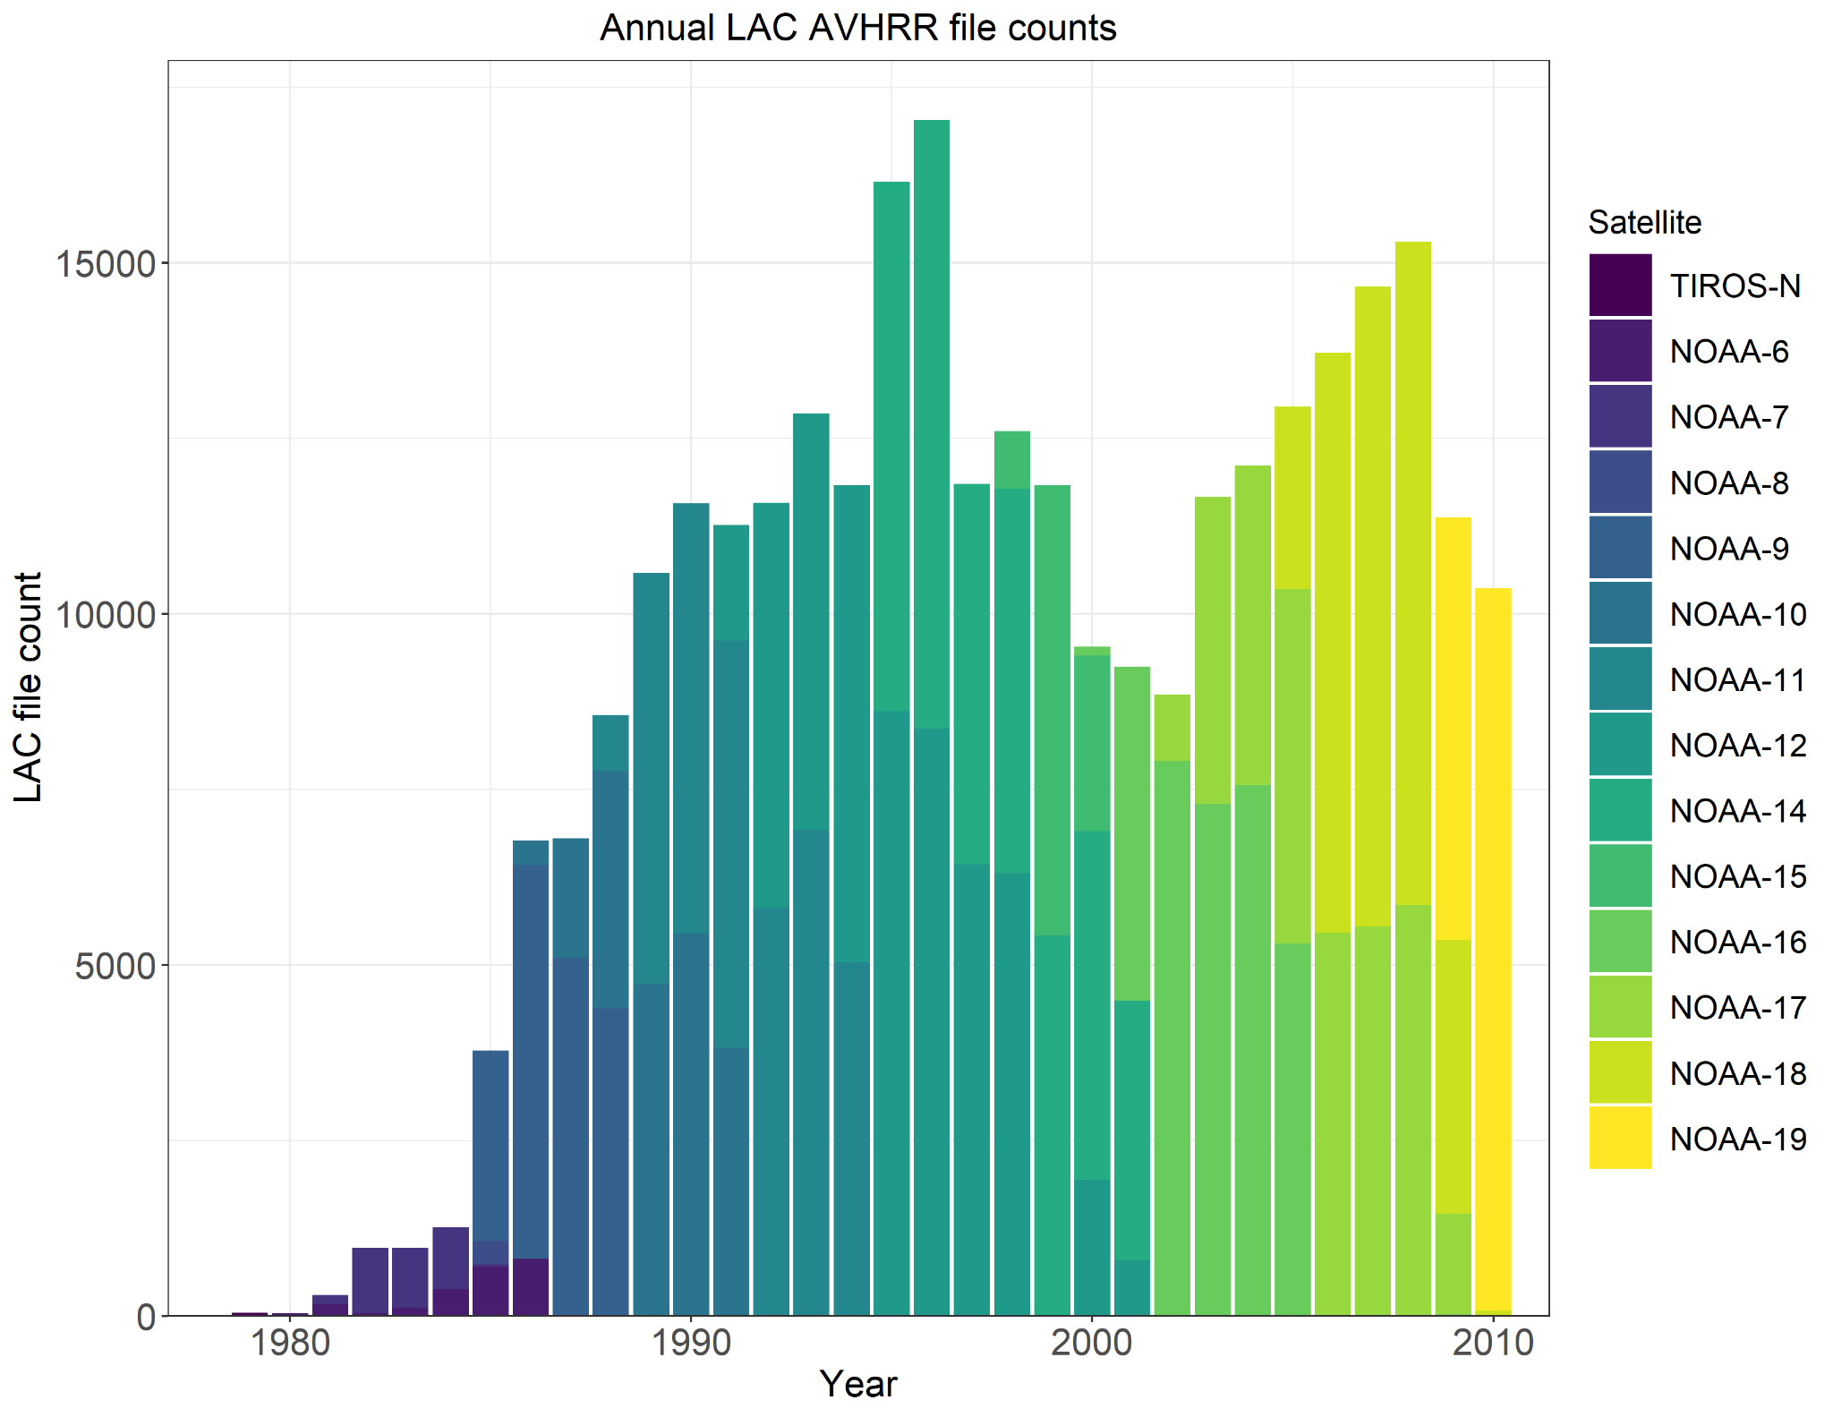
LAC Data in
NOAA CLASS
Annual File Counts

Slide 17
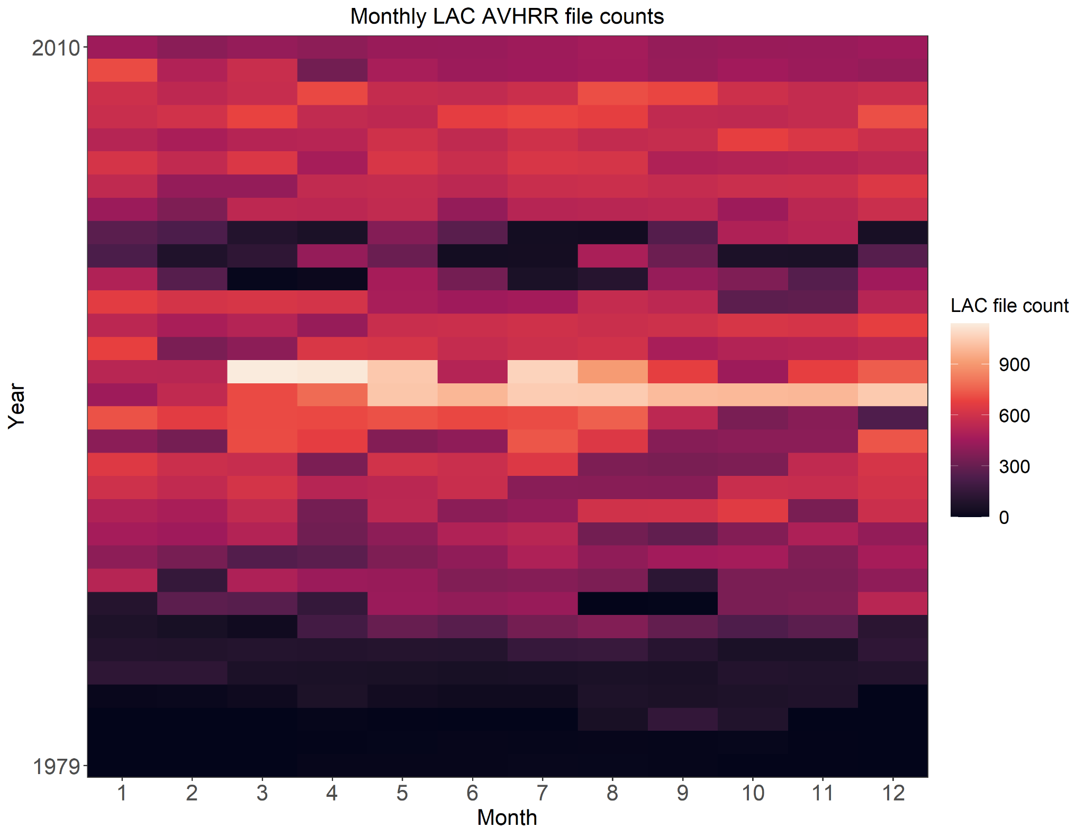
LAC Data in
NOAA CLASS
Monthly File Counts

Slide 18
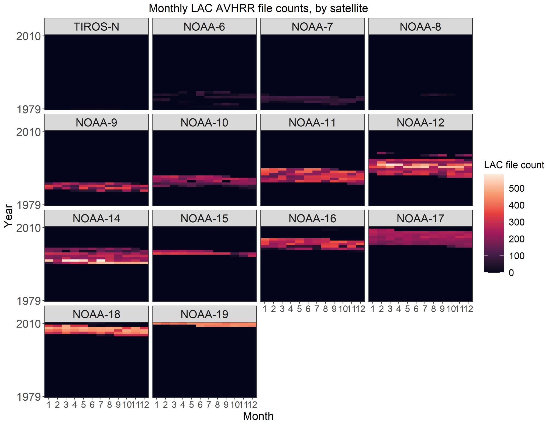
LAC Data
in NOAA CLASS
Monthly File Counts, by Satellite

Slide 19
Appendix

Slide 20
Additional Details on Duplicate Datasets
Likely duplicate datasets (that is, those with intersecting recording periods and the same data type, receiving station, satellite, and processing block) were identified and for each likely duplicate set, the dataset(s) with the shorter recording period was identified as the potential duplicate. These statistics are on those potential duplicates.
By Datatype
HRPT, by Receiving Station
Data Type | Potential Duplicates
HRPT | 13,137
LAC | 24,685
Station | Potential Duplicates
CF | 1
EB | 6
GC | 573
MO | 15
SF | 11,924
WI | 618

Slide 21
HRPT Visualizations for Other Stations
Hawaii, USA
Miami, Florida, USA
Monterey, California, USA
Sioux Falls, South Dakota, USA
Wallops Island, Virginia, USA
Cape Ferguson, Australia
Lannion, France

Slide 22
HRPT Data in NOAA CLASS
Hawaii, USA

Slide 23
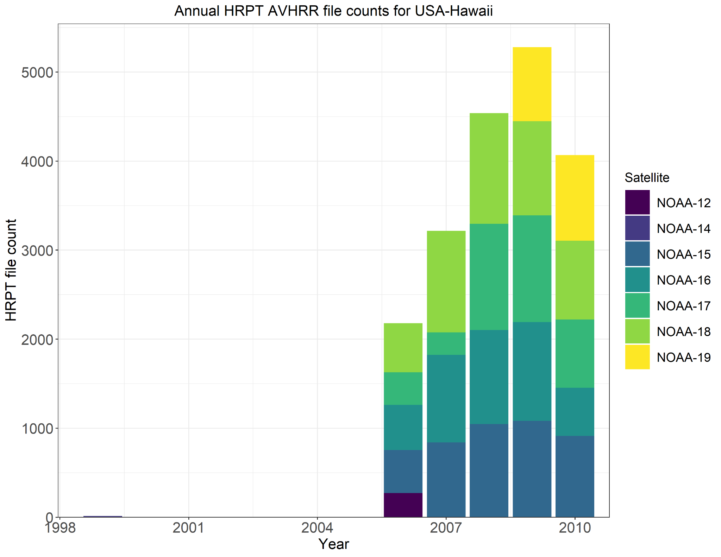
HRPT Data at
Hawaii, USA
Annual File Counts
*Note that this visualization combines data from Honolulu (1999-2000) and Ewa Beach (2006-2010) stations on Oahu

Slide 24
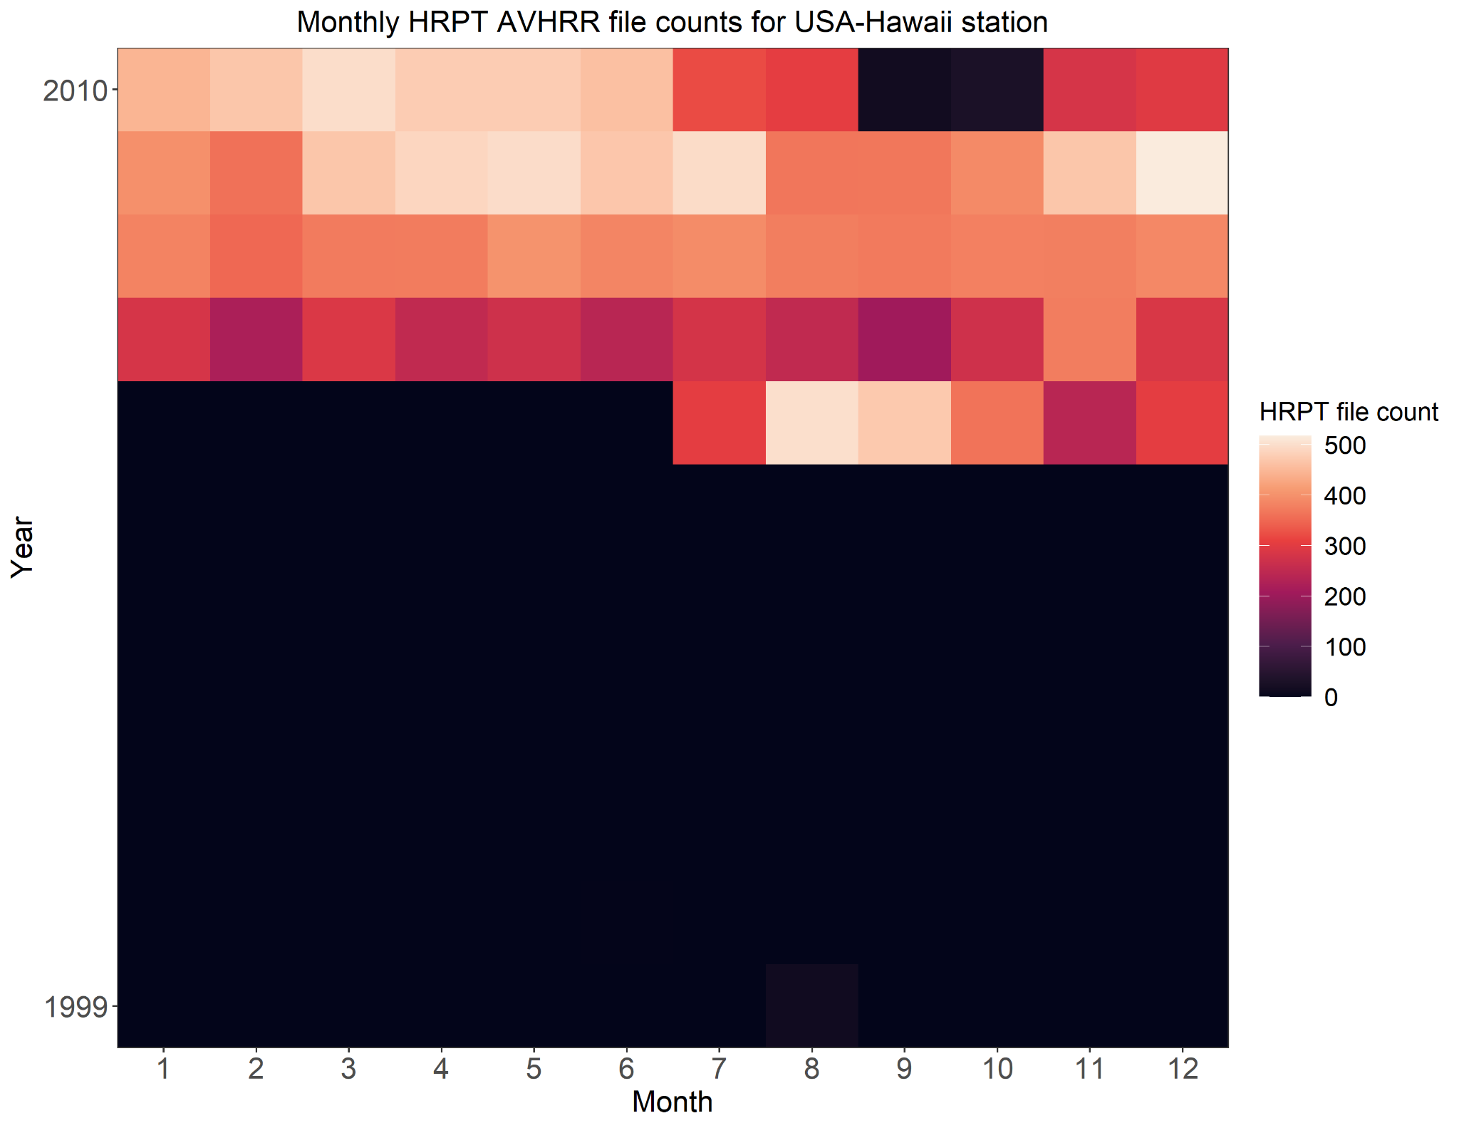
HRPT Data at
Hawaii, USA
Monthly File Counts
*Note that this visualization combines data from Honolulu (1999-2000) and Ewa Beach (2006-2010) stations on Oahu

Slide 25
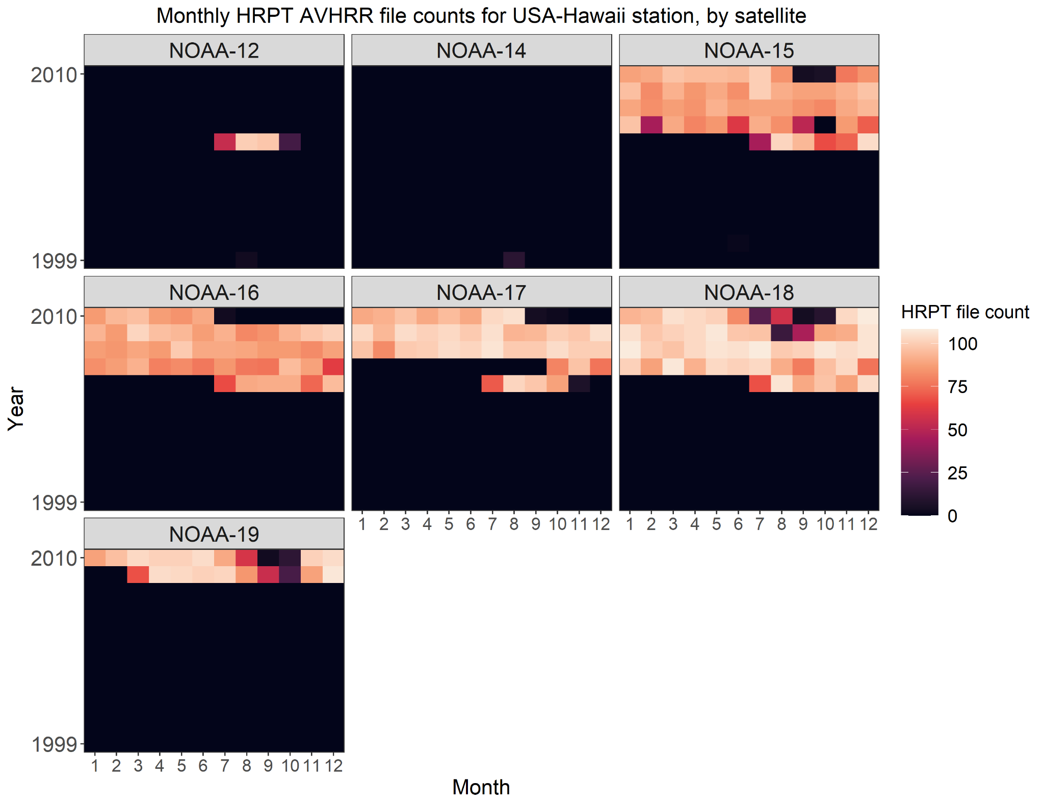
HRPT Data at
Hawaii, USA
Monthly File Counts,
by Satellite
*Note that this visualization combines data from Honolulu (1999-2000) and Ewa Beach (2006-2010) stations on Oahu

Slide 26
HRPT Data in NOAA CLASS
Miami, Florida, USA

Slide 27
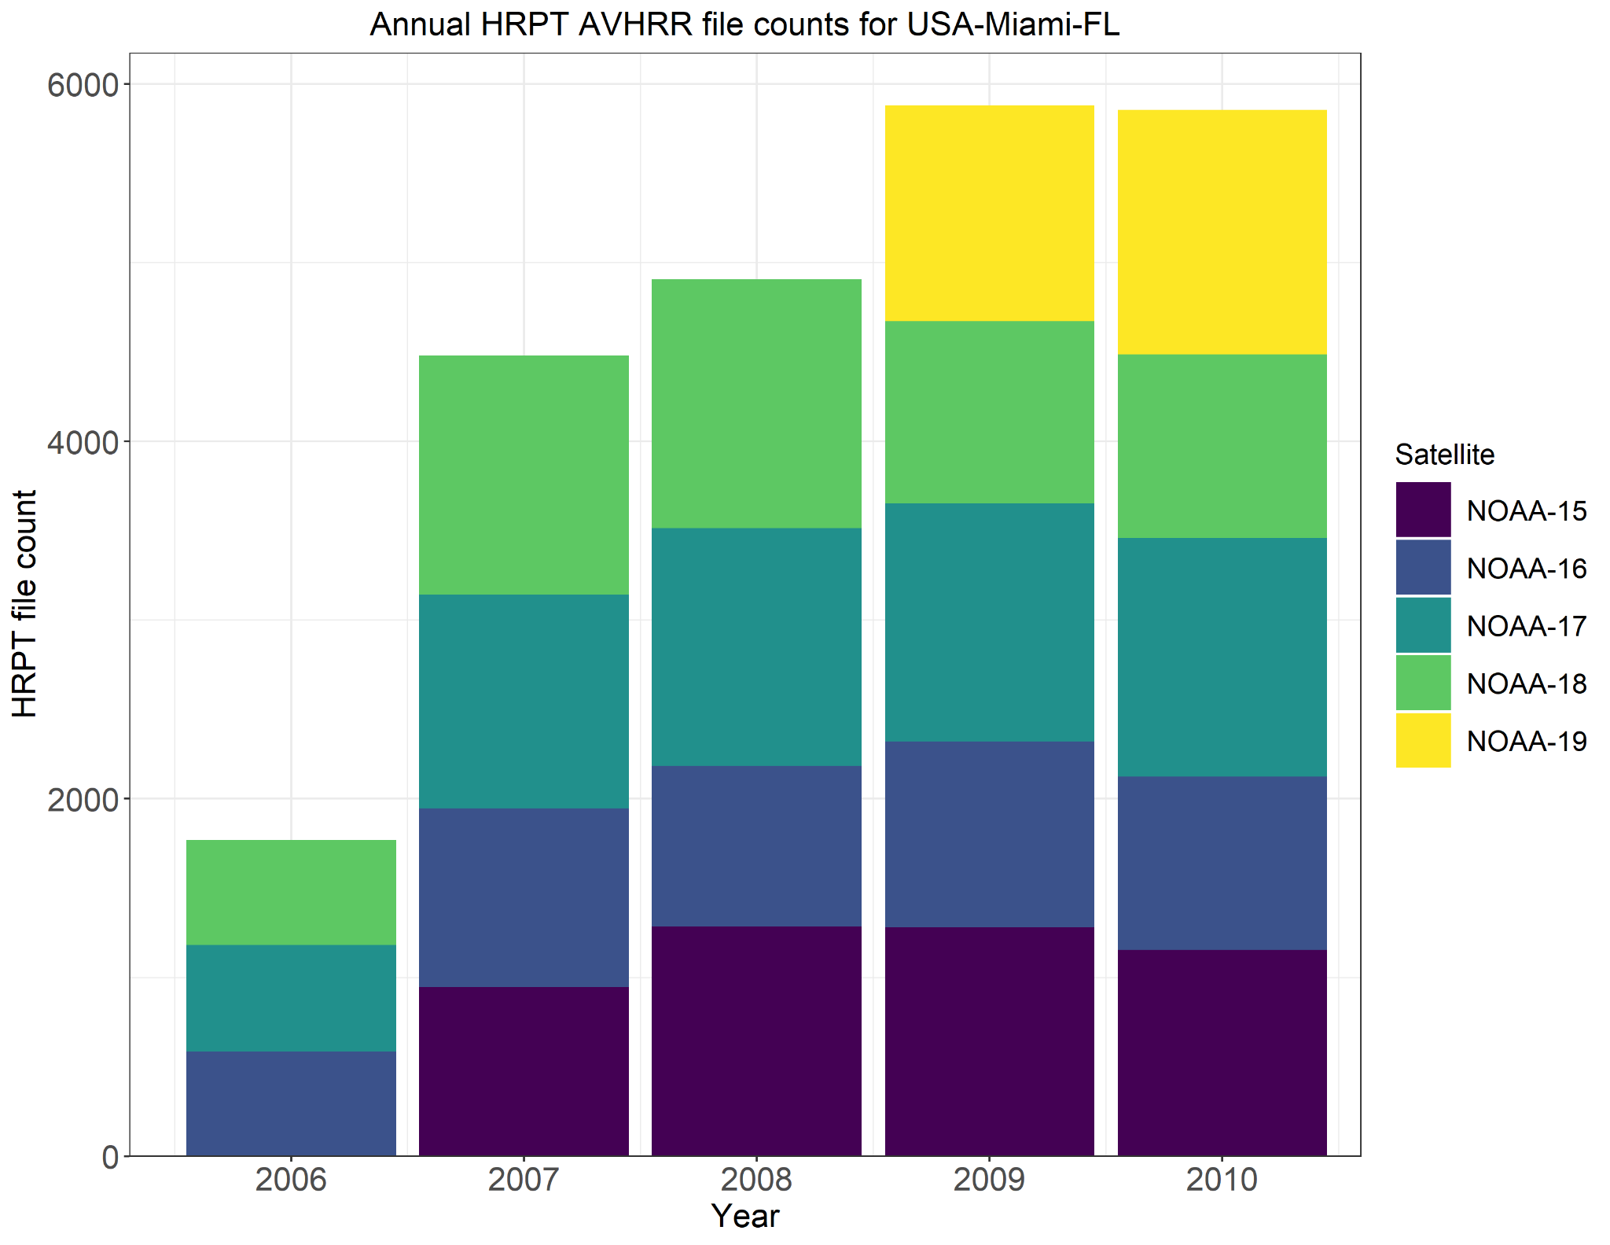
HRPT Data at
Miami, FL
Annual File Counts

Slide 28
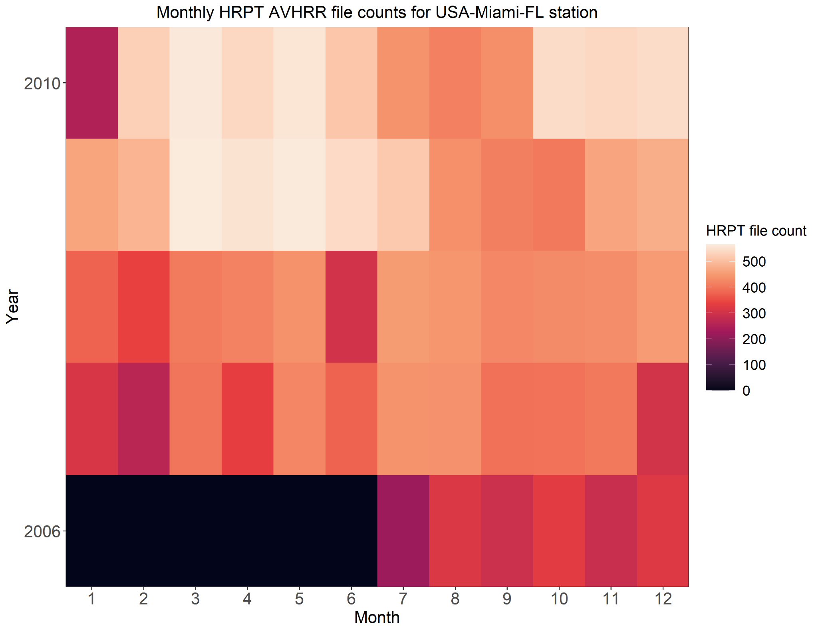
HRPT Data at
Miami, FL
Monthly File Counts

Slide 29
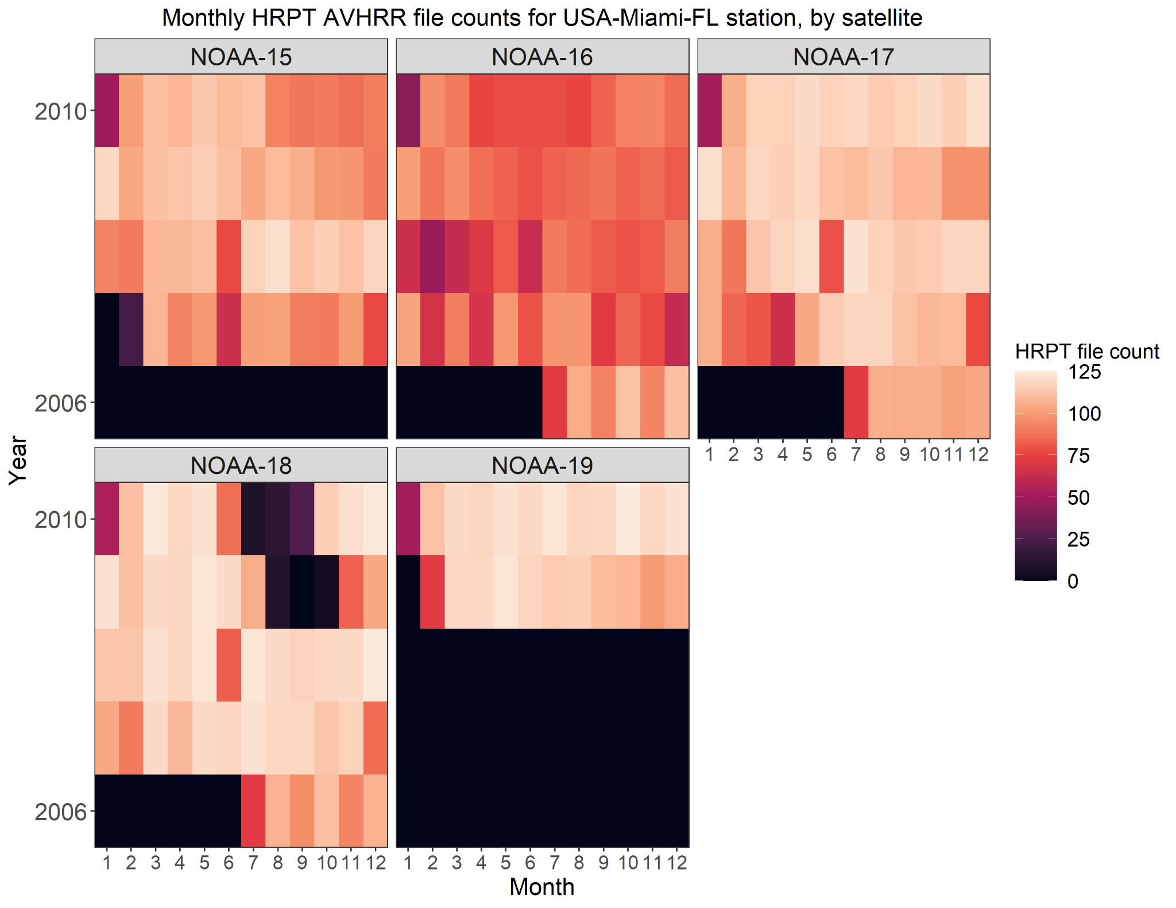
HRPT Data at
Miami, FL
Monthly File Counts,
by Satellite

Slide 30
HRPT Data in NOAA CLASS
Monterey, California, USA

Slide 31
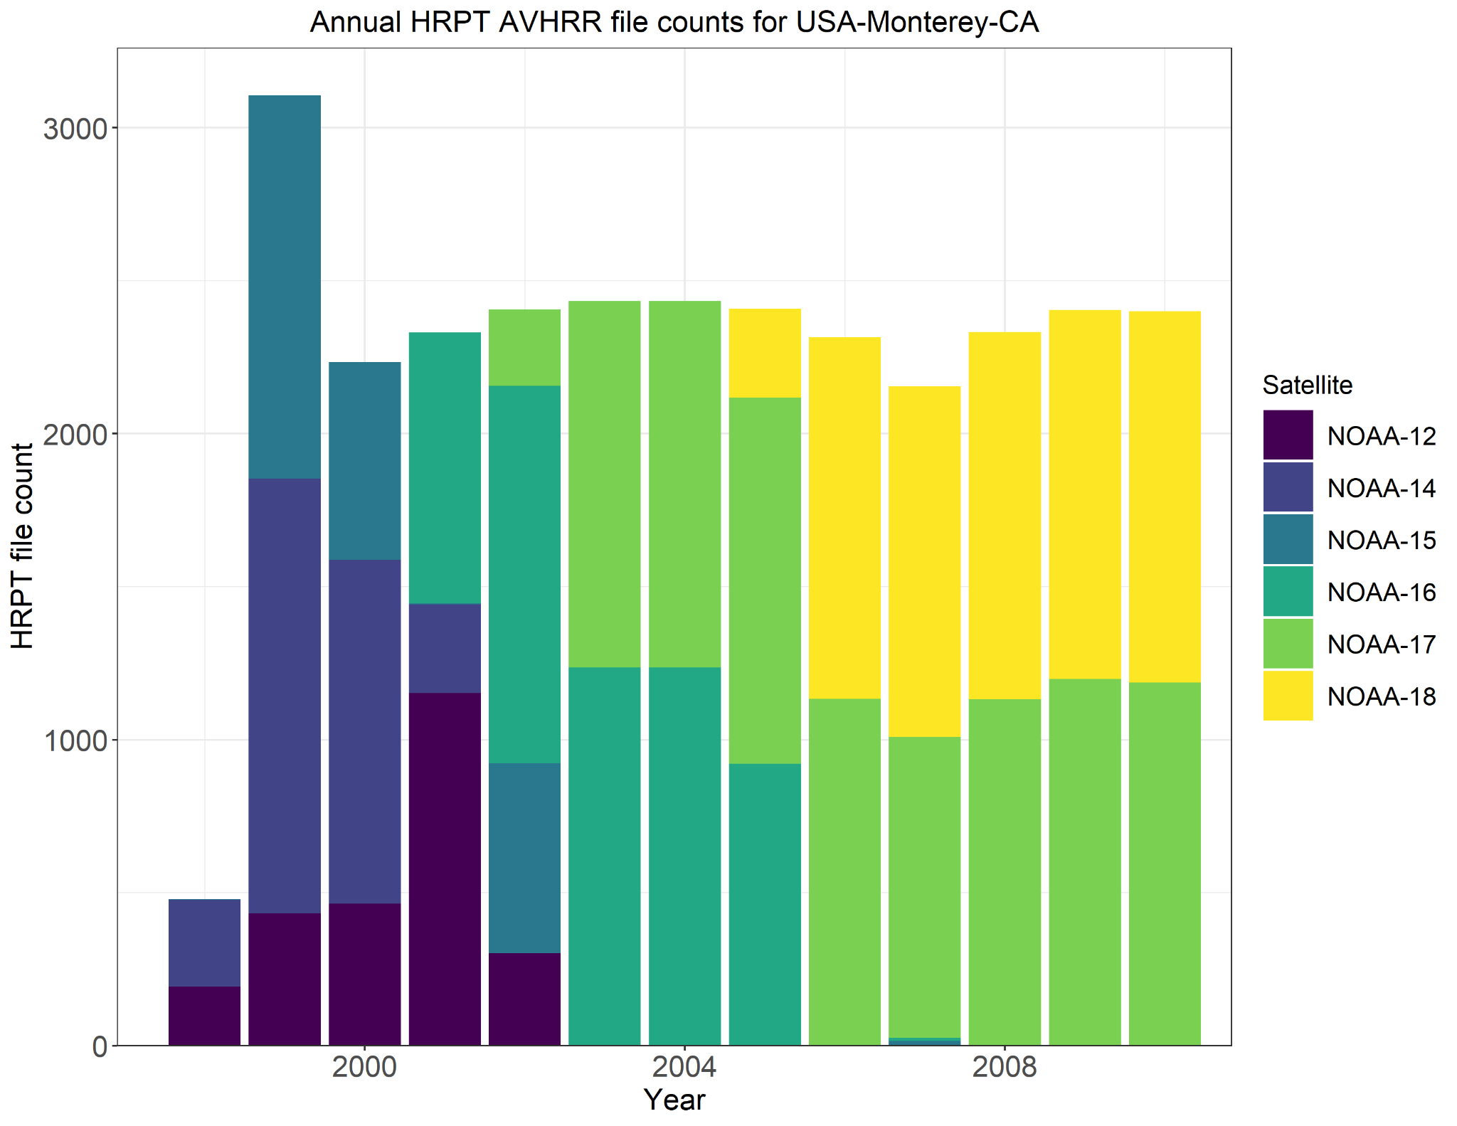
HRPT Data at
Monterey, CA
Annual File Counts

Slide 32
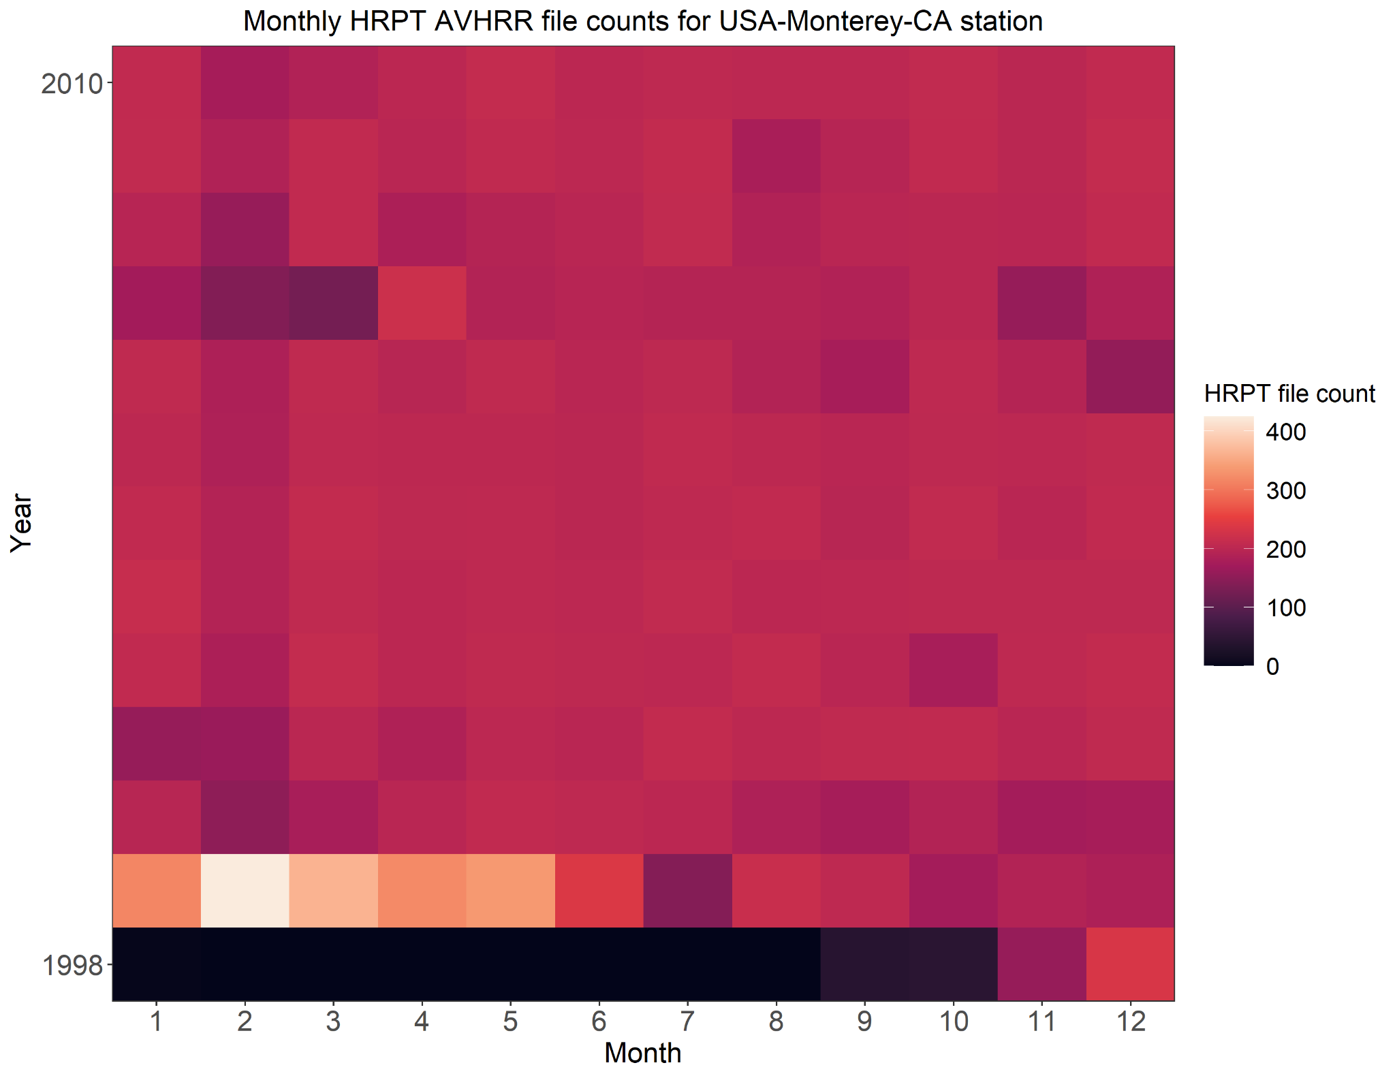
HRPT Data at
Monterey, CA
Monthly File Counts

Slide 33
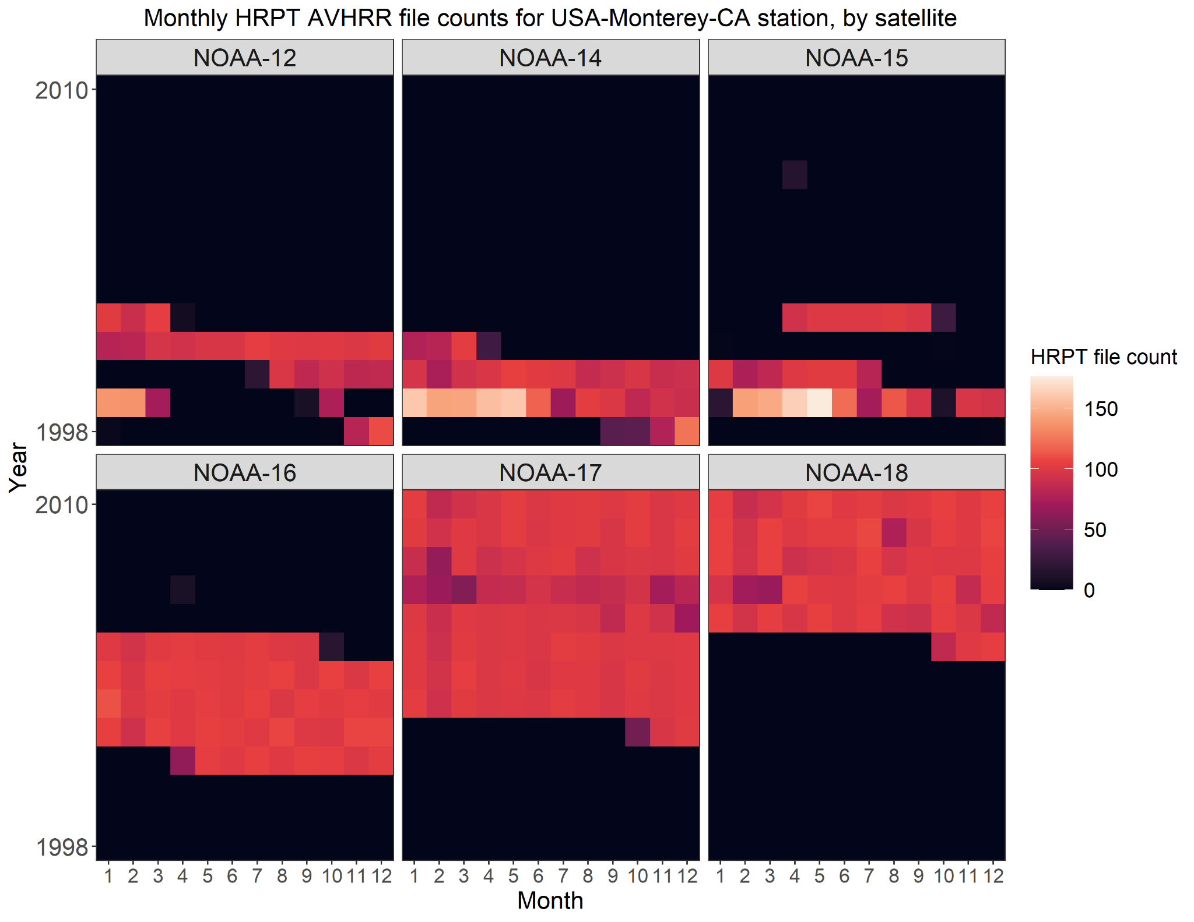
HRPT Data at
Monterey, CA
Monthly File Counts,
by Satellite

Slide 34
HRPT Data in NOAA CLASS
Sioux Falls, South Dakota, USA

Slide 35
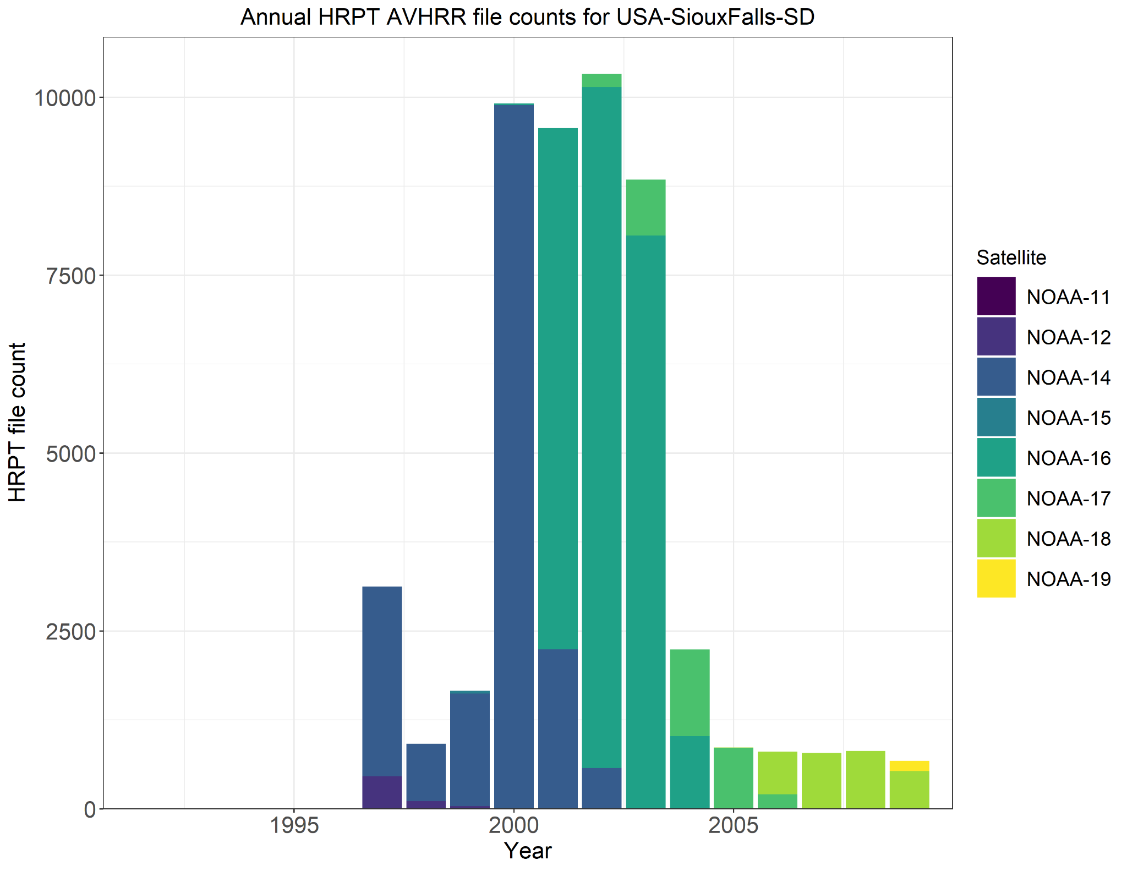
HRPT Data at
Sioux Falls, SD
Annual File Counts

Slide 36
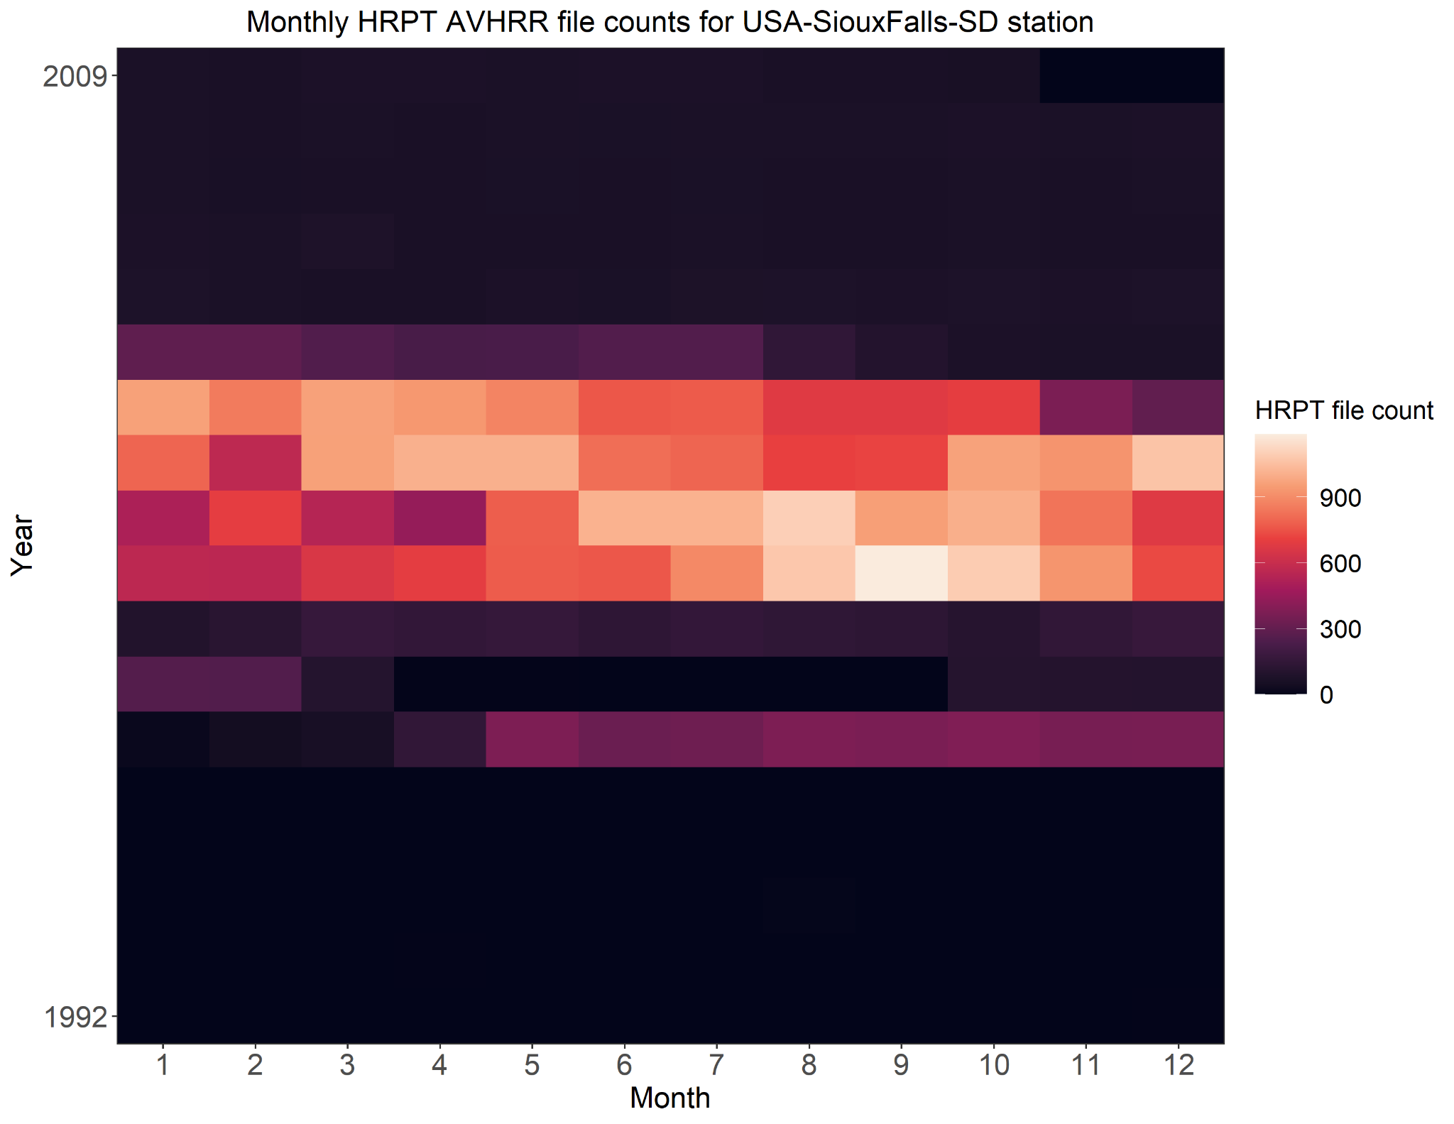
HRPT Data at
Sioux Falls, SD
Monthly File Counts

Slide 37
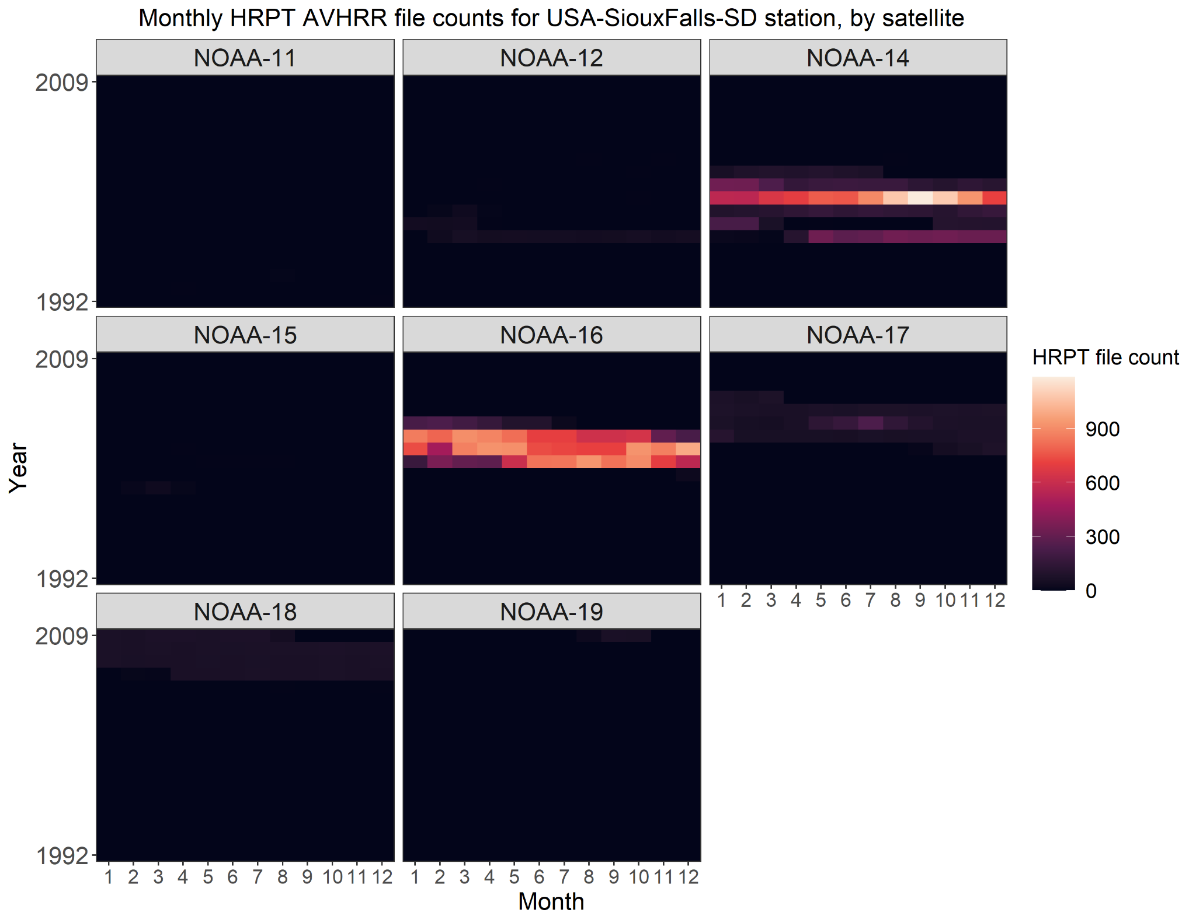
HRPT Data at
Sioux Falls, SD
Monthly File Counts,
by Satellite

Slide 38
HRPT Data in NOAA CLASS
Wallops Island, Virginia, USA

Slide 39
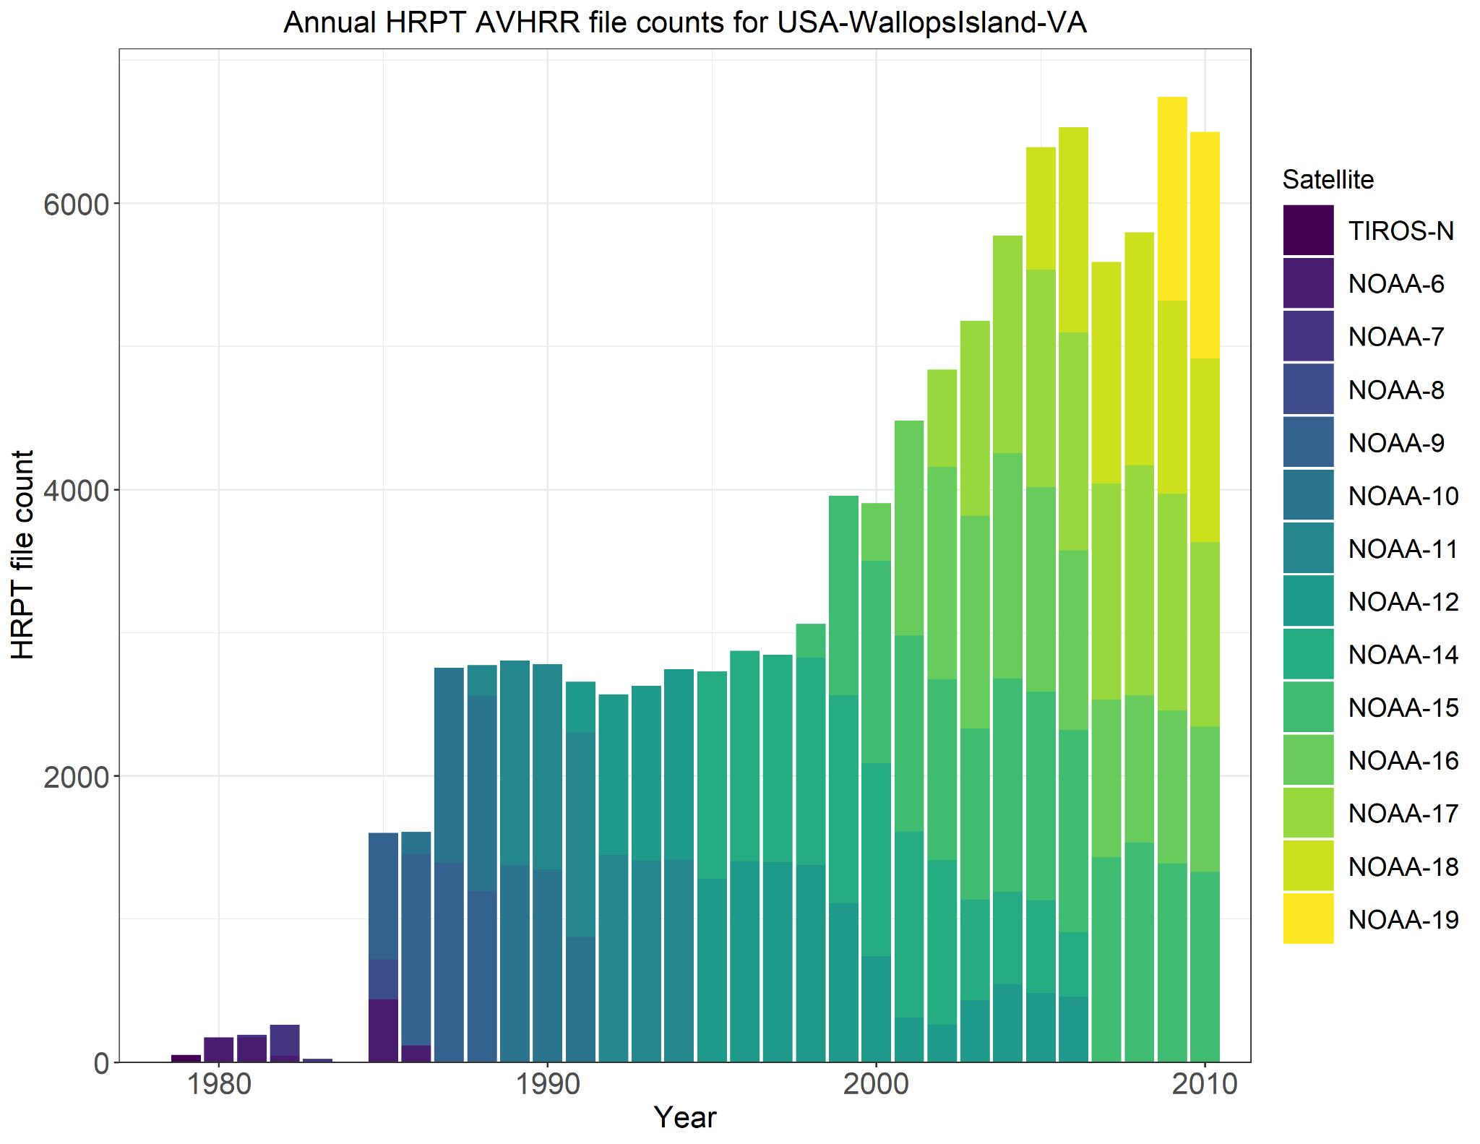
HRPT Data at
Wallops Island, VA
Annual File Counts

Slide 40
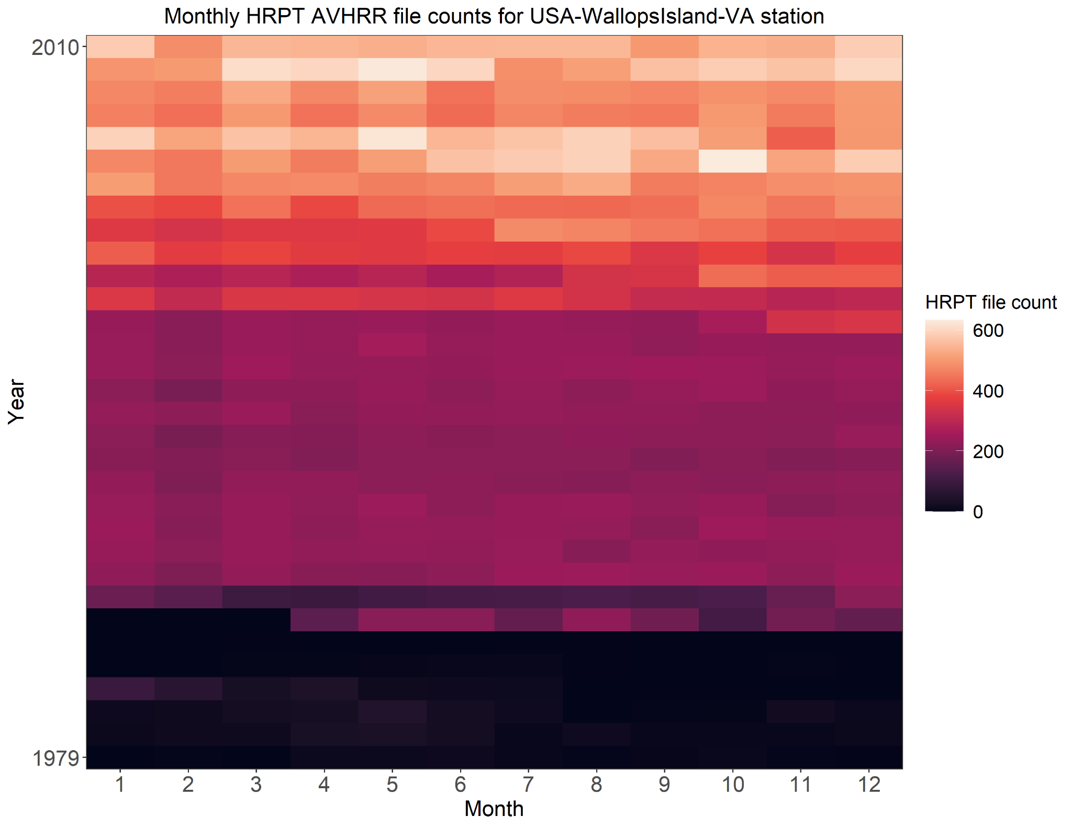
HRPT Data at
Wallops Island, VA
Monthly File Counts

Slide 41
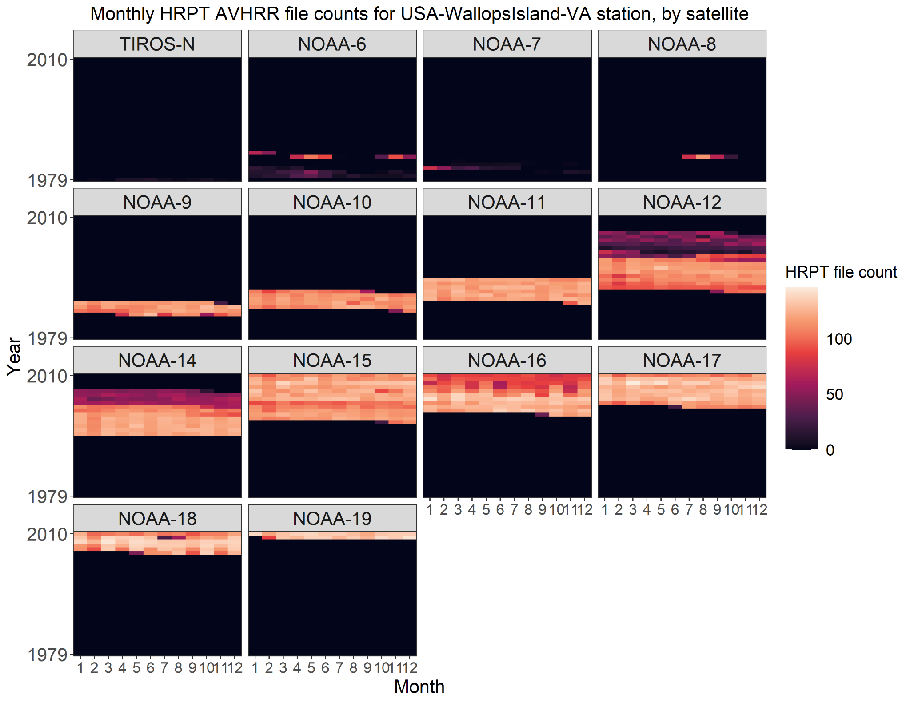
HRPT Data at
Wallops Island, VA
Monthly File Counts,
by Satellite

Slide 42
HRPT Data in NOAA CLASS
Cape Ferguson, Australia

Slide 43
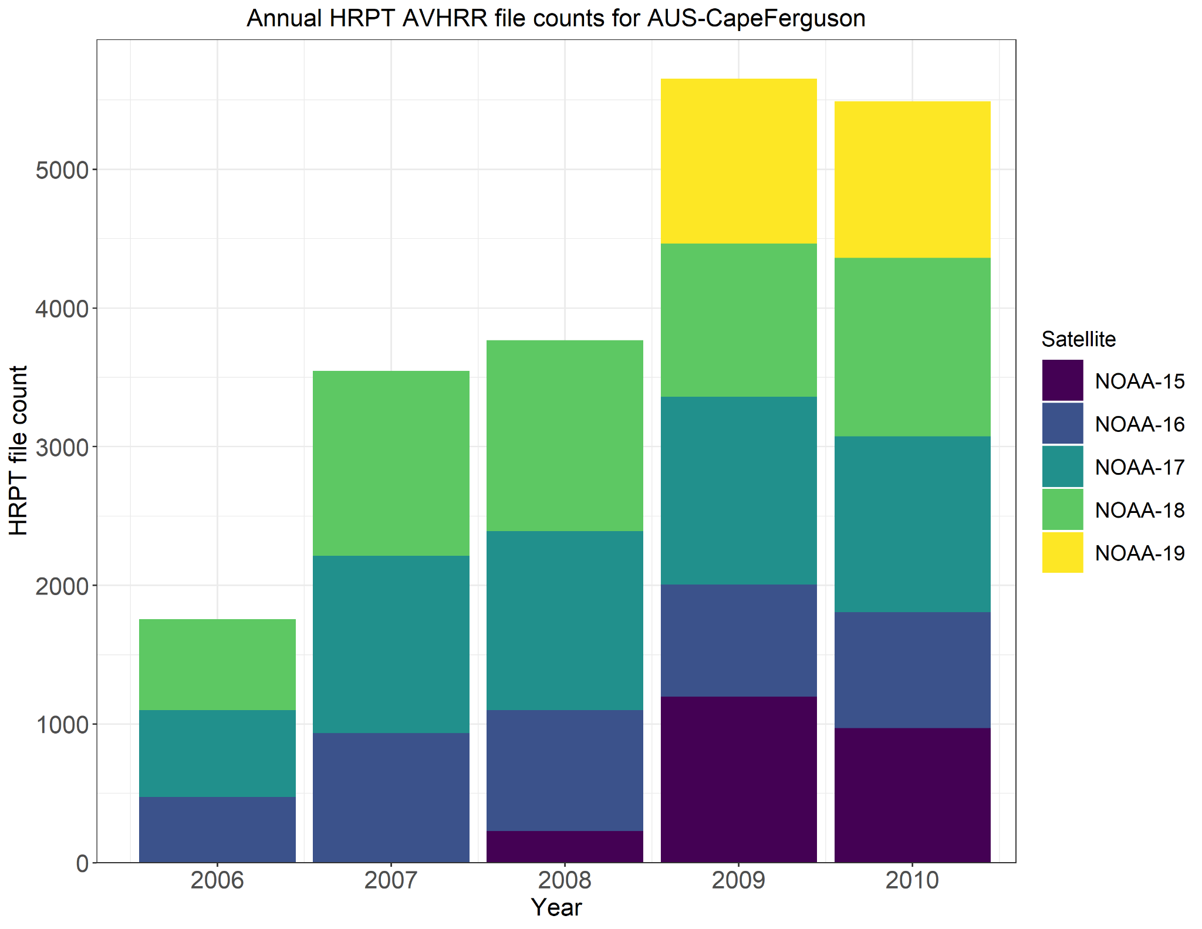
HRPT Data at
Cape Ferguson, Australia
Annual File Counts

Slide 44
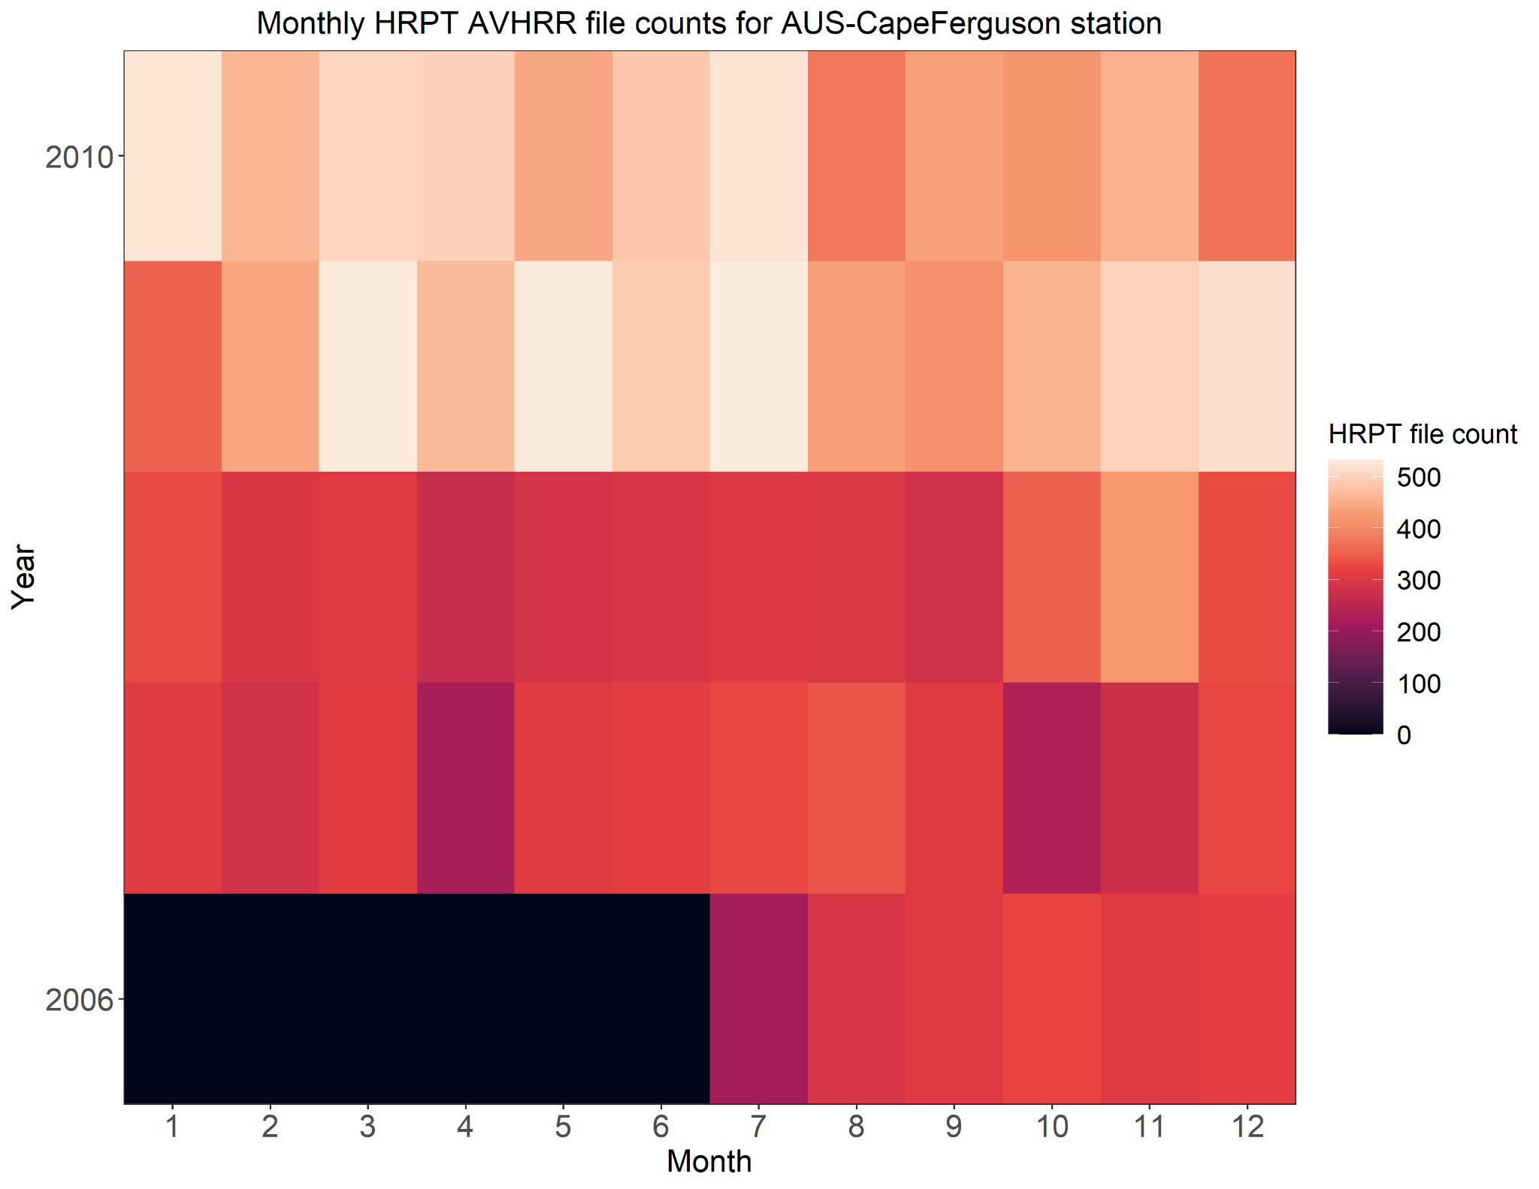
HRPT Data at
Cape Ferguson, Australia
Monthly File Counts

Slide 45
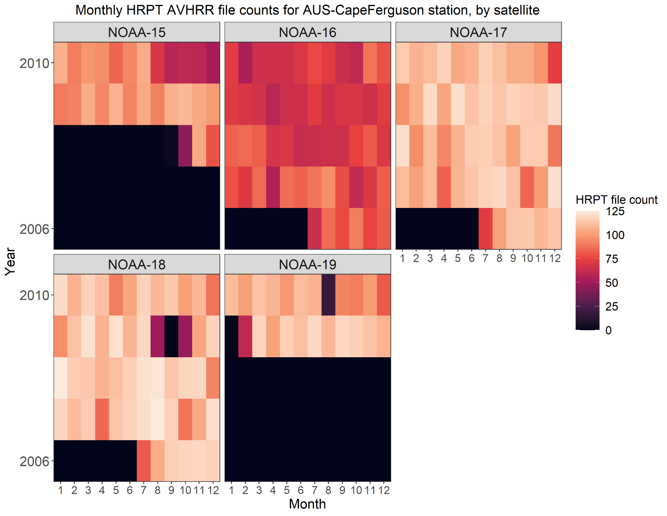
HRPT Data at
Cape Ferguson, Australia
Monthly File Counts,
by Satellite

Slide 46
HRPT Data in NOAA CLASS
Lannion, France

Slide 47
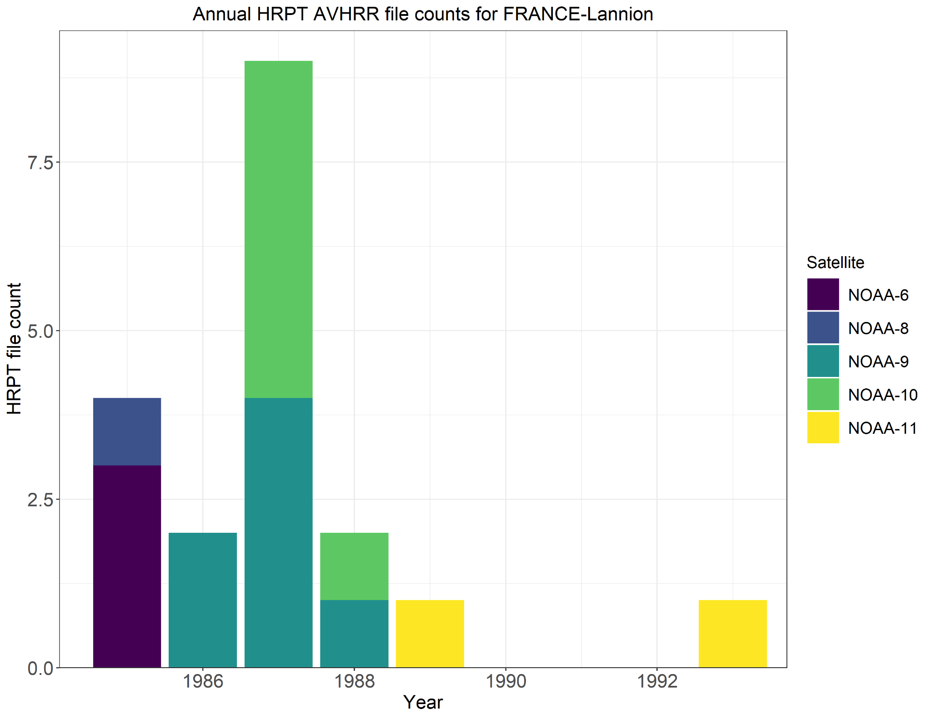
HRPT Data at
Lannion, France
Annual File Counts

Slide 48
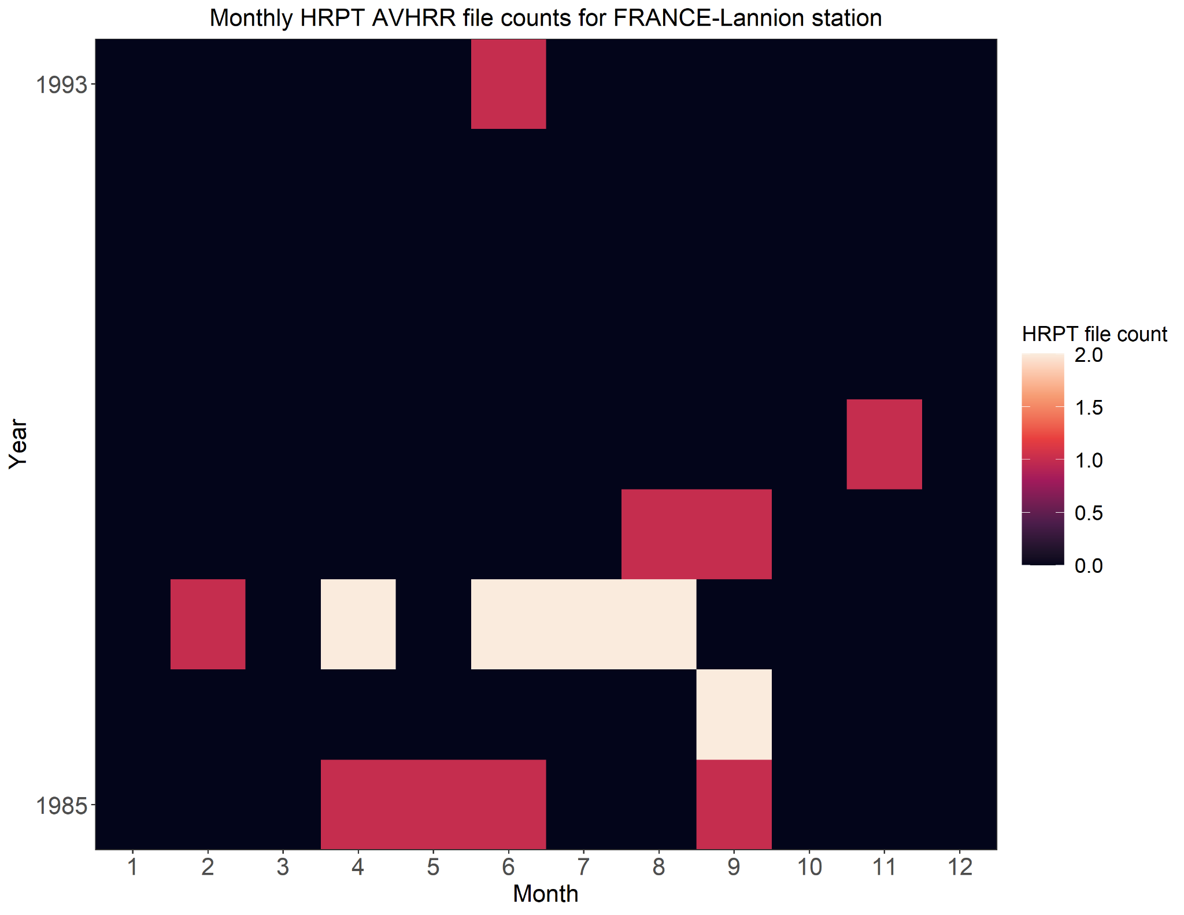
HRPT Data at
Lannion, France
Monthly File Counts

Slide 49
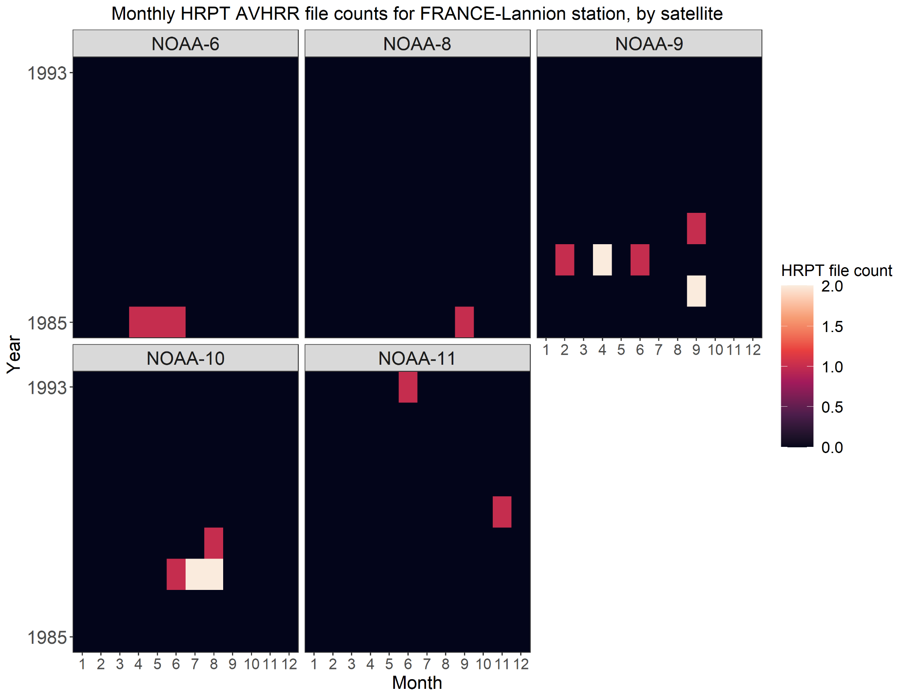
HRPT Data at
Lannion, France
Monthly File Counts,
by Satellite

