Slide 1



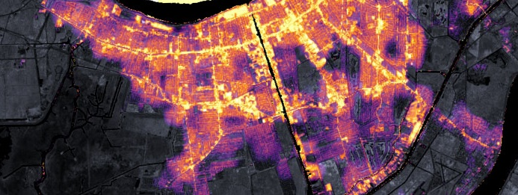

Copernicus Sentinels Ground Segment Architecture
Razvan Cosac, ESA
Agenda ID: 2023.04.20_10.40
WGISS-55
Cordoba, Argentina (CONAE)
18-20 April 2023

Slide 2
Executive Summary
Legacy Copernicus Ground Segment Architecture
Transformation
Current Copernicus Ground Segment Set-up
Long Term Archives Services
Data Access Services
Copernicus Data Space Ecosystem

Slide 3
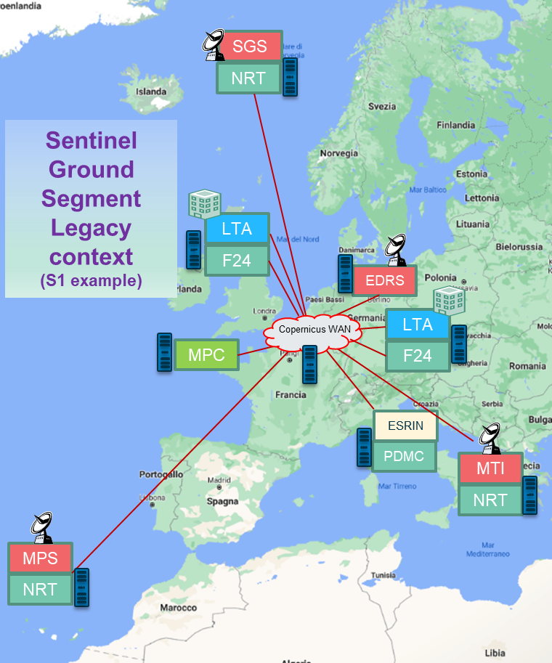
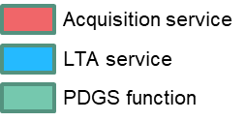
Legacy Ground Segment Architecture
The initial design and implementation approach for the Ground Segment operations was established >10 years ago based on:
  High re-use of legacy software to control costs and optimise schedule.
  High re-use of proven system architecture, inheriting a traditional split of functions and physical centres.
  Dedicated HW procurement and deployment at various centres.
Resulting in a large number of physical centres distributed across Europe hosting dedicated GS infrastructures, connected by a dedicated Wide Area Network.
This implementation has successfully supported the CSC operations, however…
  Dependencies between the different service providers
  Difficulty to separate between infrastructure issues & service provider issues (e.g. data access service)
  No flexibility for reconfiguration

Slide 4
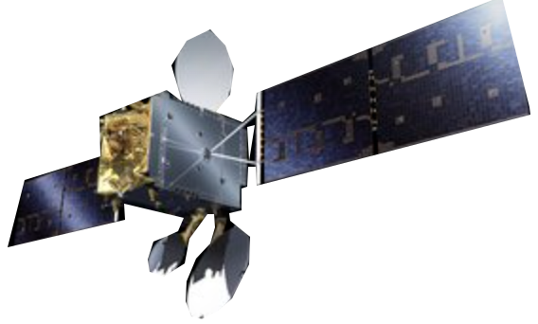
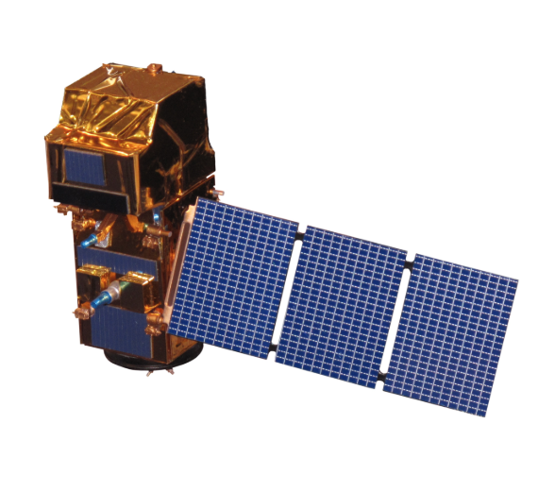
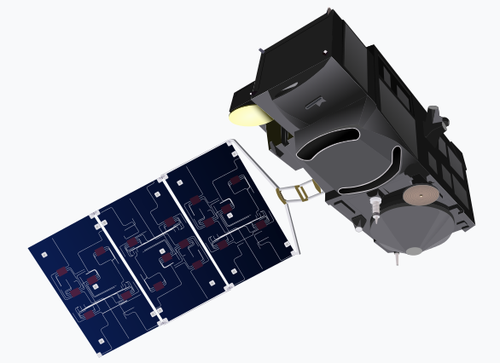
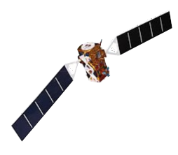
Ground Segment Transformation
2014
2015
2016
2017
2018
2019
2020
2021
2022
GS Transformation
Dedicated deployment infrastructure
Dedicated one-off software solutions
Long deployment & integration time
High risk of technical and industrial lock-in
Lack of flexibility to cope with new programme and user needs
High risk of operations not being affordable in the medium-long term
Relying on existing European infrustructure
Service based operations
Shorten integration times and increased flexibility
Increased operations resilience
Strong industrial competition
Increased capability to adapt to evolving programme and user needs
Capability to transparently manage operations capacity and performance according to available resources

Slide 5
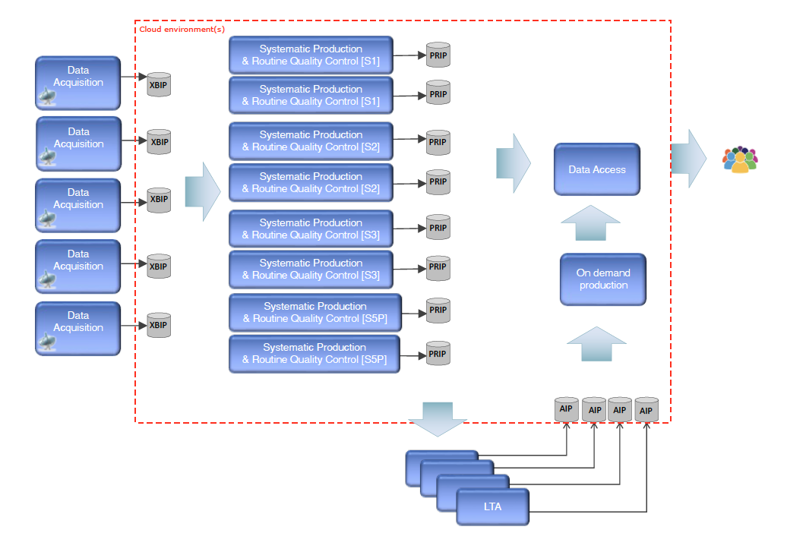
GS Architecture – Principles
The CSC Ground Segment Architecture is defined and operated against a consolidated set of principles.
Operational Services are defined through input and output interfaces and performance levels:
  largely mission independent
  map to functions directly procured from industry
Multiple Service instances for sharing operational load, technical and performance risk mitigation.
Streamlined and harmonised interfaces, masking mission specificities and simplifying integration.
Favour open source and cloud-based environments for service operations.
Allowing adaptation of operations capacities to user demand and available resources.
No dedicated infrastructure procured or provided by ESA.

Slide 6
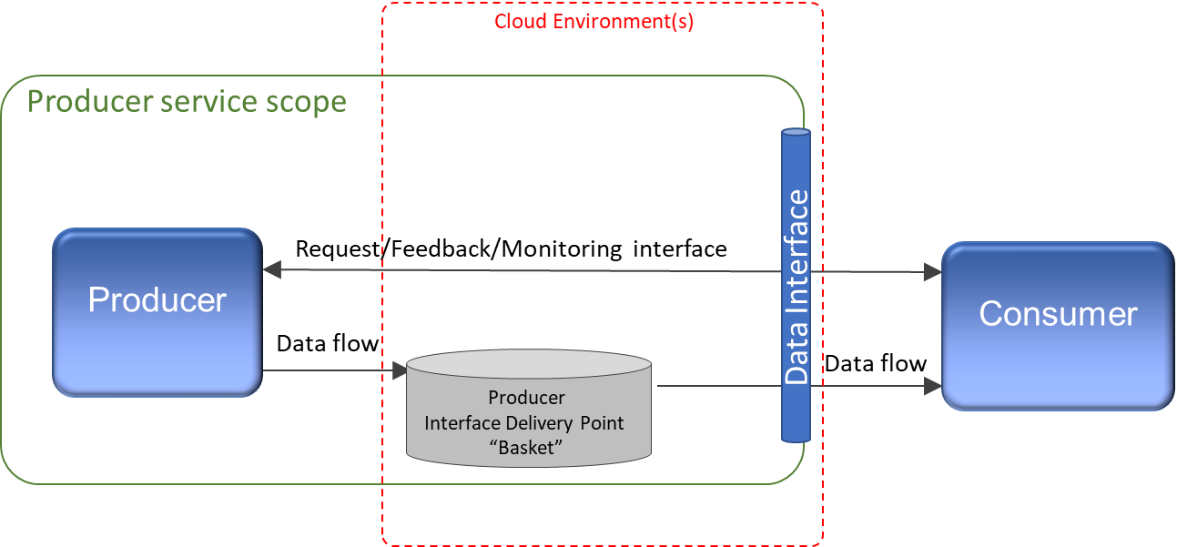
GS Architecture – Interfaces
Key concept: data exchange operations via harmonised Interface Delivery Points between GS elements:
  decouple Producers and Consumers
  hide the complexity of the service operations
Located on cloud-based environments
Short-term data rolling storage
Data exchange via internet (https)
Interfaces defined in the GS elements ICDs
Most interfaces defined through OData API offering common semantics

Slide 7
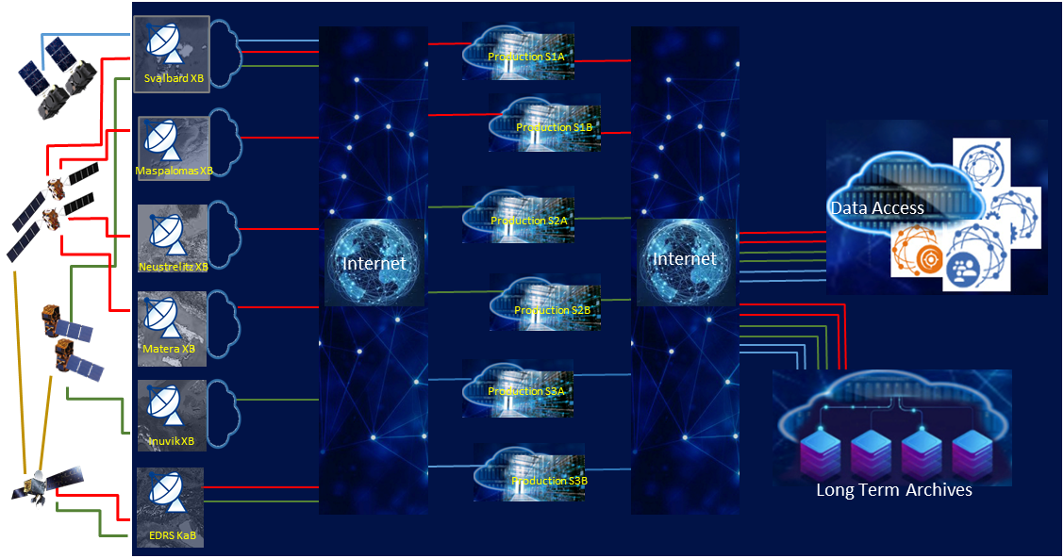
Copernicus Ground Segment Layout

Slide 8





















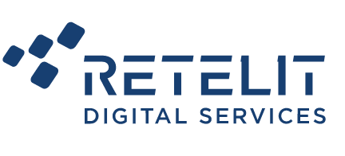


Copernicus GS – Industrial Set-up
EDRS
Maspalomas
Matera
Svalbard
Inuvik
Neustrelitz
S1
S2
Legacy Data Access
(scihub)
S3(land)
S5P
ProdS1A
ProdS1B
ProdS2A
ProdS2B
ProdS3A
ProdS3B
S1
S2
S3(land)
Copernicus Data Space Ecosystem
S5P
CCM
Complementary
LTA1
LTA2
LTA3
LTA4
Acquisition Services
Production Services
LTA Services
Data Access Services

Slide 9
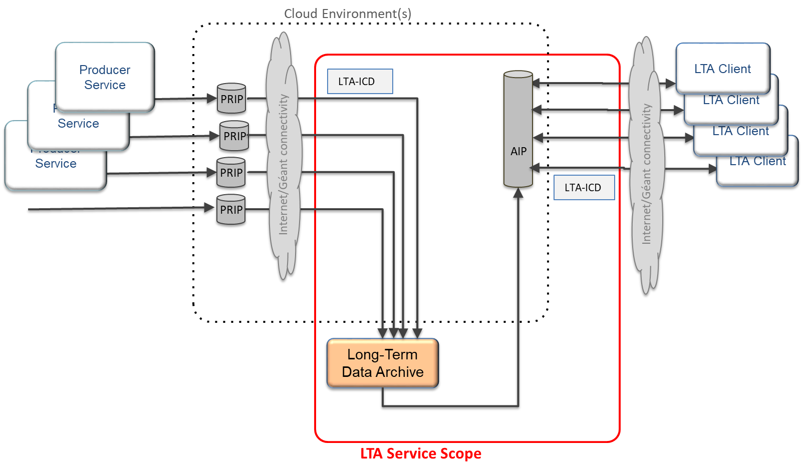
Long Term Archives Context
PRIP: Production Interface delivery Point
The location, in a Public Cloud-based environment, from where the LTA downloads the data for ingestion and archive.
AIP: Archive Interface delivery Point
The location, in a Public Cloud-based environment, to where the LTA makes data available in response to an retrieval request.

Slide 10
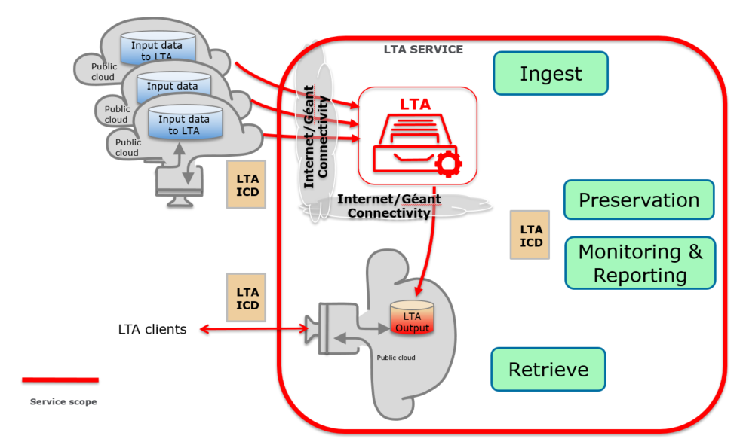
LTAs Architecture and Functions
Ingestion: The act of downloading data from the PRIP, archiving and cataloguing into the archive.
Preservation: The act of keeping the data and catalogue without any loss or degradation.
Retrieval: The act of extracting data from the LTAs as a result of a retrieval request, and making them available on the AIP for pick-up by clients.
Monitoring & Reporting: Dashboards, reporting, etc.
Other Functions:
  Generation and handling of product traces.
  Application of security requirements and monitoring.
  Improvements in environmental sustainability.

Slide 11
LTAs Overview
Company | Location of Company | LTA Location | LTA Technology | Location of AIP | Start Date
ACRI | Sophia Antipolis, France | Sophia Antipolis, France (Euclyde) | Disk/Tape Backup | Marseille, France (Jaguar) | 1st October 2020
CloudFerro | Warsaw, Poland | Warsaw, Poland (CloudFerro) | Cloud | Warsaw, Poland (CloudFerro) | 1st October 2020
Exprivia | Rome, Italy | Palermo, Italy (Open Hub Med) | Optical medium | Milan, Italy (OVH) | 1st November 2020
Werum | Lüneburg, Germany | Frankfurt, Germany (OVH) | Cloud/Tape backup | Frankfurt, Germany (OVH) | 1st November 2020
Service based contracts with associated Service Level Agreement (SLA) and Performance Indicators (PI) including some Key Performance Indicators (KPI) that measure the performance.
No Customer Furnished Items (CFIs) provided by ESA.
No phase-in. Fully readiness for operations from Kick-Off.

Slide 12
LTAs Characteristics and Sizing
LTAs are identical in terms of content: Level-0 and Auxiliary only.
LTAs configurability parameters and required sizing were established by ESA.
LTAs are also identical in terms of required configured capacity:
  Monthly ingestion rate (fresh data) : 125 TiByte
  Daily retrieval rate (from AIP) : 10 TiByte
  AIP rolling period (time before retrieved products are deleted from AIP) : 5 days
All LTAs ingest the same data. Multiple LTAs (geographically separated) increases the resilience to data loss.
LTAs each provide a distinct retrieval rate so that increasing the number of LTAs increases the overall volume of data that can be provided to users as well as maximising the overall service resilience.

Slide 13
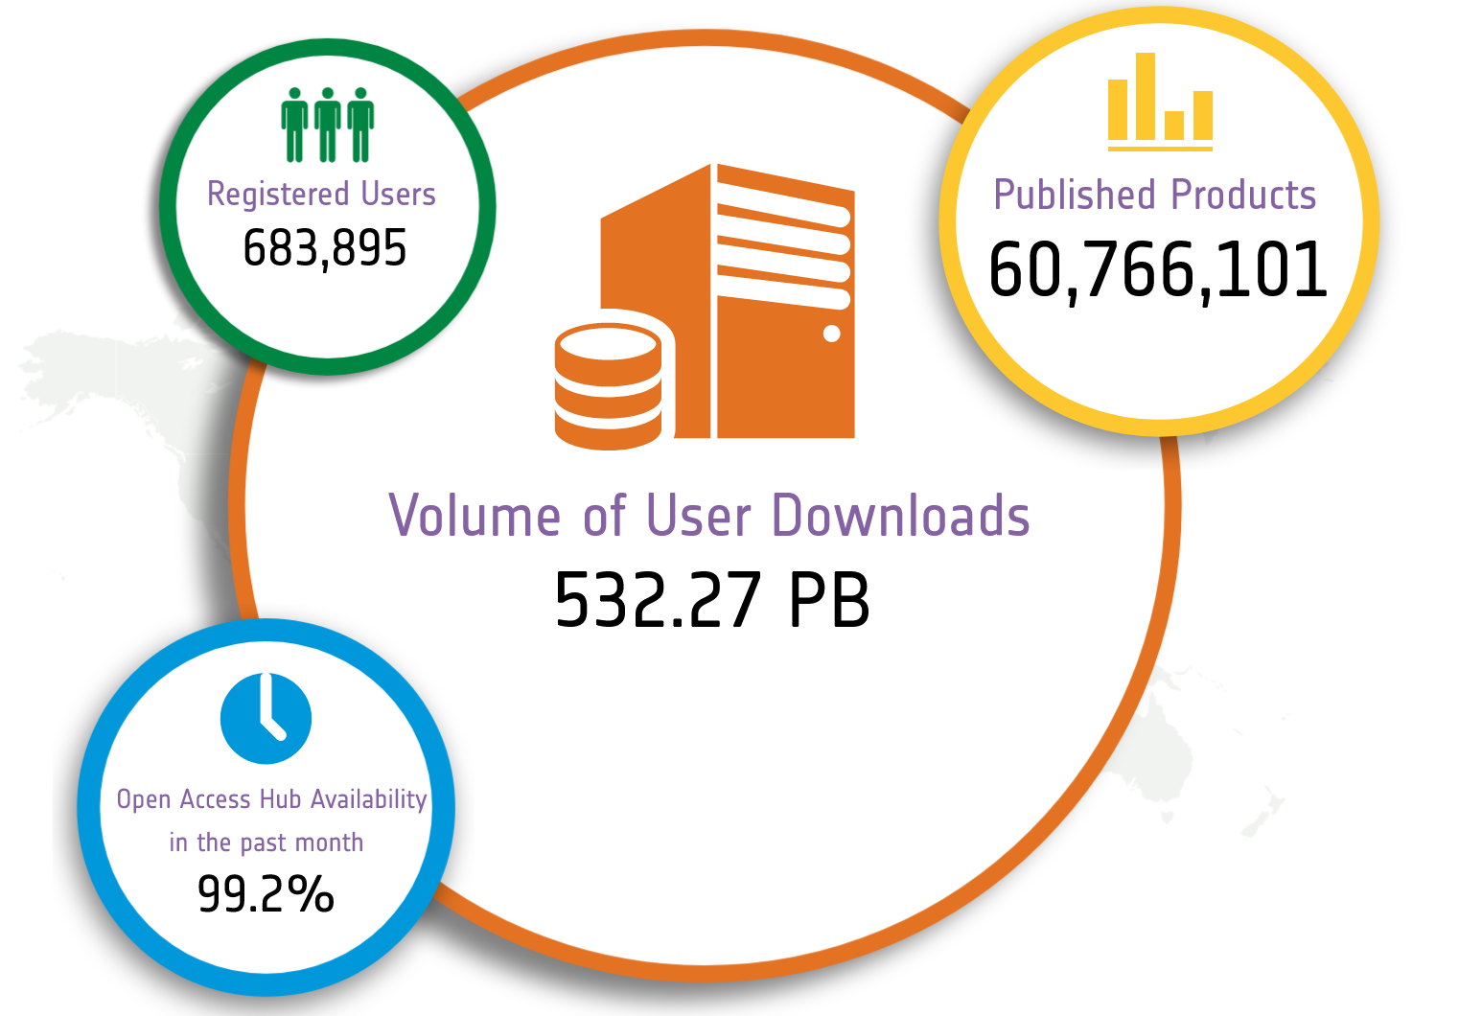
Data Access Service – Key Element
Copernicus Data Access Services: key and critical element of the Copernicus Space Component
Front-end service that provides free and open access to Copernicus Sentinel User Level Data to various user communities
One of the largest distributors of Earth Observation data worldwide

Slide 14
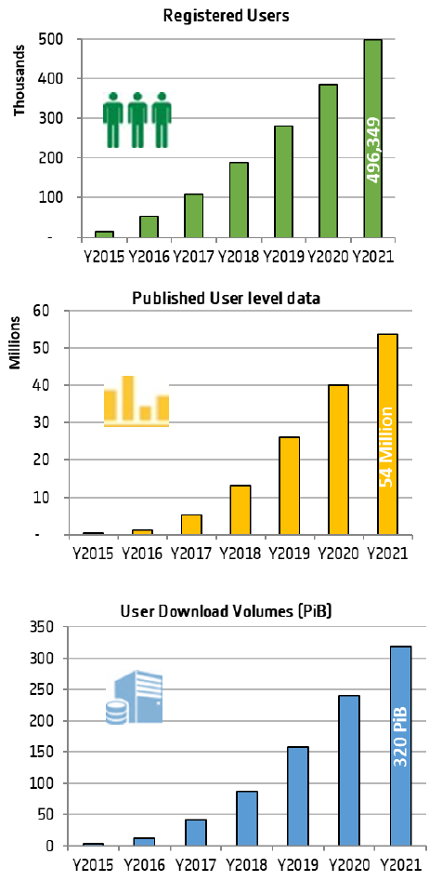
Data Access Service – Statistics
>8 years
of Data Access Service operations
>650,000
Total Registered Users
Growth in numbers of active users
>60,000,000
Total Published User Level Data
185.7 million
530 PB
Downloads in 2021
Total Volume Downloaded since start of operations
79.7 PiB
25% of the total downloaded volume

Slide 15
Copernicus Data Access – Timeline
Copernicus Data Access Service in operations since 2014
Successfully ensuring massive daily data publication and user download
Copernicus Data Access Service (scihub)
Service Continuity
User Migration
Copernicus Data Space Ecosystem
2015
2016
2017
2018
2019
2020
2021
2022
2023
2024
2025
2026
2027
Data and Information Access Services (DIASs) in operations since mid 2018
Successfully combining access to IaaS with access to Copernicus data
DIAS Service
Business offer continuity
DIAS Service
? Business offer continuity (*)
DIAS Service
? Business offer continuity (*)
DIAS Service
? Business offer continuity (*)
Specific Service Extension
(*) Potential continuity on self-sustainability basis

Slide 16



Copernicus Data Space Ecosystem Main Services and Features
Open Ecosystem on public cloud
Data Discovery and Retrieval
Streamlined Data Access
Open and Free Access to ALL Sentinel User Level Data and Copernicus Contributing Missions Core Data Sets for download and direct access using IaaS resources.
Large data set available for immediate access
Discovery, Catalogue, Visualisation tools and services
APIs + GUI
Streamlined Data Access
Harmonised access to specific Sentinel Data collections, allowing efficient temporal and spatial access via dedicated APIs (e.g. OpenEO).
Streamlined data representation and organisation including necessary data transformations (e.g. resampling, tiling using a common reference grid).
Data Discovery and Retrieval
Unified User Management
Copernicus Data Space Ecosystem
Traceability Service
On-Demand Production Service
Allowing registration and verification of traces for the Copernicus Sentinel User Level Data.
Extendable to third parties in the ecosystem.
On-Demand Production
Open and free access to on-demand Sentinel-1/2/3 L1 and L2 User Level Data.
Use of ESA operational processors.
Additional third party on-demand processing capabilities.
Traceability Service

Slide 17



Sentinel Data Lifecycle Configurability
All Sentinel User Level Data available
All Sentinel User Level Data immediately available
Data Hub Baseline (2023)
Copernicus Data Space Ecosystem Configuration
Immediate Access
Sentinel user level data
Worldwide < 6months
Immediate Access
Allowing a trade-off between storage volumes, access performance and on-demand capacity according to evolving user scenario
Deferred Acccess
Sentinel-1/2/3/5p
User level data
Sentinel user level data > 6m months
Worldwide coverage
Full mission timeline
on-demand
“Refreshed data”: on-demand with latest processing baseline
*few data
Deferred
Level 0
Preserved data
Level 0

Slide 18


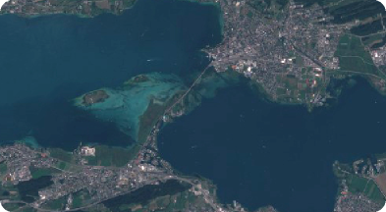
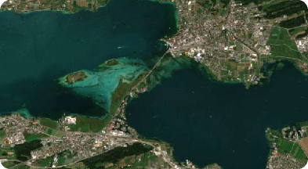
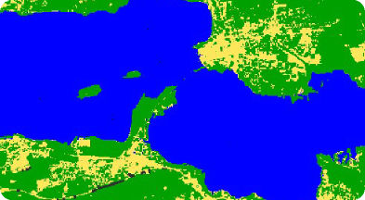
Traceability Service
Transparent insight into source of data from origin to delivery​
  Digitally signed traces​ for User Level Data
  Traces generated at each step of the process​ (BLAKE3)
Verification service​
Extendable to user-generated data​
Data retrieval
Ground segment
Level-1 product
Trace Registry
Atmospheric correction
Land Cover algorithm

Slide 19
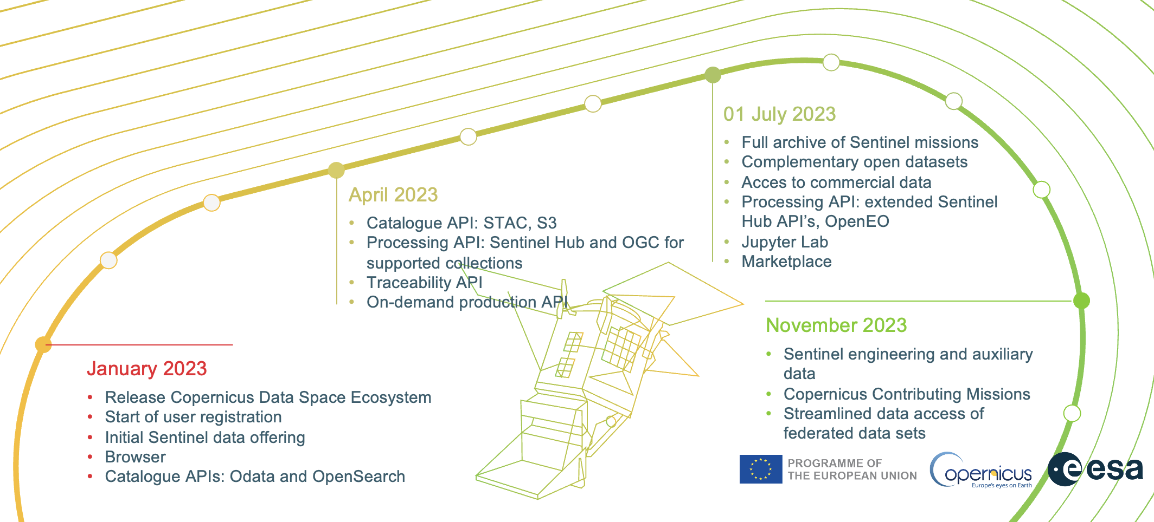
Copernicus Data Space Ecosystem Roadmap
The Copernicus Data Space Ecosystem will continuously expand over the upcoming months
Key public service capabilities and data offering available by July 2023

Slide 20
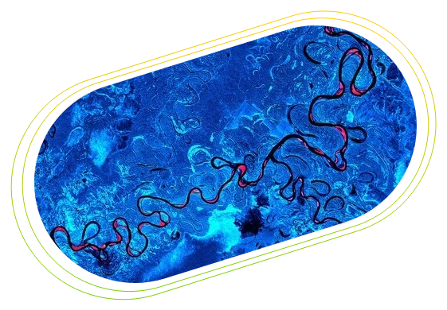
dataspace.copernicus.eu

