Slide 1
WGISS-55 Archive Technologies Evolution White Paper

Slide 2
Executive summary
Snapshot of surveys on Long Term Archive sessions addressing:
            Archive Infrastructure and technology
            Monitoring tools
            Archive volume, missions, coverage
            Archiving flows and processes
            Data format/packaging for long term archive
            Management of the relevant associated information, documentation, software and knowledge (if managed)
            Trends and Future Plans, Main Issues and Challenges
Challenges collection The main challenge of the archive is the sheer volume of data, the copious number of files, the diversity of formats and the yearly increase of data produced.
The archive is constantly enhanced to facilitate the archival process by using technological innovation and practices. To save energy, thus making the archive and its hardware environmentally friendly, green computing technologies are favorable.
The final goal of the presentation is to approve the proposed Table of Content of the CEOS WGISS deliverable: Archive Technology Evolution White Paper

Slide 3
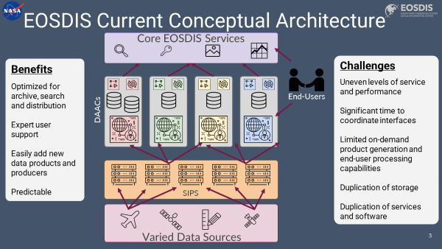
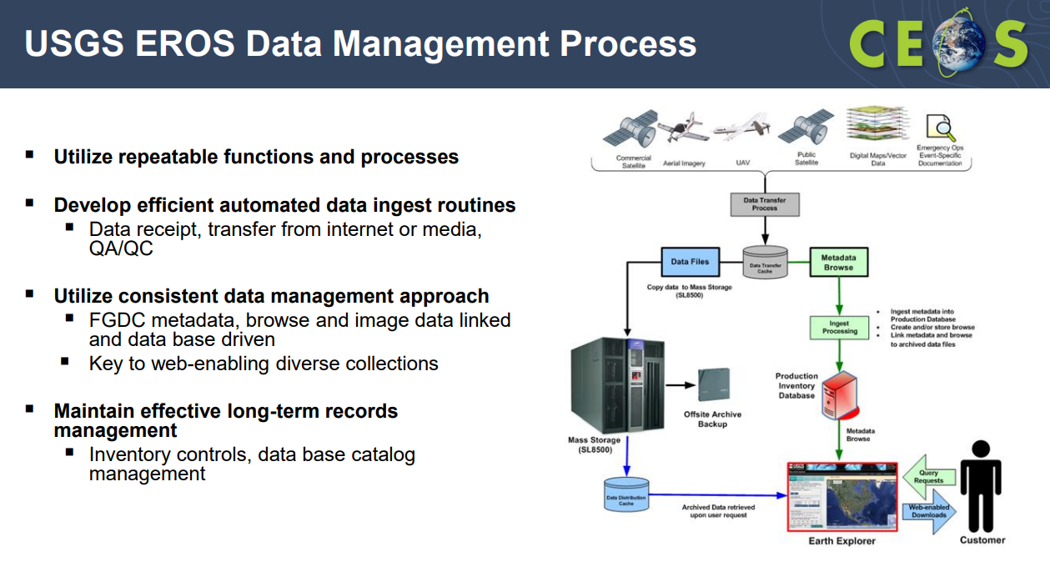
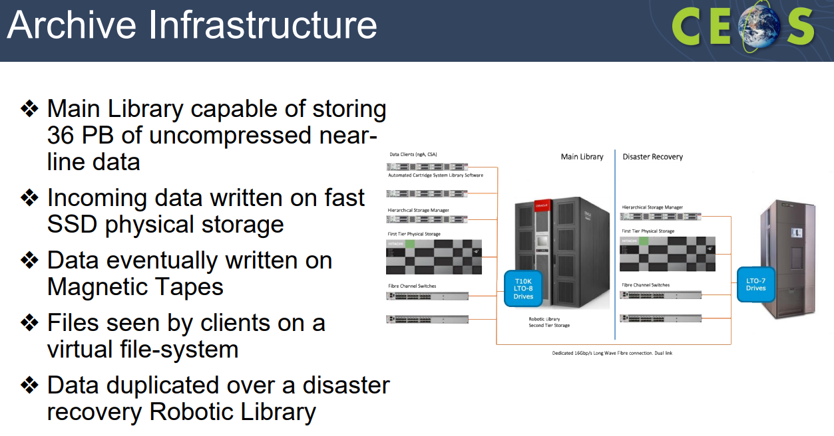
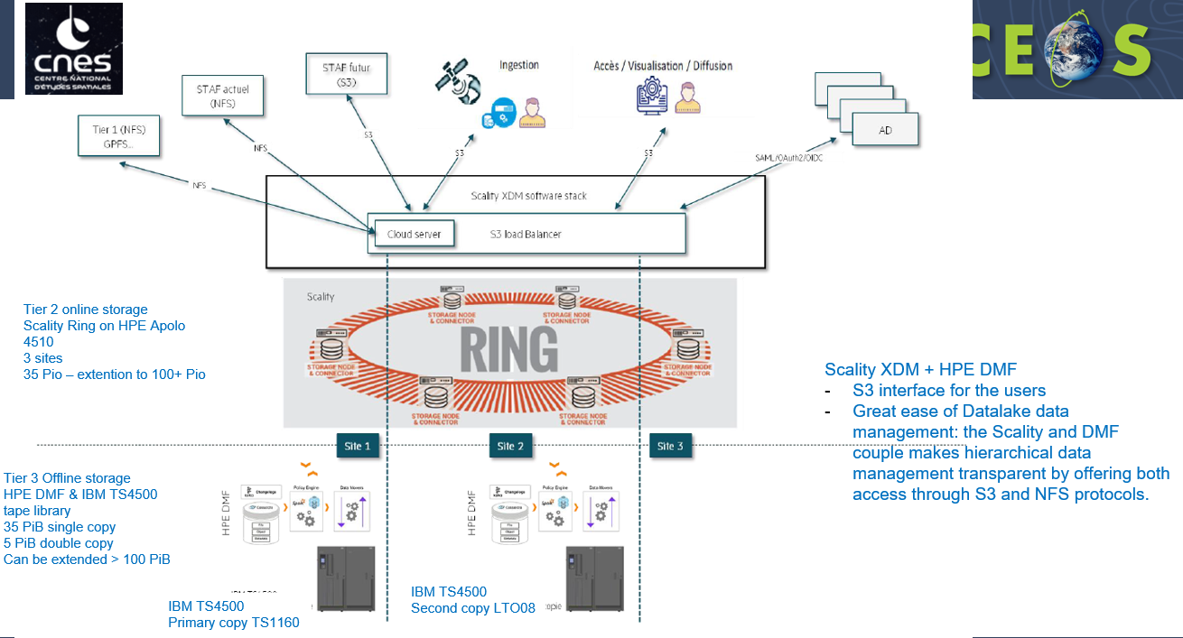
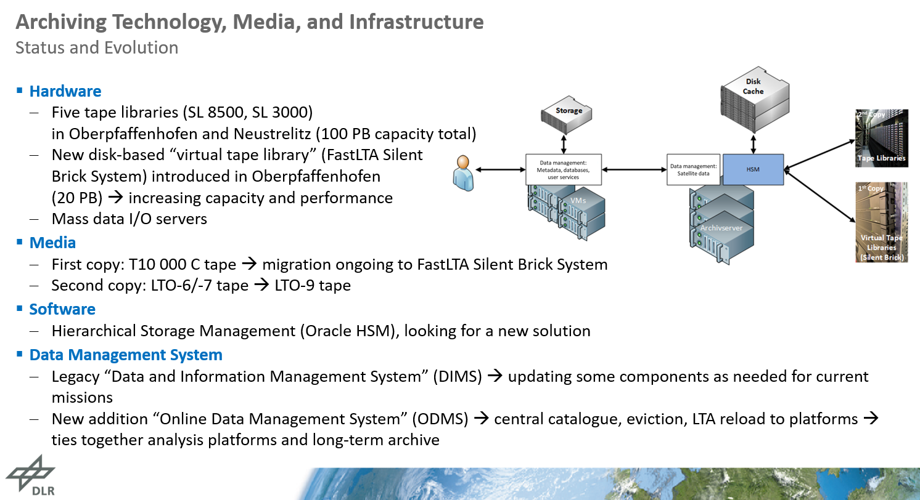

Archive Technology Surveys – WGISS#54
Notes:
Per ogni agenzia appuntati una frasetta ☺

Slide 4
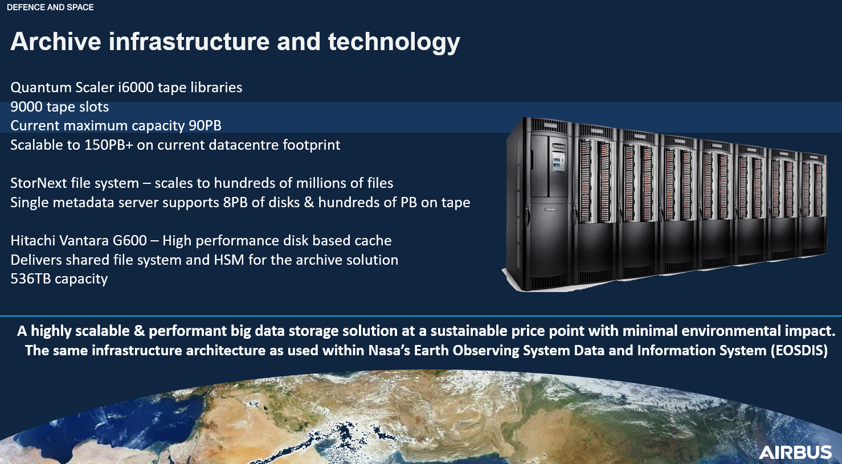
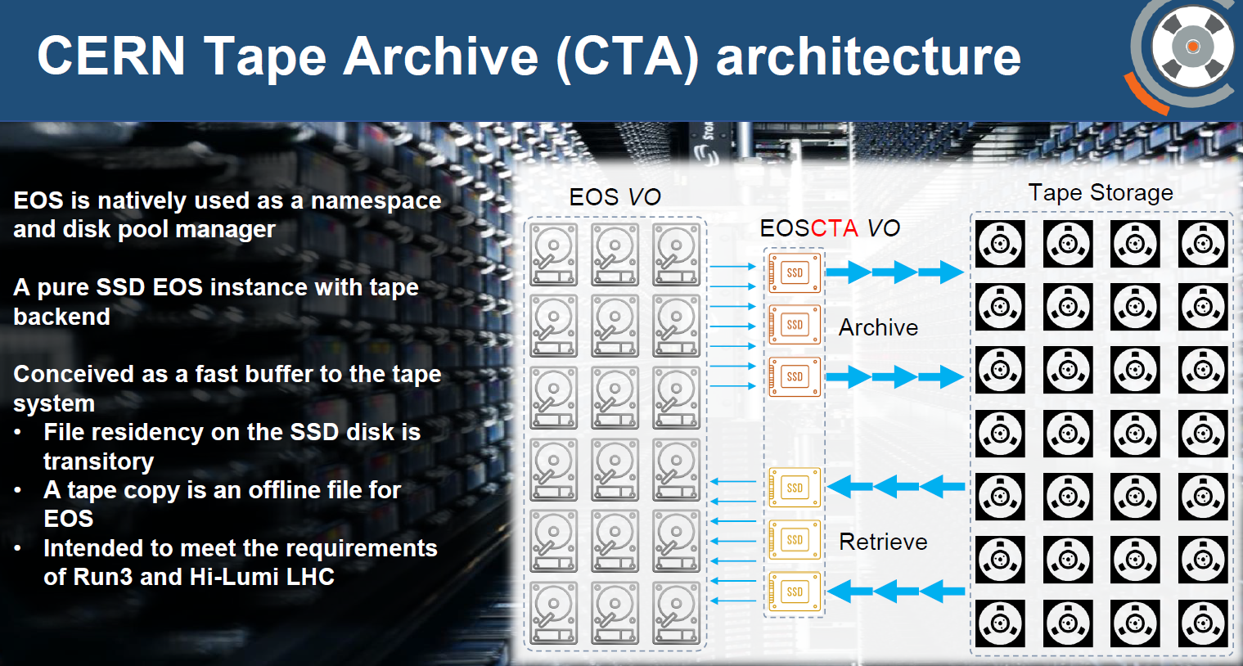
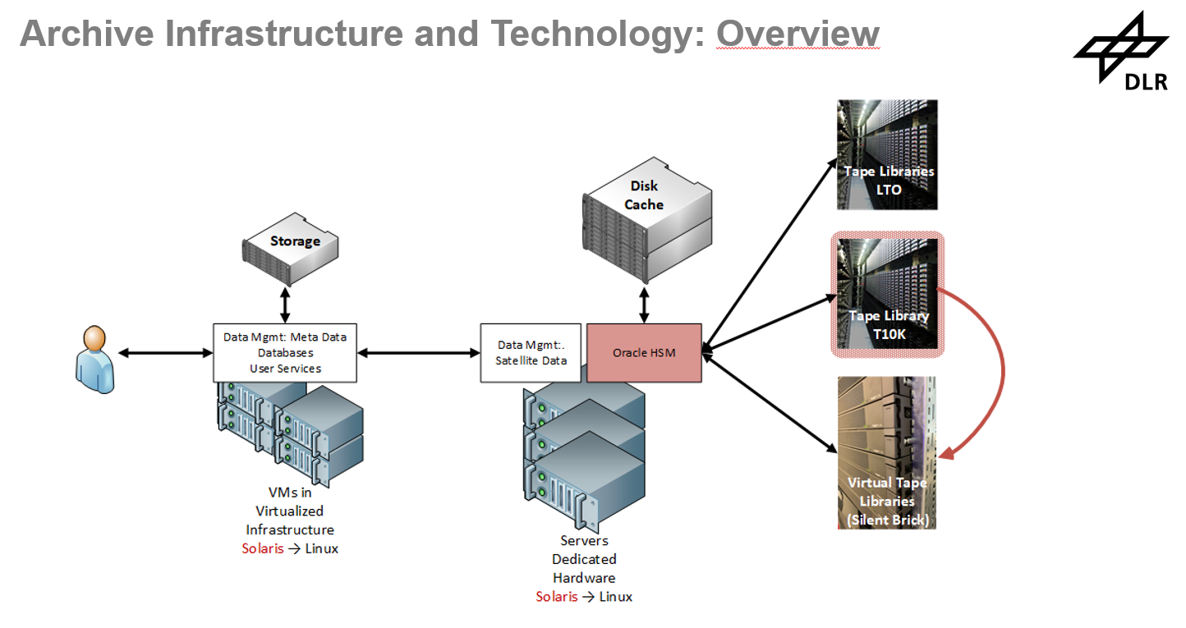
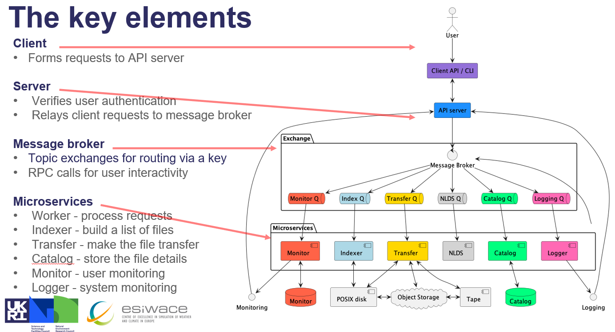
Archive Technology Surveys – LTA Technical Meeting
Notes:
Idem

Slide 5
Issues and solutions in data archiving and future challenge of “Preserving long-term data at the Exa-scale”

Slide 6
Main challenges observed
Lots of I/O affects performances due to the iNodes being constantly updated
Performances are still scarce for small files even with iNodes on separate partition/RAID
Media failures recovery takes time and uses resources (drives, storage)
Lots of false media failures alarms (caused by Network or robots)
Current Archive manager forces us being vendor (and OS) locked
Support tickets requires lots of data collection even for obvious failures
Support tickets often result in requests to update firmware
Firmware updates are complicated time consuming
Current HSM solution is cheap compared to alternatives

Slide 7
Main challenges observed (2)
Archive manager migration complicated, time consuming, expensive
Longevity of technology has side-effects (maintenance costs, obsolescence of HW)
Tape prices are not predictable. T10K tapes prices doubled when ORACLE declared the end of life of the tape family. LTO-8 tape shortage in mid 2019 due to patent infringement battle meant LTO-8 tapes where unavailable for a long period of time
With the end of some tape families and HSM archive managers, it is feared that the main vendors are moving away from tape archive solutions
We are ready for lots of data, less ready for billions of files
Extracting data from tapes is slow and complicated

Slide 8
Scarce performances for small files
Due to lots of I/O necessary to update iNodes, performances when archiving small files are scarce. The archive has been updated to cope with such limitation and the iNodes have a dedicated partition on two SSD disks in RAID1.
Performances are still scarce and were recently challenged by the bulk ingestion of ESAC Scientific Archive where we were not expecting such a copious amount of files.
The Archive has ~17 PB of data for a total of 220 Millions of files. Only the first three NAS received contained ~200 TB but over 1 Billion of files.
Consequences of such high number of files have been assessed:
Degraded file listing/queries
iNodes are reaching 500 GB of size
Increased time to dump/backup the iNodes
Huge time required to copy the data from NAS into Archive:
300,000 files per day per NAS devices
Maximum of 2 NAS copied in parallel so far
4 NAS in parallel may impact archiving operations requiring more than one drive dedicated to the activity
~4 years to complete the activity and copy the data into the current archive with 2 NAS in parallel

Slide 9
Media failures
The Main Robotic Library has 8 drives:
5x STK T10000D drives (will be decreased)
3x LTO-8 drives (3 additional drives are being purchased)
1 LTO drive is dedicated to Live data archival
1 LTO drive is dedicated to bulk ingestion of reprocessing campaigns
1 LTO drive is used according to extraction and/or additional live or bulk ingestion workload
When a tape is declared faulty, data archived onto the tape needs to be read and copied onto a new tape. This requires time, is not achievable automatically, uses two drives (one reading, one archiving).
Often tapes are declared faulty due to external factors and not strictly doe to tape failures, this is not obvious and often not known.

Slide 10
Avoid vendor locked solutions
The current HSM used in the archive, requires some software pre-requisites:
Archive manager running on Solaris on SUN Storagetek server
Automated Cartridge System Library Software running on SUN Storagetek server
QFS module used by data clients running on Redhat based linux version 6.8 (dated 2017)
NFS is used as a workaround meaning that the common 10G Network is used instead of the dedicated 16GBp/s fibre optic
Alternative Archive managers are either not compatible with iNodes (tape needs to be read from tapes) or have got “complicated” pricing schemes
Is ingesting iNodes comparable to ingesting data ? This is a key factor when choosing the HSM that will replace ORACLE HSM

Slide 11
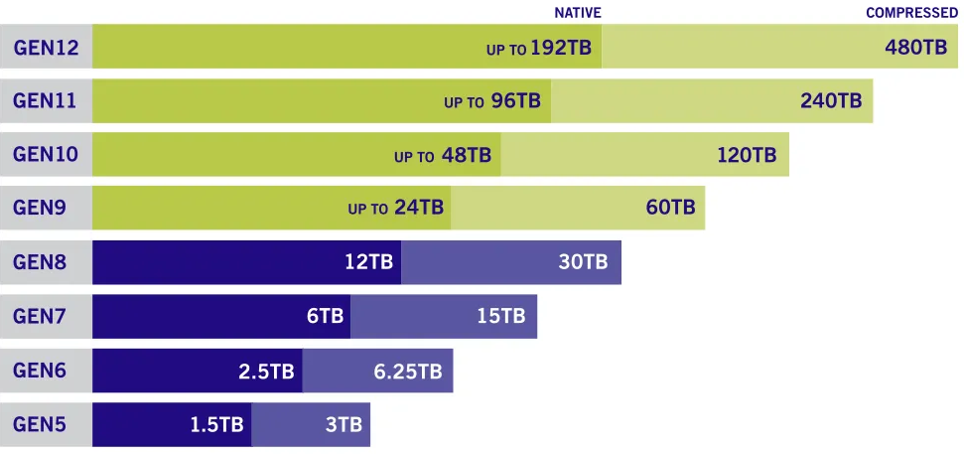
Advantages of Tape Archive
Easy to expand
Power efficient
Non enterprise tapes are cheap
Tapes evolution are on par with disk evolution
Malicious encryption of data is just not possible
Malicious deletion of data is not achievable

Slide 12

Upgrade ESRIN Archive Study

Slide 13
Archive Upgrade at ESA
To keep up with the always growing amount and variety of data produced, the archive is constantly enhanced to facilitate the archival process.
Over the course of the last 15 years, several HW upgrade have been performed to the core of the Archive, the Robotic Library.
Future upgrades shall take into account technological innovation and practices and. to save energy, thus making the archive and its hardware environmentally friendly, green computing technologies shall be favorite.
The industry has been engaged to help us drawing a roadmap and reach several goal including:
Better ingestion and extraction performances
Wider the audience using the archive
Decrease the power consumption of the whole environment
Use of innovative technology and archiving trends
Archive Kick-off
Migrated technology and data from T10KB to T10KD
Increased number of drives
Implemented 10GB Network
Upgraded fiber channels environment from 8gbp/s to 16gbp/s
Upgraded 1rst tier from mechanical HDD to SSD Disks
Optimized 1st tier – dedicated LUN for iNodes
Implemented Disaster Recovery
Introduction of 2nd tier
Migration to LTO-8 (increased number of drive to 12)

Slide 14
Background of Evolution Study
Study made to help on a possible evolution of ESA ESRIN
Archive with current or future technologies
Analysis on hardware, software and cloud services
Review of other ESA and external agencies tools
Environment-friendly approach
Based on publicly available information
Must guarantee the correct preservation of the data regardless of the medium used

Slide 15
Study approach
Archiving market survey
  Hardware (Tapes, Folio, Glass Drives, Disk Storage, OS Orchestrators etc)
  Software ( Alluxio, Atempo, Versity, MinIO, LABDRIVE, nageruHive etc)
Cloud Providers survey (on prem, public offers etc)
Standards
Existing ESA Tools (Compernicus LTA, Planetary Science Archive etc)
Other Organization (NASA, CERN, NOAA – NCEI, Eumetsat etc)
Sustainability (Energy consumption, Cooling Requirements etc)
Costs (HW and SW)

Slide 16
Key Findings
There are solutions to keep using current ESA/ESRIN storage technologies. You don't need to change the entire infrastructure because of HSM end of life
Hardware providers are developing hot, warm and cold storage solutions that can complement the current infraestructure and, definining a roadmap, could substitute it in the long-term
Some WORM storage options are already available or being developed that are based on nonmagnetic media, like optical disks or crystal based. There are some that could help ESA on the long-term perspective without needing to migrate as the media lasts for a longer time
More and more, organizations are moving to cloud-based services because of their flexibility and cost effectiveness in the short-term. However, the step to cloud needs to be planned because long-term costs and vendor locking could be an issue in the future

Slide 17
Key finding (2)
Complementary to pure cloud solutions, the hybrid-cloud approach suggestable. A mix between public access on the cloud plus cold on-premise storage would benefit in the long-term to address purecloud flaws
The preservation software market is very active and growing. In addition to the classic providers in this area, some new players are showing interesting solutions also with a very open-minded approach to avoid extra costs or cloud locking. SaaS is a trend on this market but private cloud solutions are also available
Security and sustainability are also worries in this market. Many providers are showing some environmentally friendly messages but it is not clear how much are they real or just green-washing
OAIS is the standard for preservation and needs to be followed. In addition, other standards could improve ESA/ESRIN archive operations in different directions
Big cloud providers are charging for requests or operations which makes it almost impossible to make a budget in advance
Some European cloud providers are not charging for the recovery or the model is more manageable

Slide 18
Upgrade Roadmap
Review StorageTek tape library status
  Replacement needed ?
  If kept, new management infrastructure should be acquired to replace current HSM. There are several options to do this
Decide which Cloud services are required (if any)
Check if some hybrid-cloud approach could be feasible
Define which standards need to be followed
Prepare requirements for the systems to follow and checklists for providers analysis
Evaluate archiving software alternatives between those existing on the market or build a proprietary solution
Calculate accurately the current energy consumption and heating dissipation needs for the current solution
Open RFIs with selected providers to get a deeper technical information (and pricing)

Slide 19
Conclusion
After analyzing the market, the current situation of the Archive and the reference guidelines the best solution for updating the Archive is a hybrid cloud model, which integrates the current tape storage infrastructure with a flexible model that facilitates access and improves its online capabilities.
The current Tape Library work-life has been considered sufficient to cover the needs of the coming years and therefore, the recommendation is to continue using it for some years now. The archive manager shall be replaced by any of the identified alternatives or by an integration into cloud services.
One understated advantage of continuing to use tape-based archives is the always increasing security concerns. Malicious encryption or deletion of the data is not possible or highly complicated. Moreover, to reduce energy consumption and carbon emissions using tape storage instead of hard disk is an effective solution.
ESA is defining a roadmap for the evolution of its ESRIN archive. The roadmap is the first step in the direction of assuring seamless archival, extraction, valorisation, and preservation of the always increasing ESA and Third Party Missions (TPM) EO data records and associated information.

Slide 20
Archive Technology Evolution White Paper
Archiving technology evolution paper is a formal deliverable of the CEOS Workplan to be produced by Q2 2023
Table of Content
Introduction and Scope
Current Archive Solutions in EO
Main Issues and Challenges
Archiving technology trends
Recommendations and way forward
For Discussion
First Draft by the end of May 2023
Notes:
Sulla base dei survey e dello studio sui trend tecnologici abbiamo definito un draft della ToC del documento formale richiesto dal CEOS Workplan.

