Slide 1

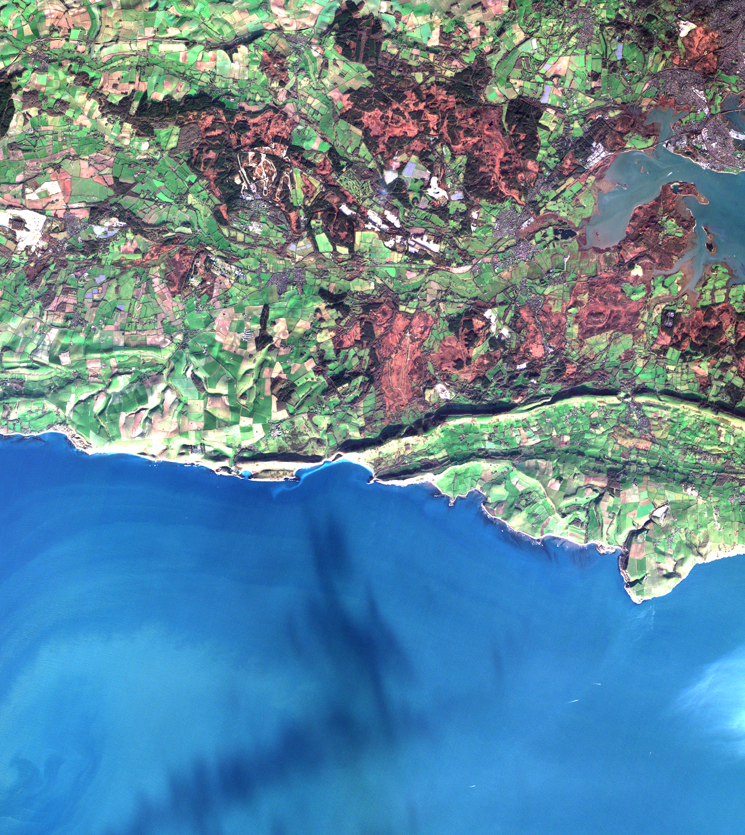

UKSA Agency Report
EO DataHub Pathfinder Project
Phil Kershaw(NCEO CEDA), John Remedios (NCEO Leicester), Esther Conway (NCEO CEDA), Jennifer Bulpett (CEDA), Patrick Griffiths (UKSA), Adrian Broad (Met Office), Sam Hunt (NPL), Emma Hatton (Satellite Applications Catapult).
Agenda ID: 2023.04.19_16:50
WGISS

Slide 2





EO DataHub – a collaboration
+ Industry

Slide 3

National Centre for Earth Observation
NCEO CEDA – PI Phil Kershaw
NCEO Leicester – PI and Director John Remedios
NCEO provides the UK’s Natural Environment Research Council (NERC) with national capability in Earth observation science – monitoring the health of our planet through satellite instruments and with world-class capability in interpreting these data.
We are a NERC research centre with more than 130 scientists distributed across leading UK universities and research organisations and led by Professor John Remedios at the University of Leicester.
The Centre for Environmental Data Analysis (CEDA) serves the environmental science community through provision of:
CEDA Archive - a long term data archive
JASMIN - a data intensive supercomputer
and participation in a host of relevant research projects
We aim to support environmental science, further environmental data archival practices, and develop and deploy new technologies to enhance access to data. Additionally we provide services to aid large scale data analysis

Slide 4
UKSA
The UK Space Agency works closely with DSIT and the UK’s Earth Observation sector to deliver the National Space Strategy. The UK Space Agency Corporate Plan outlines Earth Observation as a priority area, with a portfolio of activities that spans the entire value chain, from early technology development, through to missions, calibration and validation, and the development of trusted data for use

Slide 5
Satellite Applications Catapult
Are one of nine Catapults, uniquely established to transform the UK’s capability for innovation in specific areas and to help drive future economic growth. We help organisations make use of, and benefit from, satellite technologies, and bring together multi-disciplinary teams to generate ideas and solutions in an open innovation environment.
The aim is to support UK industry by accelerating the growth of satellite applications by exploiting the innovation potential in the UK industrial and academic communities, by being a focal point where small and medium enterprises, large industry, and end users can work together with researchers to challenge barriers, explore and develop new ideas, and bring these to commercial reality.

Slide 6
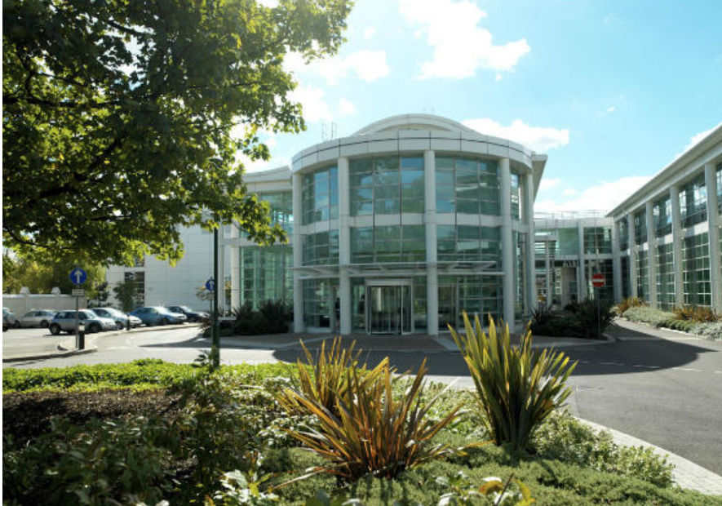

National Physical Laboratory (NPL)
NPL is UK's National Metrology Institute (NMI)
  Develop and maintain the national primary measurement standards
  Research interests cover a wide variety of measurement disciplines
NPL have led the interaction between the metrology and Earth Observation communities, in particular covering cal/val and data quality.
In the EO Data Hub project NPL will lead the development of a data quality catalogue
  Aimed at enabling users to determine with confidence which data are “fit for purpose” for their applications
https://www.npl.co.uk

Slide 7
EO Data Hub – Met Office summary
About the Met Office
The Met Office is the national meteorological service for the UK. We provide critical weather services and world-leading climate science & services, helping government, businesses and the public make better decisions to stay safe and thrive anywhere in the world.
The Met Office supercomputing system is one of the most powerful in the world dedicated to weather and climate.
Met Office role in the EO Data Hub activity
To provide knowledge, expertise, advice and guidance on our experiences with:
Public cloud computing providers relevant to the development and operations of the Data Hub, and
Interactions with important other national and international EO data platforms.

Slide 8
What is the DataHub?
Be a new ‘single point’ EO Data infrastructure, that builds on current UK EO assets and brings together the current breadth of UK EO data offerings from public and commercial centres
Provide an end-to-end adaptive infrastructure, supporting a broad range of cross-sectoral generators and users of EO datasets
Enable new EO services and tools to be developed and accessed by the UK EO data community by providing a transformational layer via the hub infrastructure - integration of user-defined tools and foster application development for specific sectors
Address key challenges in EO data access and discovery, interoperability, transparency, and trustworthiness
Enable unified but flexible access to EO data from across multiple (public and private) sources

Slide 9
Challenge: Fragmentation inhibiting growth
Disparate resources and service offerings, multiple APIs, data formats, licence agreements, operating models+
User Application
Platform
Data provider
Hosted processing facility
Data Facility
+ Findings of UKSA EO Data Architecture Report

Slide 10
DataHub – Proxy for the user to mediate access to data and services
User Application
Platform
Data provider
Hosted processing facility
Data Facility
DataHub
+ Findings of UKSA EO Data Architecture Report

Slide 11
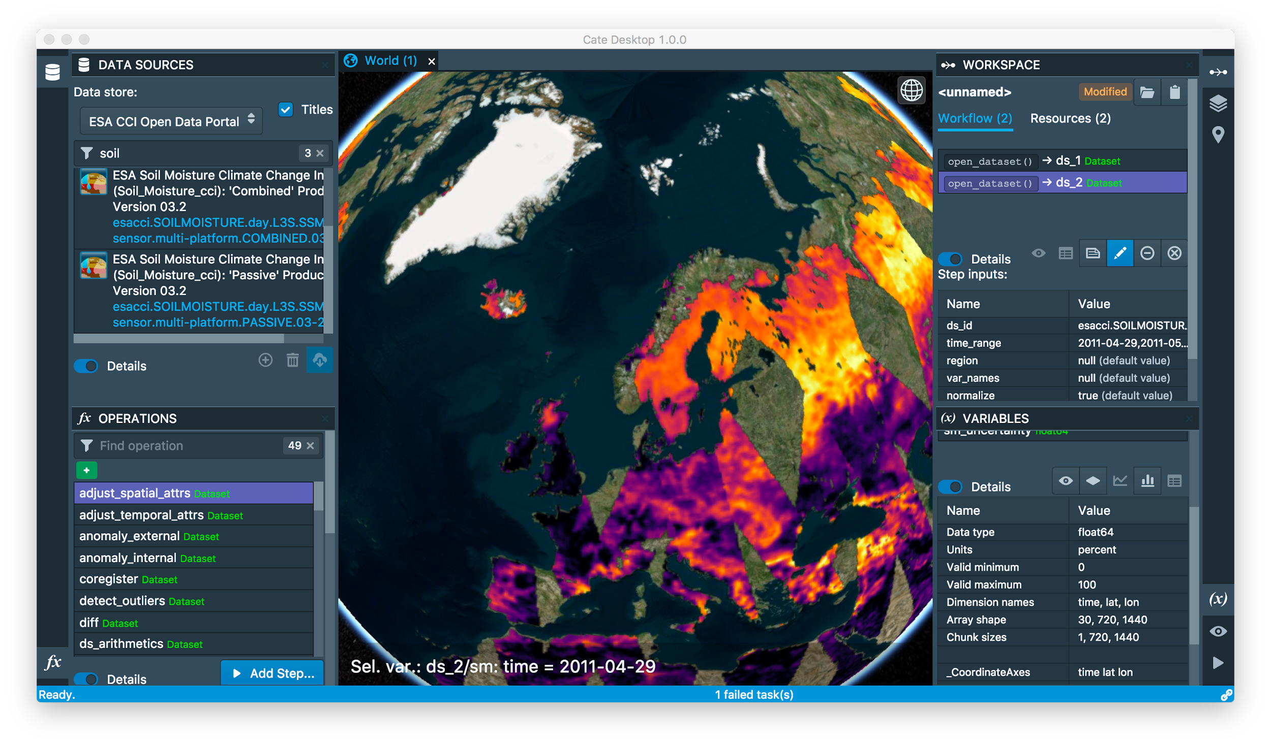
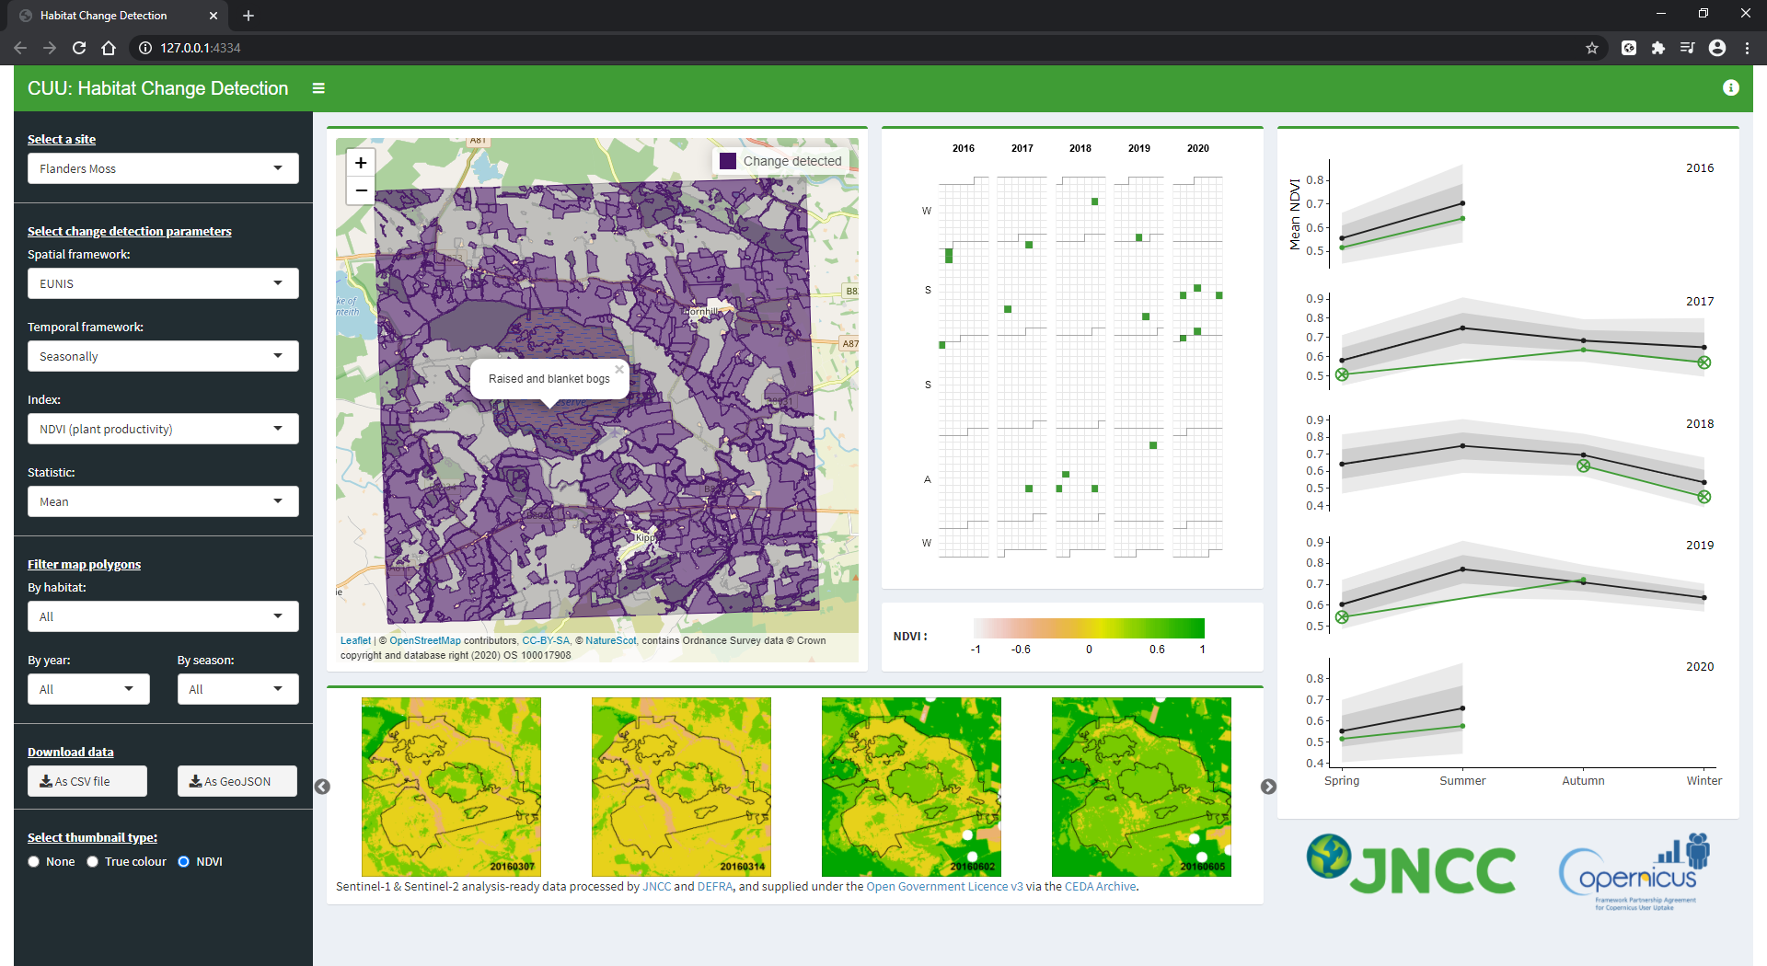
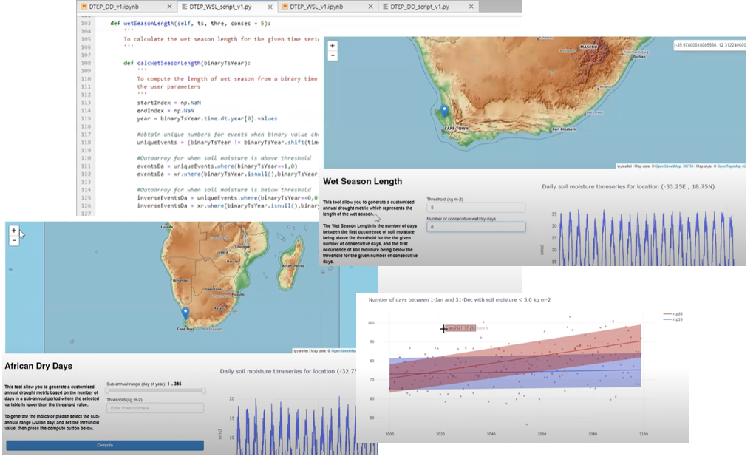
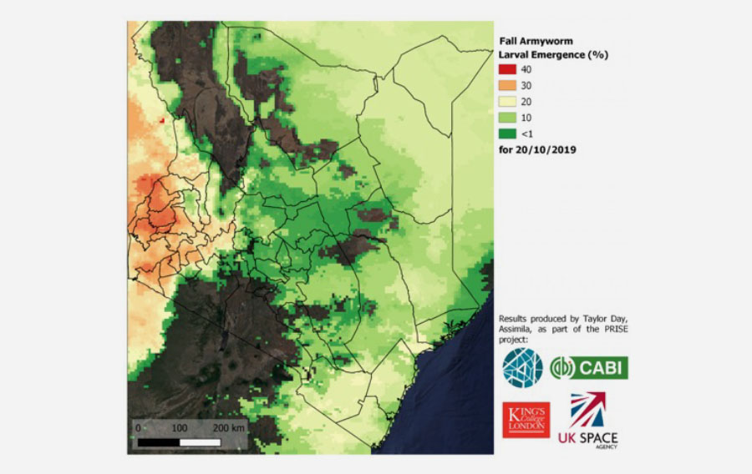
Platform Development Approach
ESA Climate Change Initiative Toolbox
JNCC – Habitat Change Detection
Web Applications and Services building on capabilities of underlying infrastructure
One example - JASMIN:
10 years experience with this model serving NERC user community and working with partners in industry and the public sector
PRISE – Assimila, CABI, KCL, STFC
ESA Digital Twin Earth Climate Explorer - Soil moisture prediction

Slide 12



High-Level Architecture
User Layer
Examples for illustration only
Climate Platform
Thematic Interactive Data Analysis Environment
Public Sector Application
Application Layer
Search data catalogue
Execute processing pipeline
Access analysis ready data cache
Data Processing Pipelines
APIs, Web presence
Hub: adaptors and interfaces
Data Hub
Resource Catalogue
ID and Access Management
Analysis-Ready data caches
QA Service
Data Adaptor 1
Data Adaptor …
Data Adaptor n
< . . . >
In-situ data processing API
Climate data facilities, commercial data providers, public space assets
Data access API
Data access API
Data Streams
Data Centre
Data Centre 2
Hosted Processing
< . . . >

Slide 13
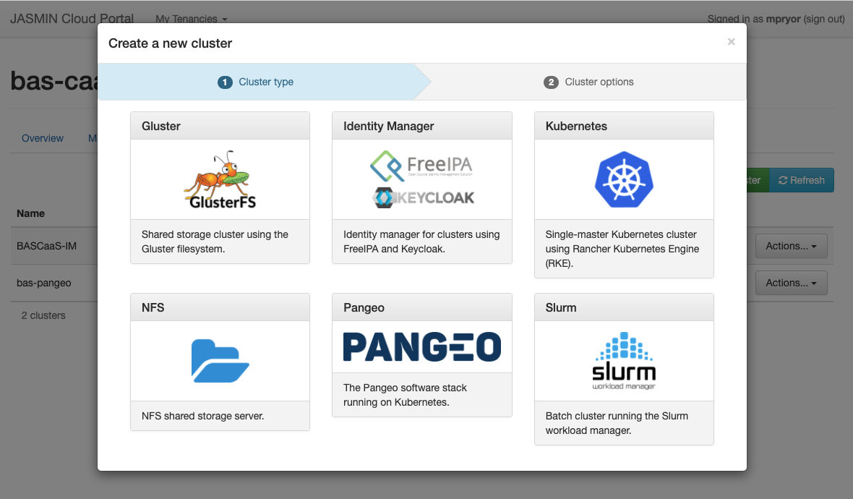
A past project: ESA Digital Twin Earth Climate Explorer as illustration of some of the principles
JASMIN HPC
JASMIN Cloud
Cluster-as-a-Service deploys ready-made Jupyter Notebook service
JULES / LAVENDAR Data Assimilation
Model outputs netCDF files to regular file system
Traditional HPC storage
Cloud Storage (S3)
Data accessed using Jupyter Notebook service
Batch computing
Cloud tenancy
netCDF
Machine Learning Training

Slide 14
 | 22/23 |  |  | 23/24 |  |  |  |  |  |  |  |  |  |  |  | 24/25
 | Q4 |  |  | Q1 |  |  | Q2 |  |  | Q3 |  |  | Q4 |  |  | Q1 |  |  | Q2 |  |  | Q3 |  |  | Q4
 | J | F | M | A | M | J | J | A | S | O | N | D | J | F | M | A | M | J | J | A | S | O | N | D | J | F | M
WP0 Project Management
Sustainability and Legacy Plan
Public cloud hosting tenders
WP1 Preparation of Data Streams
Prepare tenders+supplier engagement
Commercial EO data
Public EO data
Climate Projections
Operations
WP2 Hub Software Development
Prepare tenders+supplier engagement
Production Implementation
Operations
WP3 Platform Development
Prepare tenders+supplier engagement
Pilot implementations
Production implementations
Operations
WP4 User Engagement
Prepare tenders – user pilots
User pilots
Framing and Validation of Propositions
User Liaison and Stakeholder Forum
WP5 Quality Assurance for EO Data
Develop quality metric assessment req.s and spec for catalogue system
Tender award Public cloud hosting
1st Tender award commercial data streams
Public EO Data streams integration
Commercial EO Data streams integration
Supplier engagement
Climate Data streams integration
Tender award Production Hub
Hub MVP
Prototype Hub
Pre-production Hub
Production Hub
Tender award Platform pilots
Tender award Production Platforms
Pilot Platforms complete
Pre - ops
Commercial/Public Sector Platform integration
Commercial data integration
Climate Platform integration
Production Platforms
Tender award user pilots
User pilots complete
User pilots extension complete
Pre - ops
User pilots extension
Complete requirements definition for catalogue scheme
Define quality metric assessment and catalogue system specification
Catalogue system prototype release
Pre-production cataloguing system release
Complete cataloguing for further set of high priority missions

Slide 15
“Successful” User Pilot Projects
Dark green line = successful commercial; light green line = public; orange = academic; dashed blue = possible GEO/CEOS projects; red dashed = unfunded technical project
Technical compute
Technical Data
Scoping/system design
UCL: ARD
CEH: Hydrology
JNCC: Data Cube
Global Trust: HPC
BAS: Sea ice S1
GMV: Food
CGI: Seagrass
Telespazio: Energy
Assimila: fire
Argans-NOC: Shoreline
U. Leeds: Volcano
Specto: bare soil
SparkGEO: Assets risk
Demonstrations/Prototype
Services
Research

Slide 16





Core functional areas
Data Streams + access interfaces
Resource Catalogue
Identity and Access Management, Accounting and Metrics
Data Analysis, Processing and workflow management
allow integration of different data providers and production and caching of outputs on the Hub
support search of data and processing resources
Quality Assurance for data
grant access to secured resources, account and charge for use as required
Analyse data, develop and incorporate custom code, execute and integrate into workflows
Web presence
Presentation and glue
OGC W*S – WMS, DataCubes, Object store – COG, Zarr
STAC, OpenSearch, OGC, …
OpenID Connect, OAuth 2.0, …
Jupyter, Dask, CWL, Apache Airflow, …
Notes:
- data streams: POSIX, OGC W*S – WMS, DataCubes, Object store – COG,

Slide 17
Knowledge exchange – Interoperability Use Cases
Pathfinder approach
Value Public sector, commercial, academic communities
Project which seeks to balance complexity vs operational sustainability
Standards-based and open source
Use Cases for Applications/Platforms drive and inform Hub development priorities
Build on and extend existing software solutions where advantageous – knowledge exchange
Maximise use of existing service offerings, avoid re-invention
Leverage public cloud eco-systems for accelerated development

Slide 18
Questions ?
esther.conway@stfc.ac.uk

