Slide 1
NOAA Agency Report
Kenneth Casey, PhD, Nancy Ritchey, and Rich Baldwin
Deputy Chief, Data Stewardship Division
NOAA/NESDIS National Centers for Environmental Information (NCEI)
April 2023
WGISS-55
Cordoba, Argentina

Slide 2
One-Slide Summary
Update on NESDIS Common Cloud Framework (NCCF)
  NCCF continues progress since last WGISS update
  NESDIS Cloud Archive and Access Team (A&A) achieved Ver. 1.0 of the archive services, successfully completed end-to-end testing for identified data and is working with the Infrastructure and Solutions Teams to move to production. Initiated scalability testing of archive services.
Updates from NOAA/NESDIS/NCEI
  OneStop NOAA Data Catalog V3.0.1 in Production this week, with ~100,000 collections and tens of millions of granules loading (in process)
  Will replace existing official NOAA Data Catalog once cross-NOAA reviews complete
  CoMET updates continue but still no broad public access yet (targeting Oct 2023)
NOAA Data Governance Maturing
  New Data Governance Committee finalizing new NOAA Data Handbook

Slide 3
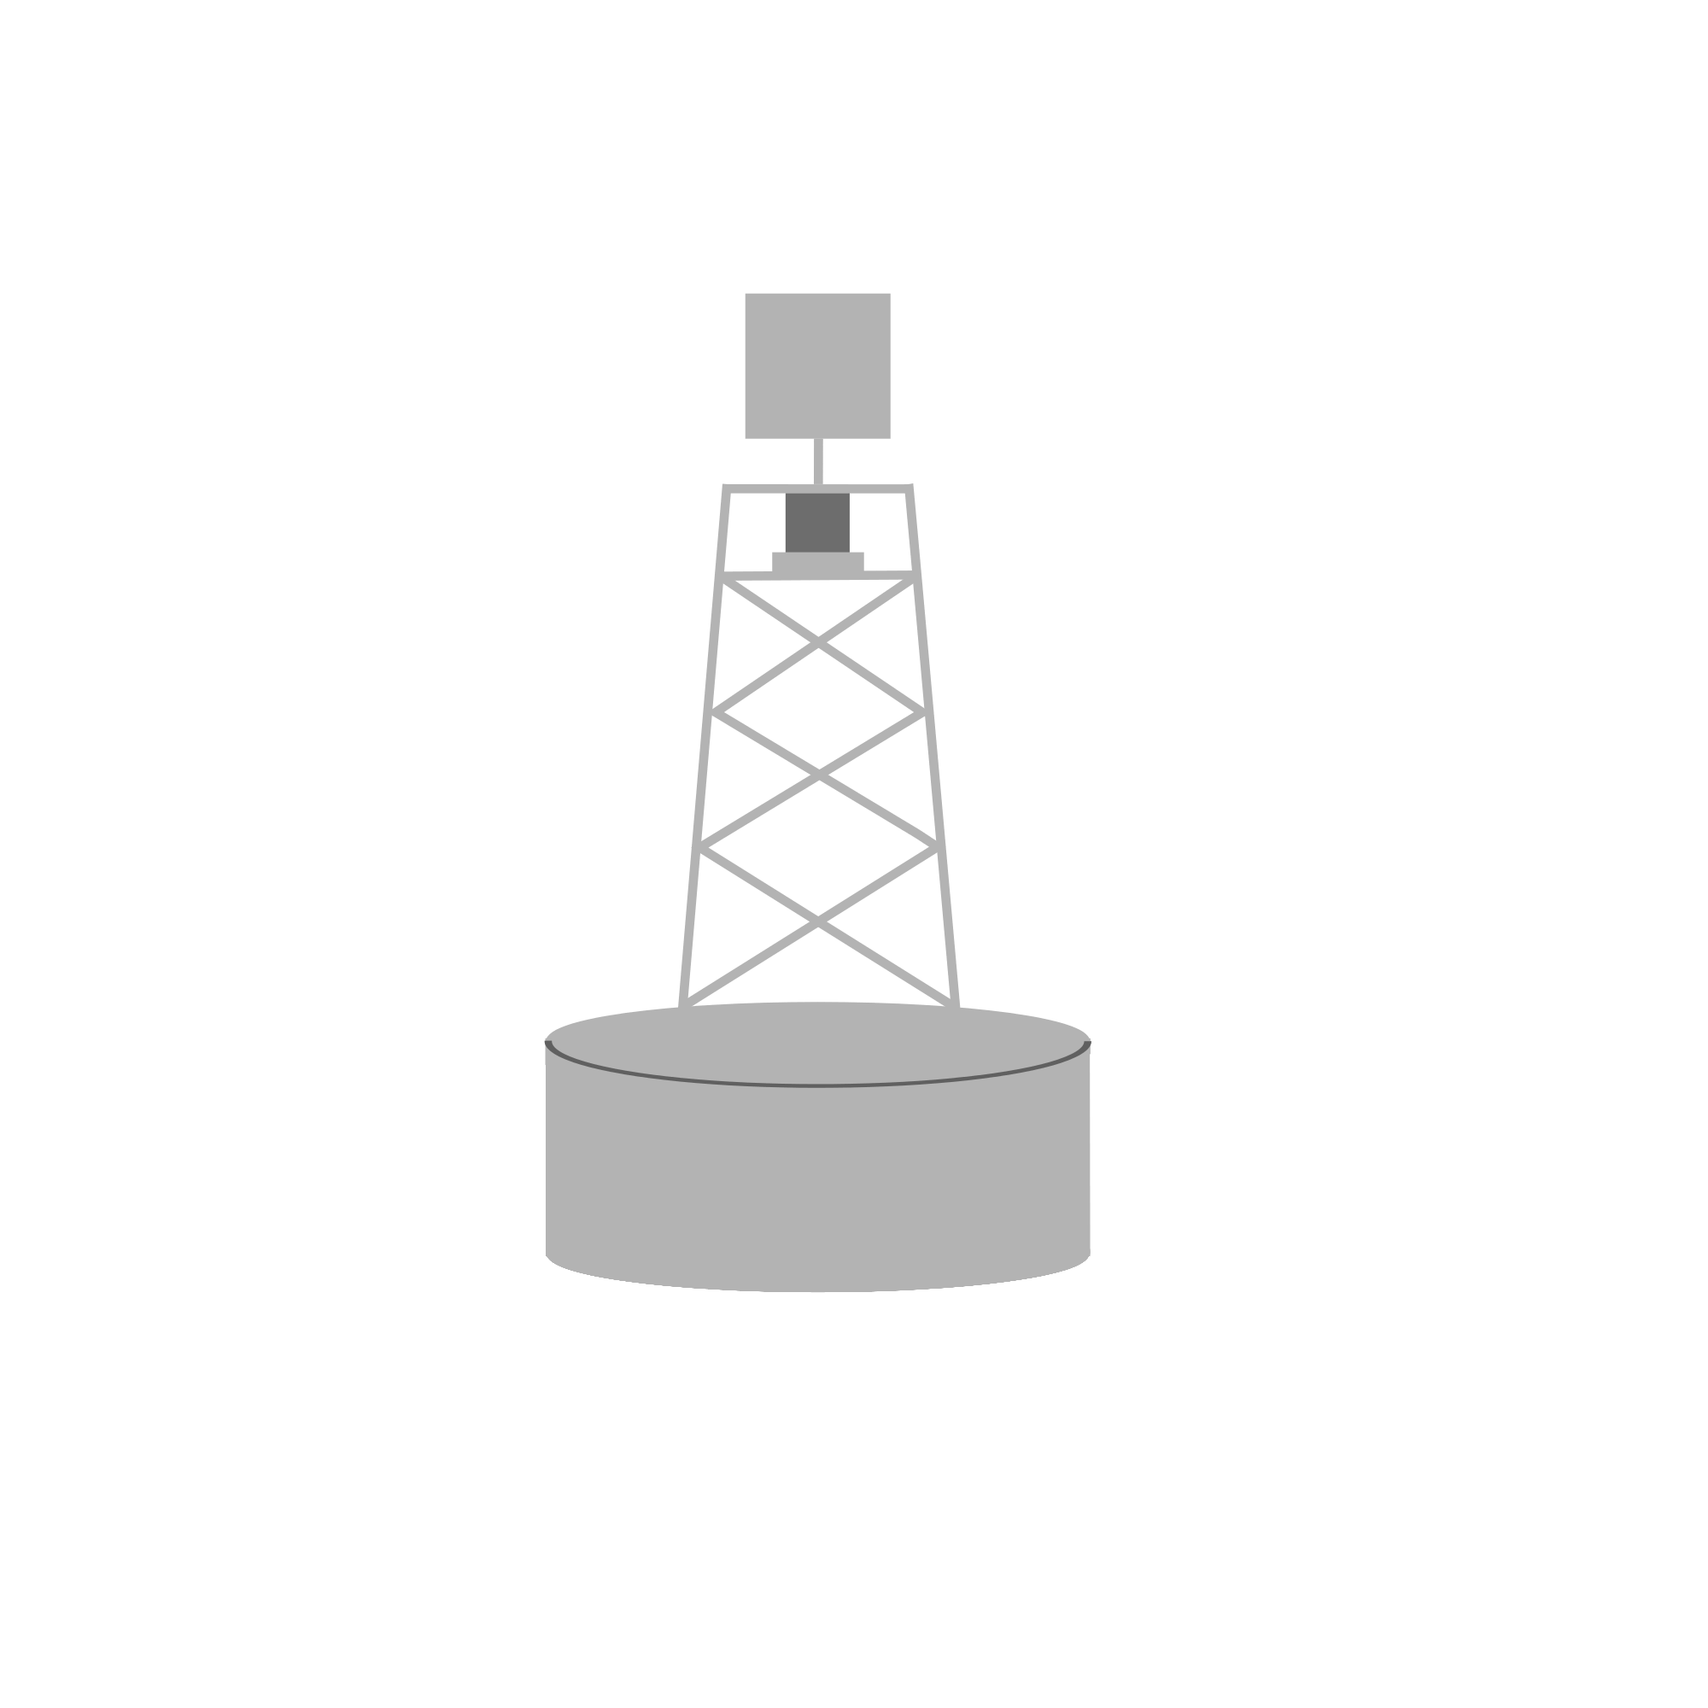

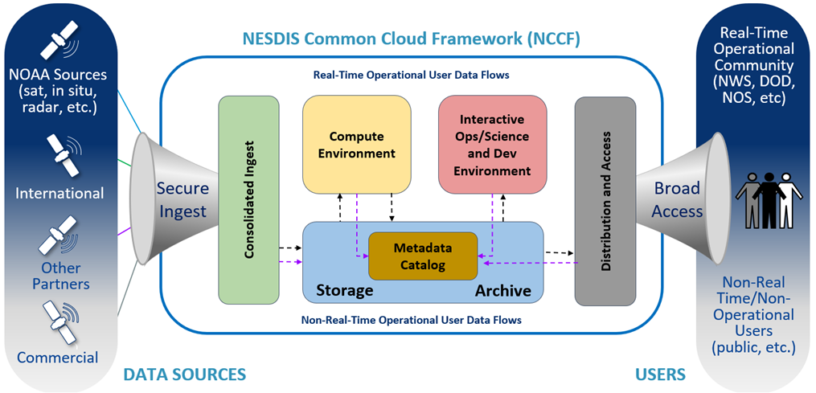
NESDIS Common Cloud Framework (NCCF)
Cloud enterprise architecture with a multi-account and multi-Virtual Private Clouds (VPC) deployment
Secure, fault tolerant, highly available, scalable architecture
Loosely coupled, independently scalable services
Implemented using Infrastructure as Code (IaC)
  Reduced failover risk
  Allows to minimize vendor lock in
Operationally deployed for high availability workflows in the Amazon Web Services (AWS) commercial cloud
Inclusion of automation to ensure secure deployment of new software and service updates
Notes:
- NESDIS is building the NESDIS Common Cloud Framework, which is a Cloud enterprise architecture that will bring the data, processing, and dissemination into the a common, secure, and scalable architecture.
- There will be loosely coupled, independently scalable service and implemented using infrastructure as code
- The high level concept is shown in this diagram with secure ingest of data and going through consolidated ingest, into storage, metadata management, and archive that is leverage for algorithms in a compute environment as well as science exploration. Finally there is distribution and access of data.
- The NCCF archive and access development is focused on this yellow highlighted box.
- This NCCF service will replace the current on-premise archives, including CLASS and three additional archival storage solutions that NCEI operates

Slide 4
Cloud Archive Timeline
2021 | 2022 | 2023 | 2024 | 2025 | 2026 | 2027
Version 1
Enterprise Archive Capability
Sustainment of Archive / Access Enterprise Functionality
NCCF Archive
Pilots to Version 1
NCCF Enterprise, Archive,
and Stewardship Development
NCCF Enterprise Archive, and Stewardship and Iterative Optimization Releases
(Specific dates subject to change)
Connection/Development of Functionality of Existing Archive Systems
Migration of Legacy Data Streams from Existing Archive Systems
Key Activities
Pilot archive capability in NCCF within 12 months - Done
Version 1 of Cloud Archive - In Progress, Complete summer of 2023
Version 2 of Cloud Archive - On Backlog, Complete by end of December 2023
Notes:
Right now we are focused on deploying that Version 1 by summer of 2023 (exact date subject to next planning increment). From there we will continue development of the archive functionality while starting to migrate data into the workflow, leveraging the migration to inform the development of the enterprise archive and access functionality.
While the full migration is expected to be complete about 2027, the ability to access data from the Cloud archive and leverage the technology will be available incrementally as we migrate data into the Cloud.

Slide 5
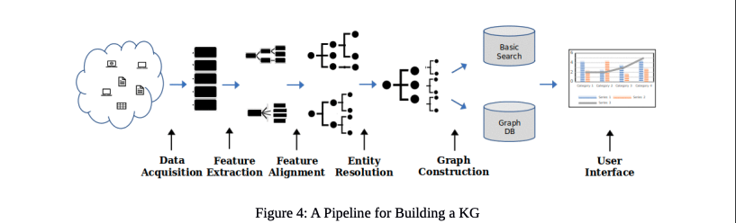
Knowledge Graph (KG) Workflow
“Methods of building a KG take us from raw, messy, and disconnected data/information that is hard to query, analyze, and visualize to a more refined, organized, cleaned, and linked product that is easier to visualize, query, and analyze.” (Baclawski et al., 2020)
https://ontologforum.s3.amazonaws.com/OntologySummit2020/Communique/OntologySummit2020Communique.pdf
Critically, the KG is an integrated component of the archive workflow, not bolted on after the fact. Information and relationships are extracted throughout the workflow, and all these pieces are part of the data model.
Notes:
Underlying this new cloud archive is a new, essential component: a knowledge graph (KG). This diagram from Baclawski et al. (2020) shows a generalized view of how a KG is built. In our KG, we start with data acquisition, then extract features from that data/metadata and align them to concepts and relationships to be stored in the graph. There are many challenges in these processes, but when done well the resulting graph enables a whole new kind of interaction… no longer are we limited by basic free-text and key-value pair type searches (show me datasets where “platform” equals “R/V Knorr”). With a KG, we can move toward knowledge discovery… think of it like a map, that helps you explore new territory and follow your own line of inquiry. Connections that simply do not exist in current systems can be discovered and explored… “oh look, this dataset was funded by the NOAA Coral Reef Conservation Program but it was also used by that application that identifies appropriate placement of offshore wind farms, which means the CRCP indirectly helped support an entirely different segment of the economy.”
One of the key challenges is to accurately and consistently capture the concepts and their relationships…. I say “platform”, you say “ship” or “buoy” or “satellite”. So we must be able to align domain-specific terms to the more generalized concepts and relationships in the KG.
Importantly, the knowledge graph is an integrated component of the archive workflow, it’s not bolted on after the fact. The information and relationships are extracted throughout this workflow, and all these pieces are part of the data model.
This enables tracking provenance and relating data, standards, processes throughout these steps. Each step in this process is considered data. For example, if I want to search for a particular feature extraction method that might fit my use case I can search across all the ones being used.
You can also search and see how a particular data set is composed that provides transparency into the data sets and how to recreate those data.
As a data user you will be able to better discover the data you want, understand the origin of those data, how to use them, and understand how that asset is connected to other assets through the “connective” power of the knowledge graph

Slide 6
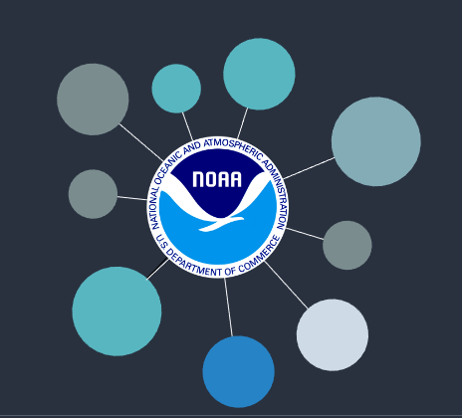
Power of a Fully-Integrated KG
Every archive workflow step is tracked and considered “data”, enabling new kinds of searches and interactions
Deep provenance inquiries become possible, enabling scientific reproducibility and transparency
Linkages to other concepts in the KG (and to other KGs) can be explored via the “connective” power of the KG
Enables Earth Digital Twin implementation
So how do we do this at scale? …
Notes:
- This full integration enables tracking provenance and relating data, standards, processes throughout these steps. Each step in this process is considered data. For example, if I want to search for a particular feature extraction method that might fit my use case I can search across all the ones being used.
- You can also search and see how a particular data set is composed that provides transparency into the data sets and how to recreate those data.
- As a data user you will be able to better discover the data you want, understand the origin of those data, how to use them, and understand how that asset is connected to other assets through the “connective” power of the knowledge graph

Slide 7
More Detail: Cloud Archive Workflow Architecture
Leverages and Builds the Knowledge Graph
Ingest
AWS EventBridge
AIU - Archival Information Unit
AIC - Archival Information Collection
DIP - Dissemination Information Package
vAIP - Virtual Archival Information Package
s3
Pre-
processor*
AIU
Workflow
AIC
Workflow
DIP
Workflow
file*
message
Event
graph
Apply Tags
Read Message and Load Task
Read Message and Load Task
Read Message and Load Task
persistent storage
persistent storage
persistent storage
Archive Data
Transform Data
= step function task
Compute Membership
Legend
persistent storage
= read
graph
= write
= predefined step
Generate AIU Record
graph
Deliver Data
Generate AIC Record
= read/write
= configurable step
graph
graph
Build AIC, DIP Messages
graph
Generate DIP Record
graph = vAIP knowledge graph interaction
Build AIC, DIP Messages
persistent storage = e.g. s3 or database interaction
Build AIC, DIP Messages
graph
*The preprocessor only applies to S3 ‘file’ events. Preprocessor is an automatic, static, and hidden model layer that adds corresponding object tags to file events in order to properly route and control workflow processing for that object. Directly submitted messages must already include required tags and will skip preprocess.
Notes:
Ensuring the workflows to ingest data and metadata and build the KG are manageable at scale requires the use of repeatable process templates. This slide illustrates the concept of the repeatable, reusable templates… configurable steps, combined with other predefined steps, are managed and executed by the Event Bus (using AWS Eventbridge), allowing us to have a full, repeatable provenance trace for every granule and every collection in the NOAA Cloud Archive. Next to each step (in grey), interactions take place with the KG (“graph”) or persistent storage (“store”, S3 or a database)

Slide 8
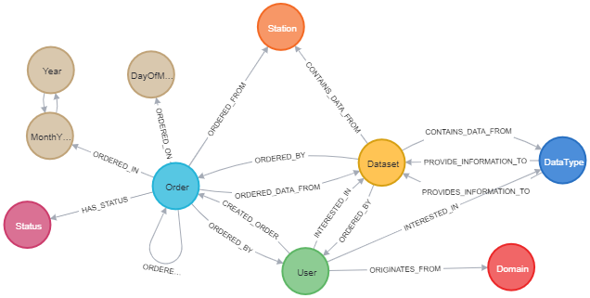
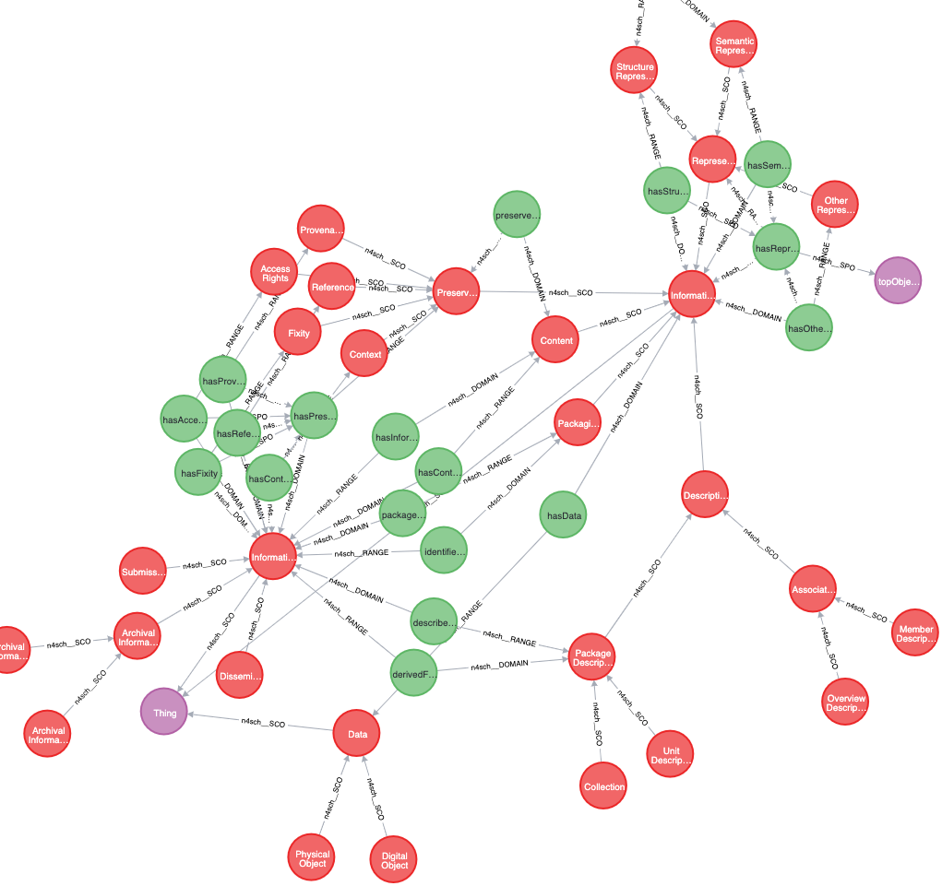
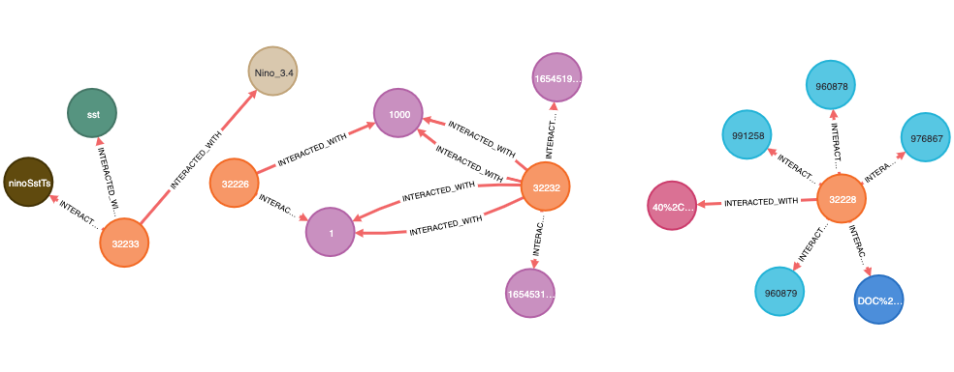


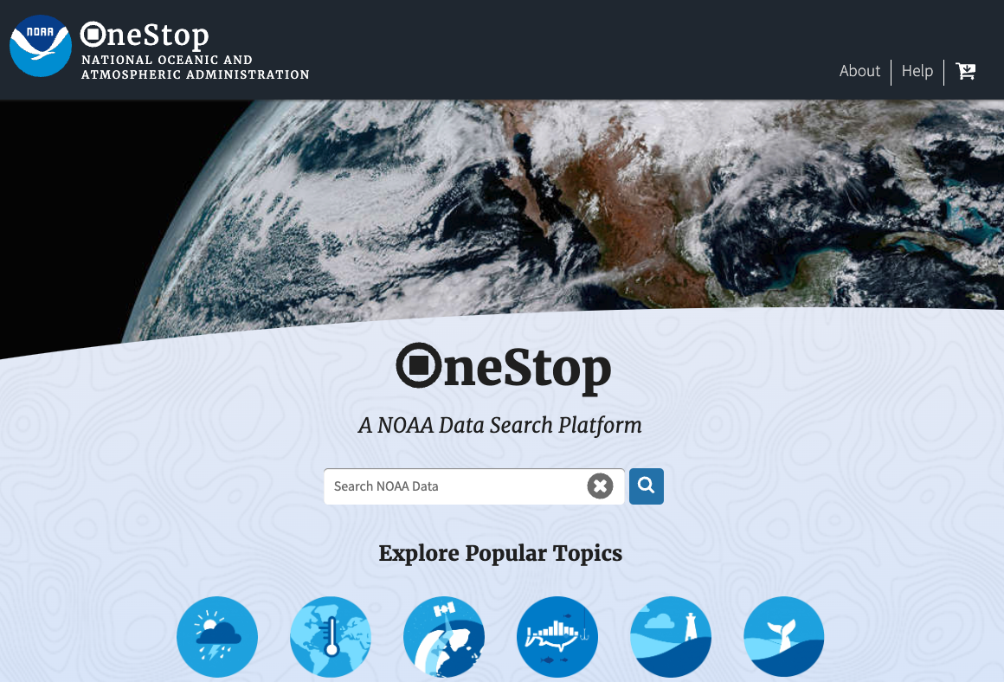
More Detail Still: More than one Graph!
For scalability/efficiency, not everything is in one graph, and not everything goes in a graph
In addition to the Virtual Archival Information Package (vAIP) graph, the holistic knowledge graph underpinning the archive, two other graphs are under development:
  Data Order Graph (DOG) - supports data ordering by users
  LOGDOG - tracks interactions with our data access systems, so we can generate knowledge from use
Cloud archive workflow can still feed OSIM (kafka, elasticsearch), CMR (Oracle, elasticsearch), or any other components of the catalog/discovery/access ecosystem
(CMR = NASA Common Metadata Repository)
Data Order Graph (DOG)
vAIP Knowledge Graph
LOGDOG
OneStop-
Inventory manager (OSIM)
Notes:
Elasticsearch image credit: https://www.elastic.co/elasticsearch/
Kafka image credit: https://kafka.apache.org/
OneStop image from the NOAA OneStop discovery portal at: https://data.noaa.gov/onestop

Slide 9
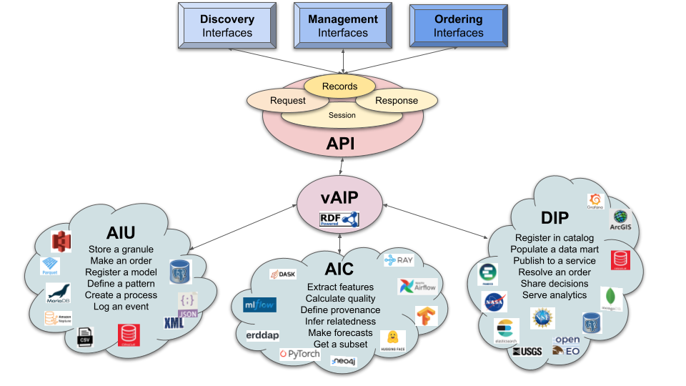
What does this all look like from the User Point of View?
Humans typically
interact here
Richer feature set!
Machines typically
interact here but also here
Notes:
Users won’t typically be interacting directly with the knowledge graph - though we plan for that to be possible eventually, and to link our KG with other KGs
The knowledge graph, however, will significantly improve the features and capabilities of online interfaces for both users and machines
New lines of inquiry will be made possible, such as revealing “similar” datasets based on a user’s queries and patterns, or usage-based discovery
In addition, linkages across repositories will be enabled, opening the door to exploration across agencies, repos, and their knowledge graphs (for example, NSF’s Open Knowledge Network)

Slide 10






The NOAA vAIP KG Connected to the Broader Ecosystem
A linked and open “knowledge network”, with many doors of entry
?
NCEI participating in the US NSF Open Knowledge Network program

Slide 11
Summary of Cloud Archive Achievements
Demonstrated Cloud Archive Workflow version 1 for Optimally Interpolated SST (OISST) product and Space Weather Follow On (SWFO) example data. Beginning work on NEXRAD Level 3
Achieving improved scalability (goal: 100k/hr) by
  Restructuring named graphs
  Using a provisioned writer for Neptune
  Implementing bulk loading to Neptune
  Adjusting query & Lambda timeouts
Vetted architecture and implementation with AWS ProServe

Slide 12
Activities at NCEI
OneStop-Inventory Manager V3.0.1 operational!
  Re-enables the official NOAA Data Catalog
  Contacts and update frequencies updated across NOAA
  CKAN (old Data Catalog) will be turned off soon
  In “soft launch” review period
CoMET updates continue, but still no broad public access
  Enabled users to have different roles for different groups of metadata records (critical step prior to public access)
  Working on automated user account setup now
  Login.gov implementation target: October 2023
CoMET = Collection Metadata Editing Tool

Slide 13
NOAA Data Governance Committee (DGC)
DGC fully established and most NOAA line office (NESDIS, NOS, NWS, NMFS…) Assistant Chief Data Officers hired
DGC nearing end of process to modernizing former NOAA Procedural Directives for Environmental Data Management into a new “NOAA Data Handbook”

Slide 14
Questions?

