Slide 1
Service Discovery: OSS Tools Metadata
Ingestion Use Cases - FedEO
Yves Coene (Spacebel for ESA), Mattia Stipa (ESA),
Damiano Guerrucci (ESA), Mirko Albani (ESA)
CEOS WGISS #55
19/04/2023

Slide 2
Outline
Introduction
FedEO (Evolution) implementation
Next steps and future work

Slide 3










Introduction
FedEO and FedEO Evolution Discovery interfaces:
  RESTful OGC API Features / OpenSearch / STAC API interface covering:
    “service” resources
    “collection” resources
    “granule” resources
  (service) search parameters advertised in:
    OpenAPI definition
    OpenSearch OSDD
    Queryables (OGC API Features Part 3 Filtering)
  Search responses in Atom / GeoJSON / JSON-LD / RDF / Turtle etc.

Slide 4
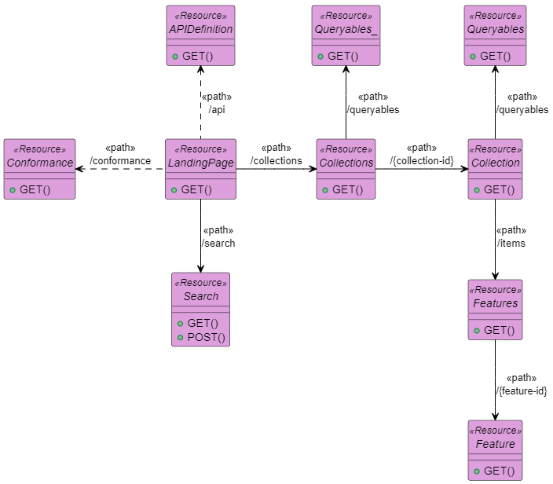

FedEO RESTful API
RESTful API offering multiple interfaces:
  OGC API – Features (Part 1: core, Part 3: Filtering)
  STAC (+ STAC API Extensions)
  OpenSearch
Content negotiation
  e.g. (GeoJSON) representations / profiles
  httpAccept or HTTP Accept header.
Read/write interface
  Consumed by OpenSearch clients,
  OGC API - Features clients,
  STAC clients, Google crawler,
  Metadata Editor, …
OpenSearch URL templates:
/collections/series/items?...
/collections/datasets/items?…
/collections/services/items?...
E.g. “service” metadata
representations:
/collections/services/items/{id}

Slide 5

FedEO Evolution implementation
Service metadata models
  ISO19119
  ISO19115-1
  INSPIRE Metadata IR
Service metadata encodings:
  ISO19139:2007 (XML),
  “Technical Guidance for … service metadata based on ISO 19139:2007”
  OGC 19-020r1 (GeoJSON), …
  ISO19115-3 (XML)
  GeoDCAT-AP v2 (JSON-LD, RDF/XML, Turtle)
  Schema.org (JSON-LD, RDF/XML, Turtle)

Slide 6
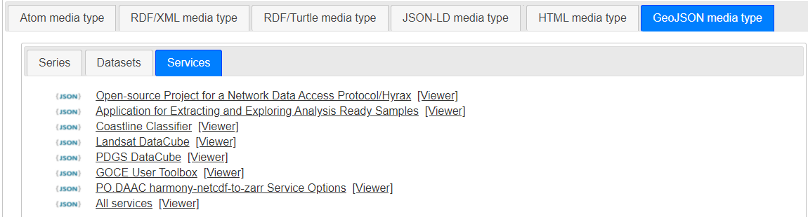
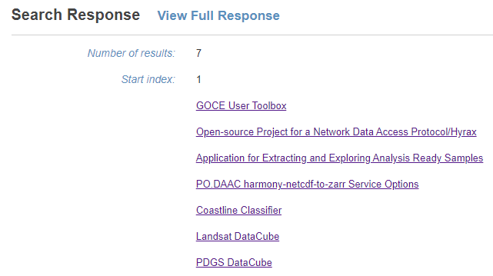
FedEO Evolution implementation
Examples:
  https://emc.spacebel.be/collections/services/items?httpAccept=text/html
  https://emc.spacebel.be/collections/services/queryables
  https://emc.spacebel.be/readme.html

Slide 7
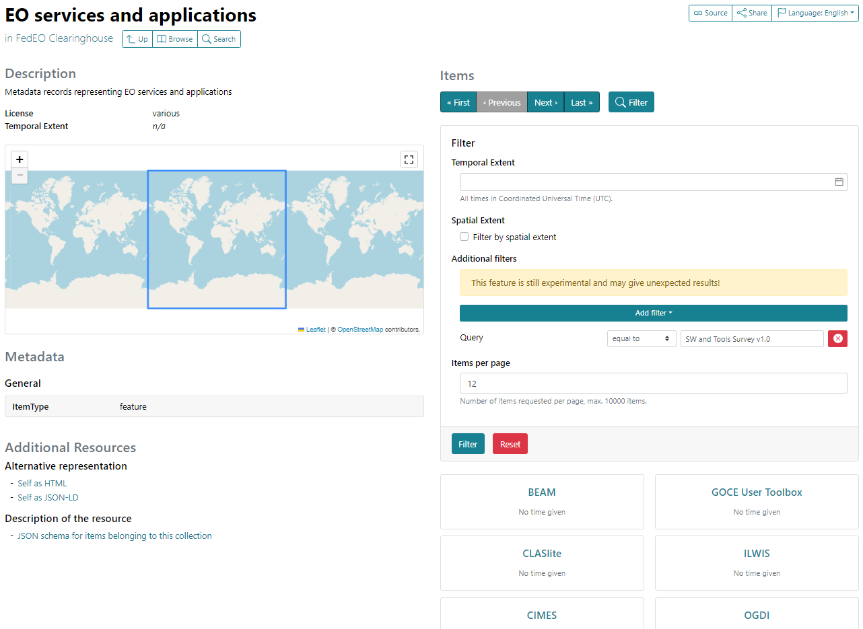
STAC API and STAC
“service and tool” metadata in dedicated OGC API Features/STAC “collection”:
  /collections/services
  /collections/services/queryables
STAC API + Filtering extension is used for discovery,
No STAC “item” representation exists for a tool/service. OGC 19-020r1 used instead.
STAC API
Filter Extension (CQL-Text)

Slide 8
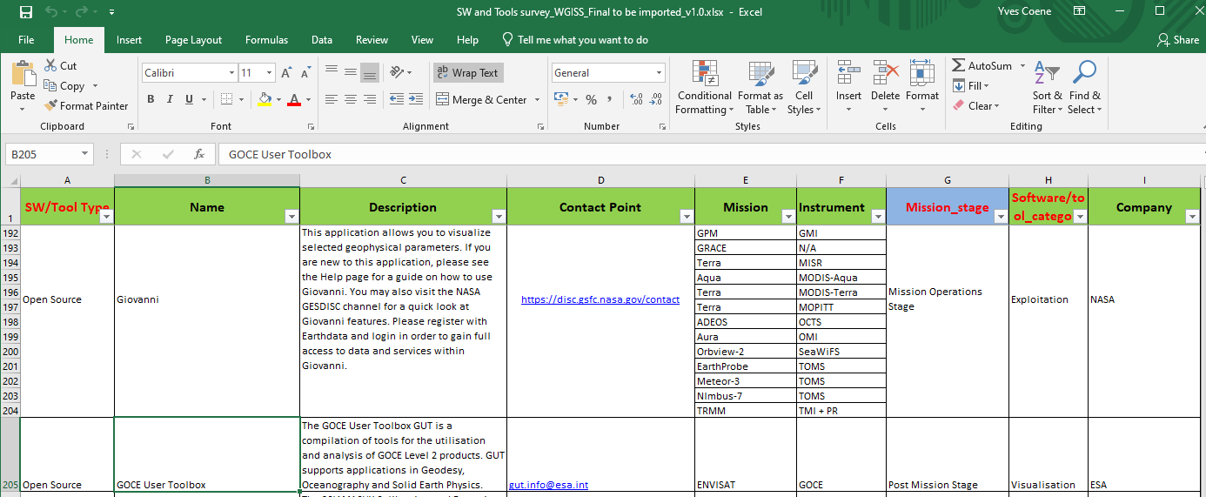
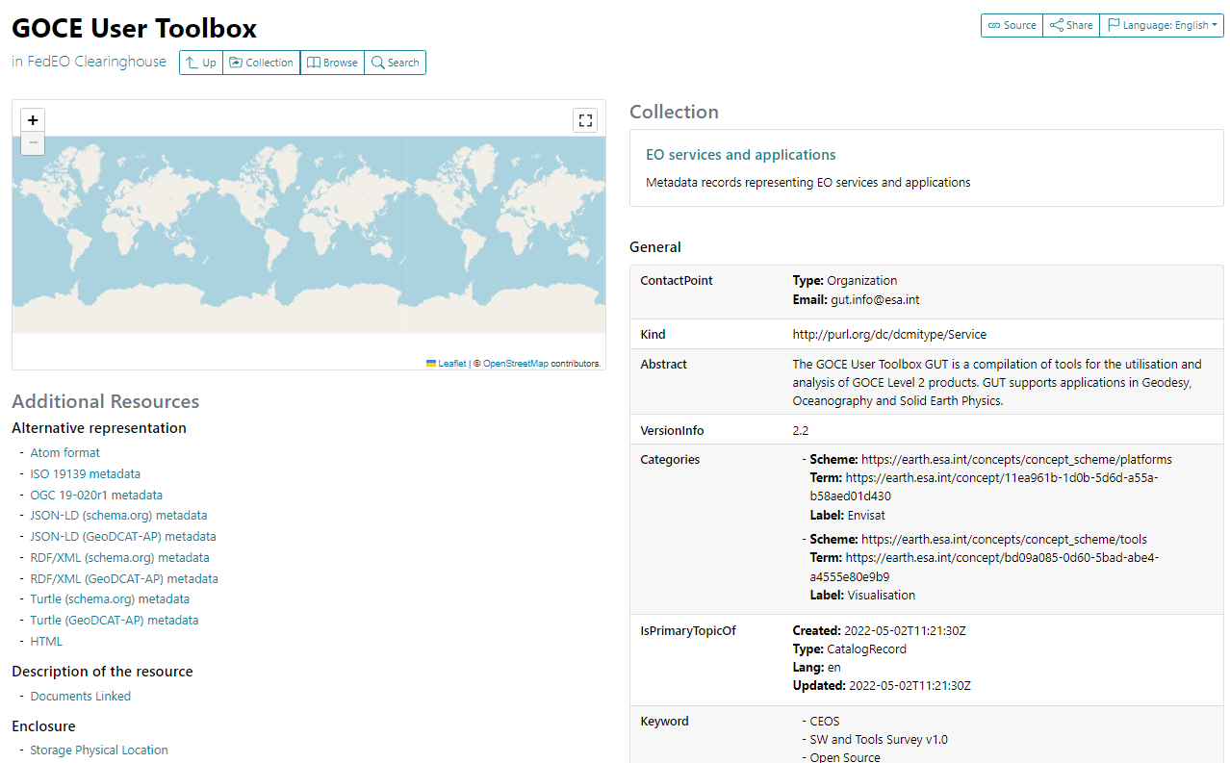

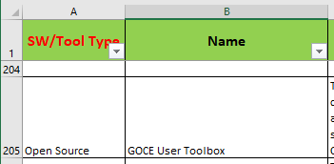
STAC API and STAC
No STAC “item” representation exists.
OGC 19-020r1 used instead.
Excel “SW and Tools” converted to OGC metadata.
OGC 19-020r1
representation of service/tool
items
One of CEOS
“SW and Tools Survey” items

Slide 9
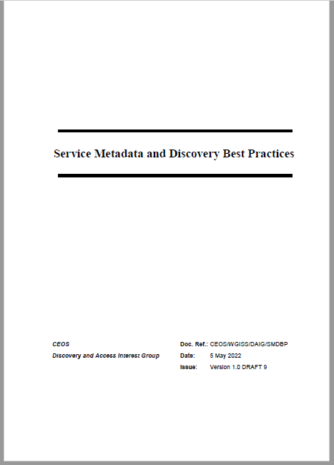
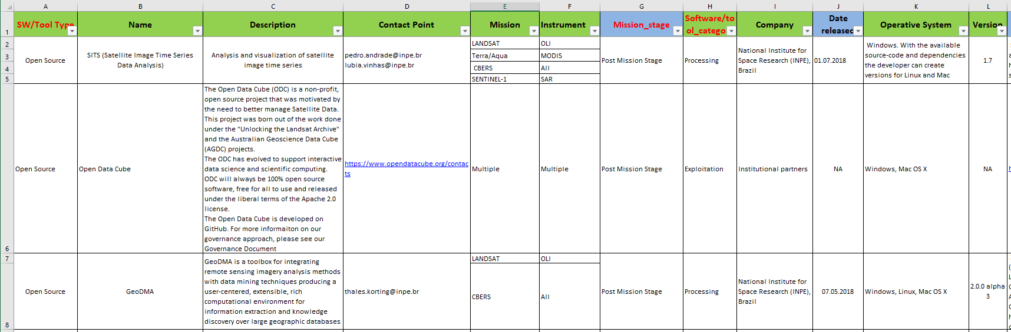
Open Source SW and Tools Survey
Excel import limitations:
  Machine friendliness
    Rows inside individual cells
    Multiple date formats
    Non-structured contact point column etc.
    Instrument/mission/software categories names to be taken from thesaurus
    Vague license “open-source”…
CEOS Service Metadata and Discovery Best Practice
  Coverage to be improved (See table)

Slide 10


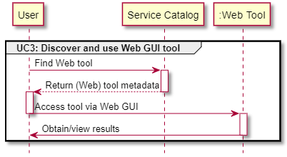
Notebook discovery
CEOS Service Metadata and Discovery (§2.3)
  Use Case 3: Web GUI tools
    Software as a Service (SaaS)
    E.g. Jupyter Notebook on Google Colaboratory, Binder, …

Slide 11

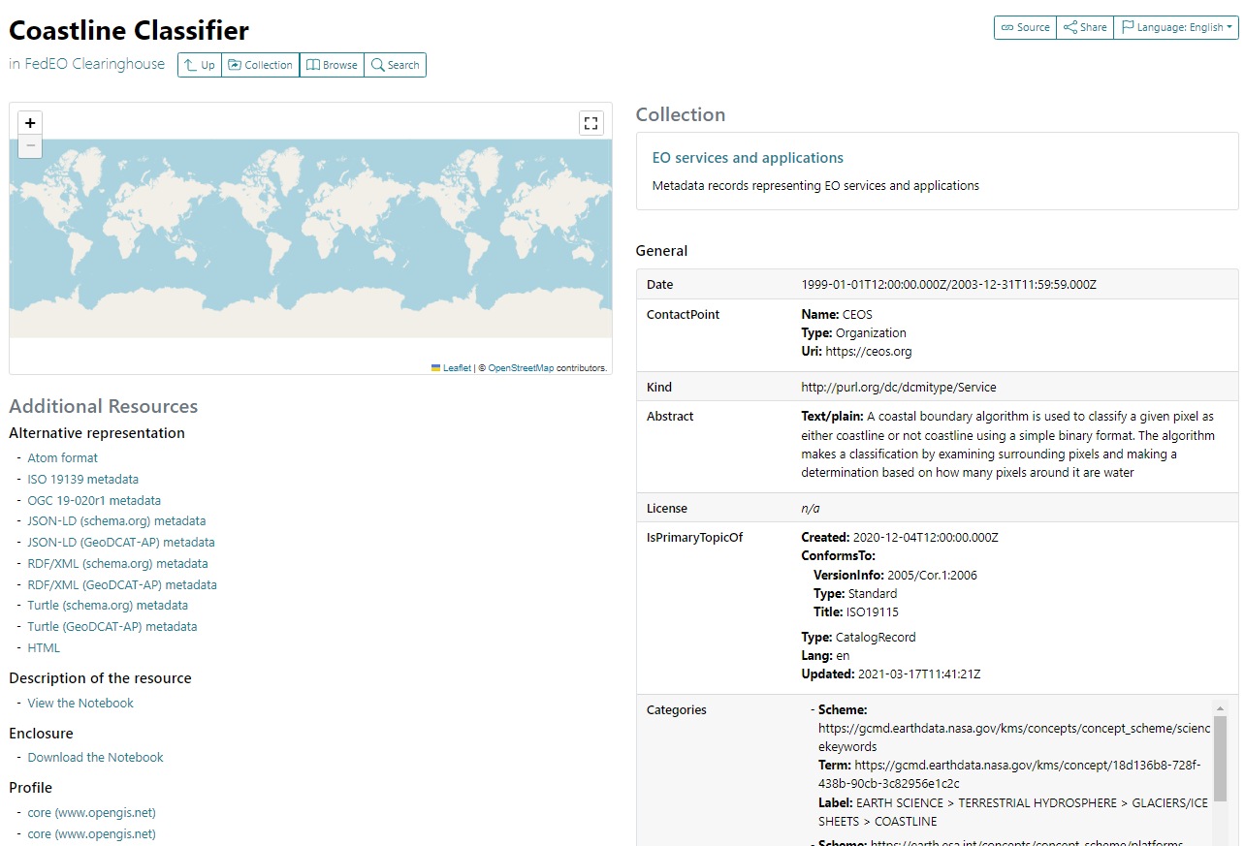
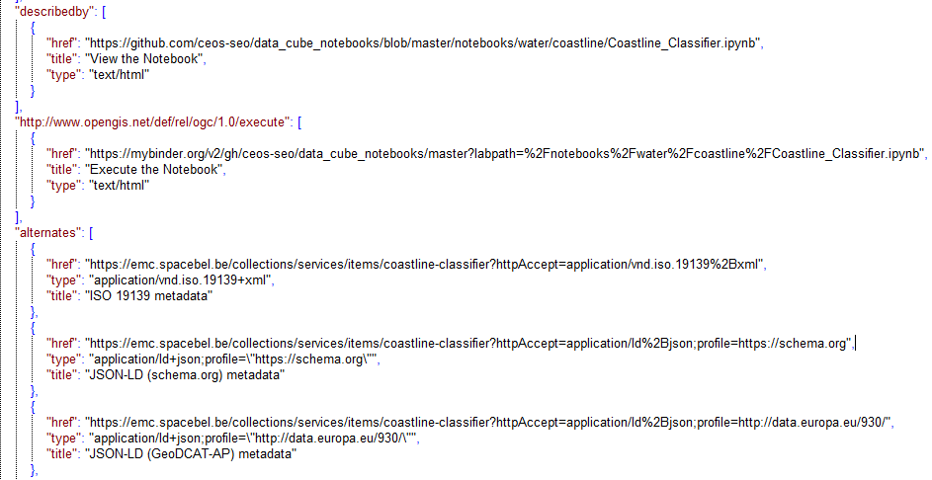

Notebook discovery
No STAC “item” representation exists.
OGC 19-020r1 used instead.
GeoJSON
representation of service/tool
items
Notes:
https://emc.spacebel.be/collections/services/items/coastline-classifier?mode=owc

Slide 12
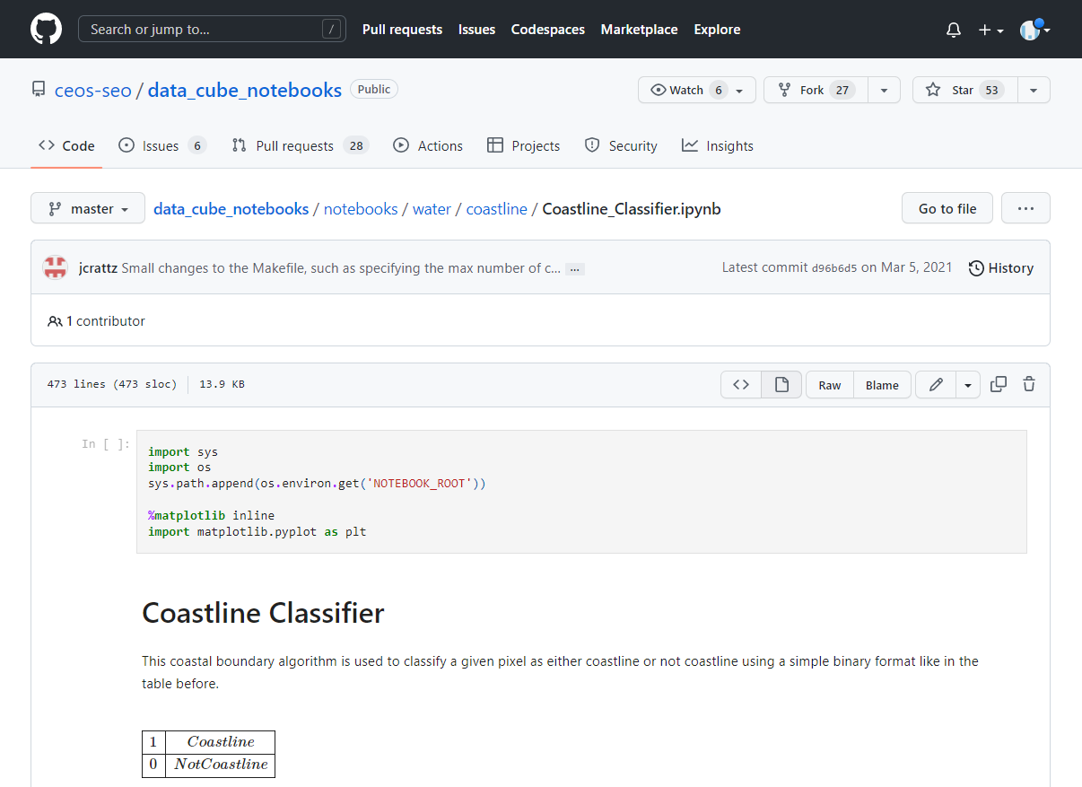
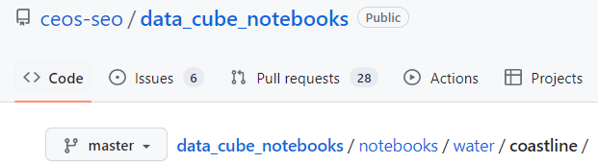

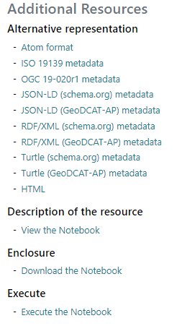
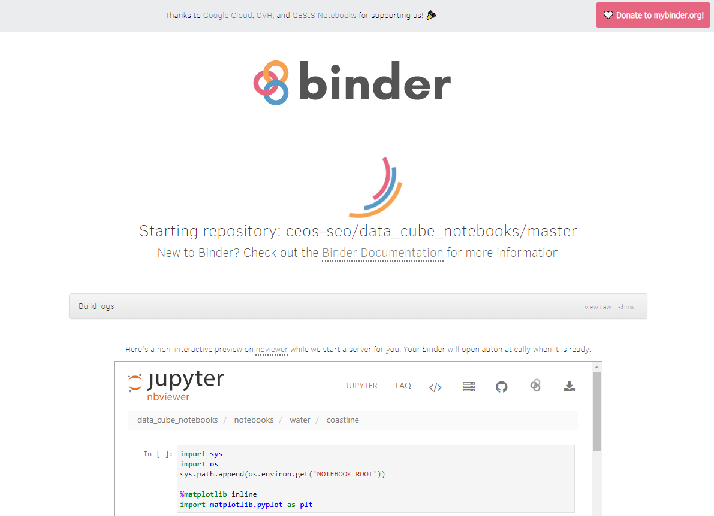
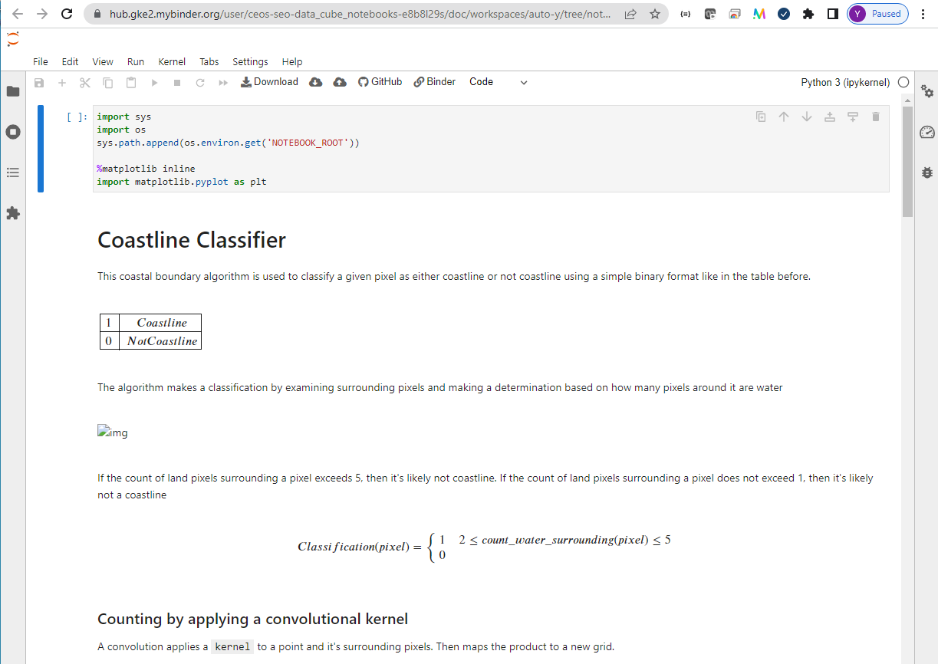
Notebook discovery
Notes:
https://radiantearth.github.io/stac-browser/#/external/emc.spacebel.be/collections/services/items/coastline-classifier

Slide 13

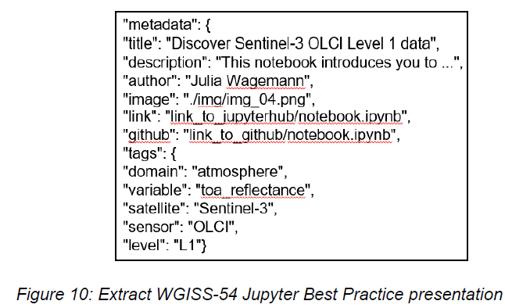
Notebook discovery
Future work:
  Exploit Notebook metadata as expected to be described in
  “WGISS Jupyter Notebooks Best Practice”
    How to get access to this draft document ?
  Use GitHub API to retrieve/update metadata content.

Slide 14
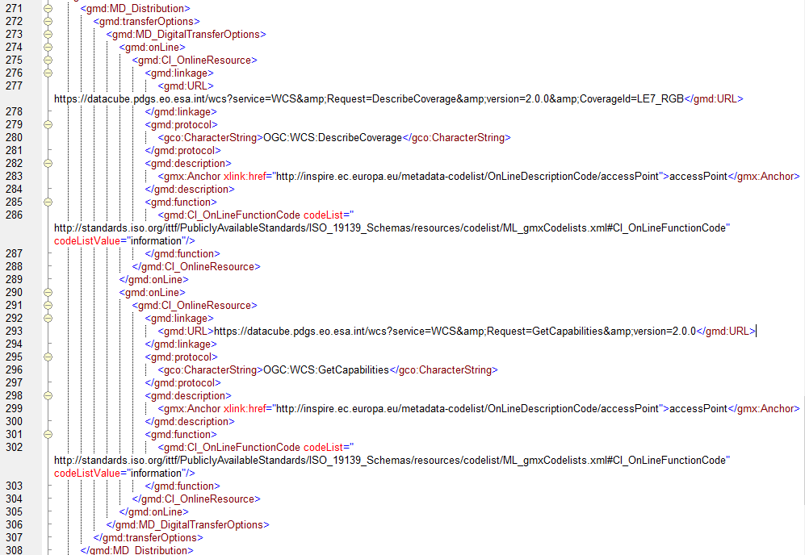
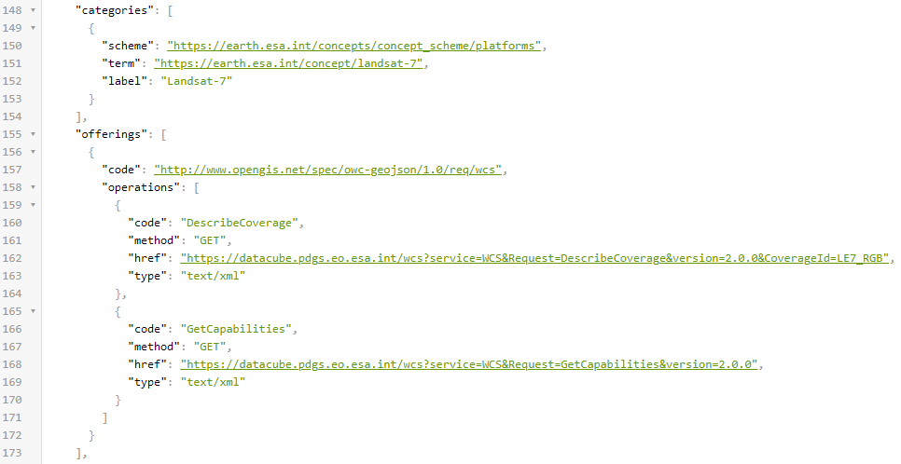
FedEO API - Supported metadata formats
Examples:
  OGC 14-055r2 offering / ISO MD_Distribution provide binding information for clients
  Encodings supported by Metadata Editor.
Notes:
https://emc.spacebel.be/collections/services/items/eo-pdgs-landsat-datacube

Slide 15
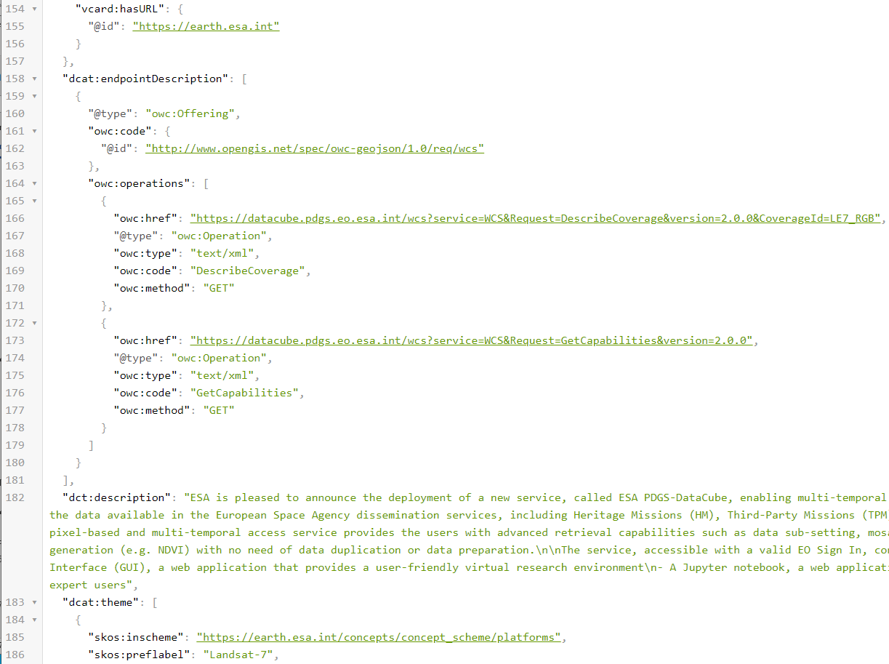
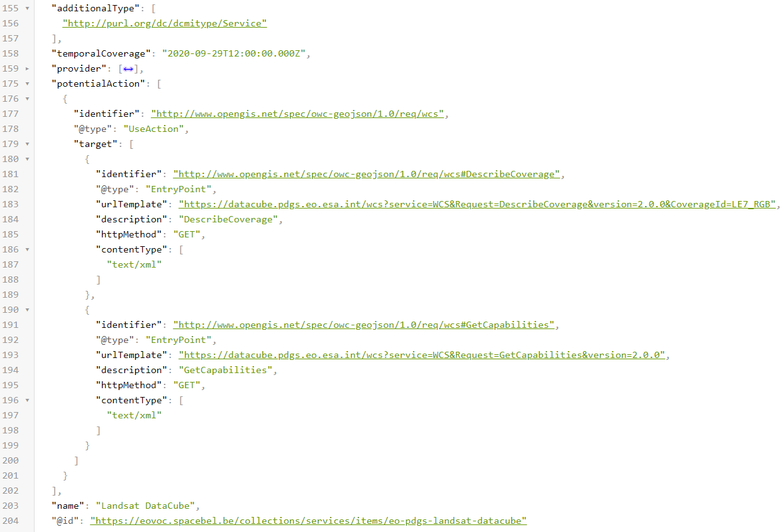
FedEO API - Supported metadata formats
Examples JSON-LD:
  GeoDCAT-AP v2.0

Slide 16
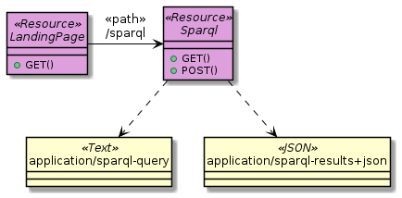
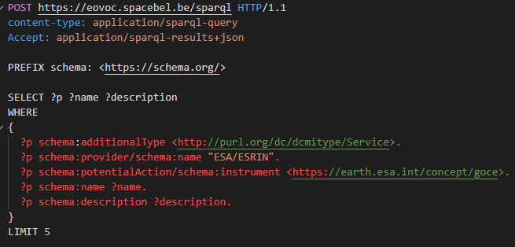
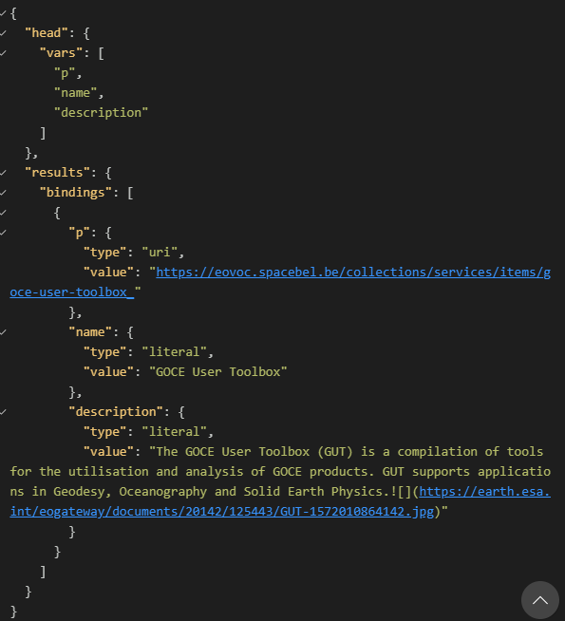

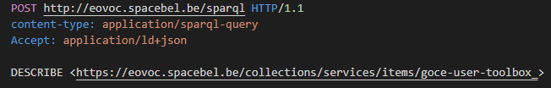
FedEO API - SPARQL Prototype
SPARQL API in front of schema.org metadata model.
  “Services from ESA related to GOCE” ?
  Full details of “GOCE User Toolbox”

Slide 17
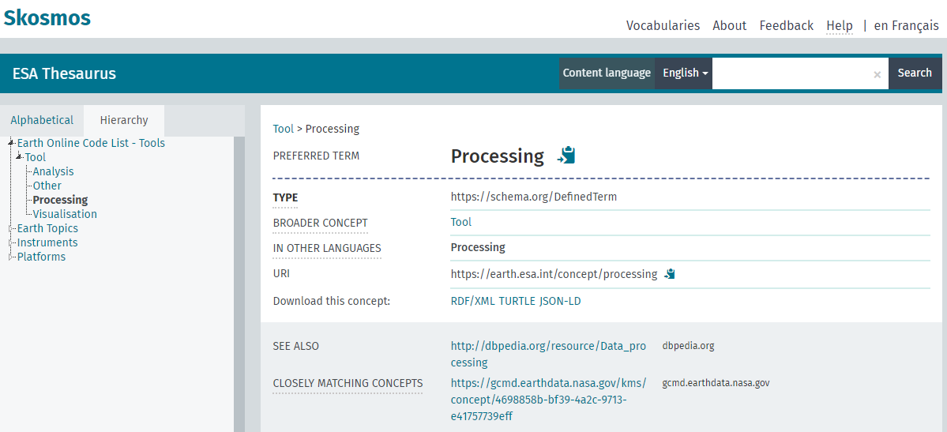
Next steps and future work
STAC
  Covers granule (item) and collection metadata, no (item) encoding/support for service/tool metadata.
  Limited support for “coupling” collections/granules with service endpoints
    See STAC Web Map Links extension https://github.com/stac-extensions/web-map-links
  STAC API might nevertheless be used for discovery (as “separate”) from STAC Item specification
ESA SKOS thesaurus extension for Tools/Services with cross-reference to GCMD.
GCMD, DBpedia

Slide 18
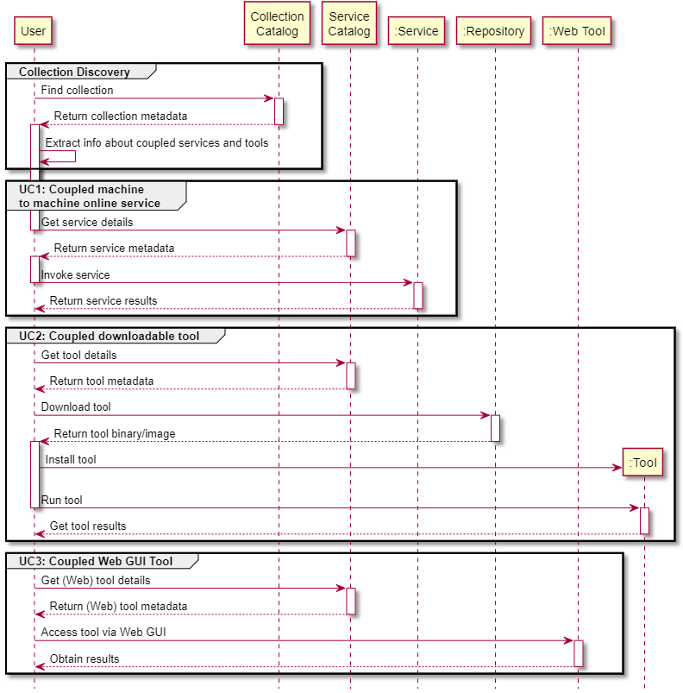

Next steps and future work
Subset to become operational as EOCAT evolution.
Cloud-Native Demonstrator:
  Including coupling of EOCAT collections
  with DataCube (service) metadata.
Improve CEOS Service Discovery and Metadata compliance
Include/host Notebook metadata, possibly extracted from Notebook internal metadata (CEOS Notebook Best Practice)
Support UMM-JSON export format to IDN
Useful for the WGDisaster ?

Slide 19


Slide 20
Spare slides

