Slide 1
WGISS-54-11: metrics for cloud-based data use
WGISS-55
April 18th - 20th, 2023
Doug Newman
NASA ESDIS Project, Goddard Space Flight Center
douglas.j.newman@nasa.gov
Minnie Wong
NASA ESDIS
min.m.wong@nasa.gov

Slide 2
Summary
‘defining and obtaining useful and valid metrics of agency data use and access in the cloud that quantify measures of success’

Slide 3
Why data use (cloud) metrics?
Metrics provide a means to measure success.
Our success is defined as ‘enabling the scientific community in their research endeavours through provision of earth science data and services’
Measurement: volume of data accessed
Measurement: number of data products accessed
Cloud access patterns are evolving from traditional access patterns. This may create perceived discontinuities between traditional and cloud access metrics. We need to understand those before drawing conclusions.

Slide 4
The evolution of data access
Metrics for cloud-based data use

Slide 5
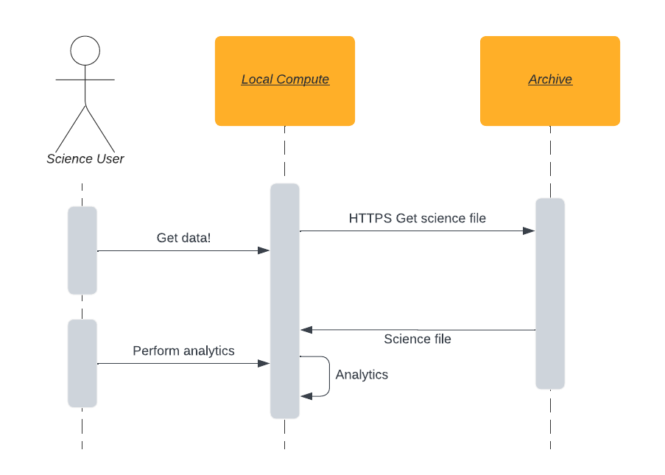
Archive format to local storage
Get the whole file(s) into my local system, maybe use some of it.
Volume of data egress
Data Access!
Number of requests
Type of data
Notes:
HTTPS - HyperText Transfer Protocol (Secure)
Originally, access manifested itself as data download by File Transfer Protocol (FTP) and later HTTP and HTTPS.
How many accesses and the volume of the data accessed are the key measurements we make. This is augmented by considering the type of data distributed, segmented broadly by discipline or narrowly by collection/dataset.

Slide 6
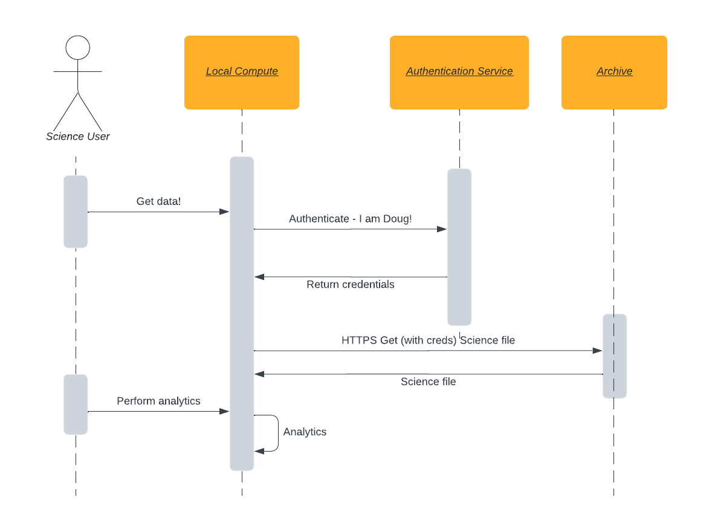
User-based metrics
Expansion of metrics beyond data volume into user dimensions
Doug’s study area
Data Access!
Doug’s country
Doug’s affiliation
Notes:
With the advent of secure HTTPS for distribution, organizations, such as NASA, were able to augment their data access metrics with user-specific dimensions by implementing an authentication mechanism in front of the data. This allowed organizations to associate user properties with data access and enable the collection of metrics in the dimensions of user discipline, organization, affiliation, country of origin, etc.

Slide 7
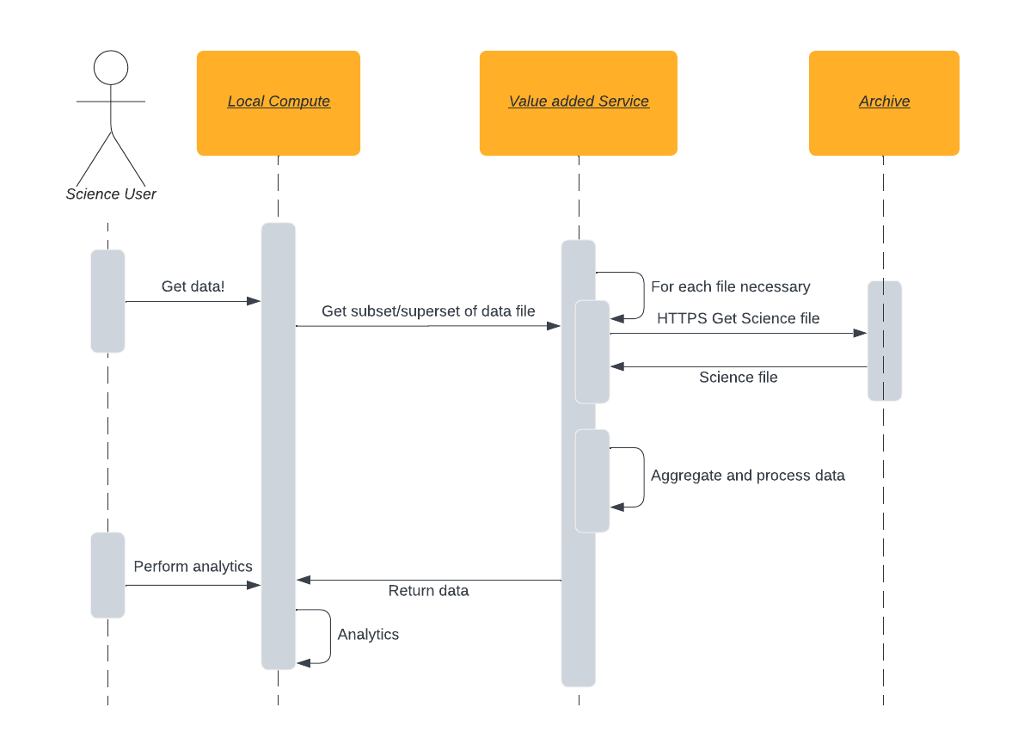
Re-packaged format to local storage
Get some of the file into my local system, use most of it.
Data Access?
Data Access?
Notes:
Users can leverage value-added services that resulted in the download of data derived from archived data. The value-added features consisted of re-formatting, re-projection, subsetting etc. These services were added to lighten the burden of storage and data wrangling to the user in order to attempt to give them just the data they wanted (ie. related to a specific spatial or temporal area of interest or a specific measurement) in a format they could use immediately.
The addition of services gave us a new measure of success. How useful were those services to the user community?
To measure that success we could compare the relative numbers of requests of data download and service invocation for serviced data.

Slide 8
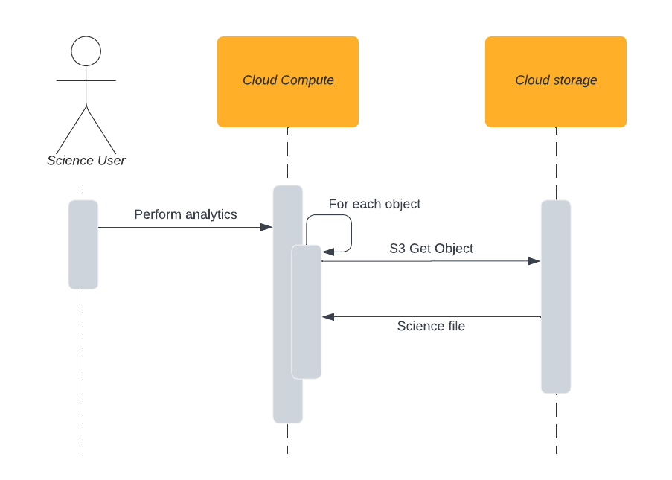
Analysis-in-place with archive format
Leveraging the cloud to provide necessary compute
Data Access!
Volume of S3 data egress
Number of S3 requests
Notes:
As the size of our data archives grow exponentially and the processing power required to analyze that data grows in lock-step, we need to provide a means to perform that analysis without being bound by the limiting factor of a user’s local compute and storage.
The near-infinite amount of elastic, pay as you go, storage and compute afforded by cloud computing will help us solve that problem.
Analysis-in-place allows users to perform their workloads on compute adjacent to the data in the cloud. This requires the utilization of cloud vendor services such as AWS Simple Storage System (S3) for data access.
But cloud computing brings new challenges with respect to measuring the usage of our data.
We need to establish if the above hypothesis is true. Will the user community favor in-place analysis over traditional local analysis as their workloads grow? How do we measure that?
As data migrates to the cloud, we can evaluate the relative amount of data being requested from outside and inside the cloud environment.

Slide 9
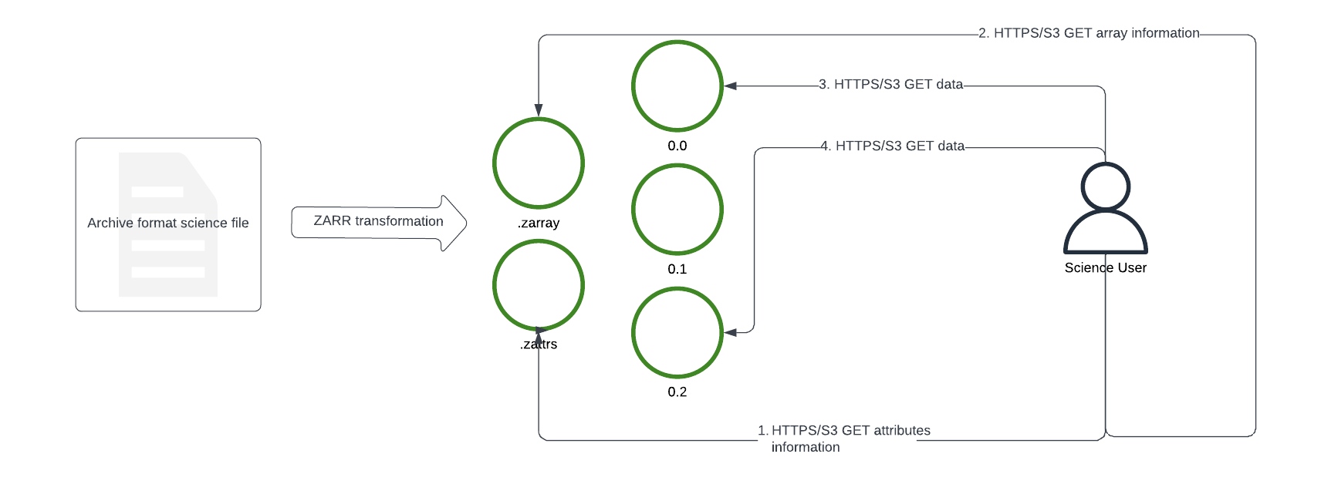
AIP with cloud-optimized formats
Improving cloud-based data access user experience
4 accesses to 2 files
Parallelize!
4 accesses to 4 files
Notes:
DMR - Dataset Metadata Response
We need to track additional modes of access to get a true picture of how our community is accessing data in the cloud and how that usage compares with on-premises access.
Cloud-optimized data formats may involve either the decomposition of the archive-oriented format’s large file structure into many smaller objects, or the partial access of larger data files.
Analysis that at one time involved the single download of an archive-formatted data file may now involve many smaller accesses via the use of HTTPS/S3 range get calls. In assessing the relative popularity of archival-format access and cloud-optimized access, the results may be skewed in favor of cloud-optimized formats if only considering the number of requests made. Conversely, if only considering volume the data access the results would be skewed in favor of archival format download.
The ability to determine what a ‘single access’ maps to in terms of requests, a request session if you will, ’is of vital importance here. Traditionally, that would be the download of a single file but for an access of data from tooling such as X-array it may involve multiple, smaller requests for parts of files (Cloud-optimized GeoTIFF (Tag Image File Format) or OPeNDAP(Open-source Project for a Network Data Access Protocol)) or multiple requests for smaller files (Zarr).

Slide 10
Technologies
Metrics for cloud-based data use

Slide 11
The ELK stack
Elasticsearch - cloud-friendly, open source, indexing and searching of metrics
Logstash - cloud-friendly, open source, logging of metrics
Kibana - cloud-friendly, open source, visualization of metrics from Elasticsearch
Elasticsearch is a trademark of Elasticsearch B.V., registered in the U.S. and in other countries.
Notes:
Log, index, search visualize!
https://www.elastic.co/
https://www.elastic.co/logstash/
https://www.elastic.co/kibana/

Slide 12
Open Telemetry
A single, vendor-agnostic instrumentation library.
An end-to-end implementation to generate, emit, collect, process and export metrics data.
A means to metric inter-dependent services at scale.
OpenTelemetry is a registered trademarks of Dynatrace
Notes:
https://opentelemetry.io/
https://www.dynatrace.com/company/trust-center/terms-of-use/

Slide 13
How NASA EOSDIS does this
Metrics for cloud-based data use
Notes:
EOSDIS - Earth Observing System Data and Information System

Slide 14
ESDIS Metrics System (EMS)
Notes:
ESDIS - Earth Science Data and Information System
https://www.earthdata.nasa.gov/eosdis/system-performance-and-metrics/esdis-metrics/eosdis-monthly-metrics#monthlymetrics-2023-tab-2

Slide 15
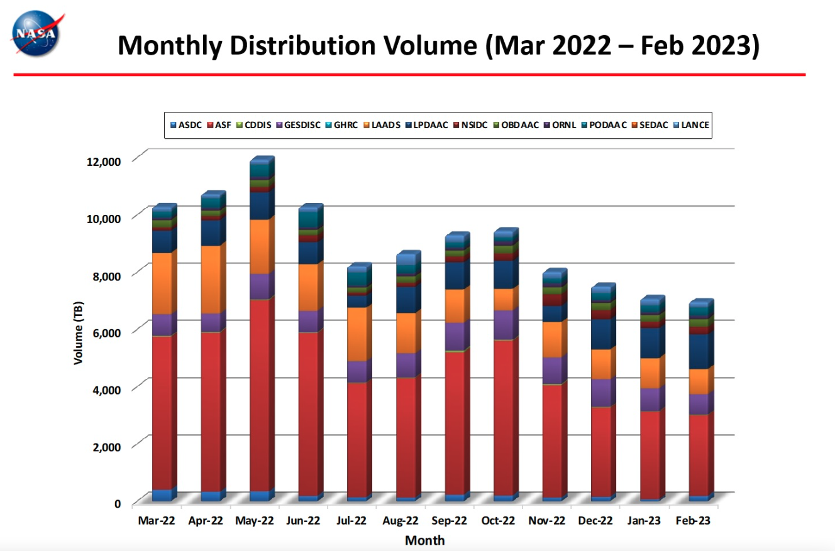
EMS
Notes:
https://www.earthdata.nasa.gov/eosdis/system-performance-and-metrics/esdis-metrics/eosdis-monthly-metrics#monthlymetrics-2023-tab-2

Slide 16
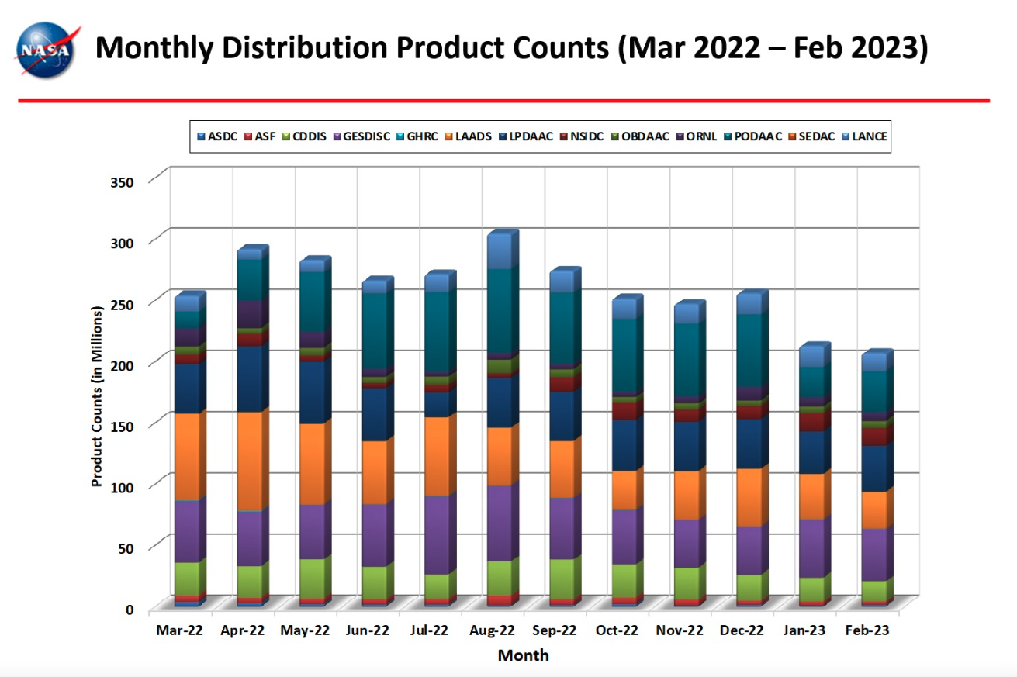
EMS
Notes:
https://www.earthdata.nasa.gov/eosdis/system-performance-and-metrics/esdis-metrics/eosdis-monthly-metrics#monthlymetrics-2023-tab-2

Slide 17
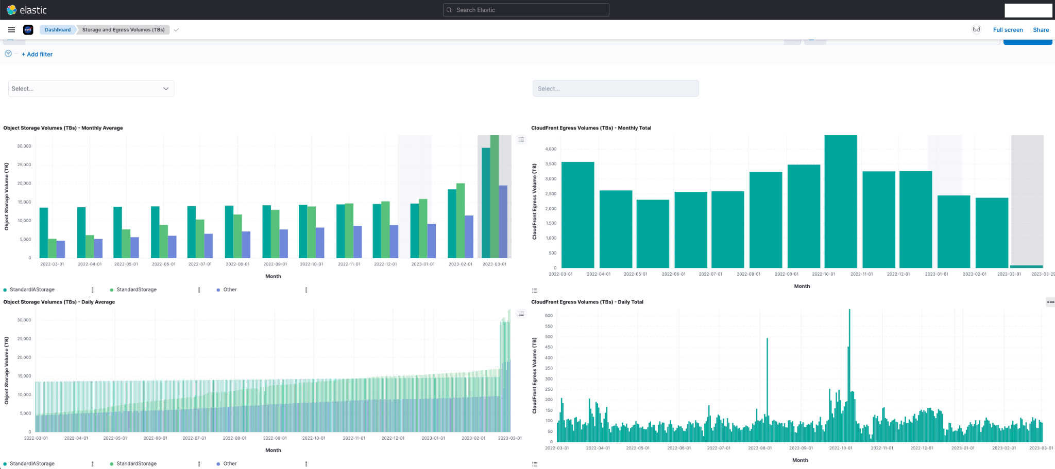
NASA cloud monitoring
We use an ELK stack in AWS to metric our egress
Notes:
https://monitoring.cloud.earthdata.nasa.gov/

Slide 18
Challenges
Understanding new access patterns
Comparing ‘apples to apples’ with respect to traditional versus cloud-optimized data access

Slide 19
New measures of success
Analysis-in-place is a viable pattern for our community
Data out of Amazon Web Service (AWS) via HTTPS vs ‘internal data access’
Our cloud architecture is ‘cost-optimized’
Usage patterns point to architectural changes
Notes:
We took a calculated risk on the cloud. Is it paying off?
Are we adopting the right architectural decisions for data access?
The usual suspects:
Is our data being used?
What are the most important options? Dataset, format, temporal, spatial,

Slide 20
Discussion
Metrics for cloud-based data use

