Slide 1
FedEO Report
Yves Coene (Spacebel for ESA), Mattia Stipa (ESA),
Damiano Guerrucci (ESA), Mirko Albani (ESA)
CEOS WGISS #55
Data Discovery and Access, 19/04/2023

Slide 2
Outline
FedEO in CEOS domain
FedEO current metrics and DIF-10 export status
Ongoing activities
  JAXA G-Portal
  VITO
FedEO evolution activities
  STAC
  Maturity Matrix

Slide 3
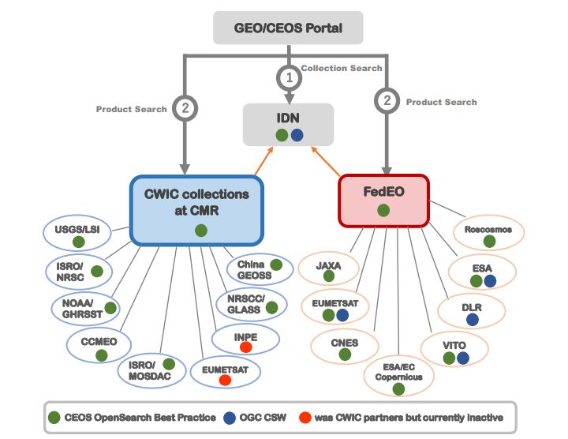
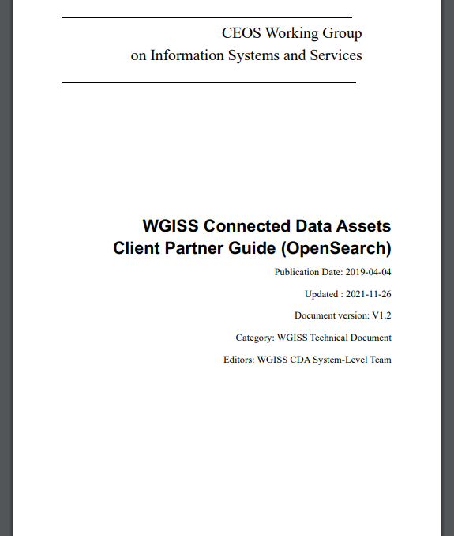
WGISS Connected Data Assets
FedEO: Federated Earth Observation missions access

Slide 4
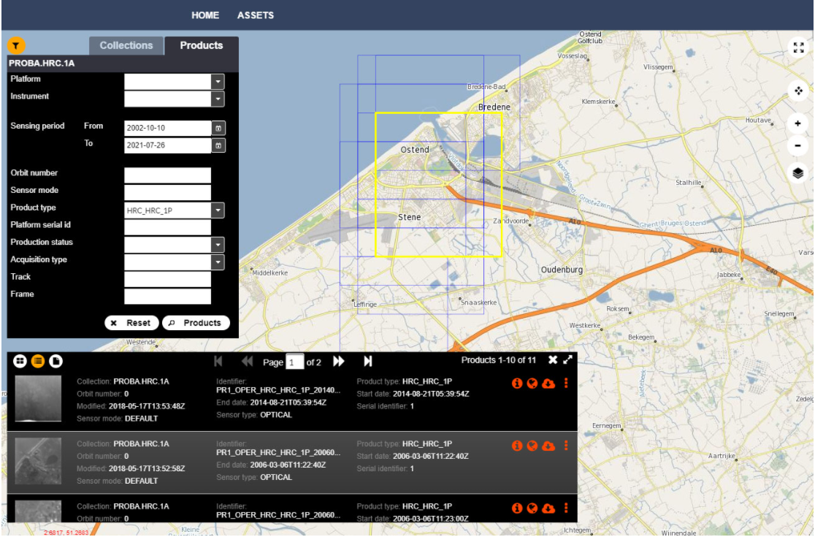
FedEO in CEOS Domain
Since 20 September 2021:
  FedEO Client available at
  https://fedeo-client.ceos.org
  FedEO Server available at https://fedeo.ceos.org/
  Validation server available at https://geo.spacebel.be
Notes:
https://earth.esa.int/eogateway/news/new-version-of-the-fedeo-client

Slide 5
FedEO Metadata Mediator
Automatic Procedure – Available on FedEO reference environment, on Operational environment at ESA since Oct 2019
Partner Metadata repository
Collection Metadata Import
(pull, e.g. daily)
Harvester
Metadata Preparation
Metadata Mediator
IDN
Complementary
Information
gcmd keyword
Metadata Preparation
IDN guideline for Information Content completeness and consistency
ESA Thesauri Service
FedEO Collection Catalogue
FedEO Gateway
ISO to DIF-10
pull
Collection Metadata Ingestion by IDN
DIF-10 Encoding
Mandatory GCMD terms
NASA DIF-10 Validator
(HERE)
IDN
repository
DIF-10 Validation

Slide 6
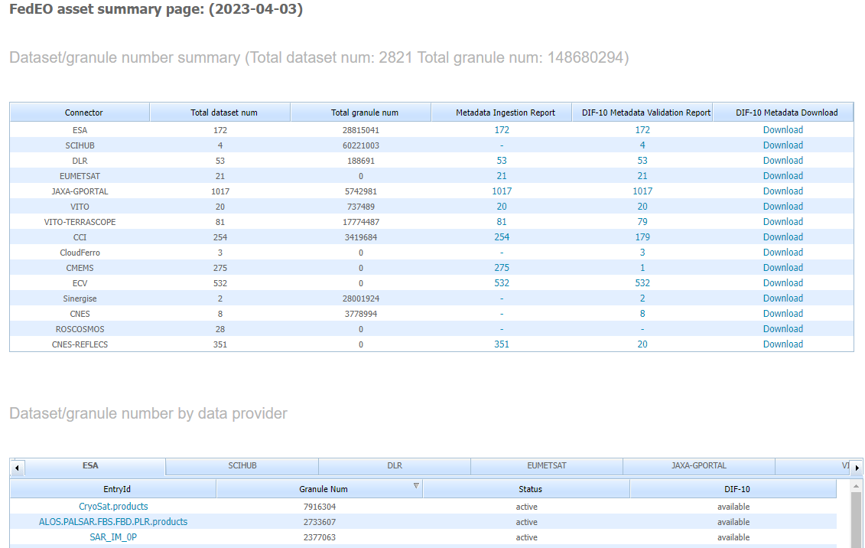
DIF-10 Metadata Export
https://fedeo.ceos.org/asset/index.html
Collections being harvested automatically by IDN, e.g. ESA, DLR, VITO, ESA CCI.
JAXA G-Portal 1017 (ready to ingest in IDN).
Additional VITO collections 99 (was 48)
See:
https://cmr.earthdata.nasa.gov/search/collections.umm_json?provider_id=FedEO&data_center=DE/DLR&pretty=true
https://cmr.earthdata.nasa.gov/search/collections.umm_json?provider_id=FedEO&data_center=VITO&pretty=true
https://cmr.earthdata.nasa.gov/search/collections.umm_json?provider_id=ESA&data_center=ESA/ESRIN&pretty=true
DIF-10 collections are available for being ingested into IDN, from
https://fedeo.ceos.org/asset/index.html
Notes:
https://cmr.earthdata.nasa.gov/search/collections.umm_json?provider_id=FedEO&data_center=DE/DLR&pretty=true
https://cmr.earthdata.nasa.gov/search/collections.umm_json?provider_id=FedEO&data_center=VITO&pretty=true
https://cmr.earthdata.nasa.gov/search/collections.umm_json?provider_id=ESA&data_center=ESA/ESRIN&pretty=true
https://access.earthdata.nasa.gov/holdings

Slide 7
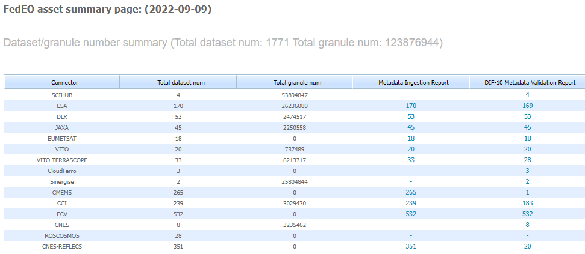
Metrics evolution
FedEO: 123.8 to 148 million granules (+20%) since WGISS-54 (Sept 2022)
ESA (EOCAT): 172 collections with 28.8 million granules.

Slide 8
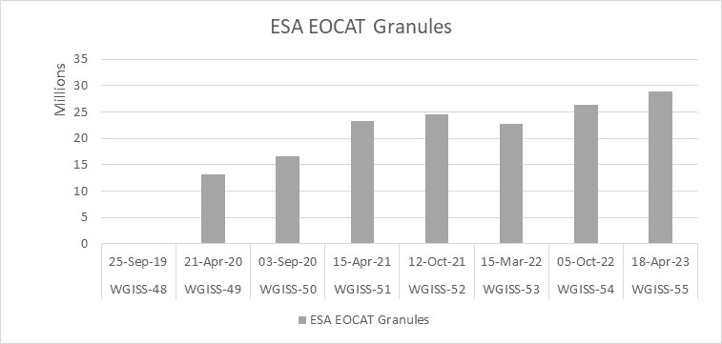
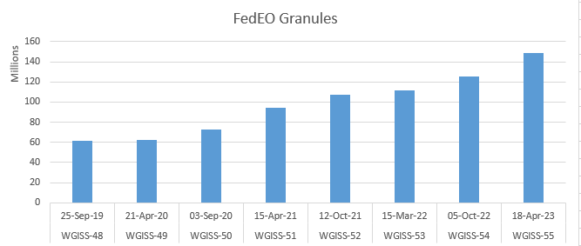
Metrics evolution

Slide 9
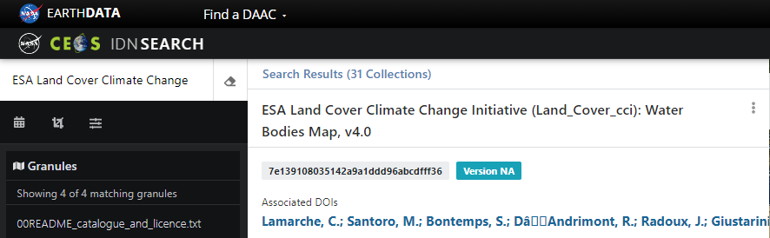
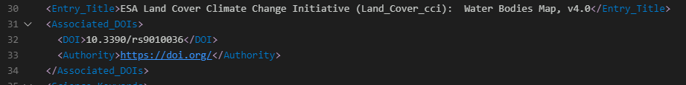
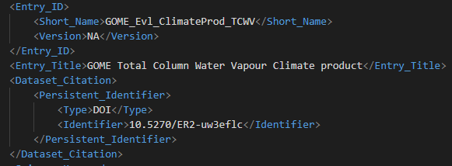
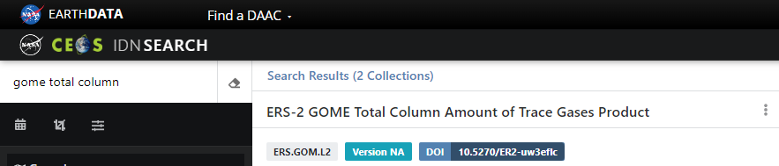
Software changes
ISO19139(-2) and DIF-10 improved:
  DOI
  Associated DOI
Associated DOI (ESA CCI)
DOI (ESA EOCAT)

Slide 10

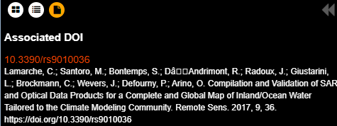
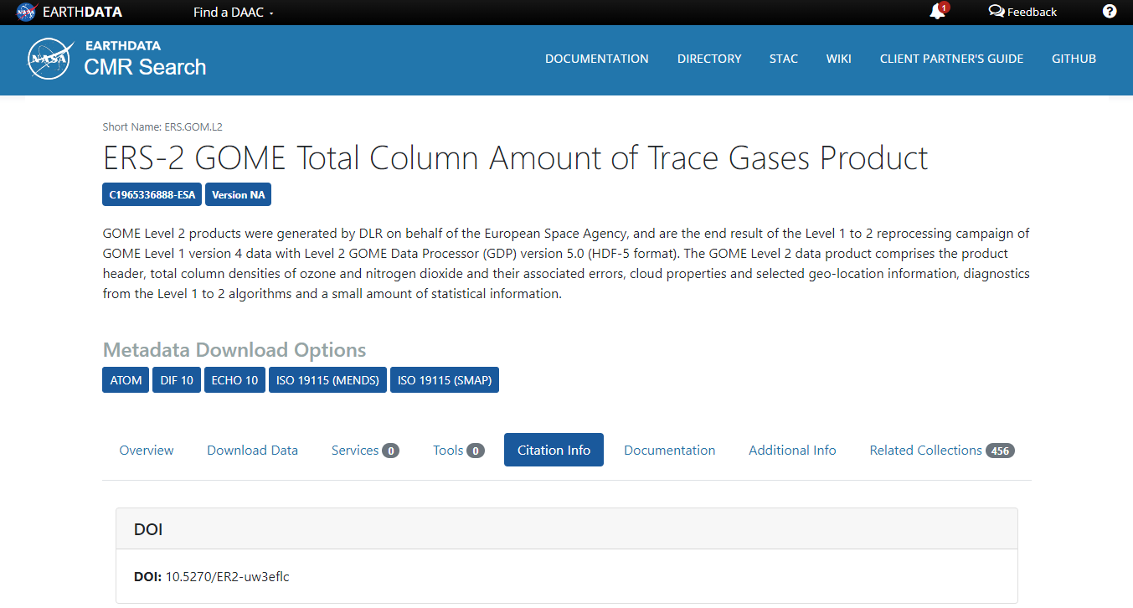
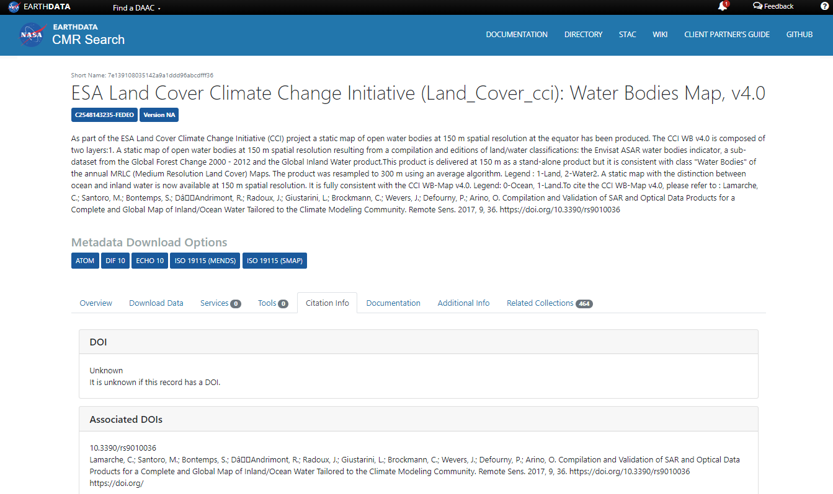
Software changes
« DOI » and « associated DOI » encoded differently in ISO metadata.
Shown by FedEO Client
Generates different DIF10 consumed by IDN/CMR.
DOI (ESA EOCAT)
Associated DOI (ESA CCI)

Slide 11
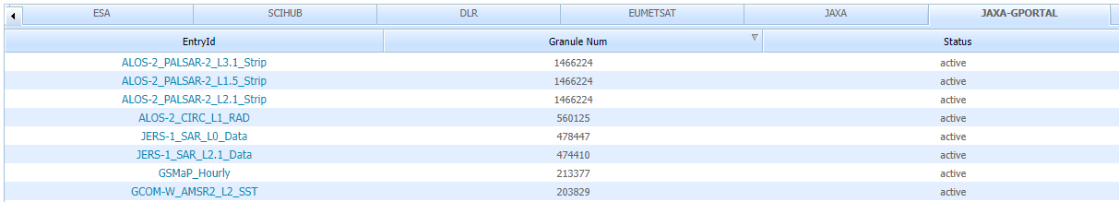
Completed JAXA G-Portal integration
JAXA G-PORTAL ( available in FedEO operational environment )
  Collections: 1017
  All collections with valid DIF10: 1017.
  Many collections with DOI and link to landing page
  Granules: 12.9 million
  Metadata (in Atom) transformed to O&M metadata (OGC10-157r4).
Notes:
https://geo.spacebel.be/opensearch/asset/index.html

Slide 12
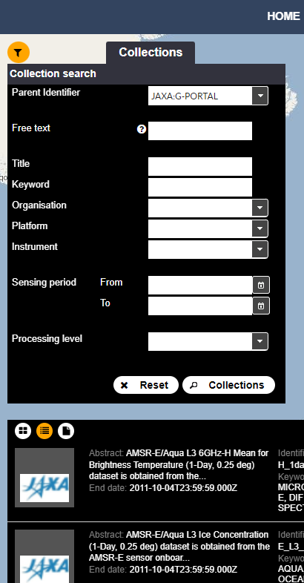
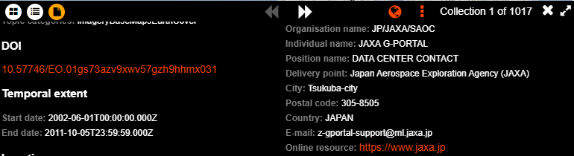
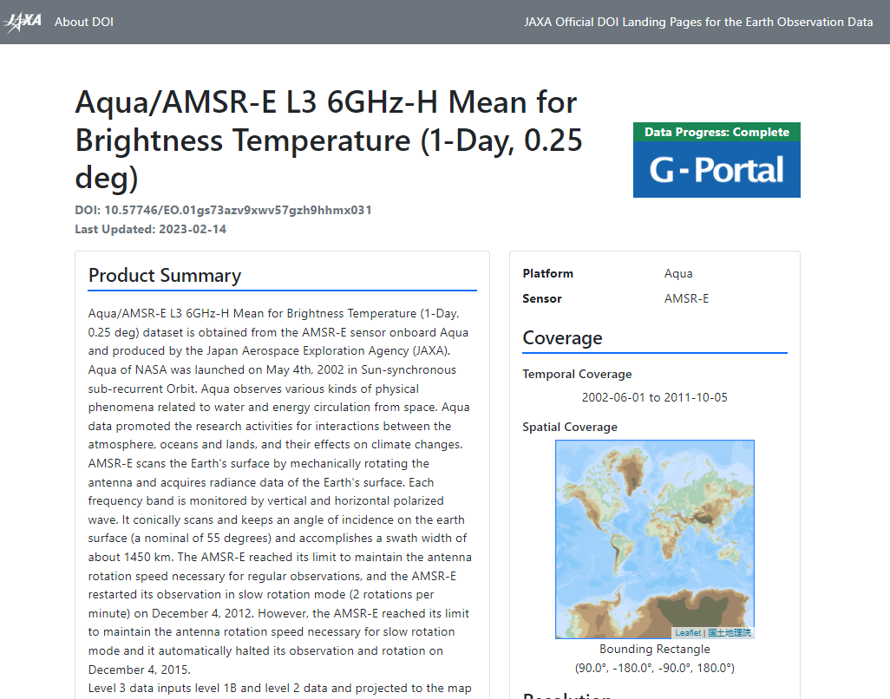
Completed JAXA G-Portal integration

Slide 13
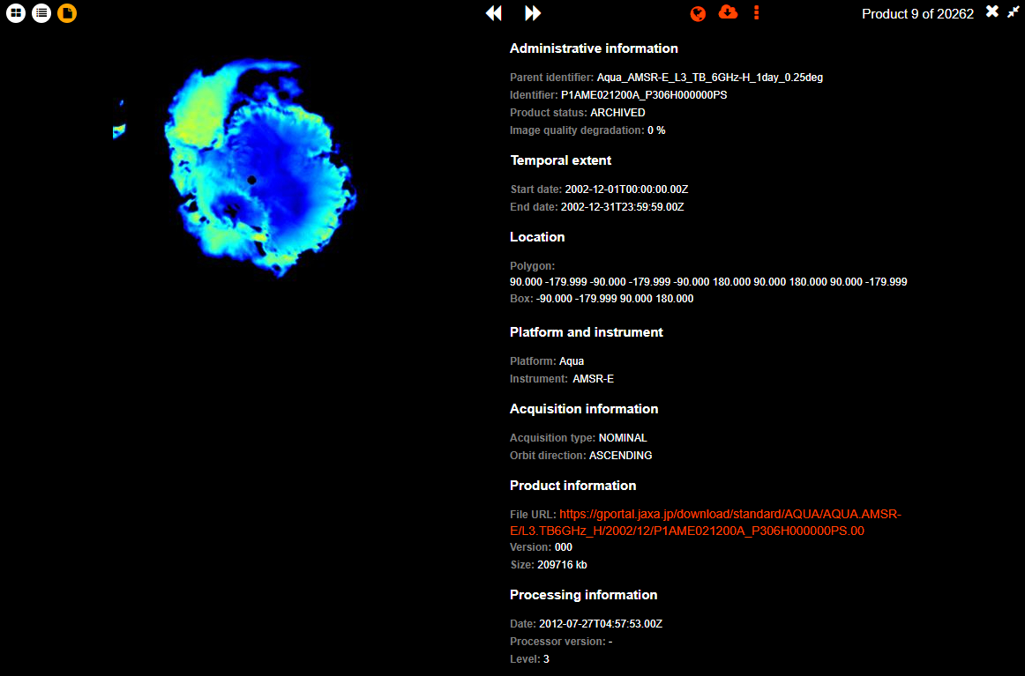
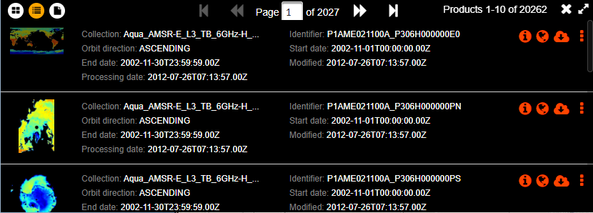
Completed JAXA G-Portal integration
BEFORE
AFTER

Slide 14
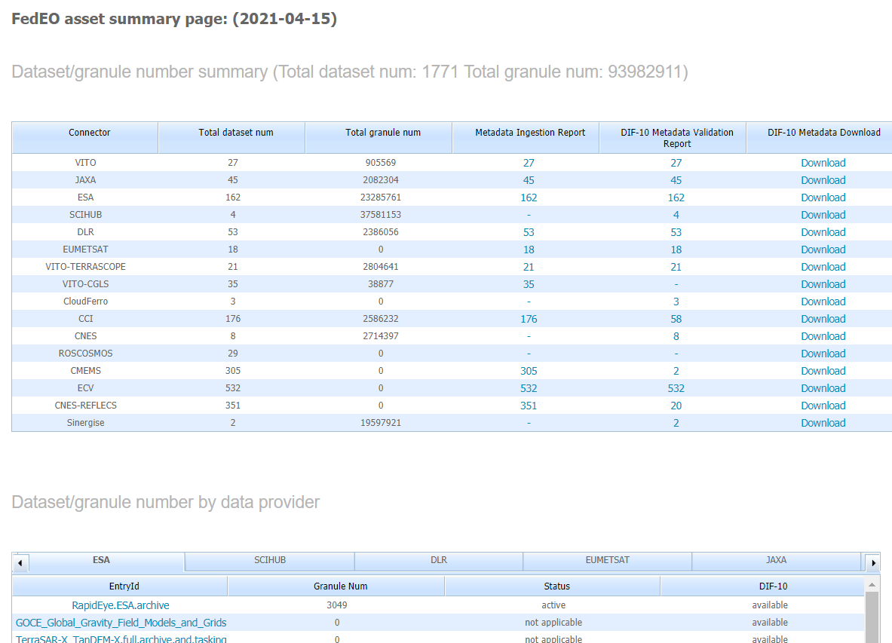
Updated VITO collections
Before
VITO “Proba-V C2” collections made available end of March 2023.
  See https://proba-v.vgt.vito.be/en/quality/proba-v-collection-2-change-summary
  Includes CEOS ARD compliant collection
  Uses Cloud-Optimized GeoTIFF (COG and HDF5)
Available for IDN ingestion: 99 (was 48).

Slide 15
Evolution – STAC API
FedEO STAC interface being enhanced implementing existing API + existing API extensions
  Granule search
    STAC API Item Search (GET and POST)
    STAC API Filter Extension
      Initial support for CQL-Text (Basic-CQL2)
  Collection search
    STAC Collection Search Extension
    STAC API Filter Extension
      Initial support for CQL-Text (Basic-CQL2)
Will offer similar capabilities using STAC API and GeoJSON responses as current OpenSearch/Atom including two-step search.
  Collection “id” from collection search is “collections” parameter for Item search.
  Search parameters advertised in Queryables objects

Slide 16
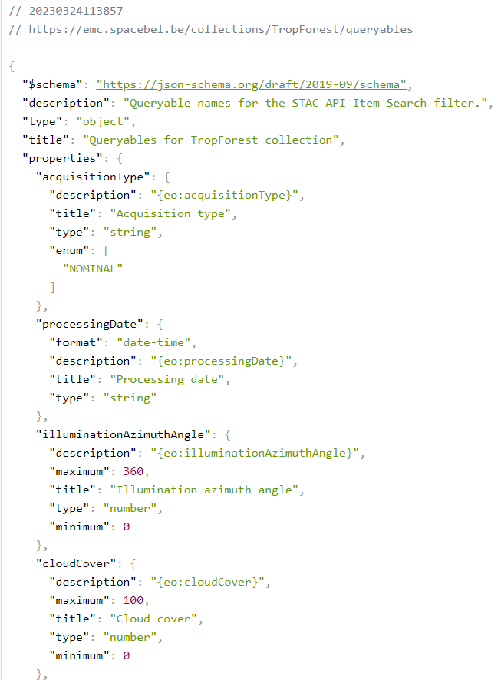
Evolution – STAC API
Filter Extension (for granules)
  /collections/{collectionId}/queryables
  JSON Schema encoding
  Equivalent to collection OSDD
    type, format, minimum, maximum, enum
  Available via “link” in collection representation
Filter Extension (for collections)
  /collections/queryables
  JSON Schema encoding
  Equivalent to collection OSDD
  Available via “link” in /collections response.

Slide 17
API-Features Part 3 & STAC: Filtering
Query complexity
/ expressiveness
Any additional HTTP query parameter
advertised in OSDD (collections, granules, …).
“CQL2” has also multiple conformance classes starting
from “Basic-CQL2”.
any + filter
“Filter” conformance class. Any additional query parameter
advertised in Queryables response and used in CQL2 filter expression
as value of “filter” HTTP query parameter.
any + “and”
“Queryables as Query Parameters” conformance class
Any additional HTTP query parameter
advertised in Queryables response (implicit “and”).
built-in + “and”
Using HTTP query parameters listed in the spec,
e.g. datetime, bbox, ids, … No Queryables response required.
OpenSearch
OGC API Features
Part 3
STAC API
+ Filter Extension (Items)
+ Collection Extension (Collections)
[March 2023]

Slide 18
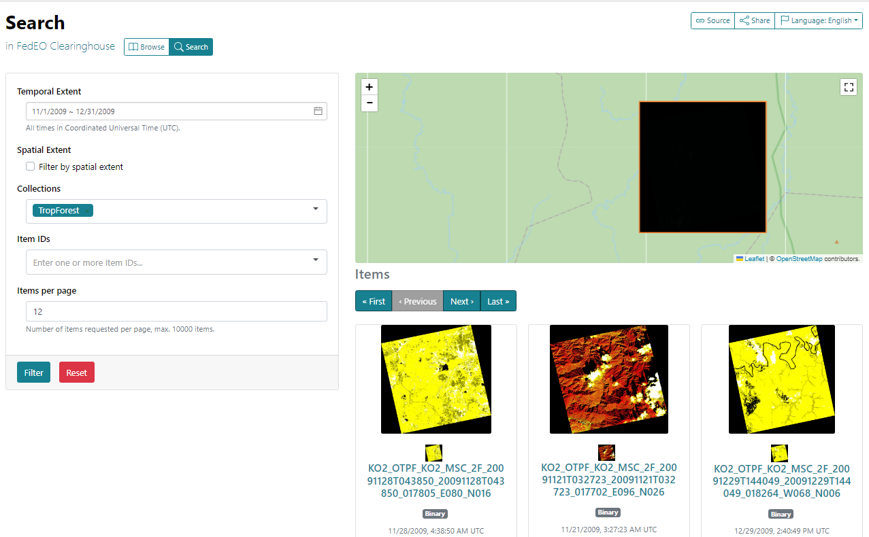
Evolution – STAC API
STAC Search accessed with STACBrowser

Slide 19
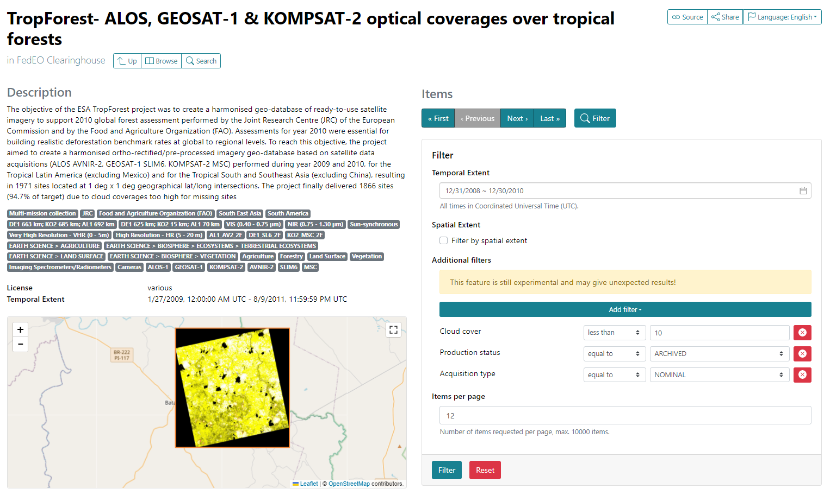
Evolution – STAC API
STAC Filter extension accessed with STACBrowser via “Filter” button on collection page.

Slide 20
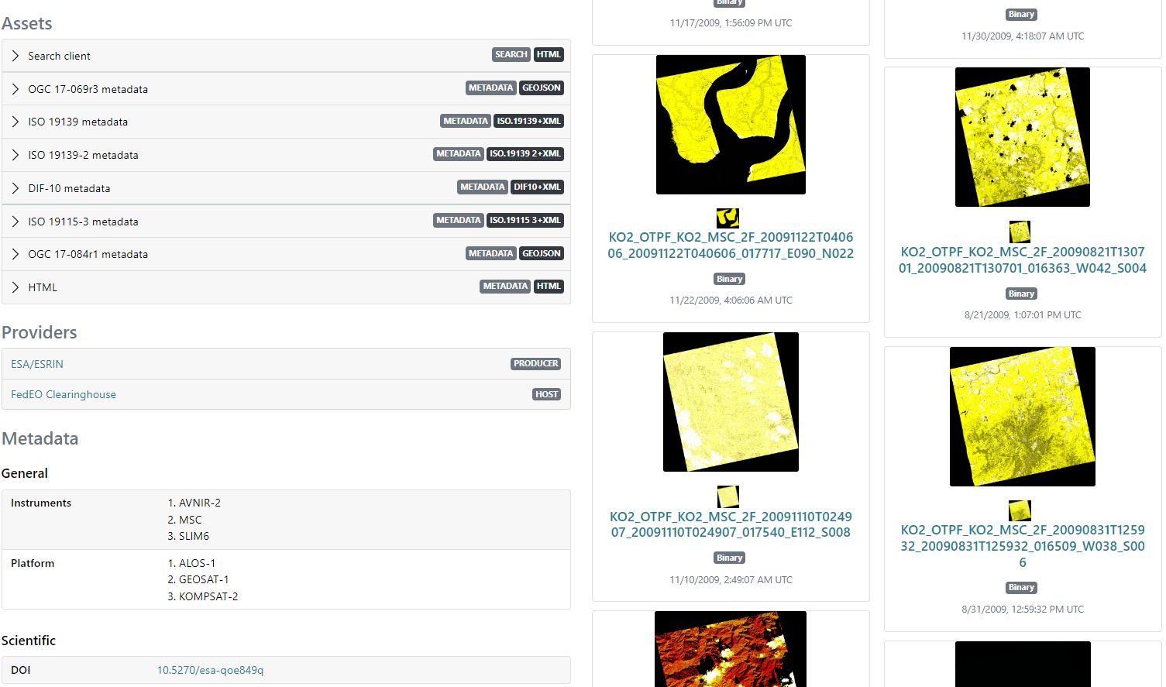
Evolution – STAC API
Access to collection assets, DOI info etc.

Slide 21
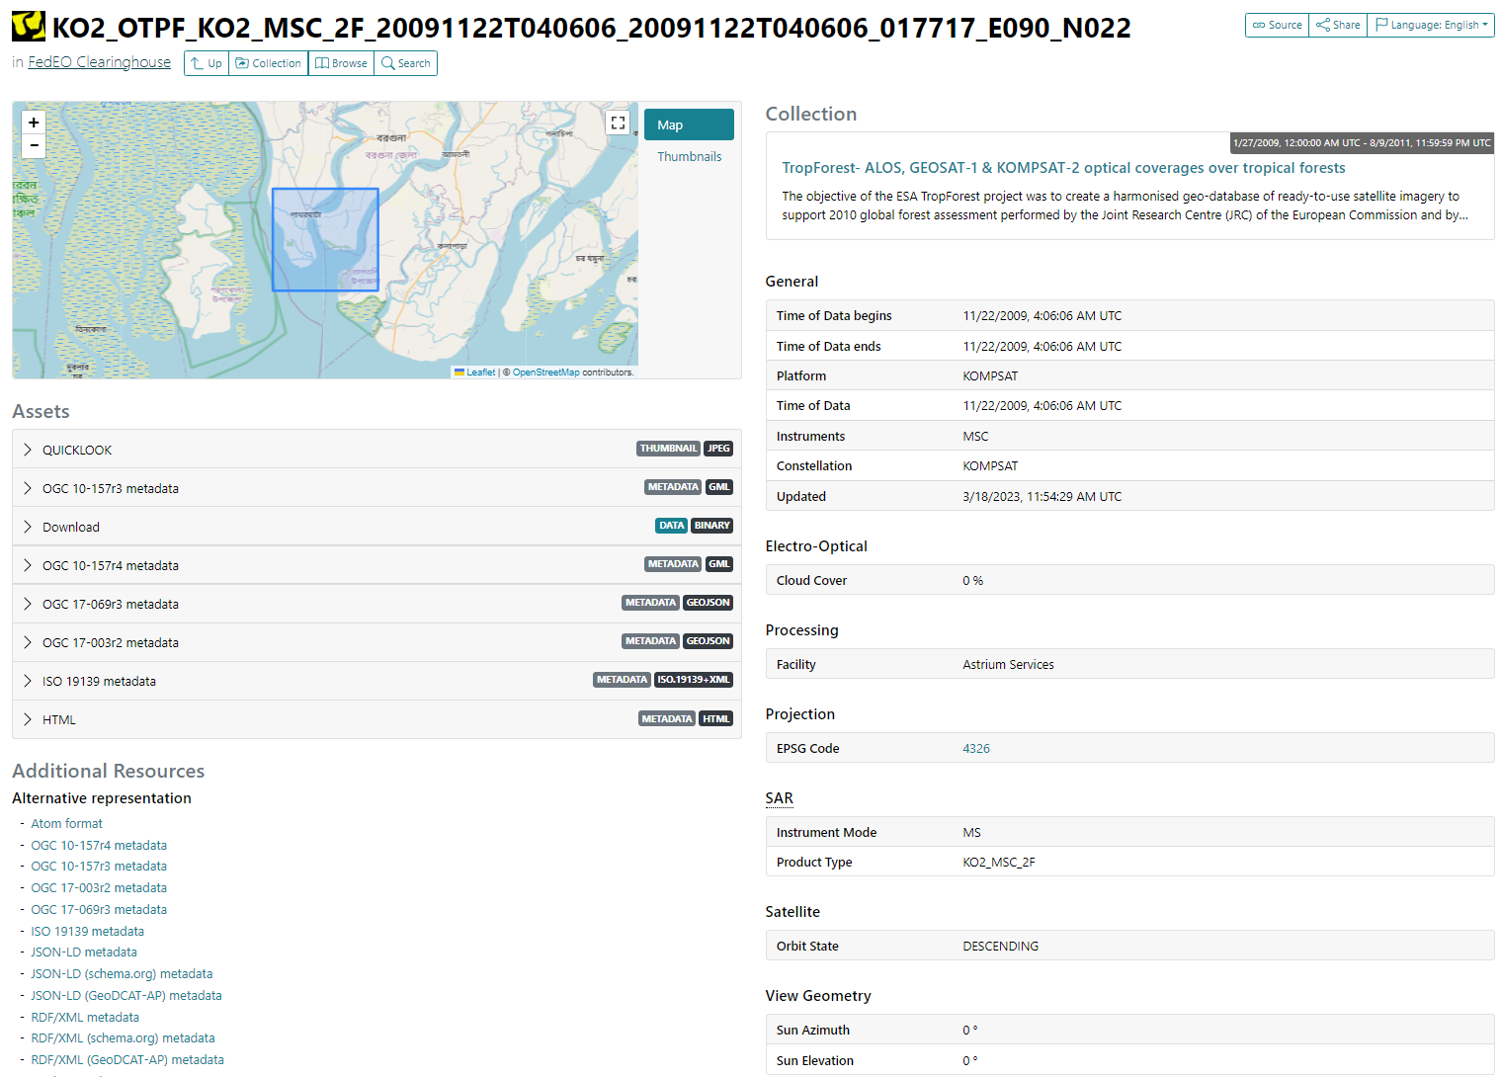
Evolution – STAC API
Granule information
  Assets
  Multiple extensions:
    EO
    Processing
    Projection
    View geometry
    …

Slide 22
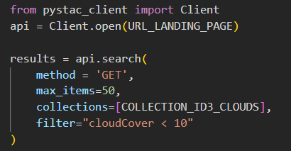
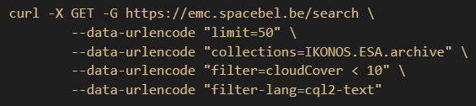
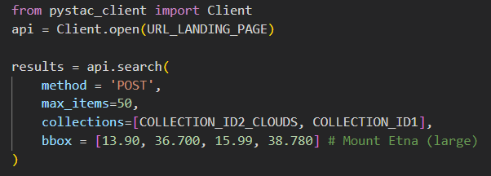
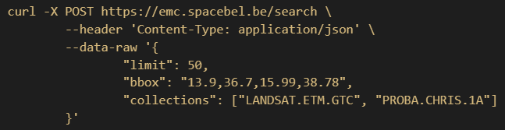
Evolution – STAC API
Online documentation:
  Implemented with Jupyter Notebooks and JupyterBook
  Will become available at https://github.com/eovoc/eo-books.
  With curl and pystac_client examples

Slide 23
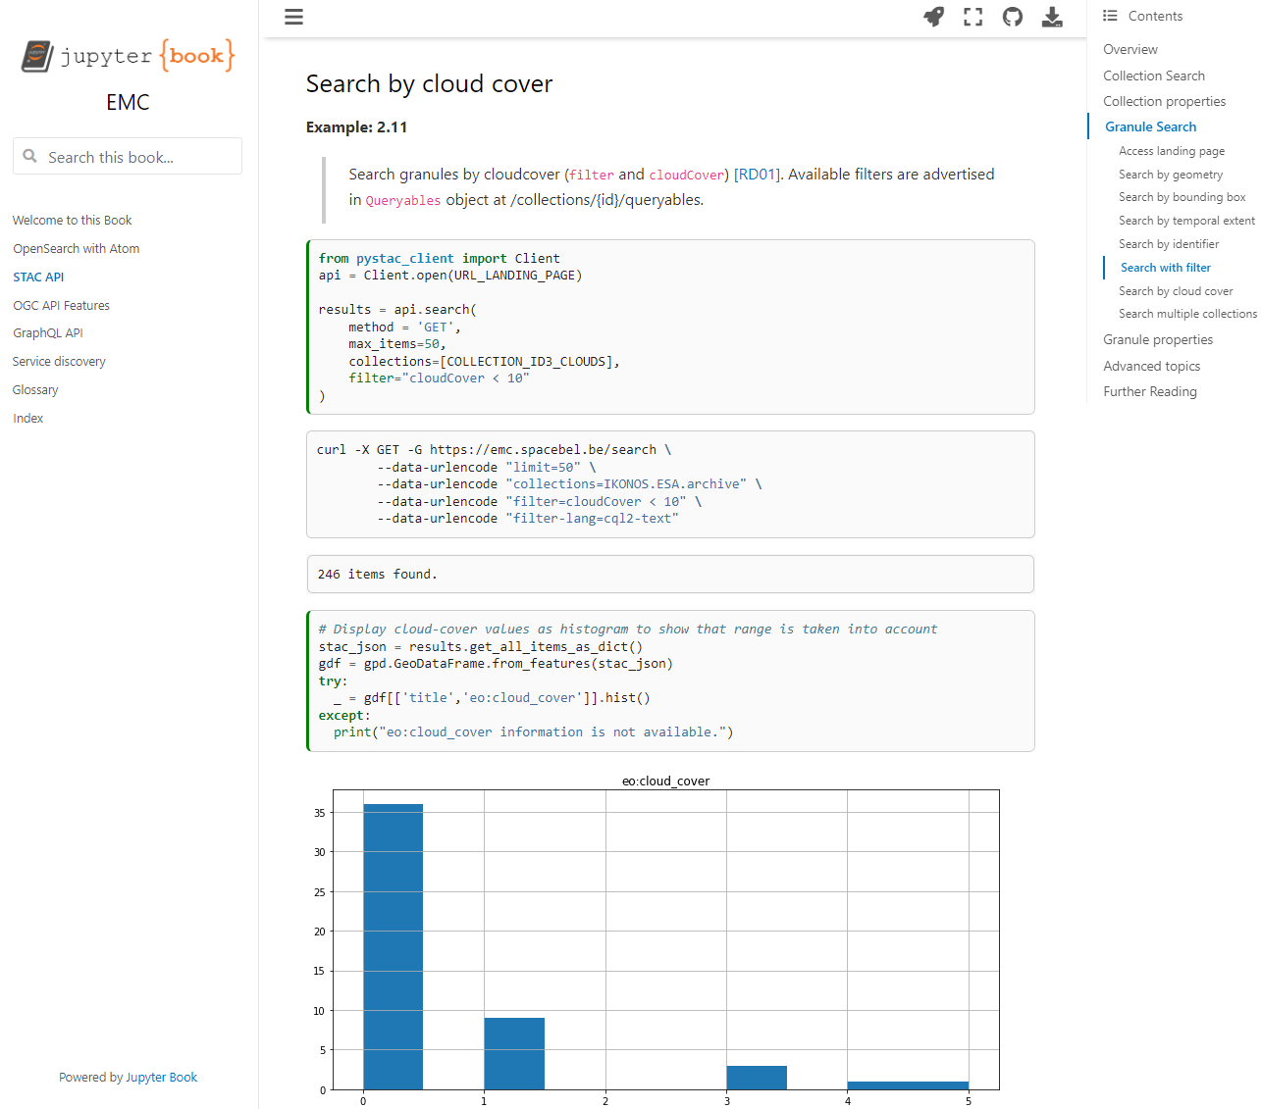
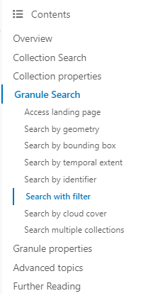
Evolution – STAC API

Slide 24
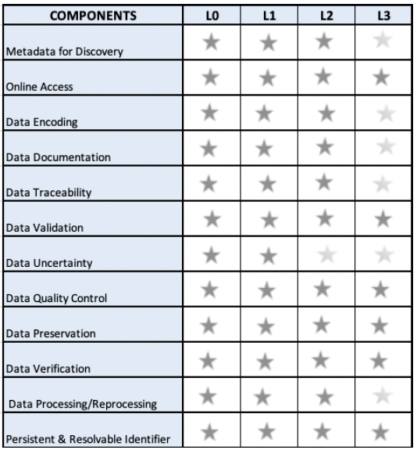
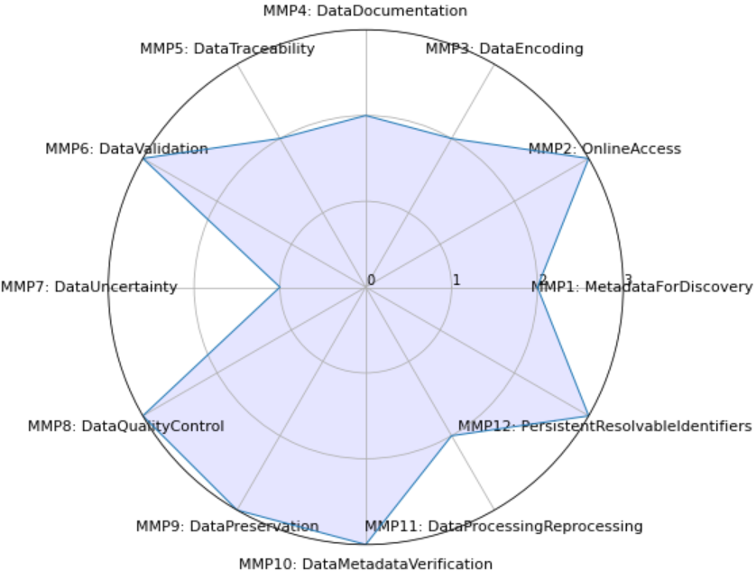
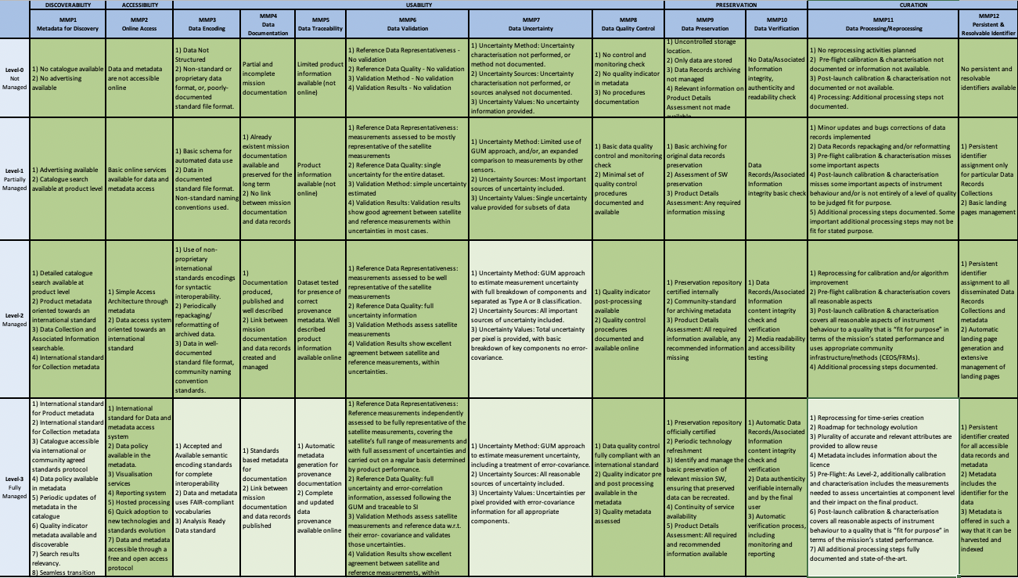
Evolution - Data Mgt and Stewardship Maturity Matrix
Data Management and Stewardship Maturity Matrix
  May be included in catalog for collections (if available)
    As asset or link available from /collections/{collectionId} e.g. /collections/NOAA_AVHRR_L1B_LAC
  Preliminary encoding with ISO19157-2
    Intend to provide summary
    and detailed DMSMM information
    Derive summary
    from detailed evaluation ?

Slide 25
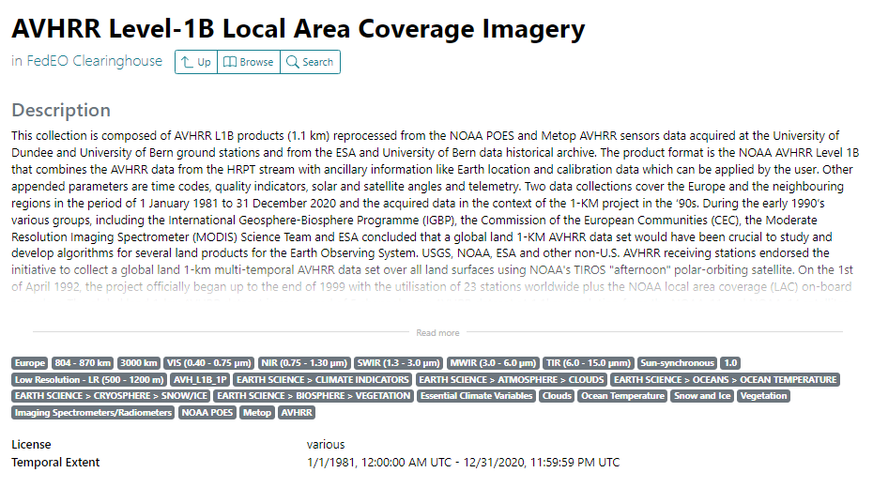
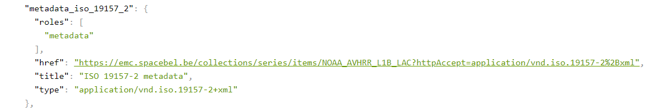
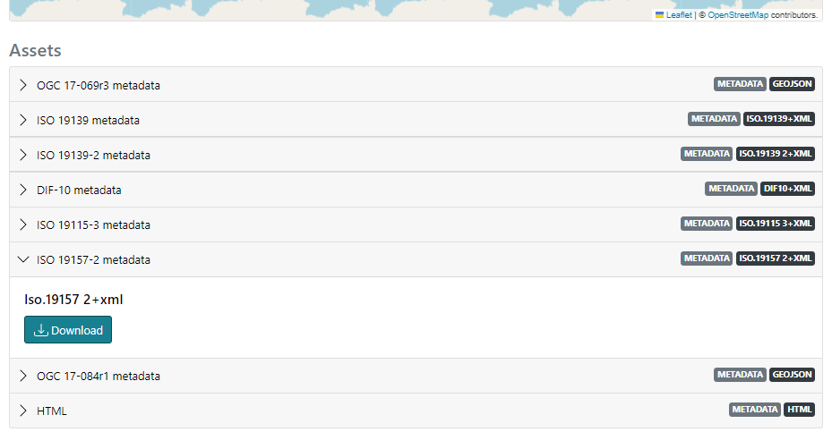
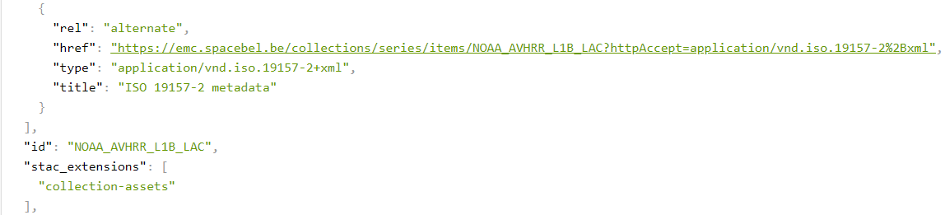
Evolution - Data Mgt and Stewardship Maturity Matrix
Available as STAC collection asset
and rel=“alternate” link in:
  /collections/{id}
  /collections/series/items/{id}

Slide 26
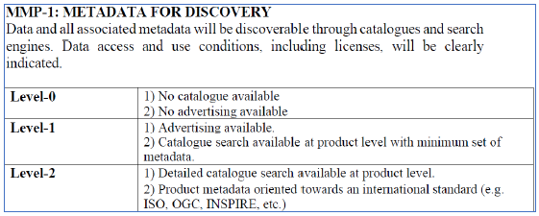
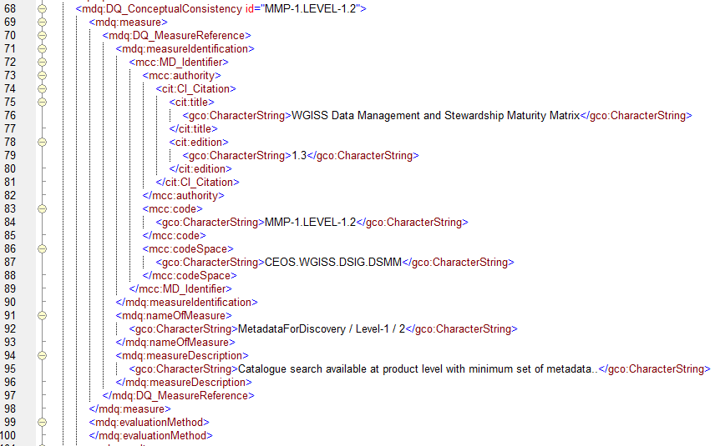

Evolution - Data Mgt and Stewardship Maturity Matrix
Mdq:measure for all criteria e.g. MMP-1.LEVEL-1.2
  Quantitative result (true/false)
  Descriptive result (justification)
Issues to derive component score from atomic criteria:
Level-0 “conditions” not relevant as
“level-0” is the minimum. Always satisfied.
Level-n (n>0) achieved when all Level-(n) conditions
and Level(n-1) conditions satisfied.
Notes:
A similar representation is proposed by the IHO (International Hydrographic Organization). https://github.com/IHO-S100WG/S100-Schemas/blob/master/S100%20Edition%204.0.0%20Schemas_FINAL.zip

Slide 27


