Slide 1
WGISS-55 GeoZarr SWG

Slide 2
Executive Summary
GeoZarr SWG was created in January 2023
Objective is to develop conventions for storing geospatial data in Zarr, a cloud-native, multidimensional data format.
The project emerged from outcomes of the ESA GSTP Hyperspectral Data Store & Access (HDSA) initiative
Interested ?
  Contact: Christophe.noel@Spacebel.be

Slide 3
Agenda
GeoZarr Starting Point
  HDSA Project
  GeoZarr Extension
GeoZarr SWG
  History
  Members
  OGC Process
Current status and next steps

Slide 4


Starting Point
GSTP Project: Hyperspectral Data Store & Access
Objectives:
  Cloud-Native Store
  Multidimensional data (wavelength, time, …)
  Serverless subsetting/time series API (“pixel-based access”)

Slide 5
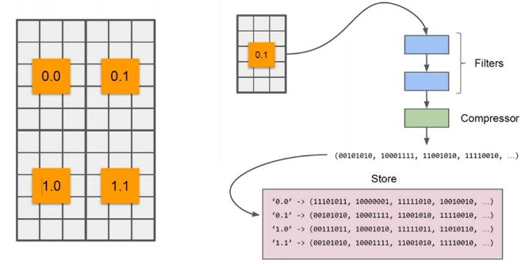
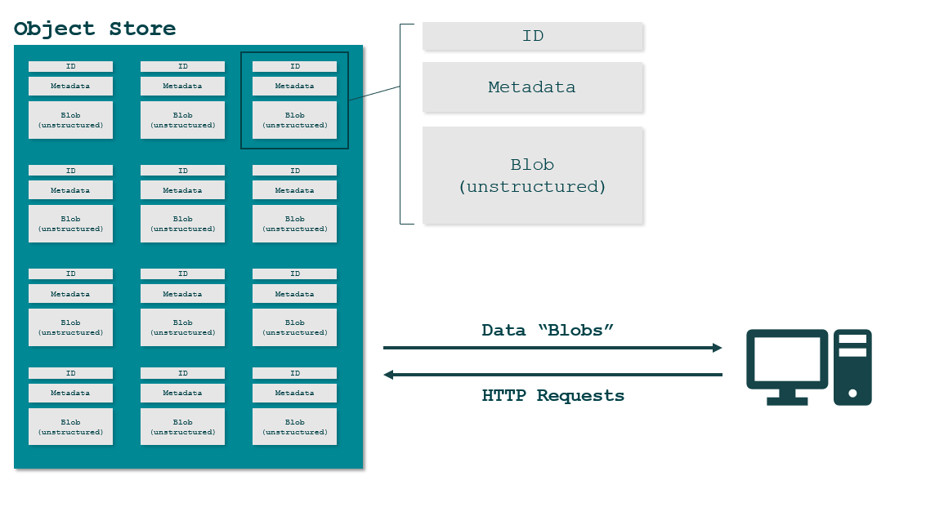










Benefits of Using Cloud-Native Data Formats
Independent chunks
→ fast & concurrent access
S3 friendly
→ Affordable & scalable
Native Access
→ No API (HTTP only)
COG is widely recognized as a leading cloud-native data format due to its scalability and efficiency

Slide 6

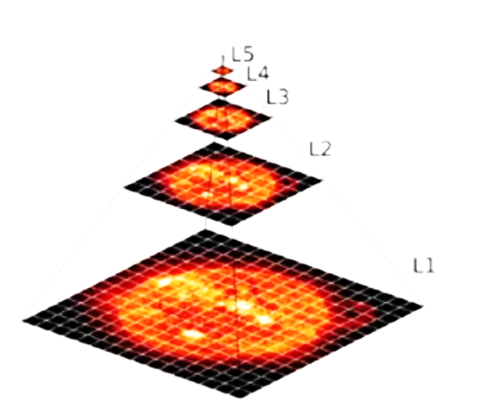
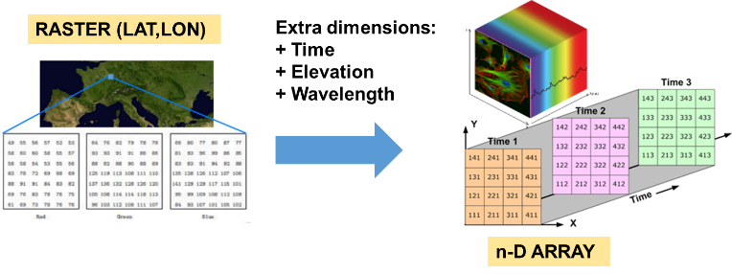
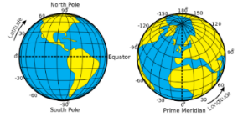
Why We Chose Zarr Over Other Formats
Independent chunks
→ fast & concurrent access
S3 friendly
→ Affordable & scalable
Native Access
→ No API (HTTP only)
Multidimensional Array
Extension-friendly

Slide 7
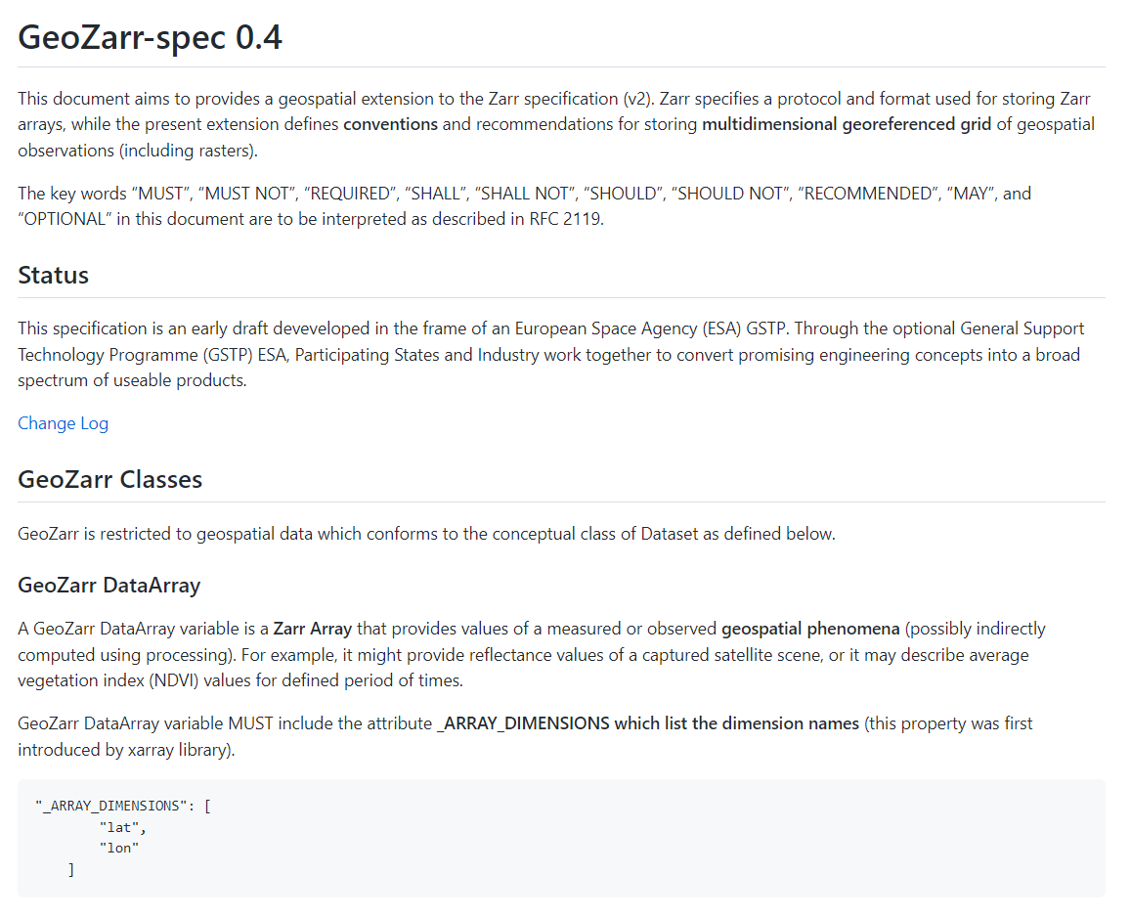


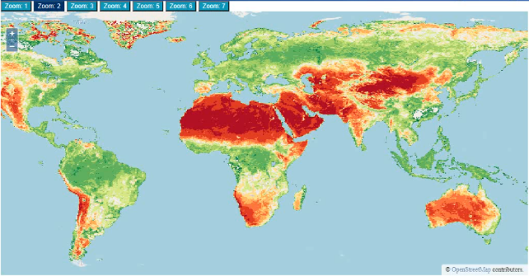
GeoZarr for a Geospatial Extension
Conventions to discover variables and coordinates
Geospatial semantics (mostly based on CF Conventions)
Map viewer friendly (multiscales, symbology)

Slide 8
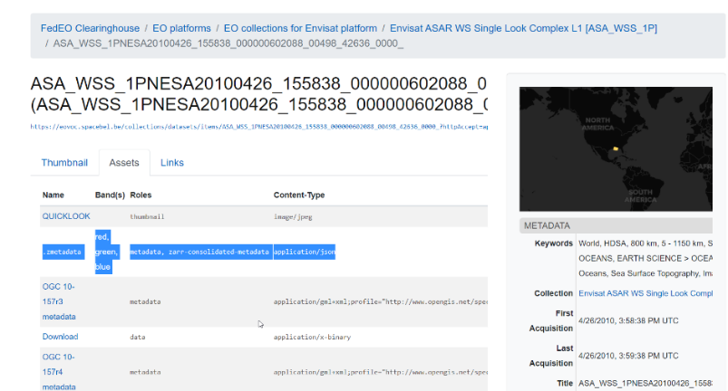
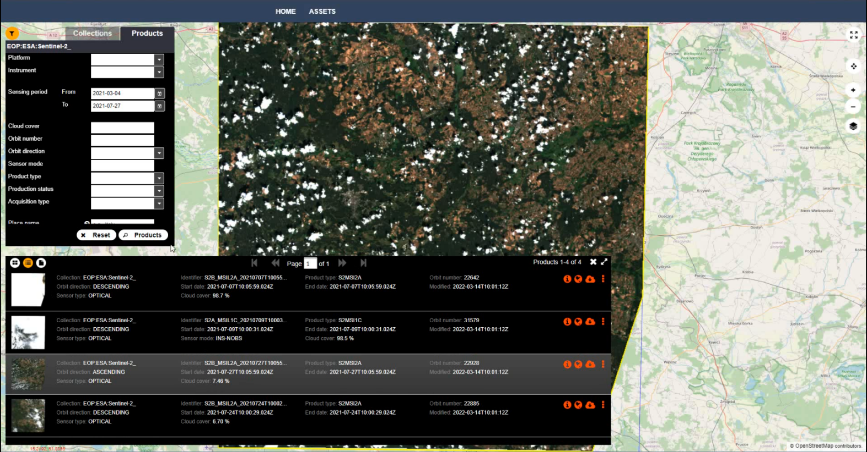
GeoZarr support in FedEO & STAC browser
FEDEO
STAC
Zarr Display
Zarr Quicklook

Slide 9
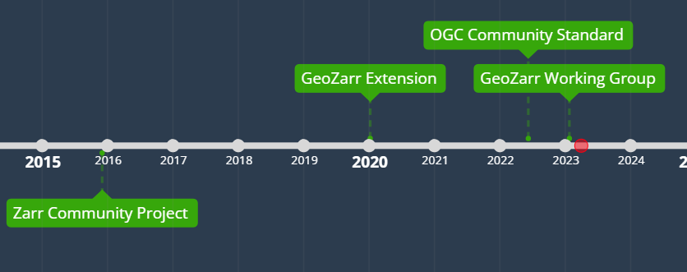
GeoZarr SWG - History
December 2015: Zarr Community Project (1st complete release)
January 2022: Geozarr draft proposed by ESA HDSA project
  Presented at WGISS-53
June 2022 – Zarr 2.0 adopted as OGC Community Standard
January 2023: Geozarr SWG team creation

Slide 10










GeoZarr SWG - Members
Brianna Pagán
Aaron Friesz
Alexey Shiklomanov
Christophe Noël
Yves Coene
WG lead
Ryan Abernathey
Zarr OGC community
GeoZarr first draft
David Blodgegtt
Sean Harkins
Chris Holmes
Amit Kapadia
OGC WaterML2, Hygrology
Anderson Banihirwe
Matthew Hanson
STAC

Slide 11
GeoZarr SWG - Meetings
19 January 2023: Kick-off
1 February 2023: Brainstorming on high-level objectives
15 February 2023: OGC standardization processes (Scott Simons)
1 March 2023: Examples of Zarr stores
29 March 2023: Spec extension vs Conventions
12 April 2023: SWG creation debate

Slide 12
GeoZarr SWG - Objectives
Conventions to store geospatial data in Zarr
  ZEP-4
Improve CF conventions
  CRS
Leverage zarr v3

Slide 13
GeoZarr SWG – OGC
Incertitude due to unprecise objectives
Concerns about OGC process (Slow ? Bureaucratic ?)
  Assessing working aside (ratification as OGC community standard)
Actions taken:
  Introduction to OGC Process
  Refinement of objectives

Slide 14
ZEP-4
GeoZarr convention will follow ZEP-0004 approach
ZEP-0004
  Proposed enhancement of Zarr (not yet validated)
  Formalize concept of Zarr convention
  Support communities standardizing domain-specific data model (in Zarr)

Slide 15
GeoZarr SWG – Current Status
Hot Topics:
  Governance & goals
  Use cases and tool chains
  Core coordinates set (e.g. XYZTBW)
  Spatial coordinates “condensed” encoding (2D + vectors + origin/offset)
  Differences between GDAL and Xarray encodings
Next Steps:
  OGC SWG ?
  Contacts with CF

Slide 16
Questions
Interest to join us ?
  Contact: Christophe.noel@Spacebel.be

