Slide 1
COOPERATION OF THE RUSSIAN FEDERATION WITH INTERNATIONAL ORGANIZATIONS USAGE OF RUSSIAN EO SYSTEMS FOR DISASTERS MONITORING
State Space Corporation ‘Roscosmos’
CEOS WGDisasters-19 Meeting
Cordoba, Argentina
April 18 – 20, 2023

Slide 2
PARTICIPATION OF ROSCOSMOS IN CEOS
AND OTHER INTERNATIONAL ORGANIZATIONS
State Space Corporation ‘Roscosmos’:
is a member of WGCV, WGISS and WG Disasters
provides the latest information on Russian satellites to update the CEOS MIM Database
hosted the following international events:
CEOS Meetings:
WGCV-33, Moscow, May 2011
WGISS-38, Moscow, September 2014
Other events:
ASEAN RS data training, Moscow, March 2015
13th GEO Plenary and Exhibition, Saint-Petersburg, November 2016
36th meeting of the International Charter on Space and Major Disasters, Moscow, October 2016
AOMSUC-8, Vladivostok, October 2017
CGMS-47, Sochi, May 2019
42nd meeting of the International Charter on Space and Major Disasters, Saint-Petersburg, October 2019
CEOS WGDisasters-19, April 18-20, 2023

Slide 3
PARTICIPATION OF ROSCOSMOS IN CEOS WORKING GROUPS
Working group | Engagement
WGISS | Participation
WGCV | Participation
WG CapD | Monitoring
WG Disasters | Participation
WG Climate | Monitoring
CEOS WGDisasters-19, April 18-20, 2023

Slide 4
RUSSIAN EO SYSTEMS USED IN DISASTERS MONITORING
Spacecraft | Resurs-DK (archive only) | Meteor-M |  |  | Kanopus-V and Kanopus-V-IK |  |  | Resurs-P (archive only)
Characteristics
Launch date | 15.06.2006 | 18.09.2009 15.10.2014 28.11.2017 05.07.2019 |  |  | 22.07.2012 14.07.2017 01.02.2018 27.12.2018 5…7 years |  |  | 25.06.2013 26.12.2014 13.03.2016
Life time | 3 years | 5…7 years |  |  |  |  |  | 5 years
Onboard sensor | 28.3 / 16 | KMSS |  | MSU-MR | PSS | MSS | MSU-IK-SRM | Geoton | KSHMSA-VR
 |  | MSU-100 | MSU-50
Swath width, km |  | 900 | 450 | 2800 | 23 | 20 | 2000 | 38 | 97
Resolution, m: Panchromatic band Multispectral band | 1 / up to 3 2 - 3 / 3 - 5 | - 60 | - 120 | - 1000 | 2.5 - | - 12.5 | 200 | Better than 1 2-3 | 12 23.8
Number of spectral bands | 3 / 1 | 3 | 3 | 6 | 1 | 4 | 2 | 7 | 6
Revisit time, days | - | 2 |  |  | 4 |  |  | 3 - 4
CEOS WGDisasters-19, April 18-20, 2023

Slide 5
UNIFIED GEOGRAPHICALLY DISTRIBUTED INFORMATION SYSTEM OF EARTH REMOTE SENSING (ETRIS DZZ)
CEOS WGDisasters-19, April 18-20, 2023

Slide 6
THE FEDERAL FUND OF EO DATA
Easy search, browse and order of archive EO data
Fully automated EO data processing via new software complex and ready product delivery through personal dashboard
Fully automated technological cycle of order fulfillment
High rate of order fulfilment (from several minutes to 10 working days since request submission)
Orders can be done by private entities and paid online. Fast processing of orders submitted by legal entities via an offer contract
CEOS WGDisasters-19, April 18-20, 2023

Slide 7
MAIN STAGES OF EO DATA PROCESSING
данных
Radiometric correction
Geometric correction
Atmospheric correction
Quality control
Data insertion to Data Bank
Data release on the Geoportal
*APOI – automated stream processing of information
APOI*
данных
Databank
Information from EO spacecraft
Geoportal
Satellite tasking
Data order via EO Data Fund
API
Services
New acquisitions
Data from EO Data Fund
Federal and regional executive bodies
Private entities
Legal entities
CEOS WGDisasters-19, April 18-20, 2023

Slide 8
RUSSIAN INFORMATIONAL EO SERVICES
Services and products
7 industrial services
27 info products
FOREST CONTROL
3 basic products
3 monitoring products
CONSTRUCTION CONTROL
2 basic products
2 monitoring products
ECO-MONITORING
2 basic products
2 monitoring products
QUARRIES
2 basic products
1 monitoring product
AGRI-MONITORING
2 basic products
3 monitoring products
EMERGENCIES
1 basic product
4 monitoring products
DISTURBED LANDS
Includes services:
Eco-monitoring
Quarries
Agri-monitoring
CEOS WGDisasters-19, April 18-20, 2023

Slide 9
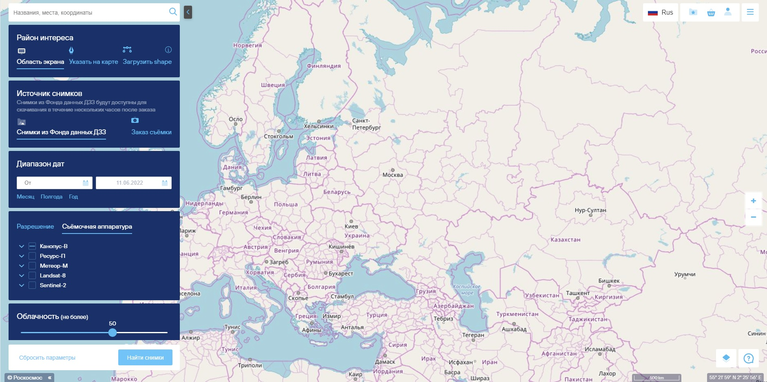
NEW GEOPORTAL OF ‘ROSCOSMOS’
Geoportal of Roscosmos is a resource which combines functions of browser for satellite imagery with a mechanism for search and order of data from the Federal EO Data Fund.
https://next.gptl.ru
CEOS WGDisasters-19, April 18-20, 2023

Slide 10
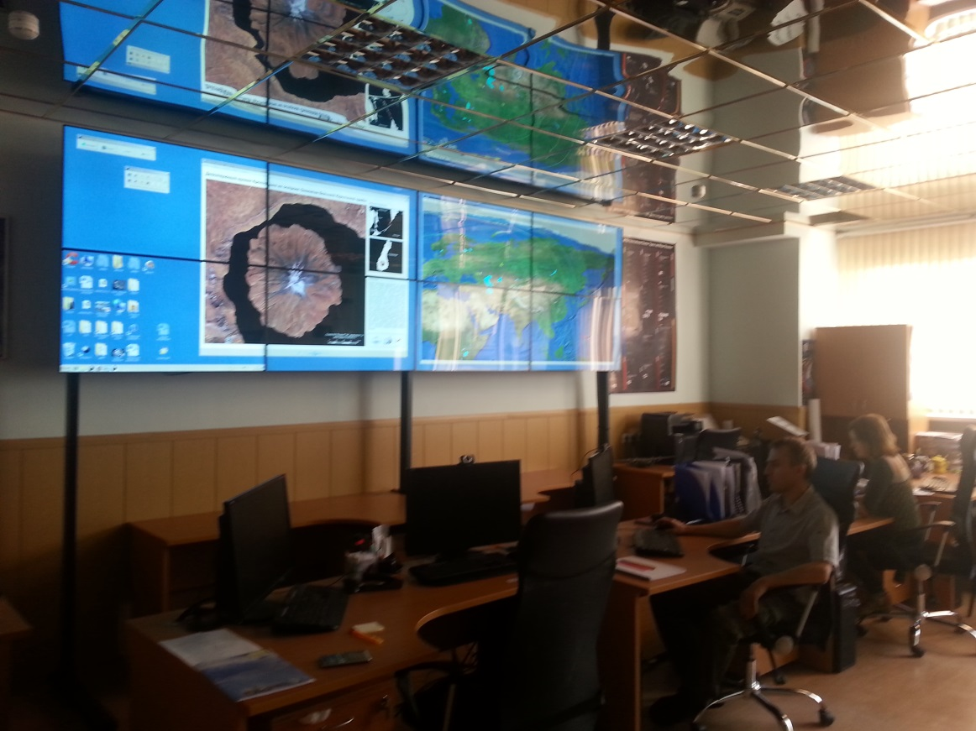
COOPERATION OF ROSCOSMOS WITH THE INTERNATIONAL CHARTER ON SPACE AND MAJOR DISASTERS
On August 28, 2013
ROSCOSMOS joined the International Charter on Space and Major Disasters.
Research Center for Earth Operative Monitoring was assigned as the ROSCOSMOS’ Operator in the Charter.
A specialized hard- and software system was deployed and a division responsible for the Charter activity support in Russia was established at the basis of Research Center for Earth Operative Monitoring.
The activation of the International Charter on Space and Major Disaster mechanism enables the implementation of international resources of multi-purpose space facilities (more than 40 satellites) in crisis and emergency situations including usage for the benefit of member nations.
CEOS WGDisasters-19, April 18-20, 2023

Slide 11
COOPERATION OF CEOS WGDISASTERS AND INTERNATIONAL CHARTER ON SPACE AND MAJOR DISASTERS
Working group CEOS WGDisasters proactively cooperates with the International Charter on Space and Major Disasters to access the EO data from the Charter members’ spacecraft over the areas of natural and manmade disasters under the cooperation procedures established between the two organizations:
CEOS WGDisasters activity leads can request Charter data during Charter activations for different purposes of their pilots and demonstrator projects.
CEOS partner organizations can offer support (e.g., science products or VA services) to the participants of Charter activations .
WGDisasters activity leads have ‘observer’ status during Charter activations in its operational system – COS2.
CEOS WGDisasters-19, April 18-20, 2023

Slide 12
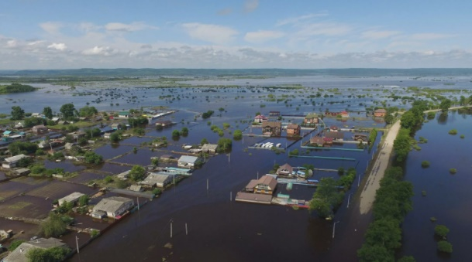
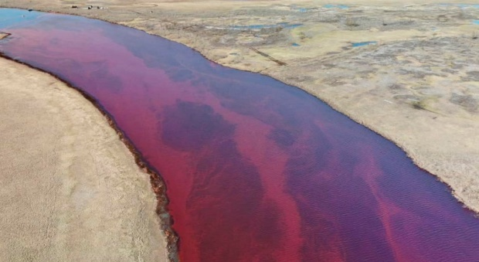
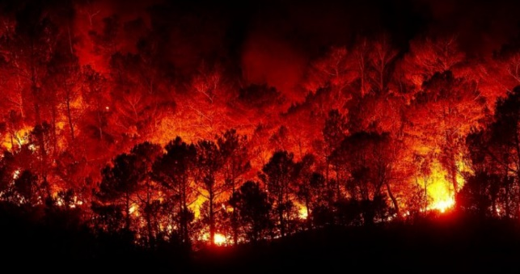
DISASTERS MONITORING
Since its accession to the Charter Roscosmos has been continuously participating in the Charter operational activities by providing Russian EO data to the countries impacted by natural and manmade disasters. In the period of 2013-2022 Roscosmos took part in 361 Charter activations and provided to its members and authorized users more than 100 million sq. km of Russian EO data (more than 4 400 scenes).
In addition, Roscosmos also provides its EO data to the EMERCOM of Russian and ensures the provision of foreign EO data of Charter members and Cooperating Bodies within the frame of major natural and manmade disasters monitoring over the territory of the Russian Federation and other countries. Within the period of 2013-2022 30 Charter activations were requested by EMERCOM, more than 384 million sq. km, (more than 7 000 scenes) of data provided.
CEOS WGDisasters-19, April 18-20, 2023

Slide 13
THANK YOU!
Committee on Earth Observation Satellites

