Slide 1
Planned use case of ML in the WildfireSat mission

Slide 2
Executive Summary
Tools to fight wildfires
Established use of ML in wildfire science and management
WildfireSat Products being targeted to investigate ML
Examples
Development pathway/Information systems being used
Final thoughts
Slide 2

Slide 3
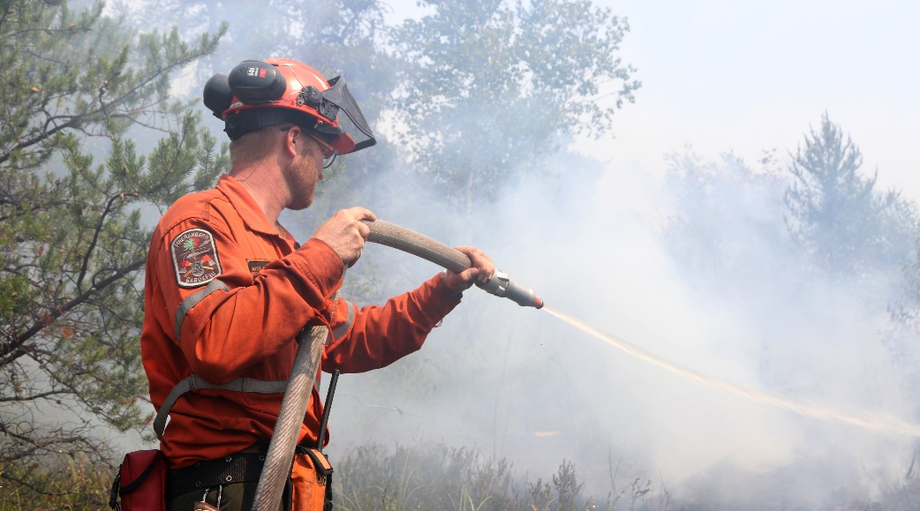
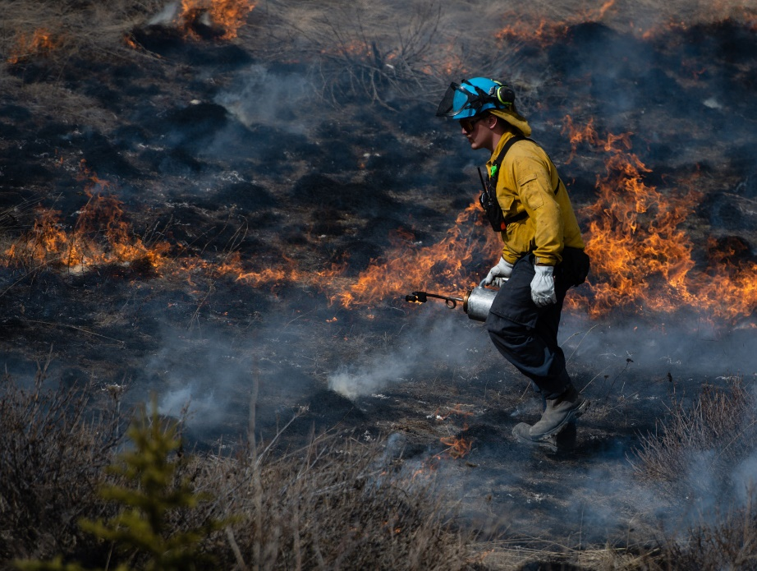
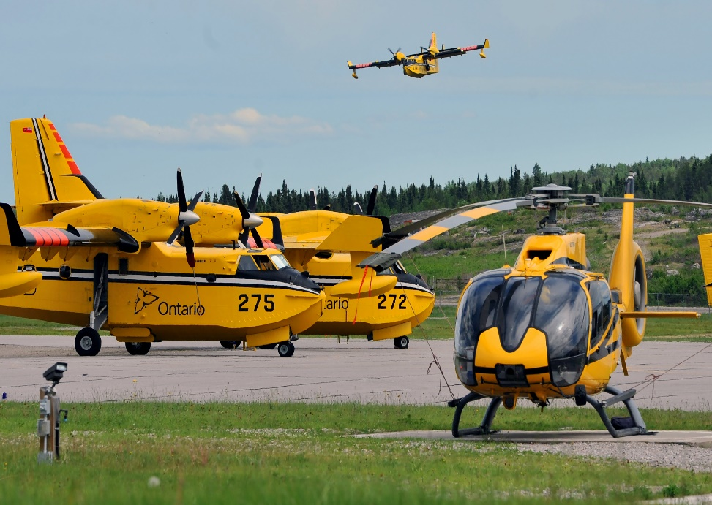
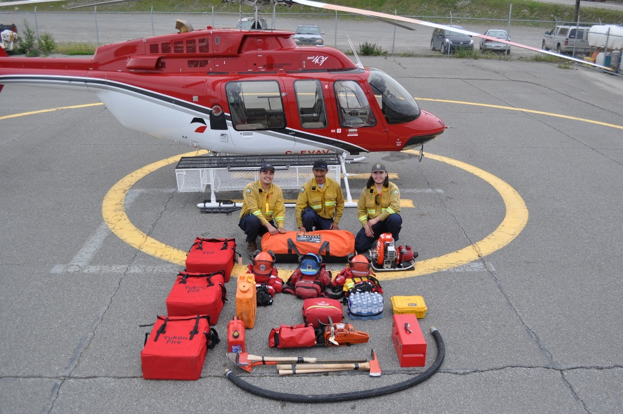
Tools to Fight Wildfires
Wildland Firefighters use a variety of tool to fight wildfires
Photos courtesy of the Ontario Ministry of Natural Resources and Forestry and the Yukon Wildland Fire Management

Slide 4
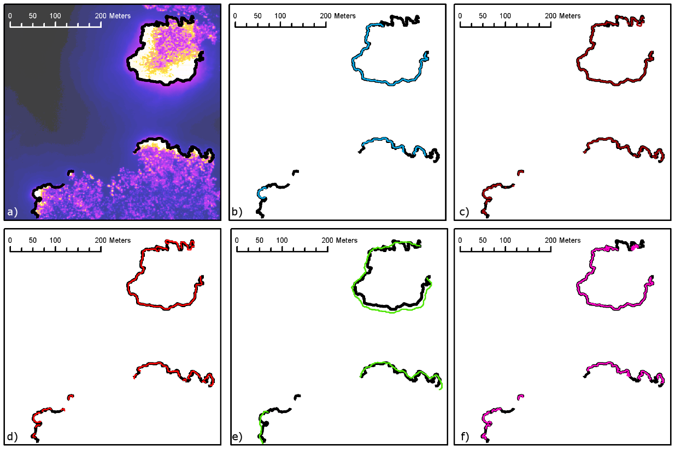
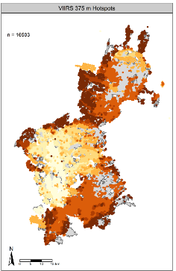
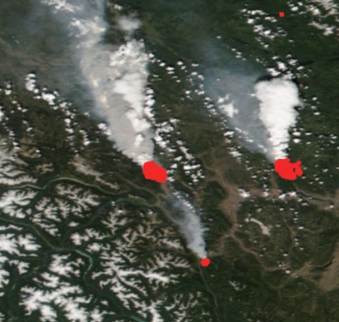
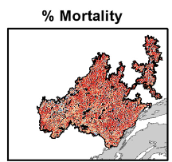
EO and ML are also tools
Above example courtesy of: Ashlin Richardson, BC Wildfire Service

Slide 5
Established use of ML in wildfire sector (a non-exhaustive list)
Wildfire applications
ML Methods
Fuels
Fire detection/perimeter/characterization
Fire weather/lightning/climate change predictions
Burned area/fire severity
Fire Spread/growth
Smoke
Post-fire effects
Socioeconomic effects
Planning/policy
Fuel treatment
Wildfire preparedness/response
Social factors
Just about any machine learning method that has been developed, has seen an application or attempted application in this area.
Supervised learning/Unsupervised learning/agent-based learning
Examples of some commonly used methods in this sector
Artificial neural-networks
Random forests and decision trees
Bayesian methods
Support vector machines
And many others..
Jain, P., et al (2020). A review of machine learning applications in wildfire science and management. Environmental Reviews, 28(4), 478-505.

Slide 6
Potential for ML in WildfireSat mission
Active fire detection
Cloud masking
Burned area
Burn severity
Multi-source fire classifications
Burned Area classifications
Combining uncertainties derived from Bayesian approach
Estimating fire arrival times
Fire Intensity product

Slide 7
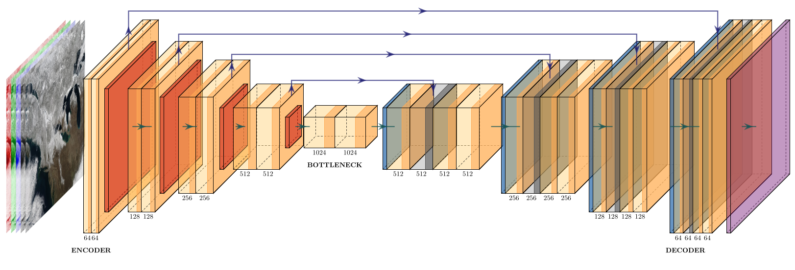
Fire Detections – Unet approach
A Convolutional Neural Network for image segmentation
Initially developed for biomedical imaging

Slide 8
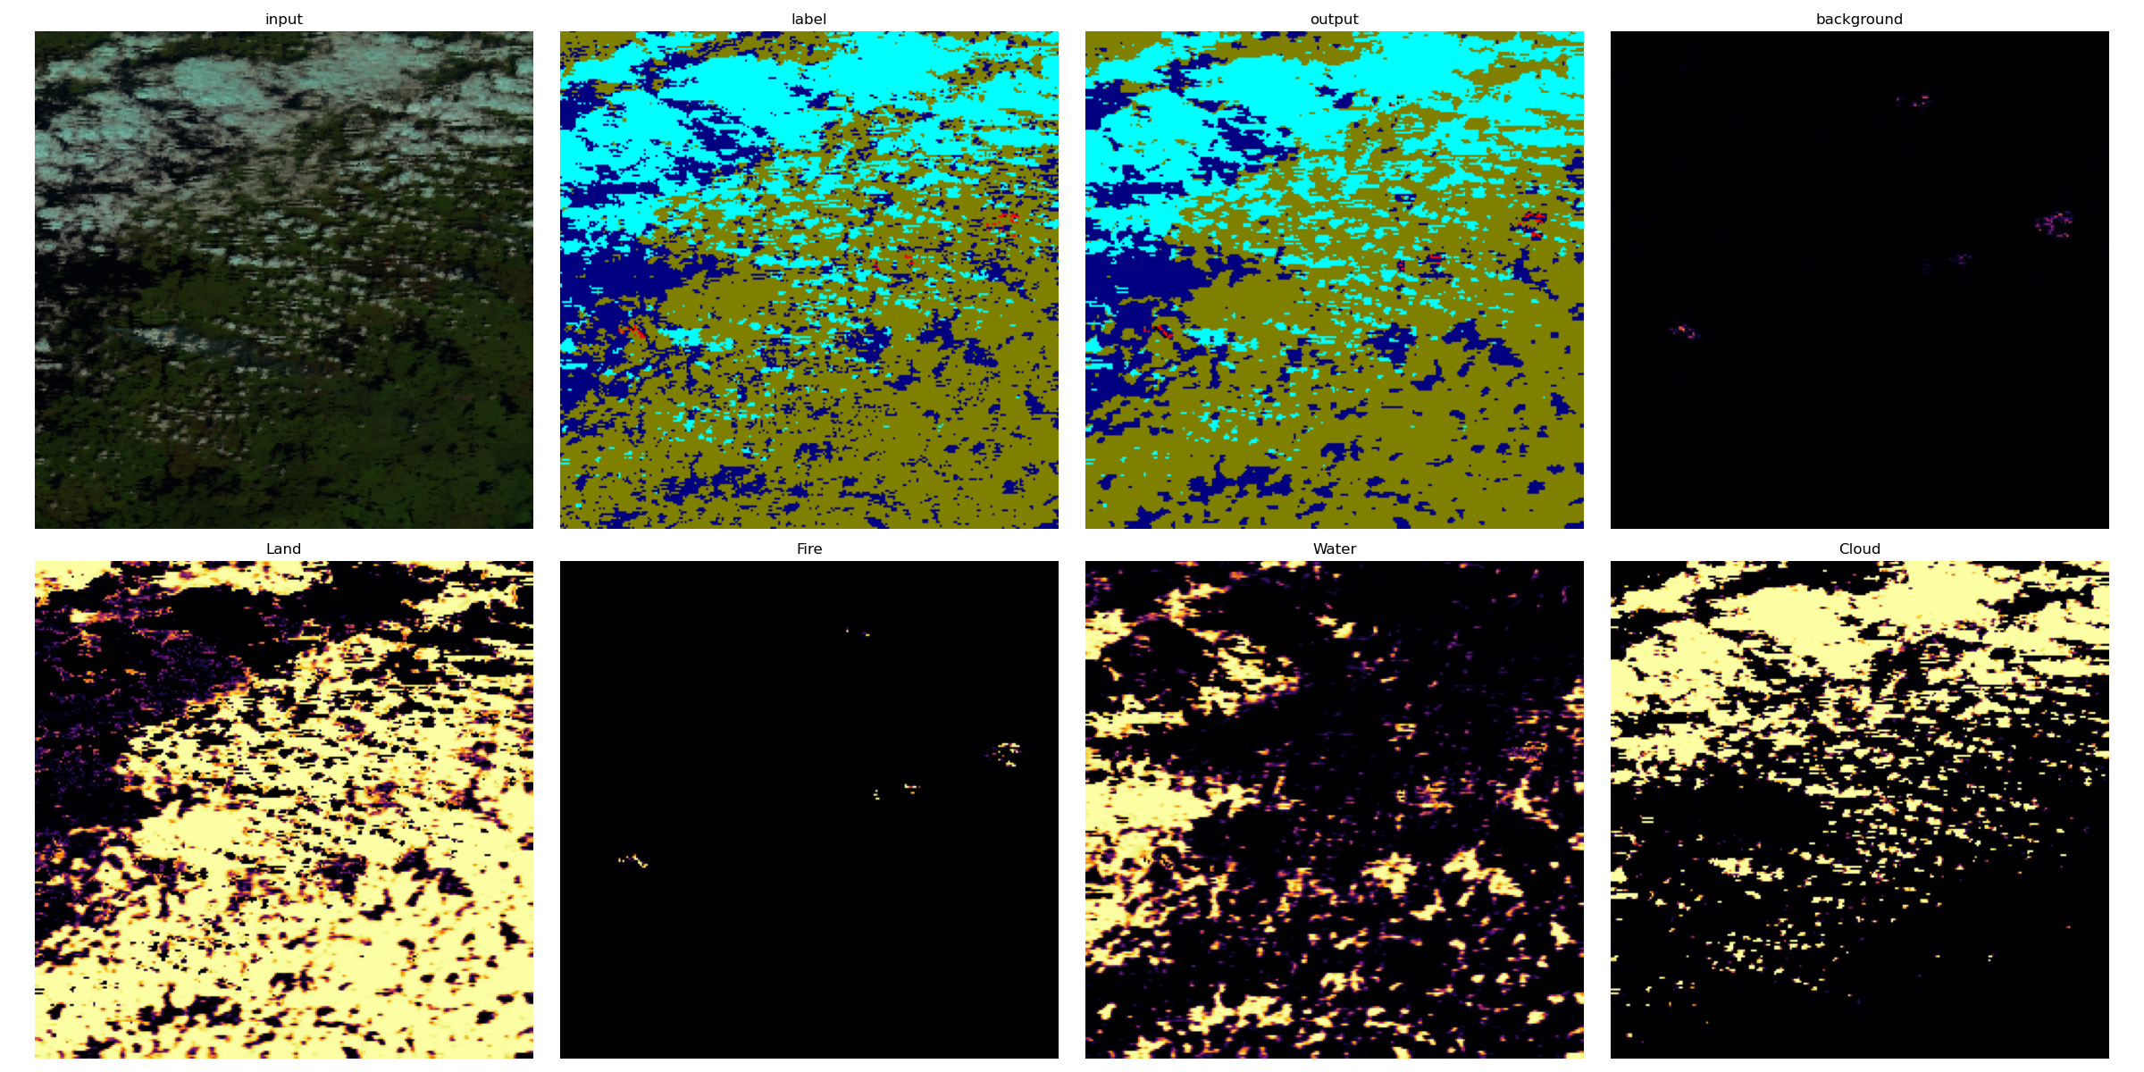
Fire Detections – Unet approach

Slide 9
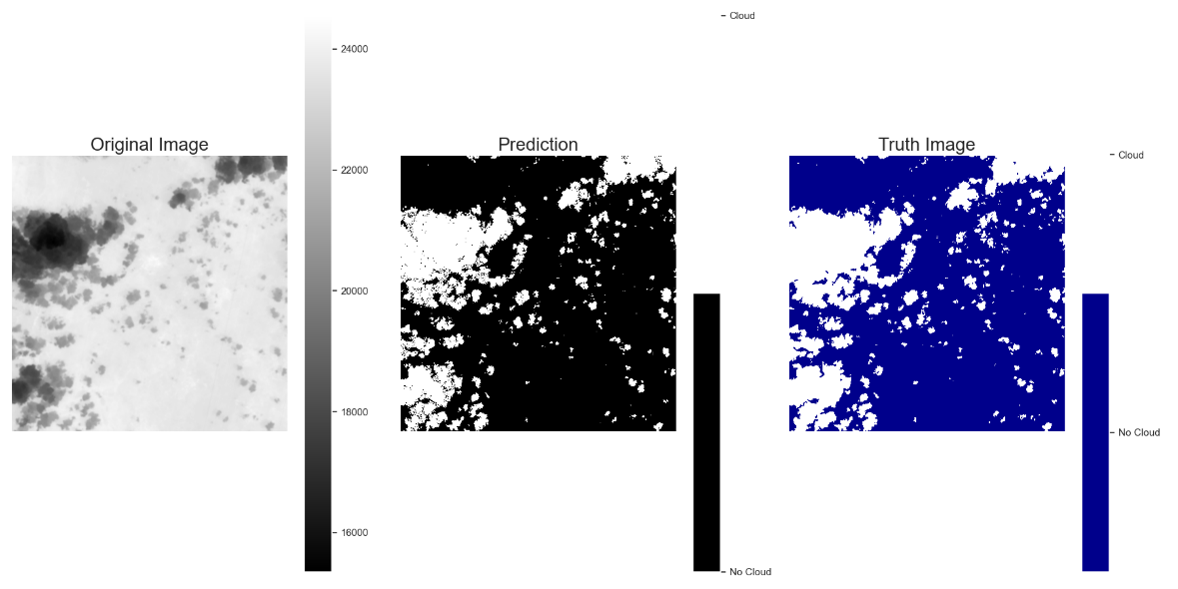
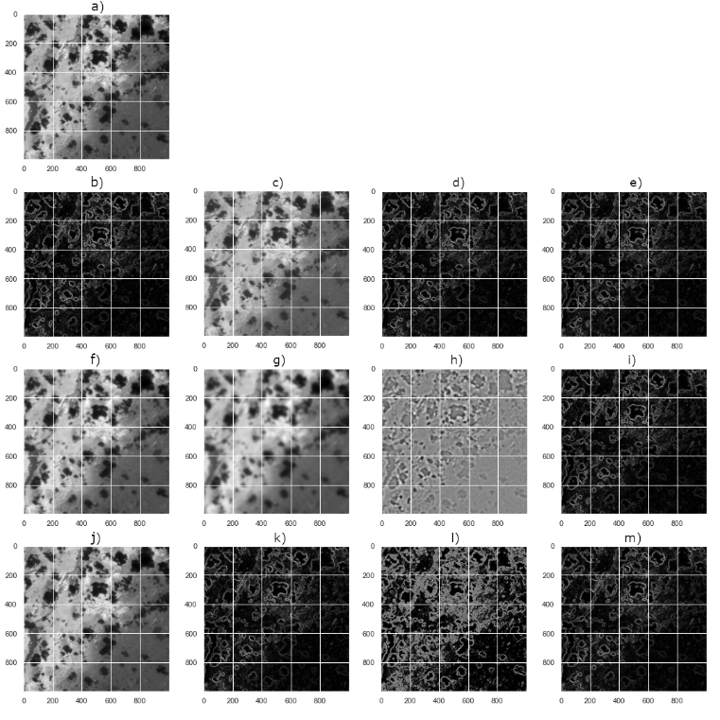
Cloud masking – an ML approach
Single-band IR Testing:
Random Forest
Gaussian Naïve Bayes
Support Vector Machine
MLP
Accuracy: 0.96 Precision: 0.94 Recall: 0.85 F1: 0.89 IoU: 0.81

Slide 10
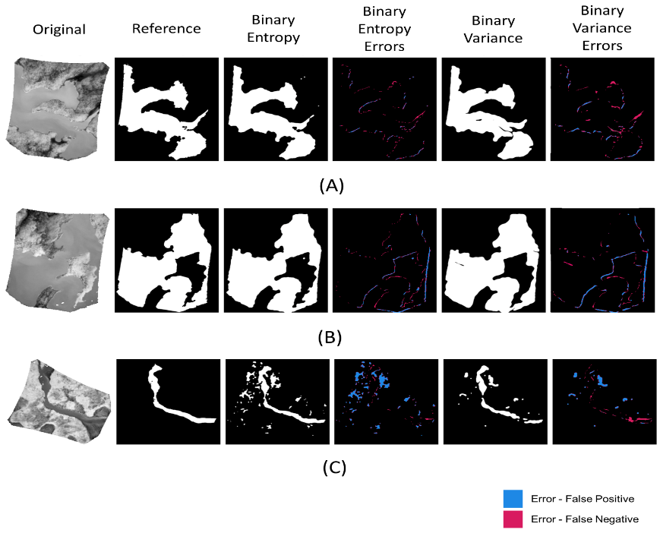
Waterbody ID – an ML approach
2018 Red Lake, ON flights of actively burning fires (single-band MWIR)
Hand-drawn waterbody dataset
Comparison with CanVec Baseline Data
Standard image filters
Random Forest (combination of many filters)

Slide 11
WildfireSat Product Development pathway
Science Development
Software Contracting
SOC Implementation
Operations
Software dev guardrails
Development of ATBDs
Sandbox environment in CWFIF
End-User engagement
Provide I/O and ATBD to contractors
ML model contracting still TBD
Oversight from GoC
Contractor + GoC to implement side-by-side
Implement in cloud-based infrastructure
Following CWFIF procedures
End-user engagement
GoC-led maintenance
End-user engagement

Slide 12
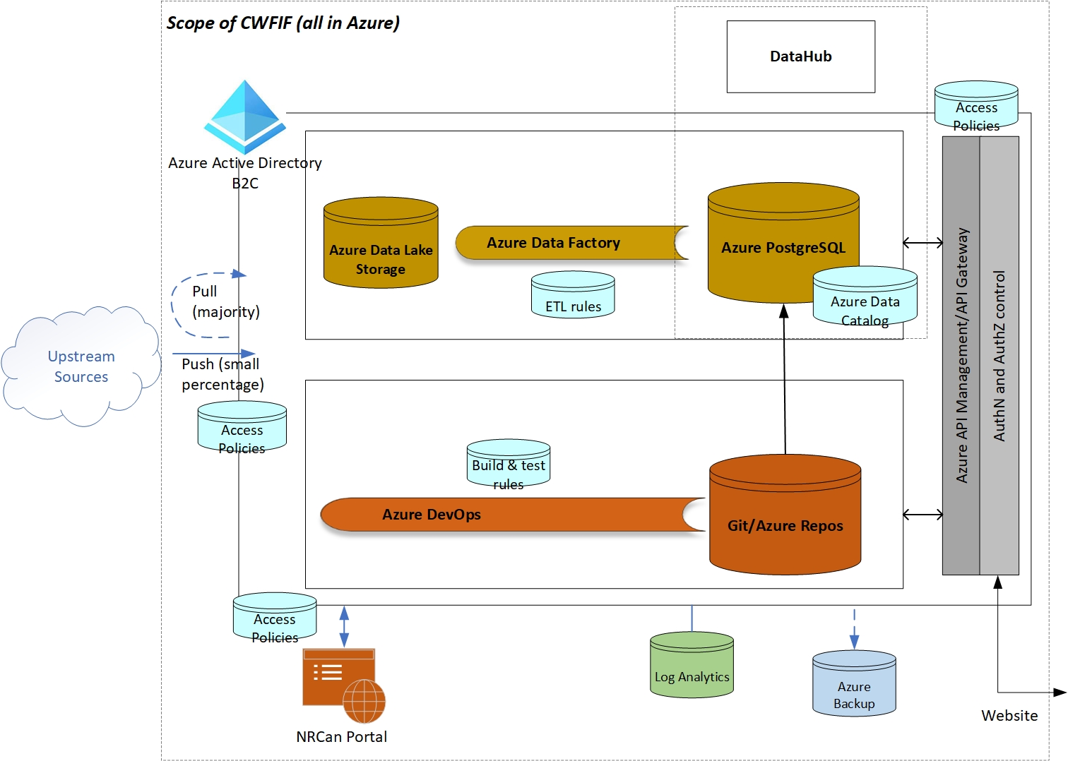
WildfireSat Product Development pathway Canadian Wildland Fire Information Framework (CWFIF)
Cloud-based Target state architecture
Standardized data/metadata/delivery/storage etc.
ML algorithms can take advantage of the scalability and flexibility

Slide 13
Final Thoughts…
It is well established that there are use cases for ML-based algorithms for a wide variety of wildfire applications
ML is not necessarily THE solution but it is A solution
We are investigating multiple ML-based algorithms for the WildFireSat mission
Evaluating trade-offs to:
ML-based over rules-based results
Implementation challenges with contracting and our information systems

Slide 14
Contact
https://www.asc-csa.gc.ca/eng/satellites/wildfiresat/
Alan.cantin@nrcan-rncan.gc.ca

