Slide 1
Presentation of WGISS AI/ML White Paper
Yousuke Ikehata, JAXA
Agenda ID: 2023.4. 19_09.55
WGISS-55
19th April 2023

Slide 2
Background and Scope
This white paper shows a use case about Deep Learning (DL), Machine Learning (ML) and Artificial Intelligence (AI), which uses EO data.
Some CEOS agencies provide DL/ML/AI data and platforms and introduce them at WGISS meetings.
But there aren't any summarized documents.
This document can lead data users to data and platforms.
Additionally, data providers can know where to upload or what cloud is proven for DL/ML/AI dataset.

Slide 3








Who and Why
Who will benefit form a White paper
  Data User
    Student majoring in remote sensing
    Data Scientist who isn’t majoring in remote sensing
  Data Provider
    Agency who plans to provide dataset for AI/ML newly.

Slide 4
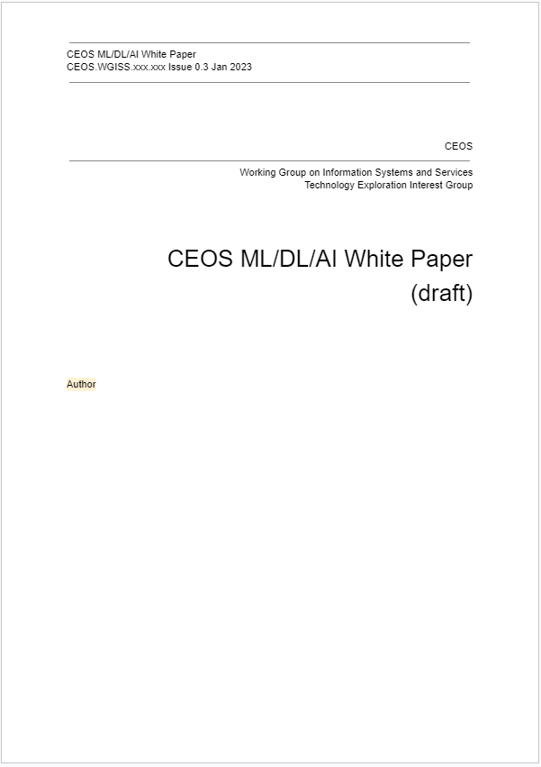
Contents
Background
Methods
Use cases
Data and platforms
Conclusion
Main contents
These sections are summary of presentations at past WGISS and CEOS agencies studies.

Slide 5
Current status
We’ve already discussed about…
  Purpose, expected readers,
  Sections
We assigned writers for “Use cases” and “Data and platforms” sections.
We write white paper in google drive in parallel.
  Please send mail to us if you want to read current version.

Slide 6
Time line
Share/Check Outline
In-house work
Share draft
Allocate author to excels part.
Report in monthly meeting
Review
Pass round in WGISS
Publish
WGISS-54
WGISS-56
WGISS-57
12 month
6 month
We’ll finish writing each use cases till end of July.
After August we’ll arrange detailedness, volumes and so on.

Slide 7
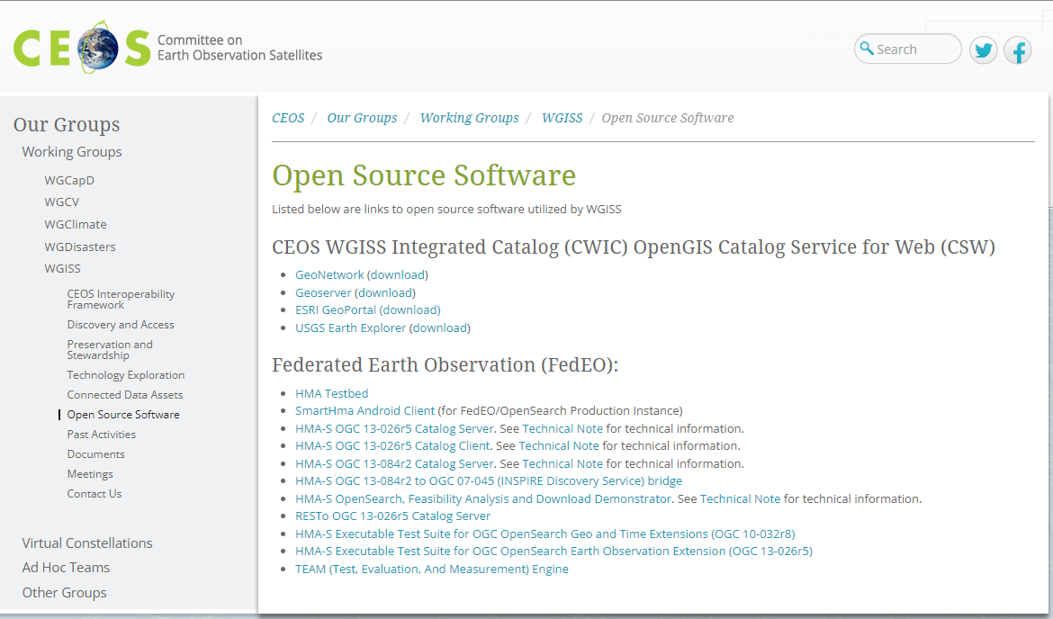
Post our survey.
We’ll publish white paper in Spring 2024th(WGISS-57).
We’ll post summary of white paper to WGISS home page.
Slide 7

Slide 8
Routine about AI/ML for WGISS.
Post/
Update home page
Collaborate with the other group.
Invite presenters to WGISS.
Publish/
Update white paper
AI/ML studies,
Reports.
WGCapD, WGDisaster, …

