Slide 1
CEOS WG Disasters : an overview for WGISS
H de Boissezon, CNES
CEOS WG Disasters Chair
Presentation to WGISS
April 19th 2023

Slide 2
Overview
Update of WGDisasters activities after March 2022 presentation to WGISS by Laura Frulla
Brief overview of WG Disasters objectives and current priorities
WG Disasters workplan status and perspectives
Overview of Pilots and Demonstrators new achievements
Challenges for activities sustainability
Notes:
The CEOS WGDisasters ensures the sustained coordination of disaster-related activities undertaken by the CEOS Agencies and acts as an interface between CEOS and the community of stakeholders and users involved in risk management and disaster reduction.
Who belongs?
Membership is open to all CEOS Agencies (Members and Associates).
Also experts from non-CEOS Agencies who have relevant expertise to contribute to the objectives of the WGDisasters.

Slide 3
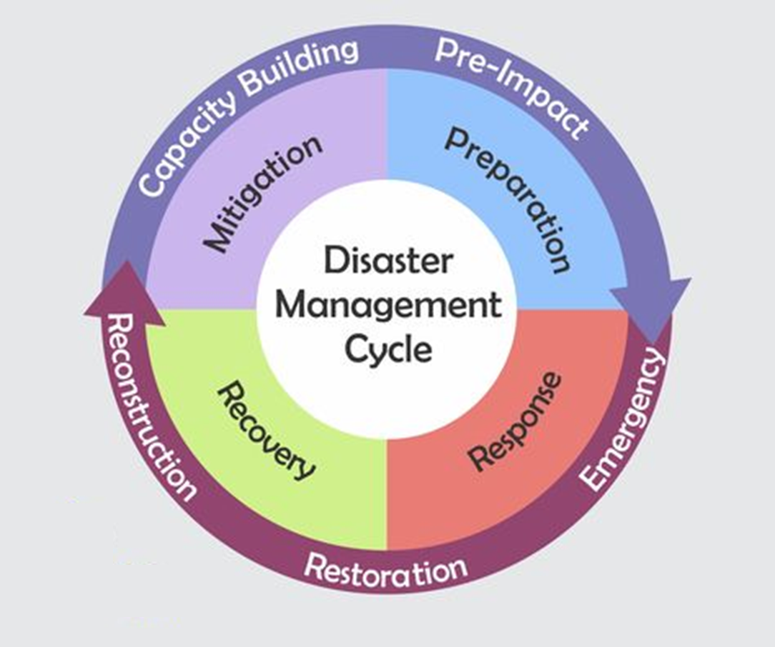
WGDisasters fundamentals
Earth observations enable identification of natural hazards, exposure of people, assets and livelihoods, and related vulnerabilities
CEOS WG Disasters Work Plan is aligned with the Sendai Framework on Disaster Risk Reduction
GEO4DRM
International Charter Space and Major Disasters
Notes:
Support the efforts of Disaster Risk Management (DRM) authorities in protecting lives and safeguarding property by means of satellite-based EO and science-based analyses
Support the implementation and monitoring of the UNDRR Sendai Framework, (mainly Priority1 “Understanding Risk”, more recently Priority4 “Build Back Better”)
Support the work of international initiatives such as GEO
Raise the awareness of politicians, decision-makers, and major stakeholders of the benefits of using satellite EO in all phases of DRM
Foster increased use of EO in support of DRM and DRR, and express related EO needs

Slide 4
WGDisasters Priorities 2022-2023
“The path to sustainability - use cases or the operational uptake of satellite EO at the local scale ”: Focus on Operational Uptake of WG successes to increase resilience
Demonstrators:
Continue to demonstrate potential but begin building path to sustainable operations post demonstrator – stronger ties to international stakeholders but also local actors
Increase focus on capacity building in all demonstrator activities
Strengthen ties to GEO WGs through increased visibility of WG Disasters activities within GEO
Explore linkages to climate related activities, especially through the impact of CC relating to extreme weather events and local impacts of climate (assessment, mitigation, resilience)
Exploit new technology opportunities, either through new missions, new activities or new data exploitation techniques
Slide 4
Notes:
Current CEOS Presidence : Paths to Sustainability: from CEOS Strategy to practical measures

Slide 5
Pilot and Demonstrator projects :
Wildfire Pilot
Flood (GEO/LEO/SAR) Pilot
Landslide Demonstrator
Volcano Demonstrator
Seismic Hazards Demonstrator
Recovery Observatory Demonstrator
Contribution to GEO :
GEO4DRM
GSNL
GEODARMA

Slide 6
Geohazards Supersites & Natural Lab
Aims to improve geophysical scientific and geohazard assessment, promoting rapid and effective uptake of new science results for enhanced societal benefits in DRR
Voluntary international partnership.
Volcanoes : Hawaii ; Iceland; Etna; Campi Flegrei/Vesuvius; Taupo Ecuador; Southern Andes; Virunga; Kamchatka Kuriles
Faults / Earthquakes : Marmara Western North Anatolian fault ; San Andreas Fault NL; China Earthquakes; Nicaragua; and a new Event Supersite
Lead : Stefano Salvi, INGV
Slide 6

Slide 7
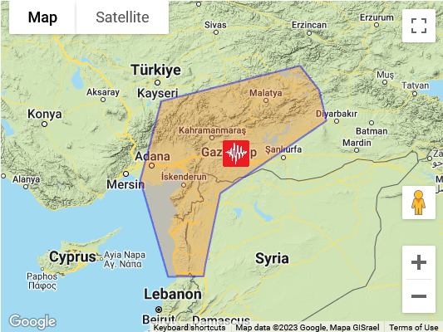
The Kahramanmaraş Event Supersite
It is coordinated by researchers from the Istanbul Technical University and KOERI, who provide scientific information to AFAD and other responding agencies.
The Supersite AoI includes areas where the additional stress transferred by the February 6 rupture may cause further fault activation in the next months/years.
The planned Supersite duration is one year.
New activity

Slide 8
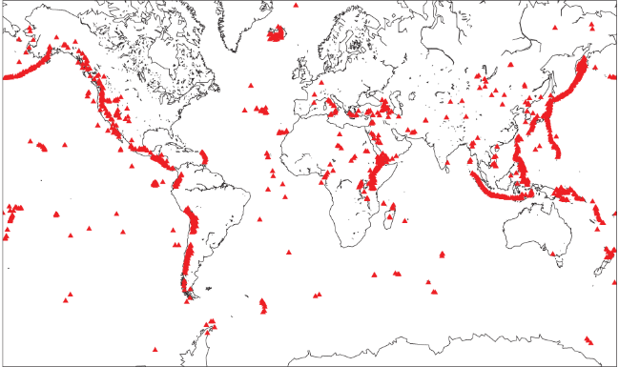
Volcano Demonstrator
Aims to evaluate the utility of remote sensing data for anticipating, detecting, and tracking volcanic eruptions.
Supports EO applications that promote volcanic disaster risk reduction worldwide.
Focus on high-risk volcanoes in areas where monitoring is not currently well developed (LAC, Africa, SE Asia).
Science driver with long-term science objectives and quick response. Evolution towards a virtual volcanoes observatory ?
Demonstrator Leads: Mike Poland, USGS; Simona Zoffoli, ASI; Susi Ebmeier, University of Leeds.
Slide 8

Slide 9
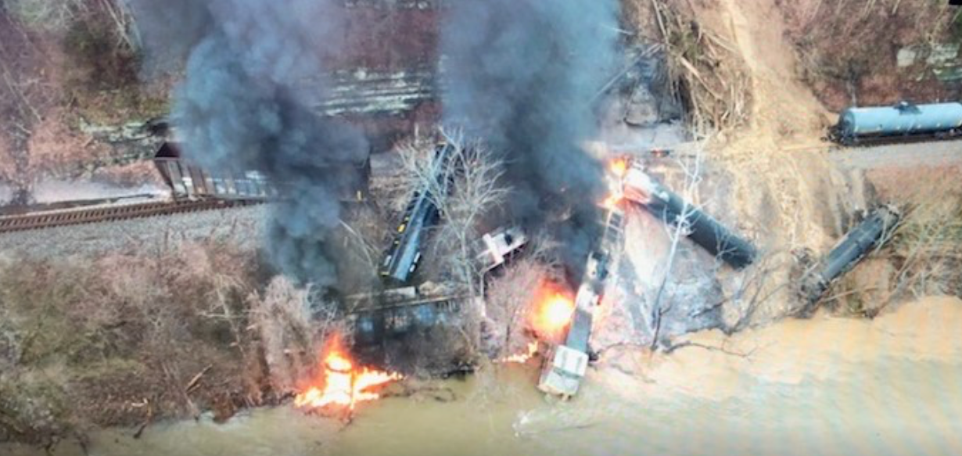
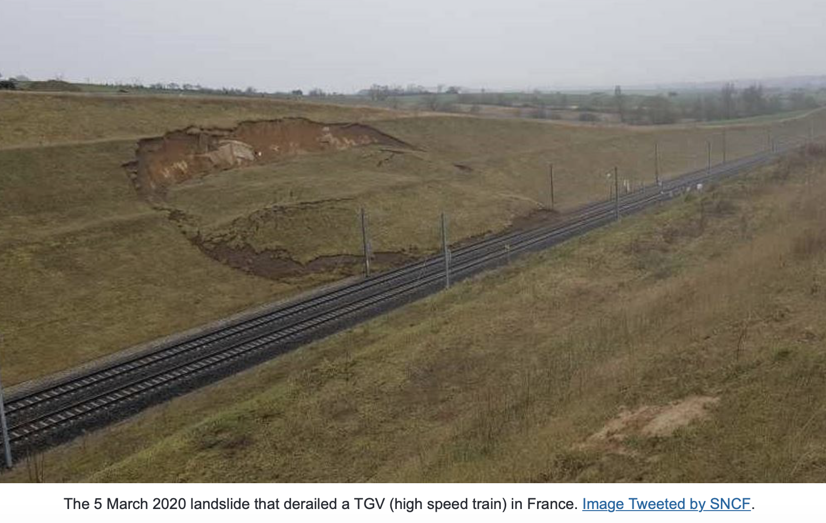
Landslide Demonstrator
Aims to demonstrate the effective exploitation of satellite EO across the full cycle of landslide disaster risk management (i. e. preparedness, response, and recovery at global, regional, and local scales), including the possibility of multi-hazard focus on cascading impacts and risk.
Elkhorn city (Kentucky, US) – February 2020 – shallow landslide / mudflow
Twofold approach with continued science globally but uptake of existing methodologies for insurance users (semi-commercial)
Demonstrator Leads: Pukar Amatya, NASA;
Jean-Philippe Malet, UNISTRA/EOST; Jonathan Godt, USGS
East France – March 2020 – landslide on high speed train TGV
Slide 9

Slide 10
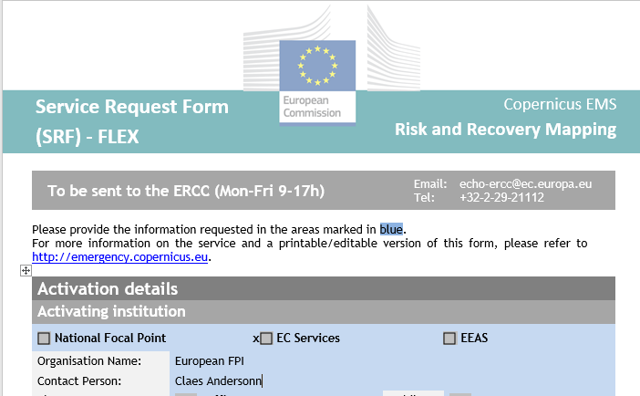
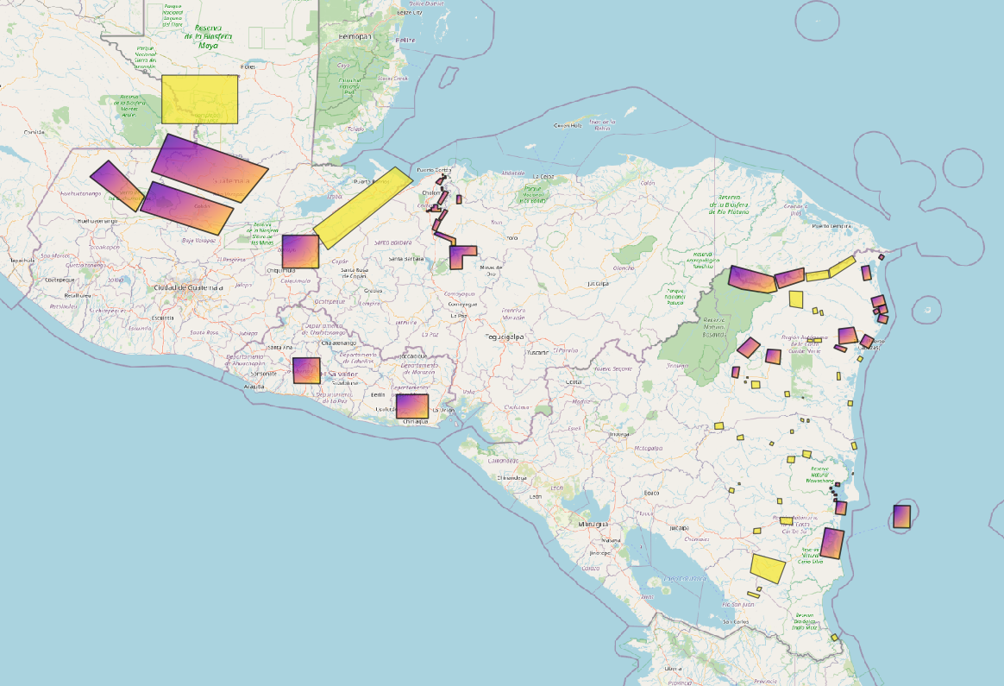
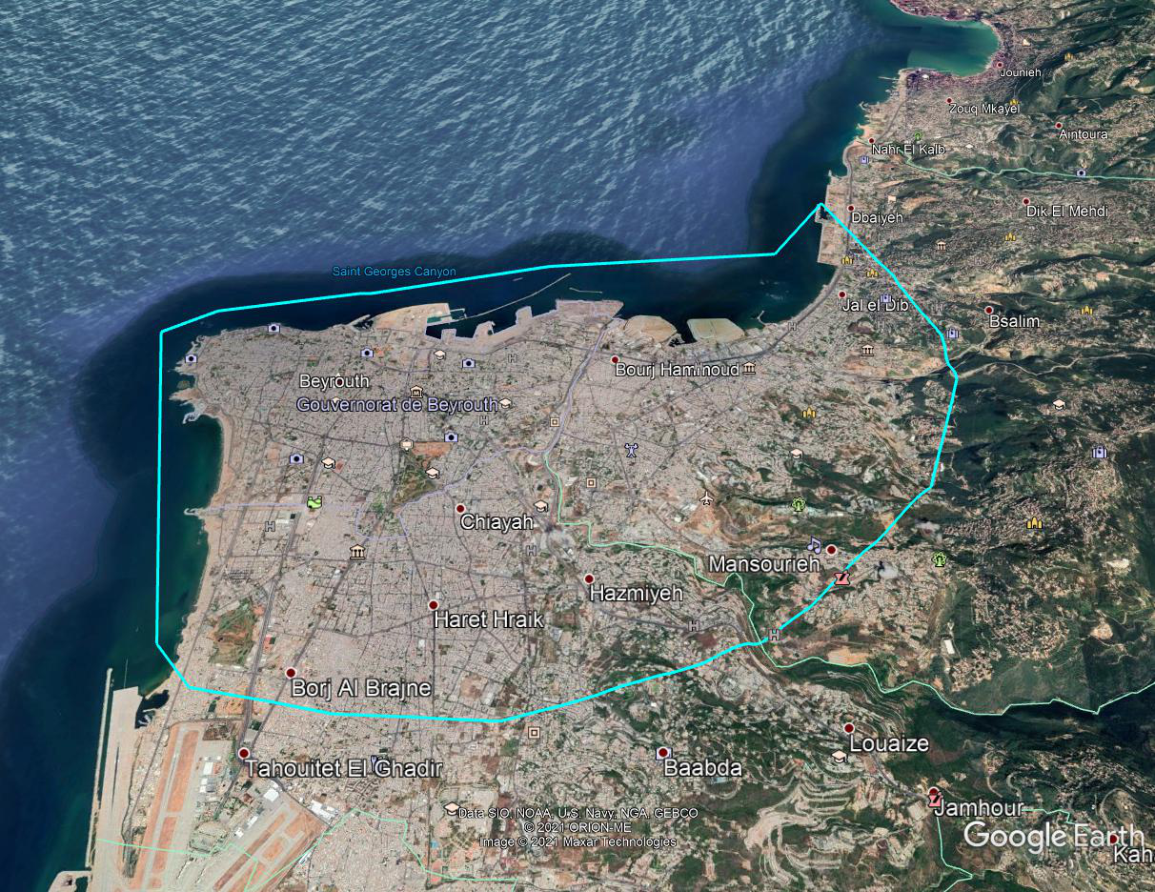
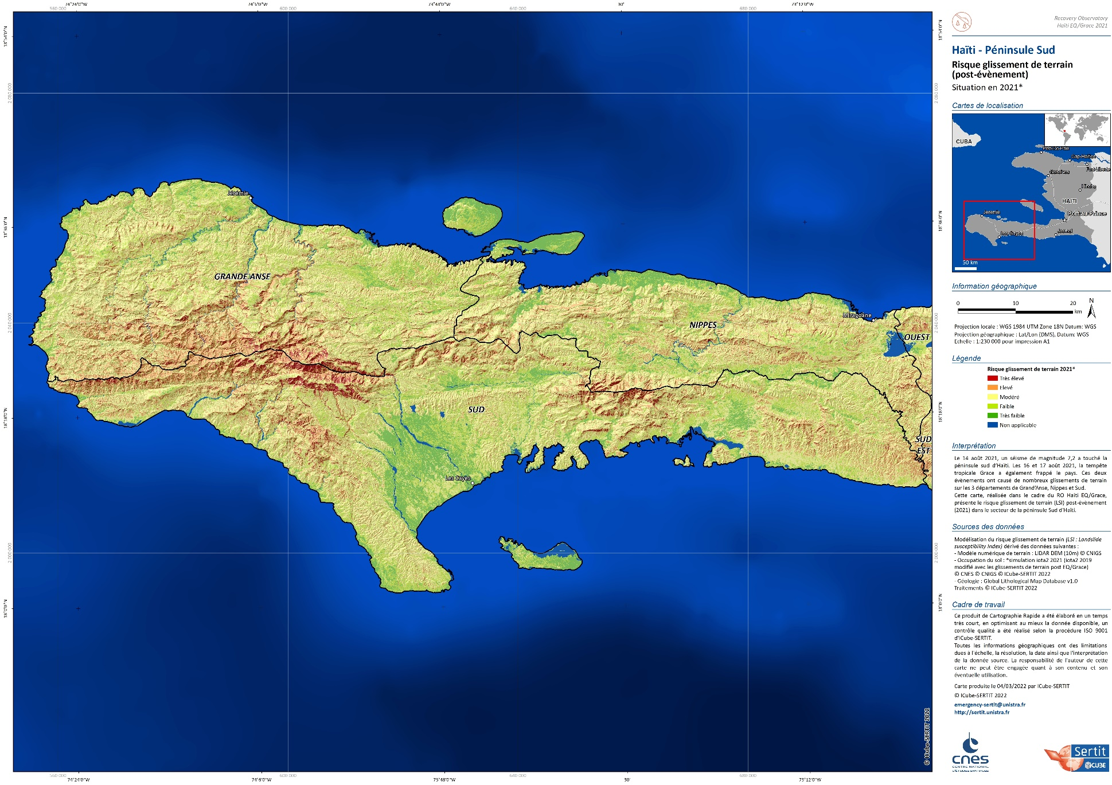
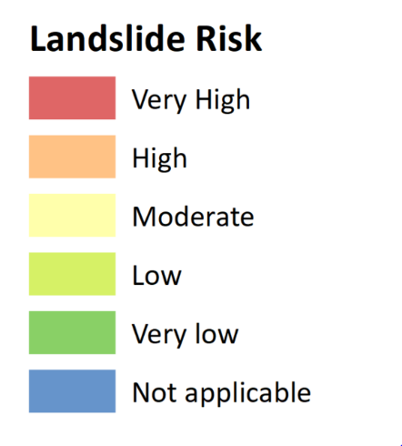
Recovery Observatory (RO) Demonstrator
Showcase contribution of satellite data and products to recovery efforts following major disaster events. Direct input to Post Disaster Needs Assessments and long-term contribution to Recovery Framework. Cited in Space Agenda 2030 (UN GA).
Pilot on Haiti (Matthew hurricane) 2017-2020;
Demonstrator objective : 3-5 ROs 2020-2023. To date:
Beirut Explosion 2020
Eta-Iota Central America 2020-21
Haiti Earthquake 2021-22
Pakistan Floods 2022
Turkey/Syria EQ : linkages with UE/WB/UNDP - possible support to Recovery Framework activities
Co-construction of the post Demonstrator process with WN, UE, UNDP and others; incremental approach to leverage PDNA / DRM funds to provide value added products in support of near and medium-term recovery
2021
Demonstrator leads : Linda Tomasini, CNES; Rashmin Gunasekera; World Bank
Slide 10

Slide 11
Pilot and Demonstrator Successes
Demonstration of technical feasibility as applied to each thematic area or phase of disaster cycle
Working-level, proto-operational uptake of EO-based products from practitioners and end users (e.g. volcano observatories, civil protection agencies, specialized research bodies….. )
Exploration of new partnerships and bridging gaps between different types of partners, including international organizations, governments, research institutes, companies, non-governmental organizations… solution-focused work to improve Disaster Risk Management using EO
Demonstration of best practices for combining diverse satellite data to improve understanding and management of risk
New activities envisaged –
CC impact / extreme events : synergy with WGClimate, SCO (Space for Climate Observatory)
Improving Disaster Risk Reduction
Geodesy for Disasters / GEO4Sendai (TBC)
Slide 11

Slide 12
Sustainability Challenges
Two sub teams for addressing this issue :
Recovery Observatory sustainability sub team :
WB, EU, UNDP, UNOOSA, UNOSAT, ASI, CNES, ESA@WB, Copernicus EMS
WG Disasters sustainability sub team :
Demonstrators and Pilot leads, GEO activities lead
On going Sustainability Survey :
Community of Practice ? Vision for sustainable use of EO ? Key partners ?
Main barriers ? Cost drivers ? Donor / Investor communities ? ….
Slide 12
Notes:
Is there a global and/or regional community of practice (CoP) in this area? How is it structured?
Is this CoP engaged in your activity? In what way?
What is the ideal vision for sustainable use of EO in your sector, built on your Pilot/ Demonstrator experience?
Have you estimated the types of data and annual volumes required for a sustainable ongoing use of EO to meet objectives? (at relevant geographical level: global, regional, national…)
In a sustainable perspective, who are the key partners that would exploit EO data / derived products / derived indicators?
What are the main barriers to sustainability? (scientific, technical, cost, human, ….)
What are the cost drivers associated with EO data exploitation that make this challenging?
Beyond the end user community, are there other potential donor communities that have a vested interest in the success of your activity (e.g. foundations, international financial institutions, insurance, etc)? Which ones would you consider most engaged or interested in your activity?
Are there “stepping stones” that would facilitate longer-term achievement of sustainability goals that could be envisaged in a post-demonstrator activity?
Do you know of successful examples of user partnerships where similar barriers have been overcome and how?
Do you have additional comment / feedback ?
subteam has been created within the WG to address sustainability issues. It will produce a final report later this year.

Slide 13
Links to other CEOS WGs
Ties to CEOS WGs:
WGCapD, joint activity to provide training and EO awareness to DRM leaders (El Salvador 2022; Africa and Asia 2023); presentation to WGCapD-12 and UN-Space “Meeting on the identification of needs of MS and UN entities for Capacity Building in the Use of Space Observations”, March 2023
WG Climate, discussions to collaborate on climate adaptation and impacts at local level (underway)
WGISS, joint session in person with WGISS-55, 18-20 April 2023; discussion on machine learning for EO applied to Disasters… and other topics ?
SIT, collaboration on sustainability and implication of new partners including private sector EO players (Volcano and Landslide Demos)
New Space Task Team (NSTT) – contribution to topic 10: “Observation gaps, commercial opportunities to fill CEOS priority requirements for climate, SDGs and disasters”.

Slide 14
Links to other CEOS WGs and GEO
Oceans Coordination Group, possible WGDisasters thematic contributions (under review)
coastal erosion
coastal floods due to Tsunamis
red tides
GEO:
DRR WG, RO one of 1st use cases for EO Risk Toolkit/RiX (UNDRR), Landslides to follow
New GEO 2025 thematic Incubators : WG Disasters working to develop use cases

Slide 15
Thank you for your attention

