Slide 1
Overview of WGISS Activities
Dr. Makoto NATSUISAKA, JAXA
Agenda ID: 2023.04.19_09.25
WGISS-55
Cordoba, Argentina (CONAE)
18-20 April 2023

Slide 2
What is WGISS?
Working Group on Information Systems and Services
WGISS promotes collaboration in the development of systems and services that manage and supply Earth observation data as a working group of CEOS.
The activities and expertise of WGISS span the information life cycle;
data preservation and stewardship,
discovery and access,
interoperability and use,
explore cutting-edge technologies.

Slide 3
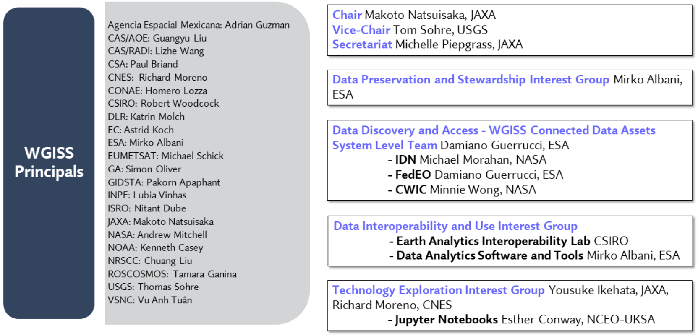
WGISS Structure
SEO/CSIRO
https://ceos.org/ourwork/workinggroups/wgiss/

Slide 4
Data Preservation and Stewardship IG
Led by Mirko Albani (ESA).
Published guidelines for Preservation Workflow, EO Data Stewardship Glossary, EO Data Preservation Guidelines, EO Data Set Consolidation Process, Preserved Data Set Content, Persistent Identifiers Best Practice, Data Purge Alert White Paper, CEOS Technical Content and Associated Information Preservation Best Practices, WGISS Data Management and Stewardship Maturity Matrix White Paper, Measuring EO Data Usage, Data Stewardship Reference Model White Paper, CEOS OpenSearch Best Practice, CEOS Service Discovery Best Practice

Slide 5
Data Preservation and Stewardship IG
“WGISS Data Management and Stewardship Maturity Matrix White Paper” attracts attentions from other groups, WGCV, CGMS (Working Group-1V), CEOS New Space Task Team.
Information exchange on how to give “Data Integrity and Authenticity” to the cloud data archives considering a trend that data replications in the clouds are increasing.

Slide 6
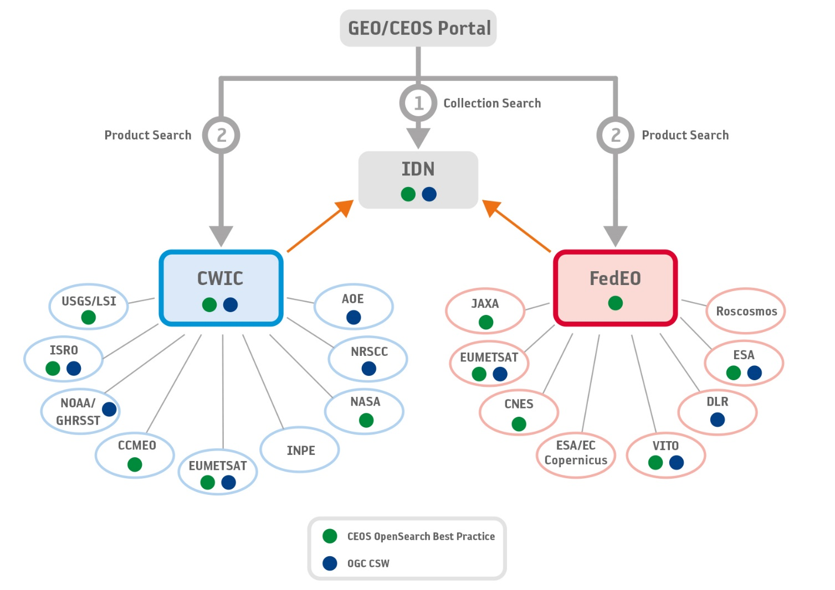
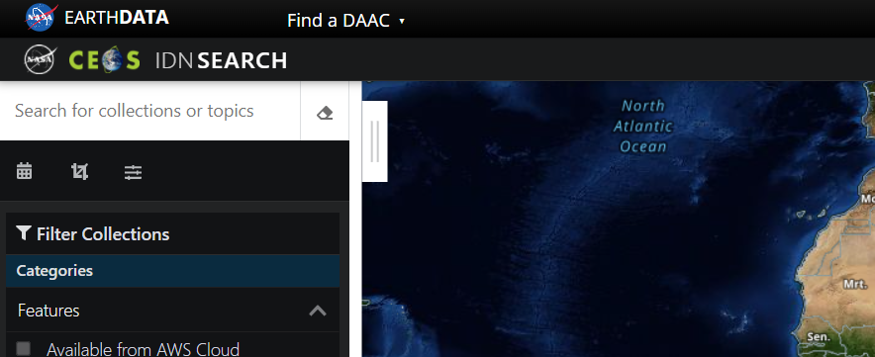
Data DISCOVERY and ACCESS IG
Led by Damiano Guerrucci (ESA).
The interest group makes the CEOS partner’s data to be findable and accessible based on “CEOS OpenSearch Best Practice” and through “WGISS Data Assets”.
IDN and FedEO are well communicated.
NASA recently introduced AI/ML as a GCMD keyword.

Slide 7
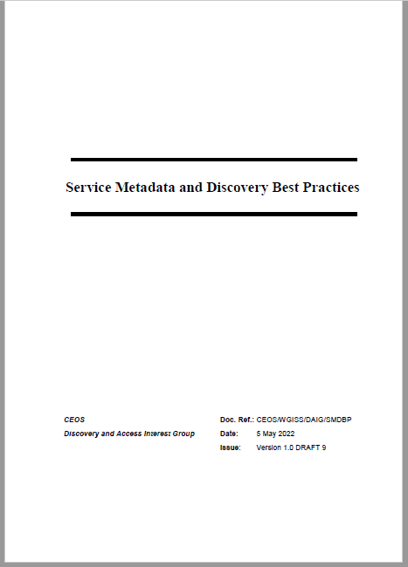
Data DISCOVERY and ACCESS IG
CEOS Service Discovery Best Practice has been newly developed.
ref. CEOS OpenSearch Best Practice (Discover EO Collection, Granules)
Scenario 1: Online machine to machine interfaces (API)
Scenario 2: Downloadable tools
- Source code, binaries, Jupyter Notebooks, Docker images, …
- Download from repository (GitHub, Zenodo, ..) or registry (e.g. DockerHub, …)
Scenario 3: Web GUI tools
- Software as a Service (SaaS)
- E.g. Jupyter Notebook on Google Colaboratory, Binder
Scenario 4: Application Package
Scenario 5: Coupled Services
Survey of applicable metadata models/elements
ISO19115-1:2014 Annex F.3 “Metadata for discovery of services”
NASA ESDIS UMM-S, UMM-T
INSPIRE Technical Guidance (Metadata),
DataCite Metadata Schema Documentation, …

Slide 8
Data DISCOVERY and ACCESS IG
OGC STAC implementation for CMR was proposed and a volunteer from CWIC provider was solicited.
STAC Best Practice is to be developed.

Slide 9
Interoperability Data and Use IG
Led by ... (Vacancy)
Leads “CEOS Interoperability Framework” by cooperating with LSI-VC, CEOS ARD OG, WGCV, and SEO.
The framework considers how to realize the “interoperability data and use” for EO data obtained by CEOS members.
The framework oversights activities of sub working group; Structural / Data Architecture, Common Reference, Terminology / Semantics / Data Context, Formats / Syntactic / Data language, Accessibility / System / Data Presentation (under review).

Slide 10
Technology Exploration IG
Led by Yosuke Ikehata (JAXA) and Richard Moreno (CNES)
Jupyter Notebook initiative as a collaboration with SEO and WGCapD has been going on. Jupyter Notebook Day was held on 21st Oct. The white paper will be issued.
AI/ML initiative was proposed at WGISS-54. Use cases, technologies, platforms, etc., focusing on the Earth observations, will be surveyed. The participation from other entities would be welcomed.
Study on federation between HPC and Archive especially on cloud was also proposed at WGISS-54.

Slide 11
WGISS Webinars
No. | Title | Date
8 | CEOS Jupyter Notebooks Day – Supporting Global Best Practice and Training | October 2022
7 | Jupyter Notebooks for Capacity Development Webinar | July 2021
6 | Future Data Access & Analysis Architecture Initiative Webinar (Joint WGISS/WGCapD Activity) | September 2019
5 | Agile Development and the Scaled Agile Framework | July 2018
4 | The Open Geospatial Consortium (OGC) Coverage Standards Suite: Introduction & Overview | January 2018
3 | The Burgeoning Role of Python for Earth Observation Data Analysis | August 2017
2 | Data Cubes for Large Scale Data Analytics | June 2017
1 | Relevancy Ranking of Data Search Results | March 2017
https://ceos.org/ourwork/workinggroups/wgiss/technology-exploration/webinars/

Slide 12
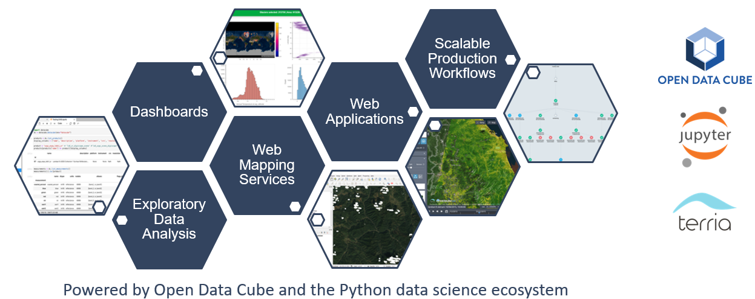
Ref. EAIL (Earth Analytics Interoperability Lab.)
“EAIL Use-cases and vision” by Jonathan Hodge, CSIRO Chile
https://ceos.org/meetings/wgiss-54/
The continuity is discussed by SEO and CSIRO.
EAIL is operated by CSIRO Chile with significant support from the Chilean Data Observatory, a public-private-academic partnership founded by the Chilean Government (Ministry of Science, Ministry of Economy), Adolfo Ibáñez University and AWS.
Landsat-5, 7, 8, 9, Sentinel 1, 2, NASA DEM, Copernicus DEM on AWS

