Slide 1
WG Disasters 19
WGGIS- 55 Joint Session
(presential & virtual)
2023
Introduction to CONAE
L. Frulla, CONAE
WG Dis-19 & WGGIS-55
Joint Session
CONAE
19th April 2023

Slide 2
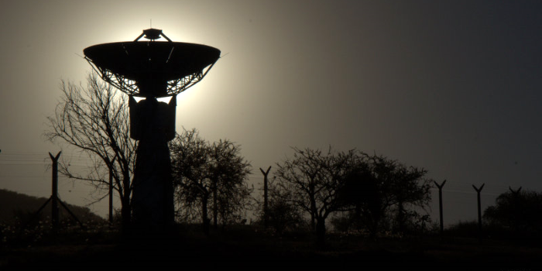
CONAE´s Main Activities
  Receiving stations operation
  Satelite monitoring and command
  Integration and test activities in dedicated laboratories
  Data reception and storage
  Data processing and products generation
  Data distribution
  Education, capacity building and user training
  Satellite missions
  Access to space
ETTdF
Ground Receiving Stations
Belgrano II
77° 52′ 25″ S
34° 37′ 39″ W

Slide 3
The Argentine National Space Plan
10 years strategic plan, periodically updated
It governs the activities and projects of CONAE since 1994 without interruption
Main objective: Go to space to observe the Earth
Make decision-making more efficient in the public and private sectors
Promote and motivate national developments

Slide 4
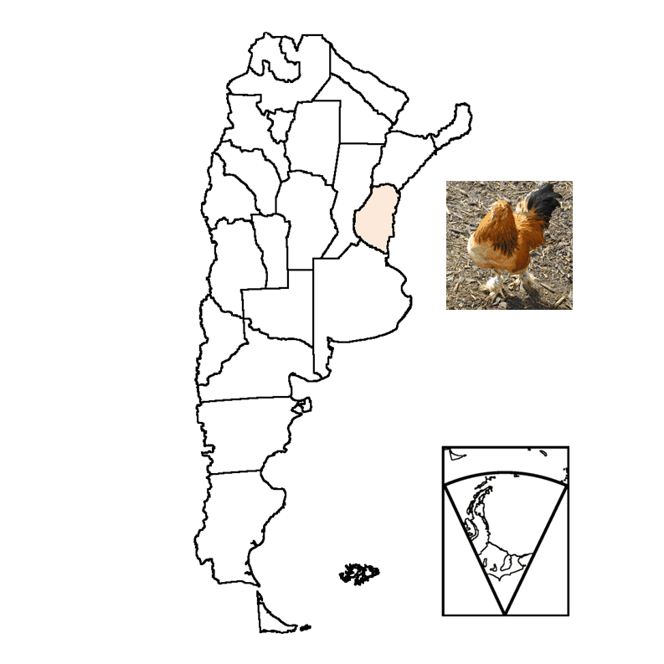


Data Processing and Products Generation (EO data)
climate change

Slide 5
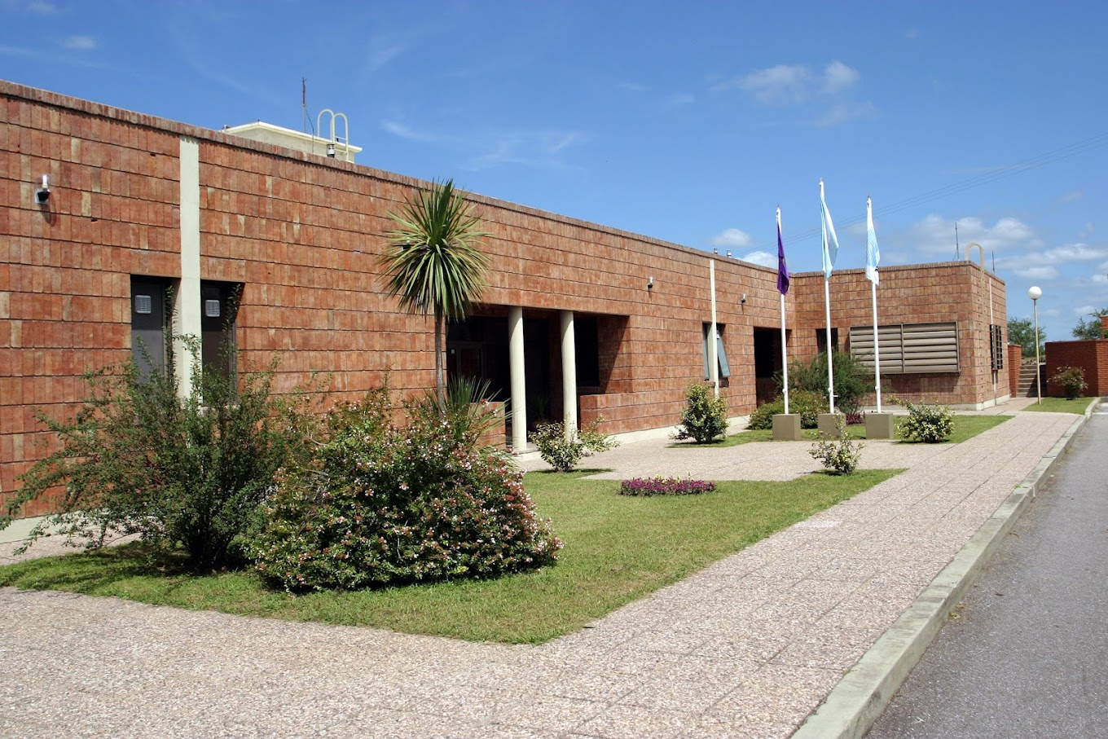
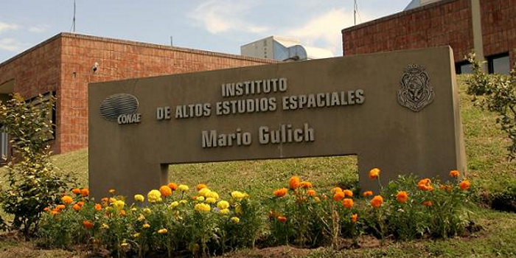
Education, Capacity Building and User Training(1/2)
Mario Gulich Institute
    Magister programs (Space Systems, Satellite Instruments, Satellite Technology, Industry and Aerospace Systems and Spatial Information Applications)
    Ph.D. Program on Geomatic and Space Systems
    A University degree on Applied Geomatics
A Program for training kids
Special short training courses for users (different topics)
    standard
    ad-hoc
AOs

Slide 6
Education, Capacity Building and User Training(2/2)
AO for SAOCOM ESA/CONAE
Promotion of Utilization and Mission Applications and Science (PUMAS)
Initiative under Earthnet's Third Party Missions Programme
For science and application developments (EO)
The call will close on July 31st, 2023
The 2nd ~ September/2023
Data available: ESA (EO), Copernicus and SAOCOM (Quota < 40 images, outside AoE)
https://www.argentina.gob.ar/ciencia/conae/misiones-satelitales/ao-iniciativa-puma-esa-conae
https://earth.esa.int/eogateway/announcement-of-opportunity/saocom

Slide 7
Satellite Missions
SABIA-Mar
∼2024/2025
SAOCOM 1
A/B
2018/2020
SAOCOM 2
∼ 2028

Slide 8


SAOCOM Mission Objectives
To satisfy user needs and the Space Information Sectors-National Space Plan
agriculture
soil moisture
hydrology
floods
6
emergencies
To operationally integrate SIASGE (Italian-Argentinian Satellites System for Emergencies Management) composed by the SAOCOM Constellation and the COSMO-SkyMed Constellation (because of the agreement with ASI)
L
pol
X
SAOCOM-L/pol , COSMO SkyMed-X

Slide 9
Level 1, Level 2 and Higher Level Products
SAR images

Slide 10
SAOCOM Data Access
From ASI-CONAE cooperation:
    Inside ASI exclusivity area:
    30º- 80ºN latitude
    10ºW-50ºE longitude
    https://www.asi.it/en/earth-science/saocom/
    Outside ASI exclusivity area, u_inter@conae.gov.ar
SAOCOM Catalogue can be navigated freely to identify already existing data. Upon registration, quicklooks can be seen: https://catalogos.conae.gov.ar/catalogo/catalogoSat.html

Slide 11
Steps to Request SAOCOM
Send letter to: u_inter@conae.gov.ar
Direct the letter to CONAE’s CEOS Principal (Eng. Raul Kulichevsky) describing the overall project, its objectives, duration, participants, the area of interest (including, if possible, files in KML or Shapefile formats).
Sign the License of Use by the project participants who will work with the images.
Require the images to u_inter@conae.gov.ar (archived/new).
Data will be transferred through FTP

Slide 12
One Click Possibility

Slide 13
SABIA-Mar Mission
Normalized Water leaving radiance maps
Chlorophyll-a concentration Maps
Diffuse Attenuation coefficient Kd (490)
Photosynthetic Available Radiation on a daily, weekly and monthly time scales
Turbidity

Slide 14
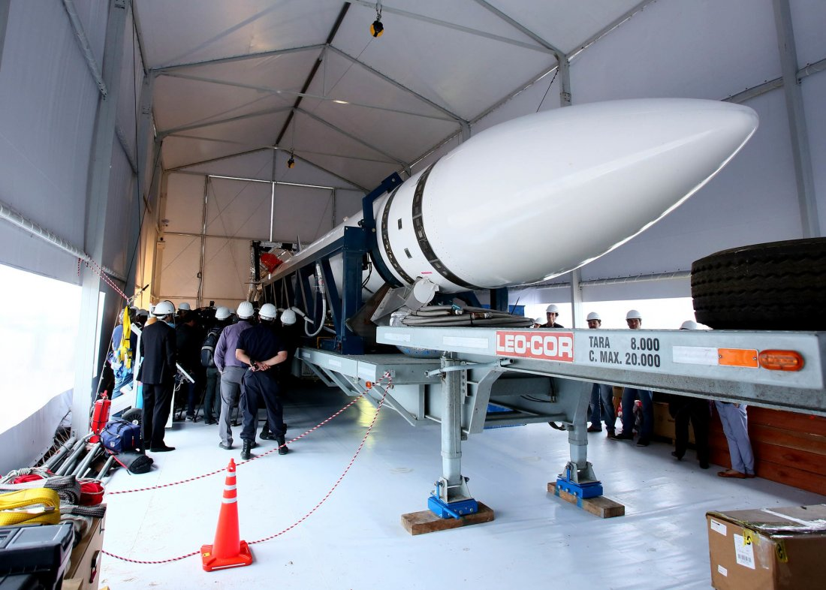
Access to Space
Objective: to provide our country with its own capacity to access outer space
Development of launch vehicle capable to inject payloads up to 750 kg in LEO
Provide launch services to argentine satellites and others from abroad
Centro Espacial Manuel Belgrano (CEMB), Bahía Blanca (Buenos Aires)

Slide 15
Thank you

