Slide 1
STAC Best Practices Activity
Yves Coene (Spacebel for ESA), Mattia Stipa (ESA), Damiano Guerrucci (ESA)
CEOS WGISS #55
Technology Exploration, 18/04/2023

Slide 2
Outline
Context
STAC use cases
Proposed approach
Preliminary results of survey
Conclusion

Slide 3
Context - STAC
“STAC” is a generic name for a family of specifications…
covering file formats and APIs,
some at v1.0, some still release-candidate,
referencing external OGC API specifications
extensible, with large set of
STAC extensions
STAC API extensions
at different levels of maturity.
The ecosystem of the above (draft) specifications allow many use cases to be realized in multiple ways, while some are not yet possible.
Notes:
https://github.com/stac-api-extensions

Slide 4
Context - STAC
Goal | Method 1 | Method 2
Item search | /items | /search
Filter | /items | /search
Search protocol | GET | POST
Use additional search parameters | Queryables as Query parameters | Filter
Query Language | Text-CQL | JSON-CQL
Collection navigation | rel=“child” | /collections
API traversal | Using rel attributes | Path assumption*
 | Rel=“items” | /collections/{id}/items*
 | Rel=“data” | /collections/{id}/queryables*
 | Rel=“queryables” | /collections/{id}/queryables*
 | Rel=“search” | /search*
*Fixed paths prevent “federation”.

Slide 5
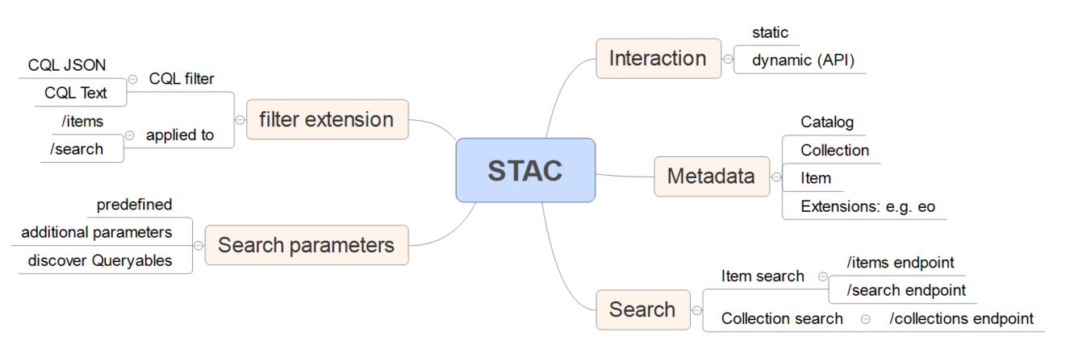
Context - STAC
Simplified “STAC ecosystem”

Slide 6
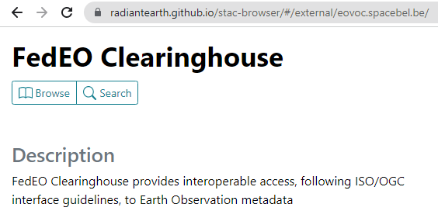
Many options leads to lack of interoperability
Multiple options for implementation lead providers and open-source tools developers to implement arbitrary (different) subsets, causing interoperability issues.
STAC-BROWSER
Pystac_client
Examples:
Search capability may or may not be accessible directly by open-source “client” and may or may not list collections on search form.
Client may not use the HTTP method or endpoint for search that a server expects.

Slide 7
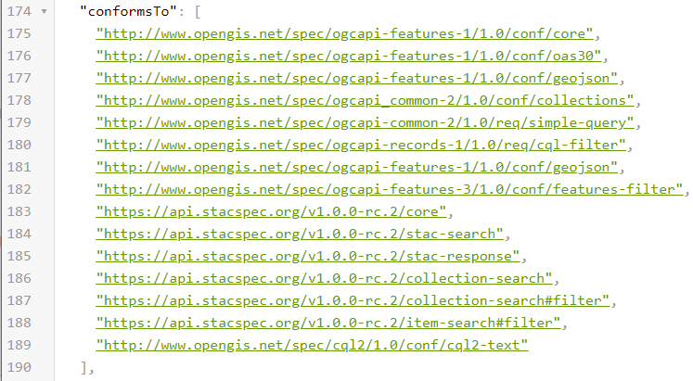
Many options leads to lack of interoperability
What should we recommend to be implemented by CEOS data providers ?
Any subset / permutation of a list of conformance classes below ?
2 (item search) endpoints x 2 methods x 2 cql-encodings x … ? Or static catalog ?
It is not cost efficient for CEOS data providers to implement multiple endpoints/methods/encodings if one would be enough.

Slide 8
Use cases to address ?
Most CEOS Best Practices start by identifying scenarios and use cases. If these are not explicit, everyone will have their own interpretation.
Our group needs to agree on the scope as there are many possibilities.

Slide 9
Use cases to determine scope of BP
Static catalog or searchable catalog (API) ?
Collection search ?
Granule search ?
Where to advertise collections ?
How to provide two-step search ?
How to advertise queryables and which ones are required/optional ?
Equivalent of current OpenSearch BP (side-by-side comparison) ?
What to put how in granule metadata ? (STAC Item)
What to put how in collection metadata ? (STAC Collection)
What names for « assets » ? E.g. bands, quicklooks ?

Slide 10
Use cases to address ?
Keywords to be used in metadata (e.g. platform names, science keywords from GCMD?)
Data provider guidance to allow for easier federation (without duplication of endpoints?)
Discovery: content item for “Get STAC item”
Publication: content item for “Insert STAC item” (in catalogue or bucket)
How to encode cloud-native access (and offerings) in STAC item
How to encode “offerings” (links to OGC service endpoints) in STAC item
Search by geometry ? Mandatory in STAC API “intersects”, optional in OpenSearch.

Slide 11
Proposed Approach
STEP 1 (WHAT): Propose applicable list of uses cases to narrow scope of STAC Best Practices:
Get SLT group feedback/confirmation and/or priorities for proposed use cases (or additional/other use cases)
STEP 2 (HOW): Prepare draft STAC Best Practices addressing selected use cases by solving issue in one of three ways:
Recommend or mandate one method over another in the Best Practices
Raise issue with appropriate STAC standards body to consolidate on single solution
Create extensions for missing/needed areas (unlikely).
STEP 3 (MEASURE): Obtain SLT feedback on STEP 2 and iterate…

Slide 12
Proposed Approach
Interact with relevant (SWG) groups (https://www.ogc.org/about/committees /swg/) for resolving issues, e.g. via their dedicated SWG GitHub repositories:
OGC API-Features
https://github.com/opengeospatial/ogcapi-features/issues
OGC API-Records
https://github.com/opengeospatial/ogcapi-records/issues
OGC API-Common
https://github.com/opengeospatial/ogcapi-common/issues
STAC Community:
https://github.com/radiantearth/stac-spec/issues
https://github.com/stac-api-extensions
https://github.com/radiantearth/stac-browser/issues

Slide 13
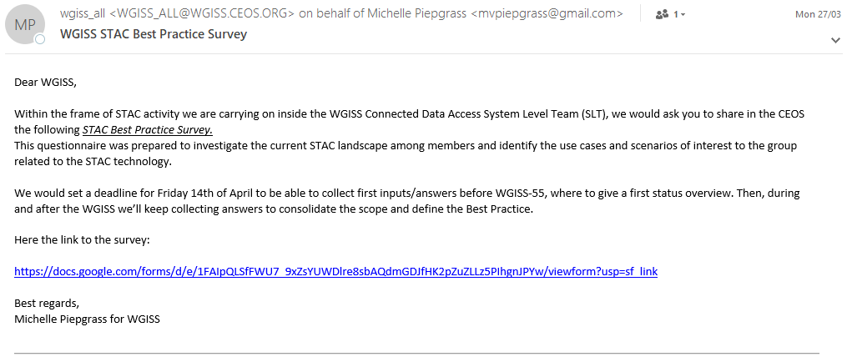
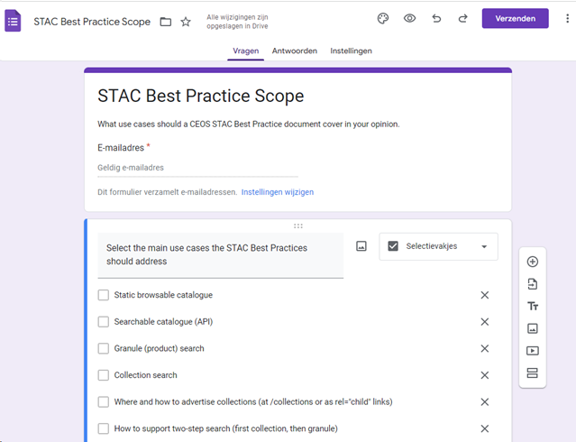
STEP 1 (WHAT) – Survey Results
Survey circulated 27/03/2023.
Status as of 16/04/2023, 17 answers including:
CNES
DLR
ECC Canada
ESA
EU/JRC
Geoscience Australia
HDF Group
JAXA
NASA
OSGeo
STFC
VITO

Slide 14
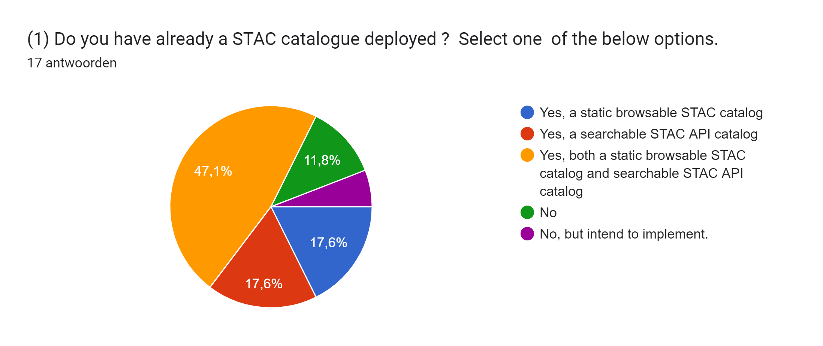

Slide 15
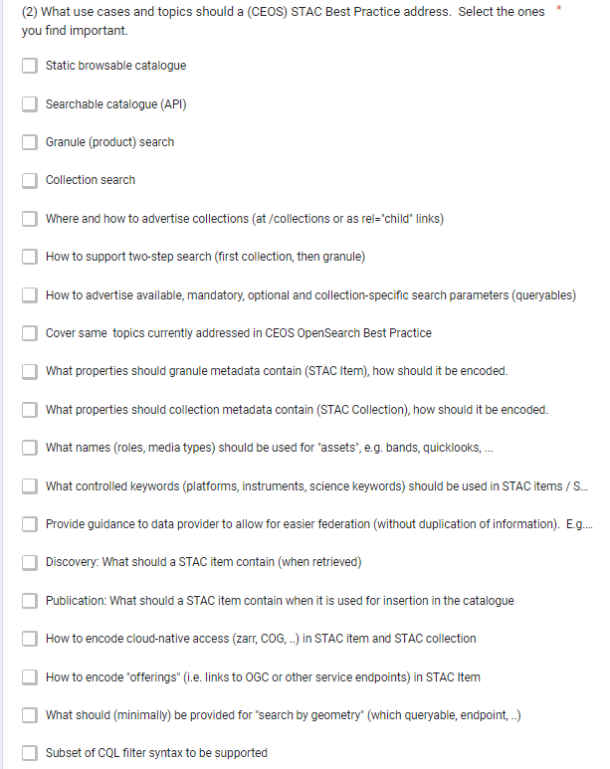
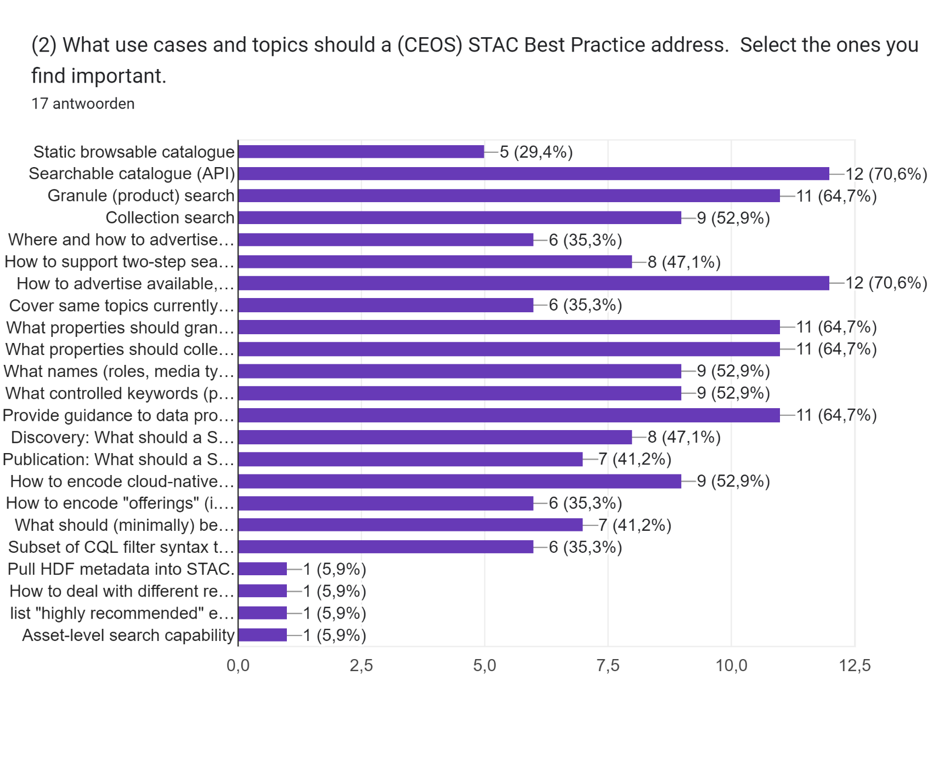
Popular topics
Notes:
Other: - How to deal with different resource access methods e.g. http download link or S3 location url. If a user knows where he will process the data, it can be useful to have a parameter (in the STAC request) to indicate where the data needs to be accessed.
Pull HDF metadata into STAC.
Asset level search capability
List “highly recommended” extensions such as projection extension that improve performance in downstream services
Recommendations for creating homogeneous collections
Recommendation to properly link raster assets in an EO product

Slide 16
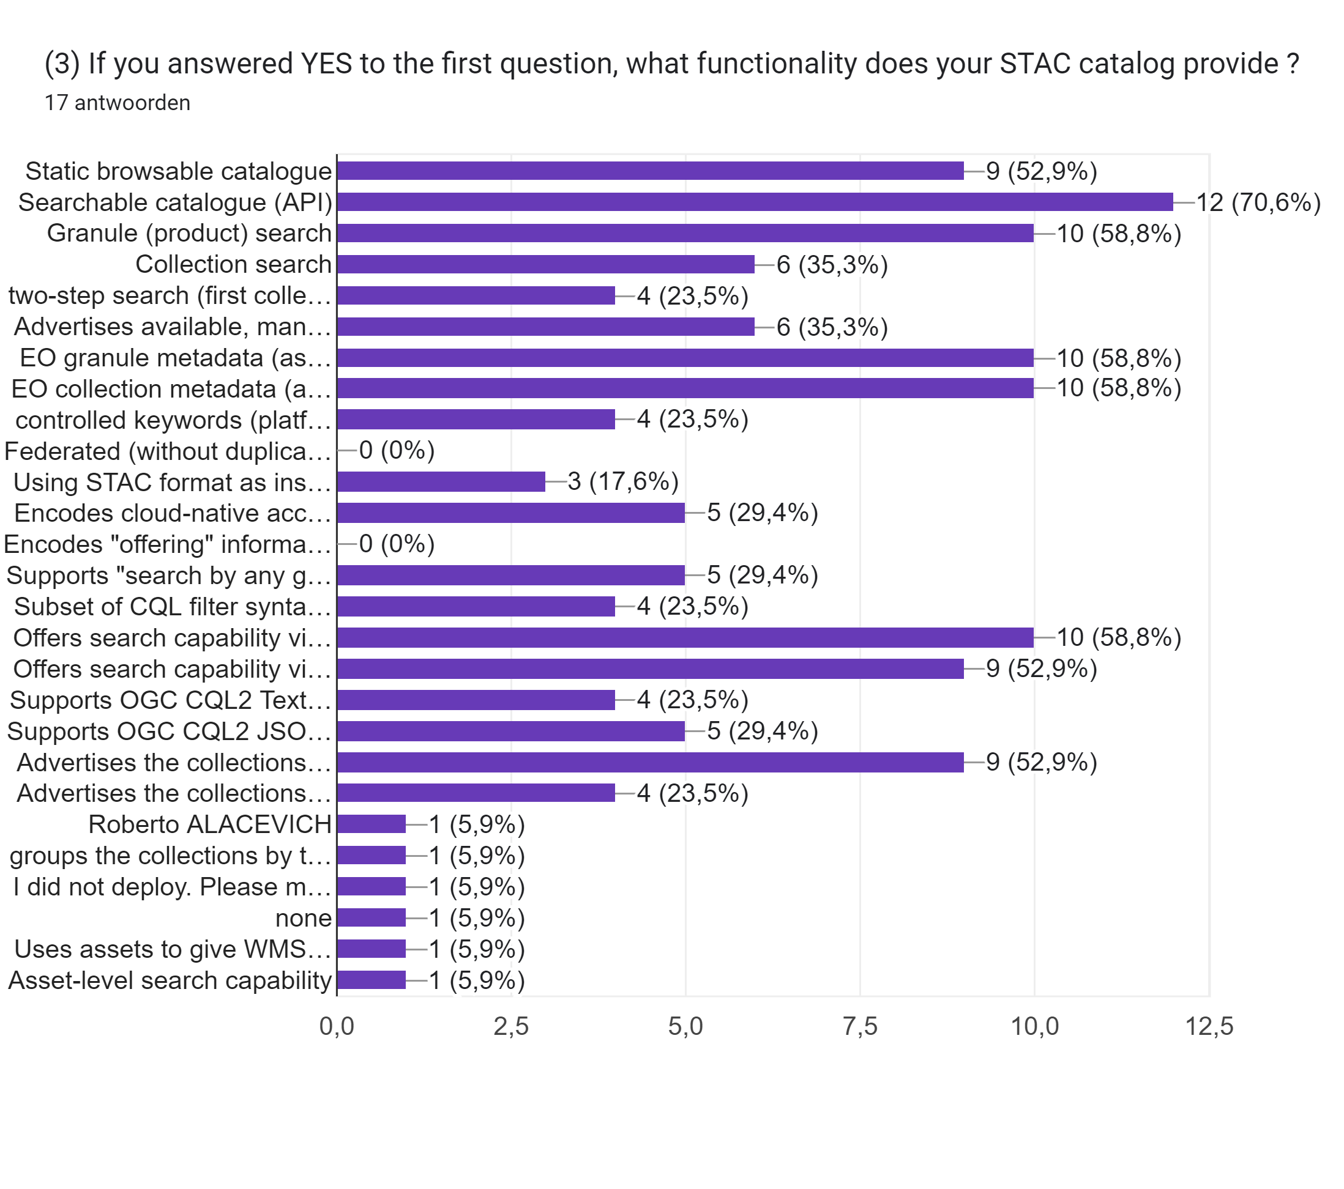
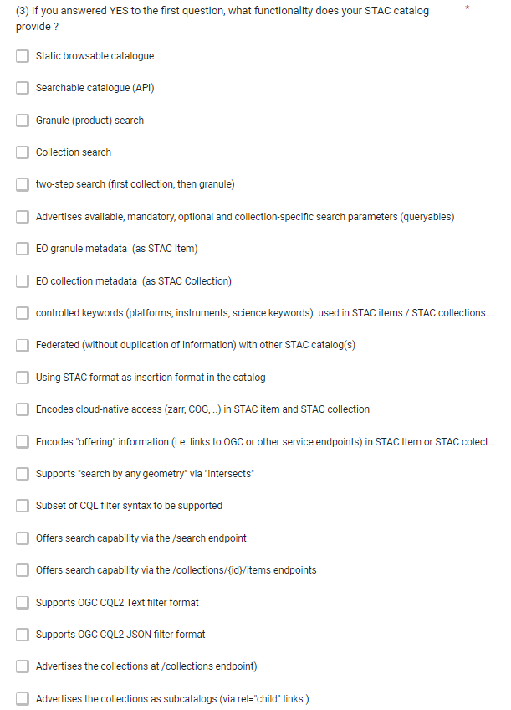
Notes:
- Other: Group collections by thematic catalogs

Slide 17
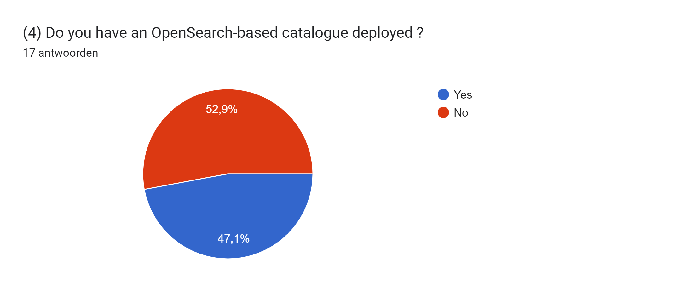

Slide 18
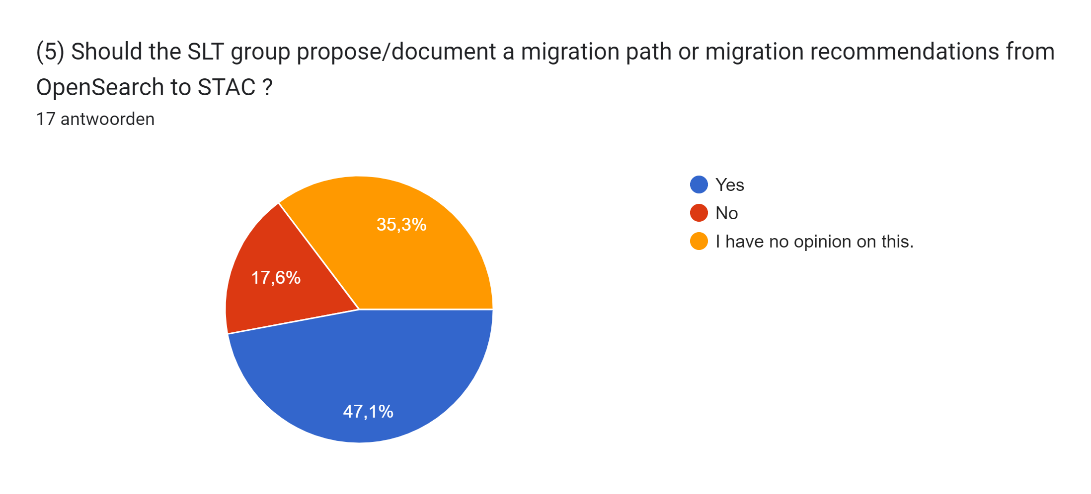
(5)

Slide 19
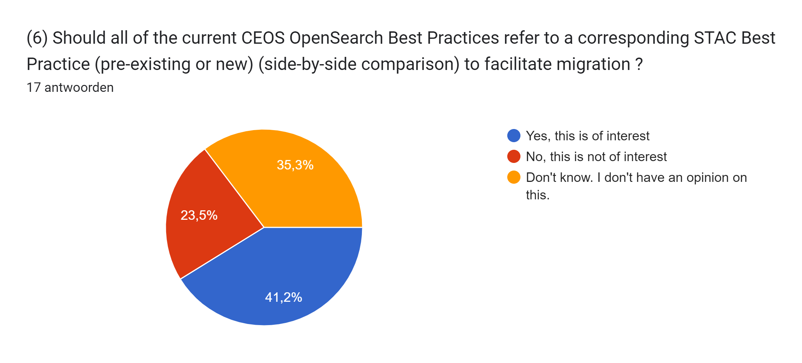

Slide 20
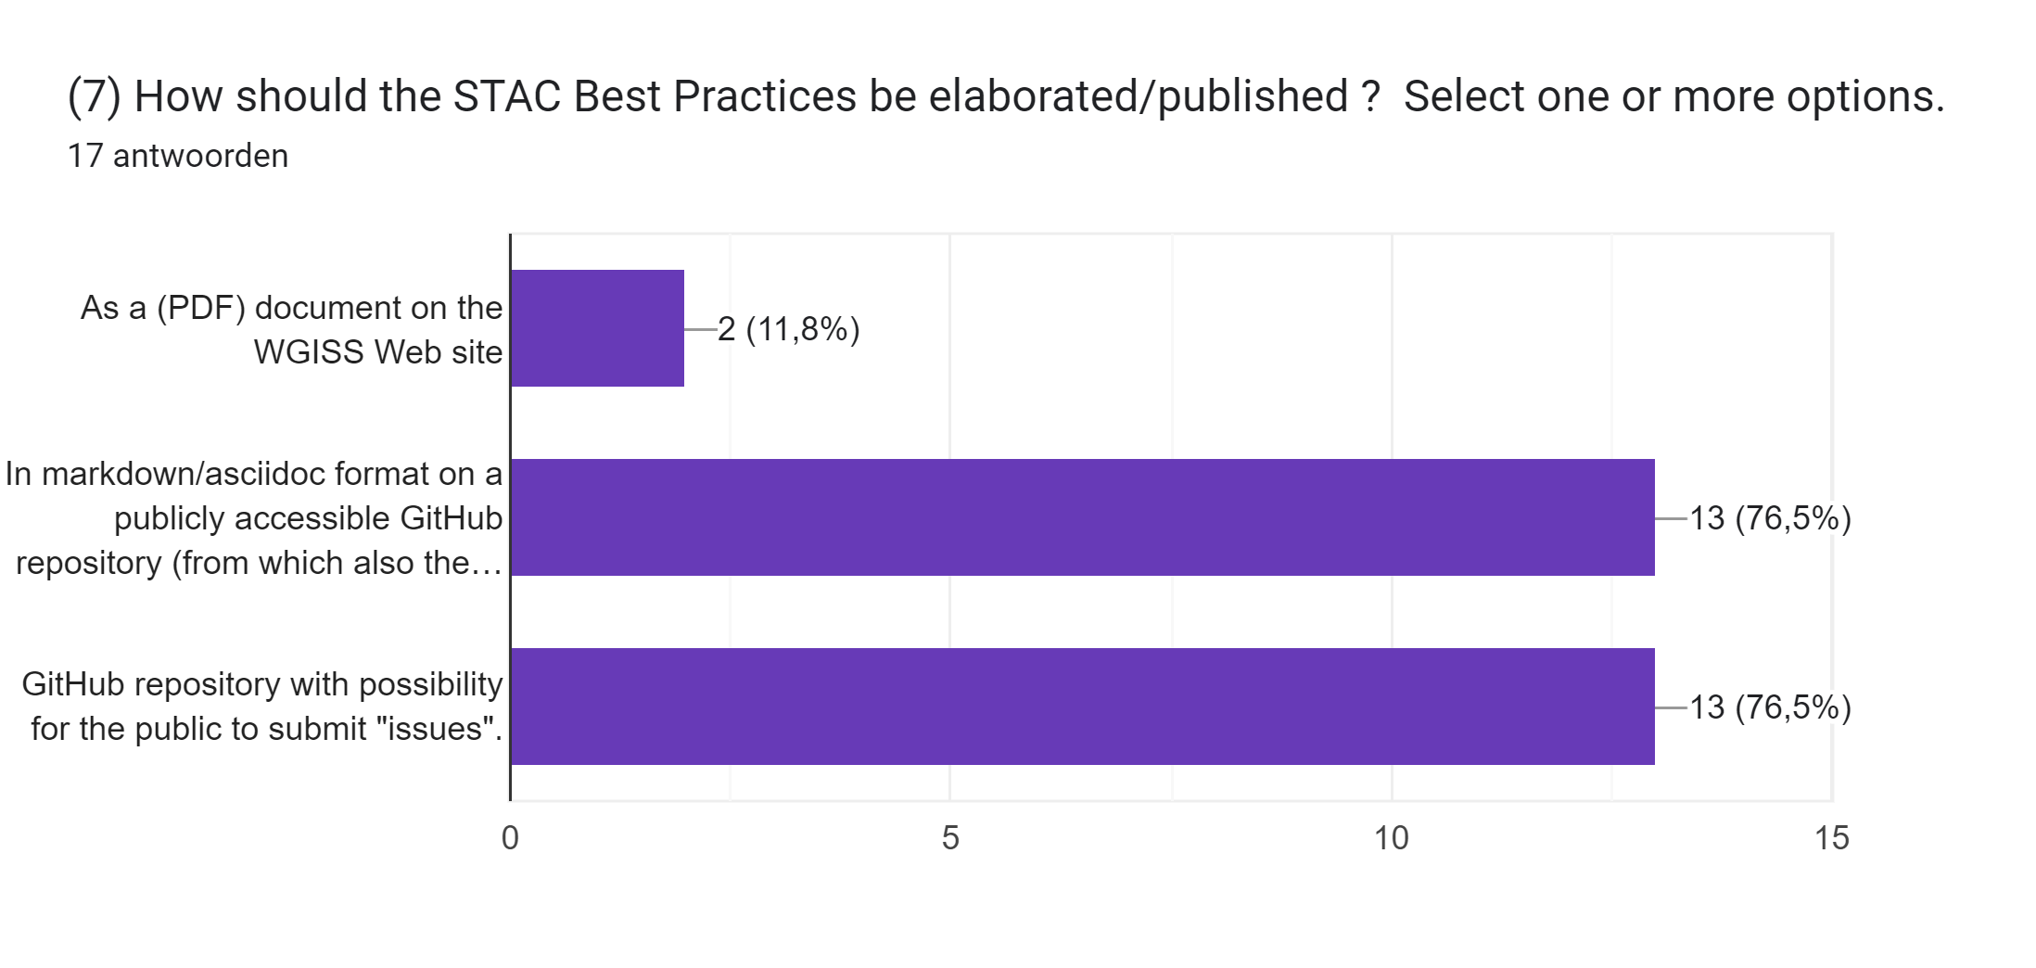

Slide 21
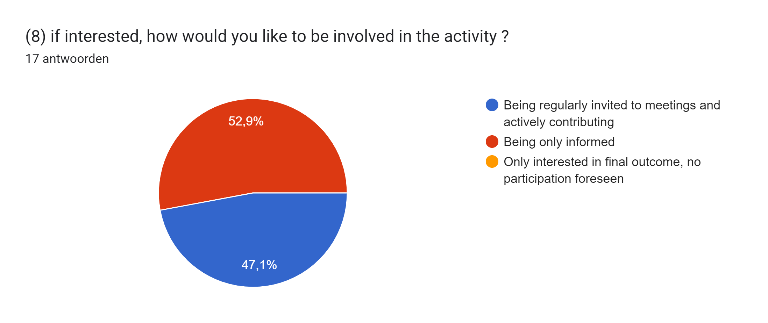

Slide 22
Conclusions
The STAC ecosystem consists of many “building blocks” supporting many use cases, often in multiple ways.
This choice produces an interoperability risk
Implementing all possibilities is unnecessarily expensive
Lack of awareness of these possibilities could lead to breakages between systems. STAC clients may not work as intended with STAC services
Proposed solution:
Adherence to Best Practices will reduce cost and interoperability risks for both client and server implementations
Roadmap with 3 steps, first step is currently underway.

Slide 23
Conclusions
Preliminary survey results based on 17 answers:
(1) 88% have deployed or will deploy a STAC catalogue
(2) less interest in static catalog (30%), most demanded topics include:
STAC API (70%)
Advertise available queryables (70%)
Guidance to allow federation (65%)
Encode collection and granule metadata, keywords etc (65%)
“other topics” proposed: e.g. asset-level search, highly recommended extensions, ..
(5)(6) Provide migration recommendations OpenSearch to STAC (45%)
(7) Best Practice in GitHub repository
(8) 47% interested to contribute/participate to meetings.
Next Steps
Conclude survey and define “scope” for Best Practice.
Start preparation of Best Practice

Slide 24
Conclusion
Your inputs are important.
There is still time to return the questionnaire.
https://docs.google.com/forms/d/e/1FAIpQLSfFWU7_9xZsYUWDlre8sbAQdmGDJfHK2pZuZLLz5PIhgnJPYw/viewform?usp=sf_link

