Slide 1
Proposal for AI/ML Survey in WGISS
Yousuke Ikehata, JAXA
Agenda ID: 2023.4. 18_14.45
WGISS-55
18th April 2023

Slide 2
Background and Scope
This white paper shows a use case about Deep Learning (DL), Machine Learning (ML) and Artificial Intelligence (AI), which uses EO data.
Some CEOS agencies provide DL/ML/AI data and platforms and introduce them at WGISS meetings.
But there aren't any summarized documents.
This document can lead data users to data and platforms.
Additionally, data providers can know where to upload or what cloud is proven for DL/ML/AI dataset.

Slide 3
Who and Why
Who will benefit form a White paper
Data User
Student majoring in remote sensing
Data Scientist who isn’t majoring in remote sensing
Data Provider
Agency who plans to provide dataset for AI/ML newly.

Slide 4
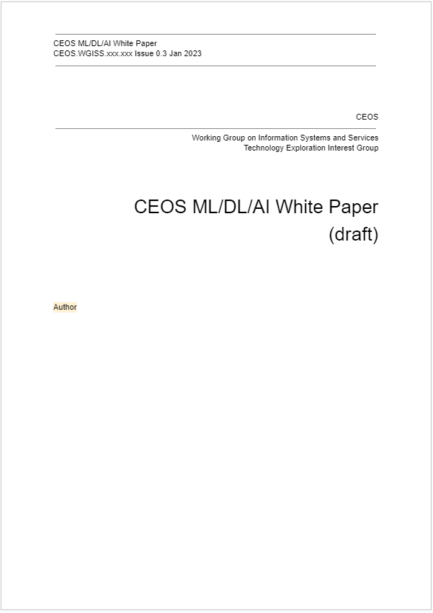
Current status
We’ve already discussed about…
Purpose, expected readers,
Sections
Outlines
Background
Methods
Usecases
Data and platforms
Conclusion

Slide 5
We need volunteers
We want to place various use cases in our white paper.
NASA, NOAA, ESA, INPE … have already introduced their studies in WGISS.
Could you write your activity about AI/ML and how about introduce your dataset and platforms?
We need supervisor about white paper.
Section about use case and platforms, data has been assigned.
But we needs comments to whole contents to refine.
We write white paper in google drive in parallel.
Please send mail to us if you want to read current version.

Slide 6
Time line
Share/Check Outline
In-house work
Share draft
Allocate author to excels part.
Report in monthly meeting
Review
Pass round in WGISS
Publish
WGISS-54
WGISS-56
WGISS-57
12 month
6 month
We’ll finish writing each use cases till end of July.
After August we’ll arrange detailedness, volumes and so on.

Slide 7
After publishing white paper
We’ll publish white paper in Spring 2024th(WGISS-57).
White paper should be update after that.
Because AI/MLs are still evolving.
We’ll still gather use cases about AI/ML.
We want to invite/call AI/ML studies to WGISS (technology exploration session).
Slide 7

Slide 8
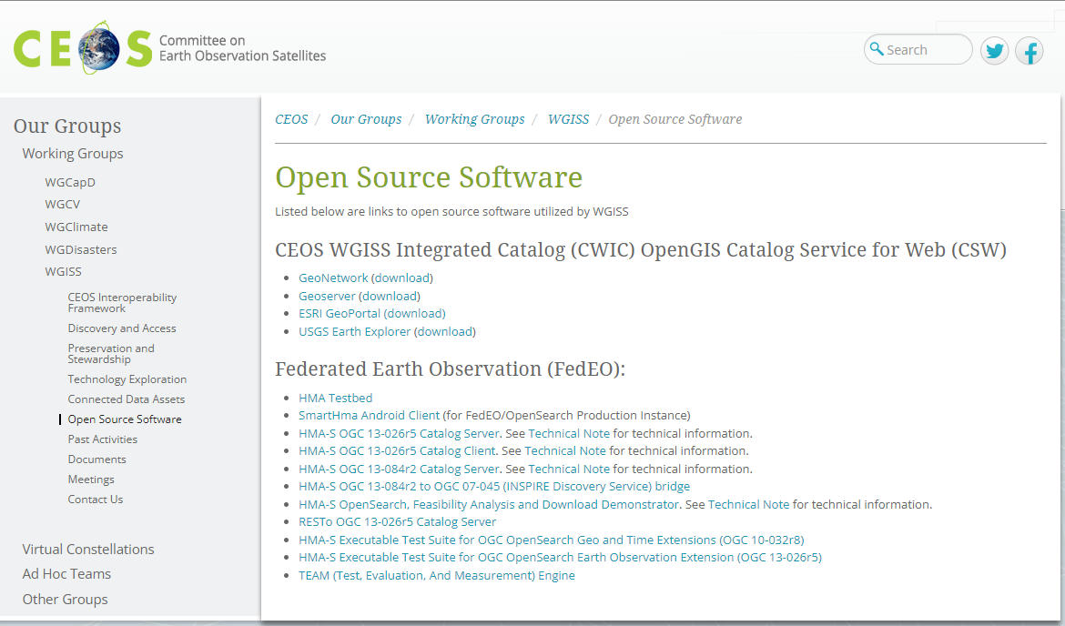
Post our survey.
Additionally, I want post our platforms and data in WGISS home page.
Most user doesn’t read white paper.
Home page is useful for access and use.

Slide 9
Routine about AI/ML for WGISS.
Update homepage
Collaborate with other group.
Invite presenters to WGISS.
Update white paper
AI/ML studies,
Reports.
WGCapD, WGDisaster, …

