Slide 1
CEOS Work Plan Deliverables for WGISS
Dr. Makoto NATSUISAKA, JAXA
Agenda ID: 2023.04.18_10.00
WGISS-55
Cordoba, Argentina (CONAE)
18-20 April 2023

Slide 2
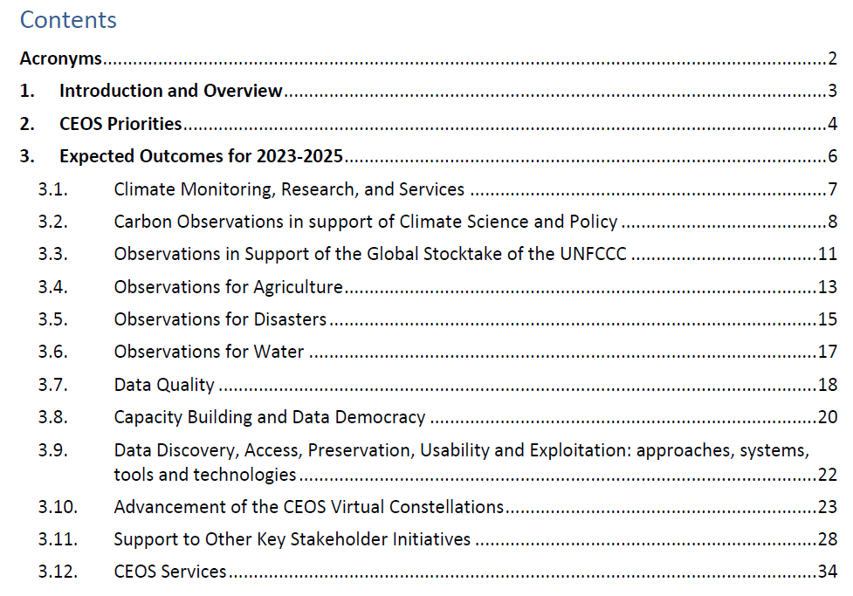
CEOS Work Plan 2023-2025
Slide 2

Slide 3
General Description
3.9. Data Discovery, Access, Preservation, Usability and Exploitation: approaches, systems, tools and technologies
Through the CEOS Working Group on Information Systems and Services (WGISS), CEOS Agencies will continue to foster the enhancement of the WGISS Connected Data Assets Infrastructure to support not only the CEOS entities, but also the external entities like GEO, UN, WMO, etc., by enabling discovery and access capabilities to mature data services provided by CEOS Agencies.
Slide 3

Slide 4
Data Discovery and Access
The WGISS Data Discovery and Access Interest Group will support adoption of supported WGISS standards (e.g., Open Geospatial Consortium, Catalogue Service for the Web and CEOS OpenSearch Best Practices) and definition of new ones, with the aim of connecting as many CEOS agencies as possible into the federated system. The Interest Group will also make the services and tools developed and operated by CEOS agencies discoverable by endorsing the application of “Service Metadata and Discovery Best Practices” issued in 2022. With the increased request for federated collaborative environment to access data and services, the Interest Group intends to explore scenarios for a federated authentication and authorisation mechanism.
Earth observation data represent a unique, valuable, independent, and strategic resource that needs to be preserved, managed and curated throughout its lifecycle to make sure it continues to provide essential information on our planet and the changes which are affecting it.
Slide 4

Slide 5
WGISS Data Preservation and Stewardship
The WGISS Data Preservation and Stewardship Interest Group continues to accomplish its data preservation and curation efforts through addressing space data and associated information archiving, preservation, consolidation and valorisation aspects, including efforts to recover heritage data currently not accessible or at preservation risk. A “Data Management and Stewardship Maturity Matrix” will be issued to help data managers and curators to accomplish their tasks. All the guidelines and best practices produced by the group will be reviewed and adjourned with latest findings and shared within and outside of CEOS (e.g. CGMS and New Space companies) to enable the maximum benefit of EO data for science, society and economic growth.
Slide 5

Slide 6
Technology Exploration
The WGISS Technology Exploration Interest Group will survey cutting edge technologies related to
the Earth observations. Survey results will be summarised and issued as guidelines and best practices.
The “Jupyter Notebook Best Practices” is to be issued in 2023 by collaborating with WGCapD, UN,
GEO, etc. Use cases of Artificial Intelligence / Machine Learning (AI/ML) focusing on EO research and
applications will be investigated and summarised in a white paper in 2024..
Slide 6

Slide 7
CEOS Interoperability Framework
need to be added;
WGISS will lead CEOS Interoperability Framework by cooperating with other CEOS entities in order to investigate …
Slide 7

Slide 8
Deliverables
Number | Objective/Deliverable Title | Projected Completion | Responsible CEOS Entity (ies) | Status
DATA-22-01 | Jupyter Notebook Best Practice | 2023 Q4 | WGISS
DATA-22-02 | Discovery and Access for Data Analytics and Processing Tools and Services | 2023 Q3 | WGISS
DATA-22-04 | Data Management and Stewardship Maturity Matrix | 2023 Q1 | WGISS/WGCV
DATA-22-05 | Feasibility Study for Common Guidelines for the STAC Implementations | 2023 Q2 | WGISS
DATA-22-06 | Archive Technologies White Paper | 2023 Q2 WGISS | WGISS
DATA-23-01 | AI/ML White Paper | 2024 Q4 WGISS | WGISS
DATA-23-02 | CEOS Interoperability Framework Roadmap | 2023 Q3 | WGISS | The due was extended by SIT-TW 2023.
Slide 8

