Slide 1
CEOS Executive Officer Report

Slide 2
Executive Summary
CEOS Mission & Objectives
CEOS Long-term Priorities
GISTDA CEOS Chair Priorities 2023
WGISS Mission & Objectives
CEOS Governance & Work Planning
2023 – 2025 CEOS Work Plan
WGISS Deliverables

Slide 3
CEOS Mission & Objectives
Primary Objectives:
To optimise the benefits of space-based Earth observation
To serve as the focal point for international coordination of space-based Earth observation activities
To encourage complementarity and compatibility

Slide 4
CEOS Long-term Priorities
Ensure that climate observation requirements identified by the Global Climate Observing System (GCOS) – and implications of the Paris Climate Agreement – are addressed.
Ensure, in the context of the Sendai Framework for Disaster Risk Reduction 2015-2030, that CEOS Agency data are made available in support of disaster risk reduction and that CEOS continues engagement with UN agencies and authorities.
Ensure that space-based Earth observations support the success of the next decade of the Group on Earth Observations (GEO), and that CEOS engagement in GEO governance and leadership is enhanced.
Proactively engage in global discussions on the critical challenges that face society, in support of the UN 2030 Agenda for Sustainable Development.

Slide 5
GISTDA CEOS Chair Priorities 2023 Space Technology for Better Environments, Economies, and Humanity
1
Supporting CEOS Preparations and Inputs to the Global Stocktake of the UNFCCC Paris Agreement
2
Supporting Exploration of New Geometries for Space Agencies and CEOS with New Space

Slide 6
WGISS Mission & Objectives
Mission: To facilitate (CEOS) data and information management, and to support the provision of services for both data providers and data users
Objectives:
To enable Earth observation data and information to be more accessible and usable to both data providers and data users world-wide through international coordination.
To foster easier exchange of Earth observation and related data and information to meet the requirements of users and data providers.
To foster the development of best practices and encourage the development of interoperable services that exploit space-borne Earth observation data.
To enhance the complementarity, interoperability and standardization of Earth observation data and information management and services with other types of geospatial data such as in situ data.

Slide 7
Governance & Work Planning
Four key governing documents primarily guide the work of CEOS:
CEOS Terms of Reference defines the mission and scope of CEOS activities
CEOS Strategic Guidance document articulates the overarching long-term (7-10 years) purpose and goals of CEOS
CEOS Governance and Processes document provides
guidelines on the structure, operations, and processes
CEOS employs to achieve its goals
4. CEOS Work Plan (3-year rolling) sets forth near-term
actions to achieve the goals outlined in the CEOS
Strategic Guidance document. Detailed work defined
as deliverables: outlined in the WP, reconciled and
tracked in CEOS deliverable tracking tool

Slide 8
2023 – 2025 CEOS Work Plan
 | Chapter in Work Plan | Responsible
1 | Climate Monitoring, Research, and Services | WGClimate
2 | Carbon Observations in Support of Climate Science and Policy | GHG Task Team, GFOI, AFOLU
3 | Observations in Support of the Global Stocktake of the UNFCCC | UNFCCC
4 | Observations for Agriculture | GEOGLAM, AFOLU
5 | Observations for Disasters | WGDisasters
6 | Observations for Water | GEO AquaWatch
7 | Data Quality | WGCV
8 | Capacity Building and Data Democracy | WGCapD
9 | Data Discovery, Access, Preservation, Usability and Exploitation: approaches, systems, tools and technologies | WGISS
10 | Advancement of the CEOS Virtual Constellations | VCs, ARD Oversight Group
11 | Support to Other Key Stakeholder Initiatives | SDG Coordination Group, NSTT, EETT, COVERAGE, COAST AHT, UN SDGs, GEOBON, GEO Blue Planet, MBON
12 | CEOS Services

Slide 9
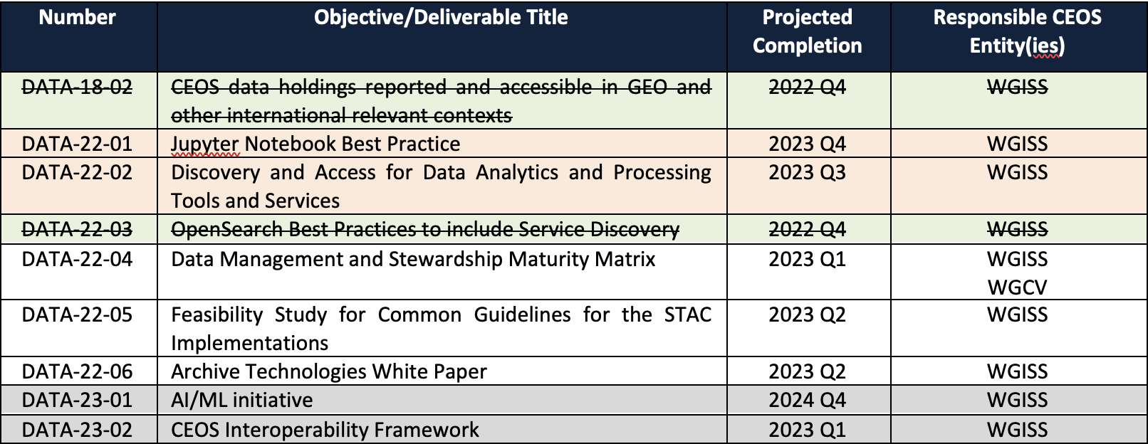
WGISS Deliverables

Slide 10
Thank you!

