Slide 1
WGISS Chair Report
Dr. Makoto NATSUISAKA, JAXA
Agenda ID: 2023.04.18_09.30
WGISS-55
Cordoba, Argentina (CONAE)
18-20 April 2023

Slide 2
Highlight of the Meeting
Share the information on CEOS activities; CEOS Work Plan 2023-2025, CEO Report
Joint session with WGDisaster; Foster Mutual Understandings, Identify Seeds of Collaborations (AI/ML, Service Discovery, EAIL)
CEOS Interoperability Framework; WGISS Contributions, What (focus and factors) will we deal with? How and who will we contribute to the activities? What will be the vision? Should we reform “Interoperability Data and Use Interest Group”? Can we treat data presentation? -> 2-hour discussions
CEOS New Space Task Team (NSTT); WGISS Contributions
Interest Group Sessions; Status Reports and Discussions on the Way Forward
Member Reports; Foster Mutual Understandings among WGISS and WGDisaster members, in especially for CONAE!, ISO/TC211
Discussion with SEO for cloud use; SEO strategy for cloud use?, Collaboration with SEO?
WGISS Organization Matter; Vice Chair Solicitation, Reformation of Interoperability Data and Use IG, WGISS vision and feedback to workplan and TOR, etc..
Slide 2

Slide 3
Major Events Since WGISS-54
2022 CEOS Plenary (Nov. 29 – Dec. 01, 2022, Biarritz in France）
CEOS Work Plan 2023-2025 Submitted ⇒ CEO Report
CEOS ARD Oversight Group ⇒ OGC/ISO211 liaison Report
CEOS Ocean Coordination Group
CEOS Engagement with Standard Organizations
CEOS New Space Task Team
CEOS Interoperability Framework ⇒ CEOS Interoperability Framework session
SIT-38 (Mar. 28-30, 2023, ESA/ESRIN in Italy)
Slide 3

Slide 4
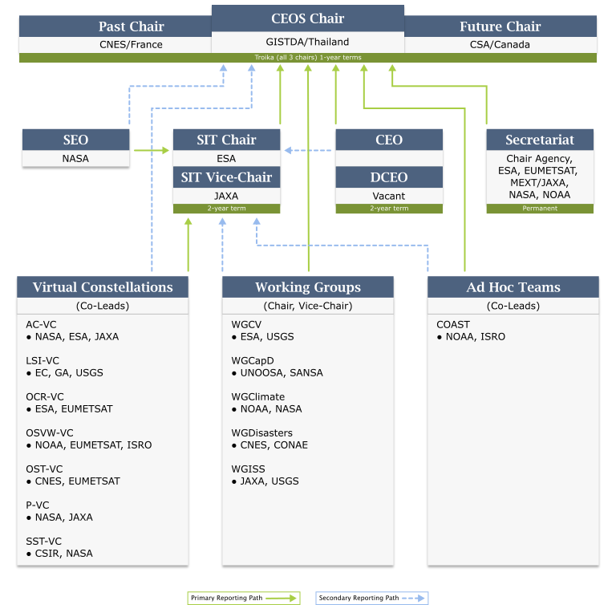
CEOS Plenary 2022
Nov. 29 – Dec. 01,2022, Biarritz in France
CEOS Chair (CNES) Decision
=> CEOS Interoperability Framework
New Chair (GISTDA) Priorities
=> “Earth Observation for Better Environment, Economy, and Humanity”; Supporting CEOS Preparations and Inputs to the Global Stocktake of the UNFCCC Paris Agreement
Supporting Exploration of New Geometries for Space Agencies and CEOS with New Space
Slide 4

Slide 5
CEOS Ocean Coordination Group
CEOS Ocean Coordination Group is a task force formally led by the SIT Chair and currently done by the Coast AHT Chair. The objective is to coordinate CEOS ocean-related activities and clarify CEOS’ contribution to the UN Ocean Decade.
6-month extension for further discussions was approved at SIT-38.
WGISS chair was invited to the activities regarding future use of EAIL, but the operation of EAIL was moved to the joint activity by SEO/CSIRO and discussion points are thematic, and accordingly the WGISS missions are considered as completed.
Slide 5

Slide 6
CEOS Engagement with Standards Organizations
The issue raised at SIT-TW 2022; In discussions around standards for Analysis-Ready Data, it became clear that CEOS was perhaps uncoordinated in its approach to engagement with standards bodies. For ARD, this coordination has since been resolved via the ongoing effort of the CEOS-ARD Oversight Group. Question remains whether CEOS generally needs more formal coordination around engagement with standards bodies, e.g., ISO / OGC / IEEE. Consultation with the CEOS community at 2022 SIT Technical Workshop side meeting – agreed that more coordination on the engagement of CEOS with standards organizations would be beneficial.
CEOS Plenary Discussion and Results
CEOS-36-09 | SIT Chair to organise a dedicated session on the topic of CEOS engagement with standards organisations at SIT-38 and invite CEOS entities to present their experience and status, with the aim of creating a snapshot inventory. | SIT-38
Slide 6

Slide 7
CEOS Engagement with Standards Organizations
WGISS was requested some input to SIT-38 and input the comments based on the discussions in the WGISS Exec meetings in 2022 as follows.
WGISS solicited a volunteer for the activity at the WGISS EXEC meetings.
WGISS doesn't have experts on standardizations except for Liping, who is a liaison with OGC/ISO-TC211 nor resources.
The direct commitment to the activity is difficult, but WGISS will support the activity through regular members of OGC/ISO-TC211 in individual agencies.
Slide 7

Slide 8
CEOS New Space Task Team
New Space Task Team was established for a period of one year, until 2023 CEOS Plenary, at 2022 CEOS Plenary.
Objective 1: Explore collaboration opportunities in New Space that bring mutual benefit to all parties, in delivering public benefit, including the identification of concrete actions
Define and propose actions within the CEOS framework that enhance the outcomes of CEOS entities (WGs, VCs, AHTs) working with New Space companies
Foster partnership at national level between individual CEOS members and their national “New Space” industry
Focus on the whole value chain – upstream and downstream sectors
Objective 2: Continue sharing country-level experience among CEOS
Slide 8

Slide 9
CEOS New Space Task Team
Commence with an assessment of the areas and issues that are common among CEOS agencies and that are predicted to impact public EO programs in future
Dec/Jan: Call for Ideas
Telcon # 1 (23 Jan 2023): Kick-off discussion
Telcon #2 (10 Feb 2023): Discussion on draft Think Piece
Telcon #3 (06 Mar 2023): Discussion continued
Develop a series of objectives and activities that will guide CEOS in fostering the combined use of public and private EO New Space capabilities, both upstream and downstream
SIT-38: Continue agency sharing of experience from SIT-37 and TW, and Accelerate the definition of actions
2023 Plenary: Issue a White Paper with Findings & Recommendations. The White Paper will highlight which topics are most productive for CEOS to pursue and which may be out of scope or problematic.
Slide 9

Slide 10
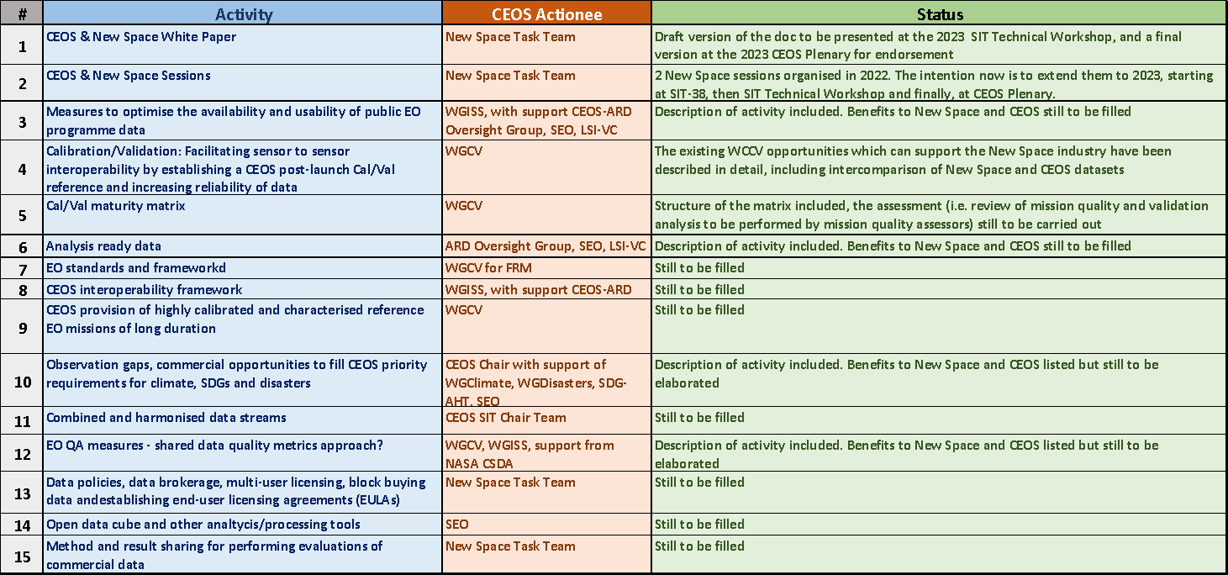
CEOS New Space Task Team
Slide 10

