Slide 1
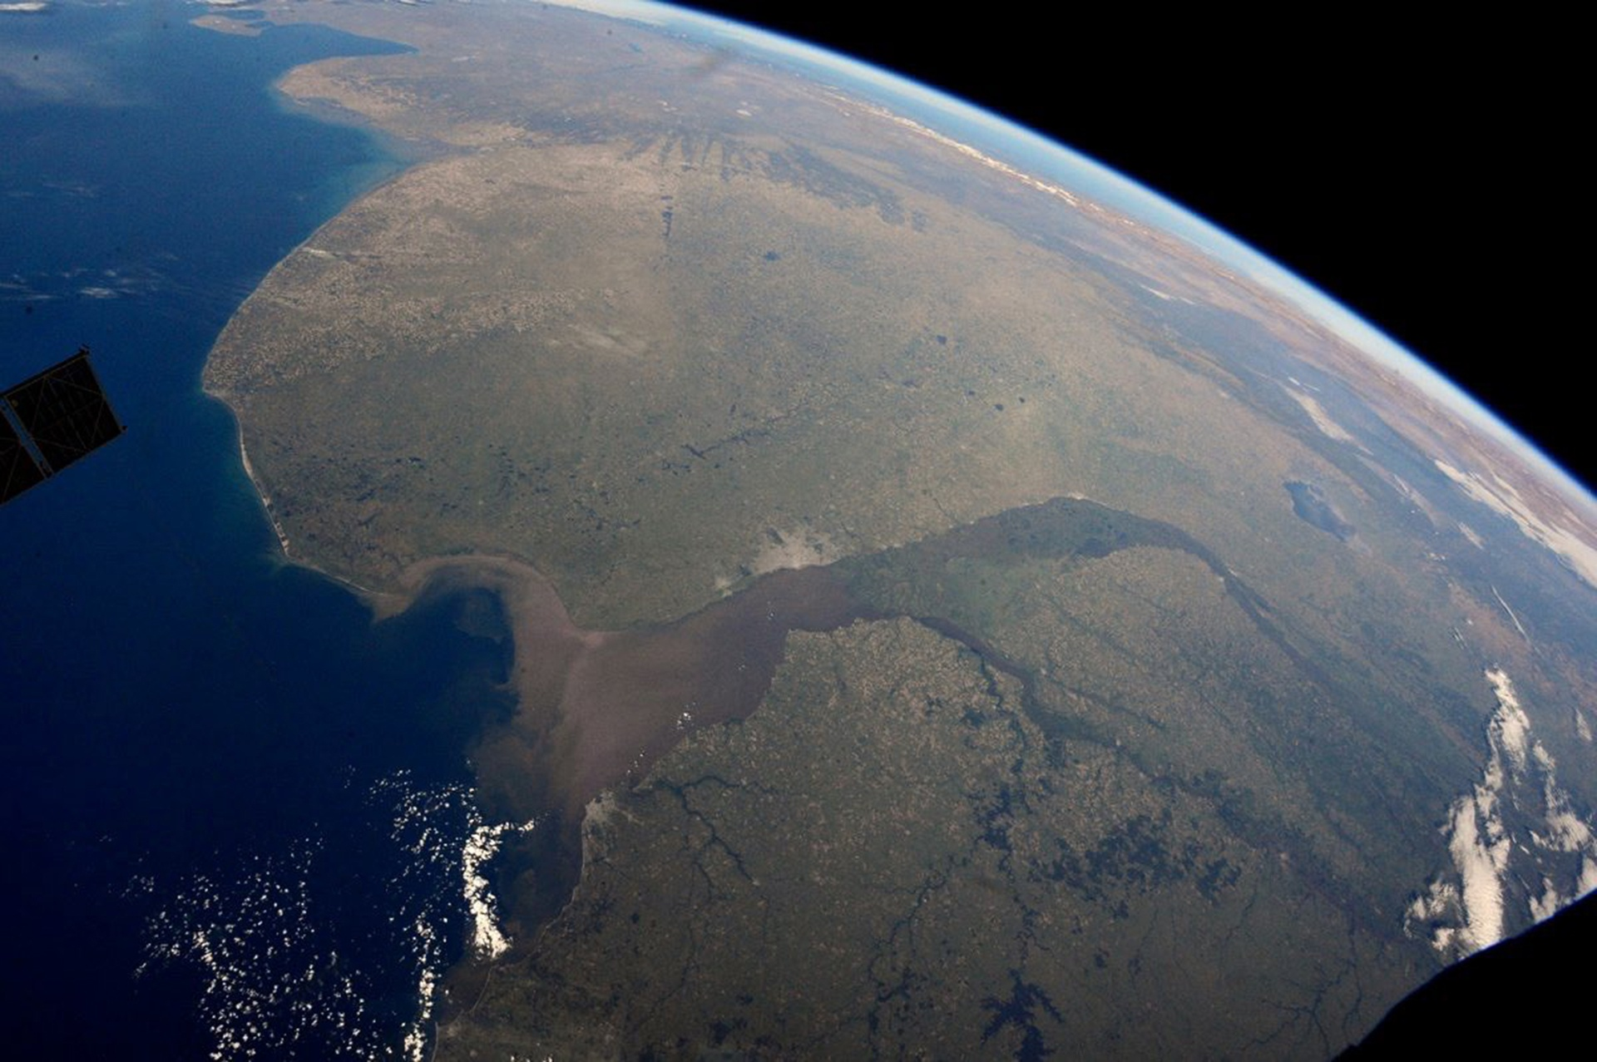
WGISS – 55
Hosted by
Comisión Nacional de Actividades Espaciales (CONAE)
Buenos Aires, Argentina
April, 2023
Notes:
1

Slide 2
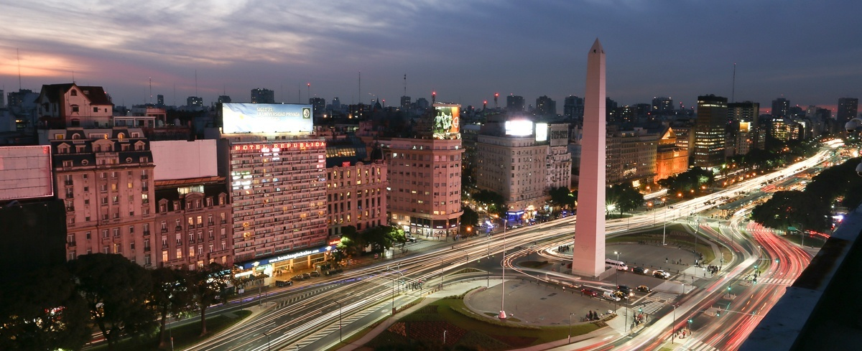
Buenos Aires City, Argentina
Notes:
2

Slide 3
Buenos Aires City, Argentina
Buenos Aires City (Ciudad Autónoma de Buenos Aires) is the capital of Argentina. Please do not confuse it with the province of Buenos Aires, which covers a much larger area of the country. In some places and services the city is listed by its acronym, CABA.
Buenos Aires City is globally known for Tango dance and music. Its gastronomy is also famous offering tasty menus of exclusive products from the Pampas, Andes and Patagonia regions. Many cultural activities and options are available, or you can take a walk to enjoy 200 years of stunning architecture.
Toursim: https://turismo.buenosaires.gob.ar/en

Slide 4
Travel
Most international flights arrive at Ministro Pistarini International Airport, best known as Ezeiza (EZE), which is 32 km (20 miles) away from downtown Buenos Aires, a journey of about 50 minutes long.
For more information about the airport and flights, please visit the official website: http://www.aa2000.com.ar/ezeiza
There is also a domestic in Buenos Aires: Jorge Newbery Airport, best known as Aeroparque (AEP).
To the city centre:
Once you get to the airport, you have several options to reach the city center : http://www.aa2000.com.ar/ezeiza/Transporte?qa=EZE
- Taxi “Ezeiza”: http://www.taxiezeiza.com.ar/
- Shuttle/Bus/remis: “Manuel Tienda León” https://www.tiendaleon.com/
Notes:
4

Slide 5
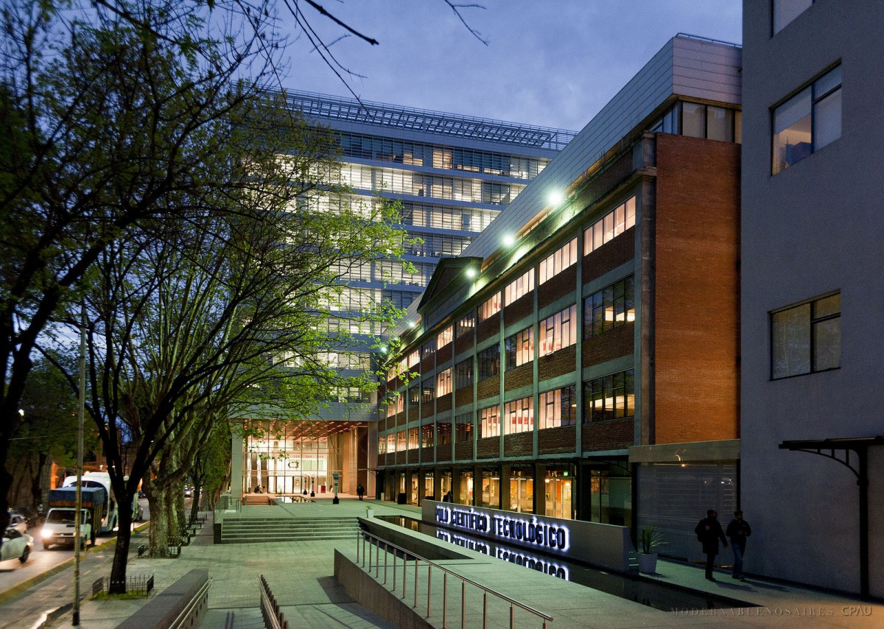
Meeting venue
The meeting will be held in “Centro Cultural de la Ciencia – (C3)” in Palermo, a lively neighborhood of Buenos Aires city. http://c3.mincyt.gob.ar/
Godoy Cruz 2270, CABA
https://goo.gl/maps/QgEpFX5rxDFVNFPa7
Notes:
5

Slide 6
Public transport
The Palermo subway station is at 300m and connects in 15’ to the town center. (Look for the “Subte D” signal and Catedral-Cathedral directions).
For Public transport (bus/subte) you will need a “SUBE” travelcard. https://youtu.be/cgHXMWww93o
You can buy one at the station booth. The metro does not run between 11:00PM and 5:30AM approximately. On Saturdays starts at 6:00AM and on Sundays at 8:00AM. There are many bus lines, also, connecting to the town center running all night long.

Slide 7
Visa information
Requirements for all travelers regarding COVID-19:
https://cnyor.cancilleria.gob.ar/en/visas-2
Individuals holding passports issued by the following countries do not require a visa to enter Argentina for tourism purposes:
https://cnyor.cancilleria.gob.ar/en/countries-list-do-not-require-tourist-visa-when-visiting-argentina
If your country is not on the list, you will need a visa to enter Argentina. More information about the requirements and instructions on how to apply can be found in:
https://cnyor.cancilleria.gob.ar/en/node/1817
Notes:
7

Slide 8
Accomodation
A list of hotels nearby the Workshop venue:
Whyndham Dazzler Palermo https://www.wyndhamhotels.com/dazzler/destinations
Krista Boutique Hotel http://www.kristahotel.com.ar
BA Sohotel http://www.basohotel.com/
Nuss https://www.nusshotel.com/
Malabia House https://www.malabiahouse.com.ar/
Vain Boutique hotel https://www.vainhotel.com/en/
Hotel Cristoforo Colombo http://www.hotelcc.com.ar/
Notes:
8

Slide 9
Further questions
For further help concerning the Scientific Organization of the Workshop you may contact Dr. Laura Frulla or Dr. Homero Lozza.
Contact:
Dra. Laura Frulla
CONAE
Av. Paseo Colón 751, 1st floor, Of. 12, CABA, Argentina
Email: lfrulla@conae.gov.ar
Dr. Homero Lozza
CONAE
Av. Paseo Colón 751, 1st floor, Of. 13, CABA, Argentina
Email: hlozza@conae.gov.ar
Notes:
9

Slide 10
Money and ATMs currency
The local currency is the Argentine peso (ARS). Please notice that locally, the same symbol as for the dollar ($) is used for the peso. Don't be confused, in shops and restaurants prices expressed using the $ symbol are in Argentine pesos always, unless stated otherwise. US dollars are usually referred to using the symbol: U$S.
It is easy to exchange money in Buenos Aires at casas de cambio (bureaux de change/currency exchanges) and at most banks - note that you'll need to provide identification. Local currency can also be withdrawn 24 hours a day from ATMs. Some shops, hotels and restaurants may accept cash payments in US dollars or euros.
Most large shops and restaurants accept credit or debit cards. For more information, please visit this link
(https://turismo.buenosaires.gob.ar/en/article/money ).

Slide 11
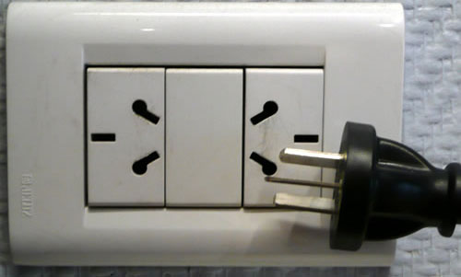
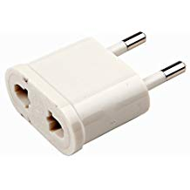
Electricity
Type I sockets
AC current outlets in Argentina are 220V, 50Hz. The standard outlet has three pins with a layout like in China (type I socket). Most sockets accommodate both the two-pin European (type I socket compatible with type E and F sockets, "two thin round pins") like plugs and the three-pin plugs (see figure).
Note: in most of the cases, this small adapter could be enough:

Slide 12
Weather
Fall!
Argentina and Buenos Aires are located in the southern hemisphere, so in April we are in autumn with a very mild weather . Temperature in Buenos Aires during this month is usually lower than 22°C (72°F) and higher than 12°C (53°F). You can visit the National Weather Forecast (https://www.smn.gob.ar/ ).

Slide 13
We wish you a pleasant stay in Buenos Aires!

