Slide 1
Access patterns & STAC at Bhoonidhi ISRO
WGISS-54
Tokyo, Japan (JAXA)
3-7 October 2022

Slide 2
Executive Summary
Bhoonidhi Portal
Current Data access mechanism
Data access pattern by users
Need for new Access Mechanism
Why STAC
STAC Implementation @Bhoonidhi
Road Map

Slide 3
Bhoonidhi Portal
As ISRO has huge repository of
Earth Observation data across missions and sensors with fresh acquisitions being added on a daily basis covering INDIA and its surroundings. www.bhoonidhi.nrsc.gov.in
Also has meteorology, oceanography and tropical water cycles. Data acquired from missions is disseminated in near real time through the MOSDAC. www.mosdac.gov.in
Need a standard to integrate ISRO’s catalogue internally and also make them indexable with global standards. ISRO moving toward’s STAC

Slide 4
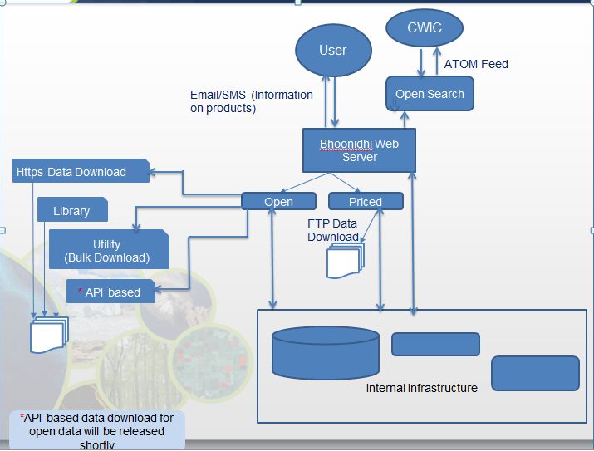
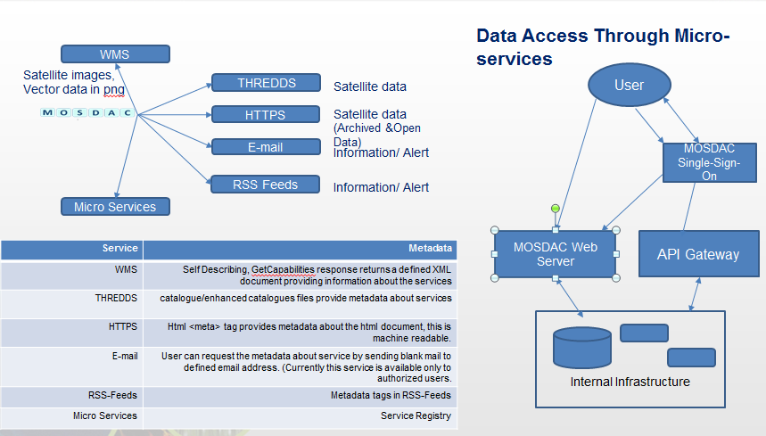
Current data access
Bhoonidhi
MOSDAC

Slide 5
Access patterns - Type
Freedraw
65 % of the searches are geospatial searches
35% of the searches are full coverage searches based on date
polygon
Date range
Location
Shapefile

Slide 6
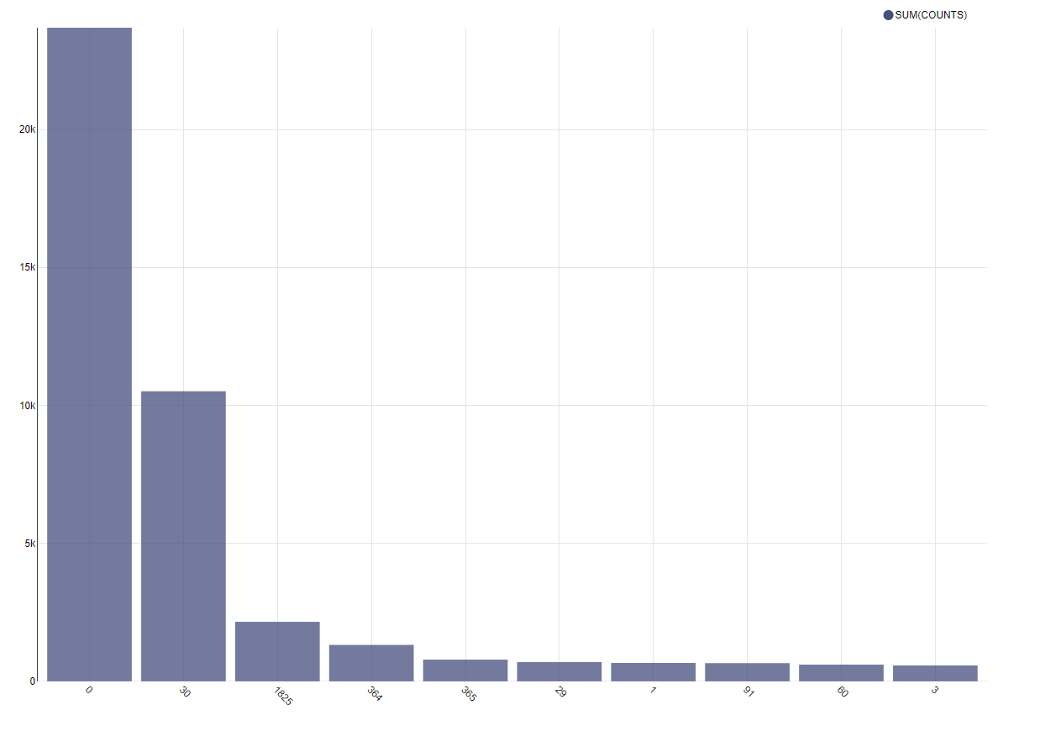
Access patterns – Time range
1 day
Our time range searches are predominantly dominated by a single data search, followed by 30 day search.
Both single day and 30 day search contribute to more than 95% of the search hit volumes and the backend needs to be optimized
Also our backend needs to be generalistic and should be able to paginate , to avoid high load latencies to all users.
30 days
5 Year
1 Year

Slide 7
Requirements & STAC
REQUIREMENTS
Should cater to fast response for short term date search around 1 day-1 month, with a provision to change/optimize later ( architecture , partitions , indexing)
Should cater to faster response for satellite based data search ( Organization : STAC , indexing )
Should cater to faster responses for Shape file based search. ( indexing )
Should handle different satellites in a single seamless way without the need to have conditional columns based on satellite. ( Organisation : STAC )
Should have provision for read replication and load balancing (STAC-FAST-API , API Gateway)
Should handle both systematic and Agile satellites
( organization : STAC )
STAC
Community support in lieu of Indexing and consumption libraries
Wider adoption· by federal agencies and industry
Integrating distributed catalogues is easier ( the case of ISRO )
Asset integration , meta data searches is supported in the standards
Open source implementations available in parts for both front-end and back-end , TTM is
Slide 7

Slide 8
POSTGIS – STAC support
Opensource softwares supporting STAC cataloguing in database :
Sat-api-pg
Pgstac
Service-stac
Others
On evaluation the following features we require were supported by pgstac.
Partition support , optimisation
Query index support , optimisation
Custom json field queryable fields optimisation
Frontend framework available for integration to expose catalogue ( STAC-FAST-API )
Slide 8

Slide 9
STAC-FAST-API
API level framework to expose database catalogue as STAC API
Works with either SQL Alchemy , PGSTAC.
PGSTAC reader , writer instance classification supported
We need to extend this based on our use cases to implement authentication , rate limiting and other business logic over data catalogues.
Slide 9

Slide 10
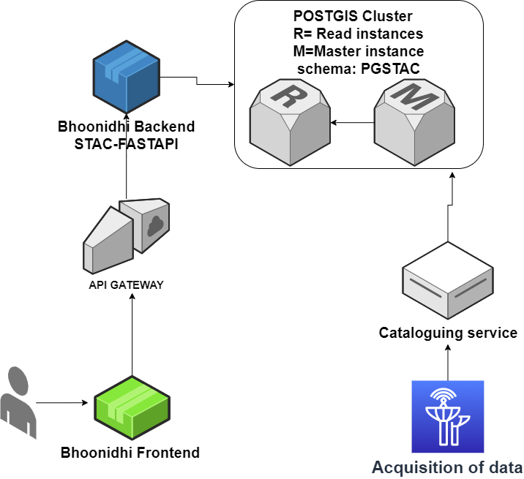
Bhoonidhi STAC architecture
Slide 10

Slide 11
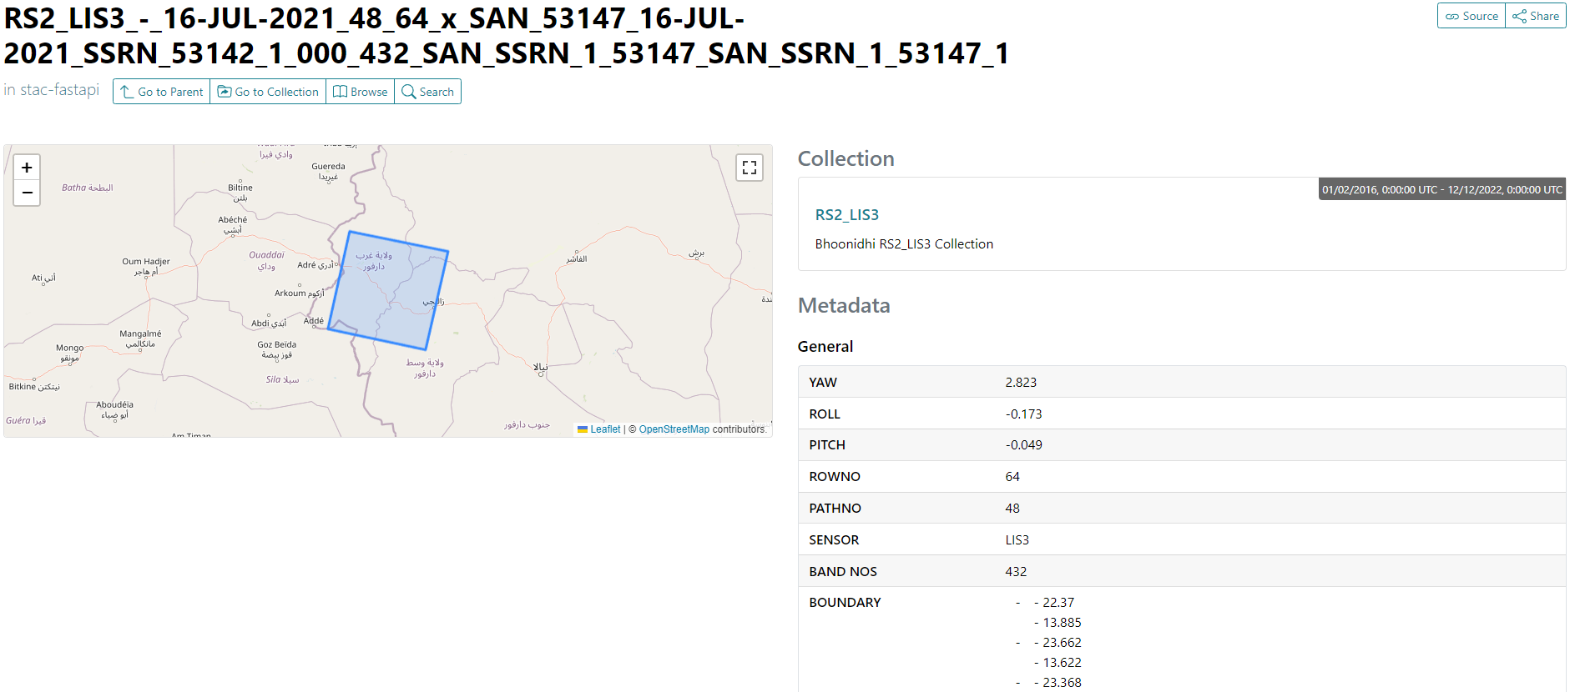
Bhoonidhi STAC in STAC Browser
Slide 11

Slide 12
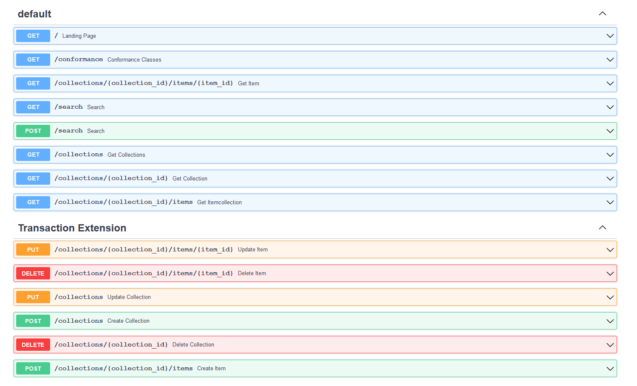
Bhoonidhi STAC in STAC-FASTAPI ( Open API)
Slide 12

Slide 13
Bhoonidhi API gateway features
Authentication
Authorization
Rate limiting
Other Web application security protections ( DDOS / Size attacks etc )
Traffic metering
Load balancing

Slide 14
Progress – Road Map
Load testing and Integration testing in works
Open API SDK generator being explored for python , java
Integration of STAC with Bhoonidhi code lab in progress
Estimated open implementation by Q1 2023

Slide 15
THANK YOU
bhoonidhi@nrsc.gov.in
Contributions: K. Radha Krishna, Ankitha Reddy, T.Sai Kalpana, Anupama Sharma ( Workflows & Product dissemination team NRSC )
Support: Manju Sarma, Nitant Dube

