Slide 1
Technology Exploration
FEDERATION
Karim Ramage, CNRS
Richard Moreno, CNES
Agenda ID: 2022.10.06_14.40
WGISS-54
Tokyo, Japan (JAXA)
3-7 October 2022

Slide 2
Summary
We face challenges which require hybridization of a huge variety of data
This may require to make different organisations and platform to better cooperate (exchange data, processing) with in mind a good energy efficiency (eg no data download or duplication, prefer big infrastructure)
Different aspects of federation will be presented

Slide 3
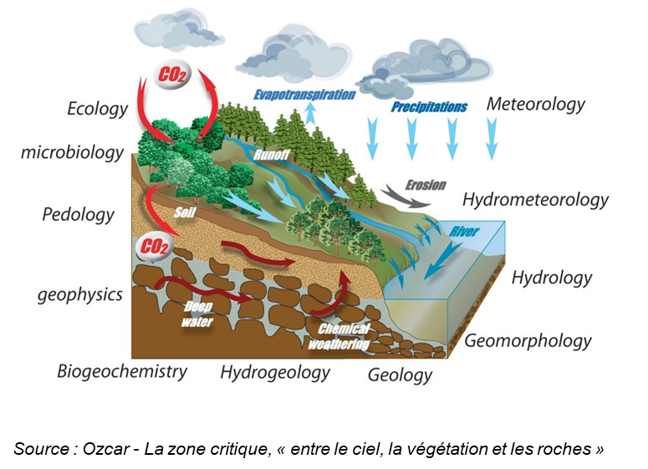
Challenges and objectives of Federations
We face challenges which require hybridization of a huge variety of data
  Types of data : space, in-situ, thematic, …
  Types of challenges:
      Climate change & adaptation
      Water cycle
      Urban environments
      Hazards and impacts on society
      Integrated approach to the critical zone
      These data are stored and exploited in a huge variety of platforms
  With a variety of technologies (storage, processing, authentication, …)
  Data hybridation require more than only data & services interoperability
  Need to build a federation
      Identity & Trust – Governance
      Interoperability: Data, services & processing
      Federated Catalogue – Data discovery
      Advanced tools adapted to the federation as a whole
Slide 3

Slide 4
Examples of federations

Slide 5
EOSC – A web of FAIR data & services for science
Slide 5

Slide 6
Destination Earth – develop a very accurate digital model of the Earth
Several datalake
Several HPC: EuroHPC
Several cloud providers
Slide 6

Slide 7
DestinE Data Lake (Eumetsat) ⬄ also a federation
DestinE Data Lake :
Self-standing component built from geographically distributed physical elements that reference and provide seamless access to data
Provision of data & information available from a large number of external data spaces
Near-data processing
➔ Harmonization for data & services federation through edge Bridge Services linked to Central Services
Bridge Services :
Located on premises of HPC and Large Data Holders
Integrated with Federated Identity Management
High performance internet access
High performance LAN access to internal HPC infrastructures
High capacity storage for Data Warehouse/Exchange
Deployed on IaaS and PaaS infrastructures
Big data Processing
Data as a Service (HyperCubes, core data storage)
Central Services :
Identity Management
High performance internet access
Private WAN linked to data holdings
IaaS and Paas for users
Big data Processing (Faas, Dask, OpenEO, AI/ML, Analysis Ready Data, …)
Data as a Service (Fresh Data pools, Catalogs, Analytics/Reporting, …)
Slide 7

Slide 8
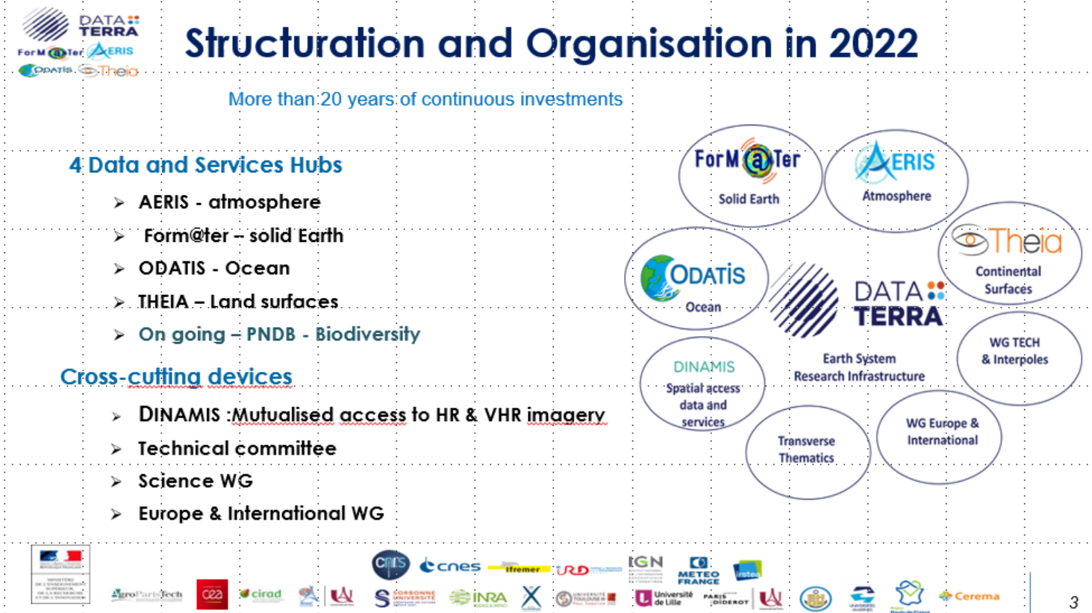
Data Terra – French Research Infrastructure
Data & Services of the Earth System
& 30+ data and services centers
Slide 8

Slide 9
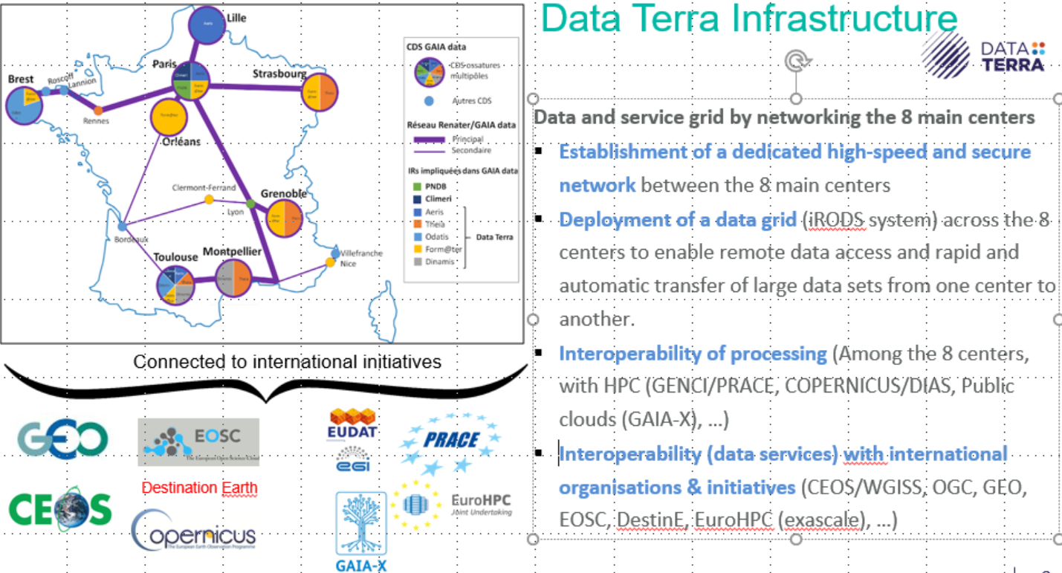
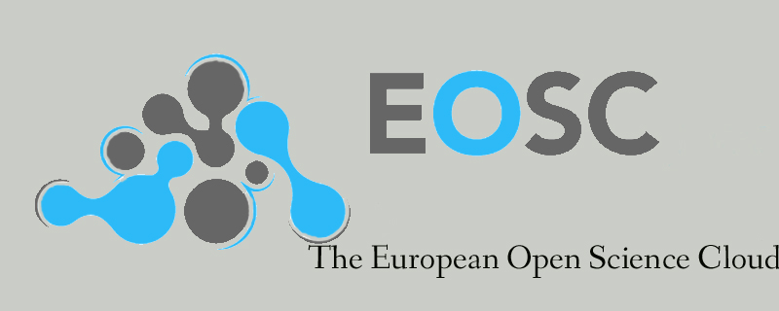
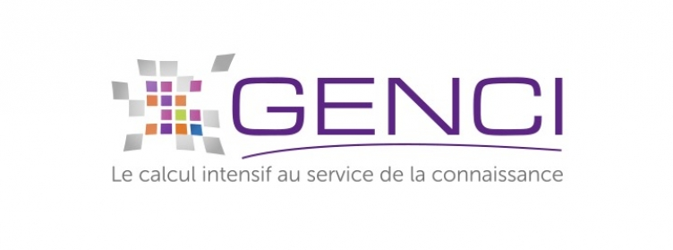
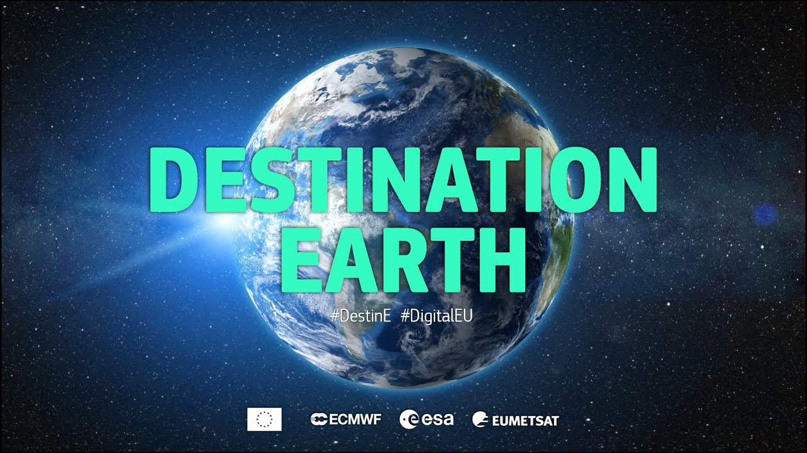
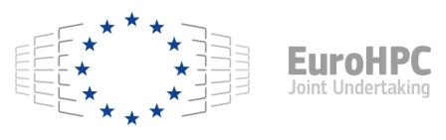



Data Terra – French Research Infrastructure
Data & Services of the Earth System
Based on 8 data&services centers: regional HPC
Adapted to the need of the scientic communities
Avoid data download by scientists
Propose advanced services to users
Centralised authentication
Data are not duplicated, but are located in different places
Move processing close to the data – as much as possible
Ability to move data between centers: iRODS grid
Need for high speed network
Connected to external platforms
Major European programs related to scientific data
French & European HPC if needed: extra processing power, already funded
Public clouds (to be implemented) : extra processing power & resources more convenient for private sector
Connected to external platforms
French & European HPCs
Public clouds
European programs
Slide 9

Slide 10
GAIA-X – A Federated and Secure Data Infrastructure
Gaia-X strives for innovation through digital sovereignty.
Goal is to establish an ecosystem, whereby data is shared and made available in a trustworthy environment.
The intention is to give the control back to the users by retaining sovereignty over their data.
Outcome will not be a cloud. It is a federated system linking many cloud service providers and users together in a transparent environment that will drive the European data economy of tomorrow.

Slide 11
Example of GAIA-X – European clouds federation to foster data usages
Data spaces ⬄
European Data Strategy
Federated Identity Management
Trust management
Federated access
Policies & Usage control
Usage control for data protection
Security concepts
Relation between service providers and consumers
Rights & obligations of participants
On-Boarding & certification
Self description
Service Governance
Monitoring & metering
Network ⬄ Backbone
Interoperability (data, services, processing)
Slide 11

Slide 12
Different aspects of federations
Derived from GAIA-X model

Slide 13
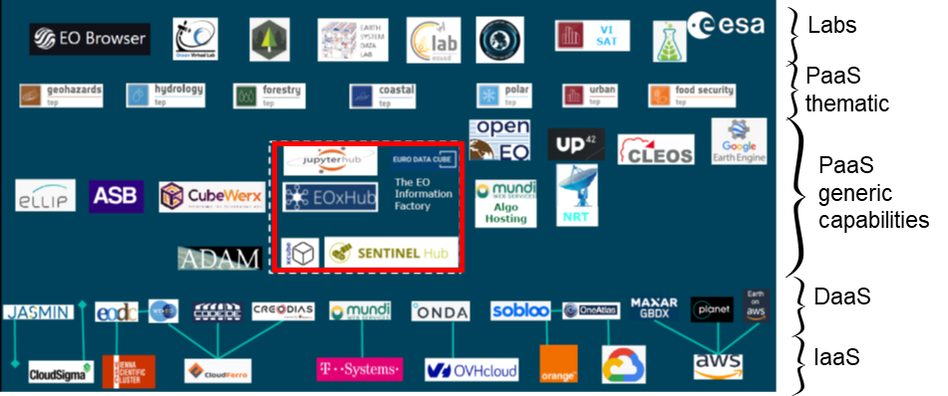
First draft of federation model
Users / Applications
Smart services
Sectorial dataspaces (Green deal, agriculture, …)
Community & organisations Data Space (including services & platforms)
Federation Services
  Federated catalogue & discovery, Identity & Trust, compliance (CTS), sovereign data exchange
Platforms ⬄ PaaS
  DataCubes (EAIL), Notebooks
Data & services ⬄ DaaS
Infrastructures ⬄ ~IaaS
  Network, HPC, clouds
  Business model
Infra
ESA model for platforms

Slide 14
Iaas - Infrastructures
Federation
PaaS
DaaS
IaaS
Types of infrastructures:
  Cloud (public & private) : AWS, Google, OVH, Orange BS, T-System, Cloud Ferro, Microsoft, EGI, …
  HPC (mostly public) : PRACE/GENCI, EuroHPC, EGI, Regional HPC, organizations HPC (eg CNES, IFREMER, DLR, …)
  Edge instances
  Network : in Europe GEANT/RENATER – for public cloud associated to egress - & last mile network
    Dedicated bandwidth
    Secured communication channels (private WAN / VPN)
    Security: Definition of trusted zones and partners
Compliance (legal: regulation & policies)
  Business model (can be at no cost – based on scientific excellence – or funded by projets/users)
  Transparency for contractual terms & references
  Regulations: in Europe GPDR, Security (eg EC cybersecurity requirement or NASA NGAP), …
Portability, Interoperability & Interconnectivity
  Interoperability of processing : OGC testbed, OpenEO, Containers/K8S, …
  Federation of heterogeneous infrastructures : HPC, Grid Computing, cloud & different types of hardware
  Services stack deployment through IaaC on Cloud infrastructures (openstack, K8S, …)
  Interconnectivity: network, data grid (iRODS, RUCIO, Tooled S3 interface)

Slide 15
Daas – EO Data & Services Centers
Federation
PaaS
DaaS
IaaS
Types of Data as a Services:
  Data access & other services
  Space data – also in situ data useful for applications & projects
  Data Terra RI data & services centers
  Copernicus open hub – Nasa Earth Data portal – DLR Eoweb - JAXA G-Portal – CNES GeoDataHub – Airbus platform
Compliance (legal: regulation & policies)
  Business model (can be at no cost: eg open data - can have a cost: eg VHR optical data)
  Transparency for contractual terms & references
  Regulations: in Europe GPDR, INSPIRE, France: ‘loi pour une république numérique’
  Compliance: Core Trust Seal certification, maturity matrix …
  Need for DMP, DOI, licences, FAIRnesss
Portability, Interoperability & Interconnectivity
  Interoperability (may be specific to a dedicated community (eg: Ocean)
    Legal (INSPIRE)
    Organizational : SLA
    Semantic : can be specific to a community: thesaurus & ontologies & metadata model
    Technical: CSW ISO19115, Opensearch, STAC, data format (eg cloud ready),
    Standard protocols for massive data exchange (iRods, Rucio, …)
    Standard protocols for data access (OpenDAP, S3, Http API, …)

Slide 16
Paas – Platforms
Federation
PaaS
DaaS
IaaS
Types of platforms:
  Mix data, services and infrastructure + AI & software to analyse data, including notebooks (Pangeo), no Code, On demand processing, Datacubes
  Copernicus DIAS, CNES GeoDataHub, NASA Earthdata cloud platform, G-Portal+JSS3 & Tellus (JAXA)…
  Google Earth engine, SentinelHub (Sinergise), ESA TEP
Compliance (legal: regulation & policies)
  Business model
  Transparency for contractual terms & references
  Regulations: in Europe GPDR, INSPIRE, France: ‘loi pour une république numérique’
  Compliance: Core Trust Seal certification, CEOS maturity matrix (Discoverability, Accessibility, Usability, Preservation, Curation …)
Portability, Interoperability & Interconnectivity
  Interoperability (may be specific to a dedicated community (eg: Ocean, or biodiversity, …)
    Legal (INSPIRE)
    Organizational
    Semantic : can be specific to a community: thesaurus & ontologies & metadata model
    Technical: CSW ISO19115, Opensearch,

Slide 17
Federation services
Federation
PaaS
DaaS
IaaS
Federated catalogue & Discovery portal for data & services (inc. Notebooks, Datacubes, …)
  Global thesaurus, metadata model, ontologies, …
  Self description
  Service Governance
  Monitoring & metering
Identity & Trust:
  Federated Identity Management
  Trust management: eg verification of genuity/integrity of data in the federation
  Federated access : IAM : Edugain in Europe for research activities
Sovereign Data Exchange
  Policies & Usage control – eg data policy ⬄ promotion of open science
  Usage control for data protection
  Security concepts
Compliance (legal: regulation & policies)
  Business model & Transparency for contractual terms & references
  Regulations: in Europe GPDR, INSPIRE, France: ‘loi pour une république numérique’
  Compliance: Core Trust Seal certification, maturity matrix, …
  Rules to be part of the federation
  Architecture of standards (various accepted standards & reference architecture)
    & associated governance : manage evolution of the PRAAS (Policy, Rules, of Architecture standards)

Slide 18
Federation – governance & rules
Federation
PaaS
DaaS
IaaS
Governance
  Define the architecture of standards & Data policy (licences, DMP, cost model, interop of processing, …)
  Can decide (which project can run in the federation, …)
Rules for onboarding in the federation
  Need to answer the need of the community (data, services , processing power, …
  Minimum level of security
  Technical readiness
  Energy efficiency
  Availability of skilled persons able to propose support
  Performances, SLA
  FAIRness level (maturity matrix or certification CTS)

Slide 19
Federation: cross services
Federation
PaaS
DaaS
IaaS
Cross services
  Data discover
  Data Access (STAC, S3, …)
  Common authentication: keycloak + link to federation of identity (eg EduGain in Europe)
  Support to users (at any level of the federation)
  Support to data providers (increase FAIRness)
  Ability to move/duplicate data from one Data center to another
  Move processing to the Data & use efficient (energy) infrastructures
  Notebook/Nocode/Datacubes/… able to handle the geographic distribution of data
  Ability to deploy a distributed workflow on the different part of the federation
    Orchestrator
    Data movers (Rucio, iRods, S3 based tools
    With criteria for the distribution: energy efficiency, cost, availability of resources (Disk, CPU, network)

