Slide 1
Machine Learning and Graph
WGISS-54
October 6th, 2022
Doug Newman
NASA ESDIS Project, Goddard Space Flight Center
douglas.j.newman@nasa.gov

Slide 2
Summary
Enabling machine learning (ML)
Using machine learning
Enabling knowledge graphs
Using knowledge graphs
Fostering communities
ESDSWG
ESIP
Discussion
Notes:
ESDSWG - Earth Science Data System Working Groups
ESIP - Earth Science Information Partners

Slide 3
Enabling machine learning
Machine learning

Slide 4
NASA ESDS disposition to ML
‘Training data sets are an essential tool for Machine Learning and Artificial Intelligence (AI/ML) methods…
it is critical that they are archived and cataloged…
[and] should be indexed in NASA’s Common Metadata Repository (CMR) and made discoverable alongside data in CMR’
NASA ESDS March 4, 2022
Notes:
ESDS - Program Executive for Earth Science Data Systems

Slide 5
New GCMD keywords
See Valerie Dixon’s talk!
Notes:
GCMD - global change master directory

Slide 6
Improving cloud-native data access
Metadata to describe access
Region
Bucket
S3 URL
Investigating balance between access patterns and metrics
Relax registration/authentication for public, non-EULA’d data
Based on data access experiences from our community
Notes:
URL - universal resource locator
EULA - End User License Agreement

Slide 7
Leveraging machine learning
Machine learning

Slide 8
GCMD Keyword Recommender
Using ML and Natural Language Parsing techniques to map collections to a set of GCMD keywords based on the collection description.
Utilizes a data corpus of ~23,000 earth science journal articles and the domain-specific word embedding capabilities of the Word2Vec model, we created the ES2Vec classifier.
79.4% accuracy of keywords recommended from collection metadata
In operations with the Metadata Management Tool.
Notes:
https://en.wikipedia.org/wiki/Word2vec

Slide 9
Enabling knowledge graphs
Knowledge graph

Slide 10
CMR GraphDB
The Common Metadata Repository (CMR) will expose a low-level graph traversal API for their collection-centric graph database using the following standards-based APIs,
SPARQL
Gremlin
Cypher
With the intention to fuel the development of novel derived knowledge extraction techniques in the community.
Notes:
SPARQL -
API - application programming interface

Slide 11
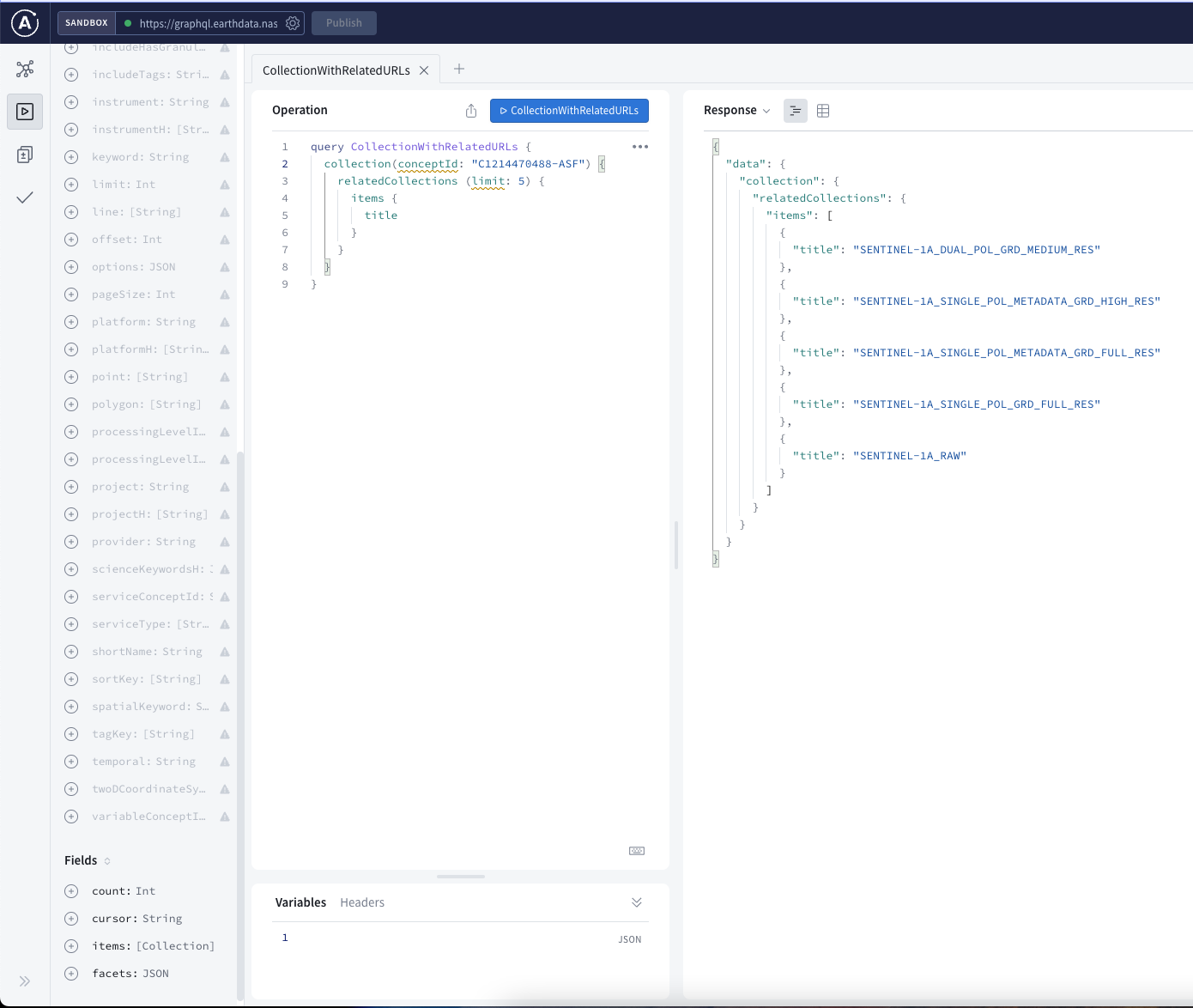
CMR GraphQL
CMR exposes a GraphQL API at
graphql.earthdata.nasa.gov
This API exposes a schema-based query mechanism for relationships between collections, services, variables etc.
Notes:
API - application programming interface
URL - POST https://graphql.earthdata.nasa.gov/api data: {"query":"query CollectionWithRelatedURLs {\n collection(conceptId: \"C1214470488-ASF\") {\n relatedCollections (limit: 5) {\n items {\n title\n }\n }\n }\n}"}

Slide 12
Leveraging knowledge graphs
Knowledge graph

Slide 13
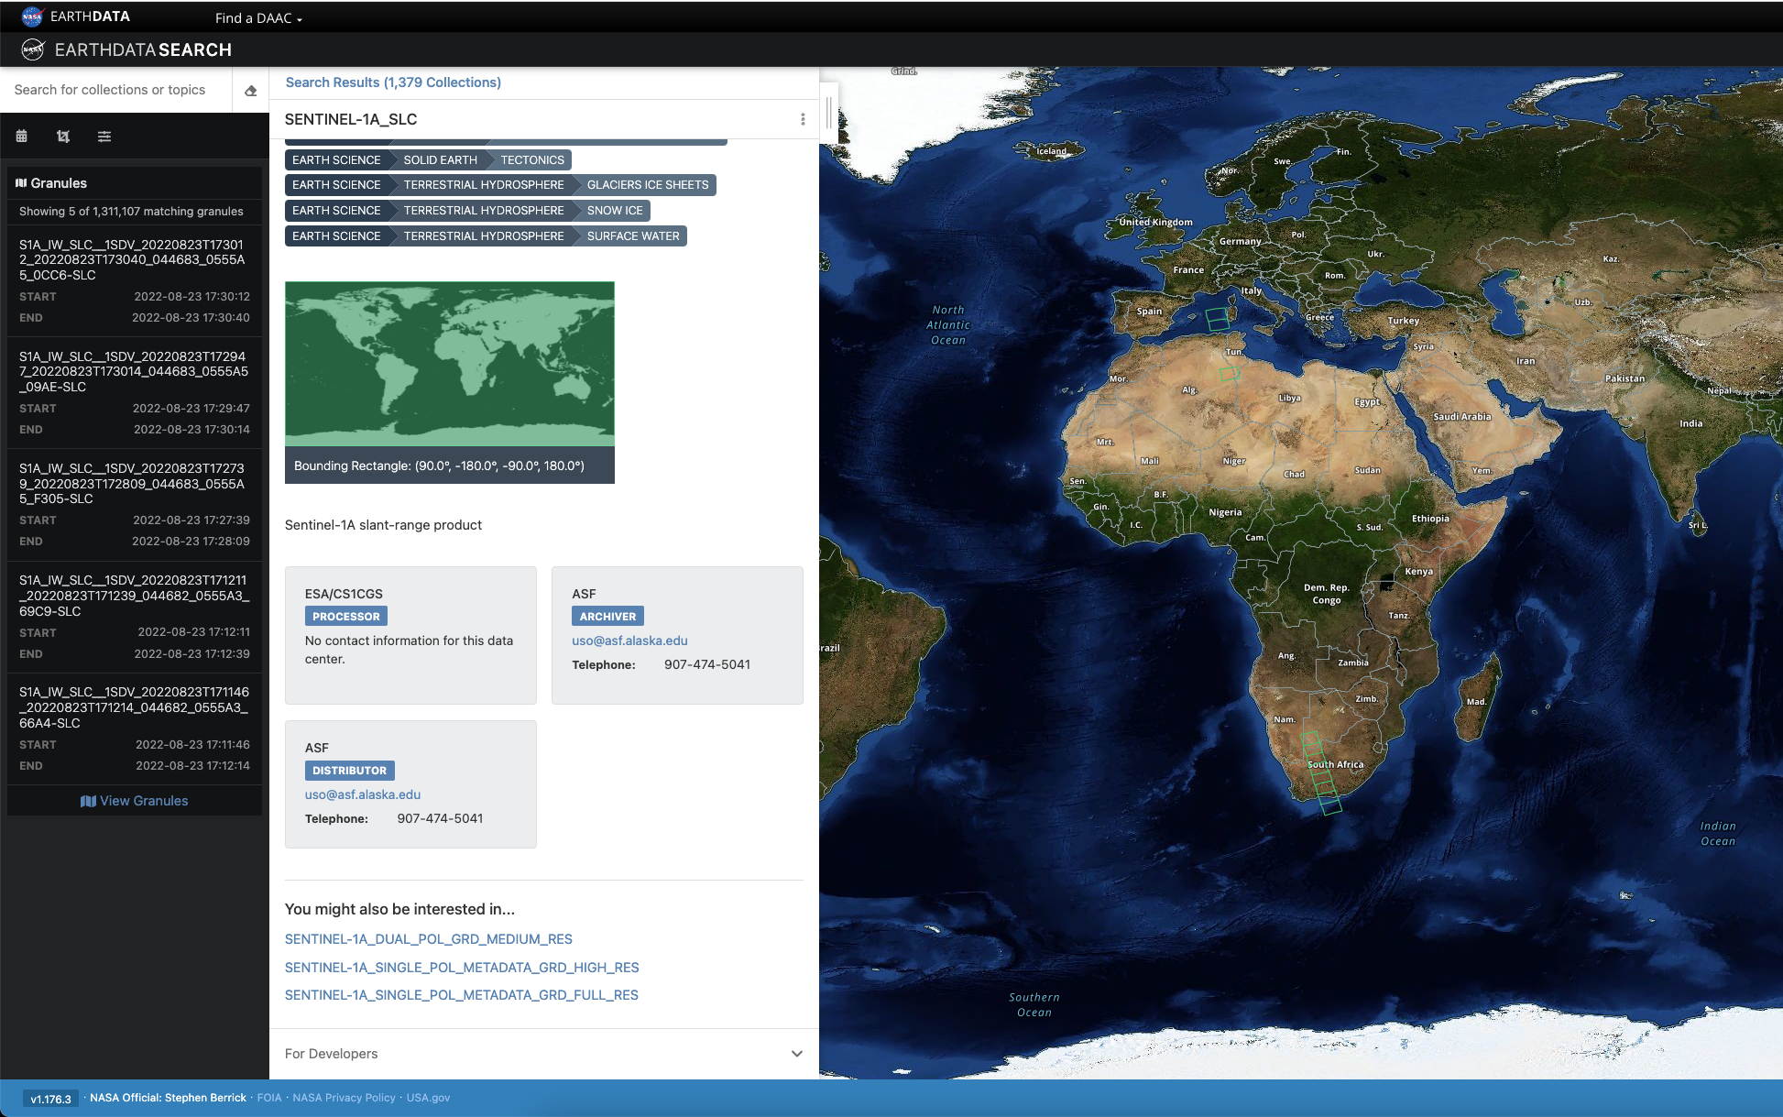
Earthdata Search
EOSDIS are using a graph database to store existing knowledge from collection metadata.
The graph has enabled us to extract new knowledge in the form of collections related by shared resources.
This is the first feature that has been powered by our graph database. More are coming.
Notes:
https://search.earthdata.nasa.gov/search/granules/collection-details?p=C1214470488-ASF&pg[0][v]=f&pg[0][gsk]=-start_date&ff=Available%20from%20AWS%20Cloud&tl=1661284160.224!3!!

Slide 14
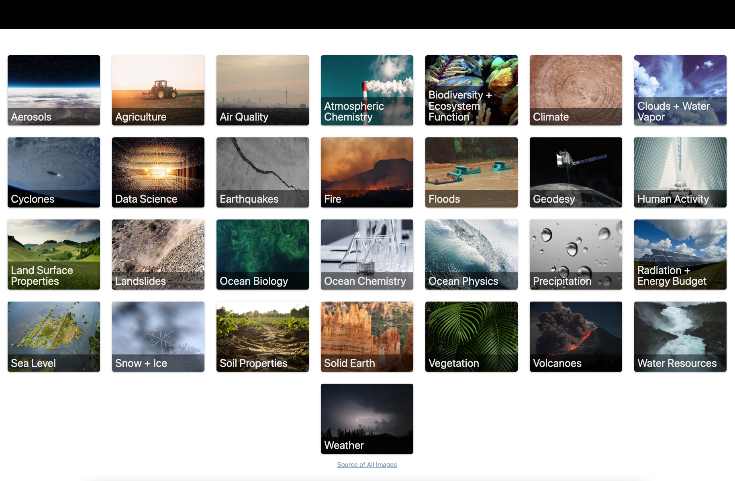
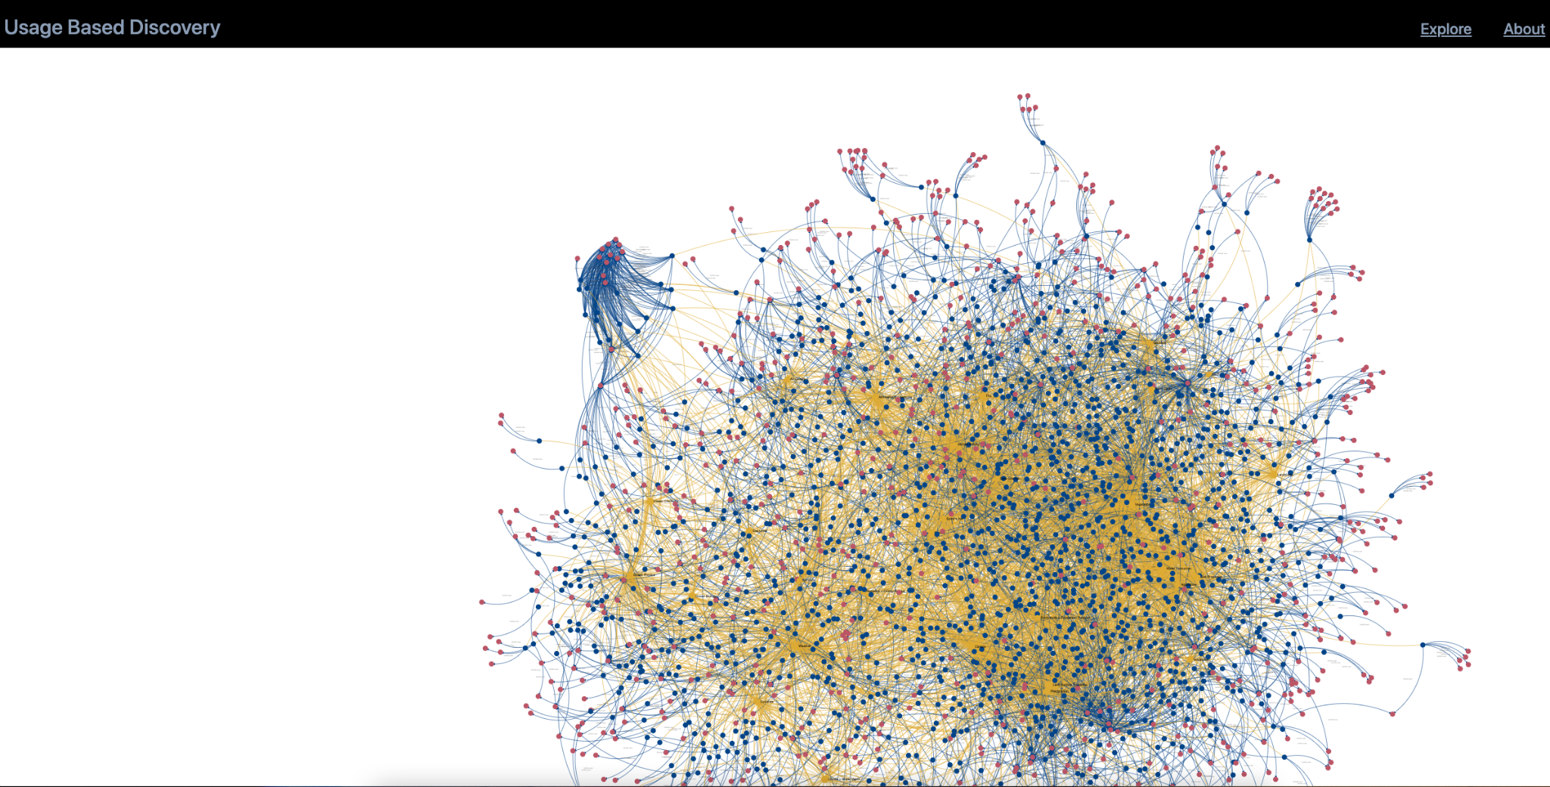
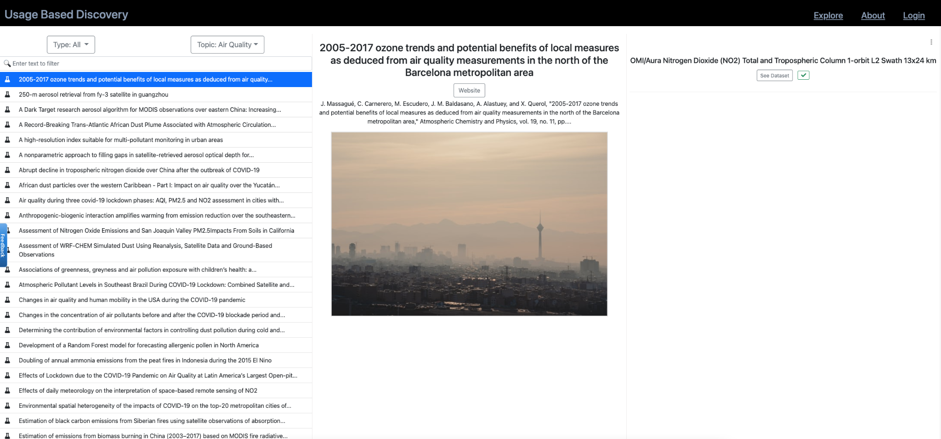
ESIP’s Usage-based discovery
Notes:
ESIP - Earth Science Information Partners
UBD - https://r1z8b20vl9.execute-api.us-west-1.amazonaws.com/

Slide 15
ESDSWG
Fostering communities - Earth Science Data System Working Groups

Slide 16
Machine learning capacity
The Earth Science Data System Working Groups (ESDSWG) is a NASA organization... The chartered role of the ESDSWG focuses on the exploration and development of recommendations derived from pertinent community insights of NASA's heterogeneous and distributed Earth science data systems.
The Machine Learning Capacity Development Working Group aims to develop training methods to improve the ability of domain scientists and/or information learn and apply machine learning techniques.

Slide 17
Activities
Task 1 - Machine Learning on AWS
Task 2 - Survey on Earth AI Applications
Task 3 - Machine Learning Tutorials
Task 4 - Machine Learning on NASA’s Earthdata Cloud

Slide 18
ESIP
Fostering communities - Earth Science Information Partners

Slide 19
Vision: To be a leader in promoting the collection, stewardship and use of Earth science data, information and knowledge that is responsive to societal needs.
Mission: To support the networking and data dissemination needs of our members and the global Earth science data community by linking the functional sectors of observation, research, application, education and use of Earth science.

Slide 20
ML Cluster activities
Sharing experiences and resources on machine learning and its applications in the Earth and space sciences, and developing training materials to share with the broader ESIP Community.

Slide 21
Discovery cluster activities
Exploring usage-based discovery, including relationships between datasets and types of usage, from publications to applications to policy-making.
Usage-based discovery
Federated Knowledge graphs

Slide 22
Discussion

