Slide 1
CEOS COAST:
A CEOS EAIL
Use Case
Paul M. DiGiacomo, NOAA
Agenda ID: 2022.10.06_09.30
WGISS-54
Tokyo, Japan (JAXA)
3-7 October 2022

Slide 2
CEOS Coastal Observations, Applications,
Services, and Tools (CEOS COAST)
What is CEOS COAST?
Coastal Zone (land-sea-people interface) Focused Team
  Leverage global Earth observation data (satellite + in situ) to tackle coastal problems affecting society - Coverage | Frequency | Resolution
  We engage with regional coastal stakeholders in product Co-Design and Co-Development
  EAIL has enabled COAST product developers to readily transfer technology and leverage processing efficiencies
  COAST has trained both the NOAA and ISRO teams in use - we are poised to embrace EAIL more fully

Slide 3







CEOS Coastal Observations, Applications,
Services, and Tools (CEOS COAST)
We are looking for more participants!

Slide 4
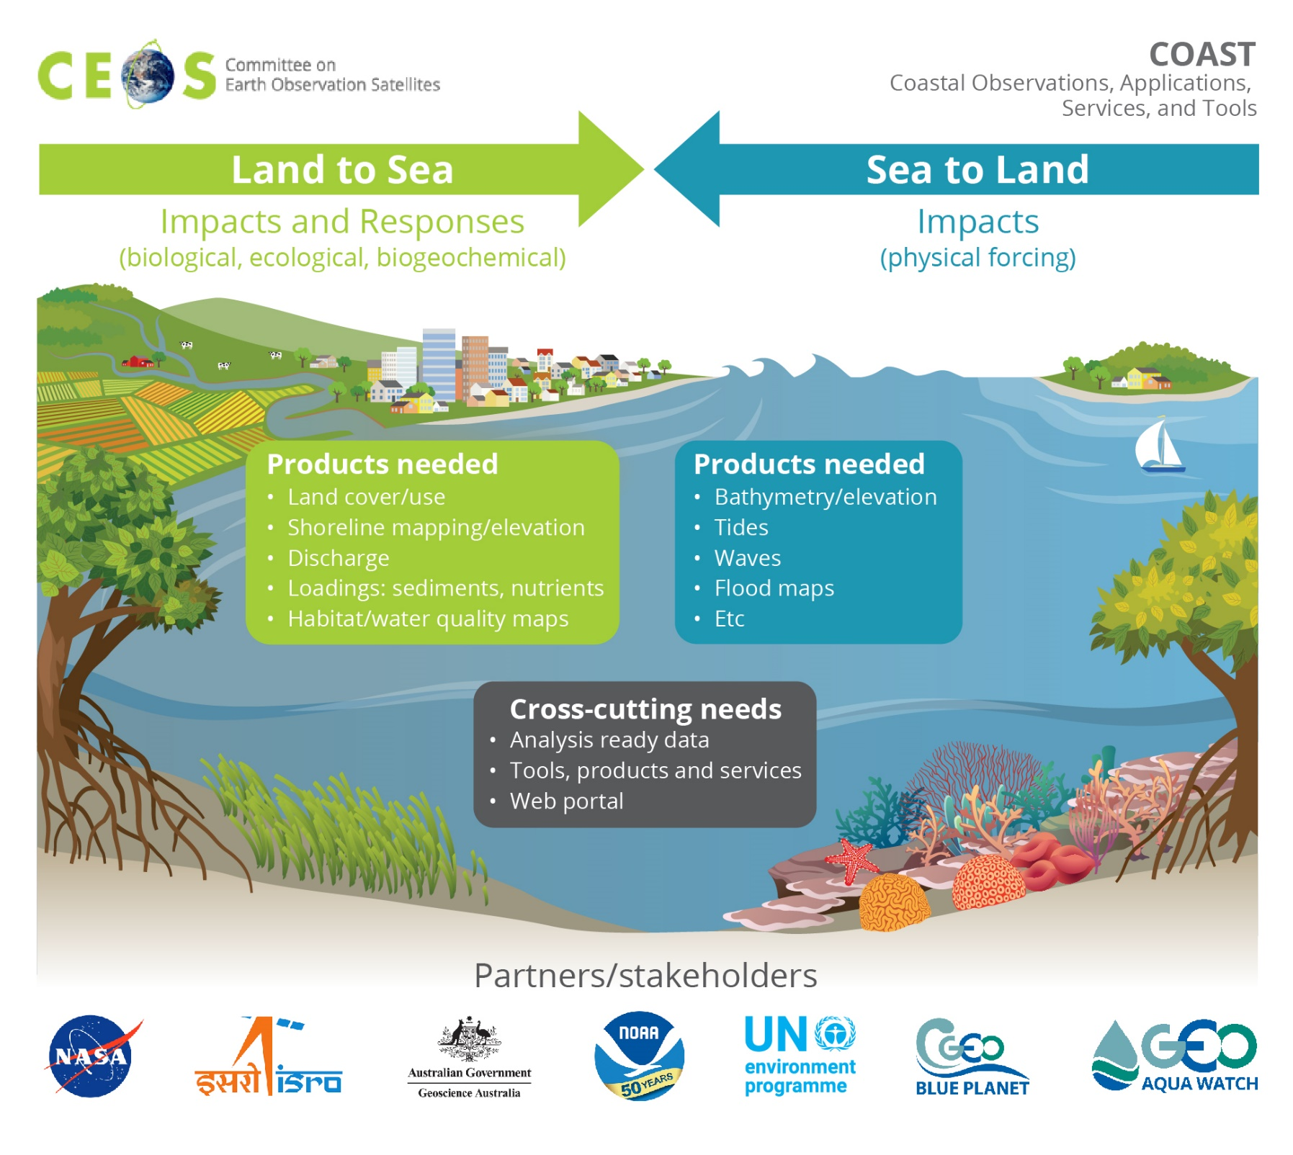
CEOS COAST Phase 2: 2020-2022
Identified 2 Pilot Projects to develop coastal products, services and tools
Themes:
Shoreline mapping
Bathymetry/
Flooding
Turbidity & Sediment Loading
Coastal Eutrophication

Slide 5
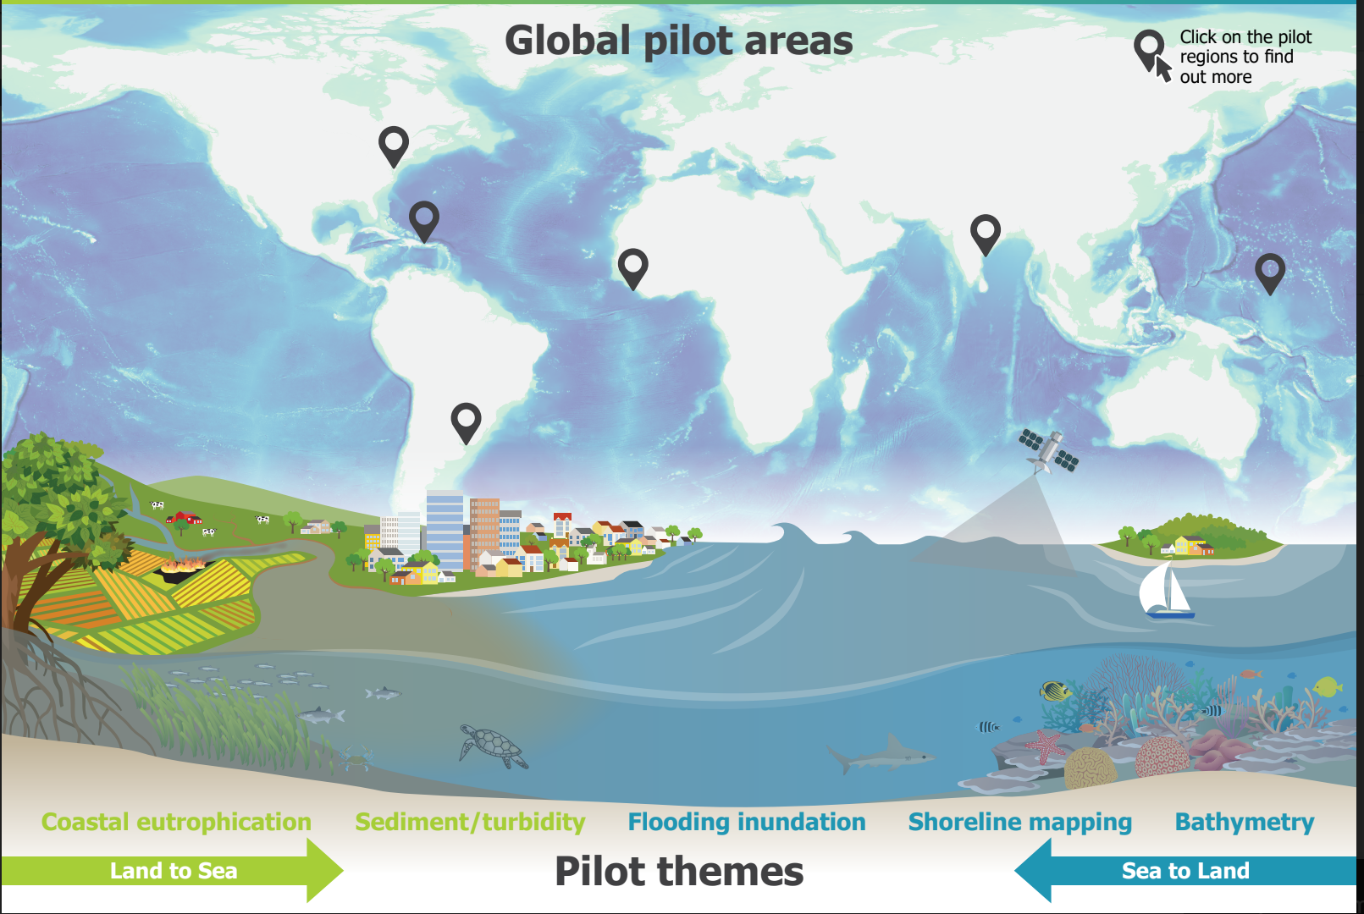
Continental:
Chesapeake Bay
Bay of Bengal
West Coast of Africa
Rio de la Plata
Small Island Nations:
Caribbean & Pacific

Slide 6
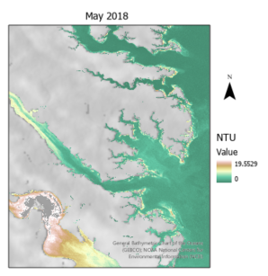
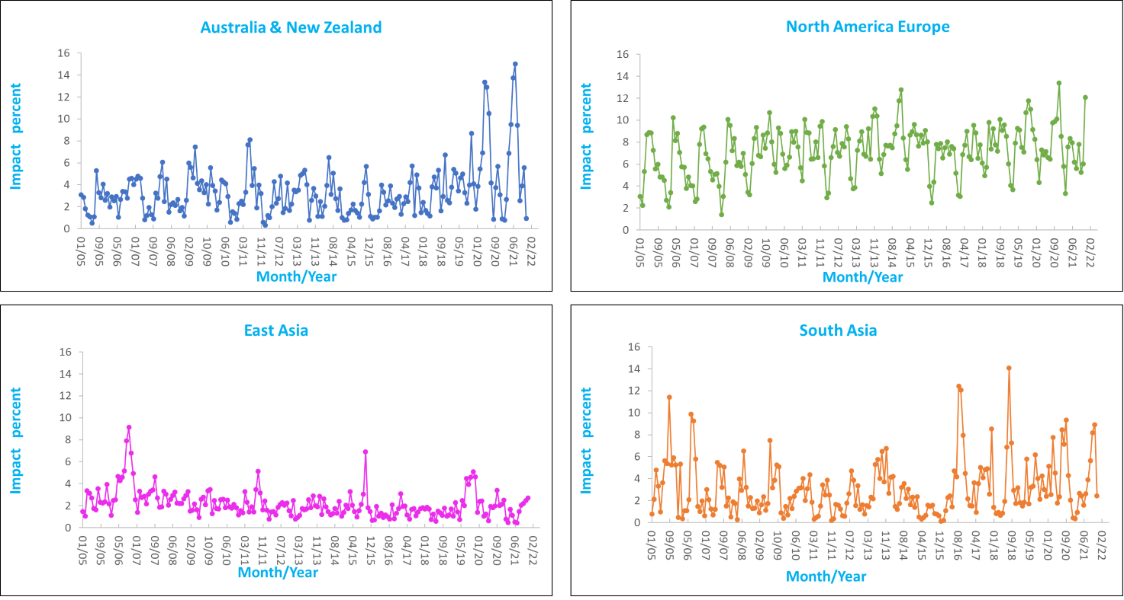
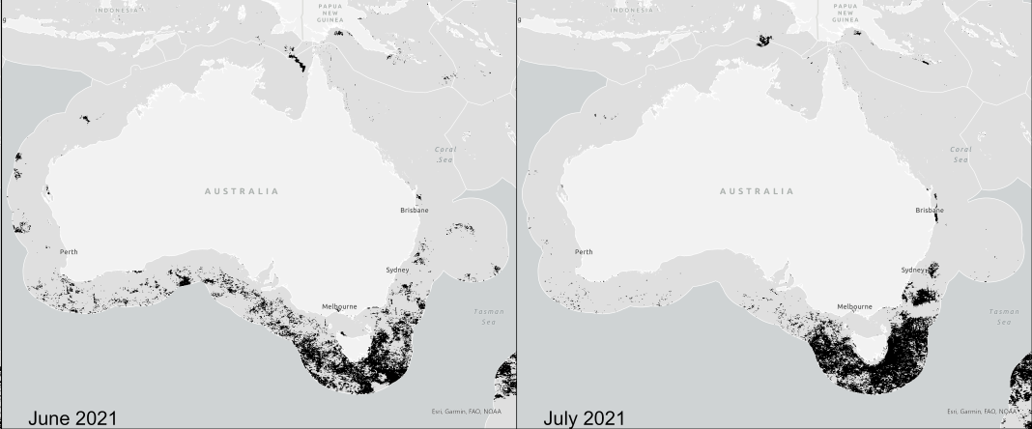
CEOS Coastal Observations, Applications,
Services, and Tools (CEOS COAST)
Regional EEZ Chlorophyll-a Deviation from Baseline (2005 – 2021)
HABITAT
MAPPING
COASTAL
EUTROPHICATION
Distribution of Deviating Pixels in the Australian Region for June/July 2021

Slide 7
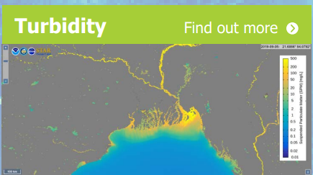
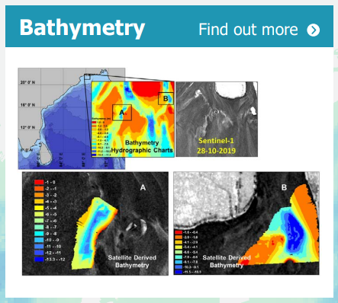
CEOS Coastal Observations, Applications,
Services, and Tools (CEOS COAST)

Slide 8
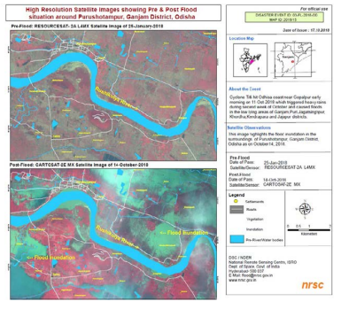
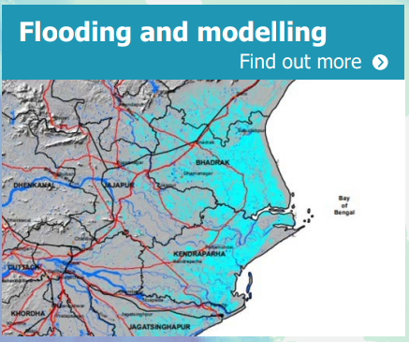
CEOS Coastal Observations, Applications,
Services, and Tools (CEOS COAST)

Slide 9
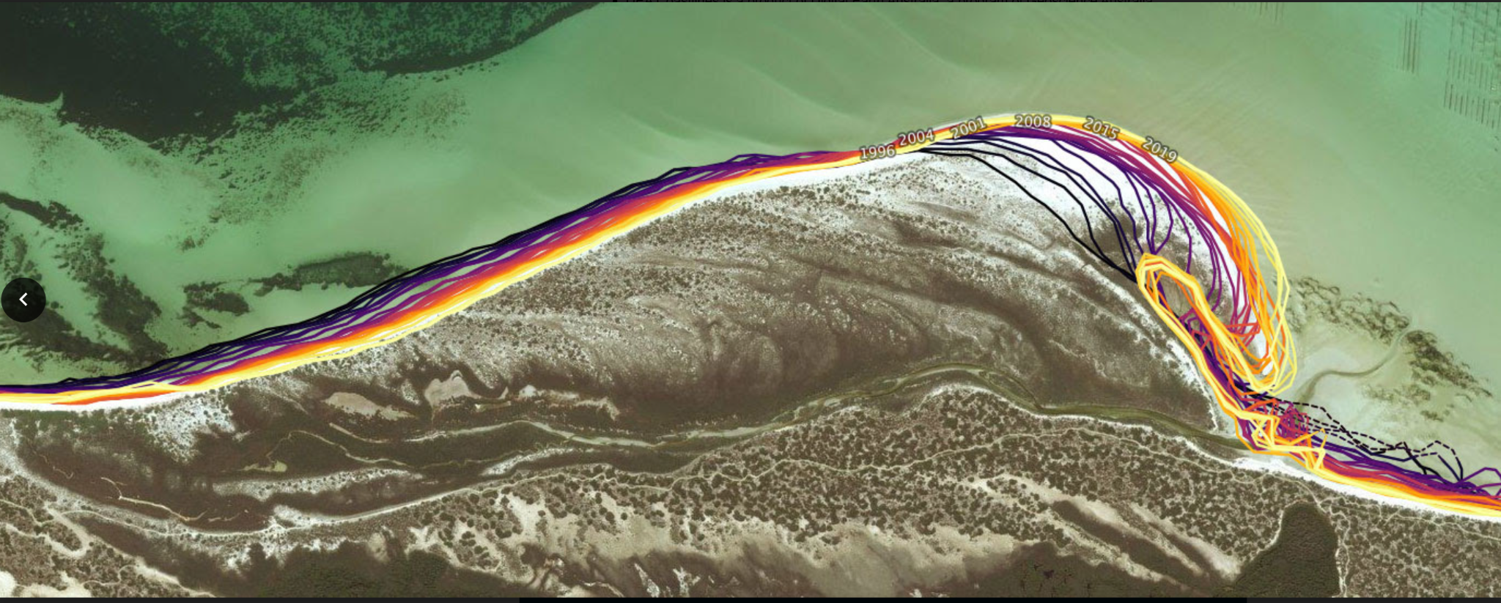
CEOS Coastal Observations, Applications,
Services, and Tools (CEOS COAST)
SHORELINE
MAPPING

Slide 10
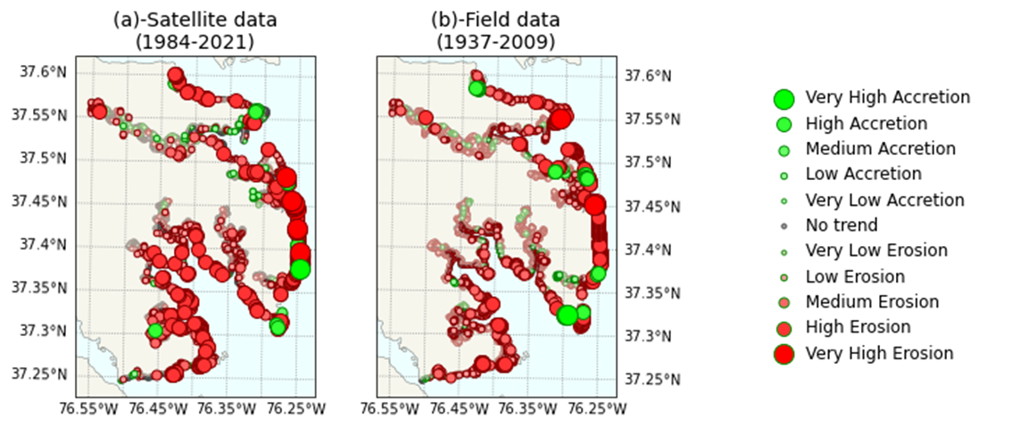
CEOS COAST Shoreline Mapping
Shoreline evolution in the Middle Peninsula area of the Chesapeake Bay assessed from Landsat-5/7/8 and Sentinel-2 imagery (1984-2021) demonstrates:
Reasonable agreement with field assessments (1937-2009) accounted for the differences in the analyzed periods

Slide 11
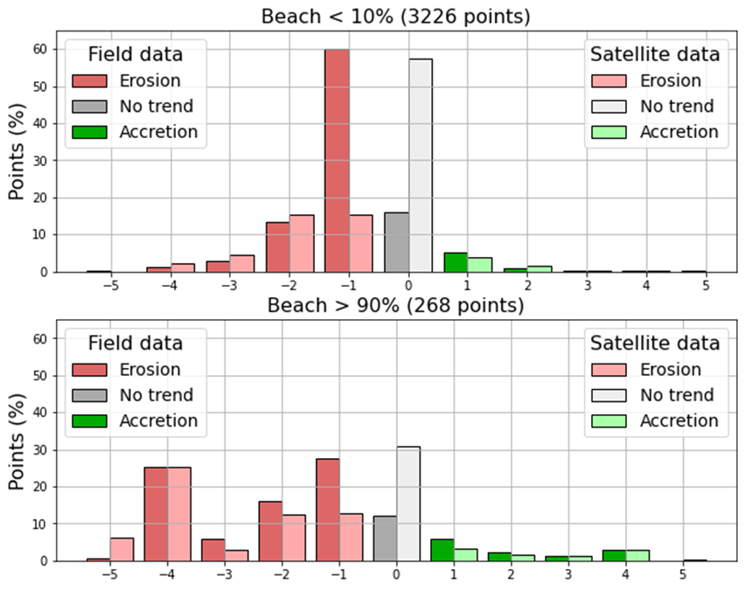
CEOS COAST Shoreline Mapping
Shoreline evolution in the Middle Peninsula area of the Chesapeake Bay assessed from Landsat-5/7/8 and Sentinel-2 imagery (1984-2021) demonstrates:
Intensive shoreline evolution (mostly erosion, sometimes accretion) in the coast segments classified as ‘beaches’
Significant stabilizing effect of shoreline structures like marinas, boathouses, docks, ramps, etc.
Erosion
Accretion

Slide 12
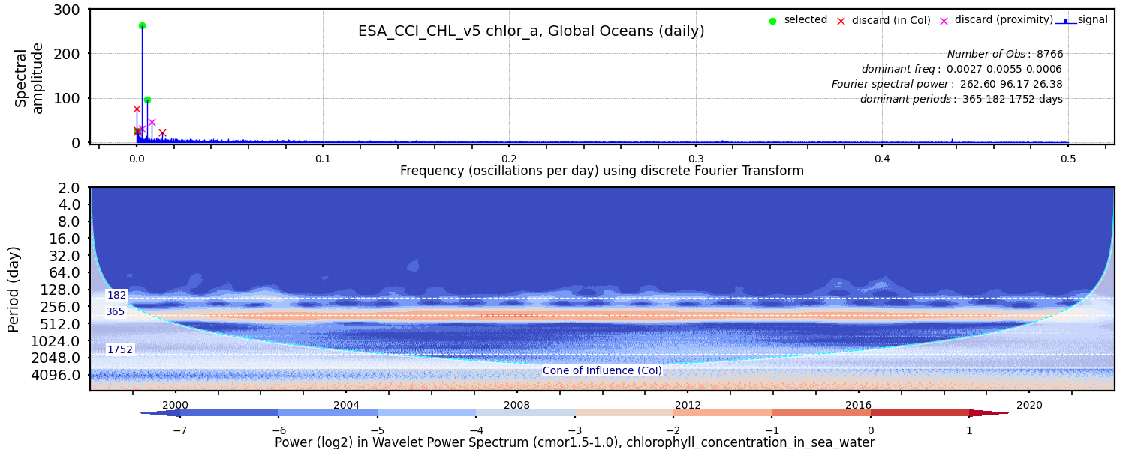
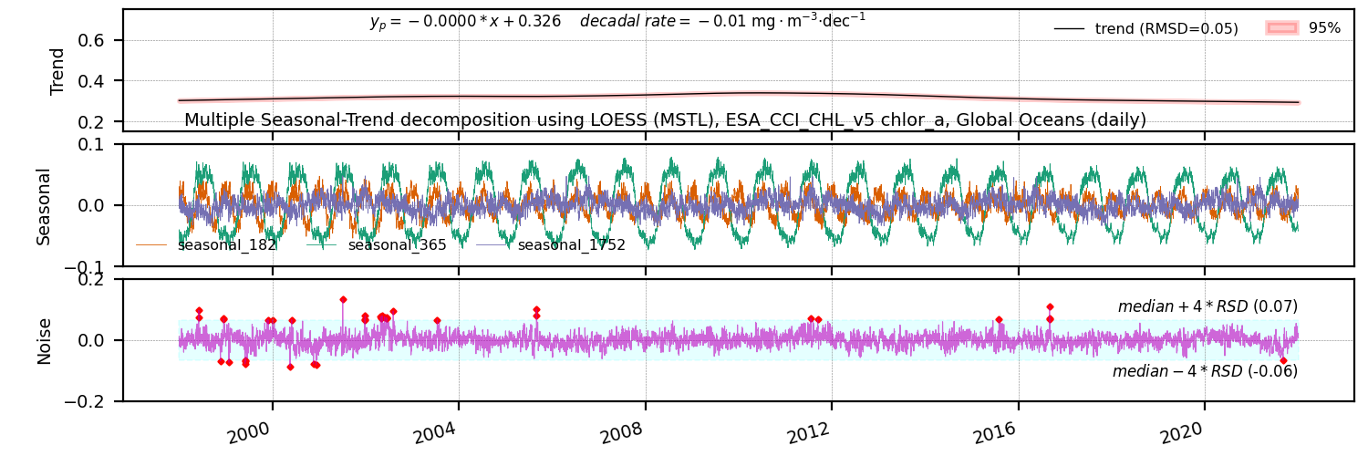
CEOS COAST: Trends in Parameters
Fourier transform and Wavelet analysis to detect periodicities in global CHL-a
- Interactive and tiled maps of “rate of trend” will be available in the AKH.
- Trend in global oceans using multiple seasonal decomposition.
- Analysis will be performed on regional scale too and for multiple ocean parameters (SST, SLA)

Slide 13
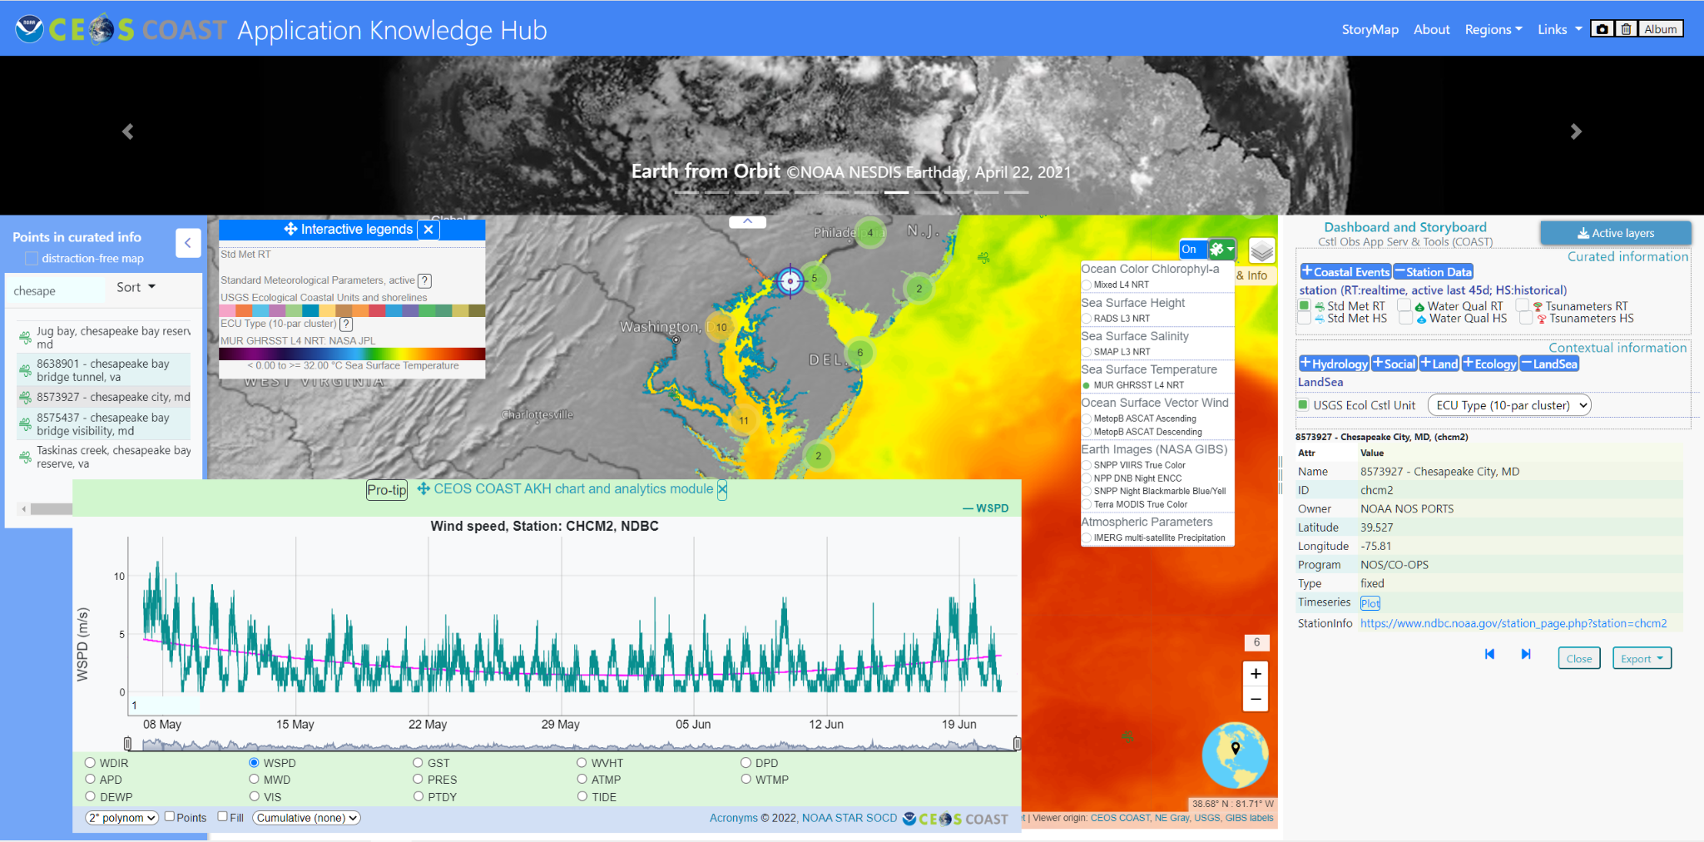
CEOS-COAST Application Knowledge Hub
Access coastal data/info products through a curated Knowledge Hub!

Slide 14
Upcoming Work Plan Activities & Needs
❖Upcoming Product Development Areas:
Blue Carbon (with MBON); Biodiversity (with GEOBON, CEOS TT et al.)
Habitat Mapping/Monitoring (e.g., seagrasses/mangroves, w/GEO Blue Planet)
Beta release and expansion of CEOS COAST Application Knowledge Hub
❖Additional Pilot Regions:
❖ Polar (Arctic focus); Asia
❖Needs:
❖ Ingest and utilize data/products from additional CEOS missions
❖ More emphasis on using the CEOS EAIL which will require further
sustainment and development support to expand capabilities and data offerings
❖Ask: Looking for interested CEOS agencies to provide active leadership and support in these new and expanding areas

Slide 15

Thank you!
CEOS Coastal Observations, Applications,
Services, and Tools (CEOS COAST)
Want to get involved?
Email CEOS-COAST Co-Chair:
Paul.DiGiacomo@noaa.gov

