Slide 1
AVHRR DMSMM Use Case
Paolo Castracane
Rhea Group for ESA
Agenda Item # 2022.10.05_15.20
WGCV-WGISS Joint Meeting, Tokyo, Japan
5th October 2022

Slide 2
Quality Assessment Framework
Mission success is dependent upon quality assurance. Data Quality adds significantly to the values of datasets.
Because the commercial satellite sector grow, space agencies identified the need for systematic evaluation of commercial satellite data to understand how it may be integrated into their programmes.
NASA launched the CSDA Project and ESA the EDAP project to meet this need.
NASA and ESA are working toward a comprehensive ESA-NASA Evaluation Framework that will include the utility of these data for Earth science research and applications
ESA Earthnet
NASA Commercial Smallsat Data Acquisition (CSDA) Program

Slide 3
EDAP Best Practice Guidelines
EDAP: The ESA Earthnet Data Assessment Pilot (EDAP) project is intended to perform quality assessment for various EO missions.
EDAP aims to assess satellite mission data quality in the QA4EO, Earthnet and New Space (Third Party Missions – TPM) context.
EDAP approach aims to define a mission quality Cal/Val Maturity Matrix (EDAP Best Practice Guidelines Activity).
Cal/Val Maturity Matrix
Assessment results are provided in a Quality Assessment Report (QA Report) which is summarised in a Cal/Val Maturity Matrix
Approach to Grading
The assessment framework is aimed at verifying claimed mission performance and, where applicable, the mission follows community best practice to an extent that is “fit for purpose”. The particular grading criteria for each category are determined based on a logical interpretation of this principle.

Slide 4
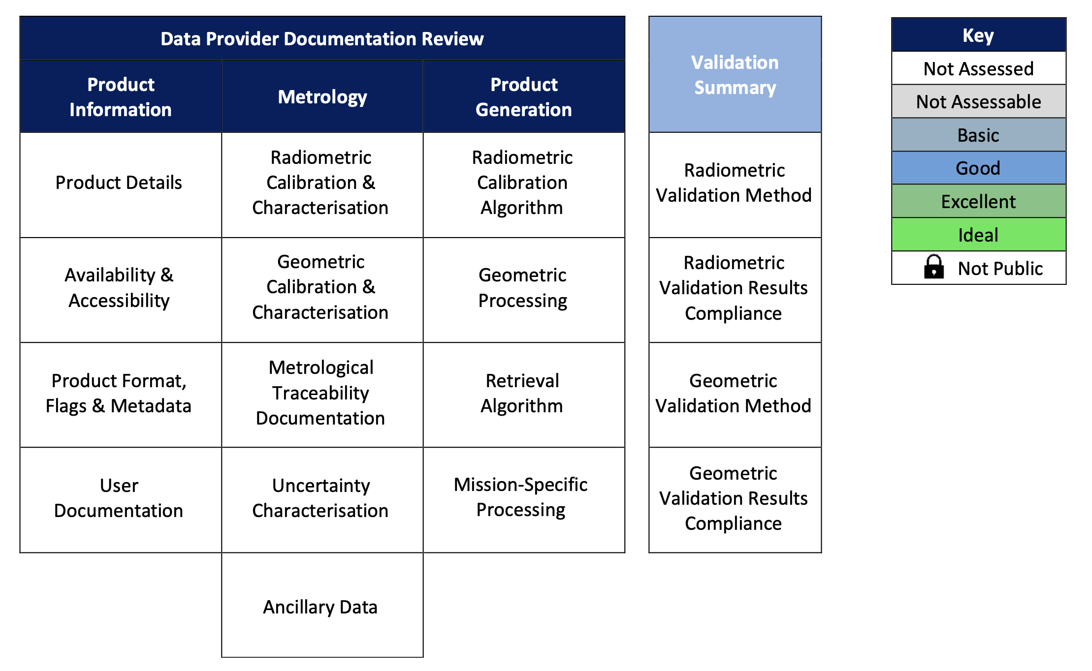
Cal/Val Maturity Matrix
Data Provider Documentation Review
Review of mission/data quality as evidenced
by its documentation
Product Information
Review of descriptive information accompanying products
Metrology
Review of evidences for metrology characterisation
Validation Summary
Summarises validation activity undertaken by an independent assessor
Product Generation
Review of “fitness for purpose” of product generation

Slide 5
Use case: AVHRR L1B Dataset
European Space Agency, 2020, AVHRR Level 1B European Data Set. Version 1.0
DATA SET SPECIFICATIONS
Digital Object Identifier (DOI):
European Space Agency, 2020, AVHRR Level 1B European Data Set. Version 1.0. https://doi.org/10.5270/AVH-f1i8784
PROCESSING LEVEL: level 1b
APPLICABLE TERMS & CONDITIONS
Utilisation of this data is subject to the Terms and Conditions for ESA's Third Party Missions scheme
Slide 5

Slide 6
Use case: AVHRR L1B Dataset
Spatial coverage: European Dataset: 90 N, 35 S, -30 W, 70 E / Out of Europe (1KM-project): 90 N, 90 S, -180 W, 180 E
Temporal coverage: European Dataset: 1981-01-01 - 2020-12-31 / Out of Europe (1KM-project): 1992-01-01 - 1999-12-31
Date of launch:2018-10-19, 1979-07-27
Operators:NOAA, EUMETSAT
Mission status:historicalArchive
Orbit height:804 - 870 km
Orbit type:Sun-synchronous
Swath width:3000 km
Current Processor Version:1.0
Resolution:Low Resolution - LR (500 - 1200 m)
Wavelengths:VIS (0.40 - 0.75 µm), NIR (0.75 - 1.30 µm), SWIR (1.3 - 3.0 µm), MWIR (3.0 - 6.0 µm), TIR (6.0 - 15.0 µnm)
Product types:AVH_L1B_1P

Slide 7
Use Case: AVHRR L1B Dataset
References:
EDAP Best Practice Guidelines website https://earth.esa.int/eogateway/activities/edap/edap-best-practice-guidelines
EDAP Mission Quality Assessment Guidelines: Mission Quality Assessment Guidelines v2.1
EDAP Optical Mission Quality Assessment Guidelines: Optical Mission Quality Assessment Guidelines v2.1
AVHRR Level 1B Local Area Coverage Imagery: AVHRR L1B LAC
AVHRR handbook PDF
Bhatt, R., Doelling, D. R., Scarino, B. R., Gopalan, A., Haney, C. O., Minnis, P., & Bedka, K. M. (2016). A Consistent AVHRR Visible Calibration Record Based on Multiple Methods Applicable for the NOAA Degrading Orbits. Part I: Methodology, Journal of Atmospheric and Oceanic Technology, 33(11), 2499-2515. Retrieved Sep 5, 2022, from https://journals.ametsoc.org/view/journals/atot/33/11/jtech-d-16-0044_1.xml
Doelling, D. R., Bhatt, R., Scarino, B. R., Gopalan, A., Haney, C. O., Minnis, P., & Bedka, K. M. (2016). A Consistent AVHRR Visible Calibration Record Based on Multiple Methods Applicable for the NOAA Degrading Orbits. Part II: Validation, Journal of Atmospheric and Oceanic Technology, 33(11), 2517-2534. Retrieved Sep 5, 2022, from https://journals.ametsoc.org/view/journals/atot/33/11/jtech-d-16-0042_1.xml
Andres Santamaria-Artigas, Eric F. Vermote, Belen Franch, Jean-Claude Roger, Sergii Skakun. Evaluation of the AVHRR surface reflectance long term data record between 1984 and 2011, International Journal of Applied Earth Observation and Geoinformation,Volume 98, 2021,102317,ISSN 1569-8432, https://doi.org/10.1016/j.jag.2021.102317 (https://www.sciencedirect.com/science/article/pii/S0303243421000246)
Michael Schmidt, Edward A King & Tim R McVicar (2008). Assessing the geometric accuracy of AVHRR data processed with a state vector based navigation system, Canadian Journal of Remote Sensing, 34:5, 496-508, DOI: 10.5589/m08-064
Cao, C., Xiong, X., Wu, A., and Wu, X. (2008), Assessing the consistency of AVHRR and MODIS L1B reflectance for generating Fundamental Climate Data Records, J. Geophys. Res., 113, D09114, doi:10.1029/2007JD009363.
AVHRR L1 Product Generation Specification. EUMETSAT. EUM.EPS.SYS.SPE.990004. 18 December 2013. https://www.eumetsat.int/media/38128
AVHRR Level 1b Product Guide. EUMETSAT. EUM/OPS-EPS/MAN/04/0029. 21 January 2011. https://www-cdn.eumetsat.int/files/2020-04/pdf_avhrr_l1b_product_guide.pdf
Mittaz, J.; Taylor, M.; Desmons, M.; Mollard, J.; Merchant, C.J. (2019): FIDUCEO: Fundamental Climate Data Record of recalibrated brightness temperatures for the Advanced Very-High-Resolution Radiometer (AVHRR) with metrologically-traceable uncertainty estimates, 1998 - 2016, v1.0. Centre for Environmental Data Analysis, date of citation. https://catalogue.ceda.ac.uk/uuid/67b206b17365444b8243182f04c8ba44
Taylor,M; Mittaz, J.; Desmons,M.; Woolliams,E. D2.2 (AVHRR): Report on the AVHRR FCDR uncertainty.7th Aug.2019 v1.1a. FIDUCEO.
McKernan, Eamonn & Montagner, Francois & Klaes, Dieter & Schluessel, Peter & Buhler, Yves. (2005). Calibration and Validation of Metop/ATOVS and AVHRR products.
Liping Di and Donald C. Rundquist. A One-Step Algorithm for Correction and Calibratioon of AVHRR Level lb Data. PE&R, 1994

Slide 8
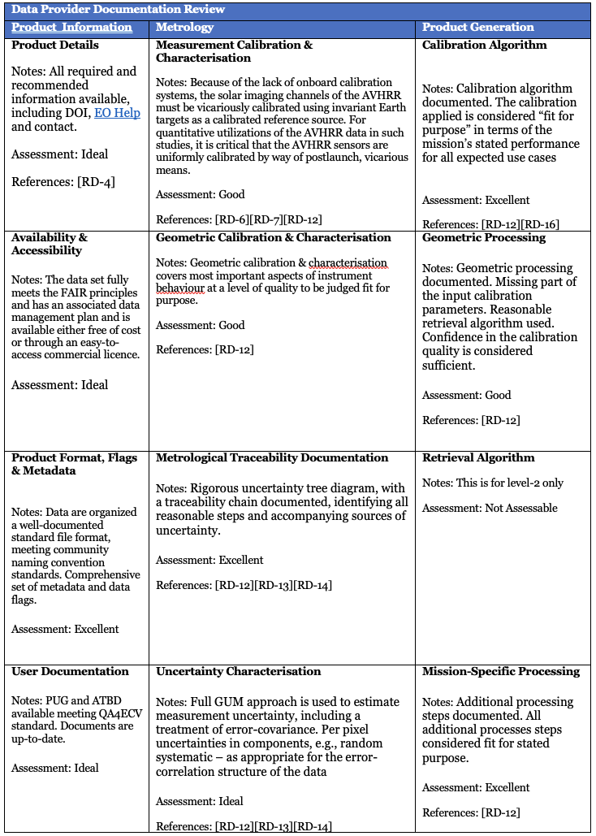
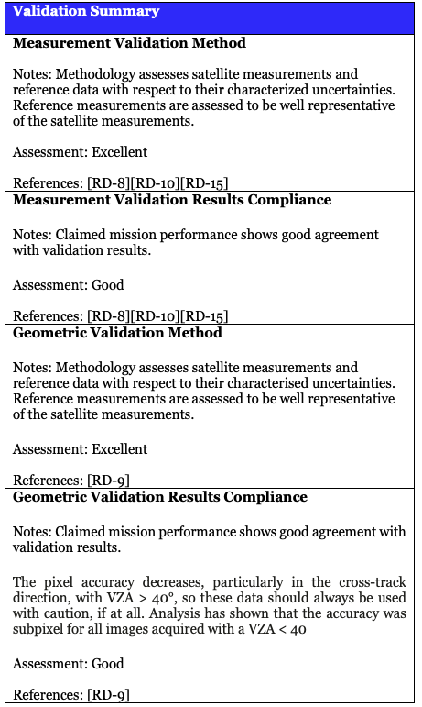
AVHRR L1B Dataset - Cal/Val Maturity Matrix - in progress
Executive Summary
This is a preliminary analysis Regarding the AVHRR L1B LAC (Local Coverage Imagery) to be confirmed by a further assessment by AVHRR sensor experts.
With nearly 4 decades of continuous and global measurements, AVHRR data represent the backbone of EO optical data. With this important inheritance it appears difficult to evaluate these historical data with modern methods.
Neverthless, we can assert that the AVHRR level 1B files provided as EO-SIP are a valuable source to generate long time series of many different Essential Climate Variables (ECVs) but require a careful and precise pre-processing. This includes the calibration of channel 1, 2 and 3A, which have no on-board calibration source but also the proper calibration of the thermal channels 3B, 4 and 5. Furthermore, some effort is needed for precise geocoding including orthorectification of the AVHRR data to guarantee a geocoding accuracy of better than 1/3 of pixel as required by GCOS. After these steps, the data can be used to retrieve snow cover extent, albedo, fire activity, aerosol optical depth, vegetation dynamics, lake surface water temperature and many more.
A number of papers are related to Cal/Val activities, with several methods and a good compliance with the Claimed mission performance.
Thanks to the FIDUCEO project a lot of information have been collected in terms of metrological treaceability and Uncertainty Characterization with the aim to exploit the data as FCDRs (Fiducial Climate Data Records).
Slide 8

Slide 9
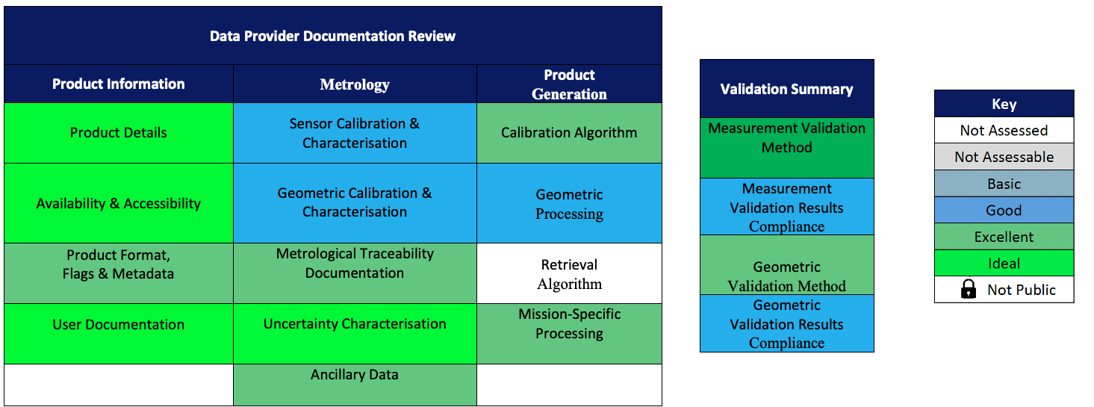
AVHRR L1B Dataset - Cal/Val Maturity Matrix in progress to be evaluated by experts
Cal/Val Maturity Matrix Summary for AVHRR L1B Dataset

Slide 10
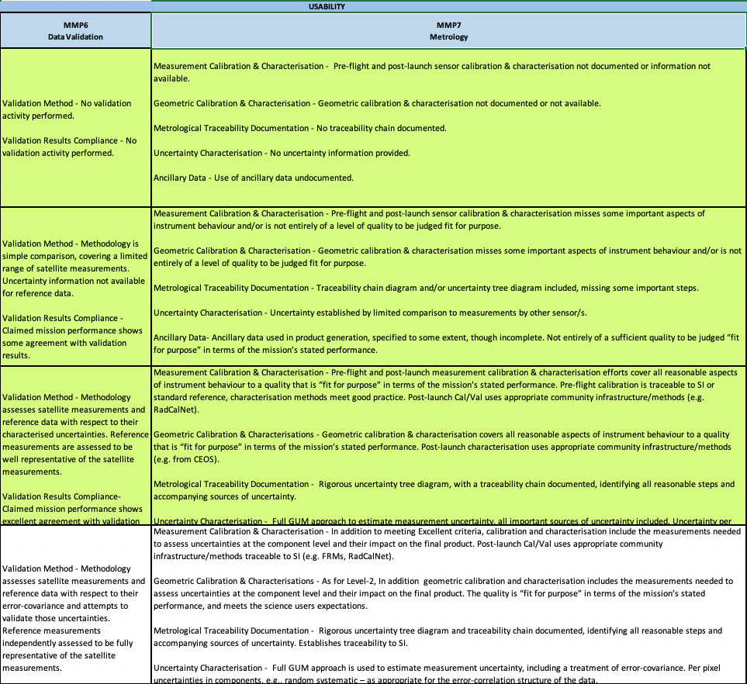
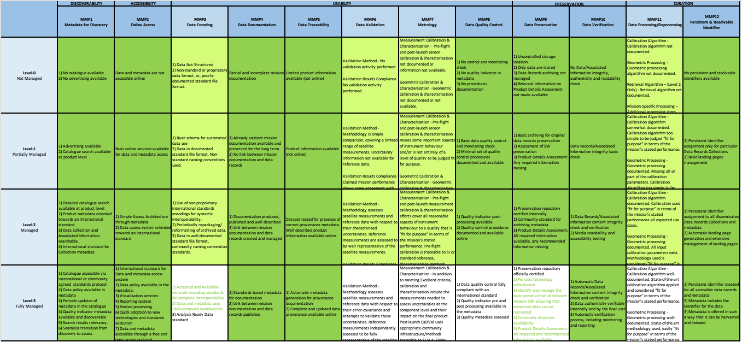
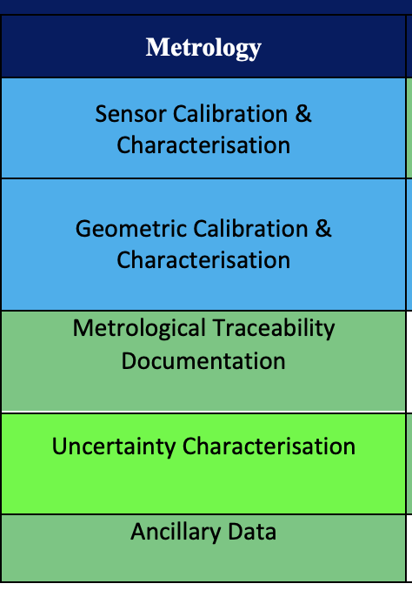
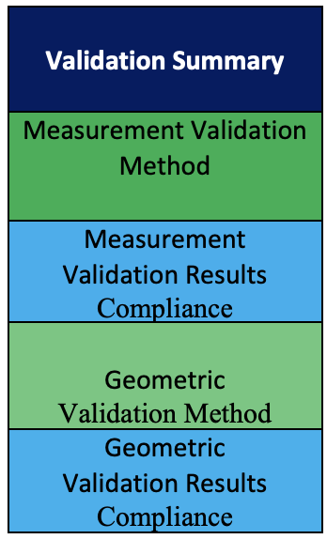
CEOS WGISS Data Management & Stewardship Maturity Matrix for the AVHRR L1B Dataset

Slide 11
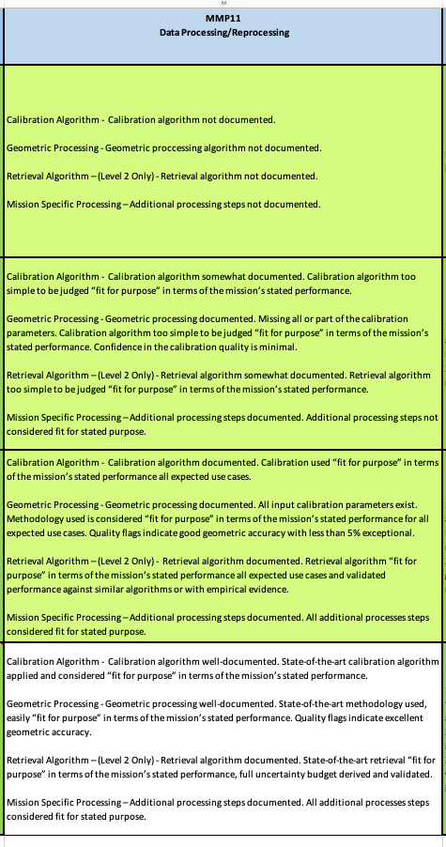
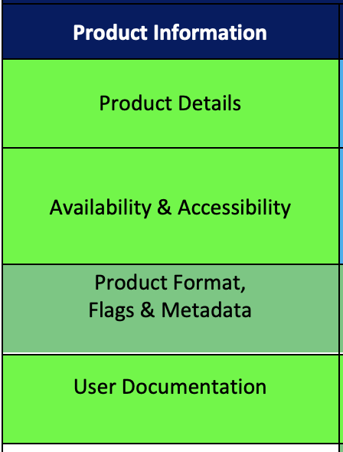
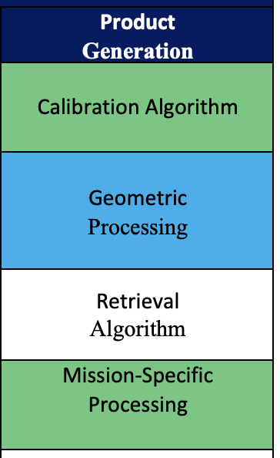
CEOS WGISS Data Management & Stewardship Maturity Matrix for the AVHRR L1B Dataset

Slide 12
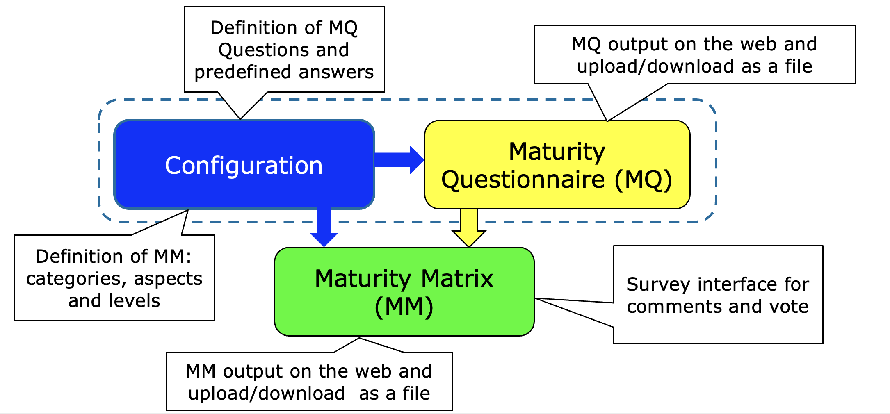
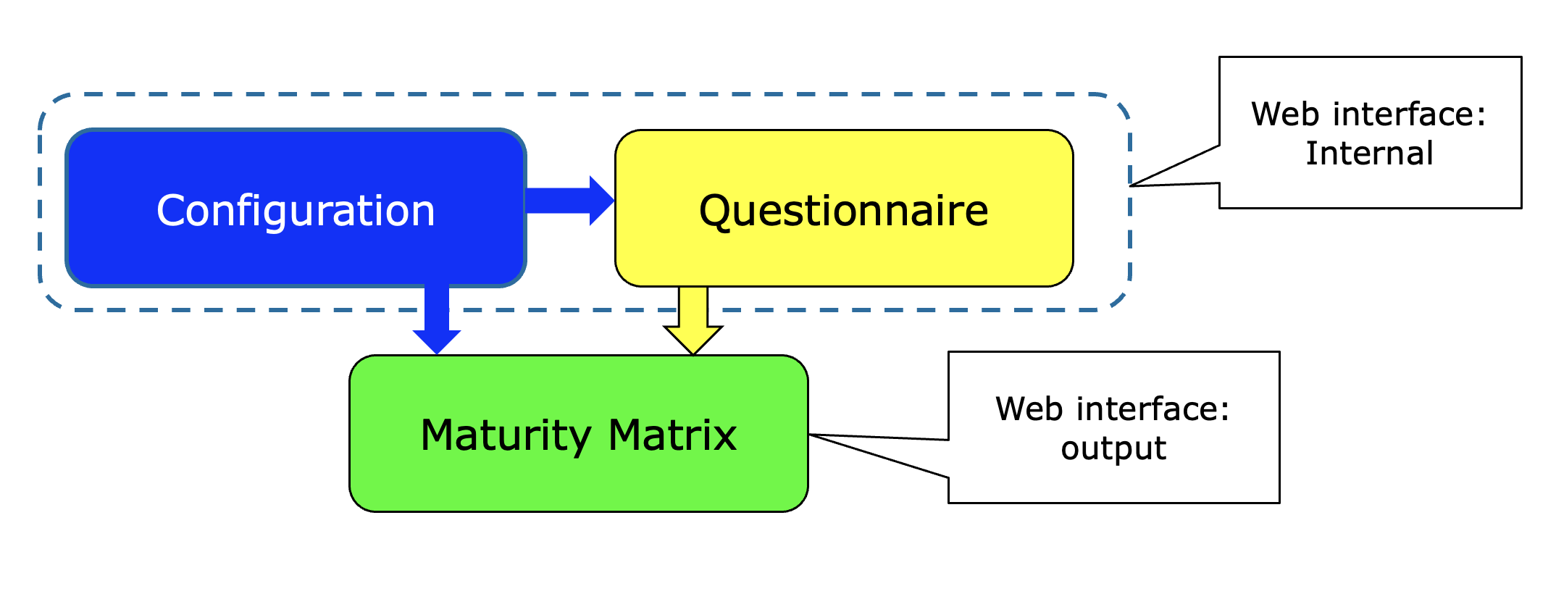
Maturity Matrix tool: Logical Overview

Slide 13
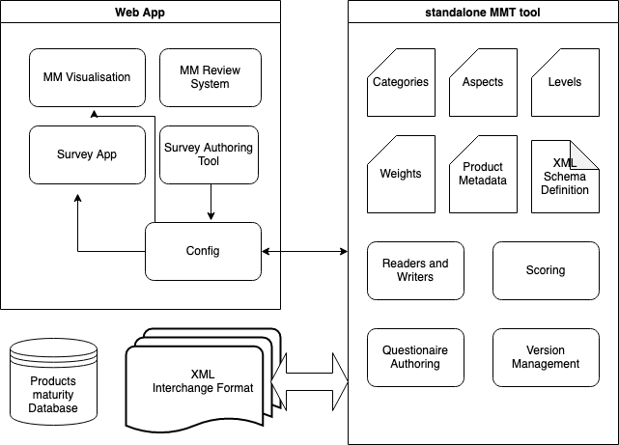
MMT Proposed Overview Architecture
Slides kindly provided by Jarek Dobrzanski and Fergal Keane (Skytek, Ireland https://skytek.com/)
Separatation of Web App and python cli tool
Cli tool encapsulates all writable and readable entities of MMT lifecycle
Any interactions with XML format is via the cli tool
Web App handles the authoring and publishing of the surveys but the questionaires and results are saved into XML file
One XML file per product
Initially a single database of created XML files representing a single source of truth on MMT status for various products and parameters

Slide 14
MMT Solution
Slides kindly provided by Jarek Dobrzanski and Fergal Keane (Skytek, Ireland https://skytek.com/)
Create a formal standard for maturity Information exchange (XML, schema)
Provide tools to read, write and author the maturity information
Make the standard universal (Satellite products, Cal/Val data etc)
Provide web platform and collaboration environment for authoring, browsing and reviewing product maturity information

Slide 15
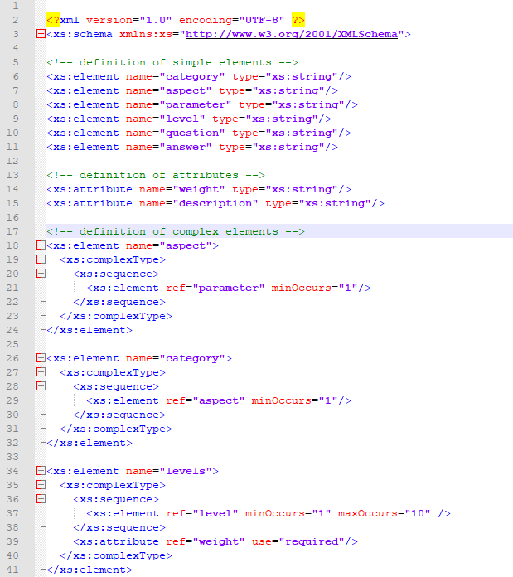
MMT Configuration
Slides kindly provided by Jarek Dobrzanski and Fergal Keane (Skytek, Ireland https://skytek.com/)
XML Schema
The XSD schema defines the Product Maturity information
The schema is versioned
Can be using for validating the XML files describing product maturity

Slide 16
MMT development approach
Slides kindly provided by Jarek Dobrzanski and Fergal Keane (Skytek, Ireland https://skytek.com/)
Separate code repositories for Web App and the CLI tool (both are considered independent software projects)
The CLI tool is a python dependency for the Web App
The CLI can be used without Web App to read, modify, version and save XML files
The versioning approach in the light of potentially multiple instances of CLI tool being used and a database representing the single source of truth about the state of MMT for any product/parameter – TBA
A potential solution to the above – offline and online mode
Utilizing existing GIT platforms (github, butbucket) for XML versioning

Slide 17
MMT Current Status
Slides kindly provided by Jarek Dobrzanski and Fergal Keane (Skytek, Ireland https://skytek.com/)
Projects set up in JIRA and Bitbucket
CD/CI pipelines setup for development and testing
Deployment pipelines for the Web App setup for AWS (terraform)
Development of the CLI tool in progress (python)
UI/UX design for the Web App in progress

Slide 18
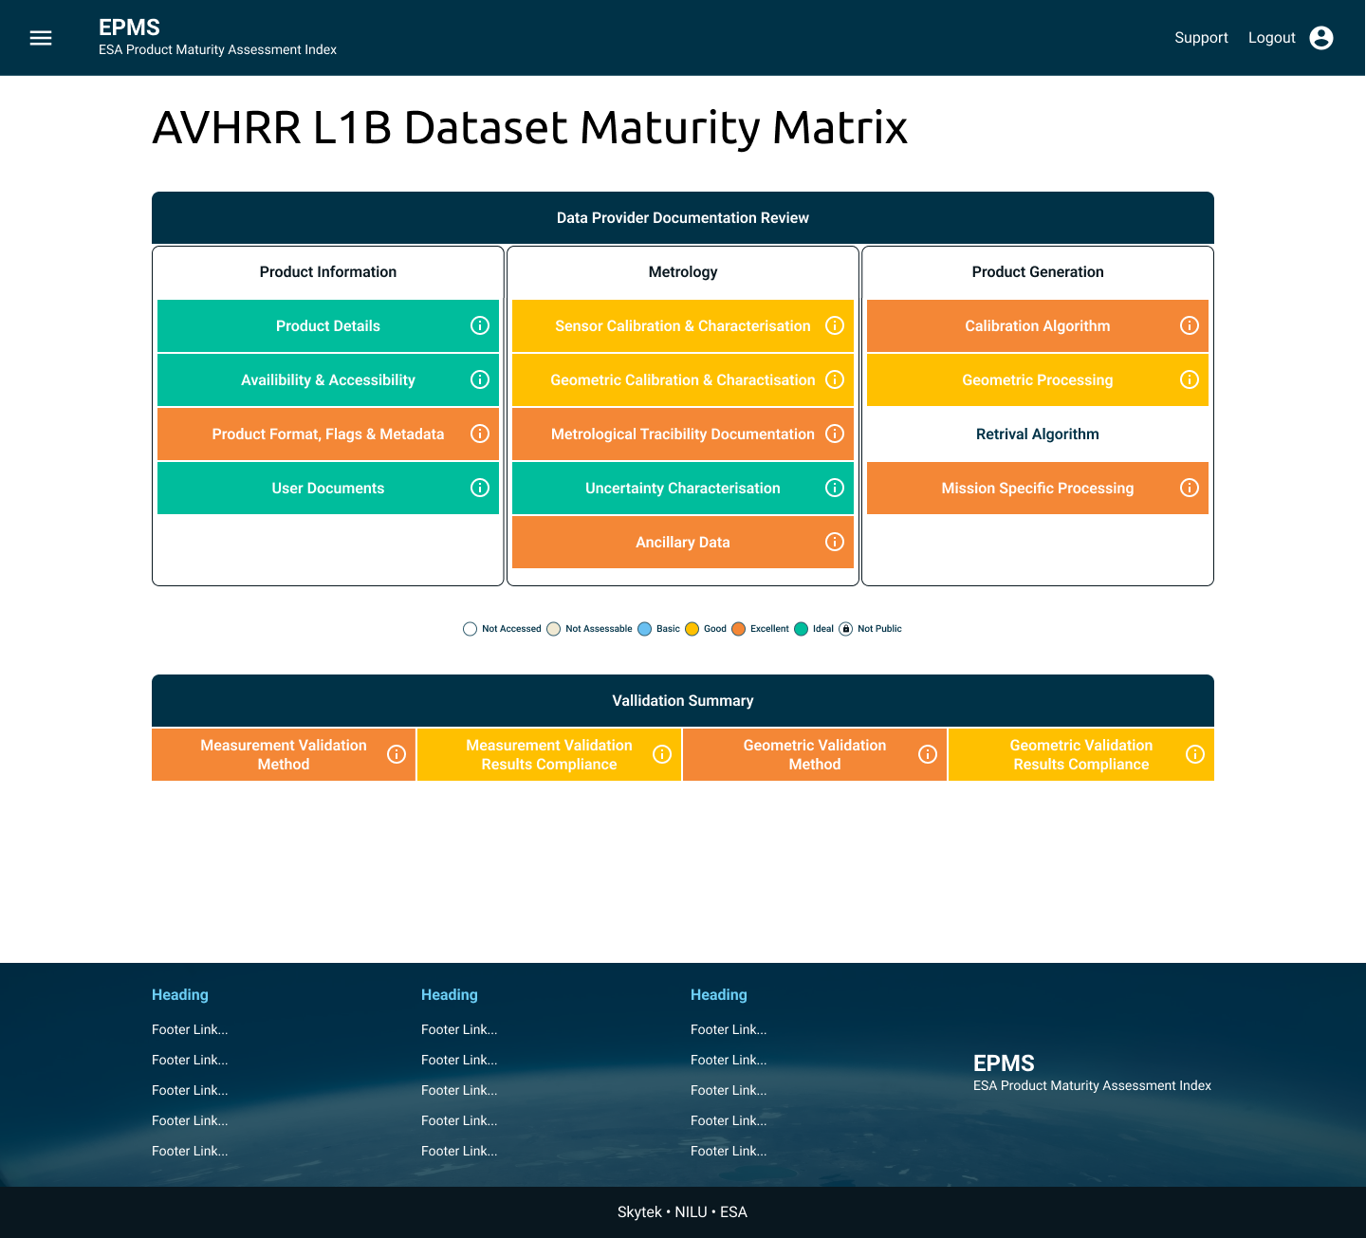
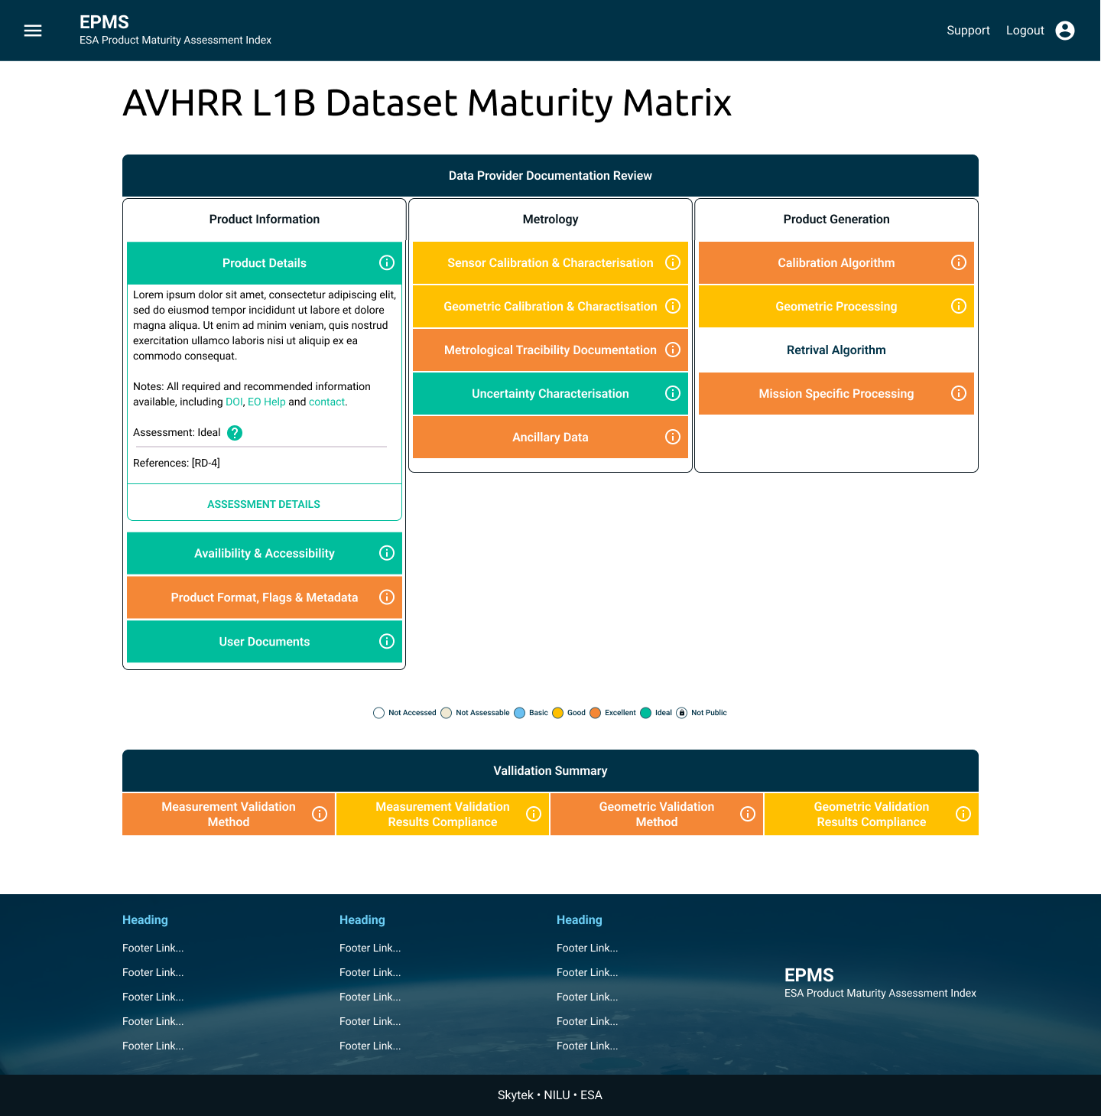
MMT – UI/UX
Slides kindly provided by Jarek Dobrzanski
and Fergal Keane (Skytek, Ireland https://skytek.com/)
Product Maturity Matrix Page
detail info

Slide 19
Thanks and Discussion
ありがとうございました

