Slide 1
ESA eoPortal
& CEOS MIM Database
M. Steventon, G. Dyke
WGISS-54
Tokyo, Japan (JAXA)
3-7 October 2022

Slide 2
Overview
ESA EO Portal
Overview
Recent revamp – priorities and changes
Future plans
CEOS Missions, Instruments, Measurements (MIM) (& Datasets) Database
Overview
Latest updates: Quarterly reports, datasets, sensor response curves, gap analysis tools, etc.
API development
Discussion
Synergies and linkages – incl. WGISS systems?
Q&A

Slide 3
ESA Earth Observation Portal (eoPortal)

Slide 4
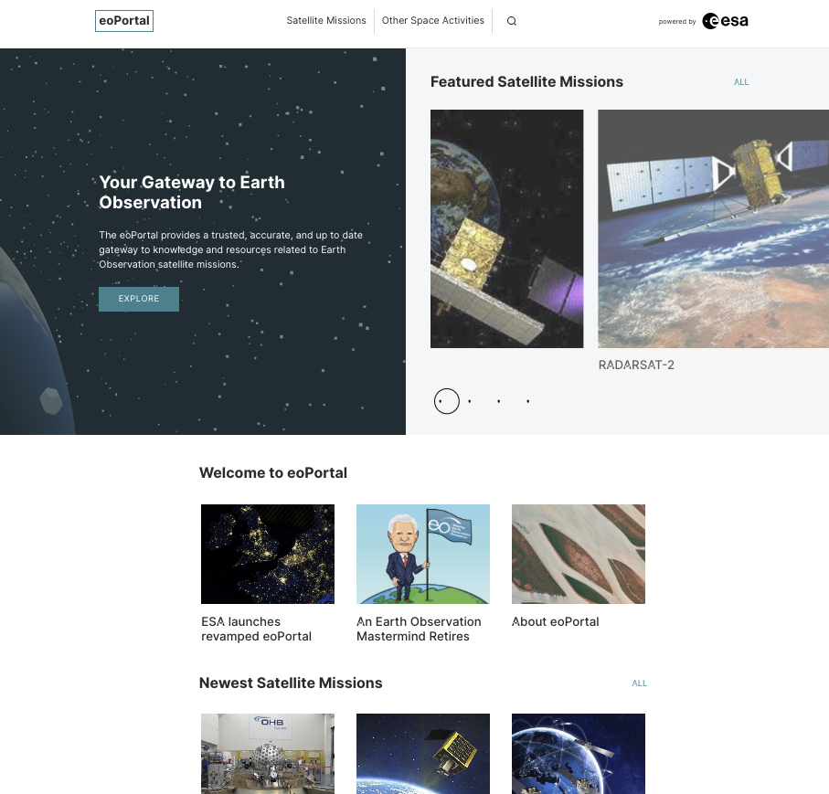
Overview
EO Portal
Maintained by ESA
eoPortal provides a trusted, accurate, and up to date gateway to knowledge and resources related to Earth Observation satellite missions.
Explaining, demonstrating, and promoting the capabilities of space systems
Long form articles
Comprehensive and rich with technical detail
Core EO reference for the community
Foundational work of Dr. Herbert Kramer

Slide 5
2022 EO Portal Updates
2022 EO Portal Updates
New modern, more secure platform
Improved user experience – clarity, accessibility, usability
Boosting engagement from the Earth observation community
Increased emphasis on analytics and web performance
Expanded editorial team
Improved satellite missions catalogue, leveraging CEOS MIM Database
  filter and discover mission articles by agency, measurements, etc.
  Increased MIM and EO Portal integration for robust indexing/framework

Slide 6
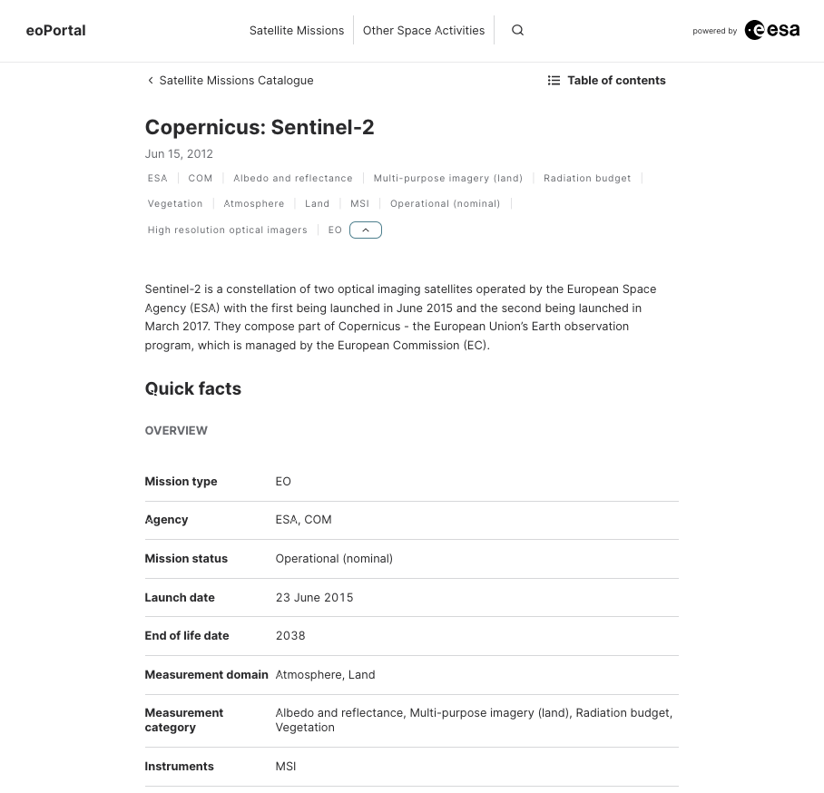

Slide 7
Future Plans
Refine current integration of CEOS Database information in the EO Portal
Consider how to add additional richness, e.g. measurements, GCOS, SDGs, disasters content from CEOS Database
Further development of the content team built off of evolution project work

Slide 8
CEOS MIM Database

Slide 9

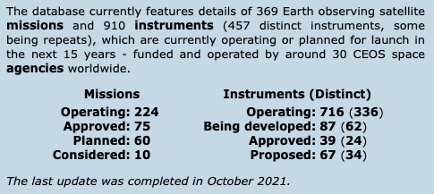
MIM Overview
Information on EO satellites based on an annual survey of CEOS member agencies.
Missions, Instruments, Measurements (& Datasets)
Representing the only official consolidated statement of agency programmes and plans.
Providing a community focal point for the coordination of future planning, research and gap analyses, and providing an interface for the user community.
Slide ‹#›

Slide 10
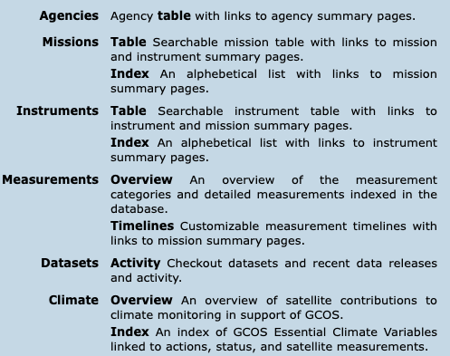
MIM Overview
Slide ‹#›

Slide 11
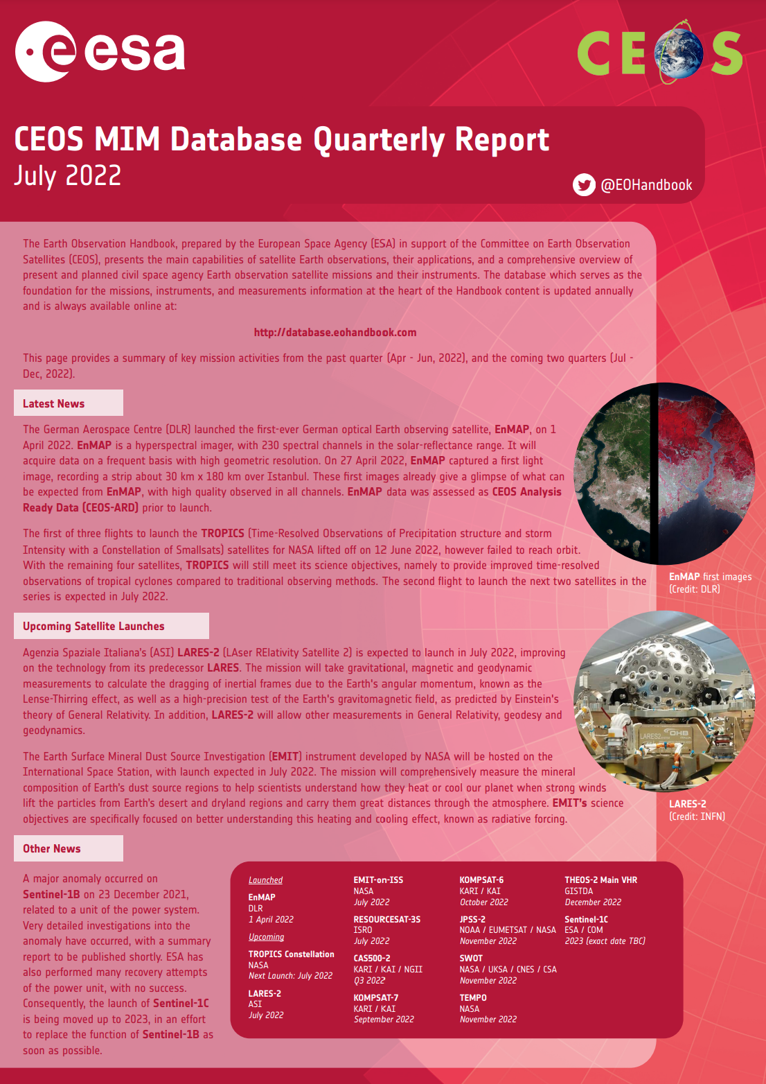
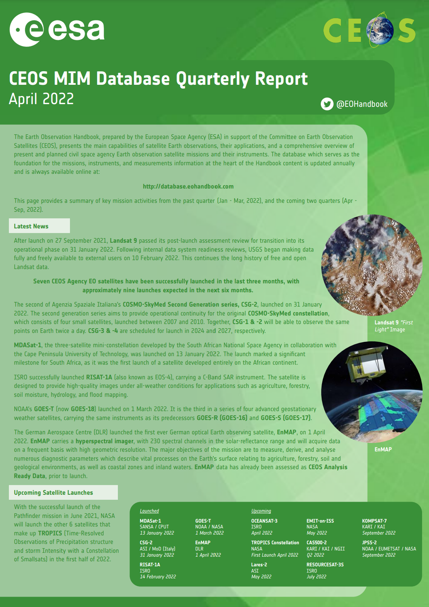
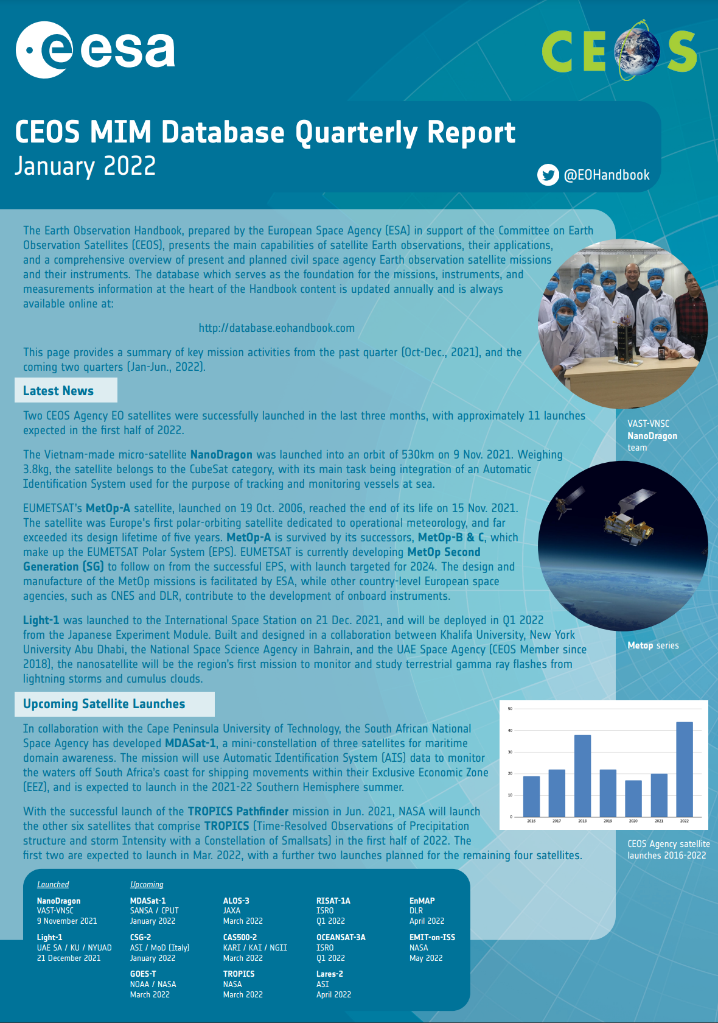
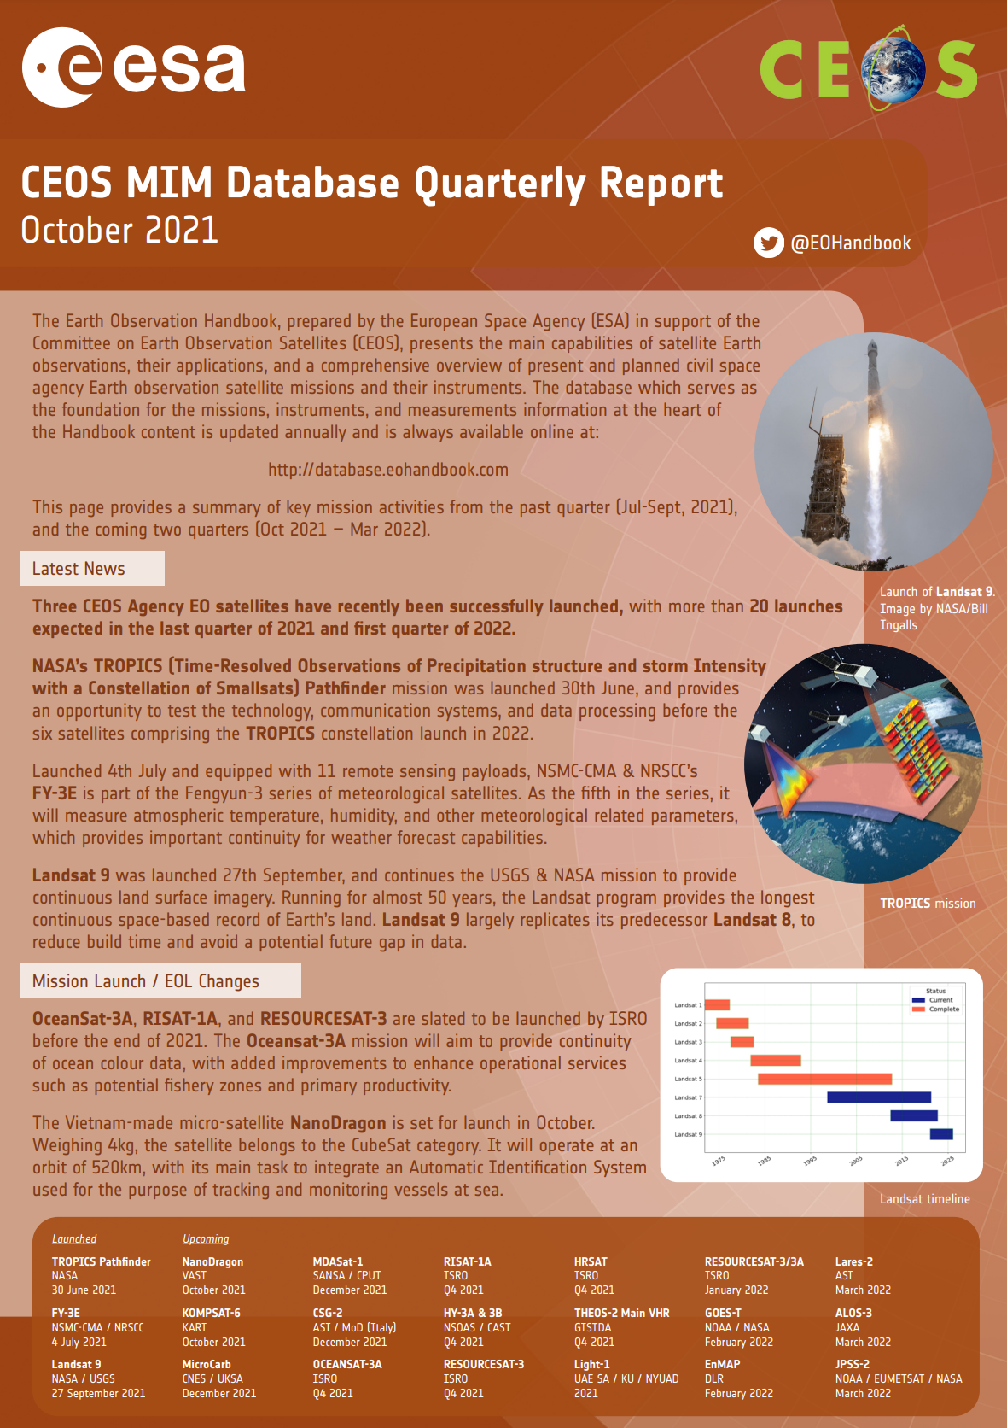
New Developments
Quarterly Reports
https://ceos.org/mim-reports-archive/

Slide 12
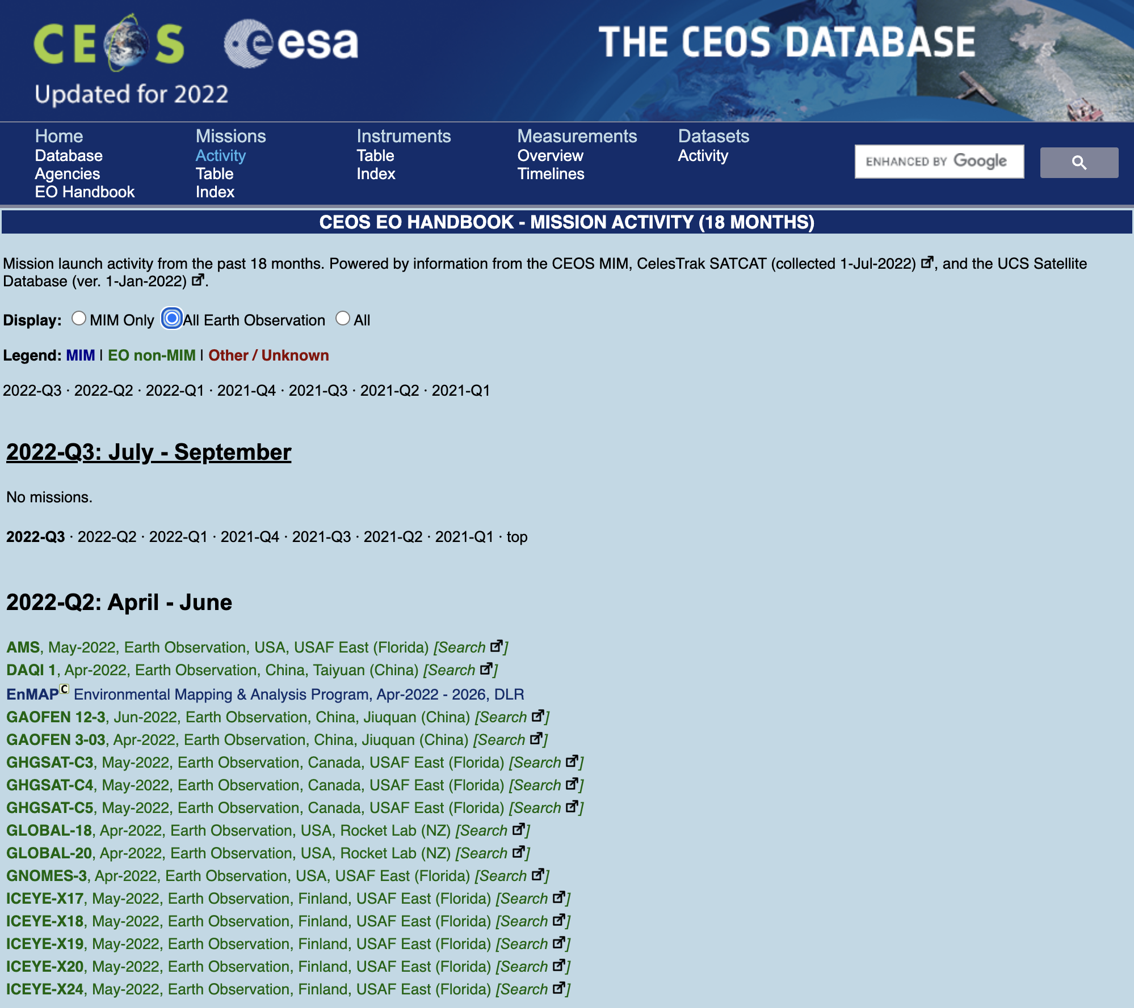
Quarterly Reports + UCS and NORAD Updates
Incorporation of information from UCS and NORAD information update during each quarterly reporting cycle -
Increases connectivity, currency, interoperability, of the database and supports survey cycle checks

Slide 13
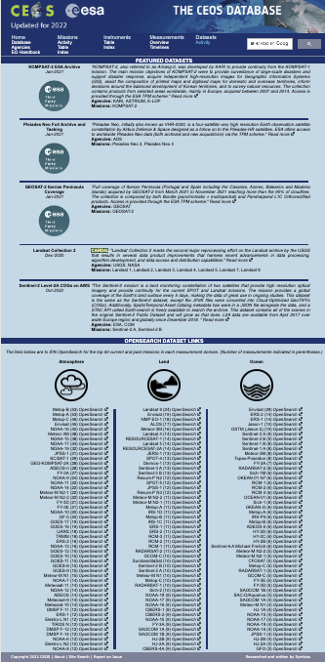
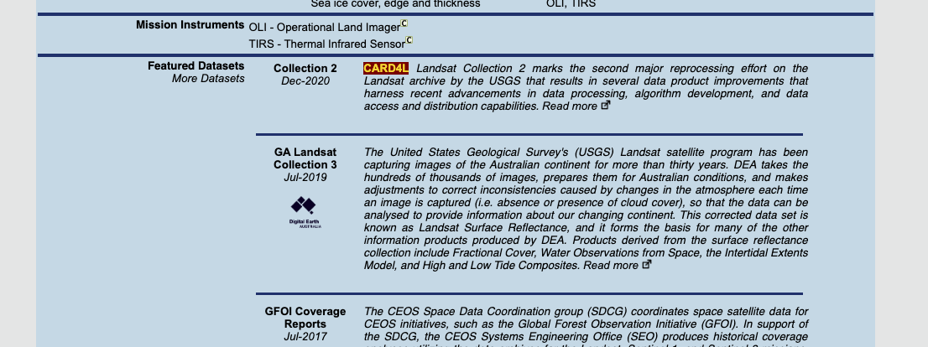
New Developments
Datasets and Access
Catalogue + Mission Record Entries
OpenSearch Integration
ESA TPM
CEOS-ARD
Featured Datasets
Commercial Cloud

Slide 14
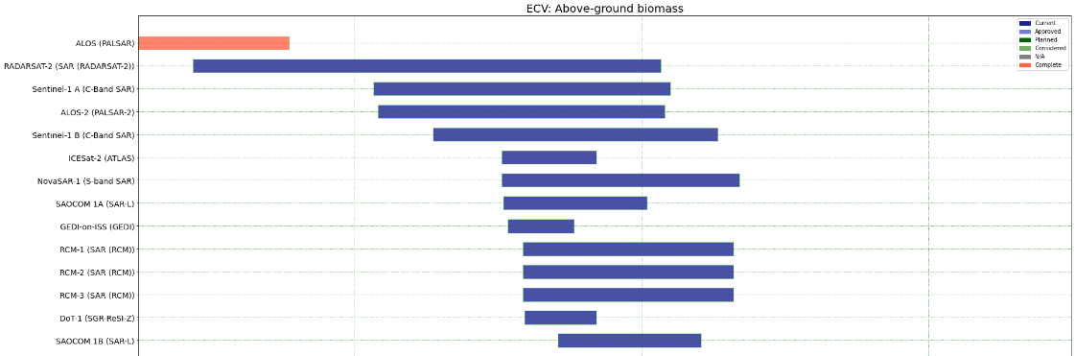
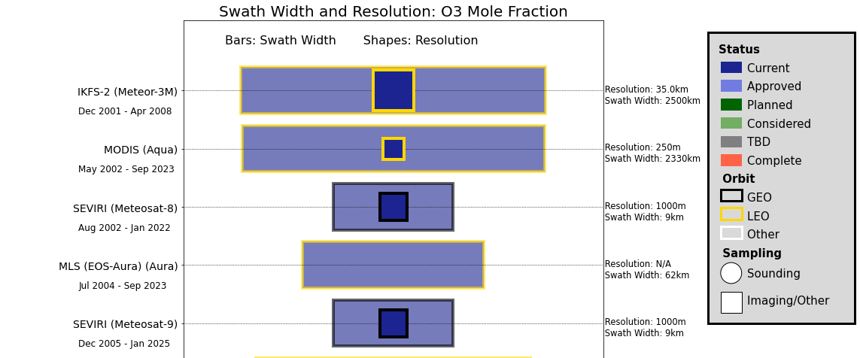
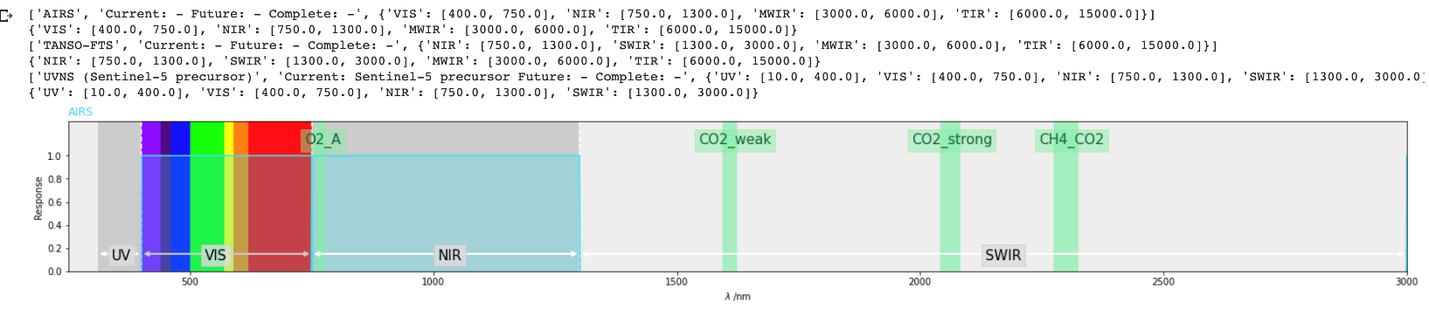
New Developments
Gap Analysis Tools
Initial release of the CEOS Database Toolkit - Python Notebooks
  https://github.com/gamedaygeorge/ceos-db-toolkit
Several analyses used for internal purposes - more can be added based on user needs

Slide 15
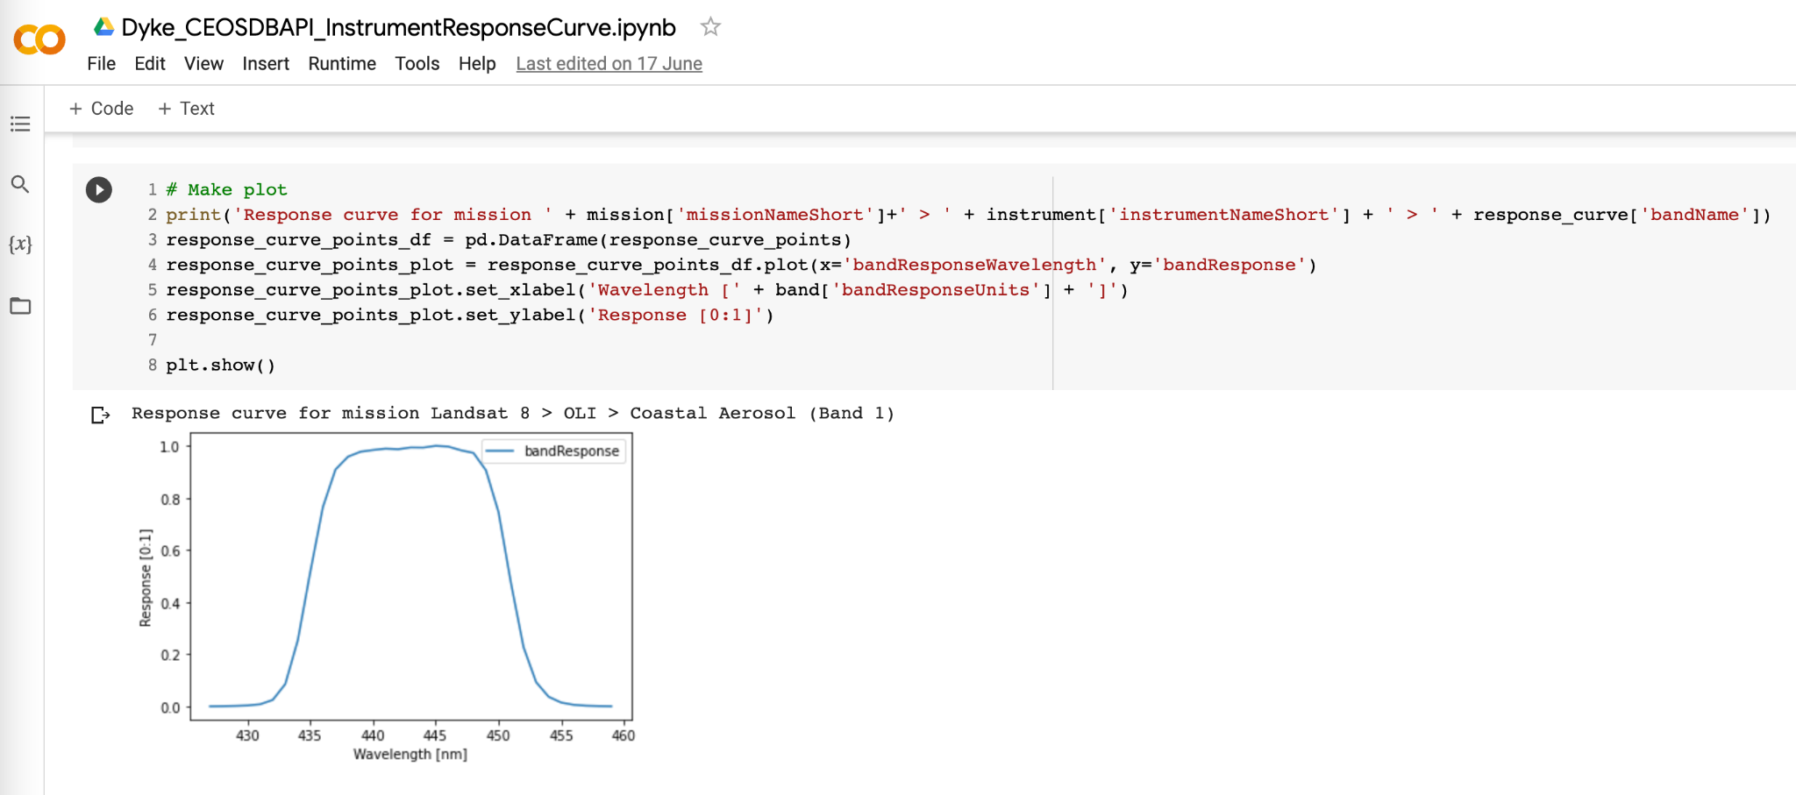
New Developments
Pilot implementation of instrument response curves for analysis
Looking to build on this capability in future based on user needs and project work

Slide 16
New Developments
A pilot API was built 3-4 years ago
Successful proof of concept but use cases not yet developed
Could be worked in future
Several small studies into using CEOS Database along with the COVE API showed promise

Slide 17
Discussion

Slide 18
Discussion
Thoughts on improvements or additions?
Connections with other CEOS systems?
  Links to WGISS work?
  API or other connectivity requirements or desirables?
  Cal/Val Portal ?
Gap analysis tools
Data discovery aspects
WGISS guidance on response curves?
Questions?

Slide 19
Thanks!

