Slide 1
ESA EO Portal, CEOS CAL/VAL Portal, CEOS MIM Database: Status, Synergies and Improvements.
P. Castracane, M. Steventon / G. Dyke
Agenda Item #
WGCV-51, Tokyo, Japan
5th October 2022

Slide 2
CEOS Cal/Val Portal https://calvalportal.ceos.org
Overview
CEOS WGCV
Utilities
Slide 2

Slide 3
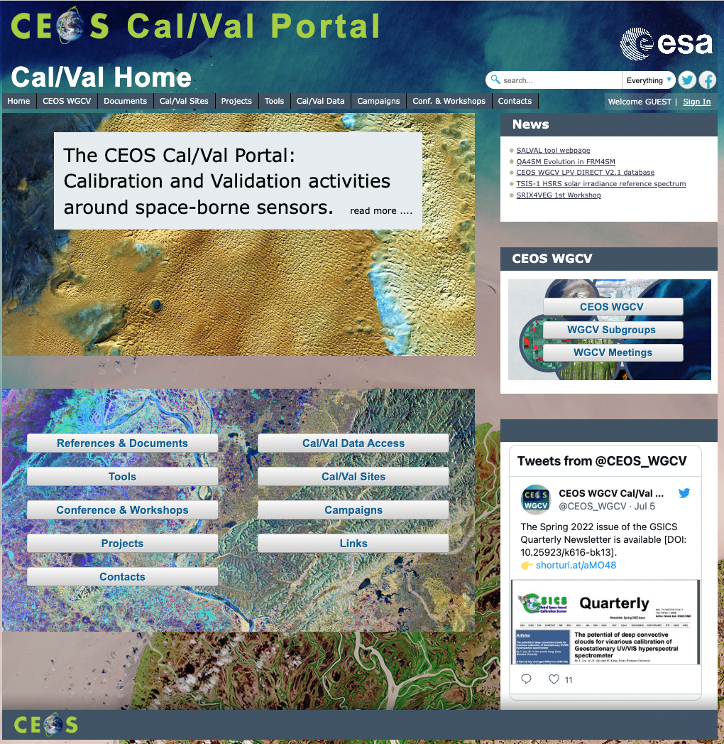
CEOS Cal/Val Portal Overview
The CEOS CalVal portal (https://calvalportal.ceos.org/) serves as the main forum for exchange and information sharing for the CEOS Working Group on Calibration and Validation.
it provides access to agreed good practices and Cal/Val protocols to the wider Earth Observation community within CEOS and beyond.
It connects users to reference data and networks and provides reliable, up-to-date and user-friendly information useful for Cal/Val tasks, facilitating data interoperability and performance assessment through an operational CEOS coordinated and internationally harmonised Cal/Val infrastructure consistent with QA4EO principles.

Slide 4
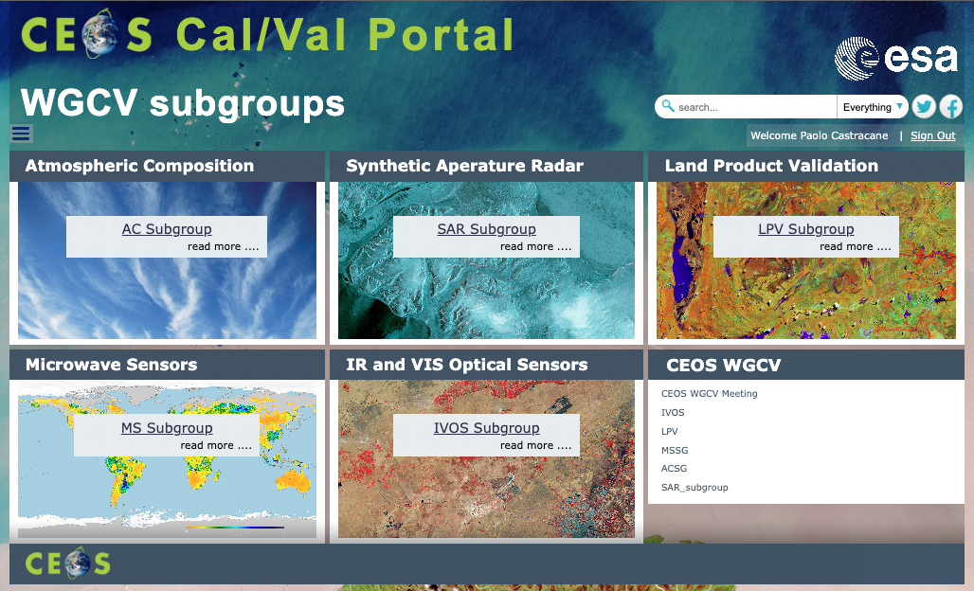
CEOS WGCV subgroups
Entry point for all the subgroups:
IVOS subgroup and SAR subgroup webpages are hosted by the portal
For LPV subgroup we link the website:
https://lpvs.gsfc.nasa.gov/
For Atmospheric Composition ACSG and Microwave Sensor MSSG we are collecting material and work is in progress.
Slide 4

Slide 5
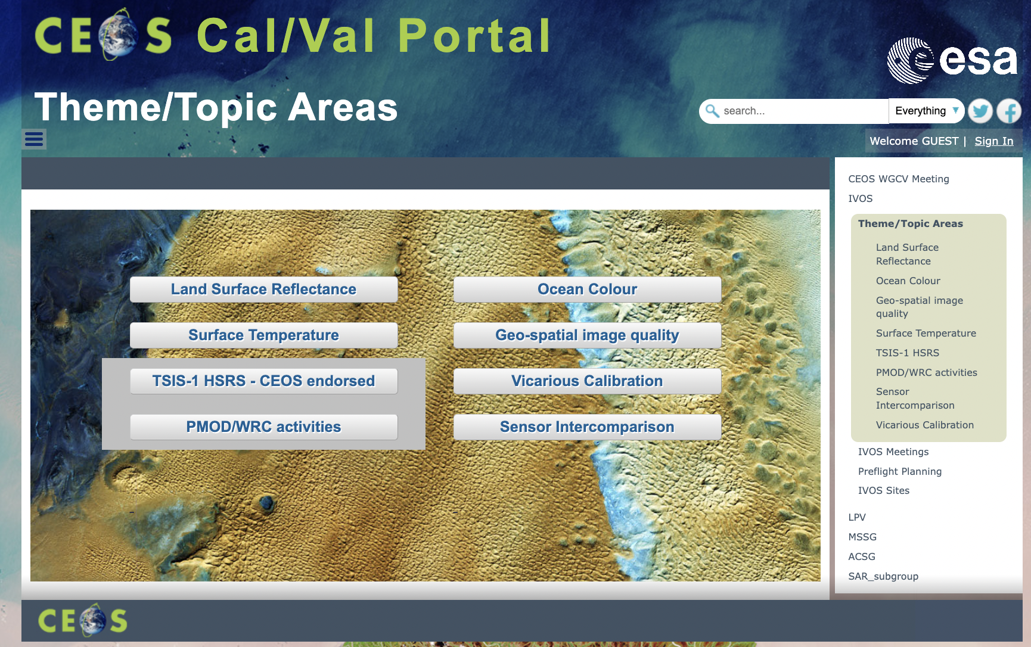
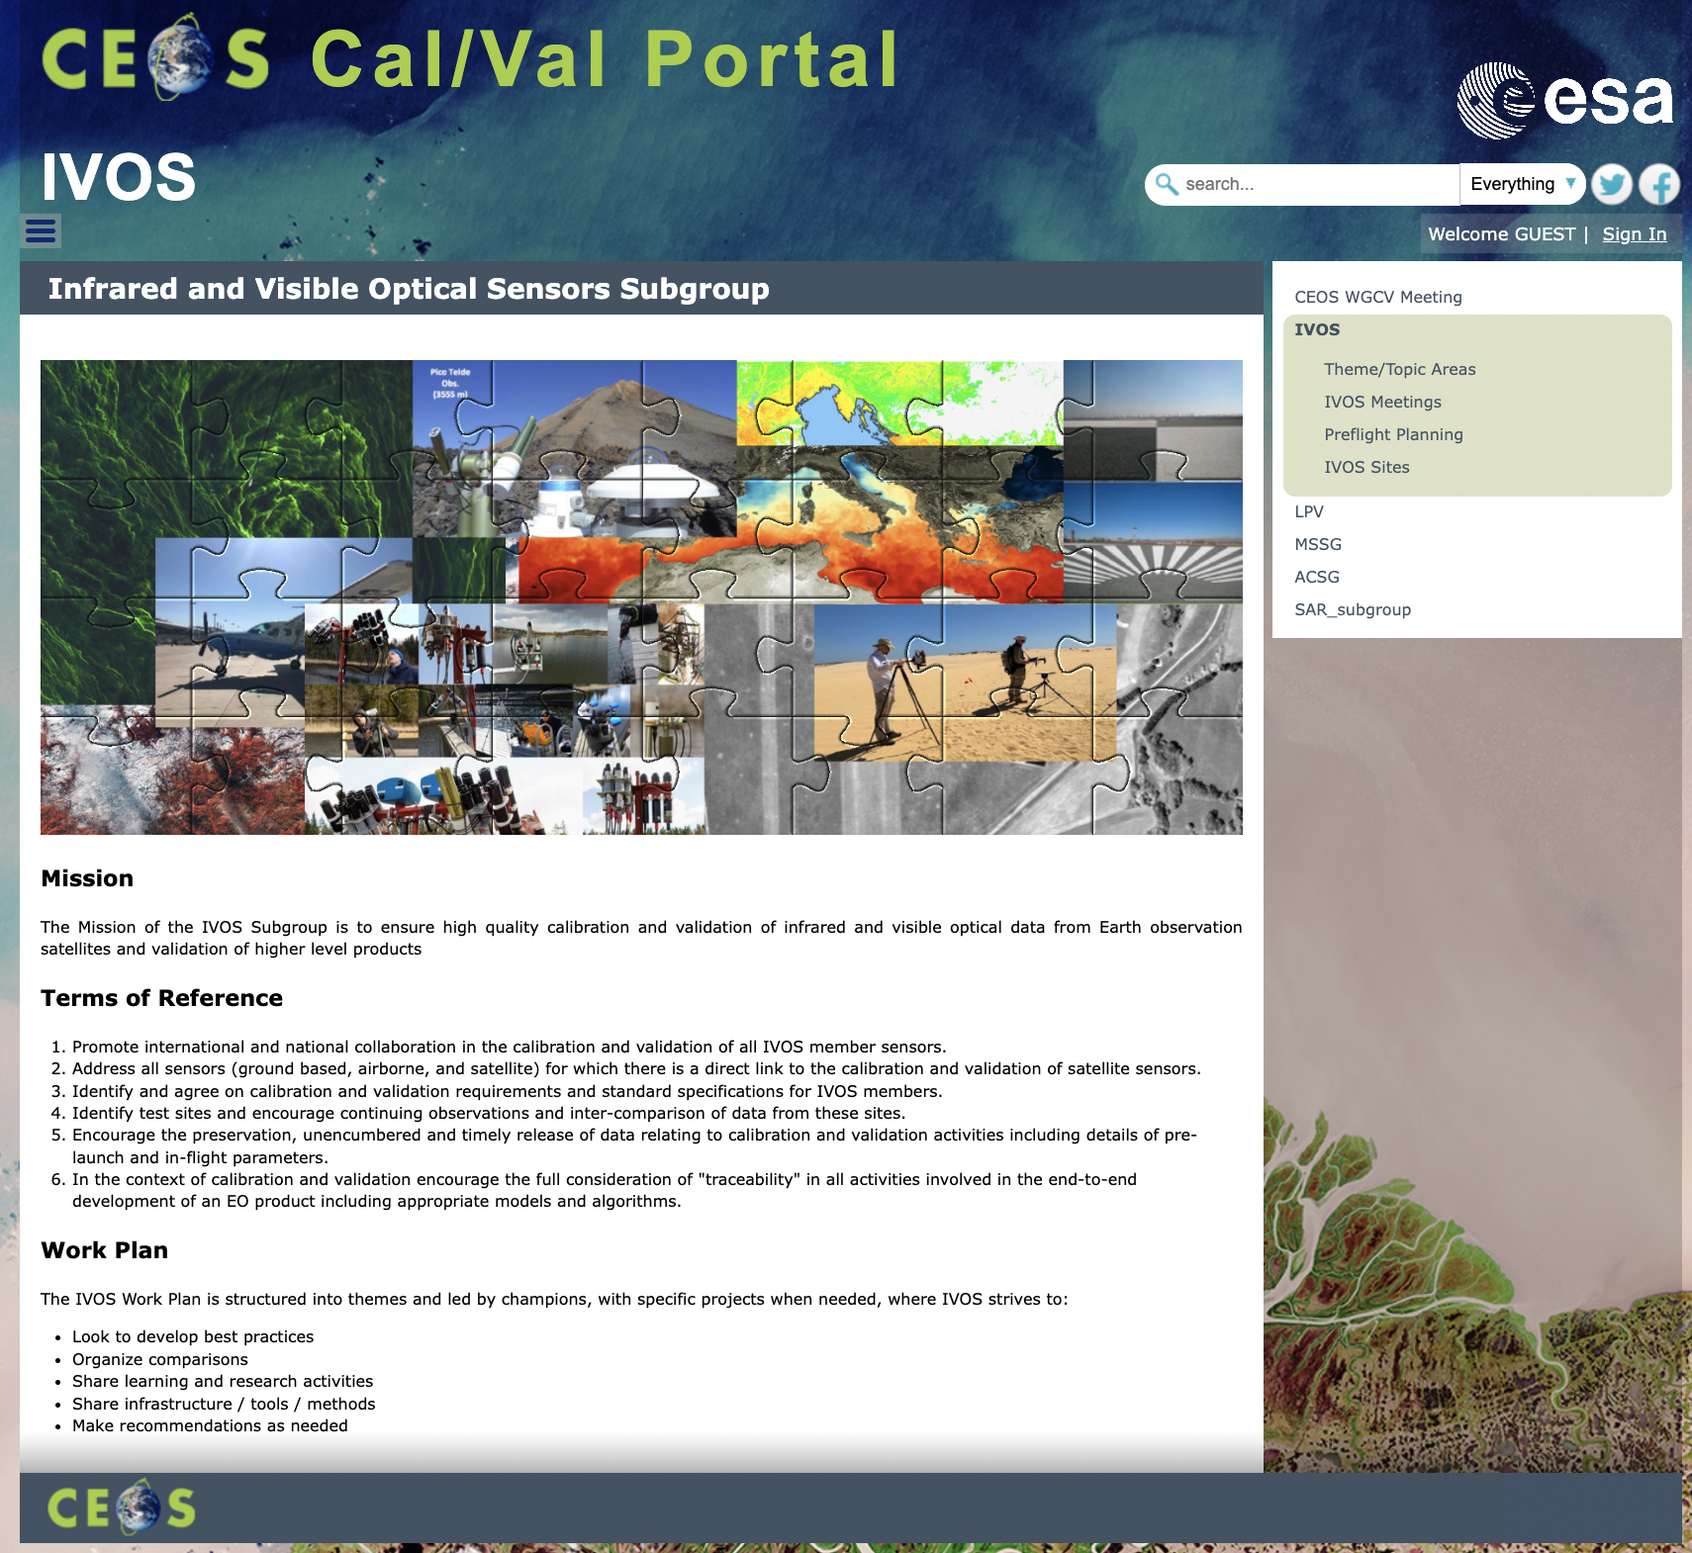
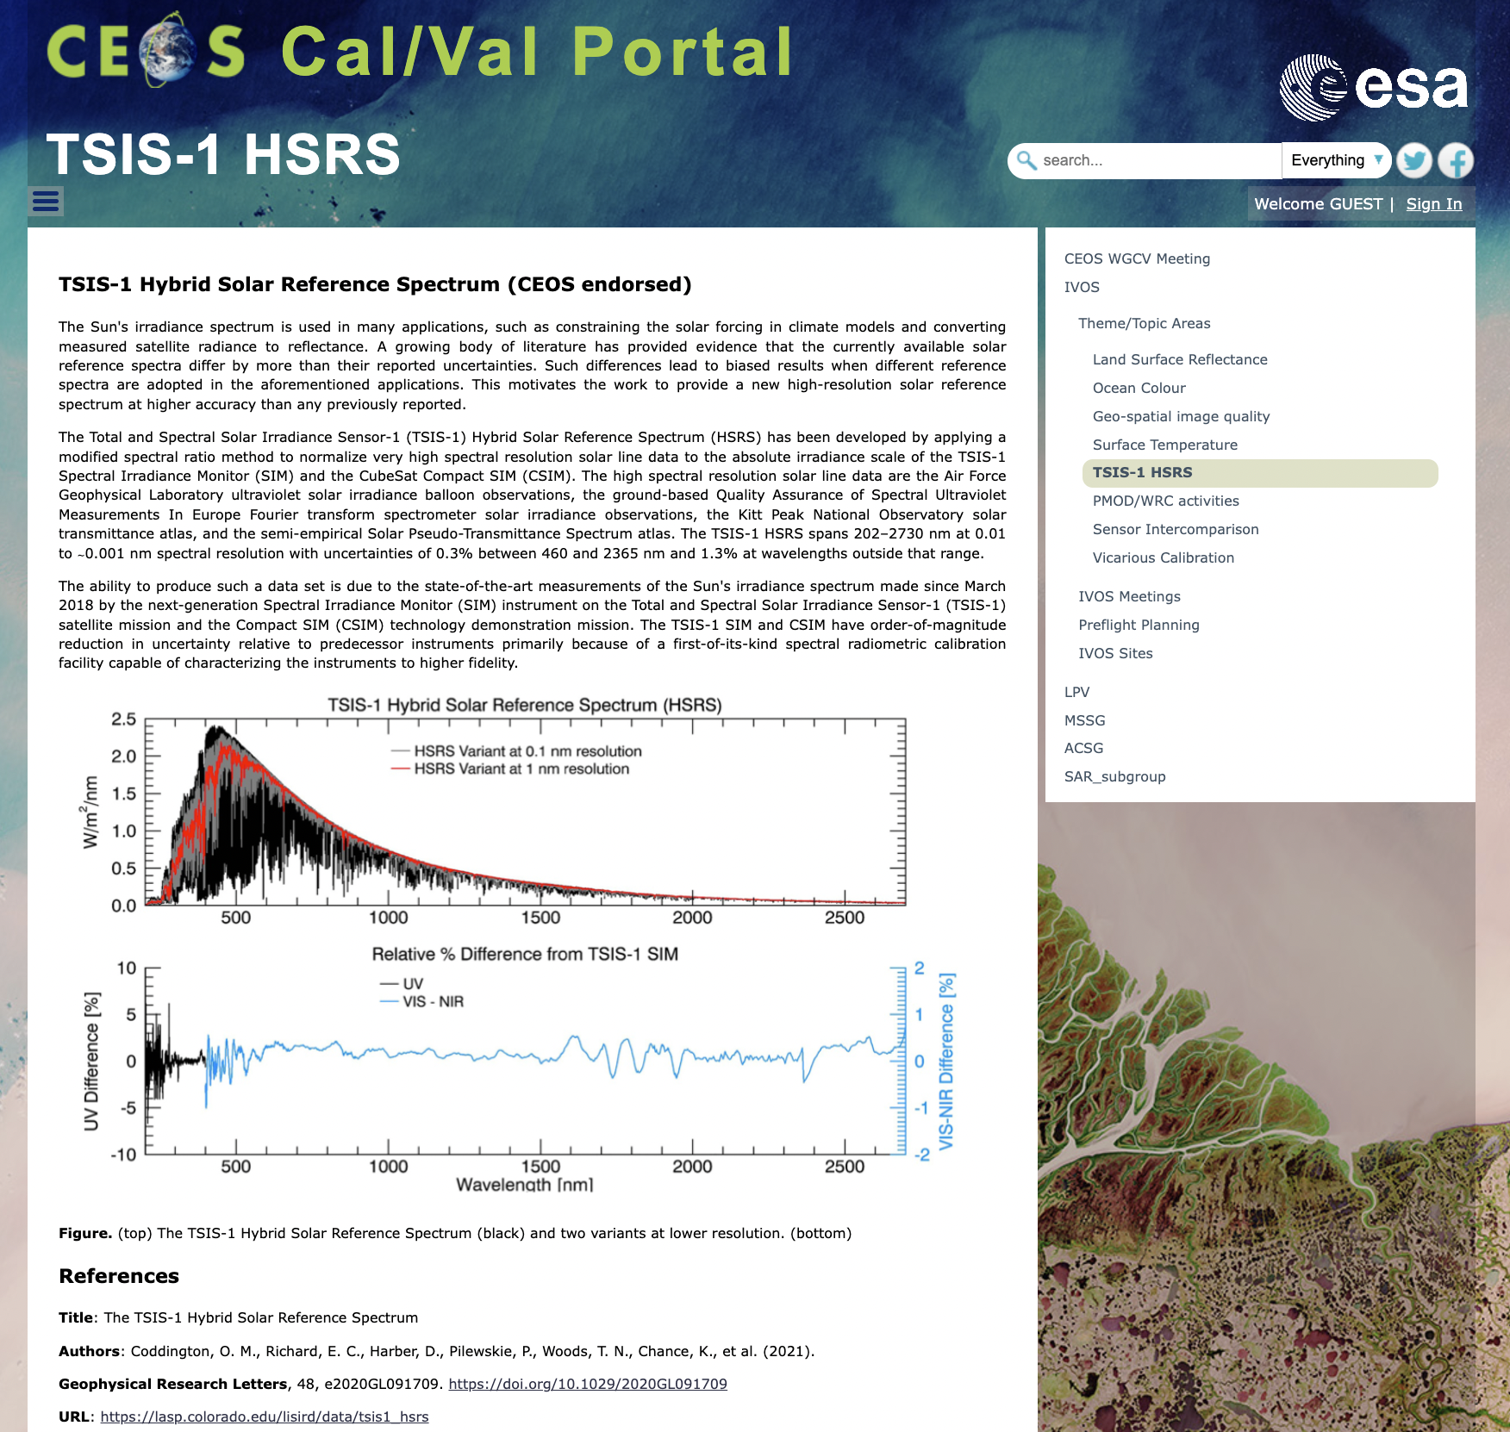
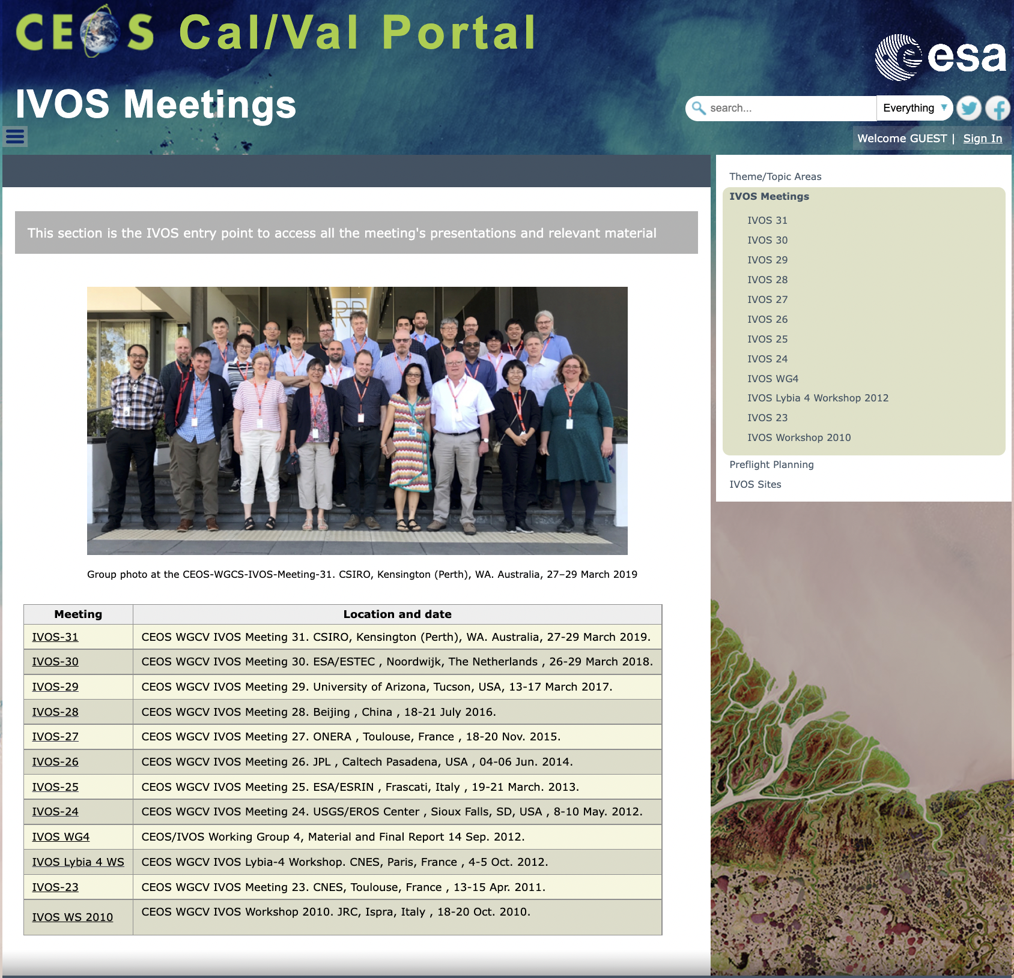
IVOS subgroup

Slide 6
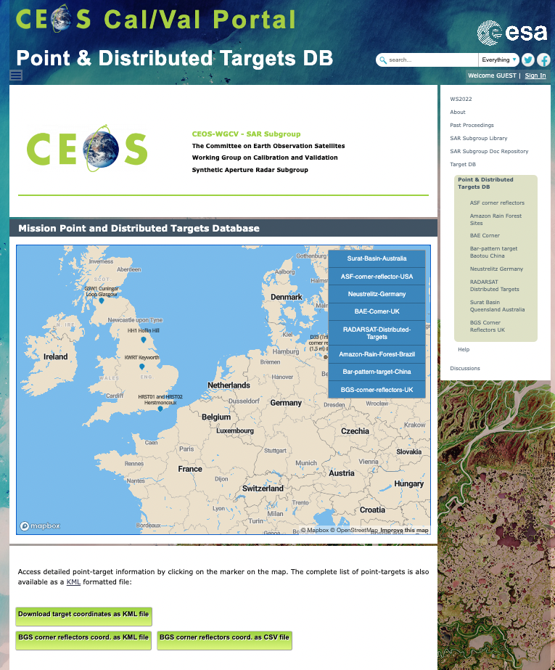
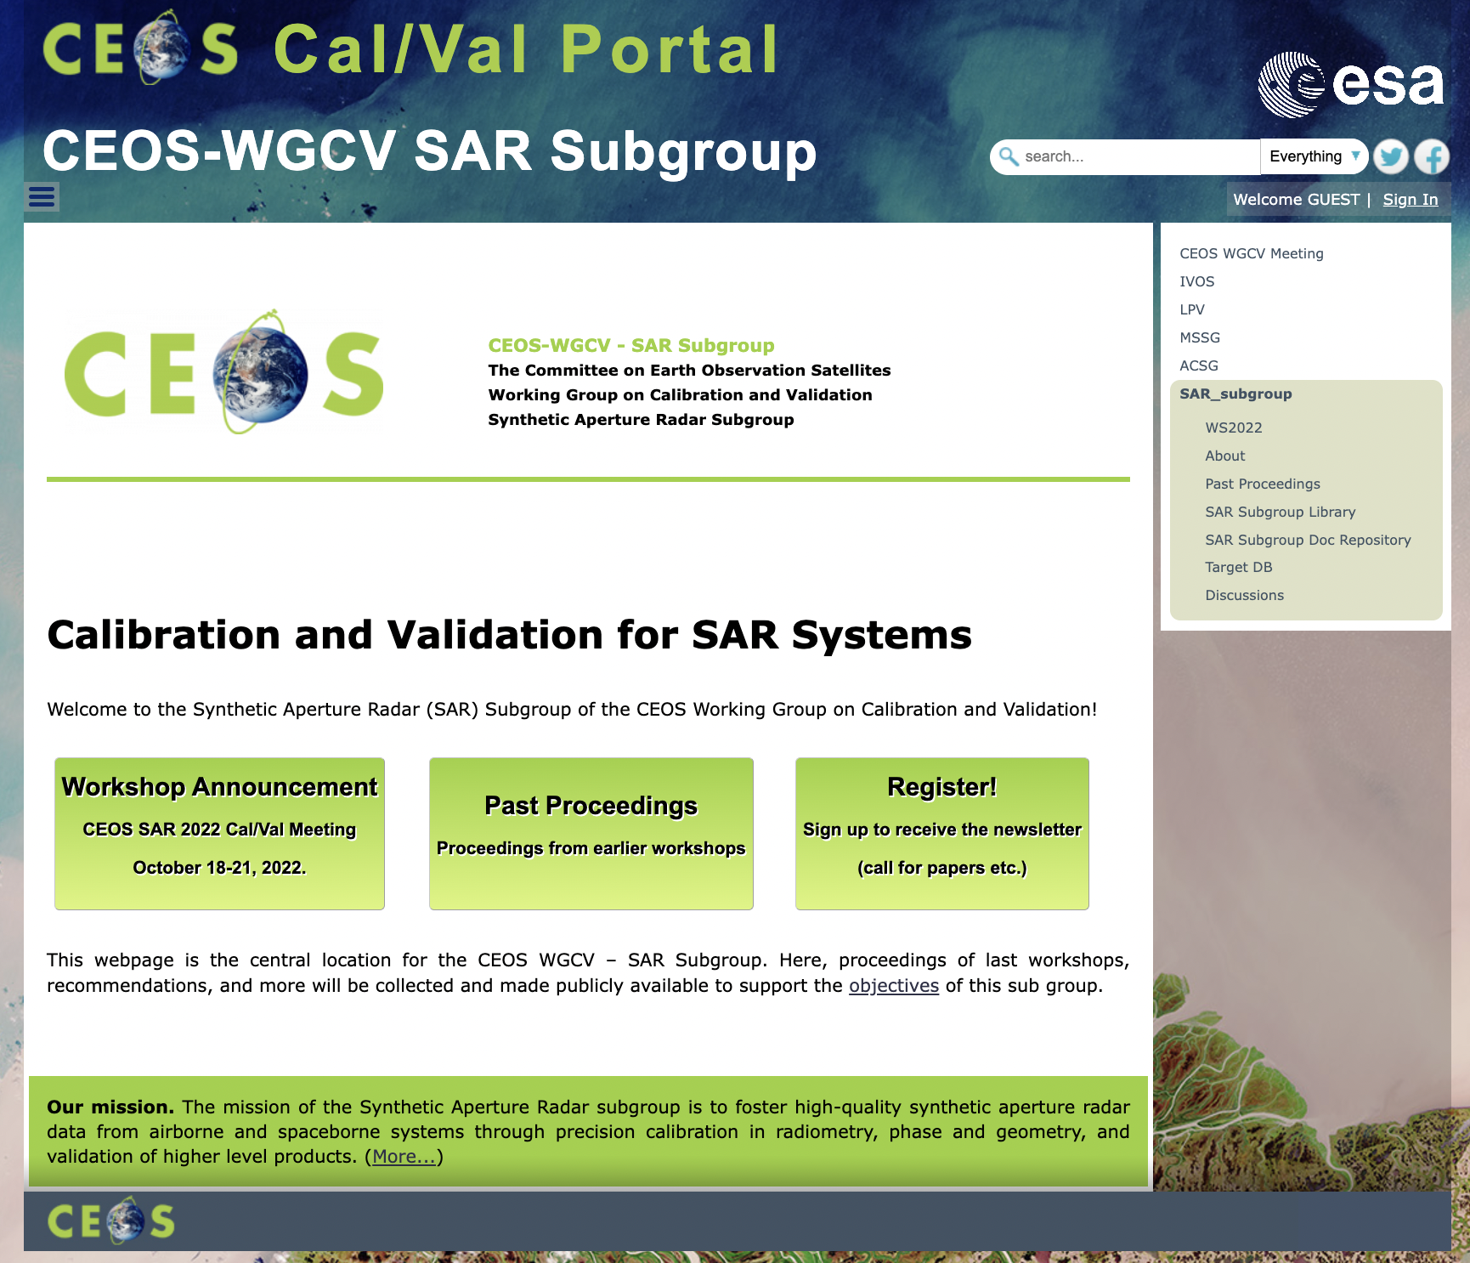
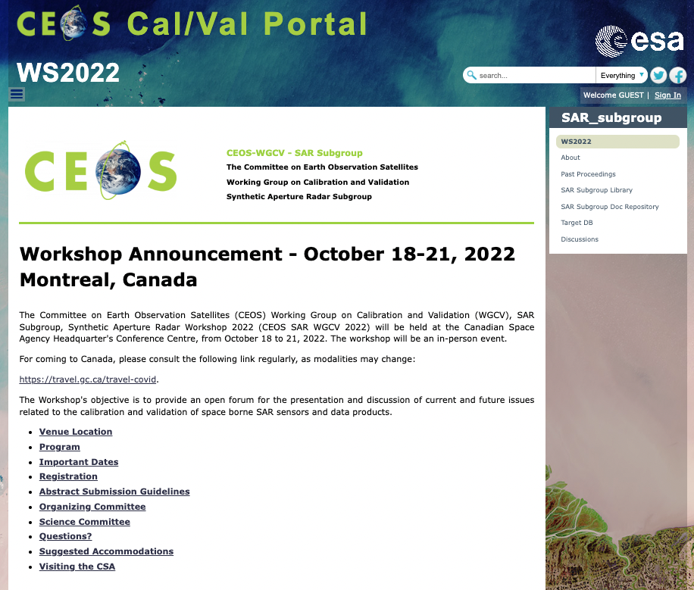
SAR subgroup

Slide 7
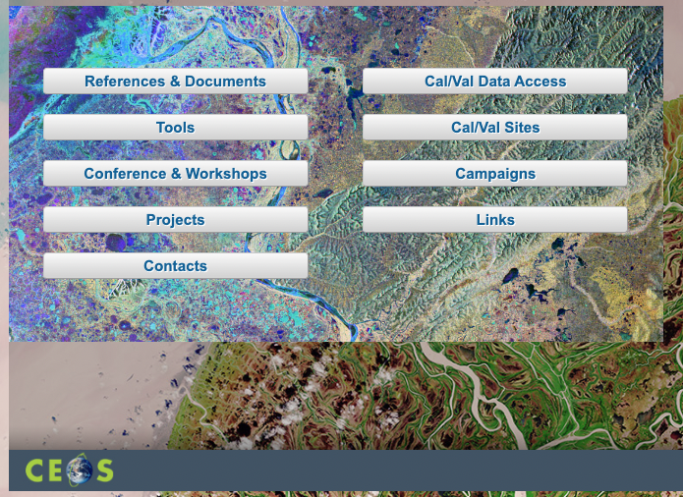
CEOS Cal/Val Portal Utilities
Utilities are made available for Cal/Val activities.
Documents,
Cal/Val Sites,
Projects,
Tools,
Cal/Val Data Access,
Campaigns,
Links,
Conference and Workshops,
News and Events

Slide 8
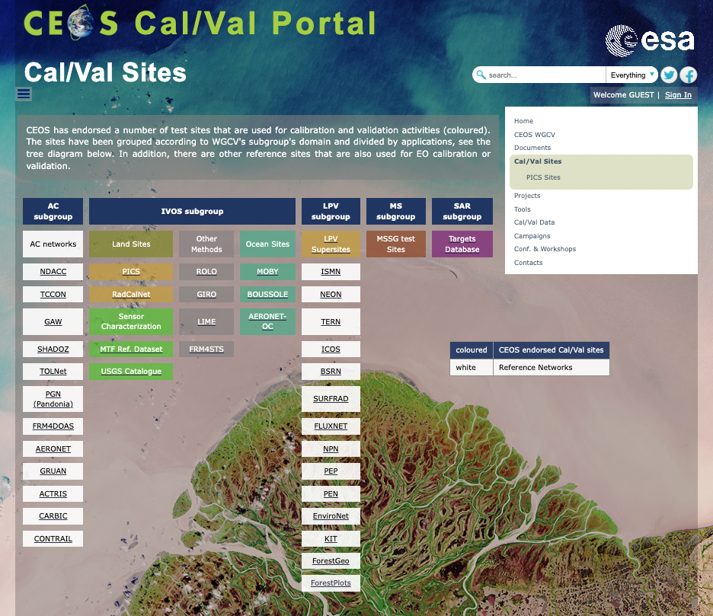
Documents and Cal/Val Sites
Documents section includes:
Documents Repository
Methods, Guidelines and Good Practices
Terms and Definitions
Library

Slide 9
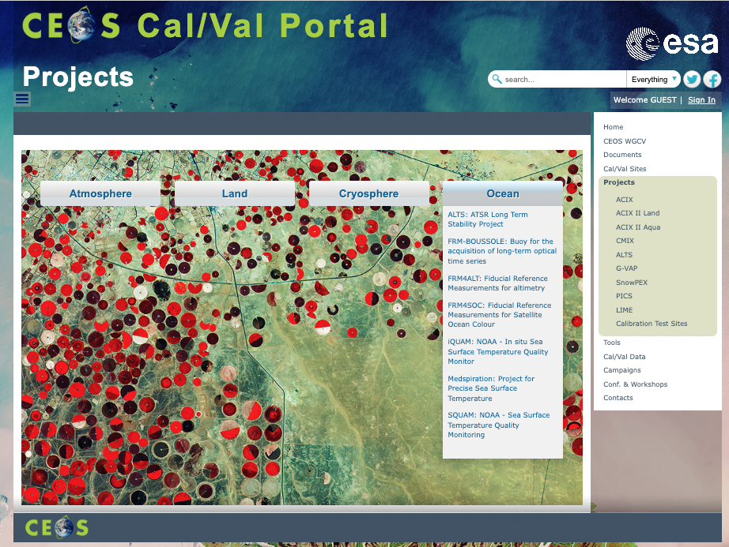
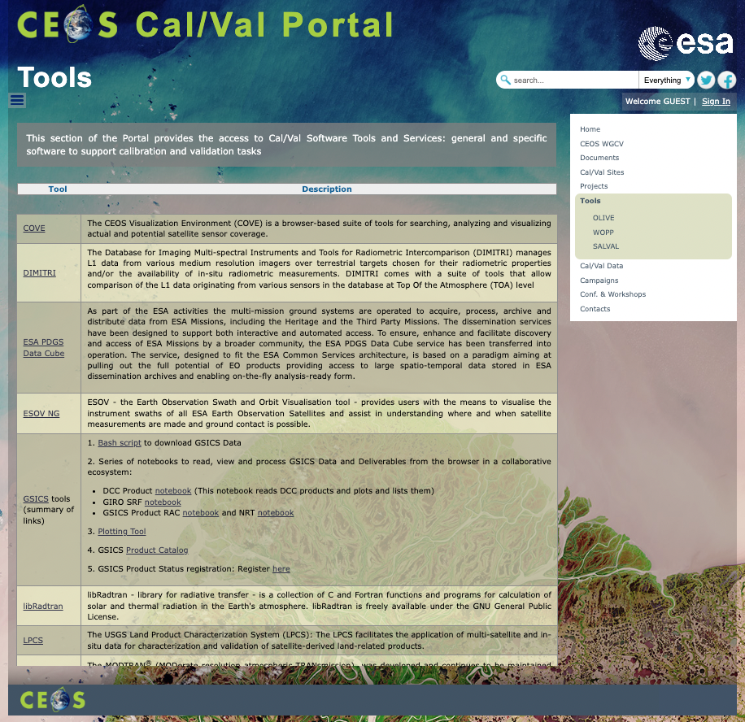
Project and Tools

Slide 10
Cal/Val Data and Campaigns

Slide 11
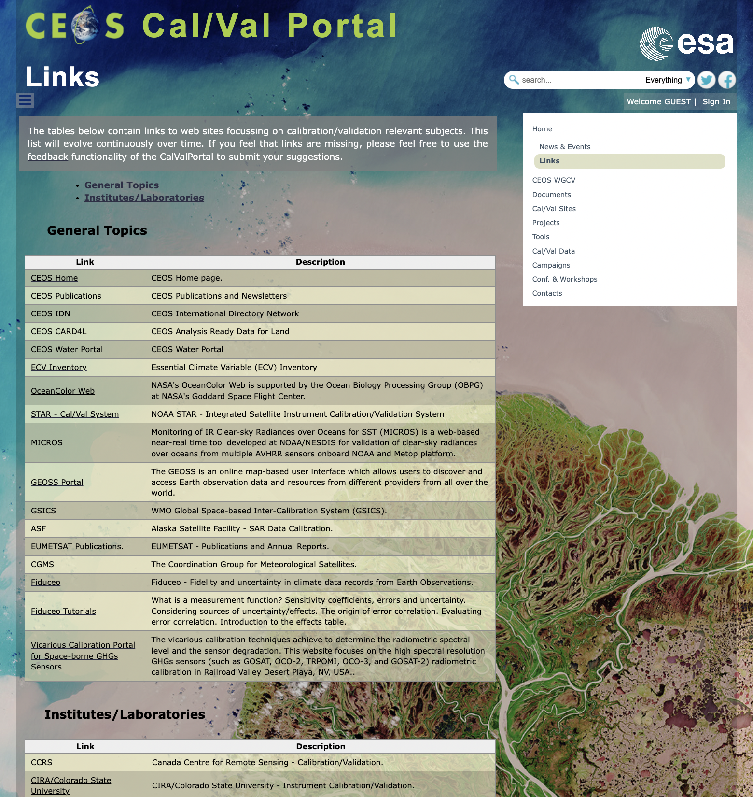
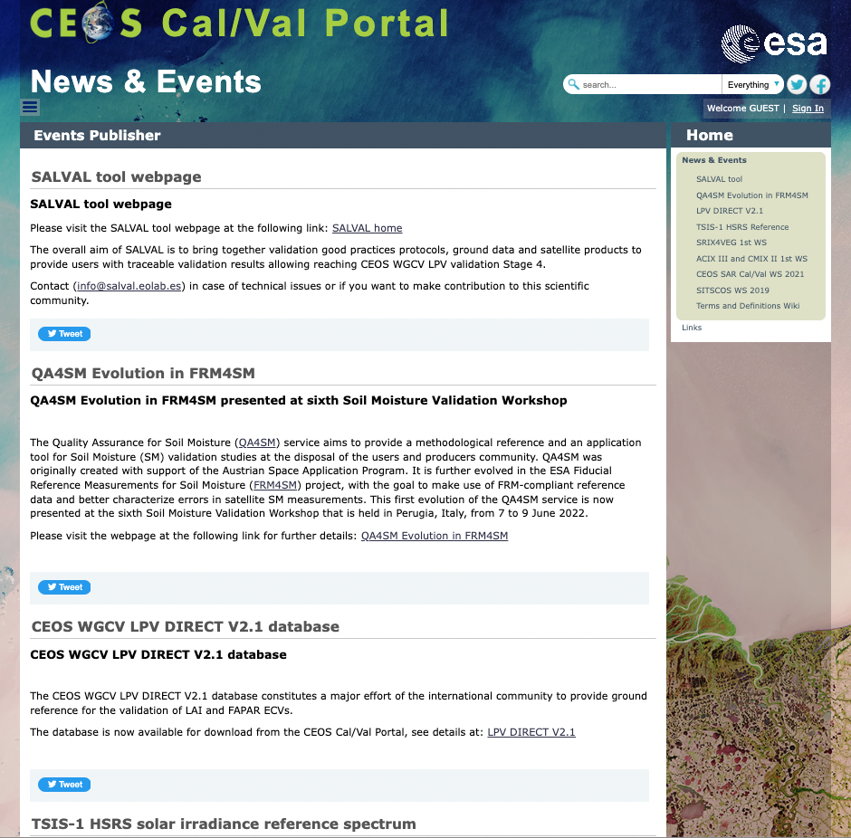
Links, News and Events

