Slide 1
WGISS Jupyter Notebooks Best Practice
Esther Conway, UKSA/NCEO
Agenda ID: 2022.10.05_10.00
WGISS-54
Tokyo, Japan (JAXA)
3-7 October 2022

Slide 2
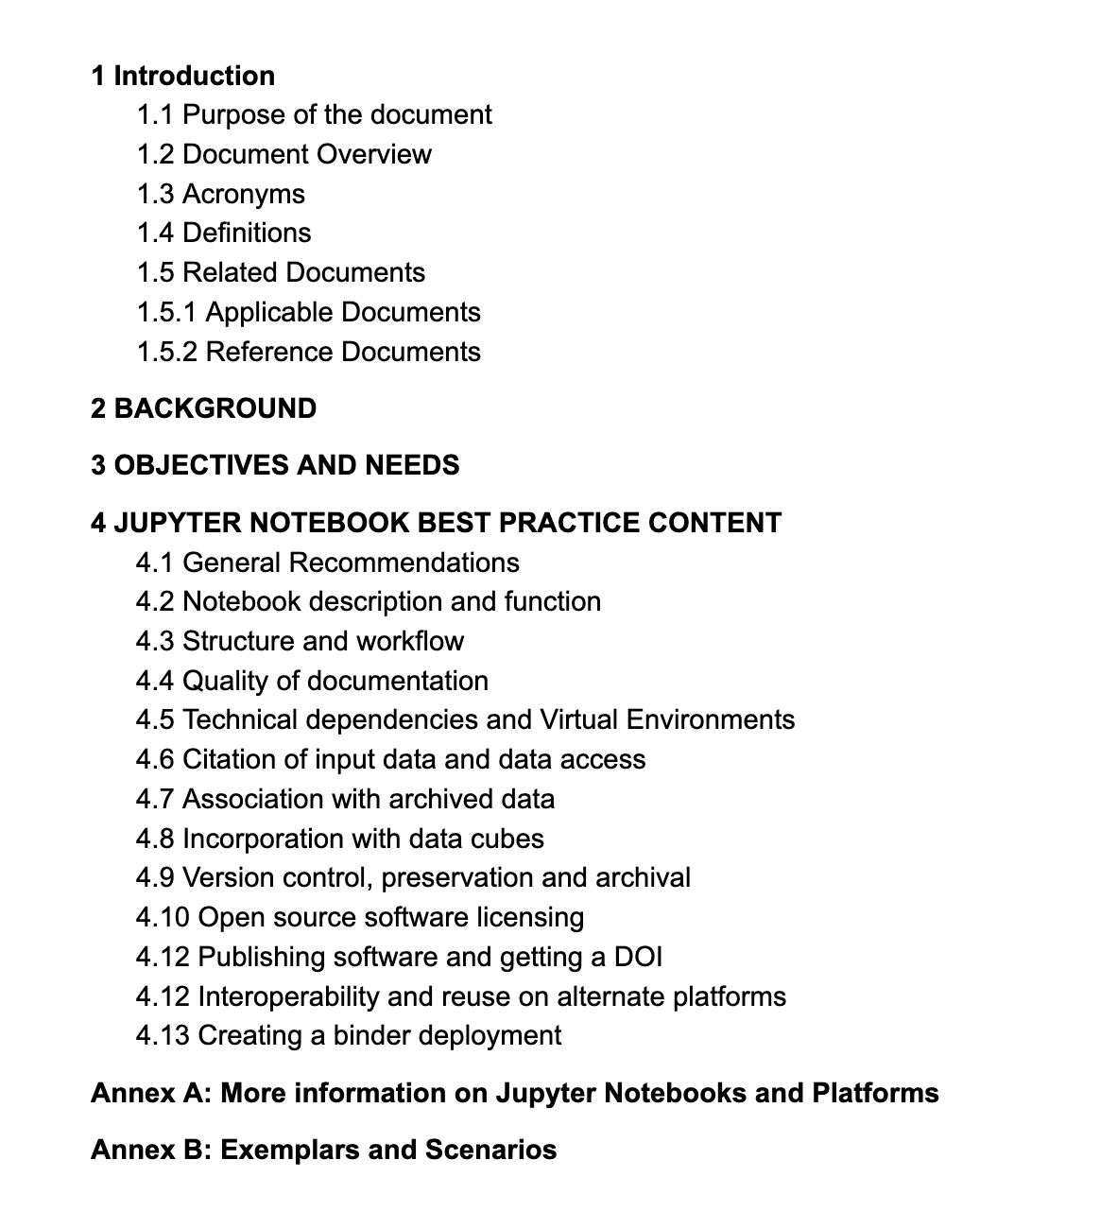
Best Practice Document Draft
https://docs.google.com/document/d/1b9HMAz1SewUjP7OTc6Hgez62Vn3BLj0Q-mPyhpZvQ18/edit

Slide 3
Target Communities
Who will benefit from a Best Practice
Data Producers
Authors of Jupyter Notebooks
Providers of EO data training
Users of EO data
EO data archivers
Providers of Data Analysis Infrastructure

Slide 4
Objectives and Needs
Issues to be addressed:
Clear understanding the purpose of a notebook and deciding if it is a reusable asset. Successfully conveying how and why a notebook should be used by its intended community.
Encourage the development of good workflow and structure within notebooks along with quality documentation. Support their reuse and adaptation by new users
Support discovery of relevant notebooks in terms of dataset, domain, application/function and skill level
Delaying technical obsolescence and ensuring longevity of relevant notebooks
Maintaining the quality of archive by timely removal of redundant notebooks
Supporting interoperability of notebooks on different platforms
Lowering barrier for EO data exploitation and raising technical skill level
Slide 4

Slide 5
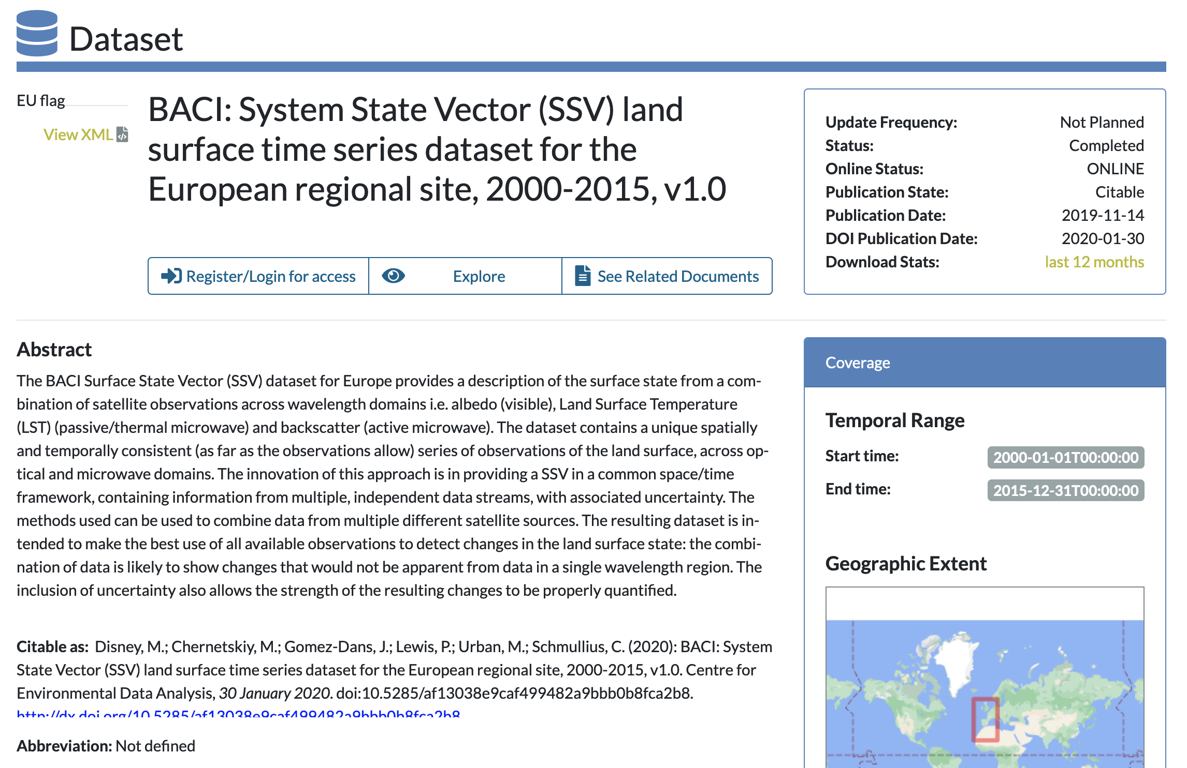
Structure, workflow and documentation
Encourage the development of good workflow and structure within notebooks along with quality documentation. Supporting their reuse and adaptation by new users
Good software engineering principles
Use of Functions
Use of Modules
Size of Notebook
Capturing Output
Linkages to external training materials
Information on formats and data structure
Support for novice users
Information on more complex processes and warnings

Slide 6
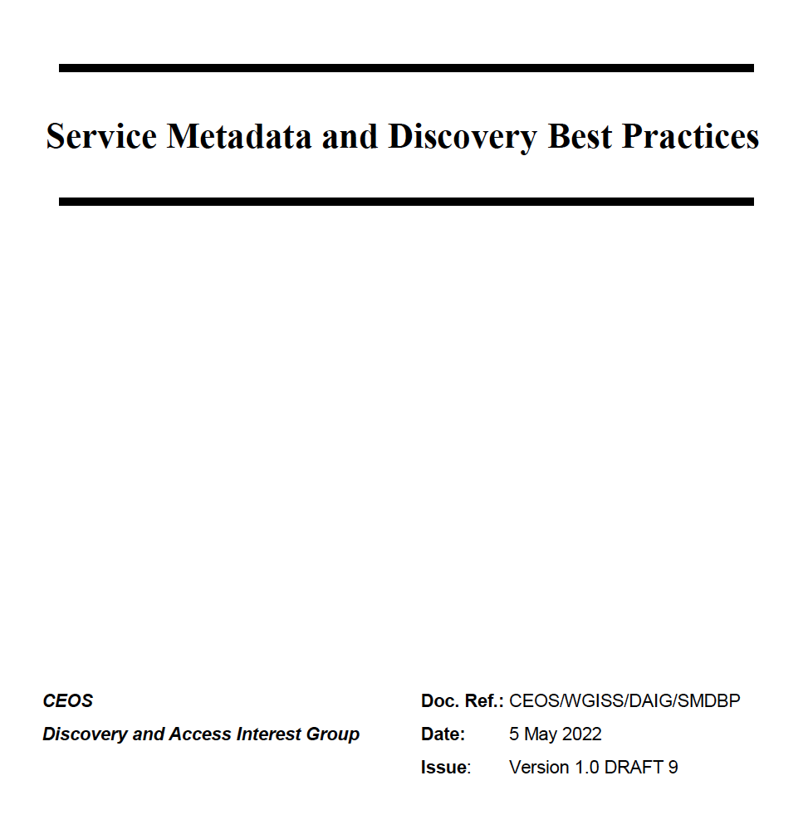
Notebook description and function
This document explains basics of opening and manipulation of the BACI Surface State Vector (SSV) files in netCDF format. SSV consists of surface reflectance, albedo, land surface temperature (LST) and synthetic apperture radar (SAR) backscatter. All datasets have the same spatial resolution, geographical projection and temporal step. Presented examples are based on the following python 2.7 libraries: netCDF4 - working with python netCDF; GDAL - Geospatial Data Abstraction Library; seaborn - enhanced data visualization and scikit-learn - machine learning library.
Datasets can be found in /group_workspaces/jasmin2/baci/sigil/baci_wp2_files/ All regional sites which are in the geographical Europe are in the same folder /group_workspaces/jasmin2/baci/sigil/baci_wp2_files/13_europe/ Datasets are in sinusoidal projection and divided by MODIS tiles https://modis-land.gsfc.nasa.gov/MODLAND_grid.html This means that processed regions are larger than BACI regional sites. Table of Contents:
1. Opening and reading 1.1 Optical data 1.2 Land Surface Temperature (LST) 1.3 Synthetic Apperture Radar (SAR) backscatter 2. Reprojection 3. Principal Componenet Analysis (PCA) 4. Clustering 4.1 Red and NIR 4.2 Red, NIR and LST 4.3 Red, NIR, LST and micowave
"metadata": { "title": "Discover Sentinel-3 OLCI Level 1 data", "description": "This notebook introduces you to ...", "author": "Julia Wagemann", "image": "./img/img_04.png", "link": "link_to_jupyterhub/notebook.ipynb", "github": "link_to_github/notebook.ipynb", "tags": { "domain": "atmosphere", "variable": "toa_reflectance", "satellite": "Sentinel-3", "sensor": "OLCI", "level": "L1"}
Credit to Julia Wagemann EUMETSAT
Slide 6

Slide 7
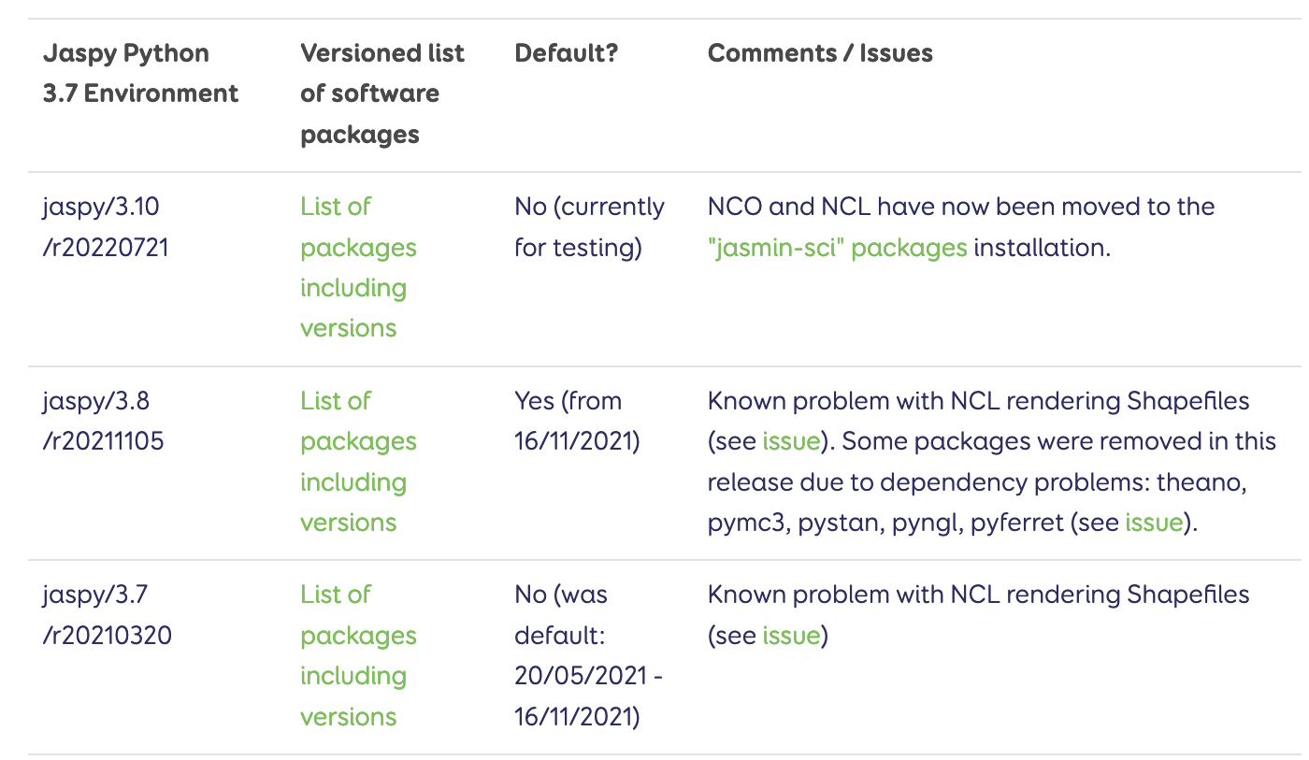
Technical dependencies and Virtual Environments
import numpy as np import netCDF4 as nc
import seaborn as sns
from scipy import stats import pandas as pd
import os
import matplotlib.pyplot as plt
%matplotlib inline
import warnings warnings.filterwarnings('ignore') warnings.simplefilter('ignore')
Language and versions
Libraries
Other Code
Virtual Machines on Data Analysis Platforms
Installing libraries from within notebook, recommending conda etc.
Setting up virtual environments
Testing
https://help.jasmin.ac.uk/article/4729-jaspy-envs#jaspy-envs

Slide 8
Citation of input data and data access
Formal Citation of data preferred level is DOI and landing page
Reference document CEOS persistent identifiers
Physical location “directions to position” of subdirectories
Clear additional instruction and link of technical requirement for remote access in cases such as OpenDAP/THREDDS
Where to apply for access and indication who can use

Slide 9
Association with archived data
Need to create a bidirectional link between datasets and the archived data
Incorporation within Catalogues adaption of documentation sections – Maintenance issue
Linkages into the IDN or other portals – (Is this an appropriate approach)
Institutional Website clearly associated with data archive

Slide 10
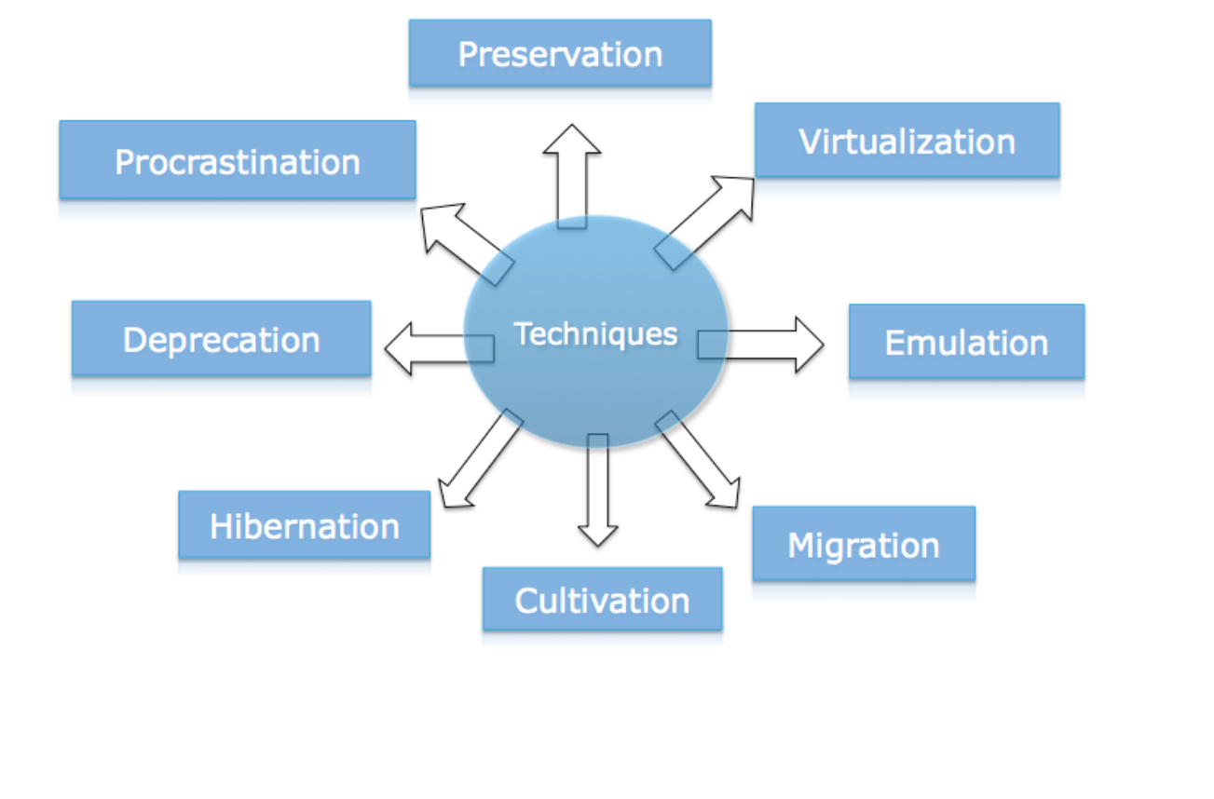
Version Control, Preservation and Archival
https://ceos.org/document_management/Working_Groups/WGISS/Documents/WGISS%20Best%20Practices/CEOS%20Technical%20Content%20and%20Associated%20Information%20Preservation%20Best%20Practices.pdf
Assume mid term preservation not long term
Allow versioning to allow permit (link to Zenodo as example)
Sufficient technical information to permit its evolution, rebuilding, emulation, virtualization etc
Storage and back up
Retire when appropriate (policy in place)
Testing or timely requirement to prevent
X

Slide 11
Software licensing
2 primary aspects to be addressed
License using creative commons as base
Citing a notebook you are evolving/reusing
https://creativecommons.org/licenses/

Slide 12
Interoperability and reuse on alternate platforms – Advanced topic

Slide 13
Creating other deployments – Advanced Topic

Slide 14
Incorporation with data cubes – Advanced Topics
Establishing Connections with Data Cubes
Defining what data gets loaded
Working with xarray
Porting Notebook from hierarchical file system to a data cube

Slide 15
More on Jupyter Notebooks !
Do we need and registry to help new users navigate the landscape?
How to help full range of agencies and developing countries enage ?
Questions: esther.conway@stfc.ac.uk

