Slide 1
WGISS Jupyter Notebooks Day
Esther Conway, UKSA/NCEO
Agenda ID: 2022.10.05_09.40
WGISS-54
Tokyo, Japan (JAXA)
3-7 October 2022

Slide 2
Save the Date Friday 21st Oct !
CEOS Jupyter Notebooks Day – Supporting Global Best Practice and Training
The CEOS Working Group on Capacity Building and Data Democracy and the Working Group on Information Systems and Services ran a joint webinar on Jupyter Notebooks for Capacity Development. The aim of this webinar was to introduce space agencies and environmental organisations worldwide to Jupyter Notebooks and take a tour of emerging services from CEOS Agencies and their applications. We illustrated how Jupyter Notebooks can be used to support capacity development and the exploitation of Earth Observation data by a broad range of users.
We surveyed the registrants of the event and the responded with 2 key requirements
The development of a Jupyter Notebooks Best Practice
Jupyter Notebooks based training
This event is working meeting to facilitate solutions to those needs
Slide 2

Slide 3
Objectives
Working meeting
Refinement of best practice
Proper alignment with other CEOS standards and initiatives i.e. Metadata Discovery, IDN and Persistant identifiers
Development of training opportunities and collaborations with CEOS CapD.

Slide 4
Agenda and Registration
Round Table asking specific technical questions
Review of Best Practice
Discussion of Training Capabilities and Requirements
Register here: https://www.eventbrite.co.uk/e/ceos-jupyter-notebooks-day-tickets-430340759797

Slide 5
Round Table Technical Questions
How many notebooks do you or would you like to actively curate and manage, what kinds of things are they used for i.e. training, data processing, visualisation etc . How are you currently describing/keeping track you resources e.g. database, self description Tags, informally.
Do you apply or make any software good practices recommendation for notebooks, please provide links to any relevant documents ?
Are you making any recommendations
Are explicitly describing the technical dependencies of your notebooks for example language version, libraries etc. Do think notebook should be self describing or should this information be kept elsewhere ?
How are you citing data your notebooks are using are you providing citations, data locations data structure and format information ?
How do you link your archived data with software, notebooks and tools for its analysis ?
Do you have a software repository for your notebooks e.g. gihub or some over way. Do you you review or test your notebooks ? When and how should they be gracefully retired ?
Can you mint your own DOI’s for notebooks or do you use something like zenodo? How do you publish your notebooks ?
What notebook services do you run, who can them and how many concurrent users can they support. How many concurrent users can the support. How do you see this evolving and do you think a registry of services and notebooks would be useful (potentially overlap with IDN )?
What joint CEOS training activities would you like to see ?

Slide 6
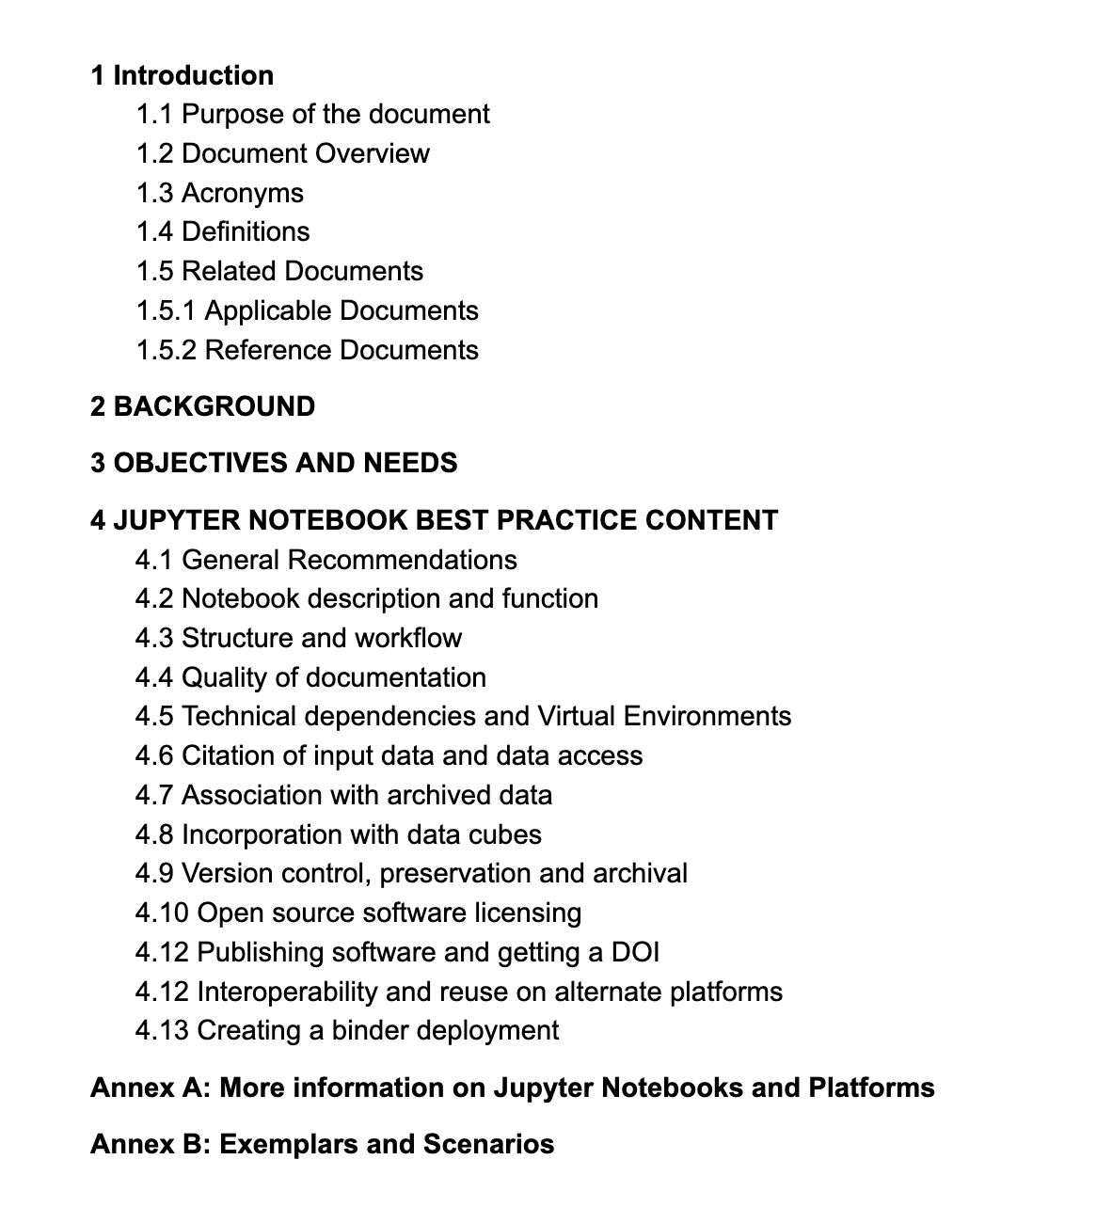
Discussion of Best Practice

Slide 7
Discussion of Training Requirements and Capabilities
How do think CEOS can support EO training using notebooks
How would be willing to contribute
Provide notebooks
Provide platforms/services
Provide trainers
Help organize or support participants
Who do you think a first event should look like ?

Slide 8
Participants – Core Group
NCEO/CEDA
ESA - PGDS
NASA DEVELOP – CAPD
NASA SEO – Google Earth Engine
JAXA
EUMETSAT
CSIRO - EAIL
Digital Earth Africa
University of Alaska Fairbanks
Slide 8

Slide 9
Particpation Extended Group
Hawassa University
University of Reading
Politecnico di Milano
CSIR
Pixalytics Ltd
Ferdowsi University of Mashhad
Federation University
University of New South Wales
UFSC
NatureScot
JNCC
Agrhymet/SERVIR WA
JAXA
Faculty of GIS and Earth Observation, University of Twente
ICIMOD
Scion
ICOS Carbon Portal, Lund University
Ocean Networks Canada
universidad Regional Amazónica Ikiam
International Centre for integrated mountain development (ICIMOD)
EAS
Universidad de Santander UDES
Center for Remote Sensing and Geographic Information Services
University of Twente
University of Glasgow
Makerere University
None
Natural Resources Canada
MPB Engenharia
National Commission on Space Activities (CONAE, Argentina)
Agencia Espacial Mexicana
Conacyt-CentroGeo
University of Duisburg-Essen
Dire Dawa University
UAE University
University of Glasgow, School of Geographical and Earth Sciences
INPE
IPMA
University of Yaounde 1
National Centre for Earth Observation
ACMAD
Secretariat of Civil Protection of the Veracruz State (México)
African Union Development Agency (AUDA-NEPAD)
USAID
FORS (Benin)
Musicoba
Lund University, ICOS
Arctic Institute of North America / University of Calgary
Brock
Independent
University of peshawar Pakistan
Instituto del Mar del Peru - IMARPE
INEGI
UKCEH (UK Centre for Ecology & Hydrology)
Ocean Sciences and Techniques Academy
University of Southampton
University of Salzburg
Verizon
University of Ibadan

Slide 10
Logistics

Slide 11
Any Sugestions ?
Continuing work in Tech Expo Monthly Meeting
esther.conway@stfc.ac.uk
Slide 11

