Slide 1
OGC Testbed-18: Secure Asynch. Catalogs
WGISS-54
Yves Coene (Spacebel s.a. for ESA)
Liping Di (GMU for NASA)
T18-Secure-Cat Project Team
4 October 2022

Slide 2
Outline
Testbed-18
Scenario and research questions
Implementation
Conclusion and next steps

Slide 3
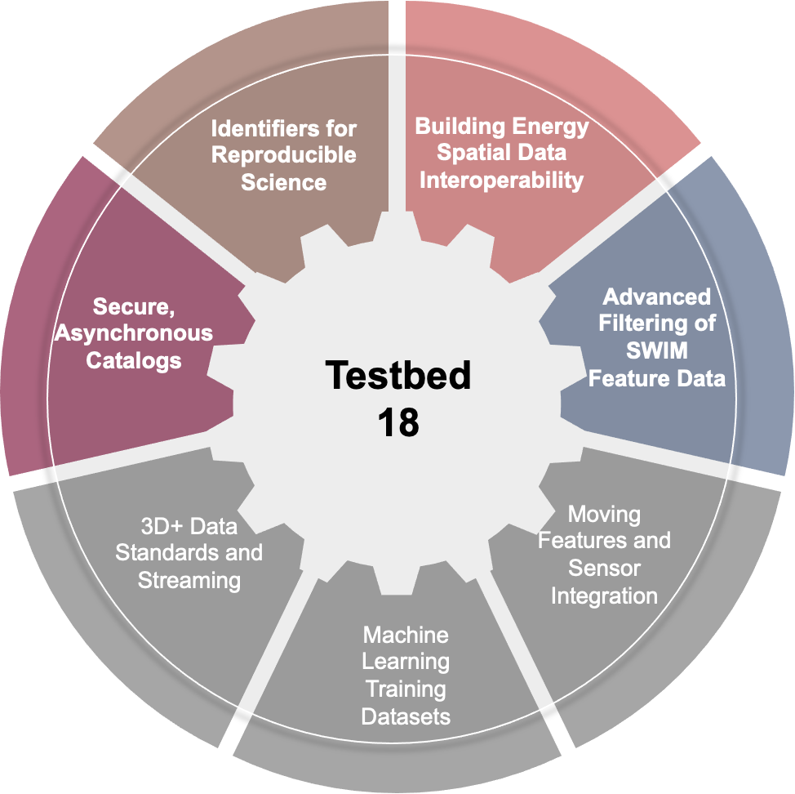
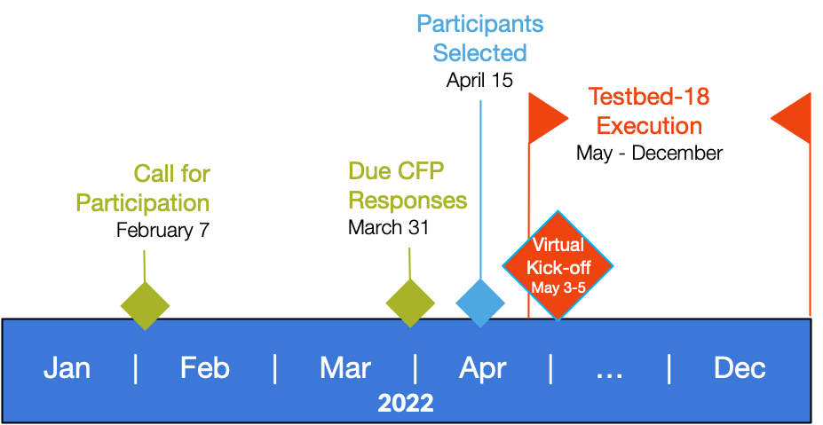
OGC Testbed-18
Yearly OGC Innovation Program initiative
2022: Testbed 18
Secure Asynchronous Catalogs: one of the activities
Notes:
https://www.ogc.org/projects/initiatives/testbed-18

Slide 4
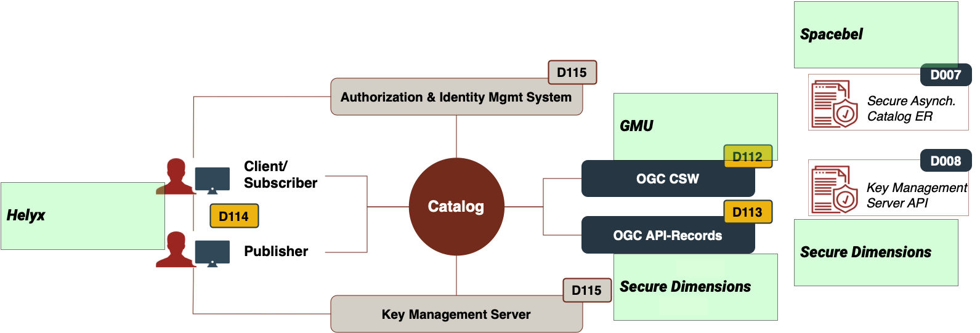
OGC Testbed-18
Thread: Catalogs, Filtering, and Moving Features (CMF)
Task: Secure, Asynchronous Catalog

Slide 5
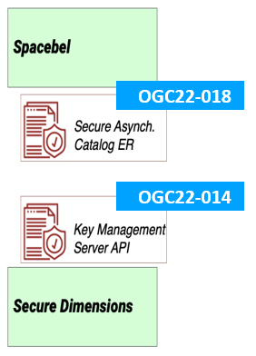
Task: Secure Asynchronous Catalogs
Sponsor: UK Defence Science and Technology Laboratory (UK-DSTL)
Participants:
GMU (USA)
Helyx (UK)
Secure Dimensions (Germany)
Spacebel (Belgium)
Deliverables:
Public Engineering Reports: OGC 22-014, OGC 22-018
Demonstrators

Slide 6
Task Objectives
Address research questions:
Can OGC API-Records support classical discovery workflows (OGC CSW/ISO 19115)
Establish asynchronous communication (subscribe to search results)
Apply “Data Centric Security” (DCS)

Slide 7
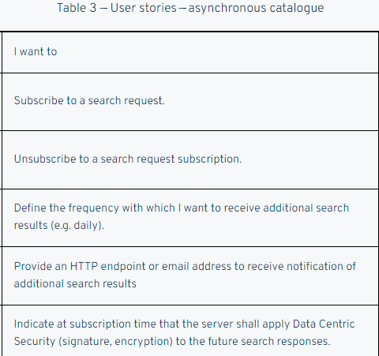
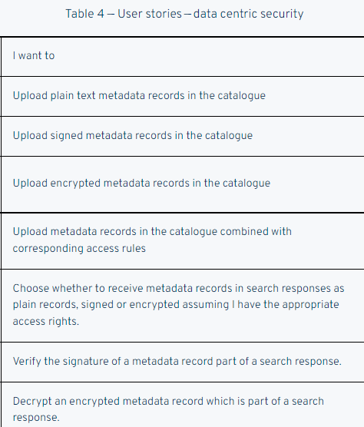
Objectives versus EO Use Cases
Asynchronous Communication
Support (catalogue) users who run the same query over and over again: get notified when additional results become available or resources change. Example: images from X over Paris with cloud-cover less than Y.
Support (incremental) harvesters. Notify when new records become available or are updated corresponding to search criteria.
Data Centric Security
Exchange encrypted/signed metadata records/results making them unreadable when not authorized (e.g. confidential, paying, DRM, …)

Slide 8
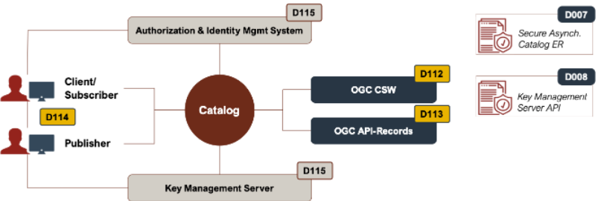
Discovery Scenario
Synchronous and asynchronous access (subscription) to catalogue
Metadata publisher with CRUD access to catalogue
Search processes supported in a classical OGC CSW environment (ISO19115:2014, ISO19115:2003).
Tailoring of OGC API-Records
Apply Data Centric Security:
Synchronous communication (search)
Asynchronous communication (subscription)
Create/update/delete operations

Slide 9
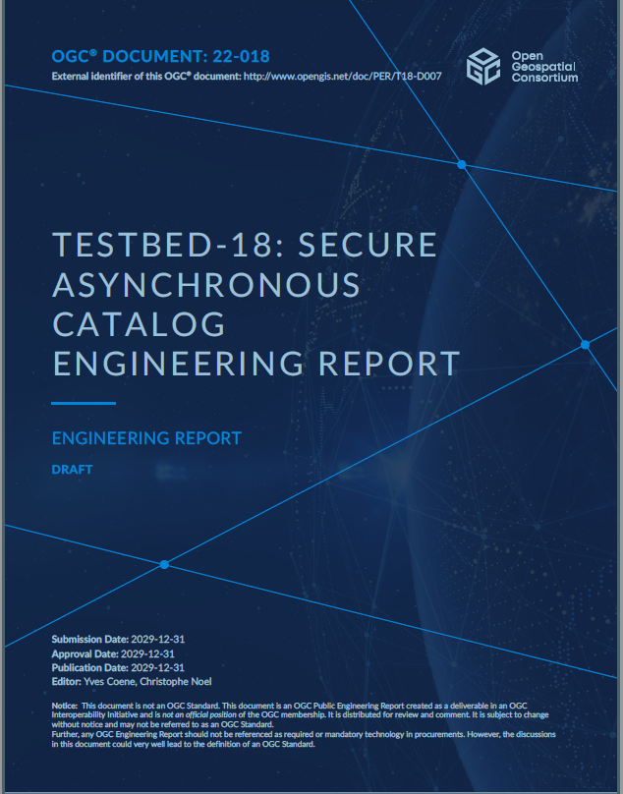
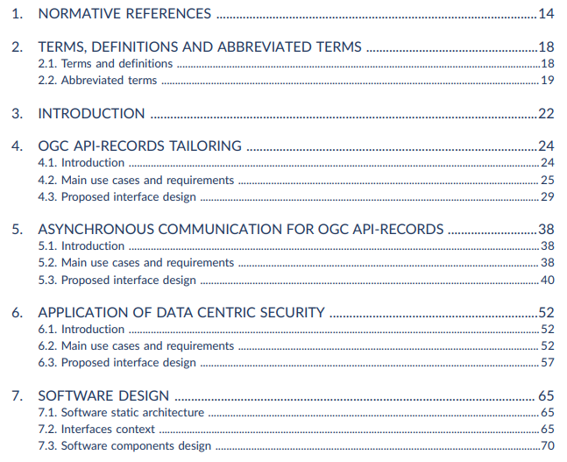
Engineering Report – OGC 22-018

Slide 10
Data Centric Security (DCS)
Definition:
Explored in past OGC Testbeds 15, 16, 17 (since 2019).
Testbed-18: Apply to metadata exchanged between Client/Subscriber, Catalog Server and Publisher using encryption and signatures.

Slide 11
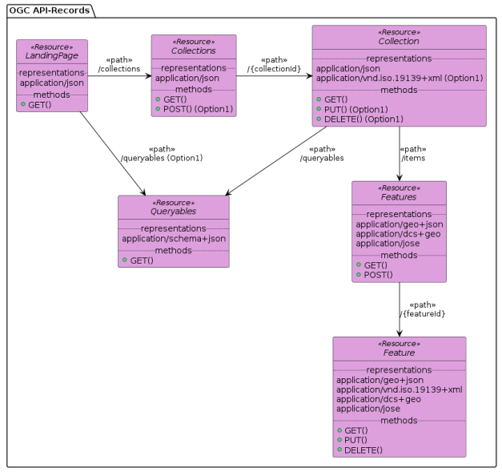
DCS Security
Apply DCS (OGC 21-020r1) to OGC API-Records catalog.
CRUD interfaces as per OGC API-Features Part 4.
Asynchronous subscription interface added.

Slide 12
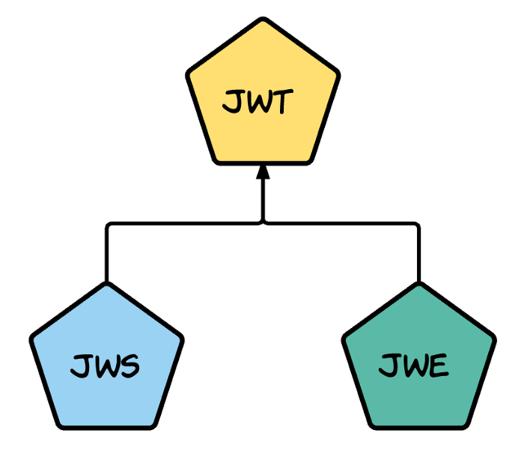
DCS Security
Two alternative approaches:
(1) Client asks server to encrypt responses with a key of his (server) choice. Server passes info (kid) in response for client to find and access key via a shared KMS (key Management System) accessible via a RESTful API (See OGC 22-014).
(2) Client gives server the (public) encryption key to use. Client decodes response with his private key. No KMS is involved.
Approaches heavily rely on existing JSON technology supported by open-source libraries:
JSON Web Token (JWT) - RFC 7519
JSON Web Key (JWK) – RFC 7517
JSON Web Encryption (JWE) – RFC 7516
Javascript Object Signing and Encryption (JOSE)
Notes:
https://medium.facilelogin.com/jwt-jws-and-jwe-for-not-so-dummies-b63310d201a3
https://jwt.io/introduction

Slide 13
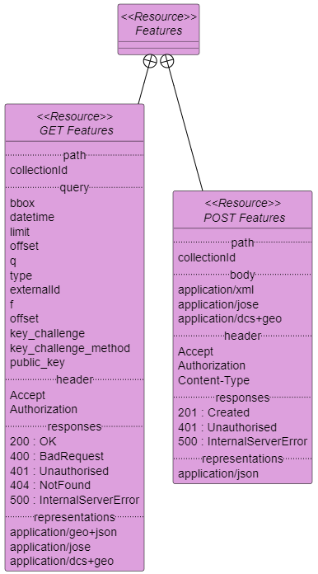
DCS Security
Search request parameters:
Query: public_key= (JWK from client)
Header: Authorisation: Bearer = access-token (obtained from IdP)
Responses:
application/dcs+geo
application/jose (RFC7515)

Slide 14
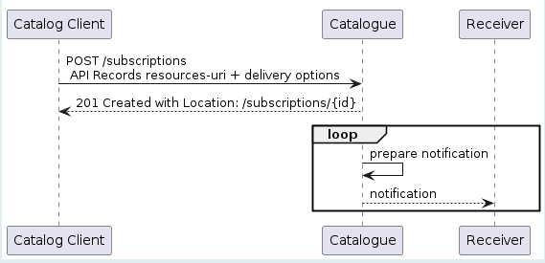
Asynchronous Communication
Via “subscriptions”
Notifications via:
Email, WebPush, Callback URL
Creation: “POST”
Update: “PATCH”
Stop: “DELETE”
Approach can be generalized for any OGC API request…
Email or callback delivery
Search request
Public key (JWK)

Slide 15
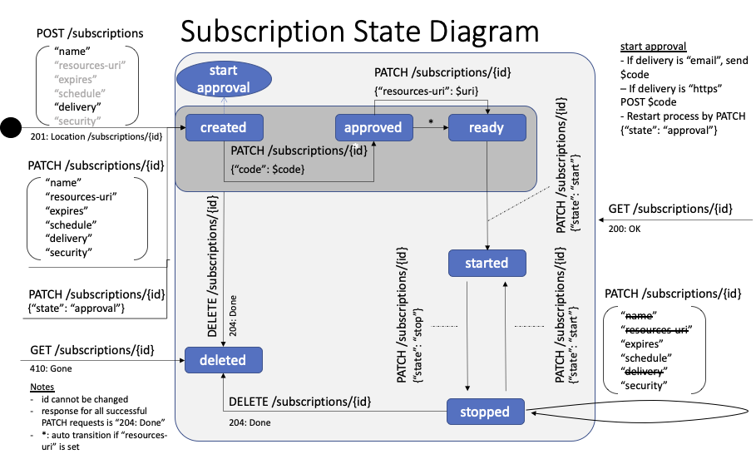
Subscriptions
Advanced state-transition diagram proposed:
Verification of email access (PATCH « code »)
Start/stop (PATCH « state »)

Slide 16
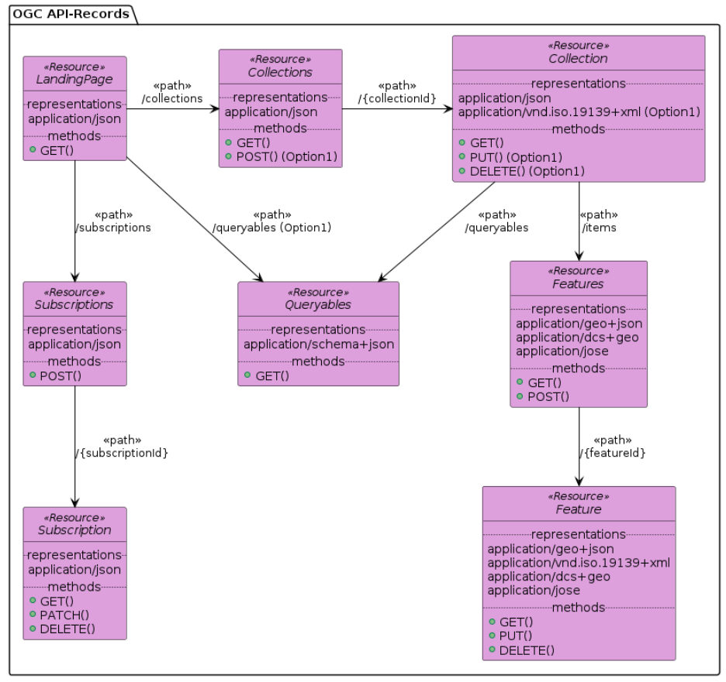
Subscriptions
RESTful API may evolve to a generic API-Notification service (not API-Records-specific)

Slide 17
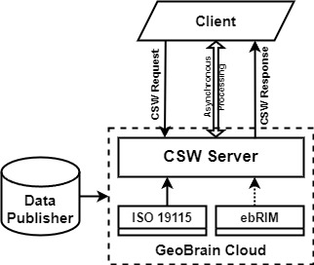
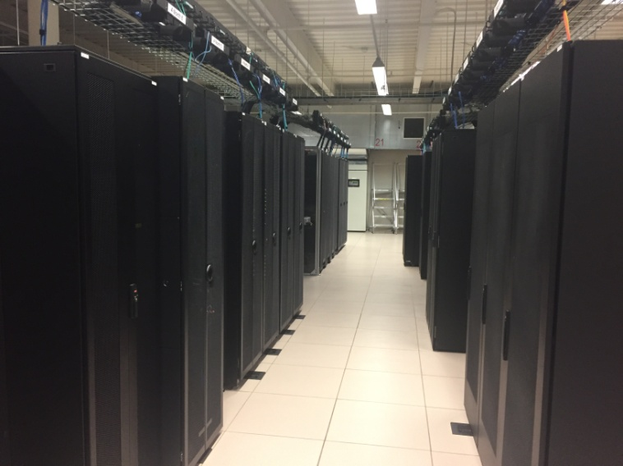
OGC CSW Implementation
GMU CSISS CSW
By George Mason University – Center for Spatial Information Science and Systems
Provides ISO19139 metadata records.
GeoBrain Cloud – private cloud platform with more than 360 CPU cores

Slide 18
OGC CSW Implementation
Designed to be compared with OGC API-Records. To understand the differences and similarities when interacting with the two types of catalog services.
CSW catalogue service based on the CSW ISO AP Profile.
The demonstration of the interactions with the client was provided.
CSW query interface and operations for insert, update, delete...
Developer’s guide provides instructions.

Slide 19
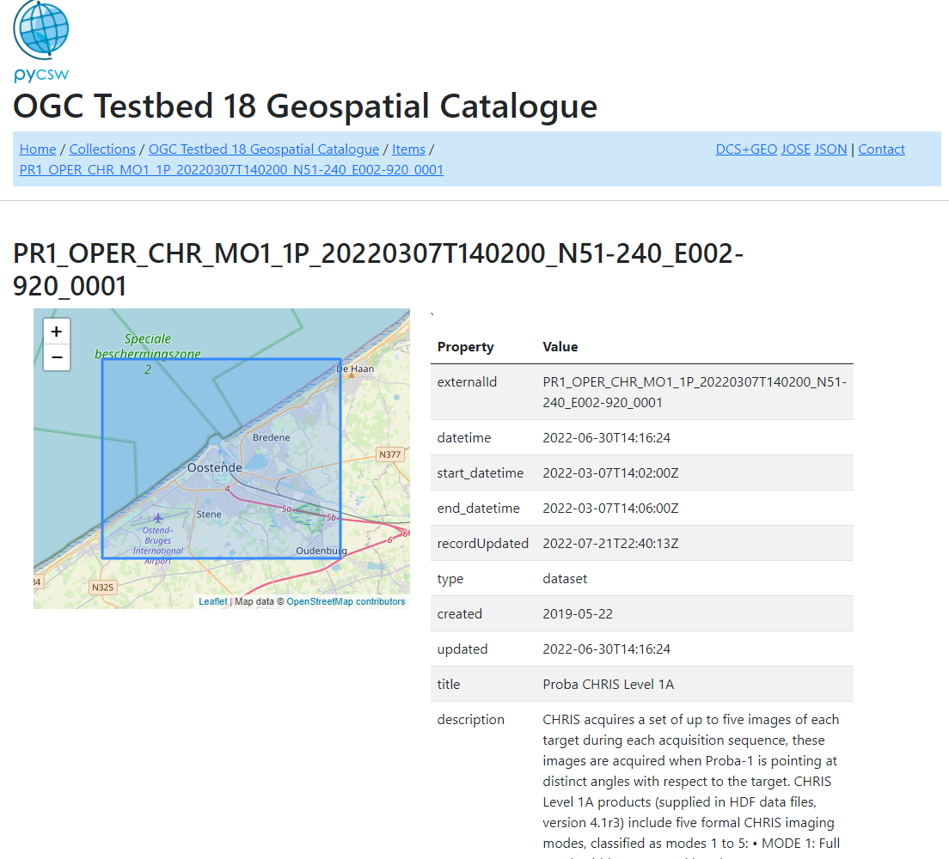
OGC API-Records Implementation
Updated pyCSW implementation
Populated with various metadata:
ESA Proba-1 granule and collection metadata in ISO19139 format served by by FedEO (EOVOC).
Agentschap Digitaal Vlaanderen metadata records (Belgium)

Slide 20
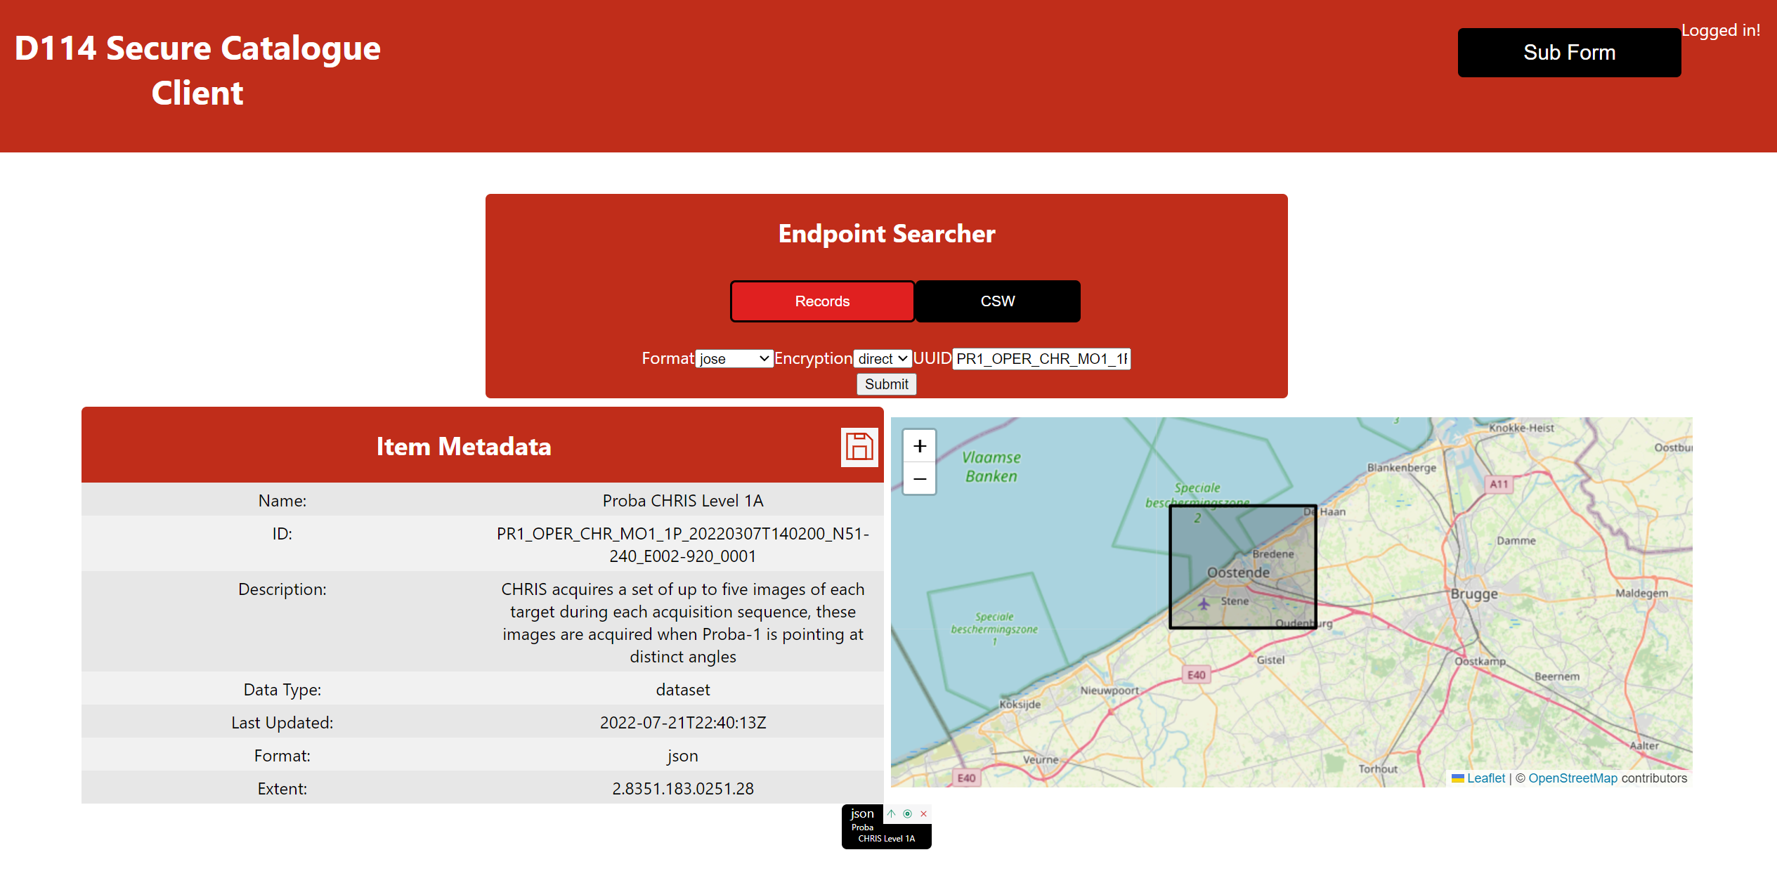
Client Implementation - React
Helyx Client (node.js, React JavaScript)
Accesses OGC API-Records + Subscription: e.g. FedEO ESA Proba-1 granule metadata.

Slide 21
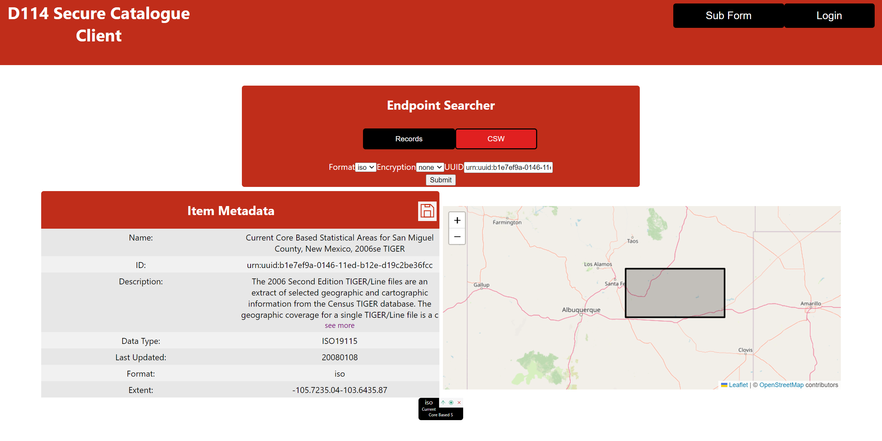
Client Implementation - React
Client also interacts with OGC CSW Server (GMU) serving ISO19139 metadata.

Slide 22
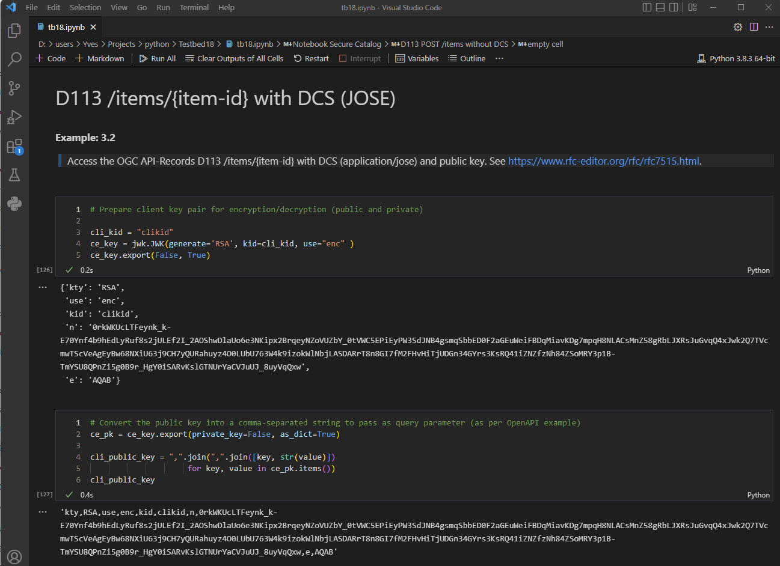
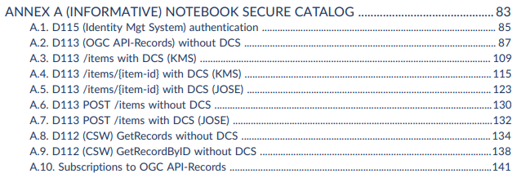
Client Implementation - Notebook
Additional integration tests (TIE) with Jupyter Notebook Client
Included as Annex A in the Engineering report (nbconvert | pandoc).

Slide 23
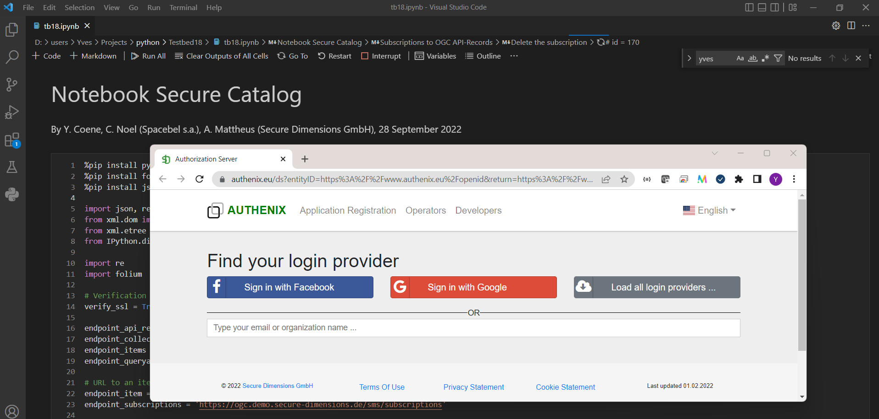
Client Implementation - Notebook
Interacts with the Identity Mgt Server (D115) to obtain access_token (OAuth) for use in secured calls:
Use of Proof of Possession (DPoP) access_token (RFC7800) is future work.

Slide 24
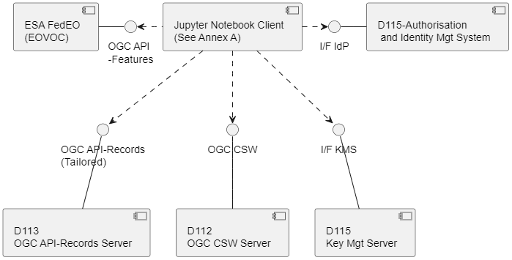
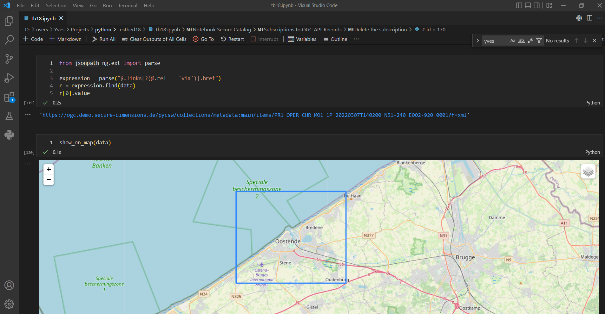
Client Implementation - Notebook
FedEO ISO19139 granule metadata retrieved and stored in OGC API-Records server using Data Centric Security

Slide 25
Get record from FedEO and insert encrypted in the OGC API-Records…
Few lines of code required as standards-based solution (JWT, JWE, JWK, ..) available in open-source libraries.

Slide 26
Conclusion and next steps
Secure Asynchronous Catalog task in TestBed-18
Solutions proposed for subscriptions, data centric security and use of ISO workflows in a JSON environment (API-Records).
Complementary to discovery scenarios considered in WGISS (IDN, CMR, FedEO)
FedEO ISO19139 collection and granule metadata used for testing.
DCS and asynchronous solutions apply equally well to OpenSearch or other OGC (JSON) API.
All info will become available in Engineering Reports OGC 22-018 and OGC 22-014 (ERs).

Slide 27
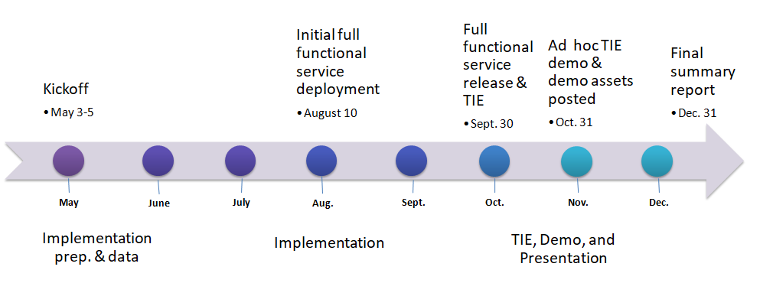
Conclusion and next steps
Next steps:
31/10/22 - Near-Final ERs posted to Pending & WG review requested
11/2022 – Final ER OGC 22-014 and OGC-22-018 posted to pending.

Slide 28
Thank You
Community

